Slide 1
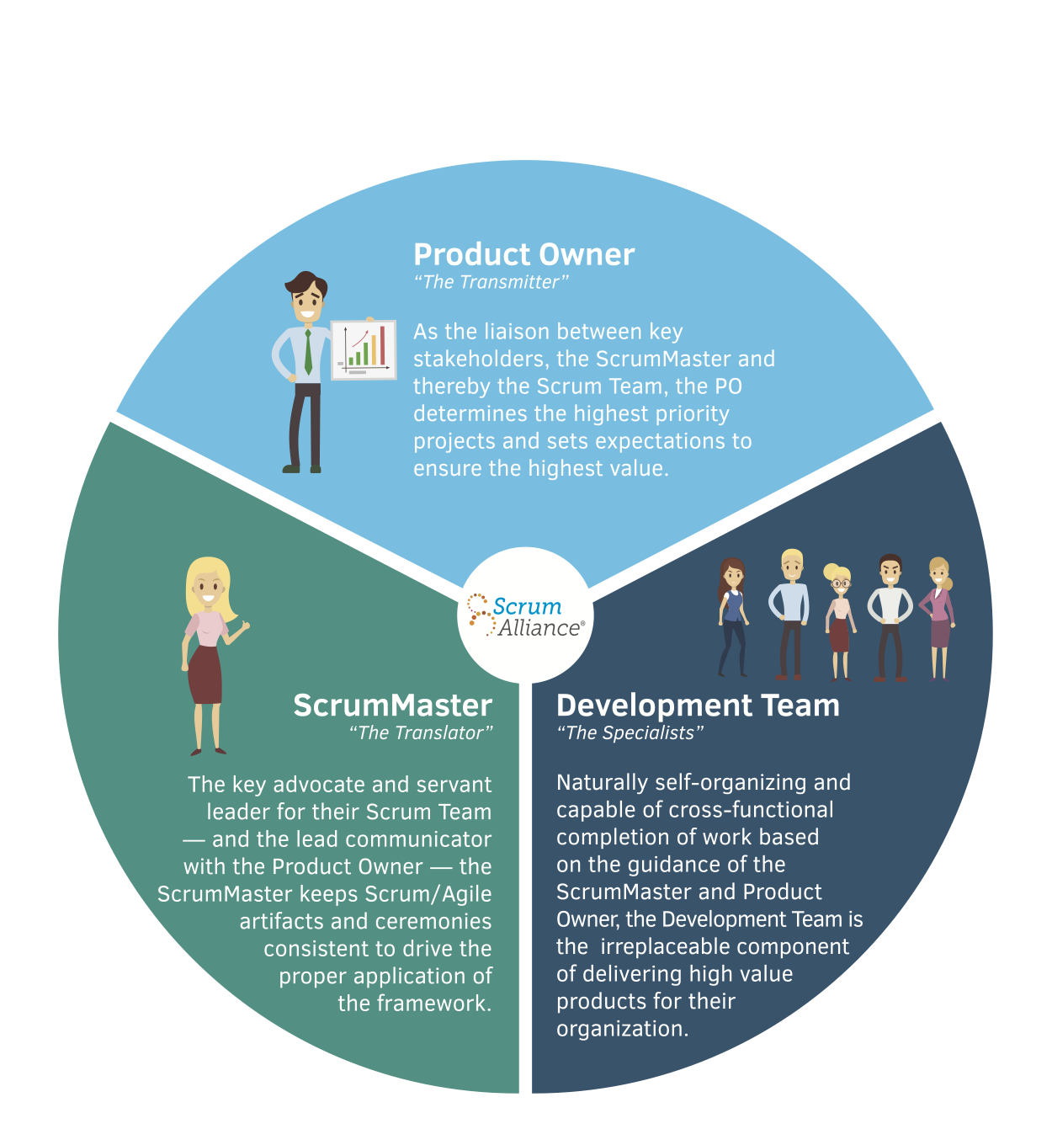
ROLES
on a
SCRUM
AGILE
TEAM
Notes:
Scrum Master - He or She will coach, educate, and guide the team on the Agile Development Process. They will do everything in their power to help the team. They serve the team, removing impediments and protects the team from any interferences.
Product Owner - owns the Product backlog and writes user stories and acceptance criteria. Responsible for prioritizing the Product Backlog and continually re-prioritizing and refining the list
, for maximizing return on investment (ROI), a spokesperson for the customer, deciding which should be at the top of the list for the next Sprint.
Development team- The Team in Scrum is “cross-functional”, is self-organizing, decides how many items to build in a Sprint, knows how best to accomplish that goal.
Text from:
https://www.visual-paradigm.com/scrum/what-are-the-three-scrum-roles/
Picture From:
https://resources.scrumalliance.org/Article/how-scrum-scrum-teams-work

Slide 2
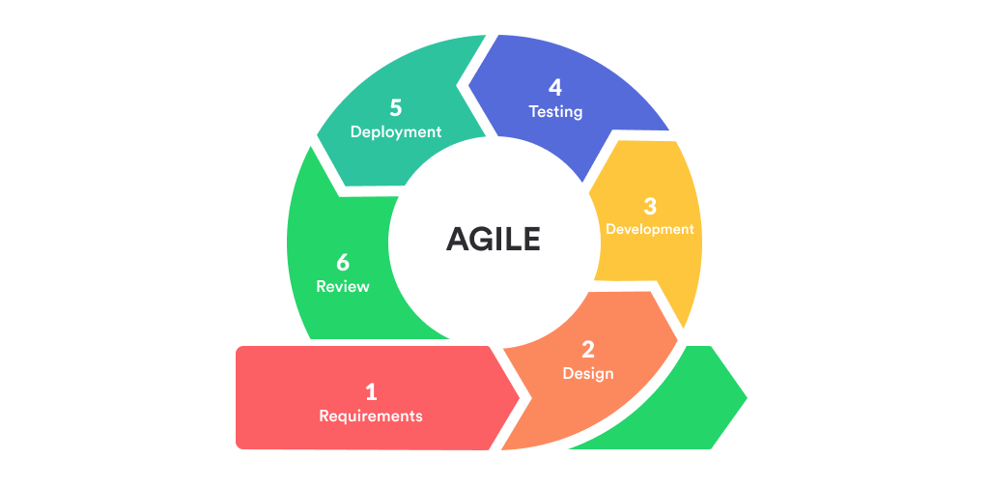
Notes:
Phase 1: Requirements
The Product Owner will gather the requirements for the project. Keeping it outlined and letting developers fill in the rest later. The Client and Product Owner will collaborate on needed features.
Phase 2: Design
Two Aspects -one is the visual design and the other is the architectural structure of the app.
Software Design
First the Product Owner introduces the requirements created during the previous stage. The team will discuss and decide how to progress and what tools will be needed.
UI/UX Design
This is where a mockup will be created. Compare competitors see what is right and importantly what is wrong.
Keep reworking it to suit the new features.
Phase 3. Development and Coding
This is the longest but is the backbone of the whole process There aren’t many changes between the iterations here.
Phase 4. Integration and Testing
This stage is spent on making sure that the software is bug-free and compatible with everything else that the developers have written before. Testing and coding should go on simultaneously making sure it is clean and business goals of the solution are met. Further iterations of this SDLC stage, the testing becomes more involved and accounts not only for functionality testing, but also for systems integration, interoperability, and user acceptance testing, etc.
Phase 5. Implementation and Deployment
The application is deployed on the servers and provided to the customers — either for the demo or the actual use. Further iterations update the already installed software, introducing new features and resolving bugs.
Phase 6. Review
At the Review, the Product Owner gathers the Development Team once again and reviews the progress made towards completing the requirements. The team introduces their ideas toward resolving the problems.
Addendum: Some Models have Maintenance include as an extra step. You do not implement software and then disappear from your customer, this probably goes with out saying.
Text from:
https://relevant.software/blog/agile-software-development-lifecycle-phases-explained/
Picture From:
https://mlsdev.com/blog/agile-sdlc

Slide 3
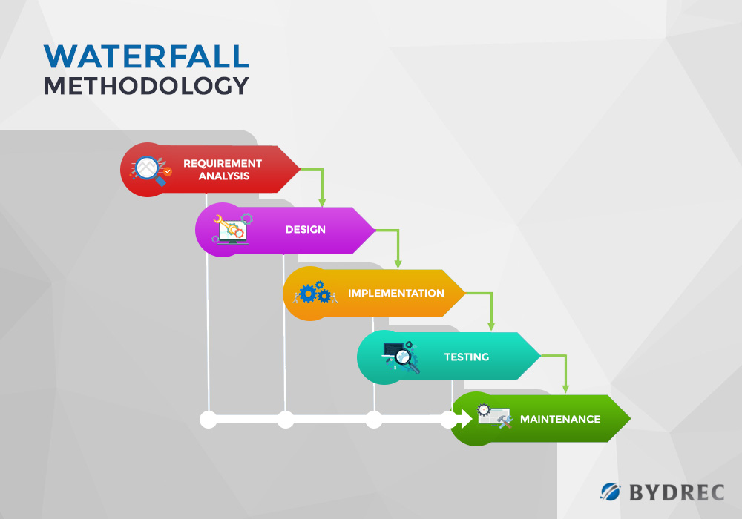
Notes:
When being asked what would have been different using the waterfall approach rather than the Agile approach for the SNHU Travel project.
Two things seem apparent. One is when the Product Owner switched objectives from taking the top destinations to pivoting to rejuvenation-spa vacations.
Pivoting like this would be more difficult due to the rigid structure of the waterfall methodology. Secondly, In the waterfall approach testing is done toward the end of the cycle.
Whereas Agile testing goes on continuously along with design and development.
Text from: SNHU Travel Project
Picture From:
https://blog.bydrec.com/a-comprehensive-comparison-between-the-agile-scrum-and-waterfall-methodology

Slide 4
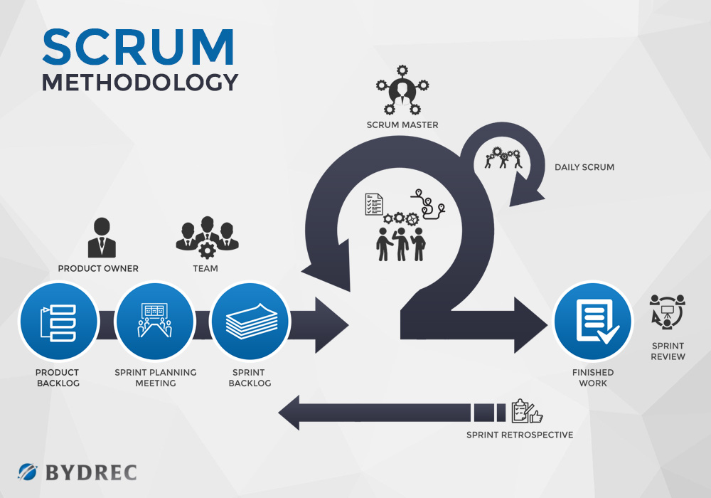
Notes:
Scrum is a type of agile methodology. It is a framework that is included in the agile approach.
In scrum methodology, the basic unit is a Sprint. Every Sprint begins with a planning meeting in which tasks for the sprint are defined.
This is also the part where the estimated commitment for the sprint goal is made.
A Sprint concludes with a retrospective or review meeting where progress is evaluated, and the next sprint lessons are figured out.
The product goes through several iterations throughout the process.
Scrum sprints may correspond to agile iterations.
Text from: SNHU Travel Project
https://blog.bydrec.com/a-comprehensive-comparison-between-the-agile-scrum-and-waterfall-methodology
Picture From:
https://blog.bydrec.com/a-comprehensive-comparison-between-the-agile-scrum-and-waterfall-methodology

Slide 5
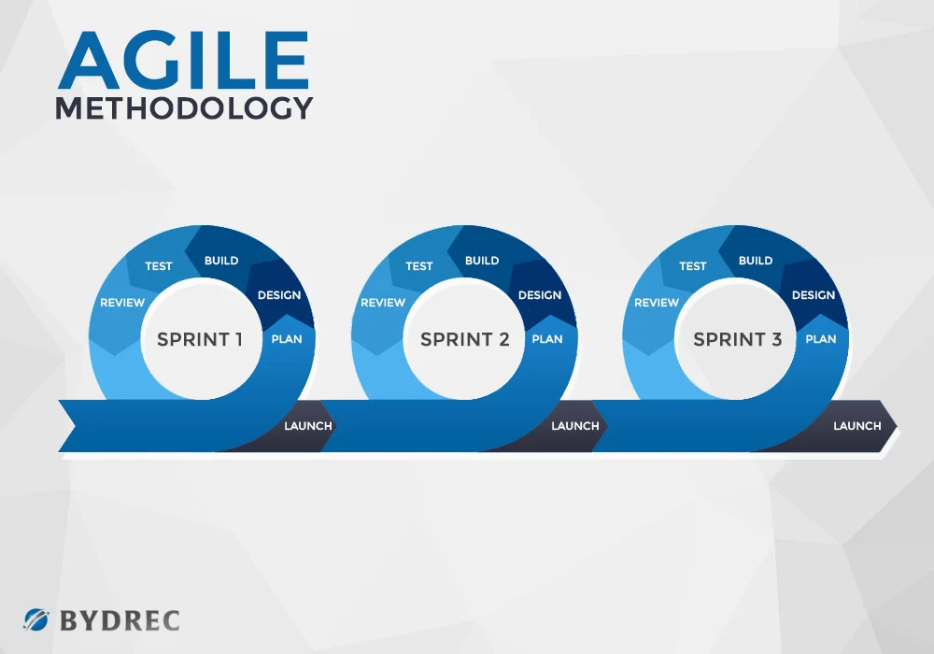
Notes:
Agile development is an umbrella term defining a set of practices and frameworks based on the values and principles laid out in the Agile Manifesto.
The agile software development community primarily focuses on the self-organizing team and collaboration.
Managers do exist in Agile they usually step in when the team is failing.
Text from: https://blog.bydrec.com/a-comprehensive-comparison-between-the-agile-scrum-and-waterfall-methodology
Picture From:
https://blog.bydrec.com/a-comprehensive-comparison-between-the-agile-scrum-and-waterfall-methodology

Slide 6
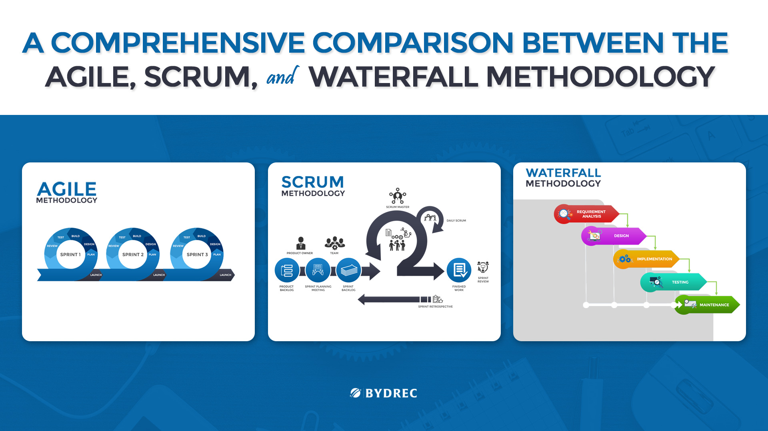
Notes:
In choosing which approach would be suited for a project. It’s essential to make the right decisions regarding of your software development process right from the start–as you might have a hard time applying changes down the line.
Whether it’s waterfall methodology vs agile or agile vs scrum, comparing frameworks allow you to have a better understanding of their advantages and disadvantages.
Depending on your project’s needs, your final choice should give the best results for the time and money spent.
Text from: https://blog.bydrec.com/a-comprehensive-comparison-between-the-agile-scrum-and-waterfall-methodology
Picture From:
https://blog.bydrec.com/a-comprehensive-comparison-between-the-agile-scrum-and-waterfall-methodology

