Slide 1

Biophysics II docking protein-protein
Joao Ferreira, Olga Ibañez, Charlotte Nachtegael

Slide 2
Protein-protein docking methods

Slide 3
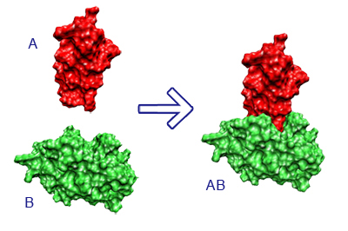
Introduction
What is protein-protein docking ?
  Protein-protein interaction
  Biological processes
  Genetic diseases
Interesting questions
  Affinity of binding ?
  Important residues for interface binding ?
https://vred.bioinf.uni-sb.de/DFG-protein-protein-docking/DATA/projectsummary.shtml
Notes:
Olga

Slide 4
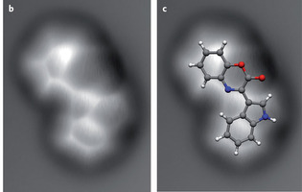
Introduction
Available material : high- and low-resolution structures of proteins
Recent advances in submolecular resolution with scanning probe microscopy, Nature Chemistry 3,273–278 (2011)
Notes:
Olga

Slide 5
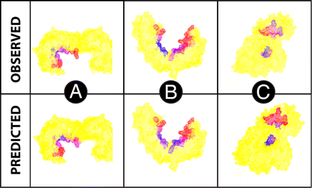
Flexibility and DOF
Notes:
Joao

Slide 6
No conformational changes
« Rigid-body docking »
Fast-Fourier transformation
Geometric hashing
When ?
Low-resolution structures
No changes or moderate enough
Notes:
Olga

Slide 7
Few conformational changes
« Partially flexible docking »
  Considering only side-chain DOF minimal flexibility
  Improve rigid-body docking
  Only if changes moderate
Notes:
Joao

Slide 8
Big conformational changes
Use high-resolution structures
Problems of high-resolution methods
  Scoring
  Increase of local minima
  Slow convergence of results
Notes:
Joao

Slide 9
Big conformational changes
How to restrict the conformational space
  Restrict number of DOF
  Template-based docking
Notes:
Olga

Slide 10
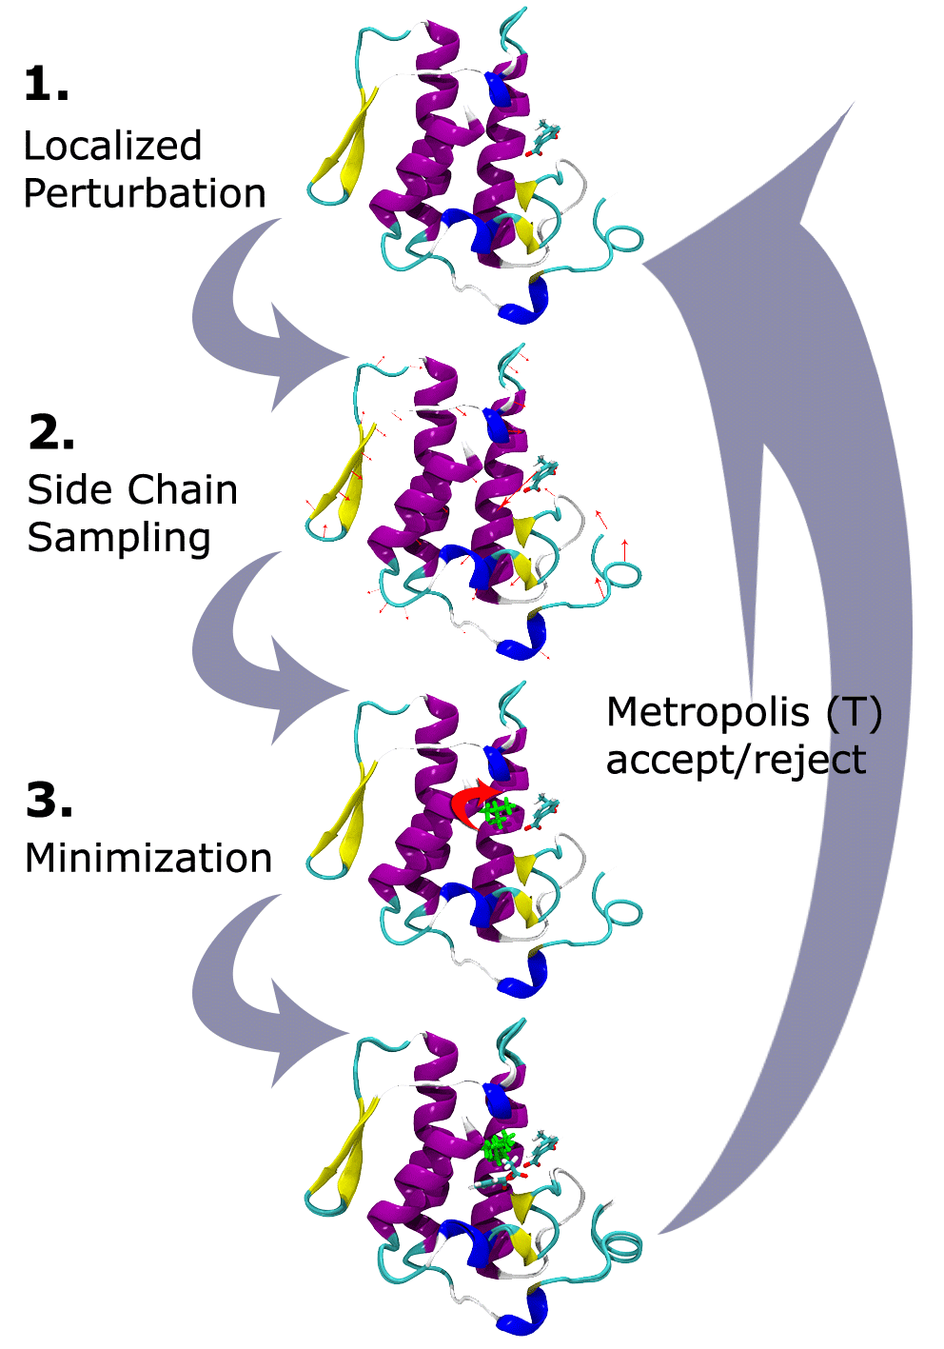
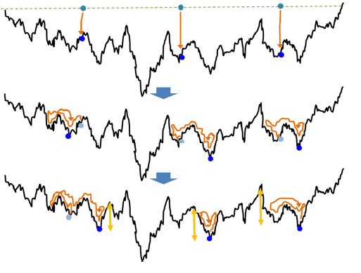
Global optimization algorithms
Single-trajectory method
  Monte Carlo Minimization
  Molecular Dynamics
Population-based methods
Notes:
Joao

Slide 11
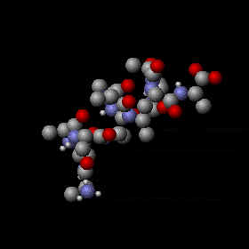
Global optimization algorithms
Single-trajectory methods
  Monte Carlo Minimization
  Molecular Dynamics
Population-based methods
Notes:
Olga

Slide 12
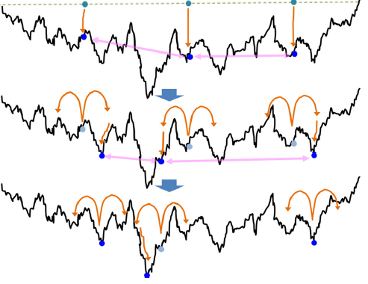
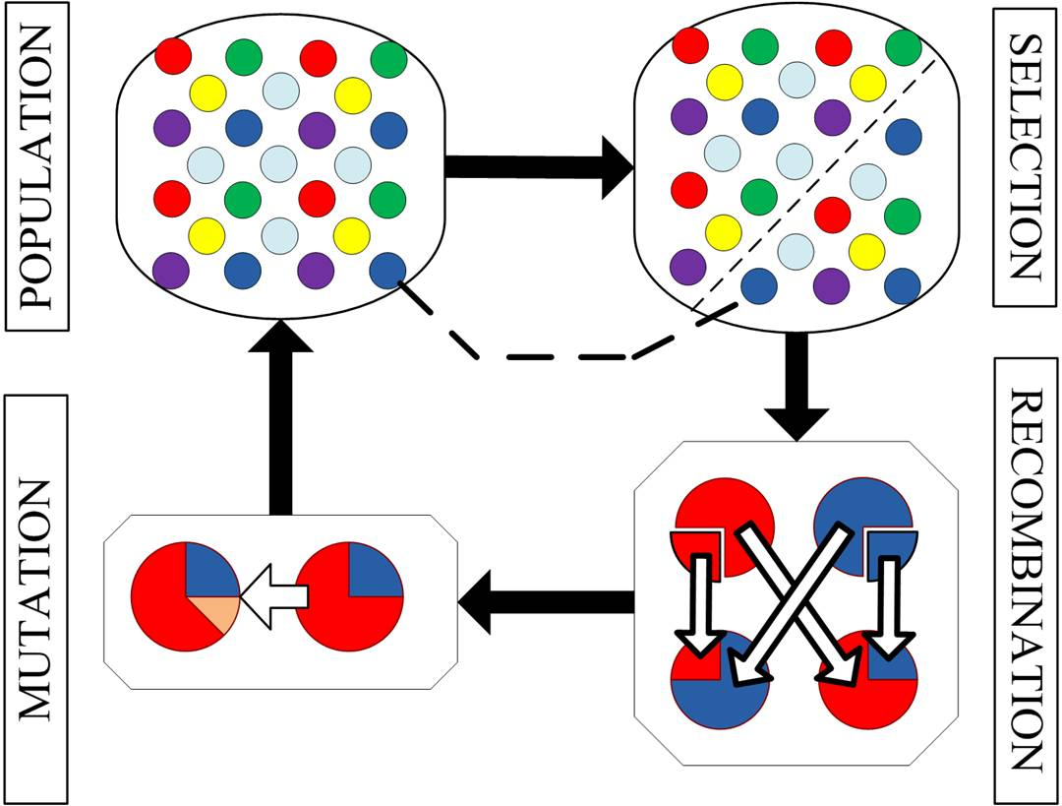
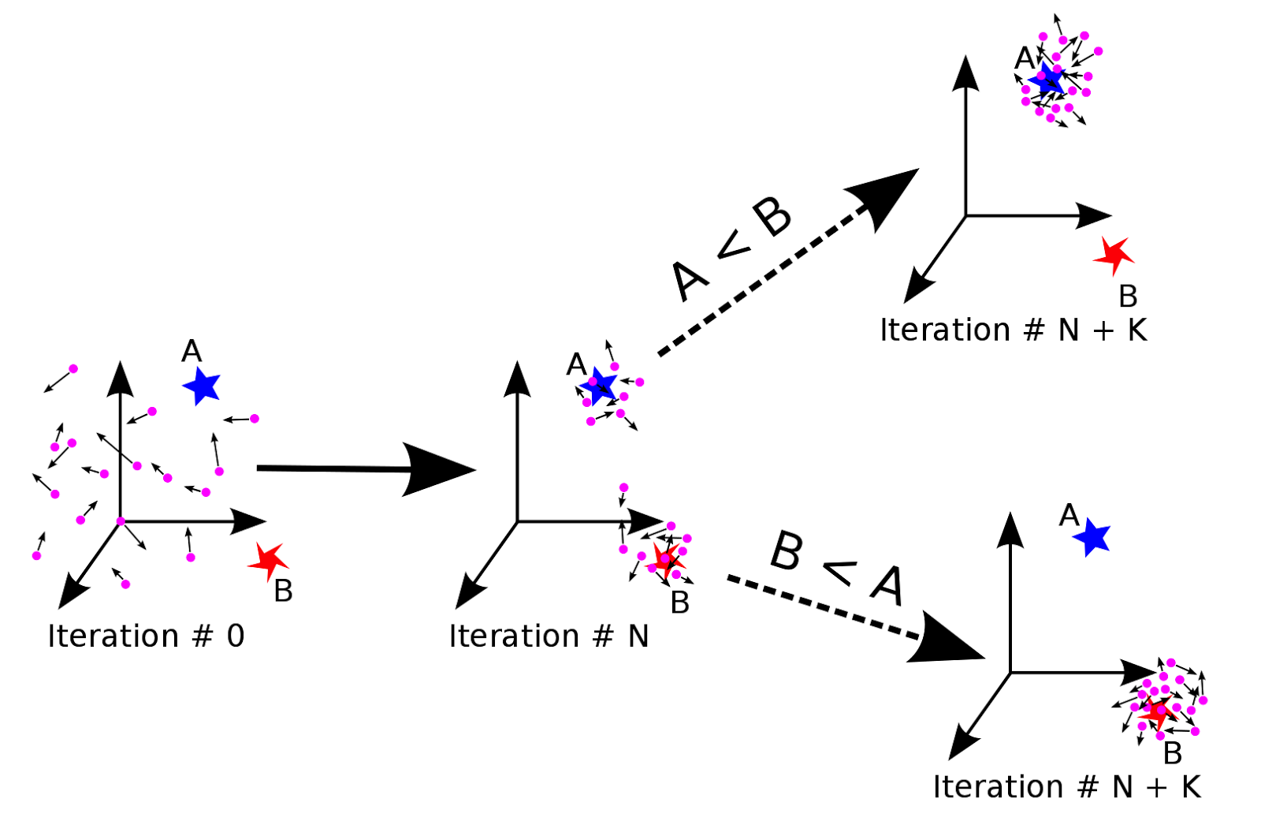
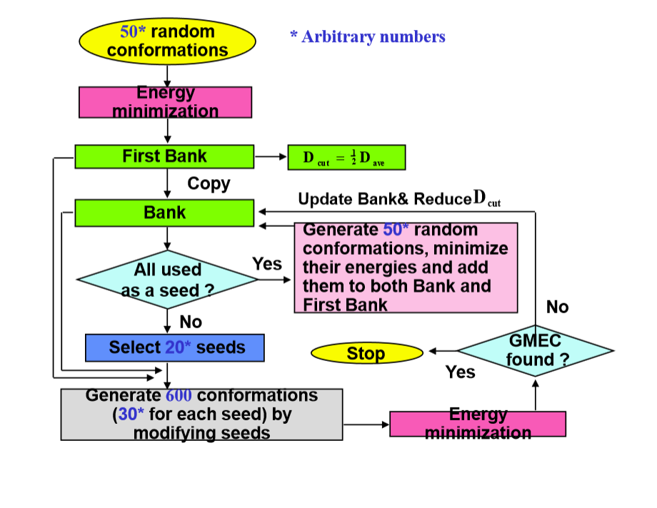
Global optimization algorithms
Single-trajectory method
Population-based methods
Notes:
Charlotte
Genetic algorithm
PSO (particle swarm optimization) : As stated before, PSO simulates the behaviors of bird flocking. Suppose the following scenario: a group of birds are randomly searching food in an area. There is only one piece of food in the area being searched. All the birds do not know where the food is. But they know how far the food is in each iteration. So what's the best strategy to find the food? The effective one is to follow the bird which is nearest to the food
- CSA (conformational space annealing) : Instead of considering a single conformation, attention is focused on a population of conformations while new conformations are obtained by modifying a “seed conformation.” The annealing is carried out by introducing a distance cutoff, D_{cut}, which is defined in the conformational space; D_{cut} effectively divides the whole conformational space of local minima into subdivisions. The value of D_{cut} is set to a large number at the beginning of the algorithm to cover the whole conformational space, and annealing is achieved by slowly reducing it. Many distinct local minima designed to be distributed as far apart as possible in conformational space are investigated simultaneously. Therefore, the new method finds not only the global minimum-energy conformation but also many other distinct local minima as by-products.

Slide 13
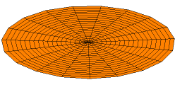
Two challenges in protein-protein docking
Backbone DOF
  Pre-sampling vs on-the-fly
  Identify regions implied in binding
  ENM method
Water role in binding process
Notes:
Charlotte

Slide 14
Two challenges in protein-protein docking
Backbone DOF
Water role in binding process
  Involved electrostatic interaction and hydrogen-bonds network
  Rotamer approach
  Docking with protein-water
Notes:
Olga

Slide 15
How to score all these structures complexes ?

Slide 16
Sampling and scoring
Sampling implicitly scores
BUT
An additional scoring step is added to rerank structures
ALTHOUGH
Methods integrating sampling and scoring give better results
Notes:
Joao

Slide 17
Why decoupling ?
Simplifies computational problem
Use of decoys set
  Can be stored
  Easy to use for development and refinment of the scoring function
Notes:
Joao

Slide 18
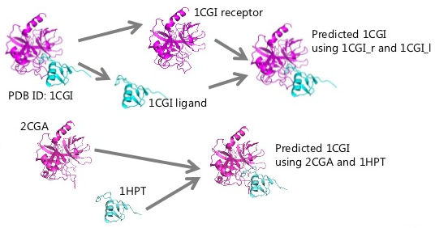
How do we build decoys set ?
Perturbation
Docking of bound proteins
Docking of unbound proteins
Notes:
Joao

Slide 19
Influence of decoys set on scoring function
Influence of nature proteins
Influence of bound/unbound proteins docking set
Influence of docking algorithm used for obtaining set
Notes:
Charlotte

Slide 20
Proof of concept : CAPRI
Part sampling + part scoring
best scorer is only as good as the 9th best predictor
6 of the best predictors were in the top 10 best scorers
Notes:
Charlotte

Slide 21
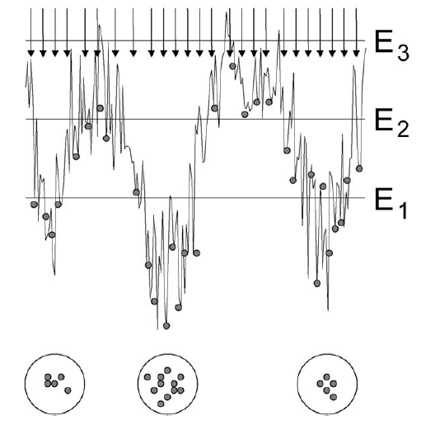
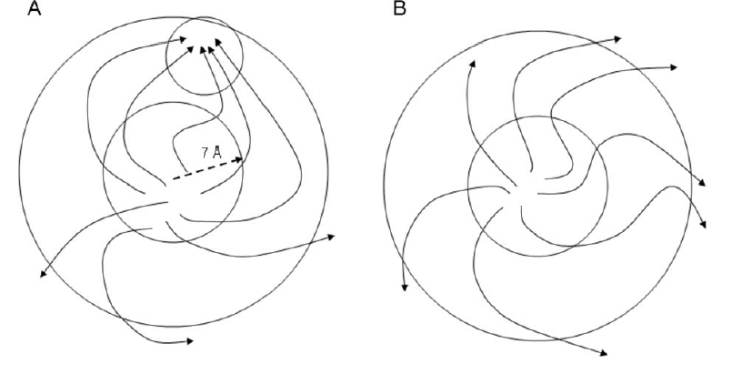
Methods integrating sampling and scoring
Monte Carlo Minimization
Concept of cluster size
Resampling clusters to refine results
Notes:
Charlotte

Slide 22
TAKE-HOME message
Choice of docking methods depends on :
  Material available : low- or high-resolution structures
  A priori information : no/few/large conformational changes for binding
Docking methods are single-trajetory or population-based
Sampling and scoring should be integrated
If not, the construction of decoys set should use a docking method as close as possible to the sampling method developed and used docking unbound proteins methods
Notes:
Charlotte

