Slide 1
Genetic Algorithms and
Ant Colony Optimisation

Slide 2
Introduction: Optimisation
Optimisation : find an extremum
Extrema can be local / global
In R^{n} (real numbers): methods with and without gradients
Local :
  With derivative (ok : space = R^{n}) ➔ gradient (possibly: first degree or even more)
  Without derivative : select a point, explore the neighborood, take the best, do it again. (type hill climber, local search)
Global :
  = local with different initial conditions.
  Method without derivatives → GA
Notes:
The derivative will give you the direction you need to go to
Genetic algorithm are non-derivative method
The complexity of a function depends on the number of local maxima

Slide 3
Combinatorial optimisation problems.
Deterministic algorithms : Explore too much and take too much time ➔ meta-heuristiques : find rapidly a satisfactory solution
Example : Scheduling problem, packing or ordering problems
The classics of the classics : TSP
  The travelling salesman problem
  N cities
  Find the shortest path going through each city only once
  Benchmarking problems
  Problems NP-complete (the time to find grows exponentially with the size of the problem (N! ~ N^(N+1/2)))
Notes:
The number of possible paths explodes with the number of cities

Slide 4
Genetic Algorithms: Introduction
Evolutionary computing
1975 : John Holland → Genetic algorithms
1992 : John Koza → Genetic programming

Slide 5
Genetic algorithms
Darwinian inspiration
Evolution = optimisation:
Notes:
20 years towards biological inspiration of the AI

Slide 6
Reproduction
2 genetic operators:
  Cross-over (recombination)
  Mutation
Fitness

Slide 7
The standard algorithm
Generate random population
Repeat
  Evaluate fitness f(x) for each individual of the population
  Create a new population (to repeat until a stopping critetion)
    Selection (according to fitness)
    Crossover (according to probability of crossover)
    Mutation (according to probability of mutation)
    evaluate the new individuals in the population (replacement)
  Replace the old population by the new (better) ones
Until stop condition; return the best solution of the current population
Notes:
Change the parameters, the initial conditions, the stop conditions

Slide 8
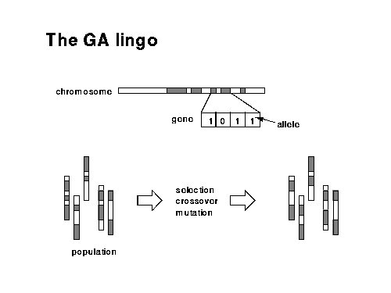

Slide 9
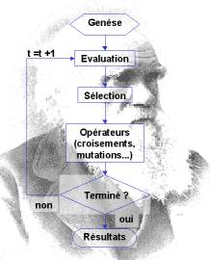

Slide 10
Chromosones encoding
Can be influenced by the problem to solve
Examples:
  Binary encoding
  Permutation encoding (ordening problems) e.g. TSP problem)
  Real value encoding (evolutionary strategies)
  Tree encoding (genetic programming)

Slide 11
Binary Encoding
Chromosome A 101100101100101011100101
Chromosome B 111111100000110000011111
Binary encoding is the most common, mainly because first works about GA used this type of encoding.In binary encoding every chromosome is a string of bits, 0 or 1.
Example of Problem: Knapsack problem
The problem: There are things with given value and size. The knapsack has given capacity. Select things to maximize the value of things in knapsack, but do not extend knapsack capacity.
Encoding: Each bit says, if the corresponding thing is in knapsack.

Slide 12
Permutation Encoding
Chromosome A 1 5 3 2 6 4 7 9 8
Chromosome B 8 5 6 7 2 3 1 4 9
In permutation encoding, every chromosome is a string of numbers, which represents number in a sequence.
Example of Problem: Traveling salesman problem (TSP)
The problem: There are cities and given distances between them.Travelling salesman has to visit all of them, but he does not to travel very much. Find a sequence of cities to minimize travelled distance. Encoding: Chromosome says order of cities, in which salesman will visit them.

Slide 13
Value Encoding
Chromosome A 1.2324 5.3243 0.4556 2.3293 2.4545
Chromosome B ABDJEIFJDHDIERJFDLDFLFEGT
Chromosome C (back), (back), (right), (forward), (left)
In value encoding, every chromosome is a string of some values. Values can be anything connected to problem, form numbers, real numbers or chars to some complicated objects.
Example of Problem: Finding weights for neural network
The problem: There is some neural network with given architecture. Find weights for inputs of neurons to train the network for wanted output.
Encoding: Real values in chromosomes represent corresponding weights for inputs.

Slide 14
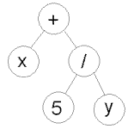
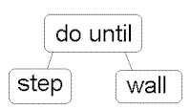
Tree Encoding
Chromosome A Chromosome B
( + x ( / 5 y ) ) ( do_until step wall)
In tree encoding every chromosome is a tree of some objects, such as functions or commands in programming language.Used in genetic programming
Example of Problem: Finding a function from given values
The problem: Some input and output values are given. Task is to find a function, which will give the best (closest to wanted) output to all inputs.
Encoding: Chromosome are functions represented in a tree.

Slide 15
Crossover - Recombination
C1: 1011|10001
C2: 0110|11100
→ D1: 1011|11100
→ D2: 0110|10001
Variants, many points of crossover

Slide 16
Crossover – Binary Encoding
Single Point Crossover
  11001011 et 10011111→11001111
Two Point Crossover
  11001011 et 10011111 → 11011111
Uniform Crossover
  11001011 et 10011111 → 11011111
Difference operators:
  11001011 AND 10011111 → 10001011

Slide 17
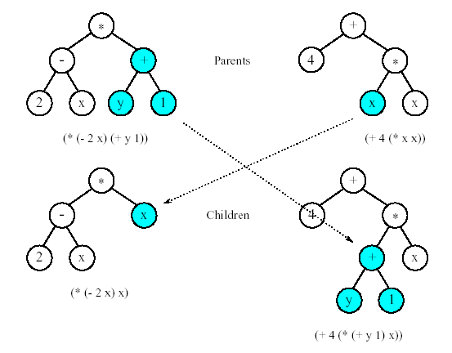
Crossover - variants
Permutation encoding
  Single Point Crossover
    (123456789) et (453689721) →(123459768)
Tree encoding
Notes:
The first succession of cities is good, but the second part is wrong and another solution is the opposite, so you hope to have the best of both

Slide 18
Mutation
D1: 101111100
D2: 011010001
→M1: 100111100
→M2: 001010101
variants

Slide 19
Mutation - Variants
Binary Encoding
  Bit inversion 101111100→111111100
Permutation Encoding
  Order changing (123456897)→(183456297)
Value Encoding
  +/- one number (1.29 5.68 2.86 4.11 5.55) → (1.29 5.68 2.73 4.22 5.55)
Tree Encoding: (ex)-change nodes

Slide 20
Selection
By roulette wheel
By rank
By tournement
Steady-State

Slide 21
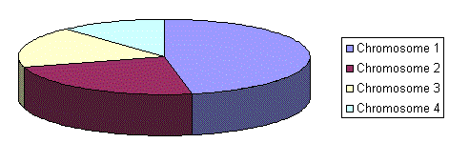
Roulette wheel
Selection according to fitness
Notes:
You associate a probability to be selected according to the fitness

Slide 22
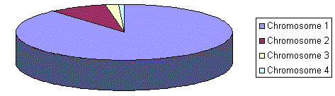
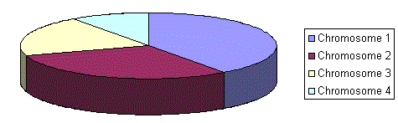
Selection by rank
Sorting of the population (n →1)
Notes:
Not necessarily good, because you exploit too much

Slide 23
Selection by tournament
Size k
Take randomly k individuals
Make them compete and select the best
Notes:
Pair-wise, compete by fitness

Slide 24
Elitism
→ Elitism: copy the single or many bests in the population then construct the remaining ones by genetic operations
Notes:
At least keep the best
You ensure some convergence

Slide 25
So many parameters
Crossover probability
Mutation probability
Population size

Slide 26
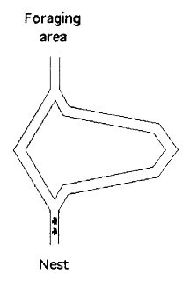
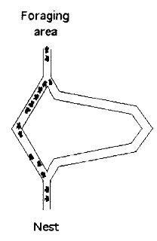
Ant Colony
In biology:
Introduction Biological MAS Ant Colony Ant Algorithms
Bee Colony Bee Algorithms Key Features Application
Notes:
They will all concentrate on the right path
The ants let pheromones containing information about the path they explored
When you have more pheromone on the left hand path because you would have more ants taking the right path (faster)

Slide 27
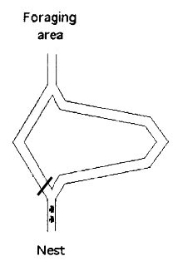
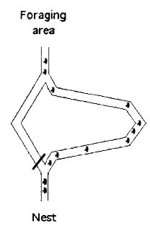
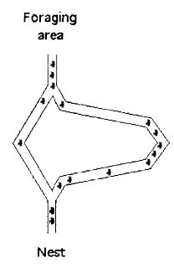
Ant Colony
Adaptivity
Introduction Biological MAS Ant Colony Ant Algorithms
Bee Colony Bee Algorithms Key Features Application
Notes:
You need to keep exploring to discover new paths with new possibilities

Slide 28
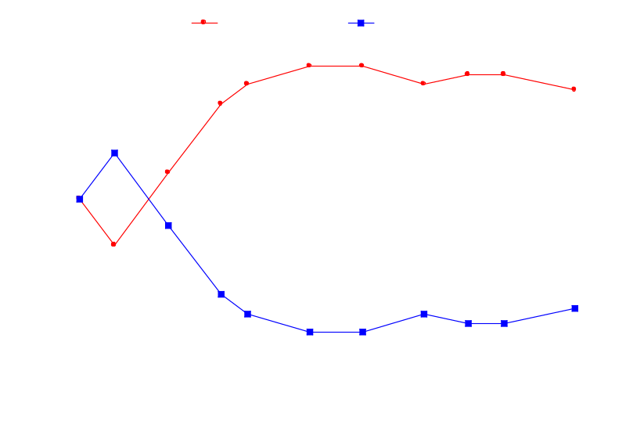
Ants Foraging Behavior
Example: The Double Bridge Experiment
Goss et al., 1989, Deneubourg et al., 1990
15 cm
A
Nest
Food
B
Simple bridge % of ant passages on
the two branches
ECAI 2002 - 22-23/07/2002 - © Dorigo

Slide 29
Ant Colony
Navigation
  At first: random
  Using pheromones as previous search experience
Recruitment (communication)
  Indirect via the environment
Ants Trail
Introduction Biological MAS Ant Colony Ant Algorithms
Bee Colony Bee Algorithms Key Features Application

Slide 30

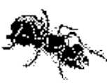
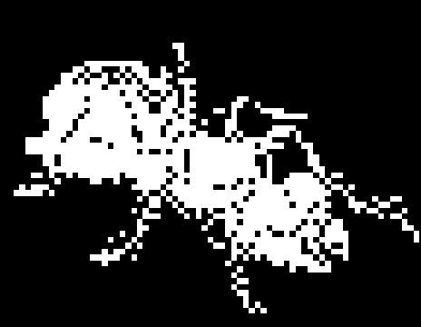
Ant System Applied to the TSP
Ant System is the ancestor of all
Ant Colony Optimization algorithms
Dorigo, Maniezzo, Colorni, 1991
Dorigo & Gambardella, 1996
Pheromone trail
Memory
depositing
?
Probabilistic rule to
choose the path
ECAI 2002 - 22-23/07/2002 - © Dorigo

Slide 31


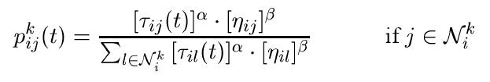
Ant Algorithms
In computer science:
Decay over time
Pheromone update
The better the solution found by the ant, the more pheromone
Probability of selecting node j in i
Ants Movie
Assumes optimisation problem
represented as a graph problem
Heuristic information
Introduction Biological MAS Ant Colony Ant Algorithms
Bee Colony Bee Algorithms Key Features Application
Notes:
Tau = pheromone value on edge from node i to j (inversely proportional to the length of the path and it depends also on the time)
Rho = pheromone evaporation rate
M = number of ants
L = Length of ant’s tour
Nu = length of edge (a priori information)
Pij = chance that ant k goes from node i to node j
Alfa and Beta influence the algorithms behaviour; alfa = 0 means action selection is based solely on edge distance information, beta = 0 means action selection is based solely on pheromone accumulation information
Stochastic choice of selecting one node according to a probability calculated acoording to tau and eta (heuristic information, based on the length of the path)

Slide 32
Ant Algorithms
For all iterations
  For all ants
  choose and perform action
  (i.e. choose next node to visit)
  Update pheromone
Introduction Biological MAS Ant Colony Ant Algorithms
Bee Colony Bee Algorithms Key Features Application

Slide 33
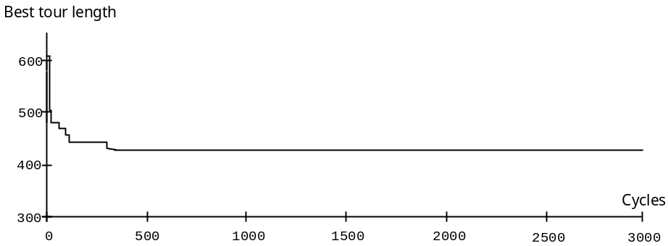

Ant System (AS): Some Results
10
7
9
Best tour length
8
3
2
4
6
1
10
5
7
Tour length
9
standard deviation
80
8
70
60
3
50
40
30
2
4
6
20
10
Cycles
0
0
500
1000
1500
2000
2500
3000
1
5
Evolution of trail distribution
Tour length std deviation
ECAI 2002 - 22-23/07/2002 - © Dorigo

