Slide 1
INTRODUCTION TO HYPER TEXT MARKUP LANGUAGE
C.NagaRaju
B.Tech(CSE),M.Tech(CSE),PhD(CSE),MIEEE,MCSI,MISTE
Professor
Department of CSE
YSR Engineering College of YVU
Proddatur

Slide 2
I
Contents
What is Web?
Types of websites
How to access the Web?
How to Addressing the Web
Domain Name Addressing
Uniform Resource Locators(URL)
Domains and protocols
Structure of HTTP Protocol

Slide 3
What is Web?
The Web (World Wide Web) is collection of information organized into Web pages
Web Page: A mixture of text, graphics, sound and animation in the HTML format, to access information through internet in easy way.
A collection of linked Web pages that has a common theme or focus is called a Web site.
The main page that all of the pages on a particular Web site are organized around and link back to is called the site’s home page.
There are two types of web applications:1)Presentation-oriented(HTML, XML pages) 2)Service-oriented(Web services)

Slide 4
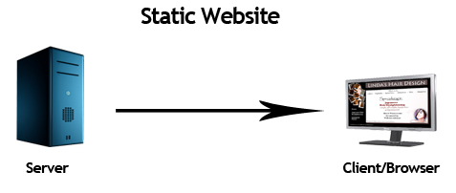
Types of websites : 1)static 2)dynamic Static website
Static website
Static website is the basic type of website that is easy to create.
You don't need the knowledge of web programming and database design to create a static website.
Its web pages are coded in HTML.
The codes are fixed for each page so the information contained in the page does not change and it looks like a printed page.

Slide 5
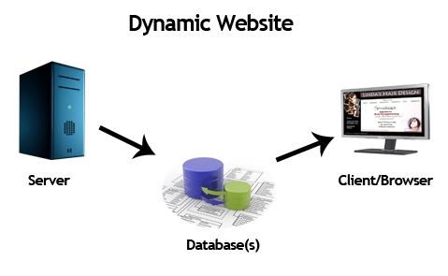
Dynamic website
Dynamic website is a collection of dynamic web pages whose content changes dynamically.
It accesses content from a database or Content Management System (CMS).
Therefore, when you alter or update the content of the database, the content of the website is also altered or updated.
Dynamic website uses client-side scripting or server-side scripting, or both to generate dynamic content.

Slide 6
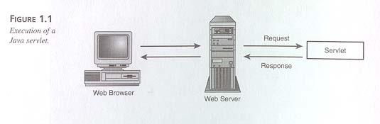
How to access the Web?
After a web site is designed it must be stored on a computer called Web server that can be accessed through the Internet
Once you have your Internet connection, then you need special software called a browser called client to access the Web.
Web browsers are used to connect you to remote computers, open and transfer files, display text and images.
Web browsers are specialized programs.
Examples of Web browser: Netscape Navigator chrome, mozillafirefox and Internet Explorer.

Slide 7
How to Addressing the Web:IP Address
Each computer on the internet does have a unique identification number, called an IP (Internet Protocol) address.
The internet IP addressing system currently using a four-part number.
Each part of the address is a number ranging from 0 to 255, and each part is separated by period / Dot
For example, 106.29.242.17
The combination of the four IP address parts provides 4.2 billion possible addresses (256 x 256 x 256 x 256).

Slide 8
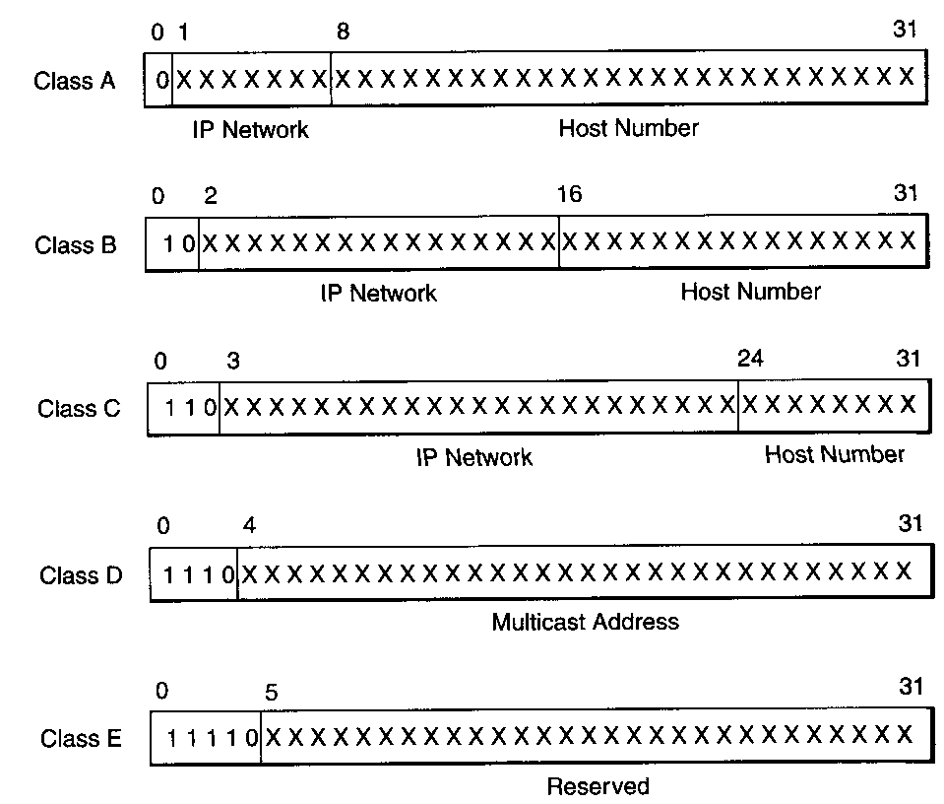
IP addresses
IP addresses are 32 bits long
10010011 10000110 00000010 00010100
↓ written as a dotted sequence
147.134.2.20
divided into 5 classes
class A: start with 0, then 7-bit code
2²⁴ = 16,777,216 hosts in subnetwork
class B: start with 10, then 14-bit code
2¹⁶ = 65,536 hosts in subnetwork
class C: start with 110, then 21-bit code
2⁸ = 256 hosts in subnetwork
class D: start with 1110
used for multicasting
class E: start with 11110
reserved for future use
IPv6 extends address size to 128 bits
extensions support authentication, data integrity, confidentiality

Slide 9
Domain Name Addressing
Most web browsers do not use the IP address to locate Web sites and individual pages.
They use domain name addressing.
A domain name is a unique name associated with a specific IP address run by host computers.
The program, which coordinates the IP addresses and domain names for all computers is called DNS (Domain Name System ) software.
The host computer which runs this software is called a domain name server.

Slide 10
Domain names can include any number of parts separated by periods.
For example, the domain name gsb.uchicago.edu is the computer connected to the Internet at the Graduate School of Business (gsb), which is an academic unit of the University of Chicago (uchicago), which is an educational institution (edu).
however most domain names currently in use have only three or four parts.

Slide 11
Uniform Resource Locators
The IP address and the domain name each identify a particular computer on the Internet.
However, they do not indicate where a Web pages are residing on that computer.
To identify a Web page’s exact location, Web browsers rely on Uniform Resource Locator (URL).
URL is a four-part addressing scheme that tells the Web browser that:
What transfer protocol to use for transporting the file
The domain name of the computer on which the file resides
The pathname of the folder or directory on the computer on which the file resides
The name of the file
pathname
protocol
http://www.chicagosymphony.org/civicconcerts/index.htm
Domain name
filename

Slide 12
Domain (s)
On the Internet, a domain is basically a registration category identifying geographic or purpose commonality.
There are seven top-level domains currently in use:
com - A commercial organization. The largest domain extension currently used.
edu - An educational establishment such as a school or university.
gov - A branch of the U.S government that is strictly reserved for that purpose.
int - An international organization such as the United Nations.
net - A network organization.
org - A non-profit organization.
mil - A branch of the U.S military that is strictly reserved for that purpose.
In other parts of the world the final part of the domain name represents the country in which the server is located like my for Malaysia, bb for Barbados, ca for Canada and uk for Great Britain.

Slide 13
PROTOCALS GOVERING THE WEB
HTTP (hyper text transfer protocol)
TCP (transfer control protocol)
IP (internet protocol)
UDP (user data gram protocol)
FTP ( file transfer protocol)
Telnet (telecommunication network)
IMAP (internet message access protocol)
NNTP (network news transfer protocol)
NTP (network time protocol)
SMTP (simple mail transfer protocol)
Ssh (secure shell)
Rsh (remote shell )
, Rlogin (remote login)

Slide 14
Hyper Text Markup Language UNIT-I

Slide 15
Brief History of HTML
Tim Berners-Lee is known as father of HTML.
The first available description of HTML was called "HTML Tags" proposed by Tim in late 1991.
HTML stands for Hyper Text Markup Language.
HTML is the standard markup language for creating Web pages and web applications.
We can create static website by HTML only.
HTML describes the structure of Web pages
HTML elements are represented by tags

Slide 16
What is Hyper Text & what is Markup Language?
Hyper Text: Hyper Text simply means "Text within Text".
A text has a link within it, is called as hypertext.
ex: www.gmail.com
Hyper Text is a way to link two or more web pages (HTML documents) with each other.
Markup language: A markup language is a computer language that represents specified layout and format of a text document.
Markup language uses tags for markup and makes text more interactive and dynamic.
NEXT PAGE

Slide 17
HTML Versions
HTML 1.0: The first version of HTML was 1.0, which was released in1991.
HTML 2.0: This was released in 1995, and it was standard language version for website design. HTML 2.0 supports extra features such as form-based file upload, form elements such as text box, option button, etc.
HTML 3.2: HTML 3.2 version was published by W3C in early 1997. This version was capable of creating tables and provides support for extra options for form elements. It also supports a web page with complex mathematical equations. It became an official standard for any browser till January 1997. Today it is practically supported by most of the browsers.
HTML 4.01: HTML 4.01 version was released on December 1999, and it is a very stable version of HTML language. This version is the current official standard, and it provides added support for stylesheets (CSS) and scripting ability for various multimedia elements.
HTML5 : HTML5 is the newest version of Hypertext Markup language, announced in January 2008. There are two major organizations one is W3C (World Wide Web Consortium), and another one is WHATWG( Web Hypertext Application Technology Working Group) which are involved in the development of HTML 5 version, and still, it is under development.

Slide 18
Features of HTML
It is a very easy and simple language. It can be easily understood and modified.
It is very easy to make effective presentation with HTML because it has a lot of formatting tags.
It is semi Structured
It contains predefined tags only. Every tag must be opened and closed properly.
It is a markup language so it provides a flexible way to design web pages along with the text.
It facilitates programmers to add link on the web pages (by html anchor tag) , so it enhances the interest of browsing of the user.
It is platform-independent because it can be displayed on any platform like Windows, Linux and Macintosh etc.
It facilitates the programmer to add Graphics, Videos, and Sound to the web pages which makes it more attractive and interactive.
HTML is not case-insensitive language, which means we can use tags either in lower-case or upper-case.
Acts as host language for CSS, JavaScript
HTML File Extension is .htm (or) .html

Slide 19
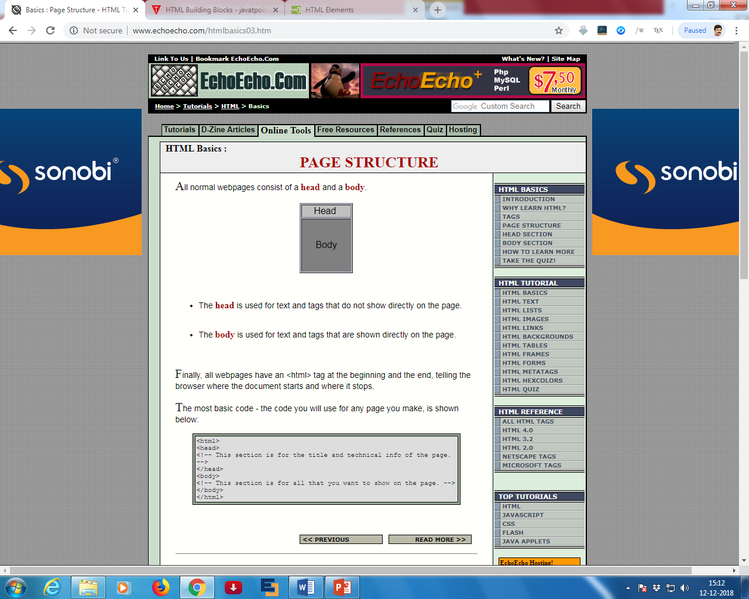
Structure of HTML Web Page
<!DOCTYPE html 5.0> <html> <head> <title> Sample Web Page</title>
<meta name="author" content="John Doe"> </head> <body> <h1>My First Heading</h1> <p>My first paragraph. </p> </body> </html>
CSS,VB Scripts, Java script and Control Info./
Any user data/information visible on web page

Slide 20
Description of HTML Example
<!DOCTYPE>: It defines the document type or it instruct the browser about the version of HTML.
<html> :This tag inform the browser that it is an HTML document. Text between html tag describes the web document. It is a container for all other elements of HTML except <!DOCTYPE>
<head> : It's should be the first element inside the <html> element, which contains the metadata (information about the document). It must be closed before the body tag opens.
<title> : As its name suggested, it is used to add title of that HTML page which appears at the top of the browser window. It must be placed inside the head tag and should close immediately. (Optional)
<body> : Text between body tag describes the body content of the page that is visible to the end user This tag contains the main content of the HTML document.
<h1> : Text between <h1> tag describes the first level heading of the webpage.
<p> : Text between <p> tag describes the paragraph of the webpage.

Slide 21
HTML text Editors
An HTML file is a text file, so to create an HTML file we can use any text editors.
Text editors are the programs which allow editing in a written text, hence to create a web page we need to write our code in some text editor.
Step 1: Open Notepad (Windows)
Step 2: Write code in HTML
Step 3: Save the HTML file with .htm or .html extension
Step 4: Open the HTML page in your web browser (Output)

Slide 22
Building blocks of HTML
Tags: Tags is a unique letter or word enclosed with in angular brackets.
It represents a formatted HTML command for a Web page designing
Ex: <html> …</html>
The opening tag may contains attributes and values to decorate the web page
Ex: <body bgcolor=“red”> ….</body>
Ex <br>
There are two type of tags 1)paired tags 2) single tags
Basically, a computer sees "A" as simply "A" but not whether it is bold, italic, big or small.
To tell the browser that an "A" should be bold we need to put a markup in front of the A. Such a markup is called a Tag.

Slide 23
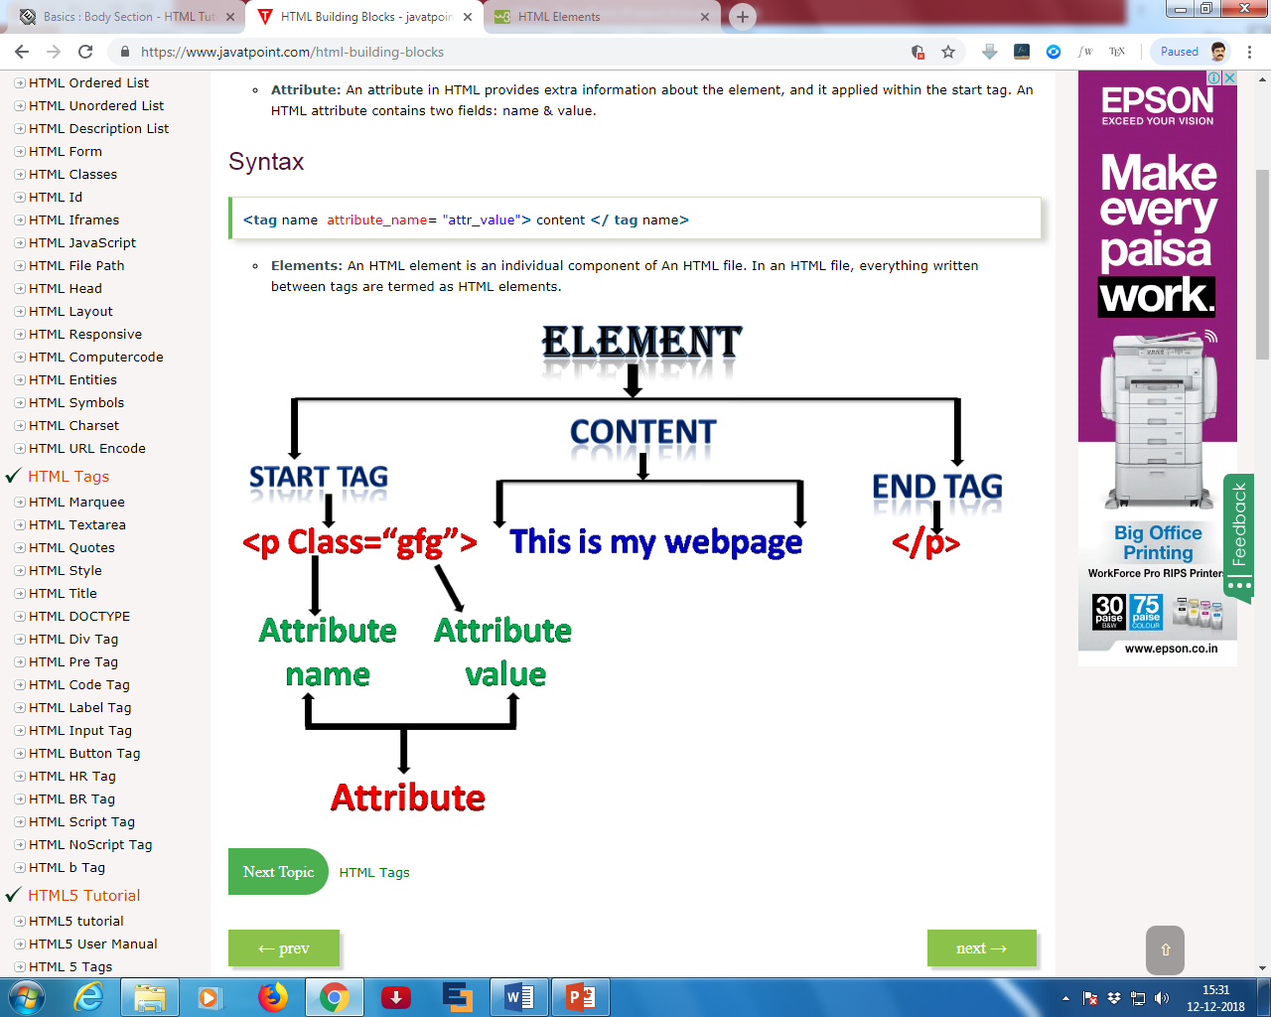
Elements: HTML element is a component of an HTML document that tells a web browser how to structure and interpret a part of the HTML document.
HTML elements can contain formatting instructions, semantic meaning, and content.
Ex: <p class=“gfg”> This is my webpage </p>
<a href="https://www.eenadu.net">Eenadu Paper</a>

Slide 24
Types of elements :
1)nested elements
2) Empty elements
3)Unclosed elements
Nested Elements: if an element is within another element is called nested element.
All HTML documents consist of nested HTML elements.
<!DOCTYPE html> <html> <body> <h1>My First Heading</h1> <p>My first paragraph.</p> </body> </html>

Slide 25
Empty HTML Elements
HTML elements with no content are called empty elements.
<br> is an empty element without a closing.
It is a line break tag
Unclosed HTML Tags
Some HTML tags are not closed, for example br and hr.
<br> Tag: br stands for break line, it breaks the line of the code.
<hr> Tag: hr stands for Horizontal Rule. This tag is used to put a line across the webpage.

Slide 26
Attribute: HTML attributes are special words used inside the opening tag to control the element's behavior.
attributes provide extra information about the element.
An HTML attribute contains two fields: name & value.
Syntax:
<tag name attribute_name= "attr_value"> content </ tag name>
Types of attributes
(1) required attributes, needed by a particular element type for that element type to function correctly;
(2) optional attributes, used to modify the default functionality of an element type;
(3) standard attributes, supported by many element types;
(4) event attributes, used to cause element types to specify scripts to be run under specific circumstances.

Slide 27
HTML – Header Related Tags
The <head> tag is a container of various important tags like
<title>,
<meta>,
<link>,
<base>,
<style>,
<script>, and
<noscript> tags.

Slide 28
The HTML <title> Tag
The HTML <title> tag is used for specifying the title of the HTML document. Following is an example to give a title to an HTML document −
<!DOCTYPE html>
<html>
<head>
<title>HTML Title Tag Example</title>
</head>
<body>
<p>Hello, World!</p>
</body>
</html>

Slide 29
The HTML <meta> Tag
The HTML <meta> tag is used to provide metadata about the HTML document which includes information about page expiry, page author, list of keywords, page description etc.
<meta name = "keywords" content = "C, C++, Java, PHP, Perl, Python">
<!-- Provide description of the page -->
<meta name = "description" content = “Easy Learning ">
<!-- Author information -->
<meta name = "author" content = “raja">
<!-- Page content type -->
<meta http-equiv = "content-type" content = "text/html; charset = UTF-8">

Slide 30
The HTML <base> Tag
The HTML <base> tag is used for specifying the base URL for all relative URLs in a page, which means all the other URLs will be concatenated into base URL while locating for the given item.
Ex:
<a href = "/html/index.htm" title = "HTML Tutorial"/>HTML Tutorial</a>

Slide 31
The HTML <link> Tag
The HTML <link> tag is used to specify relationships between the current document and external resource.
Following is an example to link an external style sheet file available in css sub-directory within web root.
<link rel = "stylesheet" type = "text/css" href = "/css/style.css">

Slide 32
The HTML <style> Tag
The HTML <style> tag is used to specify style sheet for the current HTML document.
Following is an example to define few style sheet rules inside <style> tag −
<style type = "text/css">
.myclass
{
background-color: cyan;
padding: 10px;
}
</style>

Slide 33
The HTML <script> Tag
The HTML <script> tag is used to include either external script file or to define internal script for the HTML document.
Following is an example where we are using JavaScript to define a simple JavaScript function −
<script type = "text/JavaScript">
function Hello()
{
alert("Hello, World");
}
</script>

Slide 34
Body tag and attributes
<BODY>...</BODY> | Contains the viewed portion of the document
<BODY bgcolor=”color”> | Sets the color of the background in hexadecimal code
<BODY background=”filename.xxx”> | Sets an image as a page’s background (wallpaper)
<BODY text=”color”> | Specifies the color of normal text in hexadecimal code
<BODY link=”color”> | Specifies the default color of unvisited links in hexadecimal code
<BODY alink=”color”> | Specifies the color of links on click in hexadecimal code
<BODY vlink=”color”> | Specifies the color of followed links in hexadecimal code

Slide 35
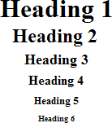
Basic Text formatting
<h1> | heading 1 | <h1>Heading 1 Example</h1>
<h2> | heading 2 | <h2>Heading 2 Example</h2>
<h3> | heading 3 | <h3>Heading 3 Example</h3>
<h4> | heading 4 | <h4>Heading 4 Example</h4>
<h5> | heading 5 | <h5>Heading 5 Example</h5>
<h6> | heading 6 | <h6>Heading 6 Example</h6>
<br> | line break | The contents of your page<br>The contents of your page | The contents of your web page The contents of your web page

Slide 36
<p> | paragraph | This is an example displaying the use of the paragraph tag. <p> This will create a line break and a space between lines. Attributes: Example 1:<br> <br> <p align="left"> This is an example<br> displaying the use<br> of the paragraph tag.<br> <br> Example 2:<br> <br> <p align="right"> This is an example<br> displaying the use<br> of the paragraph tag.<br> <br> Example 3:<br> <br> <p align="center"> This is an example<br> displaying the use<br> of the paragraph tag. | This is an example displaying the use of the paragraph tag. This will create a line break and a space between lines. Attributes: Example 1: This is an example displaying the use of the paragraph tag. Example 2: This is an example displaying the use of the paragraph tag. Example 3: This is an example displaying the use of the paragraph tag.

Slide 37
Preformatted text tag: <pre> </pre>
The HTML <pre> tag is used for indicating preformatted text. The code tag surrounds the code being marked up. Browsers normally render pre text in a fixed-pitched font, with whitespace intact, and without word wrap.
Example
<!DOCTYPE html>
<html>
<head>
<title>HTML pre Tag</title>
</head>
<body>
<pre>
This text is
in a fixed-pitch
font, and it preserves
both spaces and line breaks
</pre></body></html>
Output:
This text is
in a fixed-pitch
font, and it preserves
both spaces and line breaks

Slide 38
Presentational Elements
<b> | bold | <b>Example</b> | Example
<i> | italic | <i>Example</i> | Example
<u> (deprecated) | underline | <u>Example</u> | Example
<strike> or <s> (deprecated) | deleted text | <strike>Example</strike> Or <s>Example</s> | Example
<tt> | teletype | <tt>Example</tt> | Example
<sup> | Super Script | Written on the 31 <sup>st</sup> | Written on the 31st.
<sub> | Sub script | The ER paradox<sub>2</sub> was devised by Einstein, Podolsky and Rosen | The ER paradox2 was devised by Einstein, Podolsky and Rosen
<big> | big (text) | <big>Example</big> | Example (Tip)
<small> | small (text) | <small>Example</small> | Example (Tip)
<hr> Marquee | horizonta l rule moving | <hr width="25%" color="#6699ff" size="6“ /> <marquee>hello</marquee>

Slide 39
HTML - Marquees
An HTML marquee is a scrolling piece of text displayed either horizontally across or vertically down your webpage depending on the settings.
This is created by using HTML <marquees> tag.
Syntax:
<marquee attribute_name = "attribute_value"....more attributes> One or more lines or text message or image
</marquee>

Slide 40
The <marquee> Tag Attributes
Sr.No | Attribute | Description
1 | width | This specifies the width of the marquee. This can be a value like 10 or 20% etc.
2 | height | This specifies the height of the marquee. This can be a value like 10 or 20% etc.
3 | direction | This specifies the direction in which marquee should scroll. This can be a value like up, down, left or right.
4 | behavior | This specifies the type of scrolling of the marquee. This can have a value like scroll, slide and alternate.
5 | scrolldelay | This specifies how long to delay between each jump. This will have a value like 10 etc.
6 | scrollamount | This specifies the speed of marquee text. This can have a value like 10 etc.
7 | loop | This specifies how many times to loop. The default value is INFINITE, which means that the marquee loops endlessly.
8 | bgcolor | This specifies background color in terms of color name or color hex value.
9 | hspace | This specifies horizontal space around the marquee. This can be a value like 10 or 20% etc.
10 | vspace | This specifies vertical space around the marquee. This can be a value like 10 or 20% etc.

Slide 41
TEXT EDIT ELEMENTS
<Del> is used to delete the word or text from the document
<ins> is used to insert word or text in the document
<html>
<body>
This is my <del>python</del> program
This is <ins> not </ins> my program
</body>
</html>
This is my pythonprogram
Output : this is my program
Output : this is not my program

Slide 42
Phrase elements
1).<em>
2) .<strong>
3). <blockquote>
4.<cite>
5. <q>
6.<abbr>
7. <acronym>
8. <dfn>
9. <code>
10. <kbd>
11. <samp>
12. <var>
13. <address>

Slide 43
1)Emphasized Text tag: <em>...</em> :Anything that appears within <em>...</em> element is displayed as emphasized text in italic form.
Example:
<!DOCTYPE html>
<html>
<body>
The following word uses a <em>emphasized</em> typeface.
</body>
</html>
This will produce the following result:
The following word uses an emphasized typeface.

Slide 44
2)Strong Text tag: <strong>...</strong>
Anything that appears within <strong>...</strong> element is displayed as important text strong bold.
Example
<!DOCTYPE html>
<html>
<head>
<title>Strong Text Example</title>
</head>
<body>
The following word uses a <strong>strong</strong> typeface.
</body>
</html>
This will produce the following result:
The following word uses a strong typeface.

Slide 45
3.<blockquote> : The HTML <blockquote> element defines a section that is quoted from another source. Browsers usually indent <blockquote> elements.
Example:
<!DOCTYPE html>
<html><body>
<p>Browsers usually indent blockquote elements.</p>
<blockquote cite="http://www.worldwildlife.org/who/index.html">
For nearly 60 years, WWF has been protecting the future of nature. The world's leading conservation organization, WWF works in 100 countries and is supported by more than one million members in the United States and close to five million globally.
</blockquote>
</body> </html>
Output:
Browsers usually indent blockquote elements.
For nearly 60 years, WWF has been protecting the future of nature. The world's leading conservation organization, WWF works in 100 countries and is supported by more than one million members in the United States and close to five million globally.

Slide 46
HTML <cite> for Work Title
The HTML <cite> tag defines the title of a creative work (e.g. a book, a poem, a song, a movie, a painting, a sculpture, etc.).
Note: A person's name is not the title of a work.
The text in the <cite> element usually renders in italic.
Example: <!DOCTYPE html>
<html><body>
<p>The HTML cite element defines the title of a work.</p>
<p>Browsers usually display cite elements in italic.</p>
<p> <cite>The Scream</cite> by Edvard Munch. Painted in 1893.</p>
</body></html>
Output:
The HTML cite element defines the title of a work.
Browsers usually display cite elements in italic.
The Scream by Edvard Munch. Painted in 1893.

Slide 47
Short Quotations tag: <q>...</q>
The <q>...</q> element is used when you want to add a double quote within a sentence.
Example
<!DOCTYPE html>
<html>
<head>
<title>HTML blockquote Tag</title>
</head>
<body>
<q>Welcome to html </q>
</body>
</html>
output
“Welcome to html”

Slide 48
<abbr> for Abbreviations
The HTML <abbr> tag defines an abbreviation or an acronym, like "HTML", "CSS", "Mr.", "Dr.", "ASAP", "ATM".
Marking up abbreviations can give useful information to browsers, translation systems and search-engines.
Example:
<p>The <abbr title="World Health Organization">WHO</abbr> was founded in 1948.</p>
Output:
The WHO was founded in 1948.

Slide 49
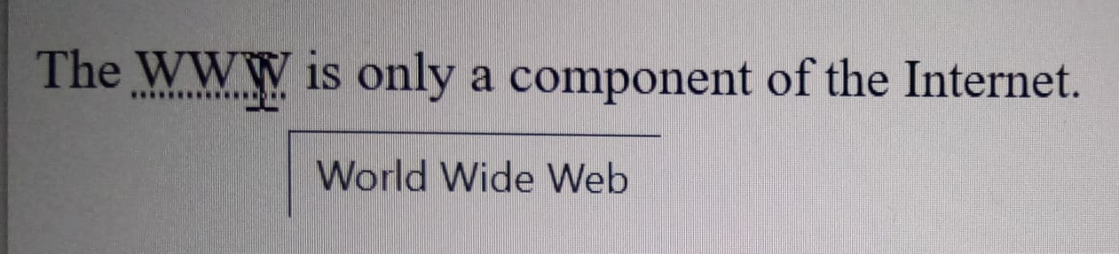
<acronym> deprecated
The <acronym> HTML element allows authors to clearly indicate a sequence of characters that compose an acronym or abbreviation for a word.
<p>The <acronym title="World Wide Web">WWW</acronym> is only a component of the Internet.</p>

Slide 50
The <dfn> tag stands for the "definition element", and it specifies a term that is going to be defined within the content.
The nearest parent of the <dfn> tag must also contain the definition/explanation for the term.
<!DOCTYPE html>
<html>
<body>
<p> <dfn>HTML</dfn> is the standard markup language for creating web pages.</p>
</body>
</html>
Output::
HTML is the standard markup language for creating web pages.

Slide 51
Computer Code tag: <code>...</code> :Any programming code to appear on a Web page should be placed inside <code>...</code>tags.
Usually the content of the <code> element is presented in a monospaced font, just like the code in most programming books.
Example
<!DOCTYPE html>
<html>
<body>
<code>
void main(){
printf(“hello world”);
getch();
}
</code>
</body>
</html>
void main(){
printf(“hello world”);
getch();
}

Slide 52
<kbd> this tag is used to define keyboard input. The content inside is displayed in the browser's default monospace font.
<!DOCTYPE html>
<html>
<body>
<h1>The kbd element</h1>
<p>Press <kbd>Ctrl</kbd> + <kbd>C</kbd> to copy text (Windows).</p>
<p>Press <kbd>Cmd</kbd> + <kbd>C</kbd> to copy text (Mac OS).</p>
</body>
</html>
The kbd element
Press Ctrl + C to copy text (Windows).
Press Cmd + C to copy text (Mac OS).

Slide 53
<var> this tag is used to defines a variable in programming or in a mathematical expression. The content inside is typically displayed in italic.
<!DOCTYPE html>
<html>
<body>
<h1>The var element</h1>
<p>The area of a triangle is: 1/2 x <var>b</var> x <var>h</var>, where <var>b</var> is the base, and <var>h</var> is the vertical height.</p>
</body>
</html>
Output:
The var element
The area of a triangle is: 1/2 x b x h, where b is the base, and h is the vertical height.

Slide 54
<samp> this tag is used to define sample output from a computer program. The content inside is displayed in the browser's default monospace font.
Tip: This tag is not deprecated. However, it is possible to achieve richer effect by using CSS.
<!DOCTYPE html>
<html>
<body>
<h1>The samp element</h1>
<p>Message from my computer:</p>
<p> <samp>File not found.<br>Press F1 to continue</samp> </p>
</body>
</html>
The samp element
Message from my computer:
File not found. Press F1 to continue

Slide 55
<address> :The HTML <address> tag defines the contact information for the author/owner of a document or an article.
The contact information can be an email address, URL, physical address, phone number, social media handle, etc.
The text in the <address> element usually renders in italic, and browsers will always add a line break before and after the <address> element.
Example
<address>
Written by John Doe.<br>
Visit us at:<br>
Example.com<br>
Box 564, Disneyland<br>
USA
</address>
Output:
The HTML address element defines contact information (author/owner) of a document or article.
Written by John Doe. Visit us at: Example.com Box 564, Disneyland USA
Section Divisions
<div> ... </div> Division or Section of Page Content
<span> ... </span> Section of text within other content

Slide 56
Font tag and attributes
<FONT>...</FONT> Changes font attributes for text within the tags
<FONT size=”value”>...</FONT> Sets the font to a size from 1 to 7, with 1 the smallest and 7 the largest
<FONT face=”name”>...</FONT> Sets the font face
<FONT color=”color”>...</FONT> Sets the font color using hexadecimal code
<font face="Calibri" size=1 color="blue"> hello world </font>

Slide 57
Setting Font Color - Methods
We can set any font color you like using color attribute.
There are following three different methods to set colors in your web page
Color names − You can specify color names directly like green, blue or red.
Hex codes − A six-digit code representing the amount of red, green, and blue that makes up the color.
Color decimal or percentage values − This value is specified using the rgb( ) property.
For Example:
<font color = "red">
<font color = "#FF00FF"> Note: #rrggbb
<font color = "rgb(0,0,0)"> Note: rgb(red,green,blue)
Note − All the browsers does not support rgb() property of color so it is recommended not to use it.

Slide 58
Anchor tag and attributes
<A>...</A> | Designates the origin and destination of a hyperlink
<A HREF=”url”>...</A> | Creates a hyperlink
<A HREF=”#NAME”>...</A> | Links to a target location in the current page
<A HREF=”URL#NAME”>...</A> | Links to a target location in a page outside your site
<A NAME=”NAME”>...</A> | Sets a target location within a document
<A HREF=”mailto:email”>...</A> | Creates a mailto link
Optional Attributes
<A HREF=”?” target=”?”>...</A> | Specifies where the linked-to document is to be placed
<A HREF=”?” rel=”?”>...</A> | Sets up a relationship between the linked-to document and the current page
<A HREF=”?” rev=”?”>...</A> | Sets up a reverse relationship between the current page and the linked-to document

Slide 59
<HTML> <BODY>
Text link<BR>
<A HREF="http://www.yahoo.com">Click here to visit Yahoo</A> <BR>
<BR>Click on below image to visit my homepage:<BR><BR>
<A HREF="http://www.gmail.com/"><IMG SRC="cnr.jpg" width=50 height=50 border=2></A>
<BR> <BR> Click on below link to send an email to me <BR>
<A HREF="mailto:nagaraju.c@yogivemanauniversity.ac.in">Email Me</A>
<BR> Click on below link to send us your comments. <BR>
<A HREF="mailto:webmaster@learnem.com?subject:comments about your site">Email Me</A>
where to open link _self , _blank,_parent, _top
<a href="https://www.w3schools.com/" target="_blank">Visit W3Schools!</a>
<h2>Relative URLs</h2>
<p><a href=“aa.html">HTML Images</a></p>
<p><a href="/css/default.asp">CSS Tutorial</a></p>
<button onclick="document.location='https://www.w3schools.com/html/html_links.asp’>
HTML Tutorial </button>
</BODY> </HTML>

Slide 60
Image tag and attributes
<IMG> | Embeds an image in the document at the location of the tag
<IMG src=”url” alt=”text”> | Adds an image with a text description
<IMG src=”url” alt=”text” align=”direction”> | Aligns an image to the left, right, center, bottom, or top
<IMG src=”url” alt=”text” border=”number”> | Sets the size of the border around an image
<IMG src=”url” alt=”text” height=”pixels”> | Sets the height of an image
<IMG src=”url” alt=”text” width=”pixels”> | Sets the width of an image
<IMG src=”url” alt=”text” hspace=”pixels”> | Sets a horizontal margin to be placed around an image
<IMG src=”url” alt=”text” vspace=”pixels”> | Sets a vertical margin to be placed around an image
<IMG src=”url” alt=”text” usemap=”map-name”> | Designates an image as a client-side image map

Slide 61
IMAGE PROPERTIES
<!DOCTYPE html>
<html>
<body>
<h2>HTML Image</h2>
<img src="18.jpg" alt="Trulli“ align=“right” width="500" height="333" border=10 hspace=10 vspace=10>
<img src="18.jpg" alt="Girl in a jacket">
<img src="18.jpg" alt="Flowers in Chania">
<img src="18.jpg" alt="Flowers in Chania">
</body>
</html>

Slide 62
IMAGE WITH AREA SHAPE
<html>
<body>
<img src="workplace.jpg"alt="Workplace" usemap="#workmap">
<map name="workmap">
<area shape="rect" coords="200,200,40,40" alt="abc1" href="abc.html">
<area shape="rect" coords="300,300,50,50" alt="abc5" href="abc5.html">
<area shape="circle" coords="400,400,50" alt="textproperties" href="textproperties.html">
</map>
</body>
</html>

Slide 63
<picture> tag is more flexible way to display image than <img>tag
<!DOCTYPE html>
<html>
<head>
<meta name="viewport" content="width=device-width, initial-scale=1.0">
</head>
<body>
<h2>The picture Element</h2>
<picture>
<source media="(min-width: 650px)" srcset="img_food.jpg">
<source media="(min-width: 465px)" srcset="img_car.jpg">
<img src="img_girl.jpg" style="width:auto;">
</picture>
</body>
</html>

Slide 64
Video
<video width="200" height="150" controls>
<source src="vid.mp4" type="video/mp4">
<source src="vid.ogg" type="video/ogg">
No video support.
</video>
Audio
<audio controls>
<source src="sound.ogg" type="audio/ogg">
<source src="sound.mp3" type="audio/mpeg">
No audio support.
</audio>

Slide 65
<IFRAME> tag for accessing YOUTUBE VIDEO
<html>
<body>
hello
<iframe width="420" height="315"
src="https://www.youtube.com/embed/tgbNymZ7vqY">
</iframe>
</body>
</html>

Slide 66
Frame tag and attributes
<FRAMESET>...</FRAMESET> | Specifies the layout of subsections in the main browser window
<FRAMESET rows=”value,value”> | Defines the rows within a frameset
<FRAMESET cols=”value,value”> | Defines the columns within a frameset
<NOFRAMES>...</NOFRAMES> | Provides alternate content for browsers that do not support frames
<FRAME src=”?”> | Defines the appearance and content of a single frame
<FRAME name=”name”> | Labels the frame for targeting by other frames
<FRAME marginwidth=”#”> | Sets the margin width of a frame
<FRAME marginheight=”#”> | Sets the margin height of a frame
<FRAME scrolling=”value”> | Creates a frame scrollbar
<FRAME noresize> | Prevents the resizing of a frame

Slide 67
Frames
<frameset> ... </frameset> Define the set of Frames
<frameset> Tag Attributes:
rows="??,??, ..." Define row sizes & number of rows (size in pixels or %)
cols="??,??, ..." Define column sizes & number of columns (size in pixels or %)
noresize="noresize" User cannot resize any frames in frameset
<frame> ... </frame> Define a frame within the frameset
<frame> Tag Attributes:
src="url" Location of HTML File for a frame
name="***" Unique name of frame window
marginwidth="?" Horizontal margin spacing inside frame (pixels)
marginheight="?" Vertical margin spacing inside frame (pixels)
noresize="noresize" Declare all frameset sizes as fixed
scrolling="***" Can the user scroll inside the frame: yes, no, auto
frameborder="?" Frame Border: (1=yes, 2=no)
bordercolor="#??????" Border Colour (*)
<noframes> ... </noframes> Unframed content (for browsers not supporting frames)

Slide 68
<!DOCTYPE html>
<html>
<frameset rows="25%,50%,25%">
<frame src="otp.html">
<frame src="abc.html">
<frame src="list.html">
</frameset>
</html>

Slide 69
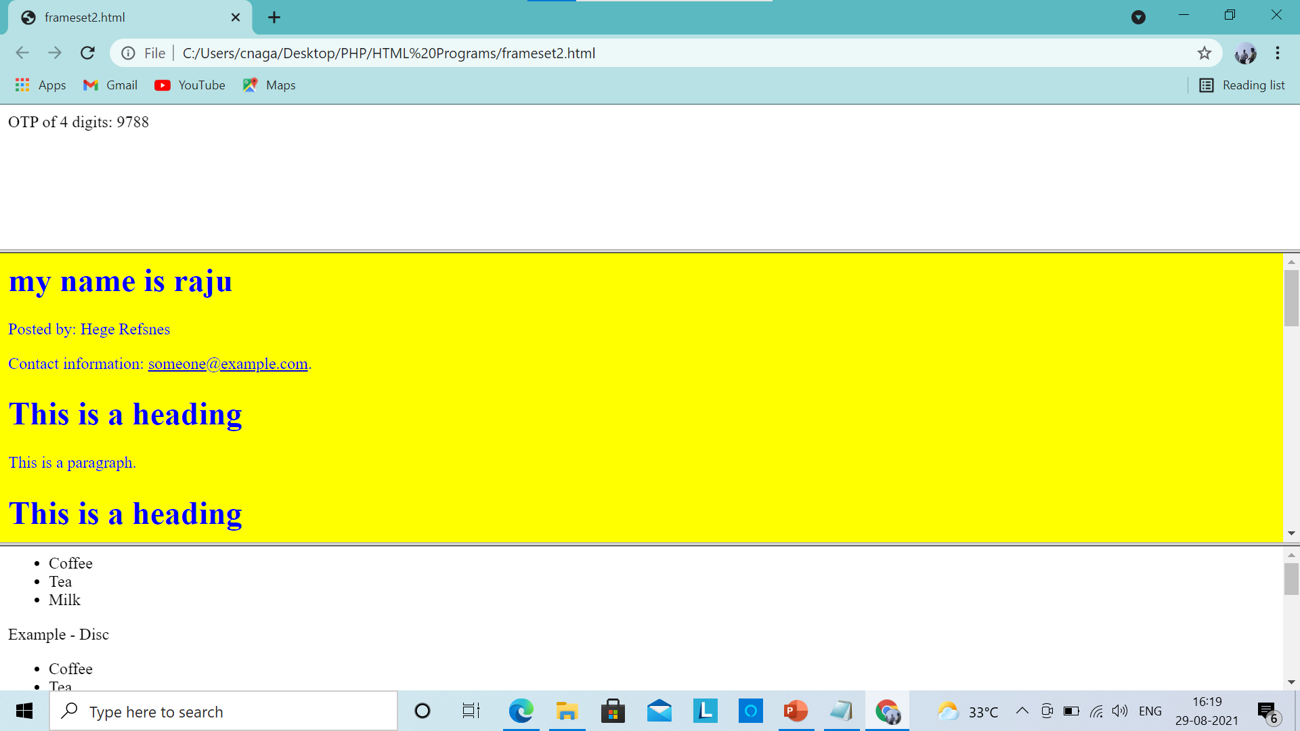

Slide 70
<!DOCTYPE html>
<html>
<frameset cols="25%,50%,25%">
<frame src="otp.html">
<frame src="abc.html">
<frame src="list.html">
</frameset>
</html>

Slide 71
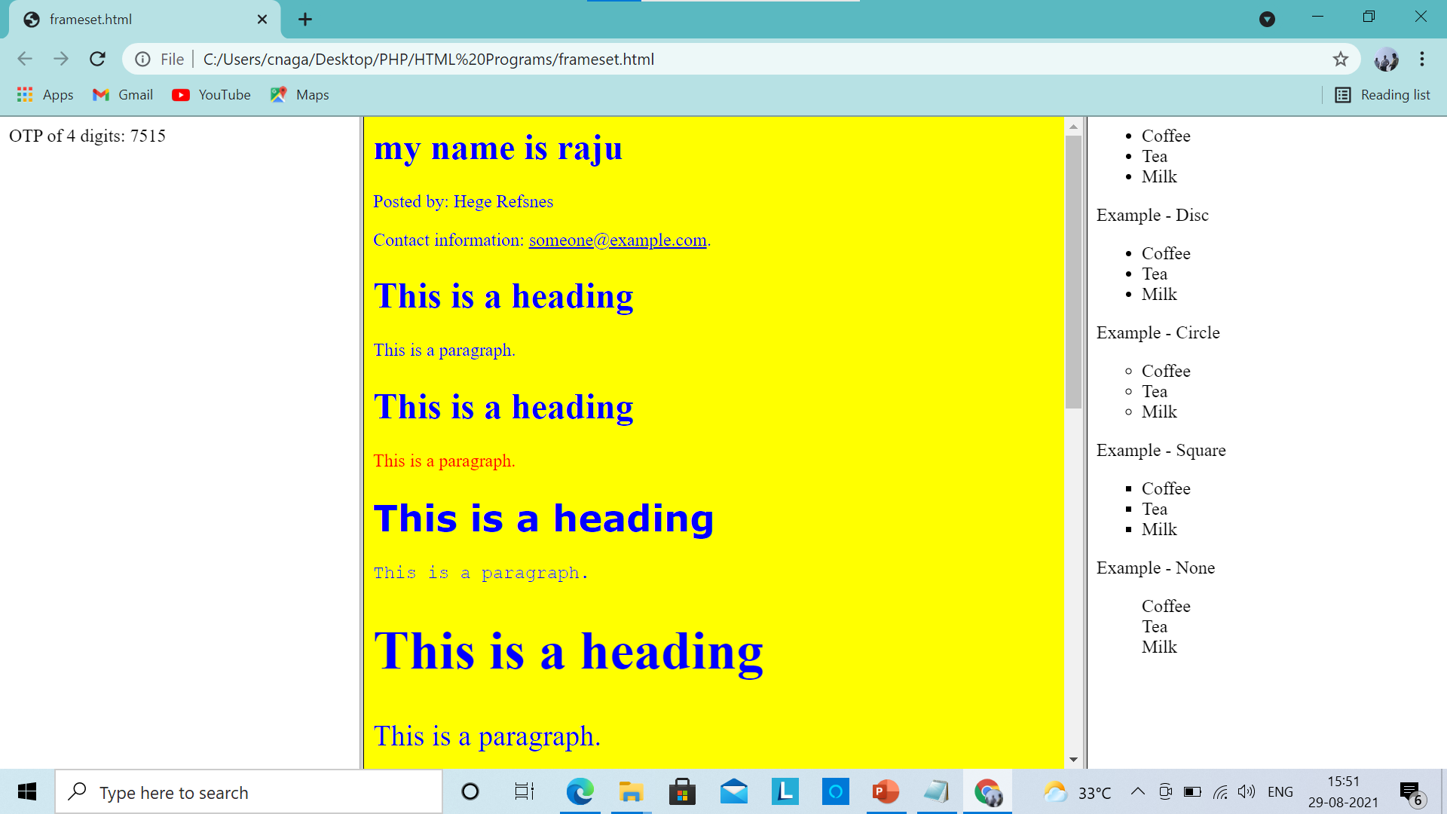

Slide 72
<HTML>
<HEAD>
<TITLE> Frameset Exmaple </TITLE>
</HEAD>
<frameset cols="30%, 70%" bordercolor="blue" noresize="noresize">
<frameset rows="100, 200" bordercolor="red">
<frame name="first-frame" src="cnr1.jpg">
<frame name="second-frame" src="list.html">
</frameset>
<frameset rows="100, 200" bordercolor="red">
<frame name="first-frame" src="cnr2.jpg">
<frame name="second-frame" src="table.html">
</frameset>
<frame name="third-frame" src=“cnr3.html">
<noframes>
<p> This document contains frames content. You browser does not support it. </p>
</noframes>
</frameset> </HTML>

Slide 73
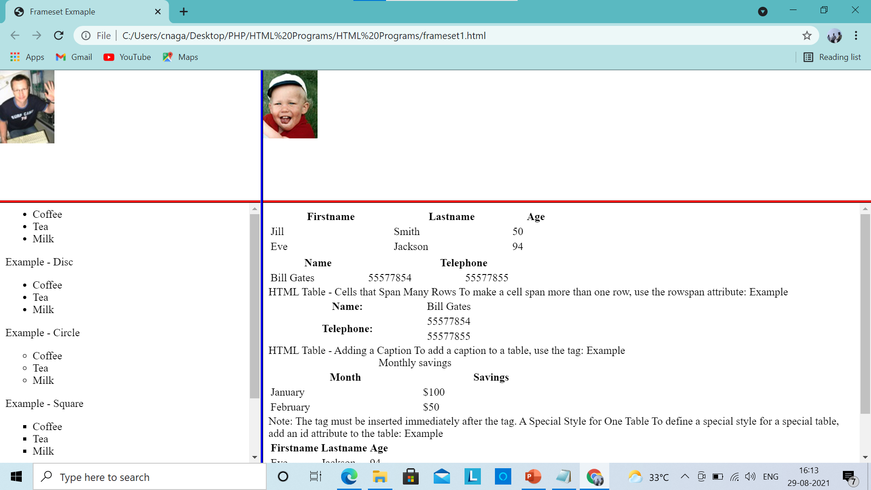

Slide 74
Disadvantages of Frames
There are few drawbacks with using frames, so it's never recommended to use frames in your webpages −
Some smaller devices cannot cope with frames often because their screen is not big enough to be divided up.
Sometimes your page will be displayed differently on different computers due to different screen resolution.
The browser's back button might not work as the user hopes.
There are still few browsers that do not support frame technology.

Slide 75
HTML Lists
HTML offers web authors three ways for specifying lists of information.
All lists must contain one or more list of elements.
Lists may contain:
<ul> - An unordered list. This will list items using plain bullets.
<ol> - An ordered list. This will use different schemes of numbers to list your items.
<dl> - A definition list. This arranges your items in the same way as they are arranged in a dictionary.
HTML Unordered Lists: An unordered list is a collection of related items that have no special order or sequence.
This list is created by using HTML <ul> tag.
Each item in the list is marked with a bullet

Slide 76
Following is an example where we used <ul>
<html>
<head>
<title>HTML Unordered List</title>
</head>
<body>
<ul>
<li>Beetroot</li>
<li>Ginger</li>
<li>Potato</li>
<li>Radish</li>
</ul>
</body>
</html
This will produce following result:
Beetroot
Ginger
Potato
Radish

Slide 77
The type Attribute
You can use type attribute for <ul> tag to specify the type of bullet you like.
By default it is a disc.
Following are the possible options:
<ul type="square">
<ul type="disc">
<ul type="circle">

Slide 78
Following is an example where we used <ul type="square">
<!DOCTYPE html>
<html>
<head>
<title>HTML Unordered List</title>
</head>
<body>
<ul type="square">
<li>Beetroot</li>
<li>Ginger</li>
<li>Potato</li>
<li>Radish</li>
</ul>
</body>
</html>
This will produce following result:
Beetroot
Ginger
Potato
Radish

Slide 79
Following is an example where we used <ul type="disc"> :
<!DOCTYPE html>
<html>
<head>
<title>HTML Unordered List</title>
</head>
<body>
<ul type="disc">
<li>Beetroot</li>
<li>Ginger</li>
<li>Potato</li>
<li>Radish</li>
</ul>
</body>
</html>
This will produce following result:
Beetroot
Ginger
Potato
Radish

Slide 80
Following is an example where we used <ul type="circle"> :
<!DOCTYPE html>
<html>
<head>
<title>HTML Unordered List</title>
</head>
<body>
<ul type="circle">
<li>Beetroot</li>
<li>Ginger</li>
<li>Potato</li>
<li>Radish</li>
</ul>
</body>
</html>
This will produce following result:
o Beetroot
o Ginger
o Potato
o Radish

Slide 81
HTML Ordered Lists
If you are required to put your items in a numbered list instead of bulleted then HTML ordered list will be used.
This list is created by using <ol> tag.
The numbering starts at one and is incremented by one for each successive ordered list element tagged with <li>.

Slide 82
Example of Ordered Lists
<!DOCTYPE html>
<html>
<head>
<title>HTML Ordered List</title>
</head>
<body>
<ol>
<li>Beetroot</li>
<li>Ginger</li>
<li>Potato</li>
<li>Radish</li>
</ol>
</body>
</html>
This will produce following result:
1. Beetroot
2. Ginger
3. Potato
4. Radish

Slide 83
The type Attribute
You can use type attribute for <ol> tag to specify the type of numbering you like.
By default it is a number.
Following are the possible options:
<ol type="1"> - Default-Case Numerals.
<ol type="I"> - Upper-Case Numerals.
<ol type="i"> - Lower-Case Numerals.
<ol type="a"> - Lower-Case Letters.
<ol type="A"> - Upper-Case Letters

Slide 84
Following is an example where we used <ol type="1">
<!DOCTYPE html>
<html>
<head>
<title>HTML Ordered List</title>
</head>
<body>
<ol type="1">
<li>Beetroot</li>
<li>Ginger</li>
<li>Potato</li>
<li>Radish</li>
</ol>
</body>
</html>
This will produce following result:
1. Beetroot
2. Ginger
3. Potato
4. Radish

Slide 85
Following is an example where we used <ol type="I">
<!DOCTYPE html>
<html>
<head>
<title>HTML Ordered List</title>
</head>
<body>
<ol type="I">
<li>Beetroot</li>
<li>Ginger</li>
<li>Potato</li>
<li>Radish</li>
</ol>
</body>
</html>
This will produce following result:
I. Beetroot
II. Ginger
III. Potato
IV. Radish

Slide 86
Following is an example where we used <ol type="i">
<!DOCTYPE html>
<html>
<head>
<title>HTML Ordered List</title>
</head>
<body>
<ol type="i">
<li>Beetroot</li>
<li>Ginger</li>
<li>Potato</li>
<li>Radish</li>
</ol>
</body>
</html>
This will produce following result:
i. Beetroot
ii. Ginger
iii. Potato
iv. Radish

Slide 87
Following is an example where we used <ol type="A">
<!DOCTYPE html>
<html>
<head>
<title>HTML Ordered List</title>
</head>
<body>
<ol type="A">
<li>Beetroot</li>
<li>Ginger</li>
<li>Potato</li>
<li>Radish</li>
</ol>
</body>
</html>
This will produce following result:
A. Beetroot
B. Ginger
C. Potato
D. Radish

Slide 88
Following is an example where we used <ol type="a">
<!DOCTYPE html>
<html>
<head>
<title>HTML Ordered List</title>
</head>
<body>
<ol type="a">
<li>Beetroot</li>
<li>Ginger</li>
<li>Potato</li>
<li>Radish</li>
</ol>
</body>
</html>
This will produce following result:
a. Beetroot
b. Ginger
c. Potato
d. Radish

Slide 89
The start Attribute
You can use start attribute for <ol> tag to specify the starting point of numbering you need.
Following are the possible options:
<ol type="1" start="4"> - Numerals starts with 4.
<ol type="I" start="4"> - Numerals starts with IV.
<ol type="i" start="4"> - Numerals starts with iv.
<ol type="a" start="4"> - Letters starts with d.
<ol type="A" start="4"> - Letters starts with D

Slide 90
Following is an example where we used <ol type="i" start="4" >
<!DOCTYPE html>
<html>
<head>
<title>HTML Ordered List</title>
</head>
<body>
<ol type="i" start="4">
<li>Beetroot</li>
<li>Ginger</li>
<li>Potato</li>
<li>Radish</li>
</ol>
</body>
</html>
This will produce following result:
iv. Beetroot
v. Ginger
vi. Potato
vii. Radish

Slide 91
HTML Definition Lists
HTML and XHTML support a list style which is called definition lists where entries are listed like in a dictionary or encyclopedia.
The definition list is the ideal way to present a glossary, list of terms, or other
name/value list.
Definition List makes use of following three tags.
<dl> - Defines the start of the list
<dt> - A term
<dd> - Term definition
</dl> - Defines the end of the list

Slide 92
Example
<!DOCTYPE html>
<html>
<head>
<title>HTML Definition List</title>
</head>
<body>
<dl>
<dt><b>HTML</b></dt>
<dd>This stands for Hyper Text Markup Language</dd>
<dt><b>HTTP</b></dt>
<dd>This stands for Hyper Text Transfer Protocol</dd>
</dl>
</body>
</html>
This will produce following result:
HTML
This stands for Hyper Text Markup Language
HTTP
This stands for Hyper Text Transfer Protocol

Slide 93
Lists
<ol> ... </ol> Ordered List
<ul> ... </ul> Un-ordered List
<li> ... </li> List Item (within ordered or unordered)
<ol type="?"> Ordered list type: A, a, I, i, 1
<ol start="??"> Ordered list starting value
<ul type="?"> Unordered list bullet type: disc, circle, square
<li value="??"> List Item Value (changes current and subsequent items)
<li type="??"> List Item Type (changes only current item)
<dl> ... </dl> Definition List
<dt> ... </dt> Term or phrase being defined
<dd> ... </dd> Detailed Definition of term

Slide 94
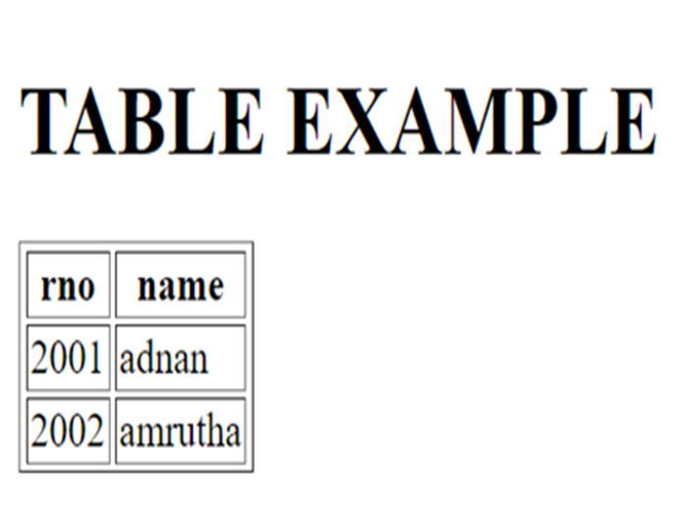
HTML TABLES
The HTML tables allow web authors to arrange data like text, images, links, other tables, etc. into rows and columns of cells.
<table> tag is used to create table.
<th> tag is used to define a table header with bold, centered table data
<tr> tag is used to create table rows
<td> tag is used to create data cells

Slide 95
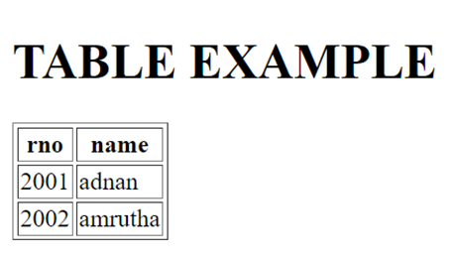
<!DOCTYPE html>
<html>
<head>
<title>HTML Table Header</title>
</head>
<body>
<h1> TABLE EXAMPLE</h1>
<table border=1>
<th> rno </th>
<th> name </th>
<tr>
<td>2001</td>
<td>adnan </td>
</tr>
<tr>
<td>2002</td>
<td>amrutha</td>
</tr>
</table>
</body>
</html>

Slide 96
Table tags and attributes
<TABLE>...</TABLE> | Generates a table
<TABLE border=”pixels”> | Sets the size of cell borders
<TABLE cellspacing=”pixels”> | Sets the amount of space between cells
<TABLE cellpadding=”pixels”> | Sets the amount of space between a border and cell content
<TABLE height=”pixels” or “%”> | Sets the height of a table
<TABLE width=”pixels” or “%”> | Sets the width of a table
<TD>...</TD> | Defines a table data cell
<TD colspan=”columns”> | Sets a cell to span columns
<TD rowspan=”rows”> | Sets a cell to span rows
<TD nowrap> | Prevents the lines within a cell from wrapping
<TH>...</TH> | Defines a table header with bold, centered table data
<TR>...</TR> | Defines a table row
<TR align=”?”> or <TD align=”?”> | Aligns the contents of a row or cell to the left, right, or center
<TR valign=”?”> or <TD valign=”?”> | Sets the vertical alignment of a row or cell to the top, middle, or bottom

Slide 97
Table attributes
1. border // no border =0 border=1
2.bgcolor //background color of table
3.background // background image
4.cellspacing // cell size pixels or
5.cellpadding // spce around cell
6.align //left ,right, center ,justify,char
7.valign // top,middle ,bottom baseline
8.width // width= 100px or width=100%
9.height // height= 100px or height=100%
10.frame // frame=“void” ,above, below, hsides, vsides, rhs, lhs, box, border
11.rules // rules=“none” , groups, cols, rows all
12. caption //caption=“hello”
13. summary // summary=“hffjgjgjgj”

Slide 98
<tr> or <td> or <th> Tags Attributes:
colspan="?" Number of columns the cell spans across (cell merge)
rowspan="?" Number of row a cell spans across (cell merge)
width="??" Cell Width (pixels or %) (*)
height="??" Cell Height (pixels or %) (*)
bgcolor="#??????” Background Colour (*)
align="??" Horizontal Alignment: left, center, right (*)
valign="??" Vertical Alignment: top, middle, bottom (*)
nowrap Force no line breaks in a particular cell
Scope // scope=“row” row,col,rowgroup,colgroup
Axis // axis=“heavy old valuable”
Header // header=“vnvjgjhgj”
Abbr // abbr=“abbruvation”

Slide 99
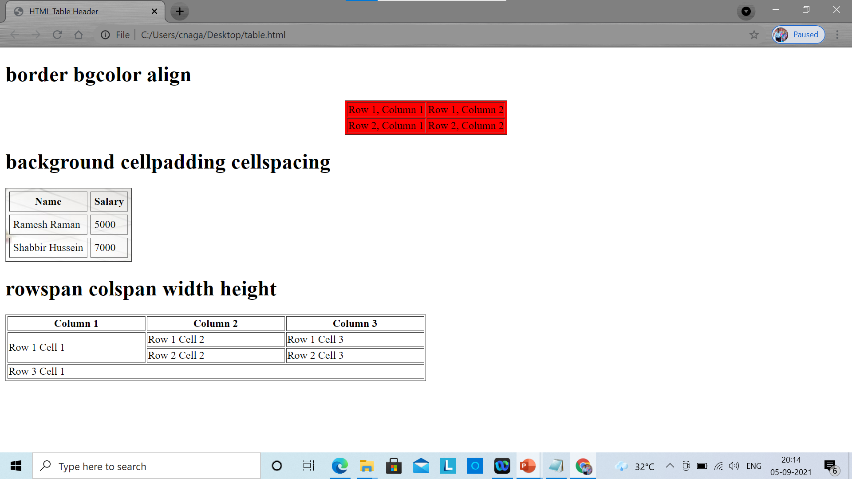
<h1> tbody thead tfoot </h1>
<table border="1" >
<thead>
<tr>
<td colspan="4">This is the head of the table</td>
</tr>
</thead>
<tbody>
<tr>
<td>Cell 1</td>
<td>Cell 2</td>
<td>Cell 3</td>
<td>Cell 4</td>
</tr>
</tbody>
<tfoot>
<tr>
<td colspan="4">This is the foot of the table</td>
</tr>
</tfoot>
</table>

Slide 100
<!DOCTYPE html>
<html>
<head>
<title>HTML Table Header</title>
</head>
<body>
<h1> border bgcolor align</h1>
<table border="1" bgcolor="red" align="center" >
<tr>
<td>Row 1, Column 1</td>
<td>Row 1, Column 2</td>
</tr>
<tr>
<td>Row 2, Column 1</td>
<td>Row 2, Column 2</td>
</tr>
</table>

Slide 101
<h1> background cellpadding cellspacing </h1>
<table border="1" background="cnr.jpg" cellpadding="5" cellspacing="5">
<tr>
<th>Name</th>
<th>Salary</th>
</tr>
<tr>
<td>Ramesh Raman</td>
<td>5000</td>
</tr>
<tr>
<td>Shabbir Hussein</td>
<td>7000</td>
</tr>
</table>

Slide 102
<h1> rowspan colspan width height</h1>
<table border="1" width="50%" height="100%">
<tr>
<th>Column 1</th>
<th>Column 2</th>
<th>Column 3</th>
</tr>
<tr>
<td rowspan="2">Row 1 Cell 1</td>
<td>Row 1 Cell 2</td>
<td>Row 1 Cell 3</td>
</tr>
<tr>
<td>Row 2 Cell 2</td>
<td>Row 2 Cell 3</td></tr>
<tr>
<td colspan="3">Row 3 Cell 1</td>
</tr>
</table>
</body>
</html>

Slide 103
<h1> tbody thead tfoot </h1>
<table border="1" >
<thead>
<tr>
<td colspan="4">This is the head of the table</td>
</tr>
</thead>
<tbody>
<tr>
<td>Cell 1</td>
<td>Cell 2</td>
<td>Cell 3</td>
<td>Cell 4</td>
</tr>
</tbody>
<tfoot>
<tr>
<td colspan="4">This is the foot of the table</td>
</tr>
</tfoot>
</table>

Slide 104
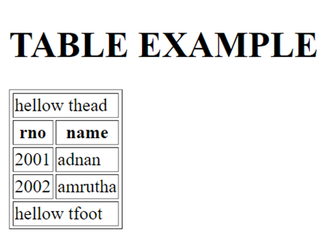
Splitting table into three parts
<Thead>… </Thead>
<Tbody> .. </Tbody>
<Tfoot>.. </Tfoot>

Slide 105
<!DOCTYPE html>
<html>
<head>
<title>HTML Table Header</title>
</head>
<body>
<h1> TABLE EXAMPLE</h1>
<table border=1>
<thead>
<tr>
<td colspan="2">hellow thead </td>
</tr>
</thead>
<th> rno </th>
<th> name </th>
<tbody>
<tr>
<td>2001</td>
<td>adnan </td>
</tr>
</tbody>

Slide 106
<tbody>
<tr>
<td>2002</td>
<td>amrutha</td>
</tr>
</tbody>
<tfoot>
<tr>
<td colspan="2">hellow tfoot </td>
</tr>
</tfoot>
</table>
</body>
</html>

Slide 107
HTML – Forms
HTML Forms are required, when you want to collect some data from the site visitor.
For example, during user registration you would like to collect information such as name, email address, credit card, etc.
A form will take input from the site visitor and then will post it to a back-end application
The back-end application will perform required processing on the passed data based on defined business logic inside the application.
There are various form elements available like text fields, textarea fields, drop-down menus, radio buttons, checkboxes, etc.

Slide 108
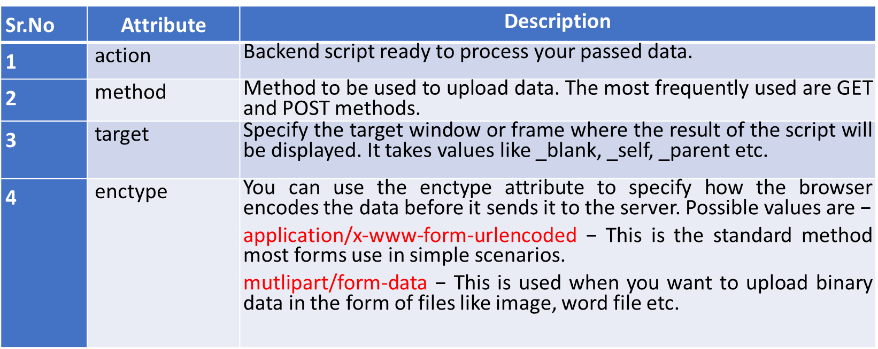
HTML <form> tag is used to create an HTML form and it has following syntax
<form action = "Script URL" method = "GET|POST">
form elements like input, textarea etc.
</form>
<FORM accept=”media type”> | Defines which MIME types are supported by the server processing the form

Slide 109
HTML Form Controls
There are different types of form controls that you can use to collect data using HTML form
Text Input Controls
Checkboxes Controls
Radio Box Controls
Select Box Controls
File Select boxes
Hidden Controls
Clickable Buttons
Submit and Reset Button
Color 10. date 11. datetime-local 12 .email 13. image 14. time 15. url 16.week

Slide 110
1) Text Input Controls
There are three types of text input controls used on forms −
Single-line text input controls − This control accepts one line of user input and display it
Password input controls − This is a single-line text input accept and display data in encrypted format.
Multi-line text input controls − This control accept more than one line of text and displays it. This is <textarea> tag.

Slide 111
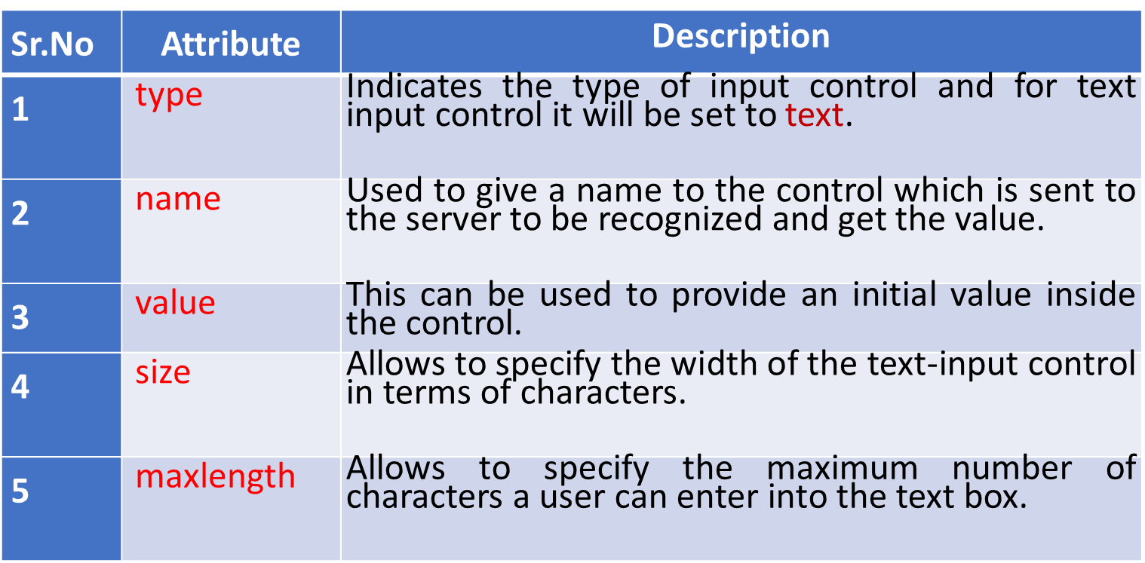
A) Single-line text input controls:This control accepts one line of user input and display it.They are created using HTML <input> tag.
Example: First name: <input type = "text" name = "first_name" />
Last name: <input type = "text" name = "last_name" />

Slide 112
Password input controls − This is a single-line text input accept and display data in encrypted format.
They are also created using HTML <input>tag but type attribute is set to password.
Syntax: Password: <input type = "password" name = "password" />
Sr.No | Attribute | Description
1 | type | Indicates the type of input control and for text input control it will be set to password.
2 | name | Used to give a name to the control which is sent to the server to be recognized and get the value.
3 | value | This can be used to provide an initial value inside the control.
4 | size | Allows to specify the width of the text-input control in terms of characters.
5 | maxlength | Allows to specify the maximum number of characters a user can enter into the text box.

Slide 113
Multi-line text input controls − This control accept more than one line of text and displays it. This is <textarea> tag.
Multi-line input controls are created using HTML <textarea> tag.
Syntax: <textarea rows = "5" cols = "50" name = "description">
Enter description here...
</textarea>
Sr.No | Attribute | Description
1 | name | Used to give a name to the control which is sent to the server to be recognized and get the value.
2 | rows | Indicates the number of rows of text area box.
3 | cols | Indicates the number of columns of text area box

Slide 114
Checkbox Control Checkboxes are used when more than one option is required to be selected. They are also created using HTML <input> tag but type attribute is set to checkbox..
Syntax:
<input type = "checkbox" name = "SUB1" value = “wt"> WT
<input type = "checkbox" name = "SUB2" value = “rs"> RS
Sr.No | Attribute | Description
1 | type | Indicates the type of input control and for checkbox input control it will be set to checkbox..
2 | name | Used to give a name to the control which is sent to the server to be recognized and get the value.
3 | value | The value that will be used if the checkbox is selected.
4 | checked | Set to checked if you want to select it by default.

Slide 115
3) Radio Button Control Radio buttons are used when out of many options, just one option is required to be selected. They are also created using HTML <input> tag but type attribute is set to radio.
Syntax: <input type = "radio" name = "Course" value = " BTECH "> BTECH
<input type = "radio" name = "Course" value = " MTECH "> MTECH
<input type = "radio" name = "Course" value = " MCA "> MCA
<input type = "radio" name = "Course" value = " MBA "> MBA
Sr.No | Attribute | Description
1 | type | Indicates the type of input control and for radio input control it will be set to radio..
2 | name | Used to give a name to the control which is sent to the server to be recognized and get the value.
3 | value | The value that will be used if the checkbox is selected.
4 | checked | Set to checked if you want to select it by default.

Slide 116
Select Box Control :it is called drop down box used to select one or more options.
Syntax: <select name = "dropdown">
<option value = "ECE" selected>ECE</option>
<option value = "CSE">CSE</option>
<option value = "EEE" >EEE</option>
<option value = "MECH">MECH</option>
</select>

Slide 117
Attributes of <select> tag
Sr.No | Attribute | Description
1 | name | Used to give a name to the control which is sent to the server to be recognized and get the value.
2 | size | This can be used to present a scrolling list box.Eg: size=“5”
3 | multiple | If set to "multiple" then allows a user to select multiple items from the menu.
Attributes of <option> tag
Sr.No | Attribute | Description
1 | value | The value that will be used if an option in the select box is selected.
2 | selected | Specifies that this option should be the initially selected value when the page loads.
3 | label | An alternative way of labeling options

Slide 118
File Upload Box : this is used to upload a file to your web site, you will need to use a file upload box, also known as a file select box.
This is created using the <input> element but type attribute is set to file.
Sr.No | Attribute | Description
1 | name | Used to give a name to the control which is sent to the server to be recognized and get the value.
2 | accept | Specifies the types of files that the server accepts.

Slide 119
Button Controls There are various ways in HTML to create clickable buttons.
You can also create a clickable button using <input>tag by setting its type attribute to button.
Sr.No | Type | Description
1 | submit | This creates a button that automatically submits a form.
2 | reset | This creates a button that automatically resets form controls to their initial values.
3 | button | This creates a button that is used to trigger a client-side script when the user clicks that button.
4 | image | This creates a clickable button but we can use an image as background of the button.

Slide 120
Hidden Form Controls :Hidden form controls are used to hide data inside the page which later on can be pushed to the server.
This control hides inside the code and does not appear on the actual page.
For example, following hidden form is being used to keep current page number.
When a user will click next page then the value of hidden control will be sent to the web server and there it will decide which page will be displayed next based on the passed current page.
Sr.No | Type | Description
1 | submit | This creates a button that automatically submits a form.
2 | reset | This creates a button that automatically resets form controls to their initial values.
3 | button | This creates a button that is used to trigger a client-side script when the user clicks that button.
4 | image | This creates a clickable button but we can use an image as background of the button.

Slide 121
Special Characters
&lt; < - Less-Than Symbol
&gt; >- Greater-Than Symbol
&amp; & - Ampersand, or 'and' sign
&quot; " - Quotation Mark
&copy; © - Copyright Symbol
&trade; ™ - Trademark Symbol
&nbsp; - A space (non-breaking space)
&#??; ISO 8859-1 character - replace ?? with the iso code

Slide 122
<html>
<body>
<form>
<h1>Text</h1>
<input type="text" name="text" value="textbox"><br>
<h1>password</h1>
<input type="password" name="text" value="password"><br>
<h1>textarea</h1>
<textarea rows = "5" cols = "50" name = "textarea">
Enter textarea description here...
</textarea> <br>
<h1>button</h1>
<input type="button" name="abc" id="xyz" value="button"><br>
<h1>hidden</h1>
<input type="hidden" value="click here hidden button"><br>
<h1>submit</h1>
<input type="submit" value="submit button"><br>
<h1>reset</h1>
<input type="reset" value="reset button"><br>

Slide 123
<h1>checkbox</h1>
<input type="checkbox"> checkbox<br>
<h1>radio button</h1>
<input type = "radio" name = "Course" value = " BTECH "> BTECH
<input type = "radio" name = "Course" value = " MTECH "> MTECH
<input type = "radio" name = "Course" value = " MCA "> MCA<br>
<h1>dropdown box</h1>
<select name = "dropdown">
<option value = "ECE" selected>ECE</option>
<option value = "CSE">CSE</option>
<option value = "EEE" >EEE</option>
<option value = "MECH">MECH</option>
</select> <br>

Slide 124
<h1>color</h1>
<input type="color"><br>
<h1>date</h1>
<input type="date"><br>
<h1>datetime-local</h1>
<input type="datetime-local"><br>
<h1>email</h1>
<input type="email"><br>
<h1>file</h1>
<input type="file"><br>

Slide 125
<h1>image</h1>
<input type="image"><br>
<h1>time</h1>
<input type="time"><br>
<h1>url</h1>
<input type="url"><br>
<h1>week</h1>
<input type="week"><br>
</form>
</body>
</html>

Slide 126
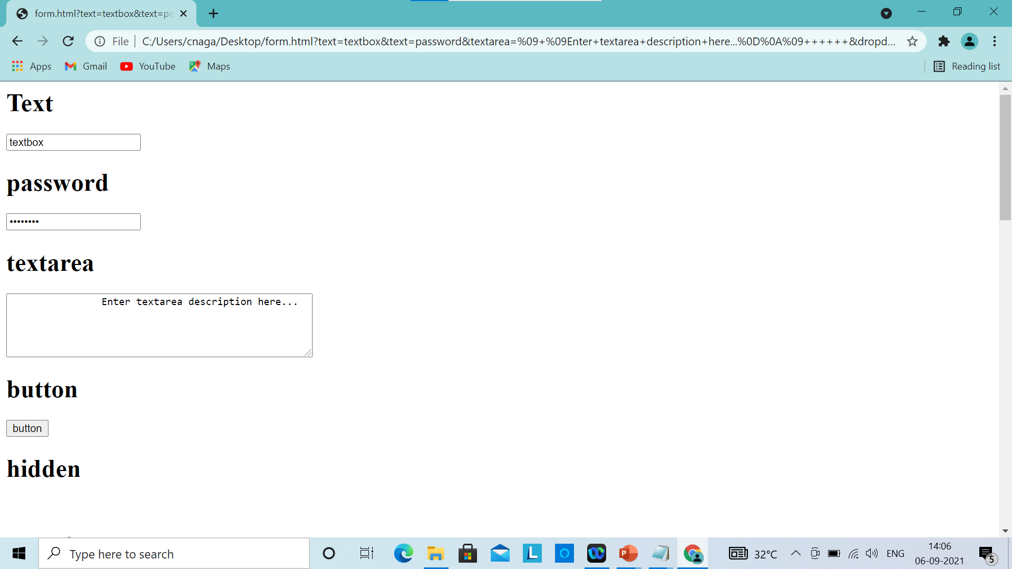

Slide 127
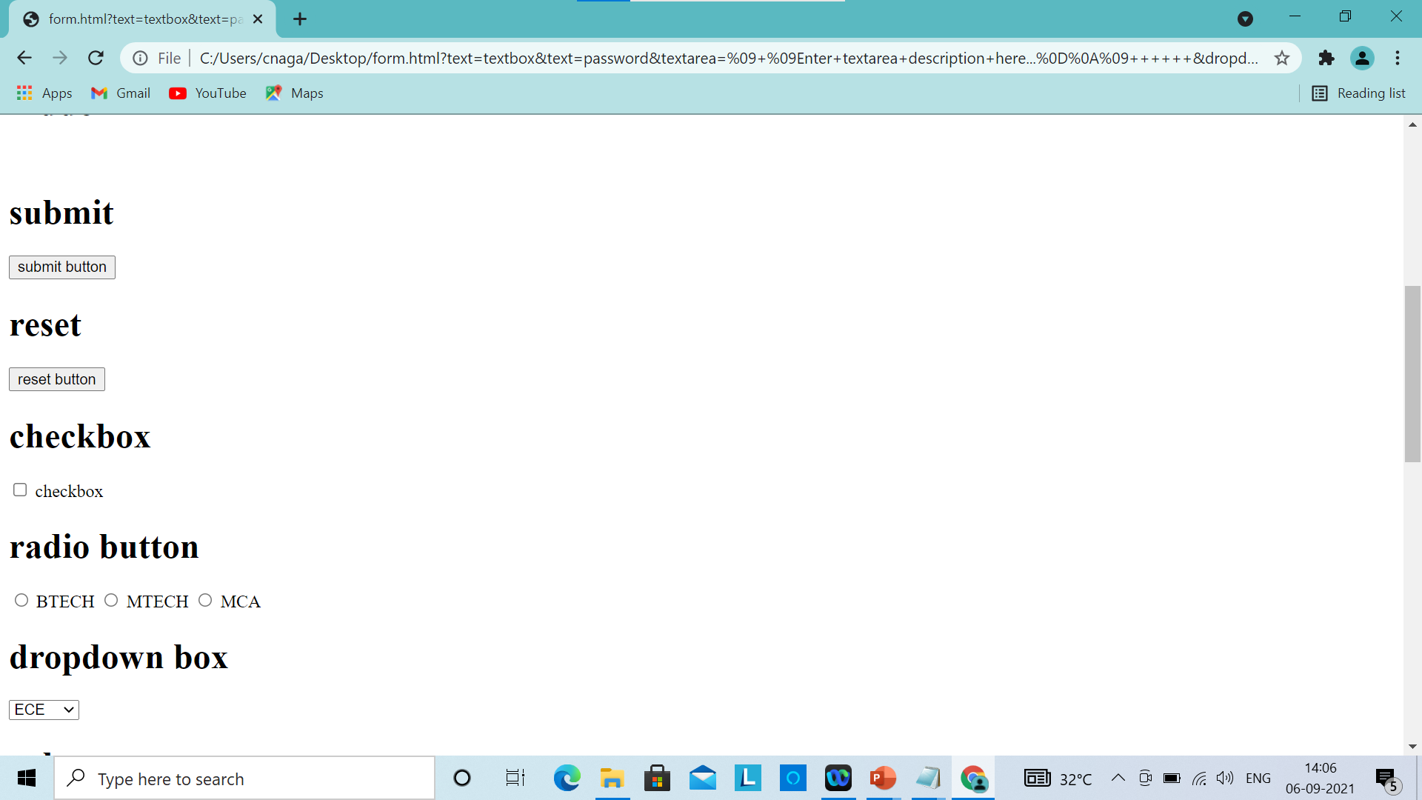

Slide 128
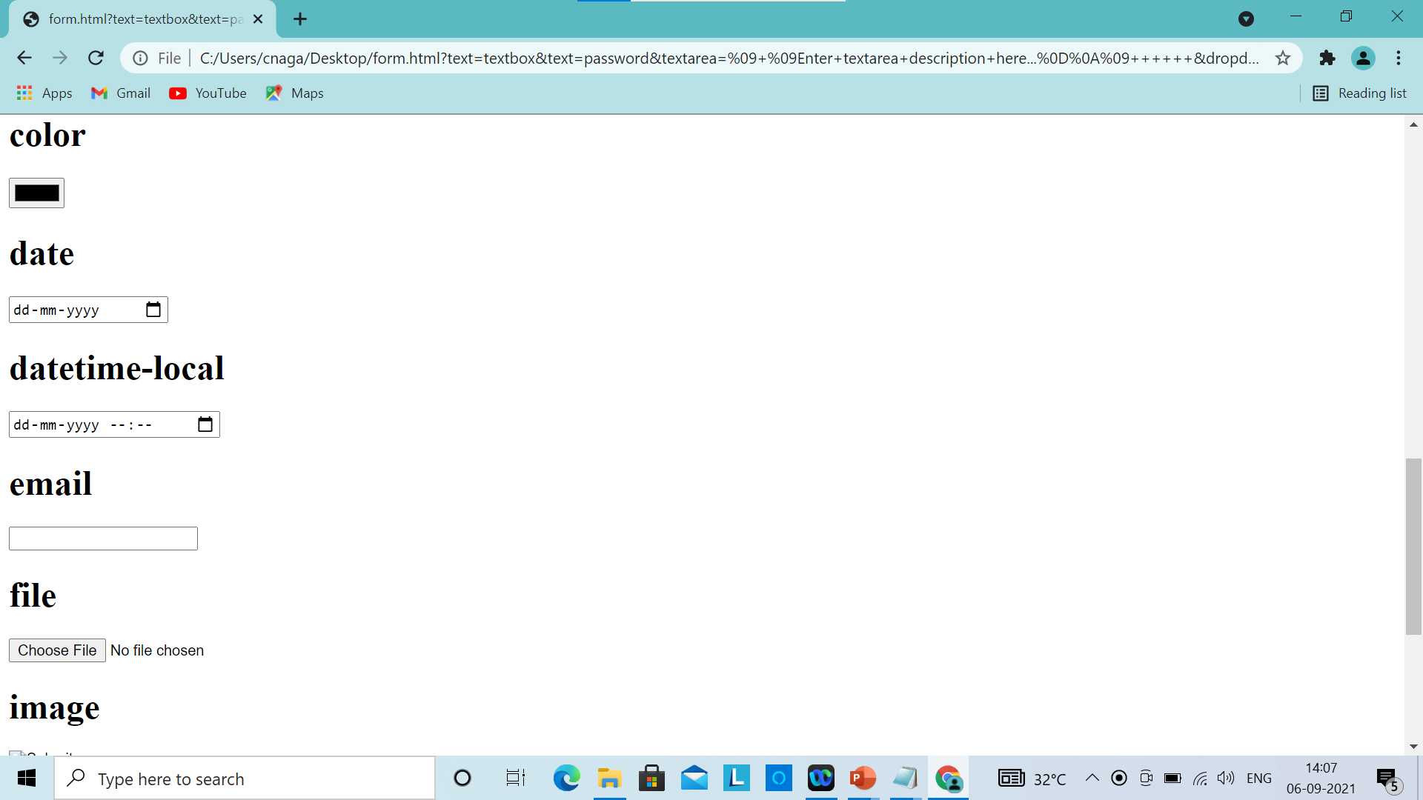

Slide 129
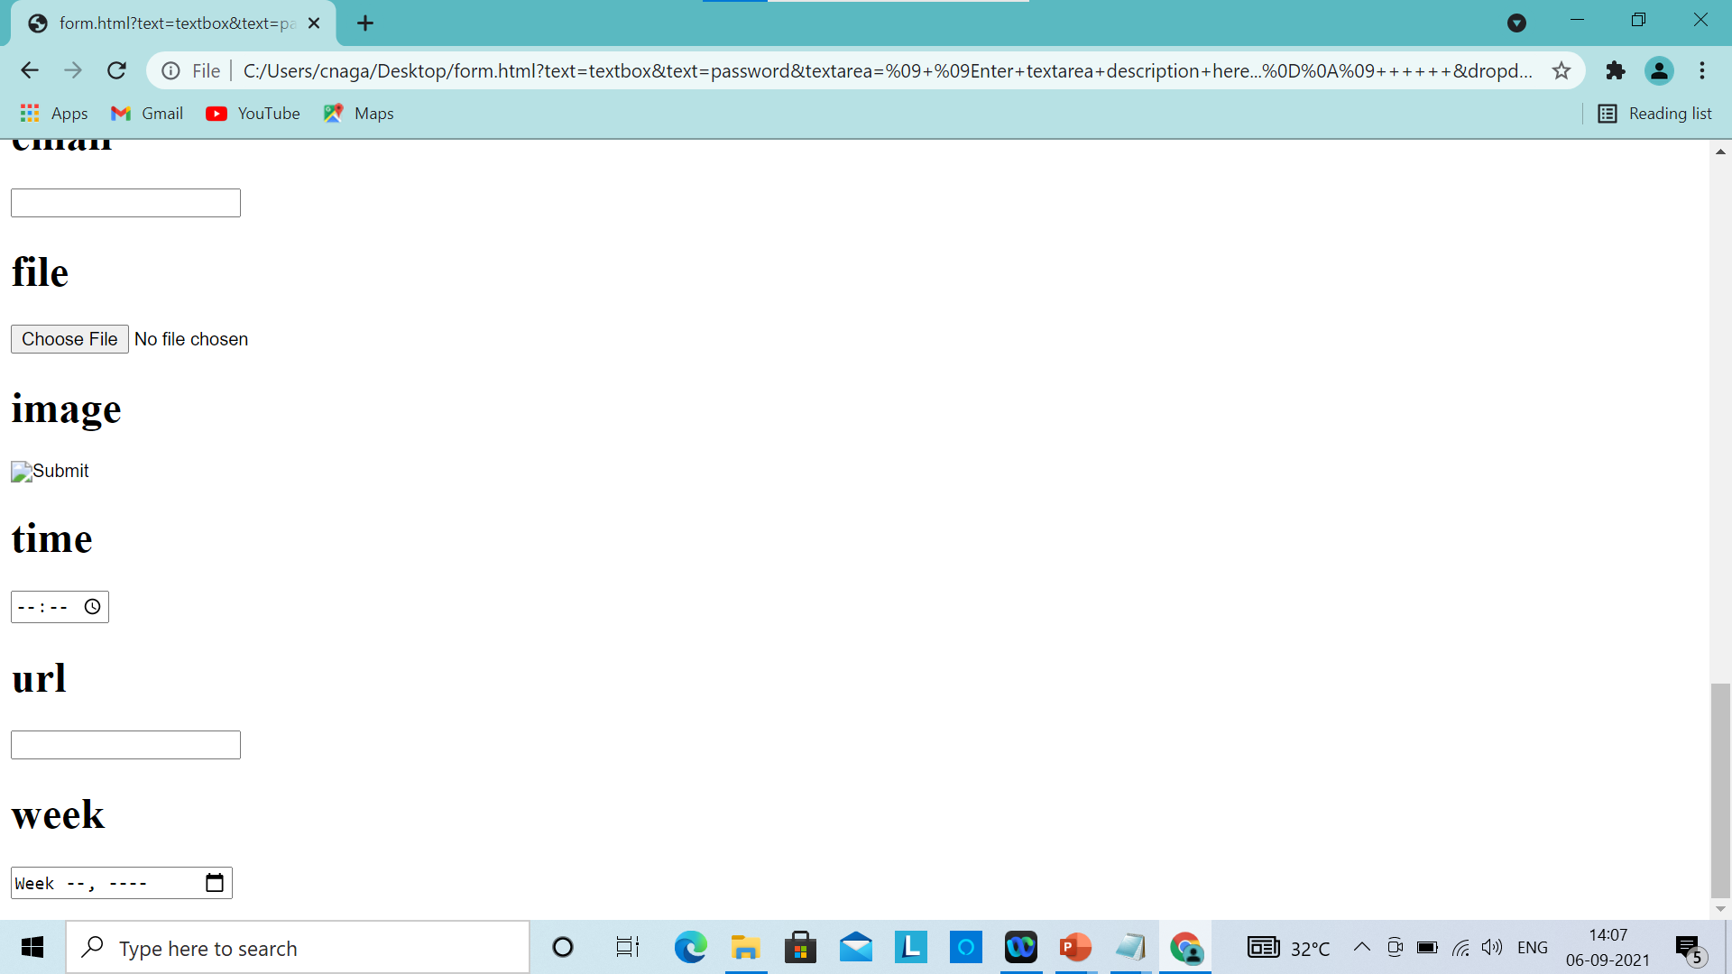

Slide 130
Thank you

