Slide 1

Energy Poverty In Texas
This Photo by Unknown Author is licensed under CC BY-SA-NC

Slide 2
Outline
Energy Burdened 101
Energy Burden in Texas
Research Questions
Data Resources
Methods
Analysis vs Validation
Linear Regression
Data Management and Replications

Slide 3
Energy Burden
Literature dates back to 1991 in Europe
Measure of energy poverty: “objective” energy burden
Critiques: doesn’t account for regional difference, socio economic and behavioral characteristics
In U.S. focus is primarily energy efficiency

Slide 4




1 in 5 Texas households energy burdened
Causes of energy poverty beginning to be studied
Still no geographic component
Eventhough speculated in studies
Source: dreamstime.com
Energy
Poverty
Source: Renewable Energy Transition Initiative
Source: pintrest.com
This Photo by Unknown Author is licensed under CC BY

Slide 5
2 Research Questions
1) Regional concentrations of energy poverty in Texas?
Method: ArcGIS mapping
2) How much of energy poverty can be explained by variables outside of structural energy efficiency?
(choosing Texas b/c….)

Slide 6




4 Data sources used to create 2 data sets: analysis and validation

Slide 7
Variables

Slide 8
Workflow

Slide 9
Regression

Slide 10
Analysis Results

Slide 11
Validation Results

Slide 12
Map Results

Slide 13
Conclusions

Slide 14

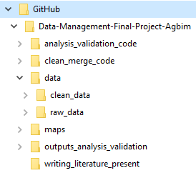
Data management
Publicly available Github and desktop repository were used to hold data
Folders were named based on their function
Files were named based on version number or function:
“clean_analysis_v1.csv”

Slide 15
Validation and replication
Replication Strengths:
All datasets were publicly available
R and R studio are publicly available
Issues:
Used excel to filter out variables I didn’t need
Literature used in literature review is not publicly available
ArcMap (ArcGIS) is not a publicly available program

Slide 16
Study Limitations

Slide 17
Sources

Slide 18
Data management

