Slide 1
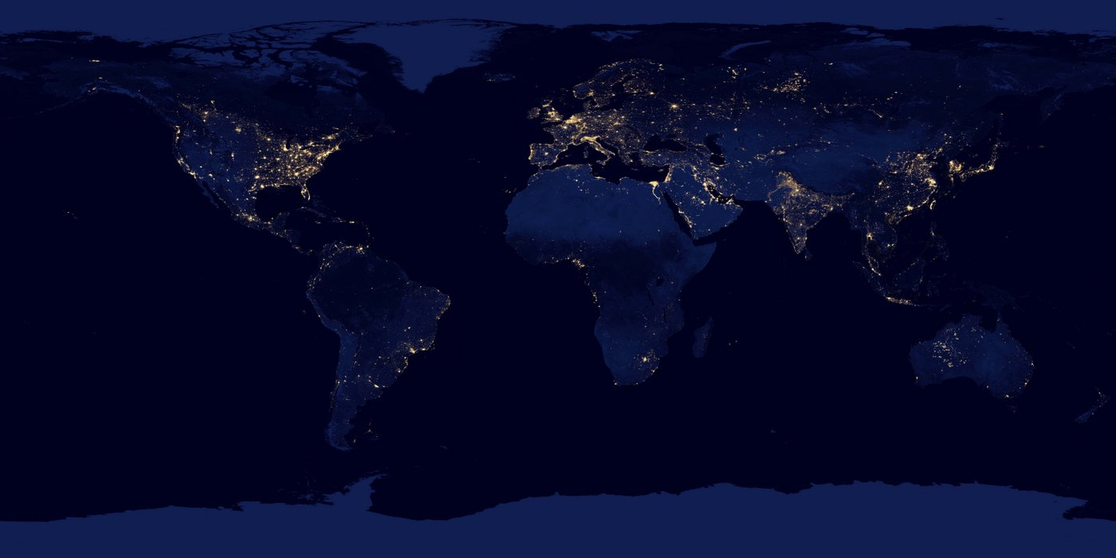
Energy Poverty In Texas
Chinelo Agbim
MPAff/M.S. EER Aug 2019
Email: cnagbim@utexas.edu
This Photo by Unknown Author is licensed under CC BY-SA-NC

Slide 2
Outline
Energy Burdened 101
Energy Burden in Texas
Research Questions
Data Resources
Methods
Analysis vs Validation
Linear Regression
Data Management and Replications

Slide 3
Energy Burden
Literature dates back to 1991 in Europe
Measure of energy poverty: “objective” energy burden
Critiques: doesn’t account for regional difference, socio economic and behavioral characteristics
In U.S. focus is primarily energy efficiency

Slide 4
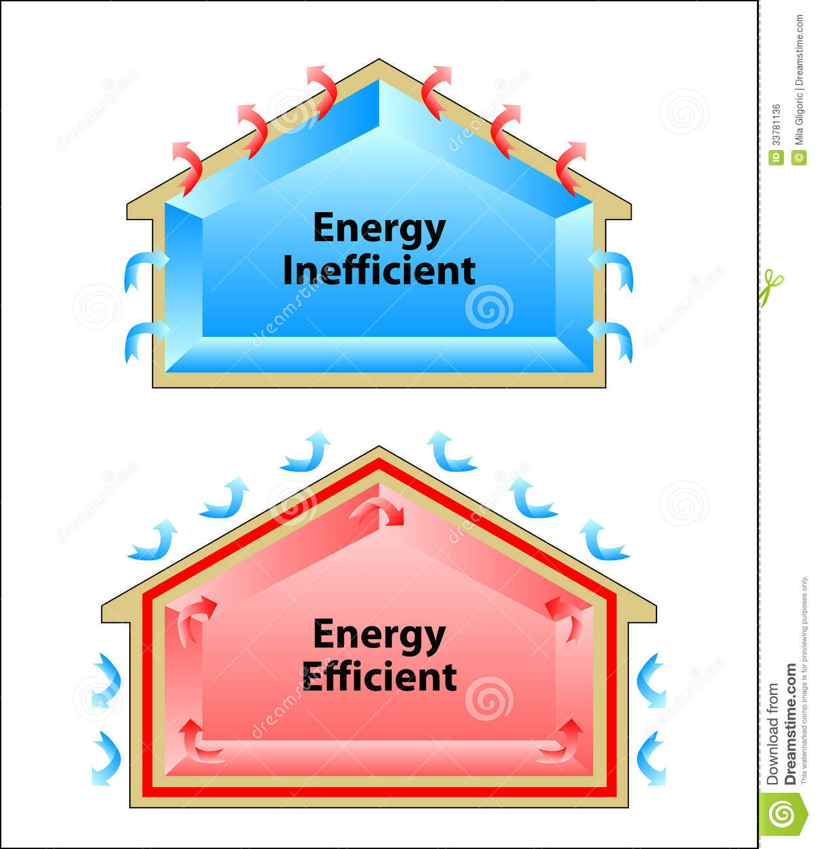

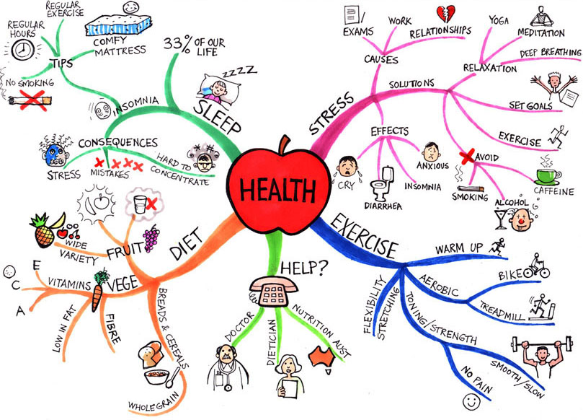

1 in 5 Texas households energy burdened
Causes of energy poverty beginning to be studied
Still no geographic component
Eventhough speculated in studies
Source: dreamstime.com
Energy
Poverty
Source: Renewable Energy Transition Initiative
Source: pintrest.com
This Photo by Unknown Author is licensed under CC BY

Slide 5
2 Research Questions
1) Regional concentrations of energy poverty in Texas?
Method: ArcGIS mapping
2) How much of energy poverty can be explained by variables outside of structural energy efficiency?
(choosing Texas b/c….)

Slide 6
Workflow

Slide 7





5 data sources used to create 2 datasets
1) Analysis
2) Validation
Unique key: County
Unique county Federal Information Processing ID ( FIP) in each data source
Notes:
Data structure----types of data and how you link them. Also talk about type like continuous or cat. Don’t need to discuss but make usre present

Slide 8
Description | Variable Prefix | Data Type
Energy Burden (energy expenditures as %of LMI) | En_burden | Continuous, nominal
Federal Identification # | fip | Nominal, integer
County Name | cnty | Nominal, integer
Socio Demographic/Economic Indicators
% pop Hispanic | pcnt_hisp | Continuous, numerical
% pop Black African American | pcnt_blk | Continuous, numerical
% Rural | pcnt_rural | Continuous, numerical
% pop over 65 years old | pcnt_sr | Continuous, numerical
Economic Indicators
Unemployment Rate | pcnt_unemp | Continuous, numerical
% pop Under Poverty Line | pcnt_pov | Continuous, numerical
% of TX State Median Income | pcnt_income | Continuous, numerical
% of Residential Units Owned | pcnt_own | Continuous, numerical
Food and Health
% pop with Low Grocery Access | pcnt_lw_access | Continuous, numerical
% pop Obese | pcnt_obese | Continuous, numerical
% pop Food Insecure | food_insec or food_rank | Continuous, numerical
% pop Uninsured | pcnt_uninsured | Continuous, numerical
Independent Variable
Key
Dependent Variables

Slide 9
Validation through different data sources
Description | Analysis Source | Validation Source
Energy Burden (energy expenditures as %of LMI) | National Renewable Energy Lab | SAME
FIP | National Renewable Energy Lab | SAME
County Name | National Renewable Energy Lab | SAME
Socio Demographic/Economic Indicators
% pop Hispanic | US Census Bureau | County Health Ranking
% pop Black African American | US Census Bureau | County Health Ranking
% Rural | County Health Ranking | SAME
% pop over 65 years old | US Census Bureau | County Health Ranking
Economic Indicators
Unemployment Rate | Bureau Labor Statistics | County Health Ranking
% pop Under Poverty Line | USDA | US Census, SAIPE
% of TX State Median Income | US Census, SAIPE | County Health Ranking
% of Residential Units Owned | US Census Bureau | County Health Ranking
Food and Health
% pop with Low Grocery Access | USDA | County Health Ranking
% pop Obese | USDA | County Health Ranking
% pop Food Insecure/Rank | County Health Ranking (%) | County Health Ranking (rank)
% pop Uninsured | County Health | SAME

Slide 10

Method: Linear Regression
$Y=β+β_{1}X_{1}+…+β_{p}$ $X_{p}$
Where Y=% of income spent on energy (i.e. energy burden)

Slide 11
Analysis Results

Slide 12
Validation Results

Slide 13
Map Results

Slide 14
Conclusions

Slide 15

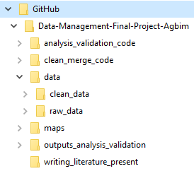
Data management
Publicly available Github and desktop repository were used to hold data
Folders were named based on their function. A “README File is included in each functionality folder
Files were named based on version number or function:
“merge_code_v1.R”

Slide 16
Replication
Replication Strengths:
All datasets were publicly available
R and R studio are publicly available
Issues:
Used excel to filter out variables I didn’t need
Literature used in literature review is not publicly available
ArcMap (ArcGIS) is not a publicly available program

Slide 17
Study Limitations

Slide 18
Sources

