Slide 1
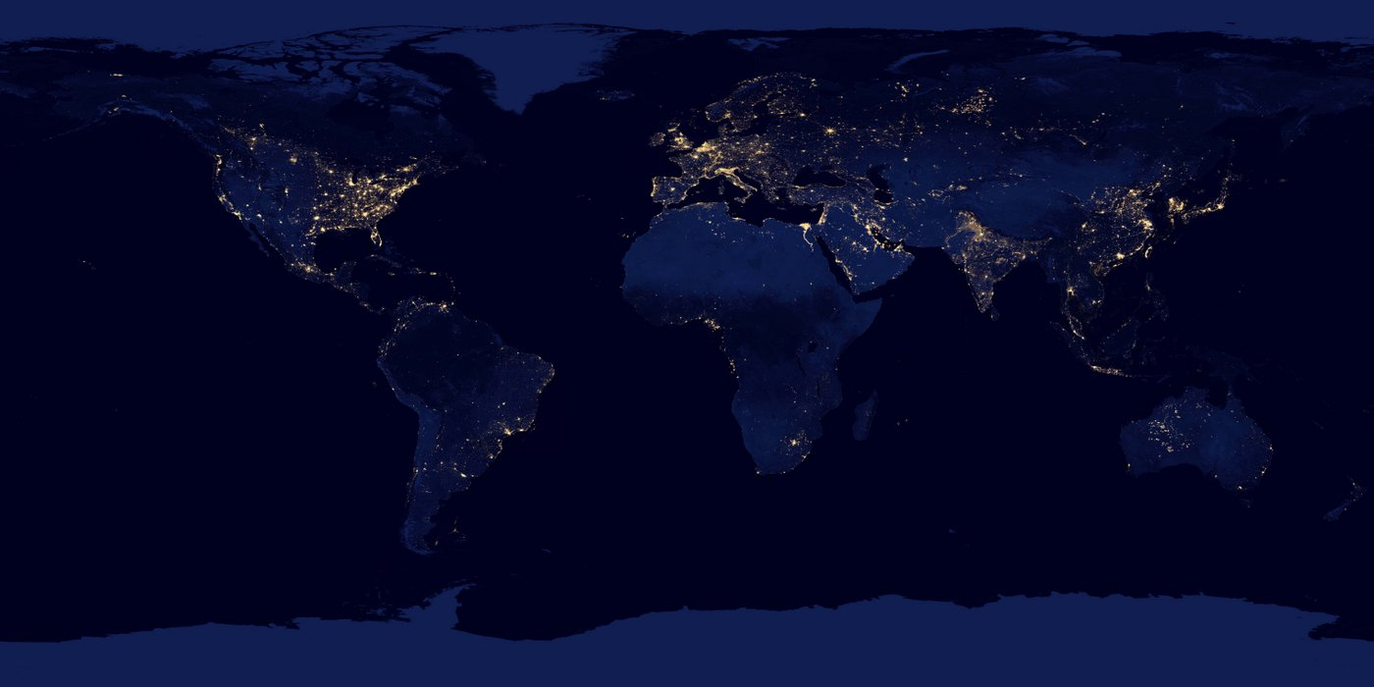
Energy Poverty In Texas: Explanatory Power of Social, Economic, and Health Indicators
Chinelo Agbim
MPAff/M.S. EER Aug 2019
Email: cnagbim@utexas.edu
This Photo by Unknown Author is licensed under CC BY-SA-NC

Slide 2
Outline
Energy Burdened 101
Motivation: Energy Burden in Texas
Research Questions
Data Resources
Workflow
Methods
Analysis vs Validation
Linear Regression
Conclusion
Data Management and Replications

Slide 3
Energy burden: a measure of energy poverty
Energy poverty: inadequate energy services
Energy burden=%income spent on energy
In U.S. literature is newer ~2010. Still focused on energy burden
Literature dates back to 1991 in Europe
Measure of energy poverty: “objective” energy burden
Critiques: doesn’t account for regional difference, socio economic and behavioral characteristics

Slide 4
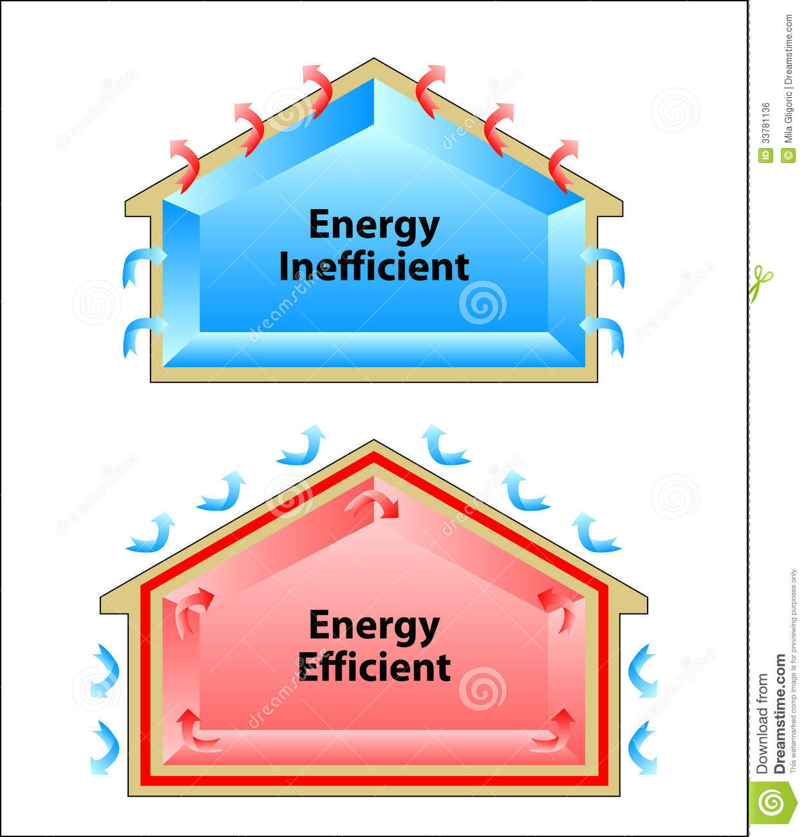

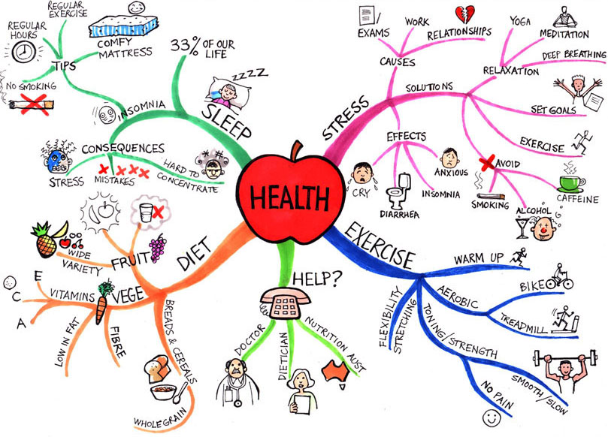

Motivation:
1 in 5 Texas Households are energy burden(spend >8% income on energy) (Wible & King, 2016)
Inadequate policy programs:
LITE UP Texas ended 2018
Only served <800,000 people (Malewitz, 2017)
Energy efficiency continues to dominate literature in U.S.
Qualitative report shows ~18% of income spent on energy in Colonias (Olmedo, 2014)
Source: dreamstime.com
Energy
Poverty
Source: Renewable Energy Transition Initiative
Source: pintrest.com
This Photo by Unknown Author is licensed under CC BY

Slide 5
2 Research Questions
1) How much of energy poverty can be explained by variables outside of structural energy efficiency?
Status: Completed
Method: Linear regression w/o dummy variable
2) Regional concentrations of energy poverty in Texas?
Status: In progress
Method: ArcGIS mapping & linear regression w/ dummy variable

Slide 6





5 data sources used to create 2 datasets
1) Analysis
2) Validation
Unique key: County
Unique county Federal Information Processing ID ( FIP) in each data source
FIP used to join NREL GIS shapefiles to energy burden data
Notes:
Data structure----types of data and how you link them. Also talk about type like continuous or cat. Don’t need to discuss but make usre present

Slide 7
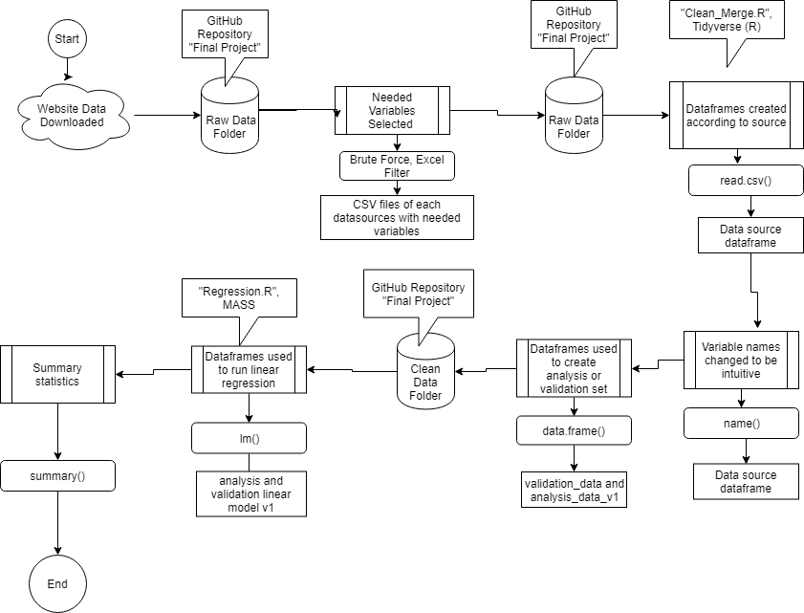
Workflow
Workflow

Slide 8
Description | Variable Prefix | Data Type
Energy Burden (county energy expenditures as %of LMI) | En_burden | Continuous, nominal
Federal Identification # | fip | Nominal, integer
County Name | cnty | Nominal, integer
Socio Demographic/Economic Indicators
% pop Hispanic | pcnt_hisp | Continuous, numerical
% pop Black African American | pcnt_blk | Continuous, numerical
% pop in rural community | pcnt_rural | Continuous, numerical
% pop over 65 years old | pcnt_sr | Continuous, numerical
%pop attended some college
Economic Indicators
Unemployment Rate | pcnt_unemp | Continuous, numerical
% pop Under Poverty Line | pcnt_pov | Continuous, numerical
% of TX State Median Income | pcnt_income | Continuous, numerical
% of Residential Units Owned | pcnt_own | Continuous, numerical
Food and Health
% pop with Low Grocery Access | pcnt_lw_access | Continuous, numerical
% pop Obese | pcnt_obese | Continuous, numerical
% pop Food Insecure | food_insec or food_rank | Continuous, numerical
% pop Uninsured | pcnt_uninsured | Continuous, numerical
Control Variable and Dummy
County is one of 32 Texas-Mexico border counties=1, If not=0 | Brdr_cnty | nominal, factor (value 0 or 1)
Median age of the residential structures in the county | House_str_age | Continuous, numerical
Dependent Variable
Key
Independent Variables

Slide 9
Validation through different data sources
Description | Analysis Source | Validation Source
Energy Burden (energy expenditures as %of LMI) | National Renewable Energy Lab | SAME
FIP | National Renewable Energy Lab | SAME
County Name | National Renewable Energy Lab | SAME
Socio Demographic/Economic Indicators
% pop Hispanic | US Census Bureau | County Health Ranking
% pop Black African American | US Census Bureau | County Health Ranking
% Rural | County Health Ranking | SAME
% pop over 65 years old | US Census Bureau | County Health Ranking
Economic Indicators
Unemployment Rate | Bureau Labor Statistics | County Health Ranking
% pop Under Poverty Line | USDA | US Census, SAIPE
% of Residential Units Owned | US Census Bureau | County Health Ranking
Food and Health
% pop with Low Grocery Access | USDA | County Health Ranking
% pop Obese | USDA | County Health Ranking
% pop Food Insecure/Rank | County Health Ranking (%) | County Health Ranking (rank)
% pop Uninsured | County Health | SAME

Slide 10
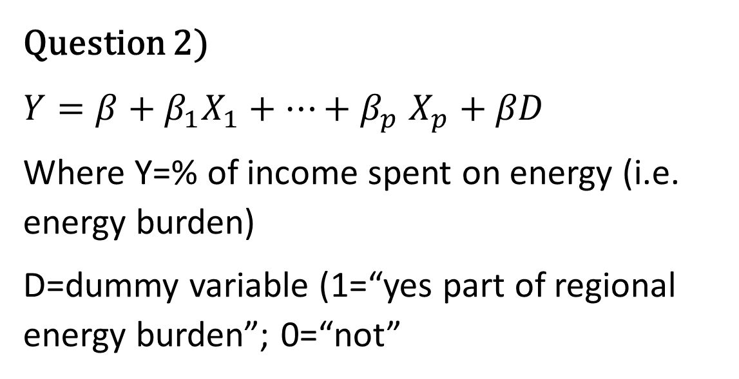
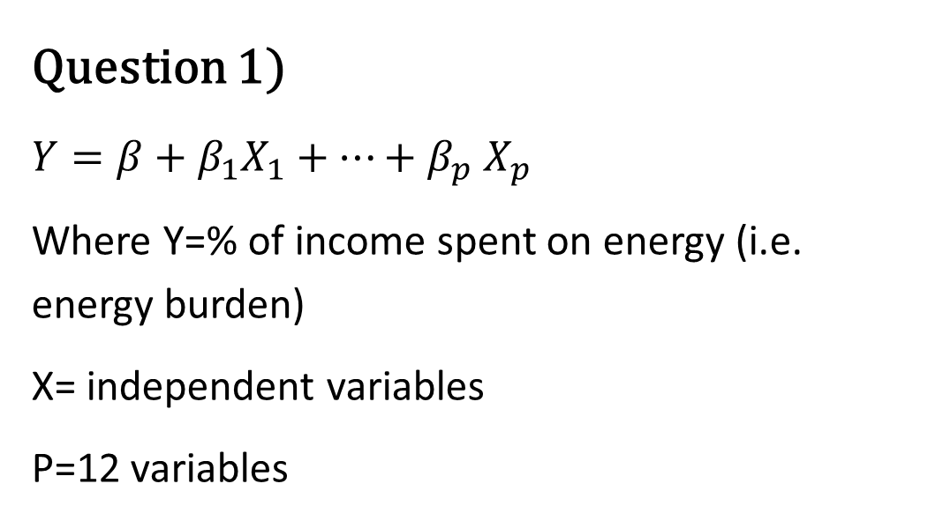
Method: Linear Regression
Question 1)
$Y=β+β_{1}X_{1}+…+β_{p}$ $X_{p}$
Where Y=% of income spent on energy (i.e. energy burden)
X= independent variables
P=12 variables
Question 2)
$Y=β+β_{1}X_{1}+…+β_{p}$ $X_{p}+βD$
Where Y=% of income spent on energy (i.e. energy burden)
D=dummy variable (1=“yes part of regional energy burden”; 0=“not”

Slide 11
Analysis Results: 6/12 variables were significant
Variable | β, Estimate | p value | Significance
Intercept | -19.630353 | 8.24E-05 | ***
% Hispanic | 0.105709 | 2.23E-05 | ***
%Black | -0.09656 | 0.01659 | *
% Rural | 0.014041 | 0.04488 | *
% Poverty | 0.244563 | 0.00011 | ***
% Ownership | 0.115634 | 1.33E-05 | ***
% Food Insecure | 0.631695 | 3.27E-06 | ***
 | R-squared: 0.5187 | Adjusted R-squared: 0.4947 | p-value: < 2.2e-16
Question 1)

Slide 12
Validation Results: 7/12 variables were significant
Variable | β, Estimate | p value | Significant
Intercept | 18.022066 | 0.007509 | **
% Hispanic | 0.083995 | 0.003676 | **
%Black | -0.096749 | 0.022043 | *
% Rural | 0.014977 | 0.036748 | *
% Poverty | 0.298564 | 4.79E-05 | ***
% Ownership | 0.106677 | 4.75E-05 | ***
% Low Access to Grocery Store | -0.272347 | 0.000392 | ***
Food Rank | -3.270252 | 5.64E-05 | ***
 | R-squared: 0.5088 | Adjusted R-squared: 0.4843 | p-value: < 2.2e-16
Question 1)

Slide 13
Map Results
Question 2) Energy poverty may be concentrated in border region (preliminary)
Median amount LMI people spend on energy is 9% vs 4.5% Texas overall

Slide 14
Conclusions
Socio demographic, economic, and health indicators explain~50% of variation in energy burden
Median low-moderate income person in Texas is spending ~9% of there income on energy
Compared to 4.5% overall (Wible& King)
USDA and County Health Ranking may have different ways of measuring access to grocery stores

Slide 15

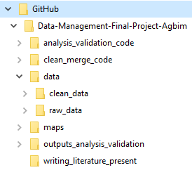
Data management
Publicly available Github and desktop repository were used to hold data
Folders were named based on their function. A “README File is included in each functionality folder
Files were named based on version number or function:
“clean_merge_code_v1.R” is the 1st draft of the code used to clean and merge datasets

Slide 16
Replication
Replication Strengths:
All datasets were publicly available
R and R studio are publicly available
Issues:
Used excel to filter out variables I didn’t need
Literature used in literature review is not publicly available
ArcMap (ArcGIS) is not a publicly available program

Slide 17
Study Limitations
County is a very large and diverse region
Energy burden data was only available from one data source. Potential validation issues
Data source documentation on creation of certain metrics was lacking (e.g. precision on how energy burden was calculated)

Slide 18
Sources
Boardman, B. (1991). Fuel Poverty: From Cold Homes to Affordable Warmth. London: Belhaven Press.
Boardman, B. (2010). Fixing Fuel Poverty: Challenges and Solutions. London: Routledge.
Bird, S., & Hernández, D. (2010). Energy Burden and the Need for Integrated Low-Income Housing and Energy Policy. Poverty Public Policy.
MALEWITZ, J. (2016, Saptember 6). Texas Stops Helping Poor Families Pay Their Electric Bills. Retrieved from The Texas Tribune: https://www.texastribune.org/2016/09/02/texas-stops-helping-poor-families-pay-their-electr/
Reames, T. (2016). Targeting energy justice: Exploring spatial, racial/ethnic and socioeconomic disparities in urban residential heating energy efficiency. Energy Policy.
Ross, L., & Drehobl, A. (2016). Lifting the High Energy Burden in America's Largest Cities: How Energy Efficiency Can Improve Low Income and Underserved Communities. American Council for Energy Efficient Economy.
Wible, J., & King, C. (2016). Household Energy Costs for Texans. Austin, Texas: University of Texas Energy Institute.

