Slide 1
Clinical Quality Language (CQL)
Bryn Rhodes
Chris Moesel
Mark Kramer

Slide 2
CQL Background
Part of CQM-CDS harmonization project
Objective is to define an author-friendly and human-readable language to define quality measures and decision support rules (QDM heritage)
Must be computable and implementable (HeD heritage)
Functional requirements defined in “Harmonization of Health Quality Artifact Reasoning and Expression Logic”

Slide 3
Overview of CQL Conceptual Architecture
Initial Population Definition
Chlamydia Test Recommended
Defined by Rule/Measure authors using CQL
Probably Sexually Active
Intermediate inference
Concepts defined in Quality Logical Model
Condition, Occurrence
Patient
Medication Treatment, Ordered
Mappings from quality logical model to underlying data models
FHIR Logic
…
Custom EHR Logic
…
CCDA Logic
REST API
e.g. SQL
Integration with back-end data stores
FHIR API
EHR
CCDA Generator
EHR
EHR

Slide 4
CQL File Structure
Each rule or measure is readable, plain text file
May include other files by reference
Logic in each file is a potentially reusable “library”
Inputs
(parameters)
Declarations
Data Retrieval
May be comingled?
(TBD)
Computation
Outputs

Slide 5
CQL Declarations
using declaration
Define the data model(s) in use in file
include declaration
Define other libraries (CQL files) referenced
context declaration
Define the overall context for the library (e.g. PATIENT or ENCOUNTER)
Anchors references in the file
parameter declaration
Define available “inputs” (and potentially “outputs”, TBD)
valueset declaration
Define user-friendly labels for value sets within the library

Slide 6
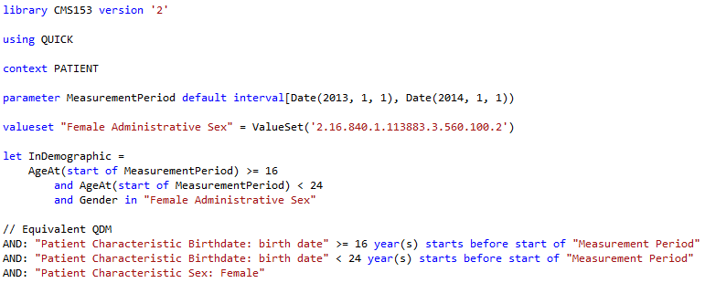
Simple Example

Slide 7
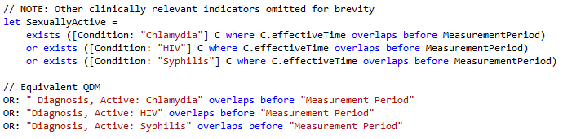
Population Criteria

Slide 8
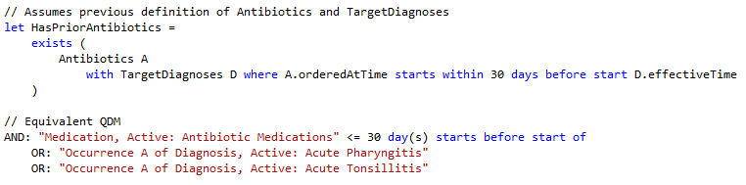
Timing Phrases

Slide 9
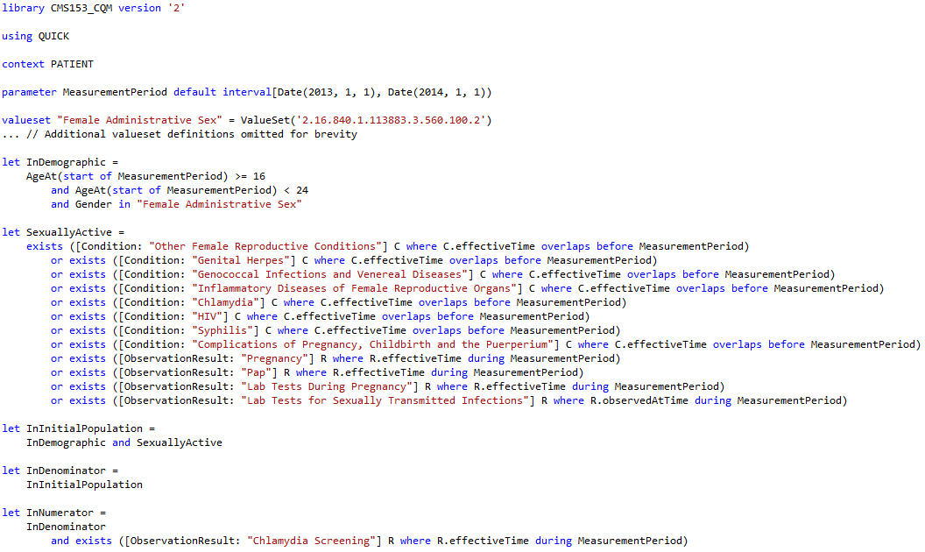
Chlamydia Screening, CQM

Slide 10
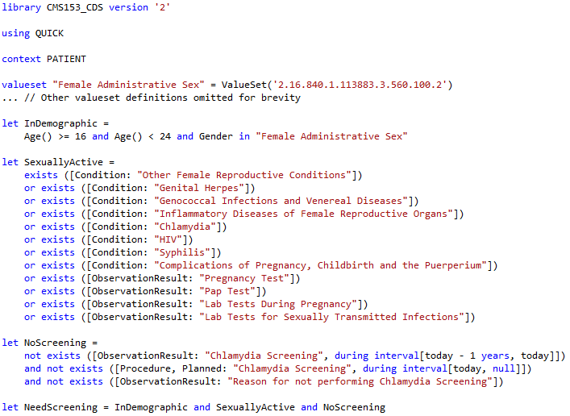
Chlamydia Screening, CDS

Slide 11
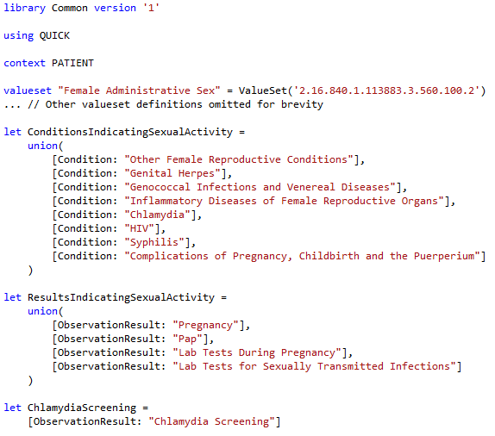
Chlamydia Screening, Common

Slide 12
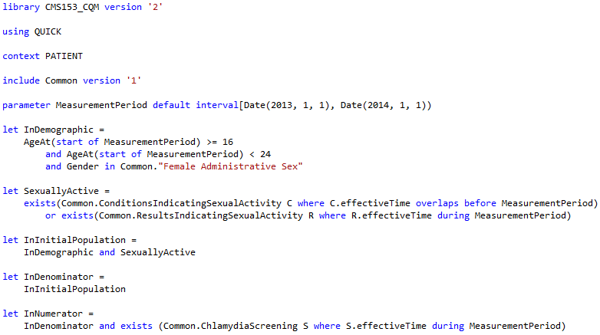
Chlamydia Screening, CQM 2

Slide 13
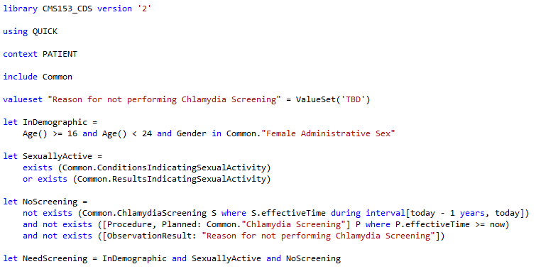
Chlamydia Screening, CDS 2

Slide 14
Next Steps
Still very much a work in progress
Completing/Refining the syntax
Mapping QUICK to FHIR
Performance/Implementation implications
Representation in XML artifacts
Clinical Quality Language Specification (ballot materials)
Sub-team meets weekly, Wed 11:00 Eastern
https://global.gotomeeting.com/meeting/join/554237525
Dial +1 770-657-9270, Participant Code: 6870541
Using a common cqframework repository
https://github.com/cqframework/OneModel

