Slide 1
Clinical Quality Language
Builds on functional requirements defined in:
Harmonization of Health Quality Artifact Reasoning and Expression Logic
Leverages
Computability achieved by HeD
Measure Author understanding (QDM Heritage)
Focus of the high-level syntax is on authoring
While providing a clear/automatic path to computable logic

Slide 2
Underlying Language and Data Source are both variable
BLUE = available concepts
There are ways device use could be inferred - if not, return “unknown”
Some Population Definition
Chlamydia Test Recommended
DSL can reference high-level concept of “ChlamydiaTest”
Uses Device
In the same way that lower-level concepts can be referenced
Sexually Active
Including the concepts explicitly defined in the “logical model”
Condition
Procedure
Medication
e.g. Condition.evaluate (DataSource, Occurrence, Filter)
As well as Data Format Specific concepts that implement a common “data provider” interface in terms of the logical model
We implement at least this
e.g. as Java library
FHIR Logic
…
Custom EHR Logic
…
CCDA Logic
REST API
e.g. SQL
FHIR API
EHR
Back end data stores

Slide 3
Anatomy of a Library
using statements
Define the data model(s) in use by the library
include statements
Define other libraries referenced by the library
context definition
Define the overall context for the library (e.g. PATIENT or ENCOUNTER)
system-understood
in terms of the model
parameter definitions
Define available “inputs”
valueset definitions
Define user-friendly labels for value sets within the library
let statements
Define the expressions that are available within the library
Can be used by the containing artifact or other referencing libraries

Slide 4
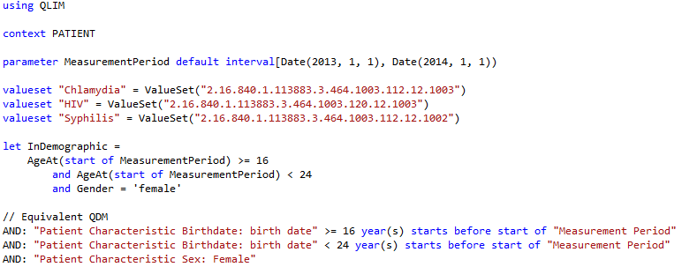
Simple Example

Slide 5
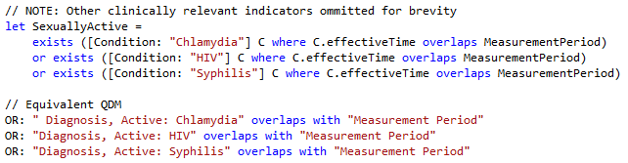
Population Criteria

Slide 6
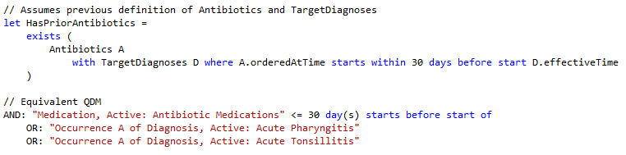
Timing Phrases

Slide 7
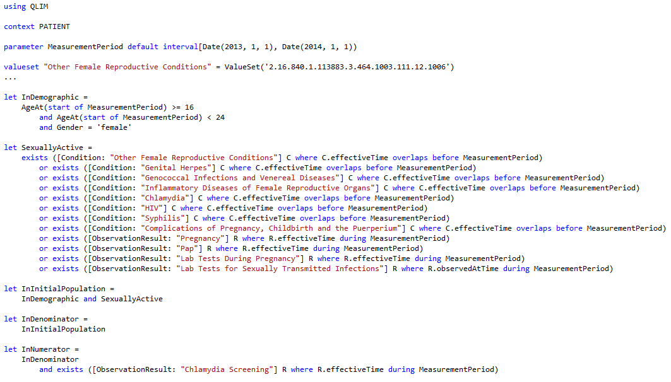
Chlamydia Screening, CQM

Slide 8
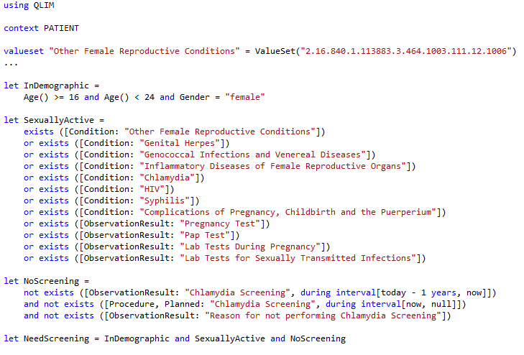
Chlamydia Screening, CDS

Slide 9
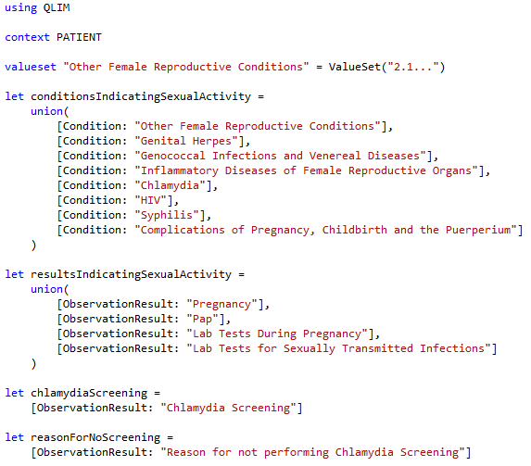
Chlamydia Screening, Common

Slide 10
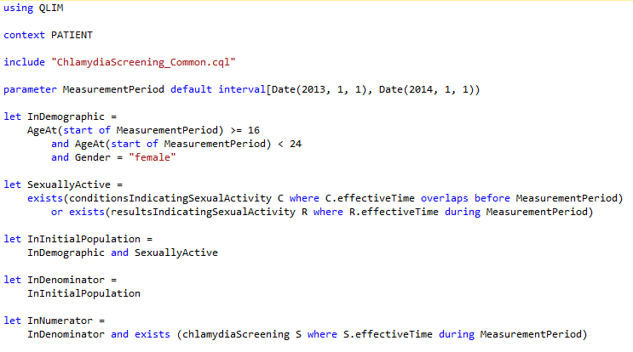
Chlamydia Screening, CQM 2

Slide 11
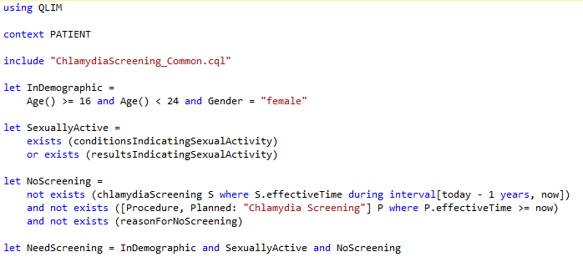
Chlamydia Screening, CDS 2

Slide 12
Next Steps
Still very much a work in progress
Completing/Refining the syntax
Mapping QLIM to FHIR
Performance/Implementation implications
Representation in XML artifacts
Clinical Quality Language Specification (ballot materials)
Sub-team meets weekly, Wed 11:00 Eastern
https://global.gotomeeting.com/meeting/join/554237525
Dial +1 770-657-9270, Participant Code: 6870541
Using a common cqframework repository
https://github.com/cqframework/OneModel

