Slide 1
Clinical Quality Language
Builds on functional requirements defined in:
Harmonization of Health Quality Artifact Reasoning and Expression Logic
Leverages
Computability achieved by HeD
Measure Author understanding (QDM Heritage)
Focus of the high-level syntax is on authoring
While providing a clear/automatic path to computable logic

Slide 2
Underlying Language and Data Source are both variable
BLUE = available concepts
There are ways device use could be inferred - if not, return “unknown”
Some Population Definition
Chlamydia Test Recommended
DSL can reference high-level concept of “ChlamydiaTest”
Uses Device
In the same way that lower-level concepts can be referenced
Sexually Active
Including the concepts explicitly defined in the “logical model”
Condition
Procedure
Medication
e.g. Condition.evaluate (DataSource, Occurrence, Filter)
As well as Data Format Specific concepts that implement a common “data provider” interface in terms of the logical model
We implement at least this
e.g. as Java library
FHIR Logic
…
Custom EHR Logic
…
CCDA Logic
REST API
e.g. SQL
FHIR API
EHR
Back end data stores

Slide 3
Anatomy of a Library
using statements
Define the data model(s) in use by the library
include statements
Define other libraries referenced by the library
context definition
Define the overall context for the library (e.g. PATIENT or ENCOUNTER)
system-understood
in terms of the model
parameter definitions
Define available “inputs”
concept definitions
Define user-friendly labels for value sets within the library
let statements
Define the expressions that are available within the library
Can be used by the containing artifact or other referencing libraries

Slide 4
Data Types
Simple Types
Boolean, String, Number, Date/Time
true, 16, "female"
Clinical Types
Quantities, Concepts (Value Sets)
3 months, 6 u"gm/cm3"
Structured Types
Model Classes, Tuples
[Encounter, Performed]
tuple { Name: "Patrick", DOB: Date(2014, 1, 1) }
List Types
{ 1, 2, 3, 4, 5 }
Interval Types
interval[today - 1 years, now]

Slide 5
Simple Expressions
Logic
A and B
A and not (B or C)
Comparison
A >= B
A <> B
Arithmetic
A + B
A + B * C

Slide 6
Timing/Interval Operations
Full set from QDM
starts before start, starts concurrent with
Timing Phrases
starts 3 days before start
starts within 3 days before start
starts within 3 days of start
Interval operators
meets, overlaps, during
Point access
start of MeasurementPeriod
Membership
X in { 1, 2, 3, 4, 5 }

Slide 7
Date/Time Manipulation
Date Construction
Date Arithmetic
Date/Time extraction
Component extraction

Slide 8
QILM Statement Structure
Every clinical statement has
Occurrence (Occurrence, NonOccurrence, UnknownOccurrence)
a Topic, either an Observable, or an Action
Observables:
Condition, Prognosis, ObservationResult, etc.
Actions:
Procedure, Medication Administration, etc.
In addition, Actions have Modality:
Proposed, Ordered, Performed, etc.

Slide 9
Retrieve
Retrieves information from the data layer
Respects current context (PATIENT, ENCOUNTER)
Specified in terms of Data Model
[Encounter, Performed]
no [Procedure, Proposal]
unknown [DeviceUse]
Optionally filter by Code
[Encounter, Performed: "Inpatient"]
Optionally filter by Date Range
[Encounter, Performed: during MeasurementPeriod]

Slide 10
Filtering
A “where” clause returns only those elements that satisfy the condition:
[Encounter, Performed: "Inpatient"] E where E.lengthOfStay > 120 days
“E” in the above example is an alias for the results in the retrieve and can be used anywhere within the query.

Slide 11
Filtering by Relationships
Use the “with” keyword to introduce a filtering relationship:

Slide 12
Set Operations

Slide 13
Combining Results

Slide 14
Let Statements

Slide 15
Conditional Expressions

Slide 16
Aggregate Expressions

Slide 17
Advanced Constructs

Slide 18
Defining Operators

Slide 19
Defining Retrieves

Slide 20
Using Libraries

Slide 21
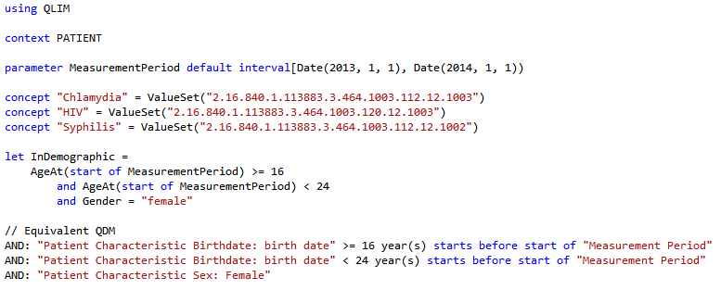
Simple Example

Slide 22
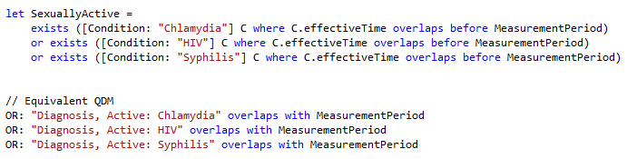
Population Criteria

Slide 23
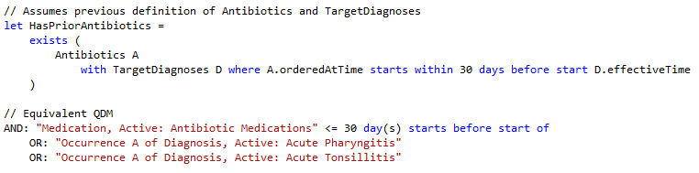
Timing Phrases

Slide 24
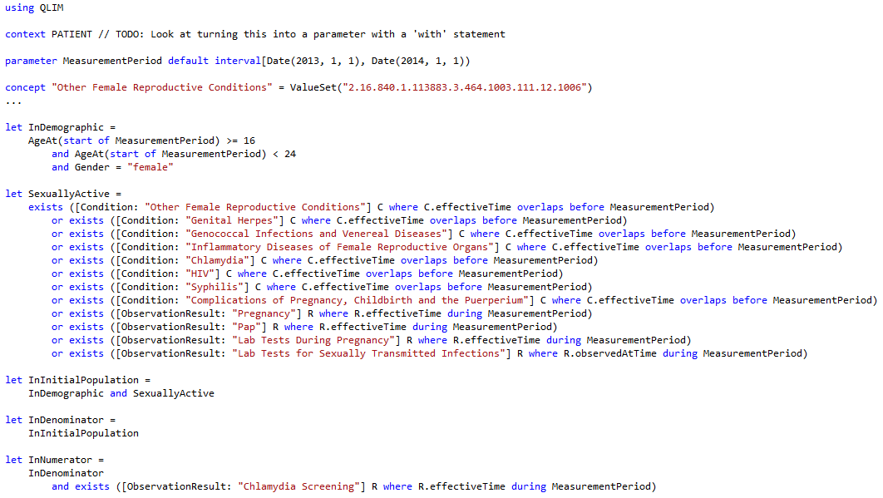
Chlamydia Screening, CQM

Slide 25
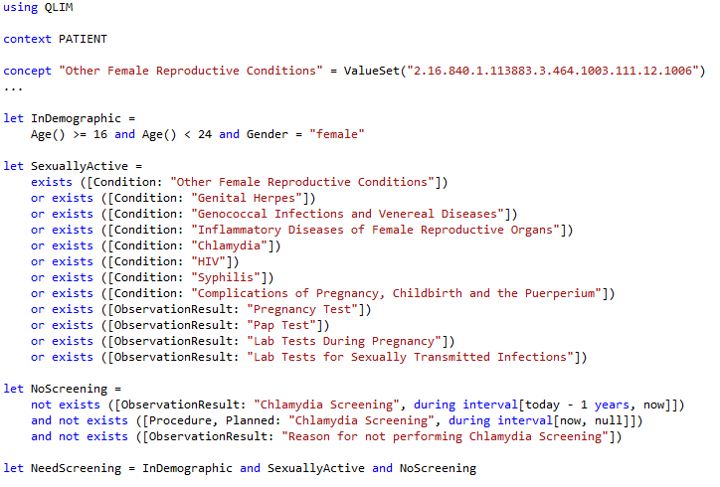
Chlamydia Screening, CDS

Slide 26
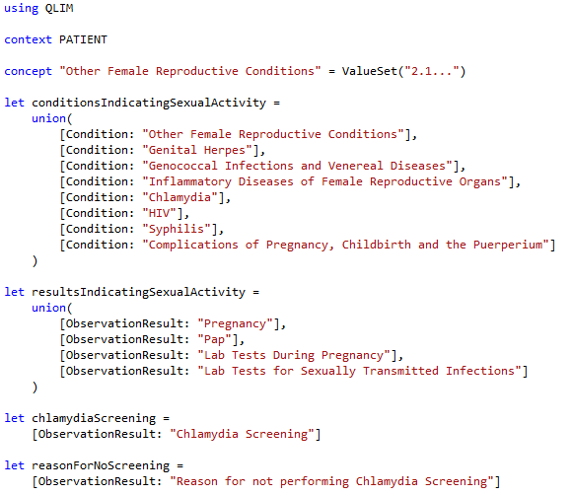
Chlamydia Screening, Common

Slide 27
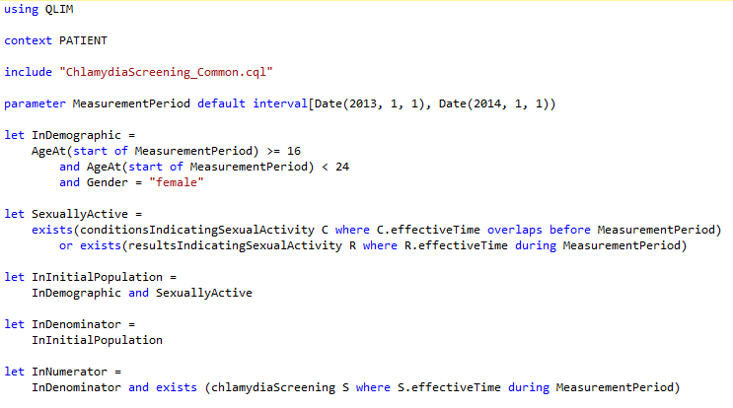
Chlamydia Screening, CQM 2

Slide 28
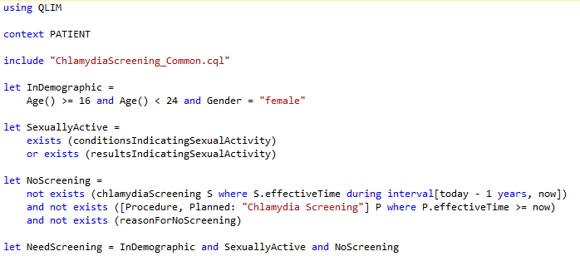
Chlamydia Screening, CDS 2

Slide 29
Next Steps
Still very much a work in progress
Completing/Refining the syntax
Mapping QLIM to FHIR
Performance/Implementation implications
Representation in XML artifacts
Clinical Quality Language Specification (ballot materials)
Sub-team meets weekly, Wed 11:00 Eastern
https://global.gotomeeting.com/meeting/join/554237525
Dial +1 770-657-9270, Participant Code: 6870541
Using a common cqframework repository

