Slide 1
Clinical Quality Language (CQL)
Bryn Rhodes
Chris Moesel
Mark Kramer

Slide 2
CQL Background
Part of CQM-CDS harmonization project
Objective is to define an author-friendly and human-readable language to define quality measures and decision support rules (QDM heritage)
Must be computable and implementable (HeD heritage)
Functional requirements defined in “Harmonization of Health Quality Artifact Reasoning and Expression Logic”

Slide 3
Overview of CQL Conceptual Architecture
Initial Population Definition
Chlamydia Test Recommended
Defined by Rule/Measure authors using CQL
Probably Sexually Active
Intermediate inference
Concepts defined in Quality Logical Model (QUICK)
Condition, Occurrence
Patient
Medication Treatment, Ordered
Mappings from quality logical model to underlying data models
FHIR Logic
…
Custom EHR Logic
…
CCDA Logic
REST API
e.g. SQL
Integration with back-end data stores
FHIR API
EHR
CCDA Generator
EHR
EHR

Slide 4
CQL File Structure
Each library is a readable, plain text file
May include other libraries by reference
Logic in each file is potentially reusable by other libraries
Inputs
(parameters)
Declarations
Data Retrieval
May be comingled
Computation
Outputs

Slide 5
CQL Declarations
library declaration
Defines the name and optional version of the library
using declaration
Define the data model(s) in use in file
include declaration
Define other libraries (CQL files) referenced
context declaration
Define the overall context for the library (e.g. PATIENT or ENCOUNTER)
Anchors references in the file
parameter declaration
Define available “inputs”
valueset declaration
Define user-friendly labels for value sets within the library

Slide 6
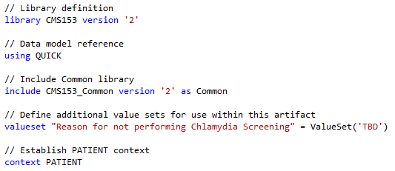
Declaration Examples

Slide 7
QUICK Statement Structure
Every clinical statement has
Occurrence (Occurrence, NonOccurrence, UnknownOccurrence)
a Topic, either an Observable, or an Act
Observables:
Condition, Prognosis, ObservationResult, etc.
Acts:
Procedure, Medication Administration, etc.
In addition, Acts have Modality:
Proposal, Order, Performance, etc.

Slide 8
Retrieve
Retrieves information from the data layer
Respects current context (PATIENT, ENCOUNTER)
Specified in terms of Data Model
('no' | 'unknown')? '[' topicType (',' activityType)? ']';
[Encounter, Performed]
no [Procedure, Proposal]
unknown [DeviceUse]
Optionally filter by Code
[Encounter, Performed: "Inpatient"]
Optionally filter by Date Range
[Encounter, Performed, during MeasurementPeriod]

Slide 9
Data Types
Simple Types
Boolean, String, Number, Date/Time
true, 16, 'female'
Clinical Types
Quantities, Value Sets
3 months, 6 u'gm/cm3'
"Female Administrative Sex"
Structured Types
Model Classes, Tuples
[Encounter, Performed]
tuple { Name: 'Patrick', DOB: Date(2014, 1, 1) }
List Types
{ 1, 2, 3, 4, 5 }
Interval Types
interval(today - 1 years, today]

Slide 10
Simple Expressions
Logic
A and B
A and not (B or C)
Comparison
A >= B
A <> B
Arithmetic
A + B
A + B * C

Slide 11
Timing/Interval Operations
Full set from QDM
starts before start, starts concurrent with
Timing Phrases
starts 3 days before start
starts within 3 days before start
starts within 3 days of start
Interval operators
meets, overlaps, during
Boundary access
start of MeasurementPeriod
Membership
X in interval[4, 6]

Slide 12
Interval Operators
Operator/Inverse | Diagram | Interpretation
X same as Y Y same as X |  | start of X = start of Y and end of X = end of Y
X before Y Y after X |  | end of X < start of Y
X meets before Y Y meets after X X meets Y |  | successor of end of X = start of Y
X overlaps before Y Y overlaps after X X overlaps Y |  | start of X <= start of Y and start of Y <= end of X
X begins Y Y begun by X |  | start of X = start of Y and end of X <= end of Y
X included in (during) Y Y includes X |  | start of X >= start of Y and end of X <= end of Y
X ends Y Y ended by X |  | start of X >= start of Y and end of X = end of Y
X
Y
X
Y
X
Y
X
Y
X
Y
X
Y
X
Y

Slide 13
Date/Time Manipulation
Date Construction
Date(2014, 1, 1, 12, 0, 0, -6)
convert '20140101120000-0600' to Timestamp
Date Arithmetic
today + 3 months - 2 days
months between start of X and end of X
duration in months of X
Date/Time extraction
date of D // returns the date without the time
time of D // returns the time without the date
Component extraction
month of D // returns the number of whole units

Slide 14
List Operations
Selector – builds a list
{ 1, 2, 3, 4, 5 }
Membership – determine if an element is in a list
X in { 1, 2, 3, 4, 5 }
{ 1, 2, 3, 4, 5 } contains X
Comparison
L = { 4, 5, 6 } // true if L has the same elements
L includes { 4, 5, 6 } // true if L includes each element
{ 4, 5, 6 } included in L // inverse of includes
Indexer/Position
{ 4, 5, 6 }[1] // 1-based, evaluates to 4
Count
Count({ 4, 5, 6 }) // evaluates to 3
First/Last
First({ 4, 5, 6 }) // evaluates to 4

Slide 15
Queries
The “query” construct is used to perform various operations, including filtering, shaping, sorting, and relating results.
Simplest query involves only a single source:
The alias “E” allows the source to be referenced anywhere within the query.

Slide 16
Filtering
A “where” clause returns only those elements that satisfy the condition:

Slide 17
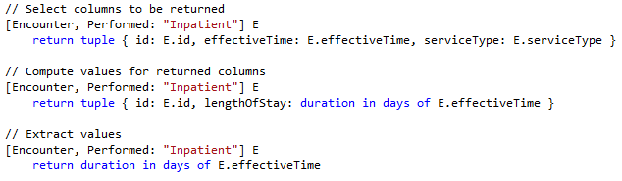
Shaping
The “return” clause allows the shape of the result to be described:

Slide 18
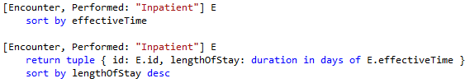
Sorting
“sort by” allows the results of a query to be ordered.
Sorting is evaluated after any “return”

Slide 19

Filtering by Relationships
Use the “with” keyword to introduce a filtering relationship:
NOTE: This operation is known as a semi-join in database languages.

Slide 20
Combining Results
The “combine” operation allows data from multiple sources to be combined:

Slide 21
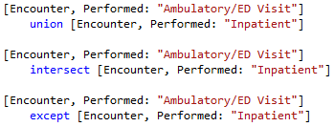
Set Operations
CQL supports standard set operations:
union, intersection, and difference

Slide 22
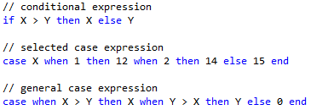
Conditional Expressions
CQL supports an “if” expression, as well as a SQL-style “case” expression:

Slide 23

Aggregate Expressions
CQL supports a full complement of aggregate expressions including:
Count, Sum, Min, Max, Avg
Std Dev, Variance, Median, Mode

Slide 24
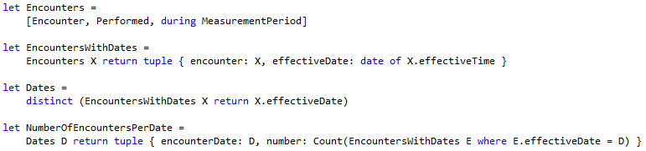
Let Statements
“let” statements can be used to break expressions into smaller chunks:

Slide 25
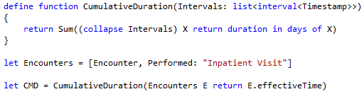
Defining Functions
CQL allows functions to be defined:

Slide 26
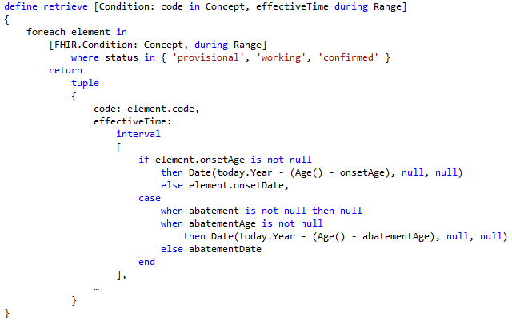
Defining Retrieves
Retrieves can be defined for concept-mapping

Slide 27
Using Libraries
Each library defines a name and optional version
Elements referenced from a library must be qualified
Element names within a library must be unique
Library names must be unique within a repository
Version number is optional for library definition
If none given, references cannot use a version
Version is optional for include definition
If specified, that version must be used
If none given, the “most recent” version is used

Slide 28
Next Steps
Still very much a work in progress
Continue to refine the syntax
Mapping QUICK to FHIR
Performance/Implementation implications
Representation in XML artifacts
Clinical Quality Language Specification (ballot materials)
Sub-team meets weekly, Wed 11:00 Eastern
https://global.gotomeeting.com/meeting/join/554237525
Dial +1 770-657-9270, Participant Code: 6870541
Using a common cqframework repository
https://github.com/cqframework/OneModel

