Slide 1
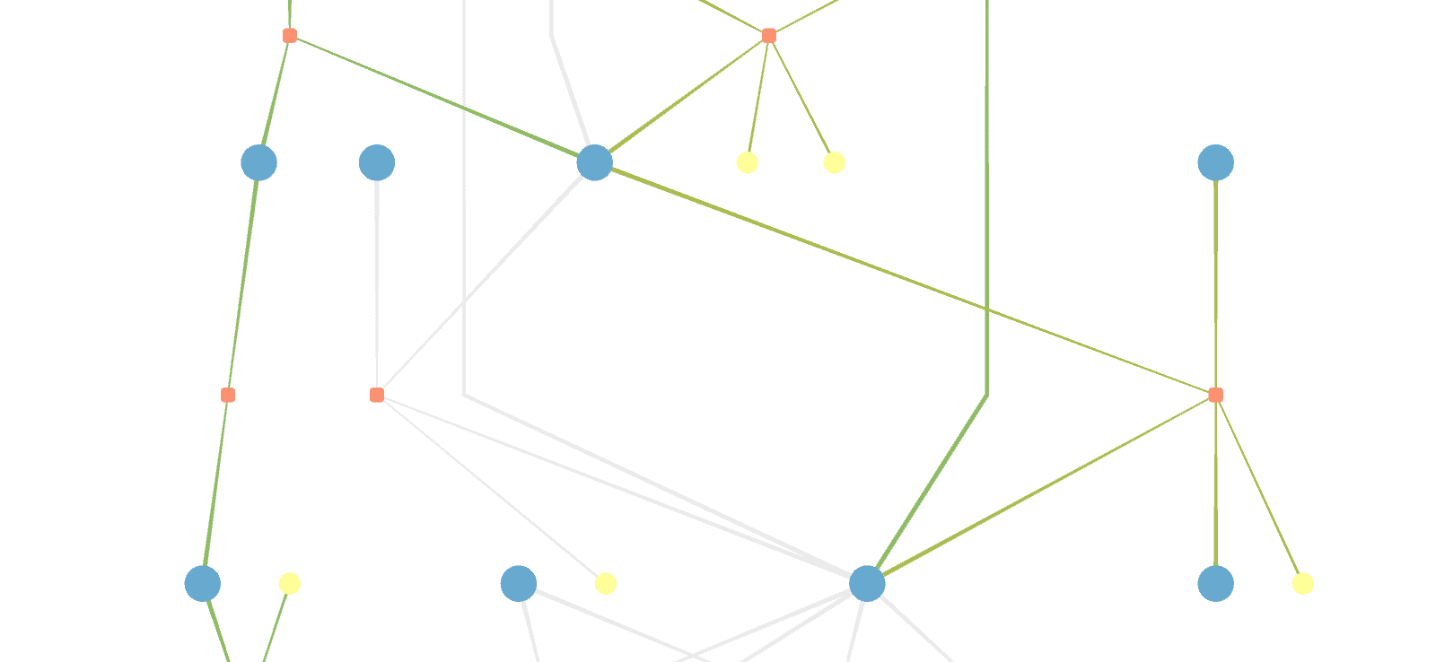
MetaViz
Metabolic Network Maps
Practical, Nicolas Huber
Supervisors: Prof. Bas Teusink, Dr. Brett Olivier

Slide 2
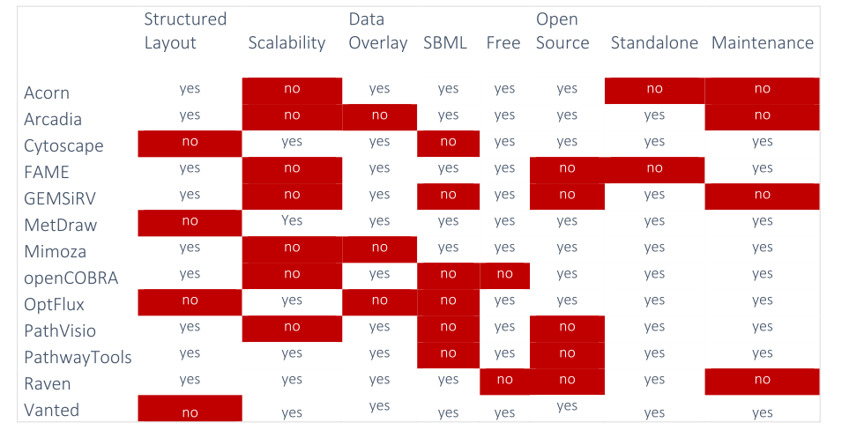
Why develop another tool?

Slide 3
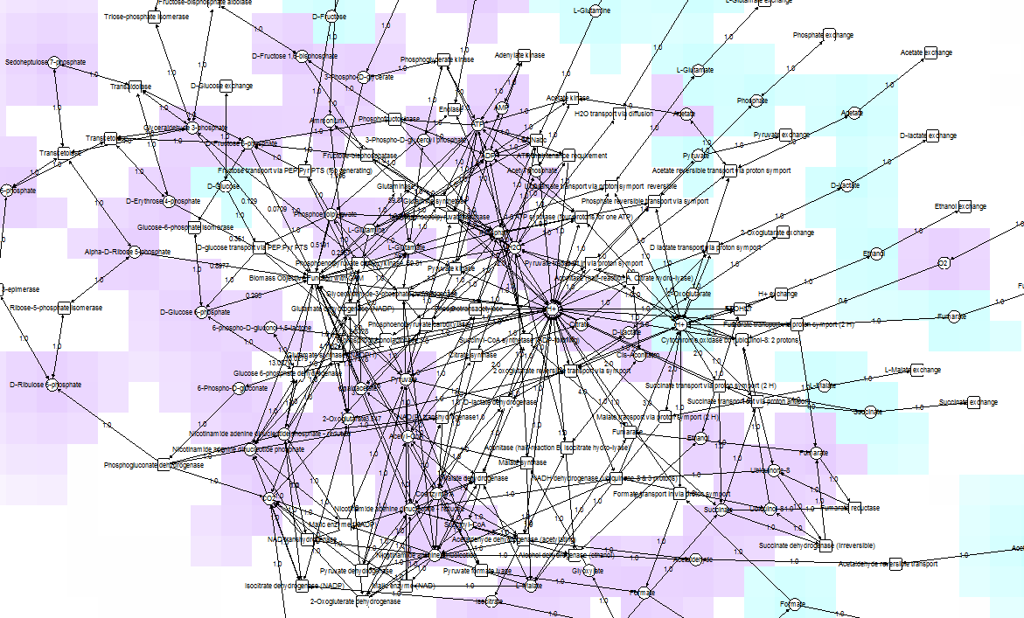
Vanted
E. coli, core model
72 species

Slide 4
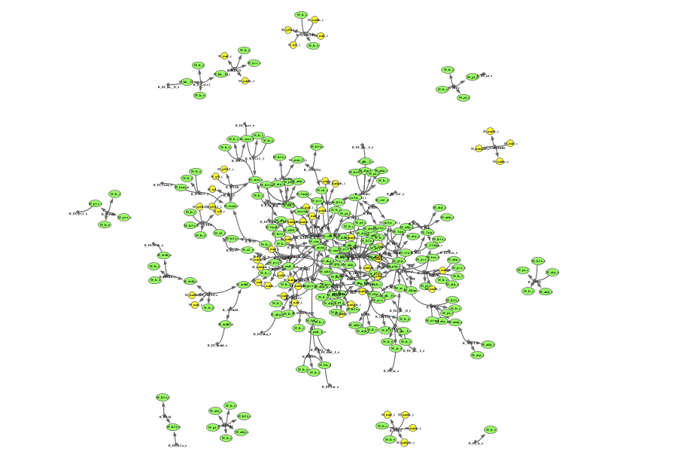
OptFlux
E. coli, core model
72 species

Slide 5
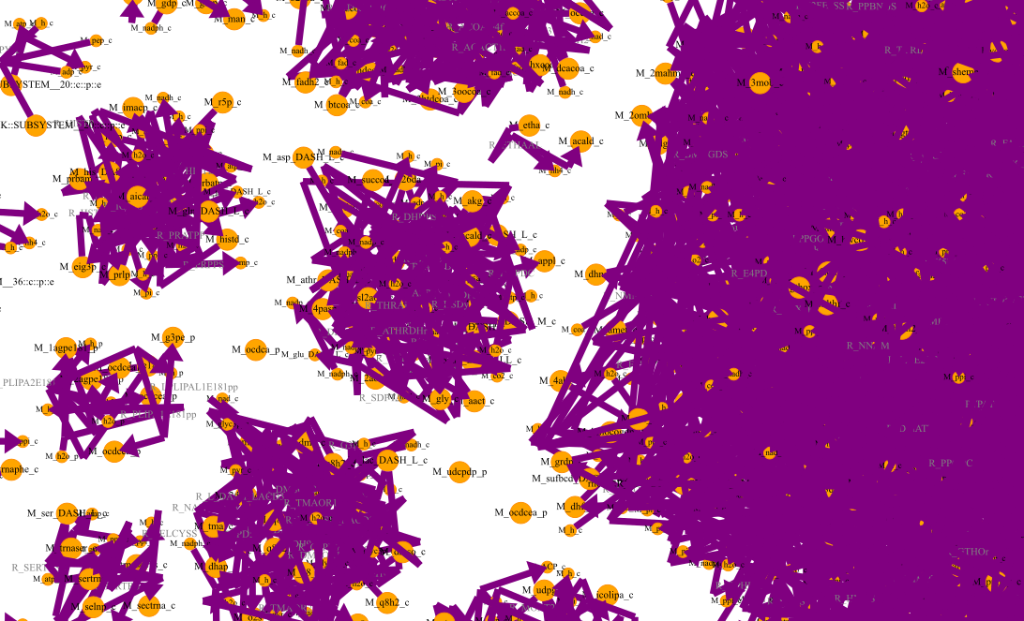
MetDraw
E. coli, genome-scale model
1367 species
(iJO1366)
automatic layout algorithms generate messy "hairballs"!
<->
manual layouting takes away valuable time!

Slide 6
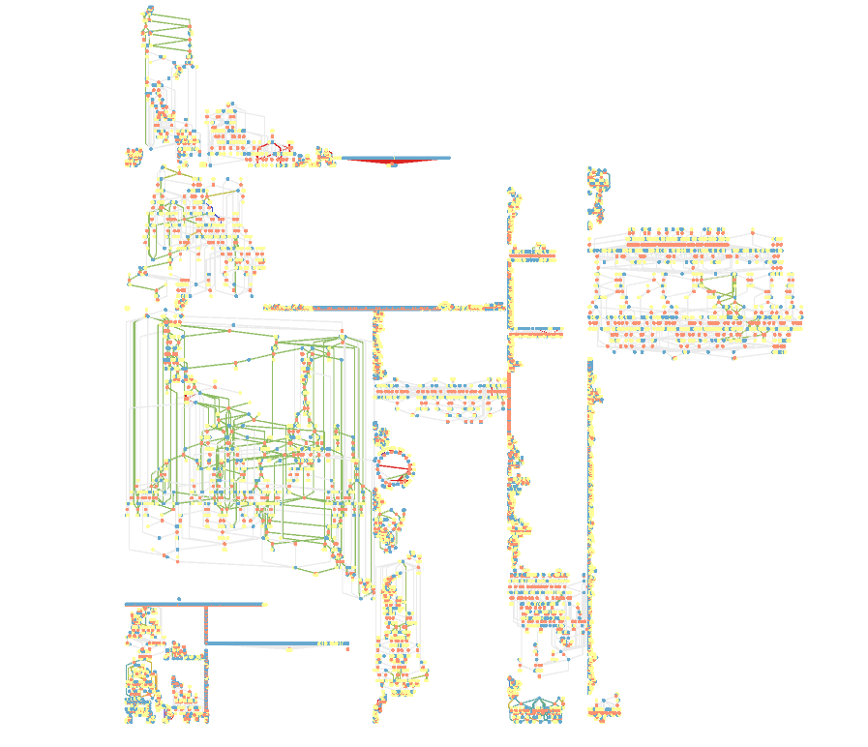
MetaViz
E. coli, genome-scale model
1367 species
(iJO1366)

Slide 7
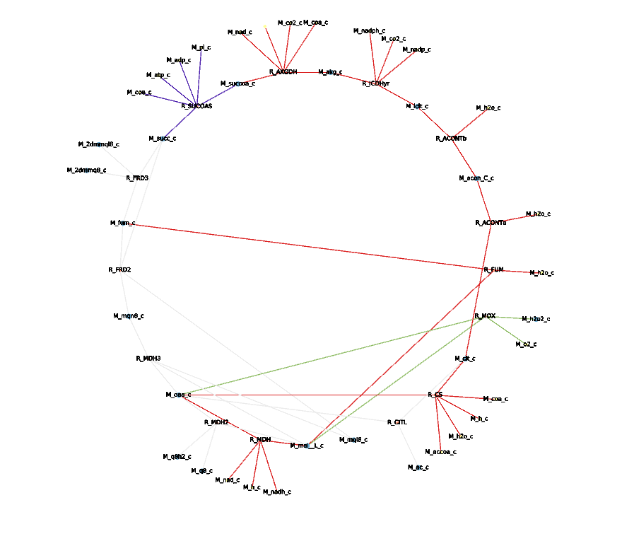
MetaViz
E. coli, genome-scale model
1367 species
(iJO1366)

Slide 8
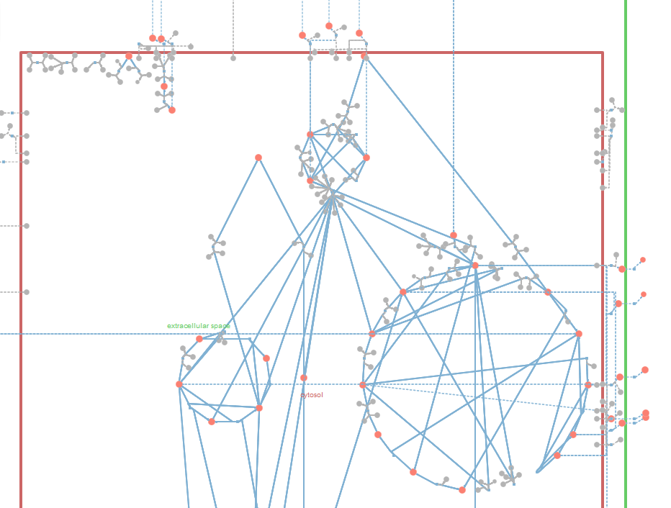
Mimoza
E. coli, core model
72 species
automatically generated layout
that structures the network graph!
how does the algorithm work?
also possible for larger, genome-scale models?

Slide 9
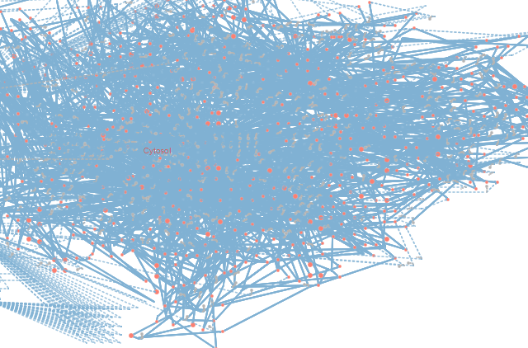
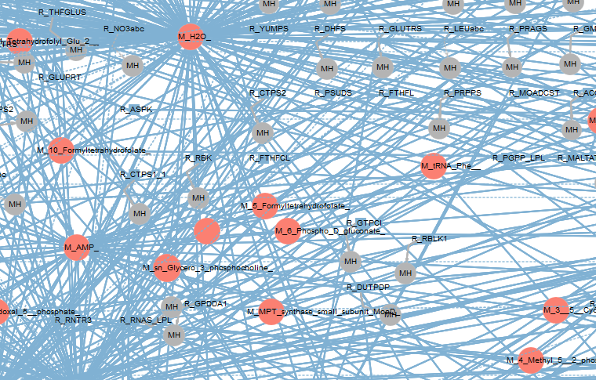
Mimoza
L. plantarum, genome-scale
775 species
(WCFS1)
Notes:
L. plantarum = Lactobacillus plantarum

Slide 10
(0. Learn more about Python, Git, SBML Level 3) ✓
1. Find and test existing model visualization tools ✓
2. Understand the Mimoza source code ✓
3. Extract the layouting part ✓
4. Write code that takes layouting basics from Mimoza
and applies additional functions
to generate structured layout even for large, genome-scale models
(✓)
(+ additional functionality such as overlaying FBA results, etc.!)

Slide 11
To Do List
Improve Layout:
take group information from SBML (if provided)
and draw individual pathways (make TCA circular, etc.)
large networks: automatically assign regions
for different parts of the graph (transport regions along edges etc. )
add more rendering features
Register on Python Package Index, integrate into MetaToolkit
✓
✓
✓

Slide 12
(0. Learn more about Python, Git, SBML Level 3) ✓
1. Find and test existing model visualization tools ✓
2. Understand the Mimoza source code ✓
3. Extract the layouting part ✓
4. Generate structured layout even
for large, genome-scale models ✓
5. Add more features, convert script to a module and register on PIP

Slide 13
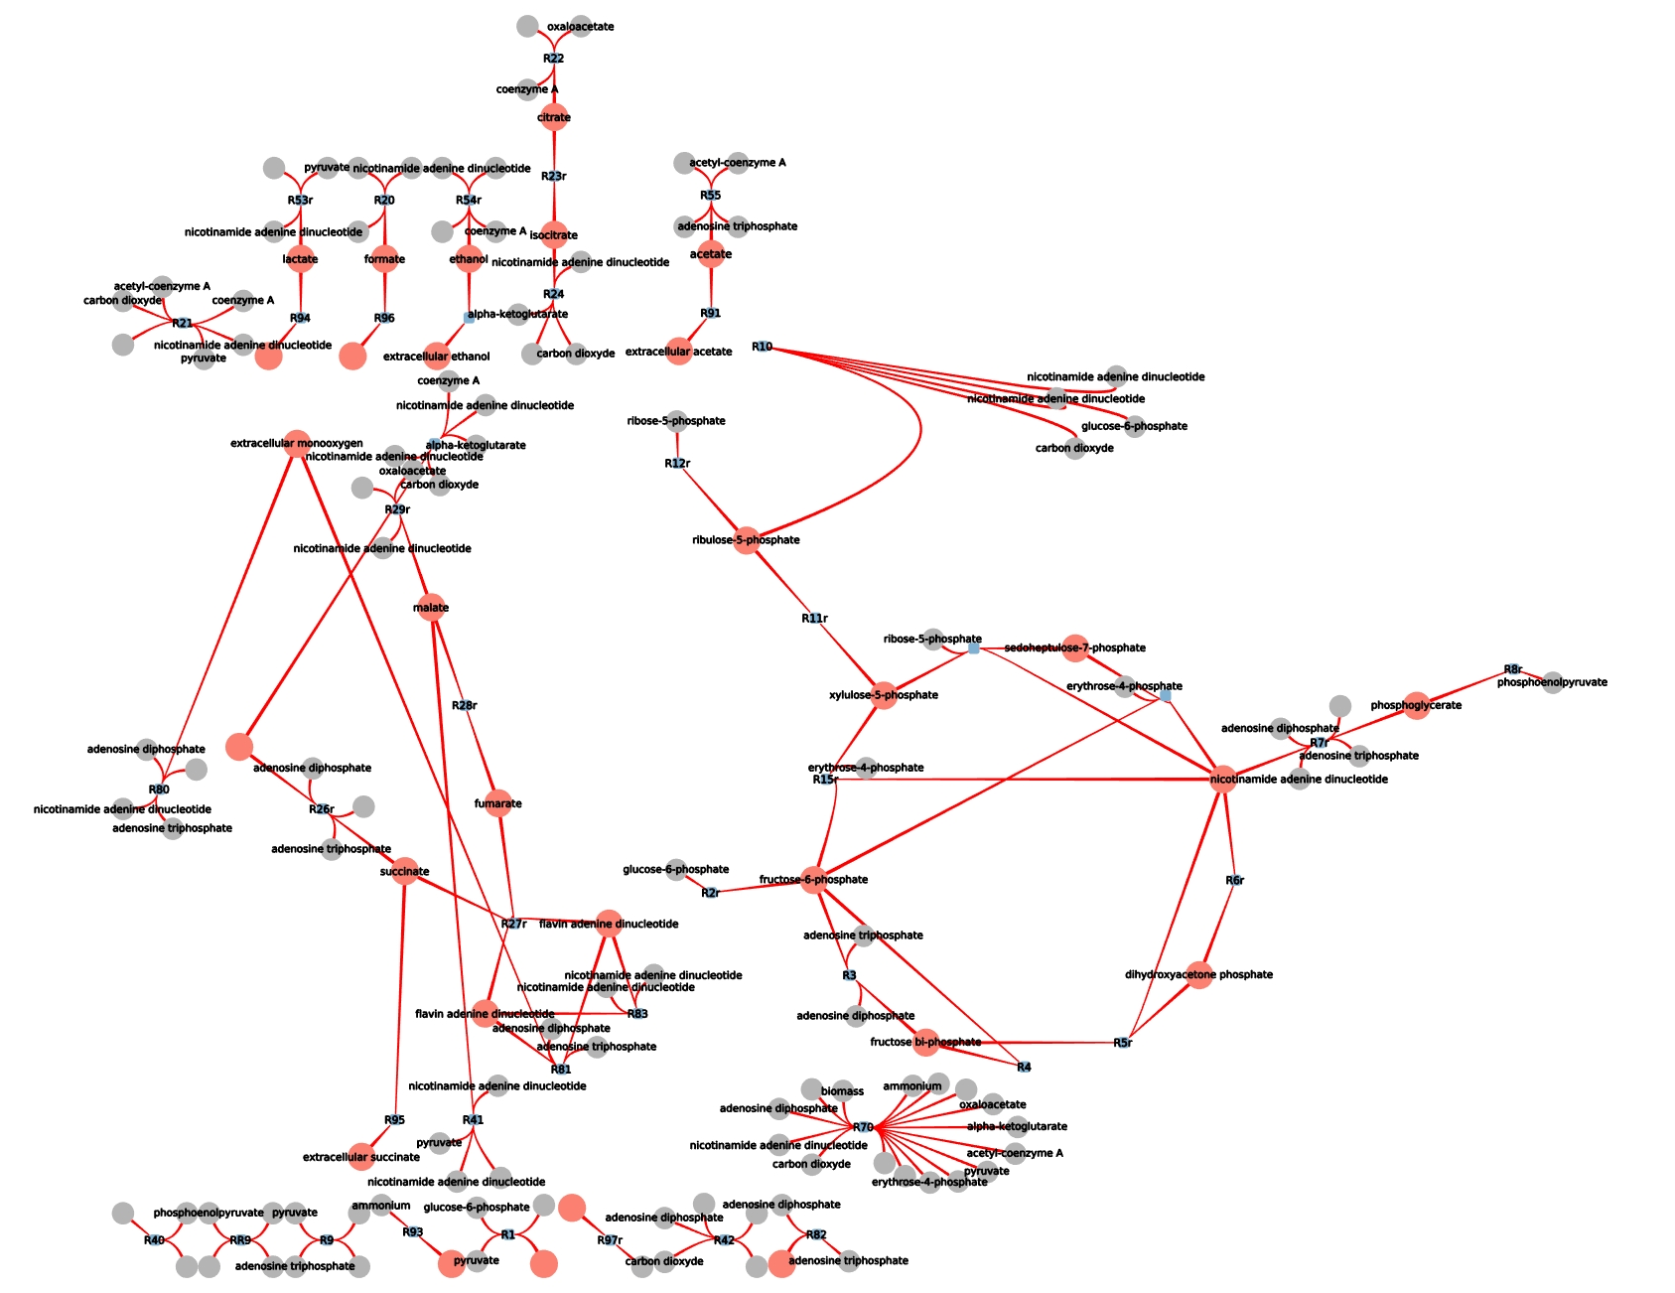
E. coli, core model
Carlson, 2003

Slide 14
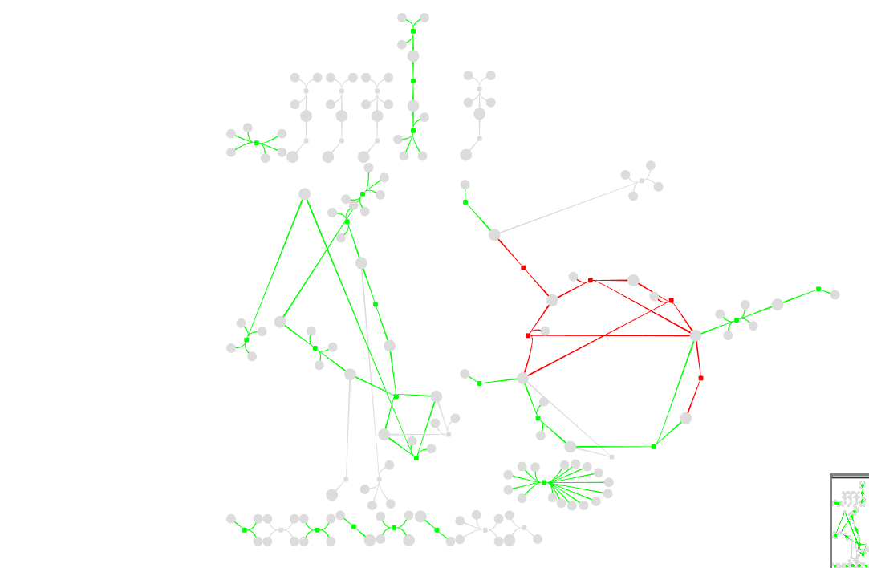
E. coli, core model
Carlson, 2003
FBA results (with CBMPY):
green = positive flux
red = negative flux
grey = zero flux
Notes:
green positive flux
red negative flux
grey zero flux

Slide 15
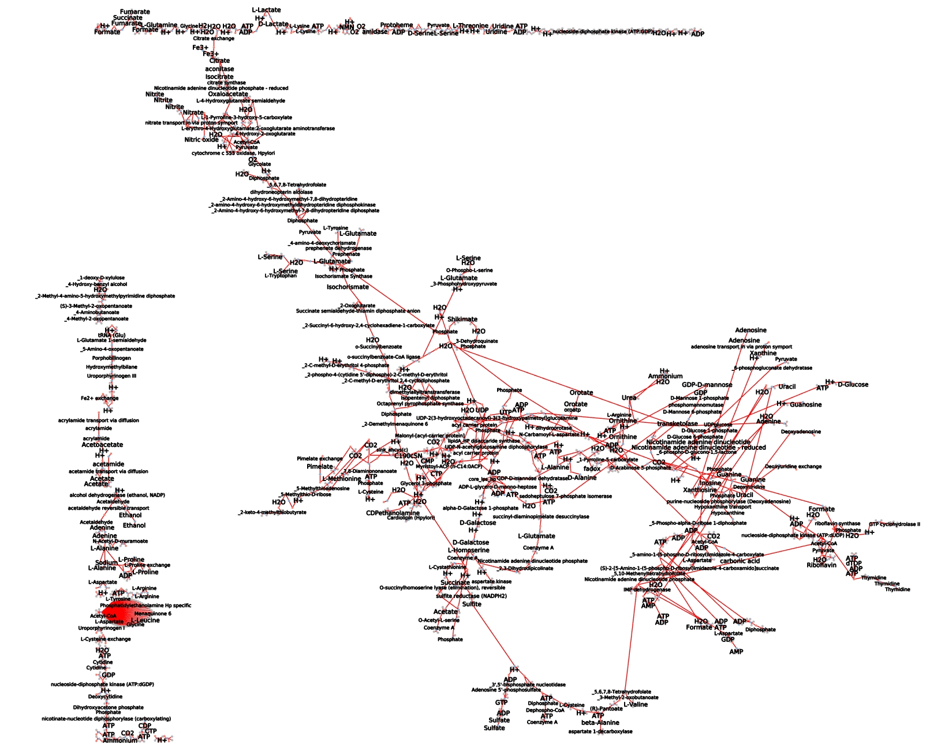
H. pylori,
genome-scale model
ilT341

Slide 16
MetaViz Features (so far)
only input: SBML level 3 file (groups annotation optional)
if no groups defined:
  clone parts of the network based on connectivity
  automatically detect cycles
if groups defined:
  layout pathways individually
  (TCA: circular, Glycolysis: linear, etc.)

Slide 17
Examples:
for different models:
add example for autoAlias
add example for pathwayLayout

Slide 18
MetaViz Features (so far)
multiple coloring options (overlay flux data, highlight pathways, etc.)
multiple output options:
  SVG
  JSON
  GML
  SBML with Layout Plugin
  SBGN
  Tulip graph file (.tlp)

Slide 19
Examples:
add example for flux overlay
add example for pathway highlighting
show SVG, GML, SBGN and Tulip

Slide 20
MetaViz Features (so far)
separation of layout and rendering information
-> layout once, render many different parts with different configurations!
all generated information stored in SQLite database
-> compatibility with other graph visualization libraries (NetworkX, d3, Plotly, etc.)

Slide 21
Examples
show example for NetworkX graph from DB
show example for d3 graph from DB (ask Willi!)

Slide 22
Use Case: Willi
show different M5_M6 visualizations (groups, auto, compartments)
show which reactions in the output files are also in the template models (implement new coloring mode for that)

Slide 23
Use Case: Stijn
show my output svg corresponding to the JSOn I gave to Stijn
add image of Stijns svg output which he generated by reading in a JSON file generated by MetaViz

