Slide 1
Metabolic Pathway Maps
Practical, Nicolas Huber
Supervisors: Prof. Bas Teusink, Dr. Brett Olivier

Slide 2
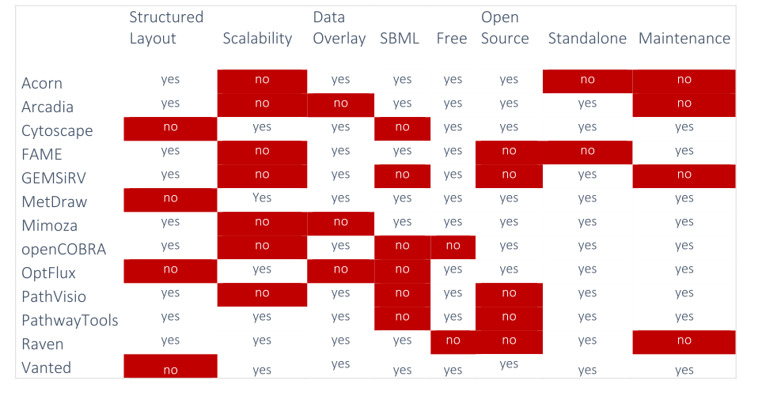
Why develop another tool?

Slide 3
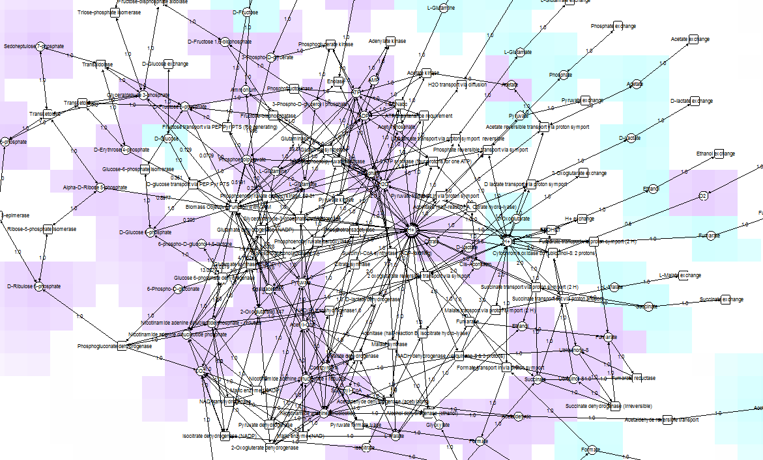
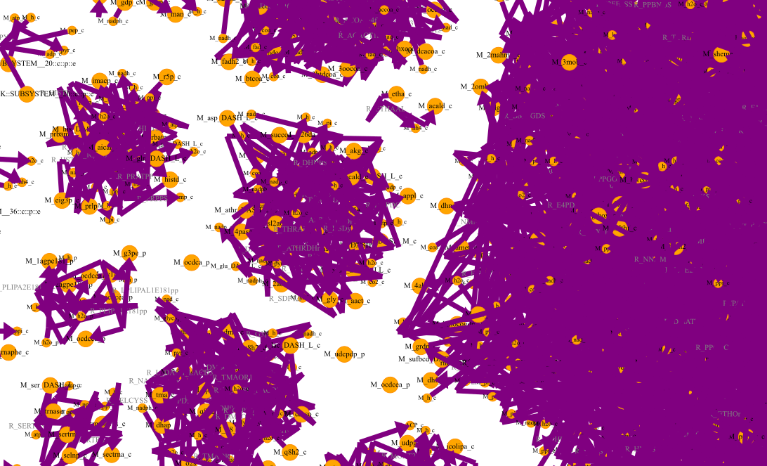
Vanted
E. coli, core model
72 species

Slide 4
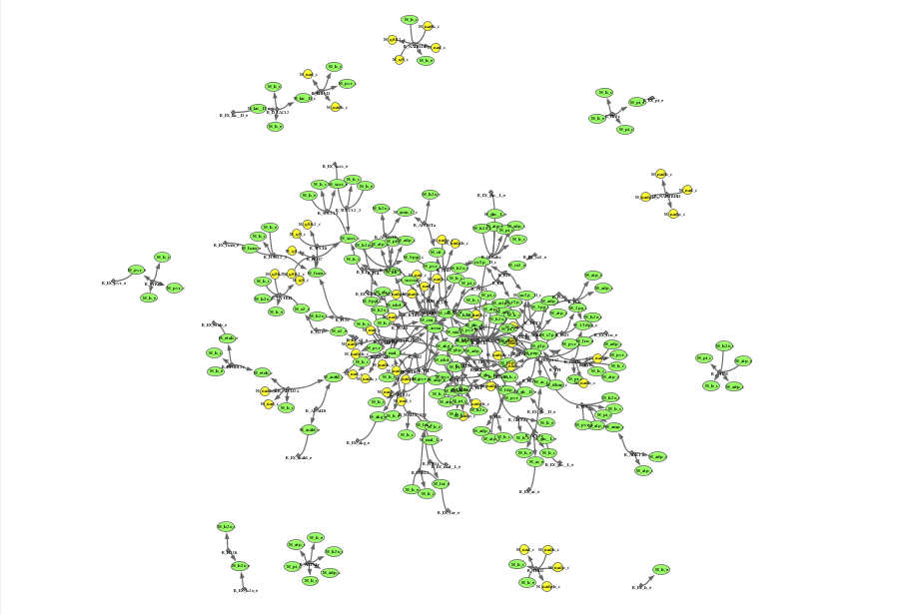
OptFlux
E. coli, core model
72 species

Slide 5
MetDraw
E. coli, genome-scale model
1367 species
automatic layout algorithms generate messy "hairballs"!
<->
manual layouting takes away valuable time!

Slide 6
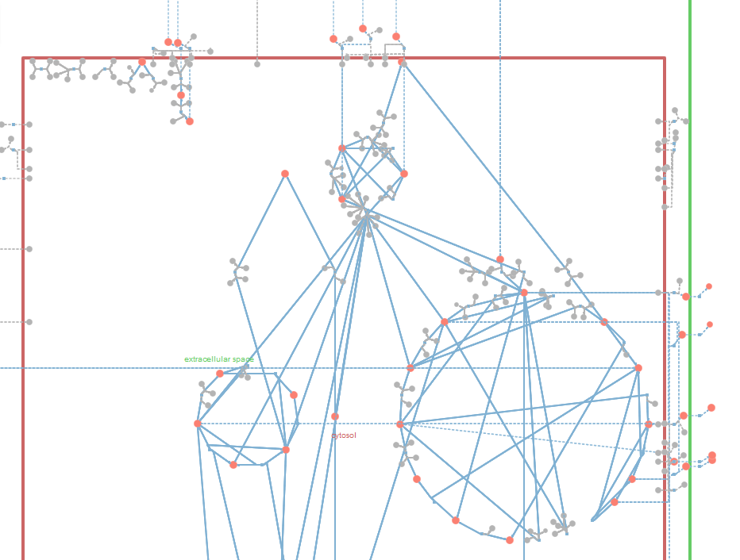
Mimoza
E. coli, core model
72 species
automatically generated layout
that structures the network graph!
how does the algorithm work?
also possible for larger, genome-scale models?

Slide 7
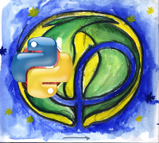
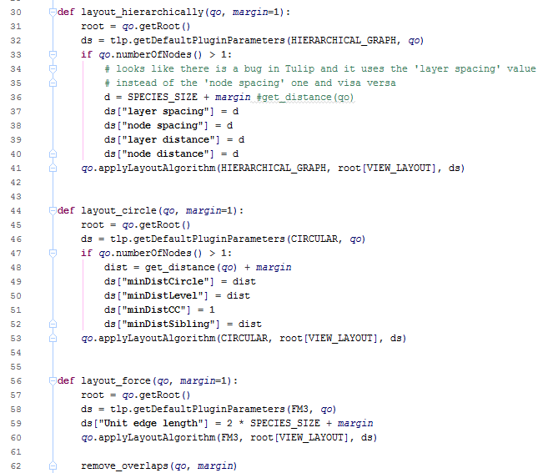
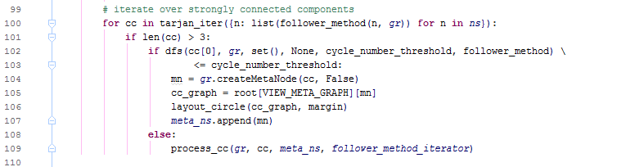
Mimoza uses the Tulip Python API:
"Tulip is an information visualization framework written in C++ dedicated to the analysis and visualization of graphs."
Tulip Layout Algorithms … are called under certain conditions (connectivity)

Slide 8
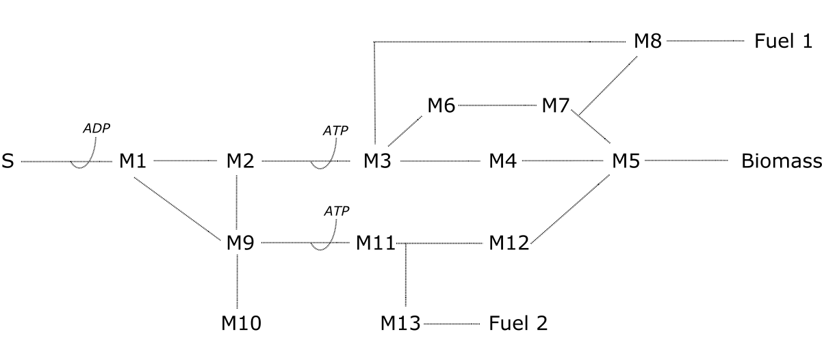
example: toymodel biofuel
19 species

Slide 9
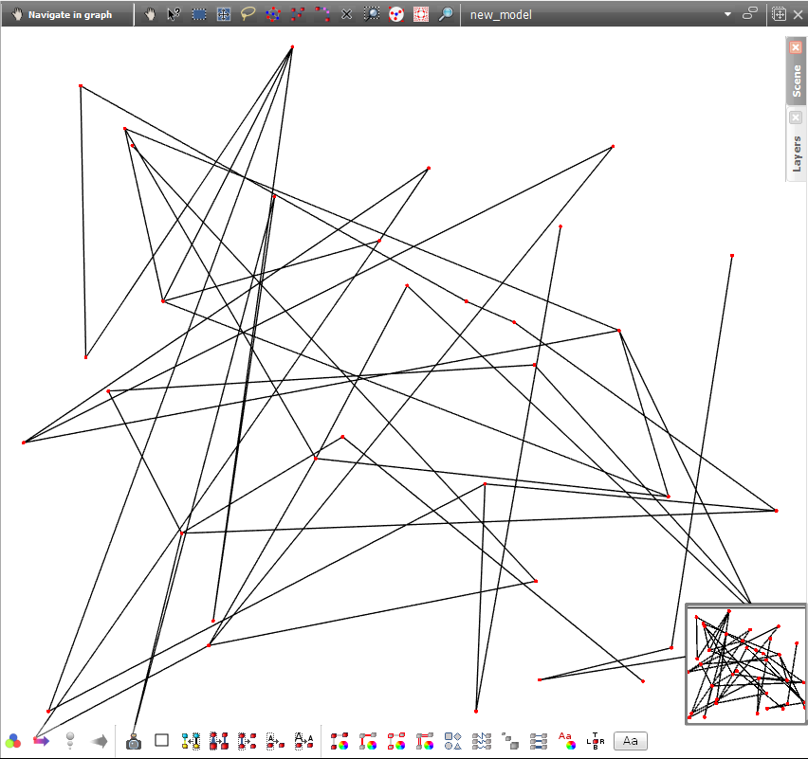
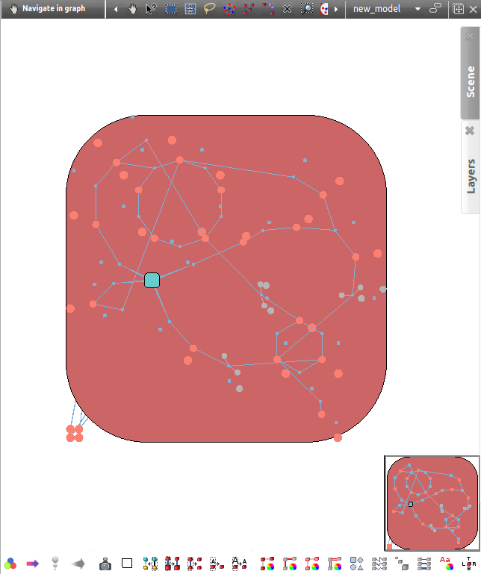
example: toymodel biofuel
19 species
Notes:
show handdrawn model first (.svg)

Slide 10
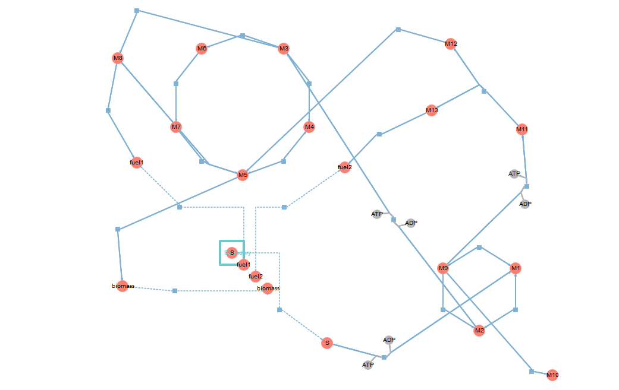
example: toymodel biofuel
19 species
Notes:
slightly different layout because 4 species have been duplicated since they are either substrate (coming from extracellular space – blue square) or are the endproduct of the model
-> layouting is very organic and chooses sublayouts (circles etc.) due to connectivity, etc. and not because of biological reasons!

Slide 11
(0. Learn more about Python, Git, SBML Level 3) ✓
1. Find and test existing model visualization tools ✓
2. Understand the Mimoza source code ✓
3. Extract the layouting part ✓
4. Write code that takes layouting basics from Mimoza
and applies additional Tulip functions
to generate structured layout even for large, genome-scale models
(✓)
(+ additional functionality such as overlaying FBA results, etc.!)

Slide 12
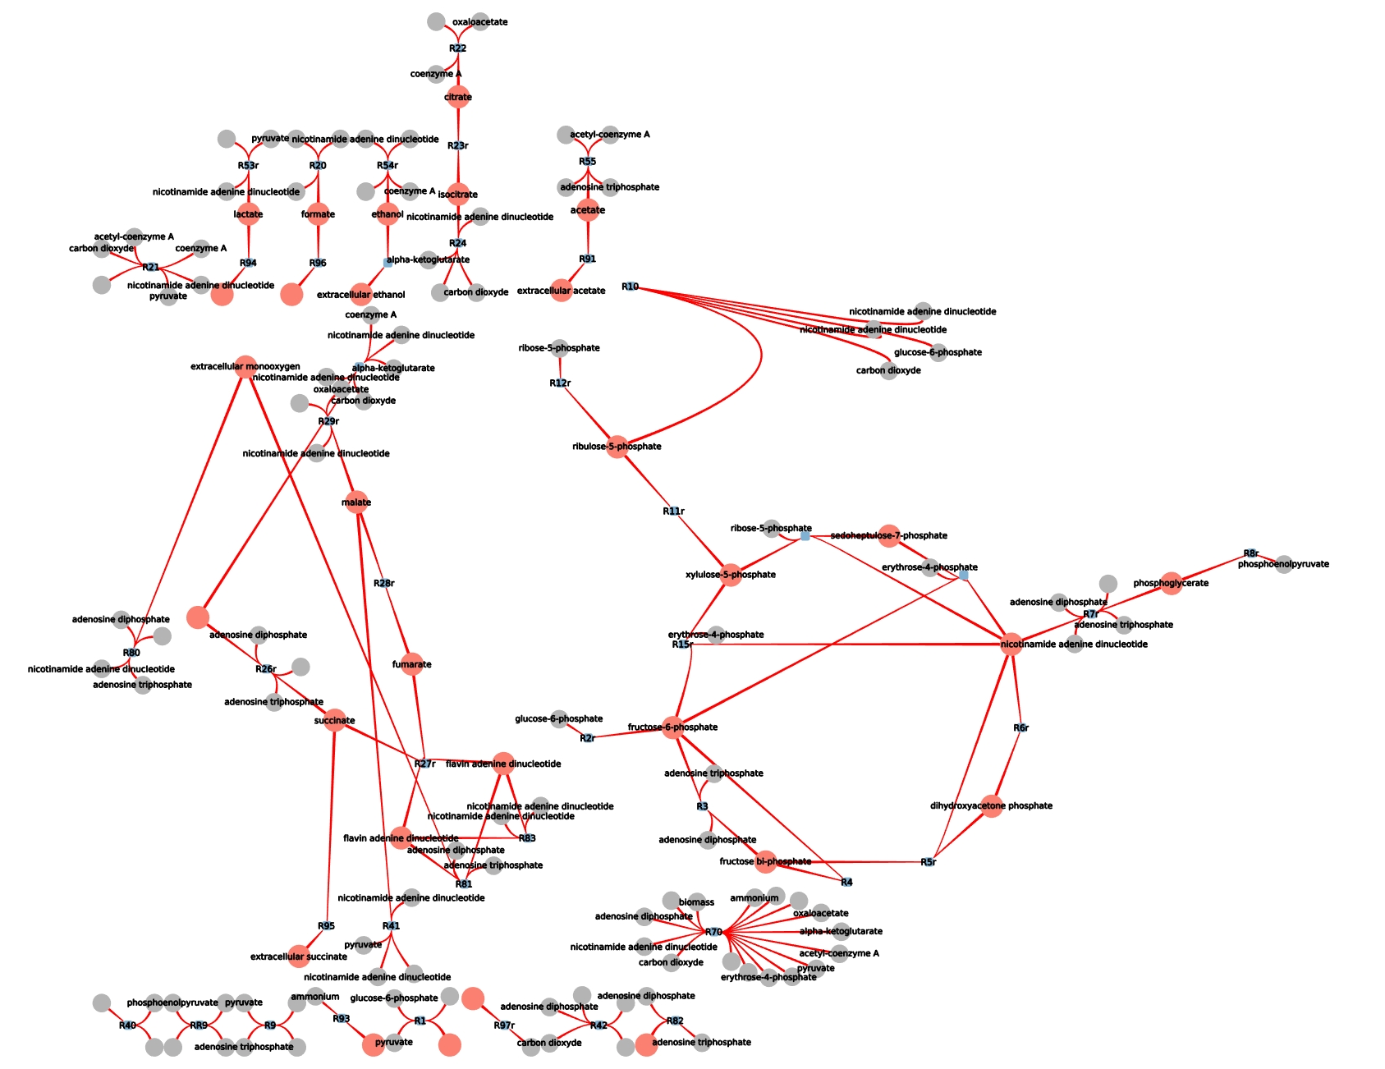
E. coli, core model
Carlson, 2003

Slide 13
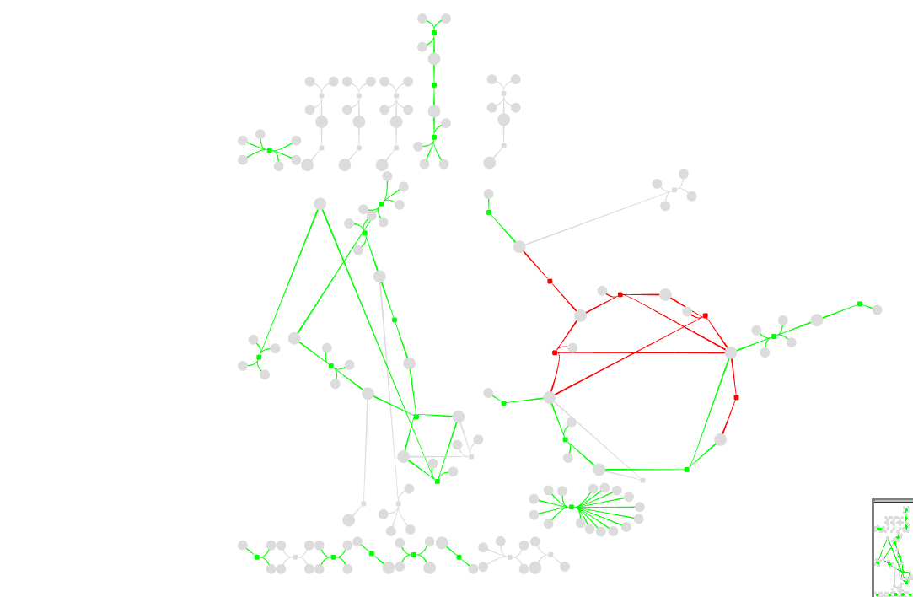
FBA results (with cbmpy):
green = positive flux
red = negative flux
grey = zero flux
Notes:
green positive flux
red negative flux
grey zero flux

Slide 14
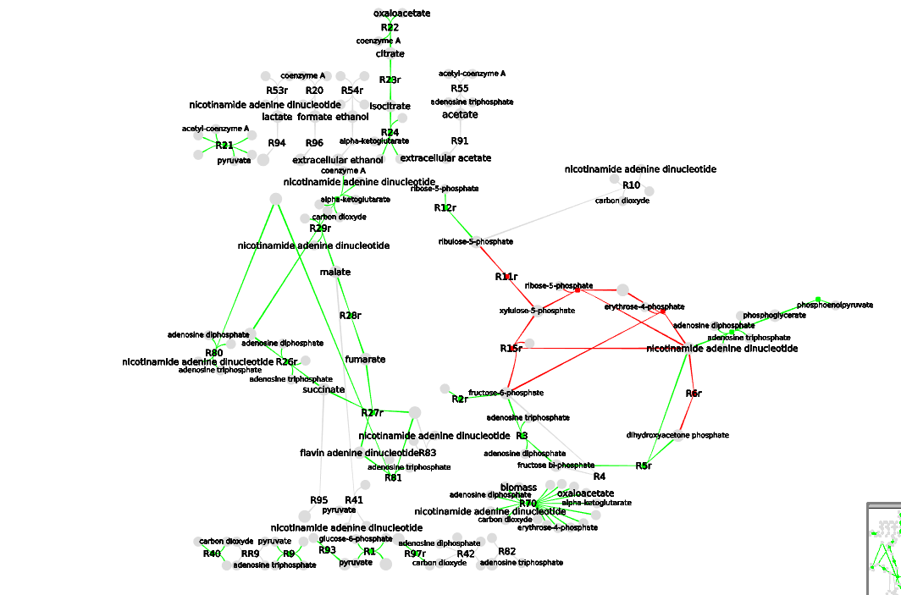
Notes:
layouting of pathways still due to graph properties (connectivity), not biological reasons => TCA cycle for instance is not drawn with circular layout!

Slide 15
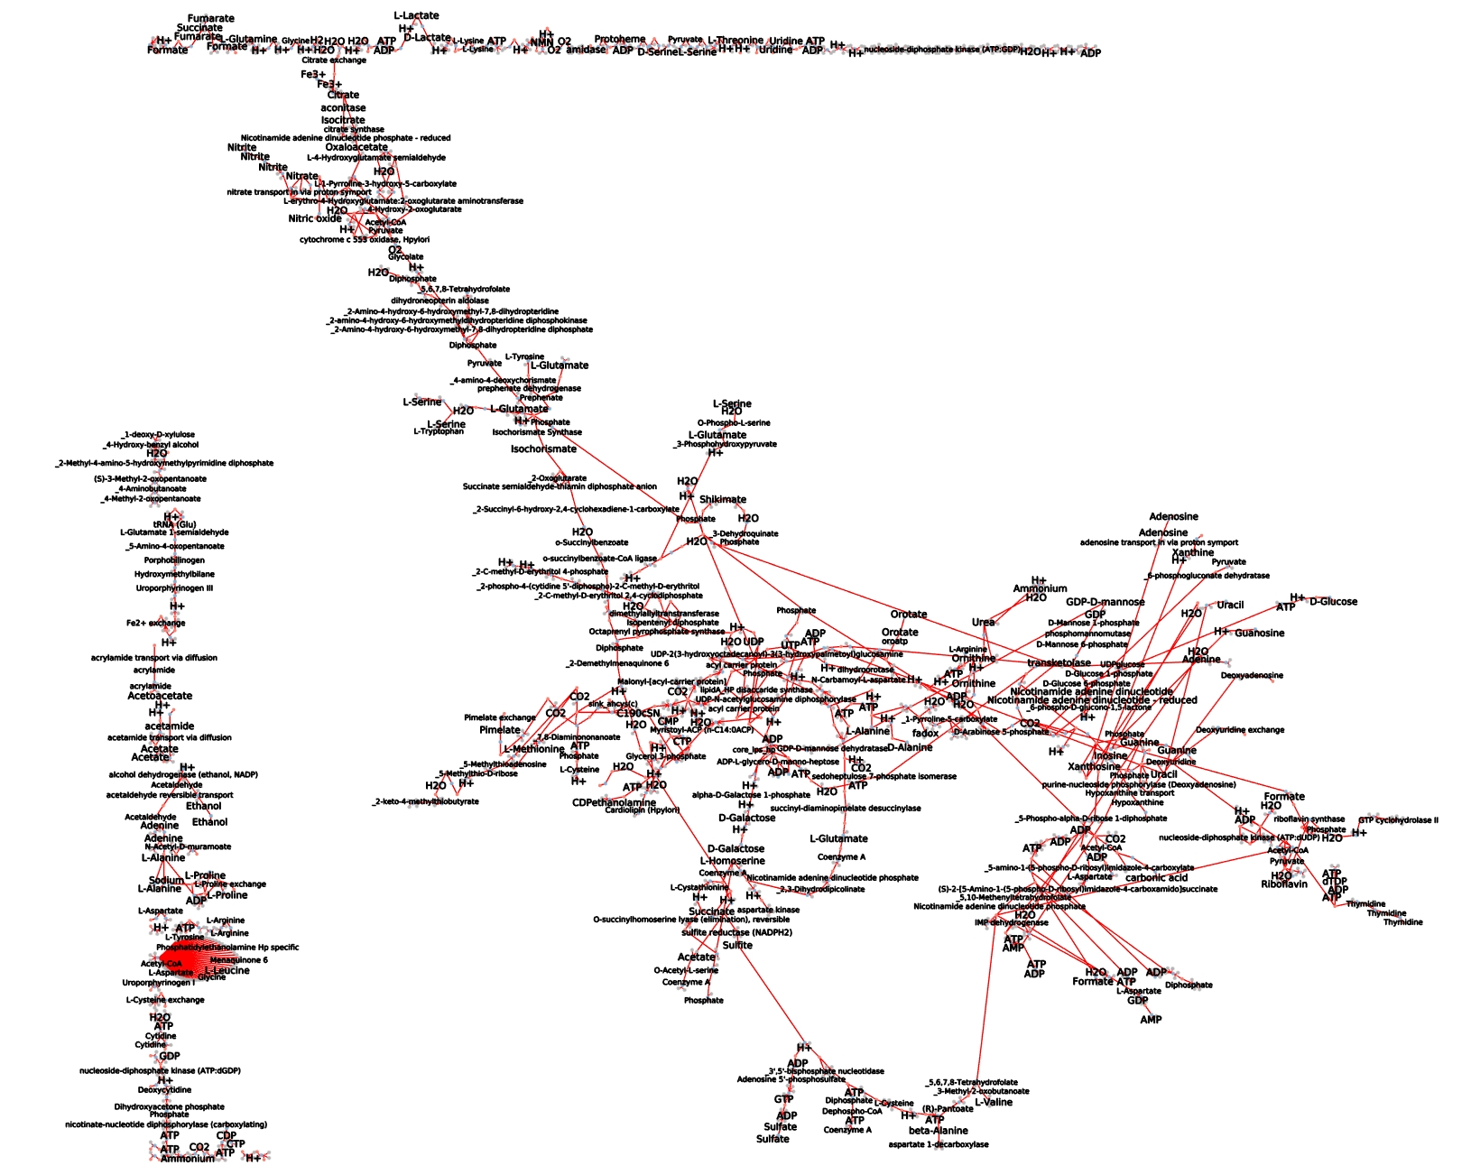
H. pylori
genome-scale model (iIT341)

Slide 16
Improve Layout:
take group information from SBML (if provided)
and redraw individual pathways (make TCA circular, etc.)
large networks: automatically assign regions
for different parts of the graph (transport regions along edges etc. )
…
Incorporate into MetaToolkit

