Slide 1
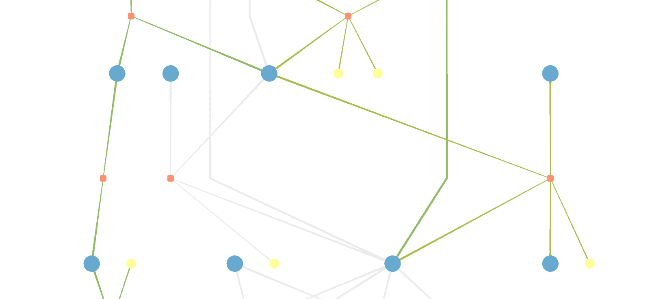


CBMViz
Metabolic Network Maps
Practical, Nicolas Huber
Supervisors:
Prof. Bas Teusink, Dr. Brett Olivier

Slide 2
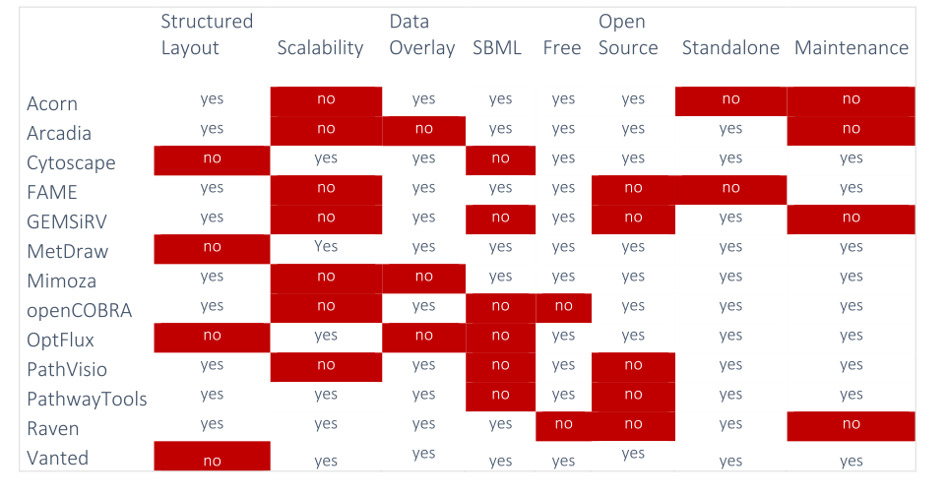
Why develop another tool?
Notes:
TODO: change matrix to include Escher comparison

Slide 3
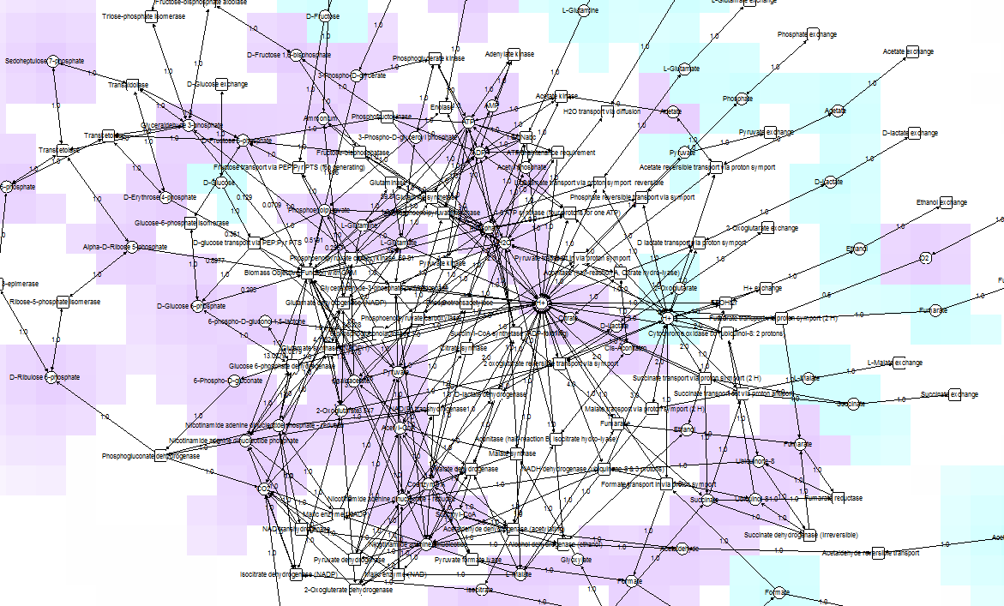
Vanted
E. coli, core model
72 species

Slide 4
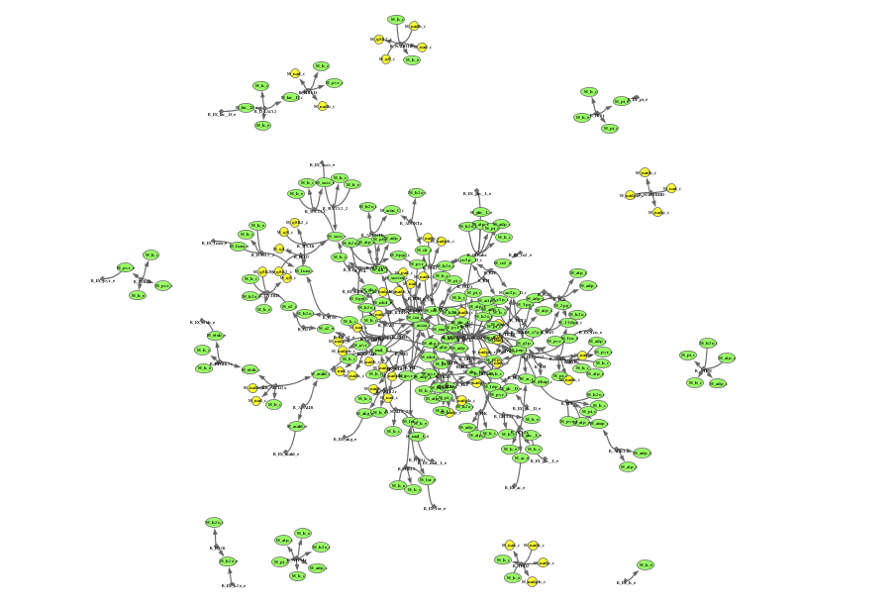
OptFlux
E. coli, core model
72 species

Slide 5
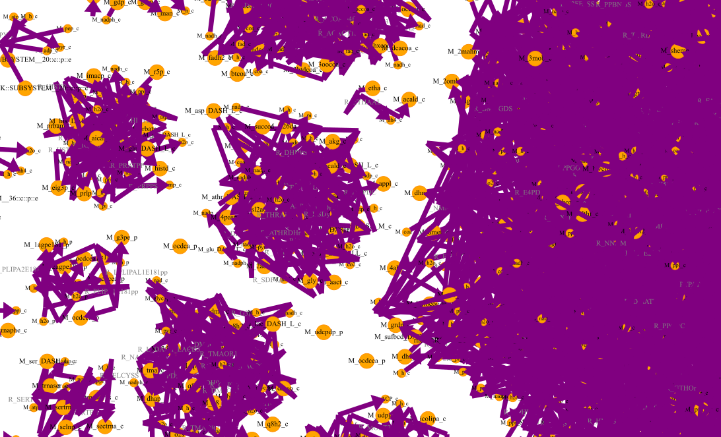
MetDraw
E. coli, genome-scale model
1367 species
(iJO1366)
automatic layout algorithms generate messy "hairballs"!
<->
manual layouting takes away valuable time!

Slide 6
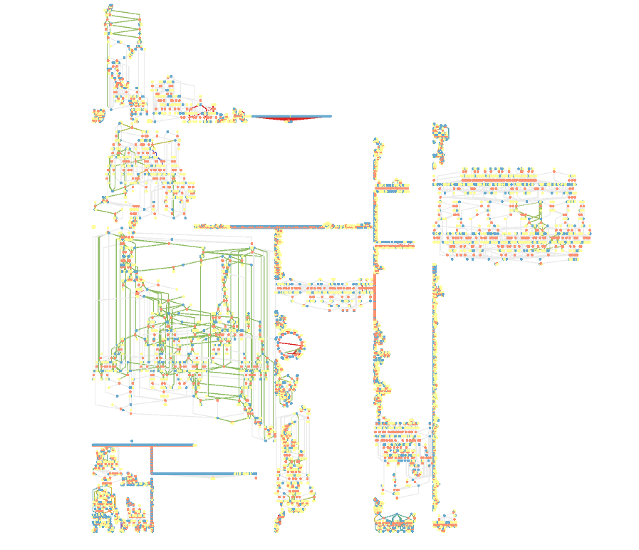
CBMViz
E. coli, genome-scale model
1367 species
(iJO1366)

Slide 7
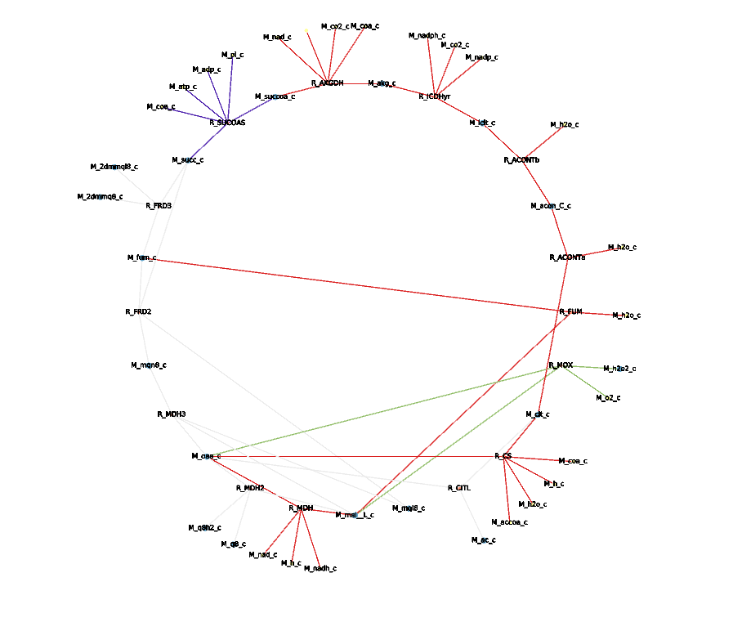
CBMViz
E. coli, genome-scale model
1367 species
(iJO1366)

Slide 8
How does it work?
read SBML file
apply color
render and export results
create layout
import layout from database / external source
export only layout data to use with other tool
modular code
→ use features individually
→ import own data
→ layout data accessible independently from rendering

Slide 9
Using CBMViz
# create Tulip graph and generate graph objects
graph, graph_props = createInitialGraph("initialGraph")
# read SBML file and create layout
graph_registry = layoutModel(sbml, graph)
# 3. apply coloring algorithms to graphs
colorGraphs(fba_results, graph_registry)
# 4. export graph as SVG, GML, JSON, SBML+layout Plugin and/or SBGN file
exportGraph(output_path, graph_registry)

Slide 10
CBMViz Features (so far)
only input: SBML level 3 file (groups annotation optional)
if no groups defined:
  clone parts of the network based on connectivity
  automatically detect cycles
if groups defined:
  layout pathways individually
  (TCA: circular, Glycolysis: linear, etc.)
Notes:
if nor groups -> identify highly connected nodes and alias/clone them

Slide 11
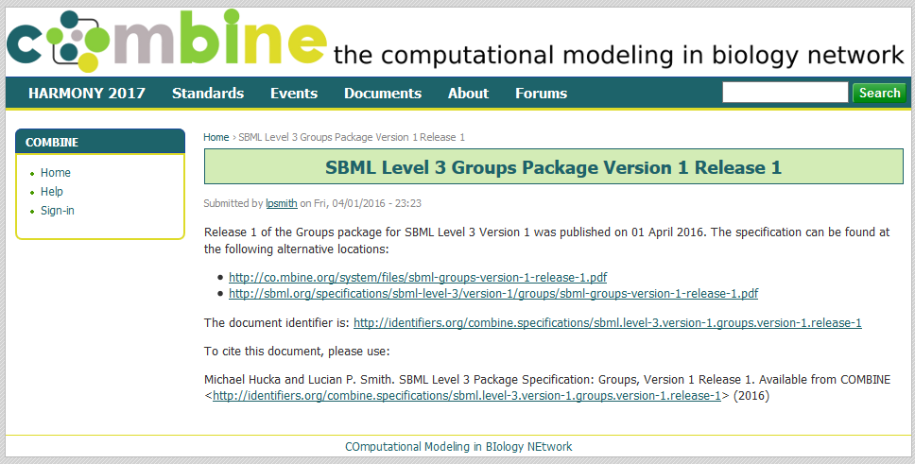
What are groups?
- groups are sets of reaction ids (of a compartment, a pathway, etc. … )
- defining groups (with CBMPY) will add a list of groups and their elements to the SBML file
Notes:
new extension for sbml level 3

Slide 12
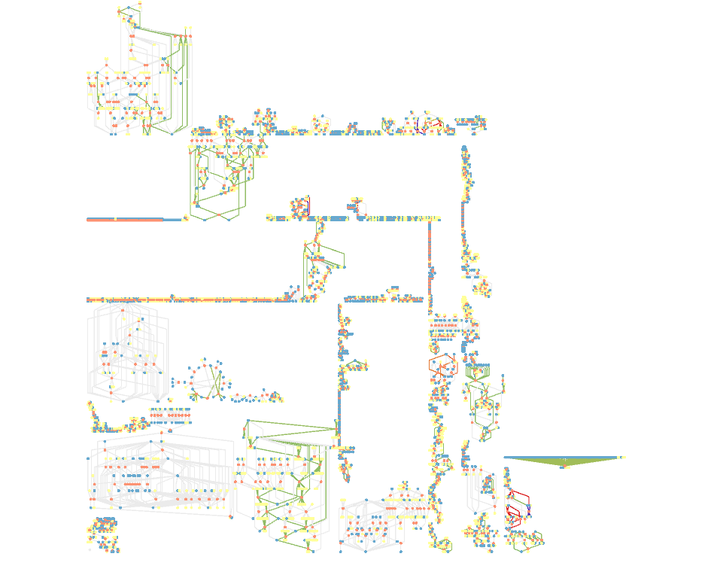
CBMViz
S. cerevisiae, genome-scale model
1059 species
(iND750)
Glycoprotein Metabolism
Oxidative Phosphorylation

Slide 13
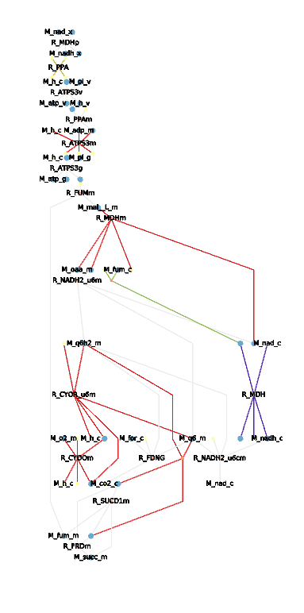
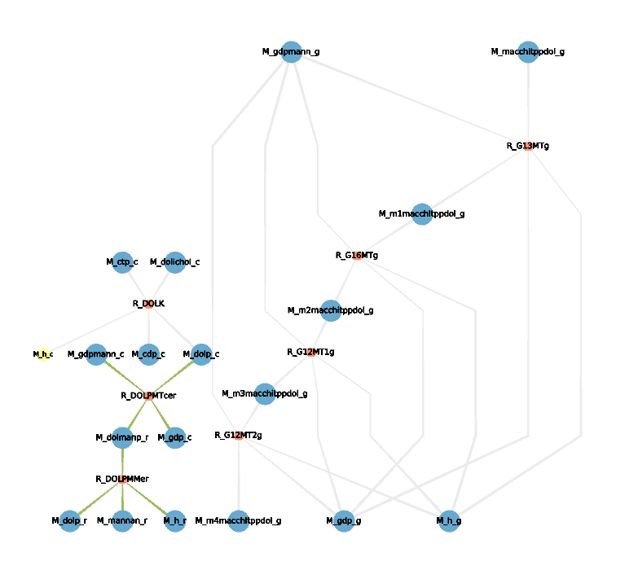
CBMViz
E. coli, genome-scale model
1367 species
(iJO1366)
Glycoprotein Metabolism
Oxidative Phosphorylation

Slide 14
CBMViz Features (so far)
multiple coloring options
(overlay flux data, highlight pathways, etc.)
multiple output options:
  SVG
  JSON
  GML
  SBML with Layout Plugin
  SBGN
  Tulip graph file (.tlp)

Slide 15
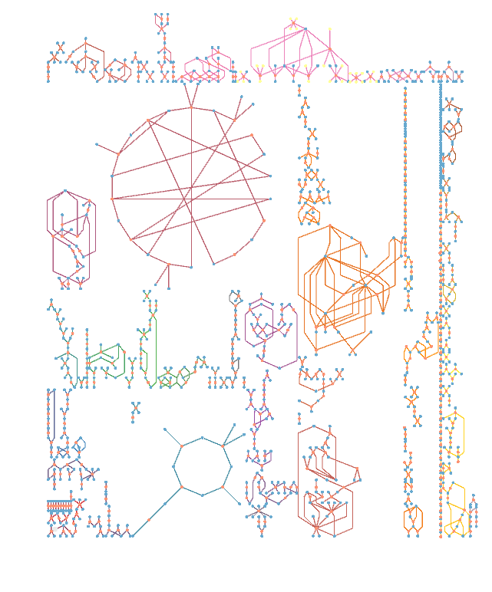
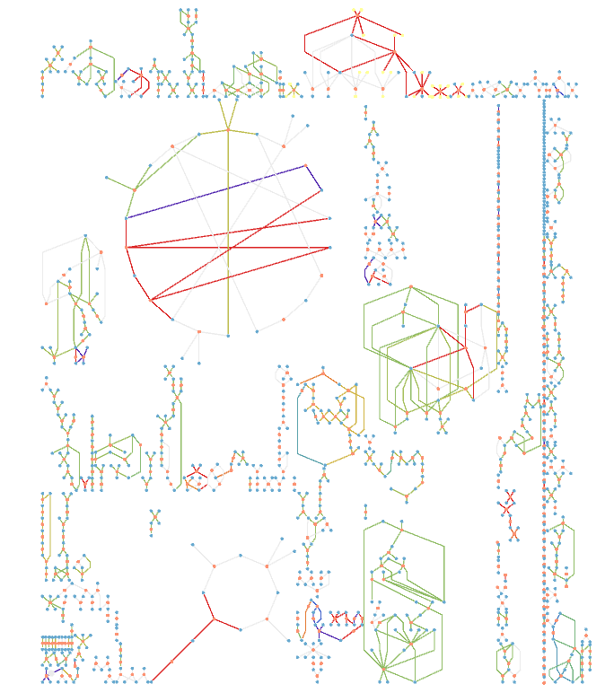
Pathway coloring
Flux coloring
Notes:
Model: iIT341
Organism:
Helicobacter pylori 26695
Genome:
NC_000915.1
Model metrics:
Component Count Metabolites485 Reactions554 Genes339

Slide 16
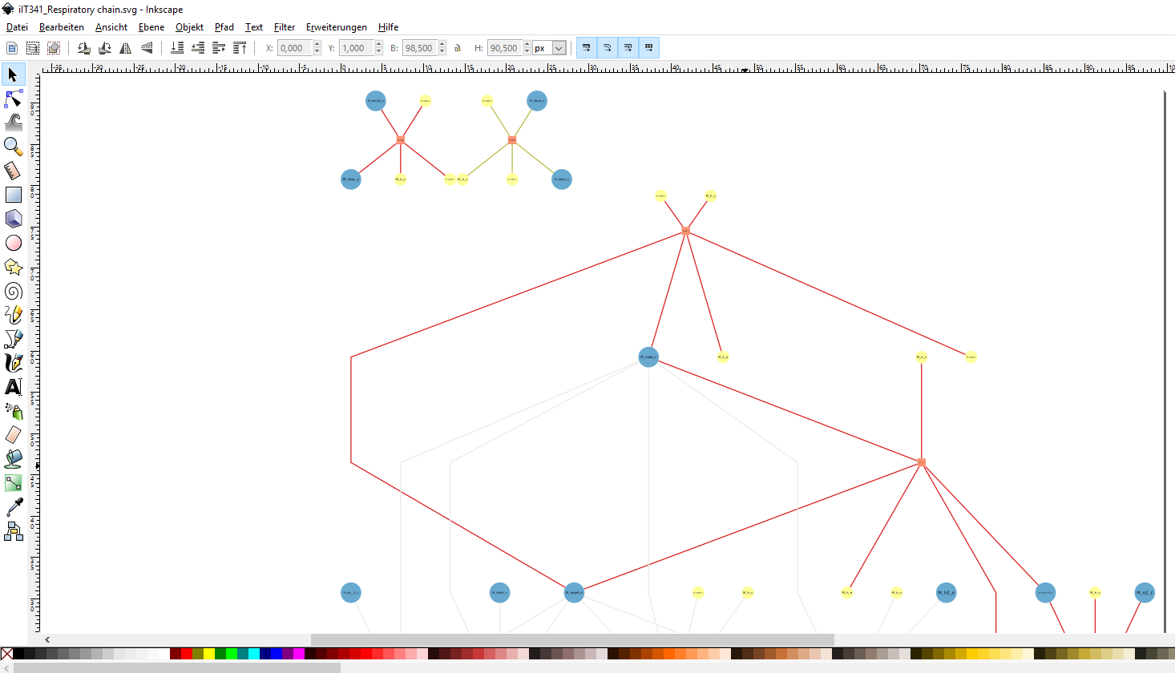
SVG output in Inkscape
Notes:
only rendered respiratory chain for performance reasons

Slide 17
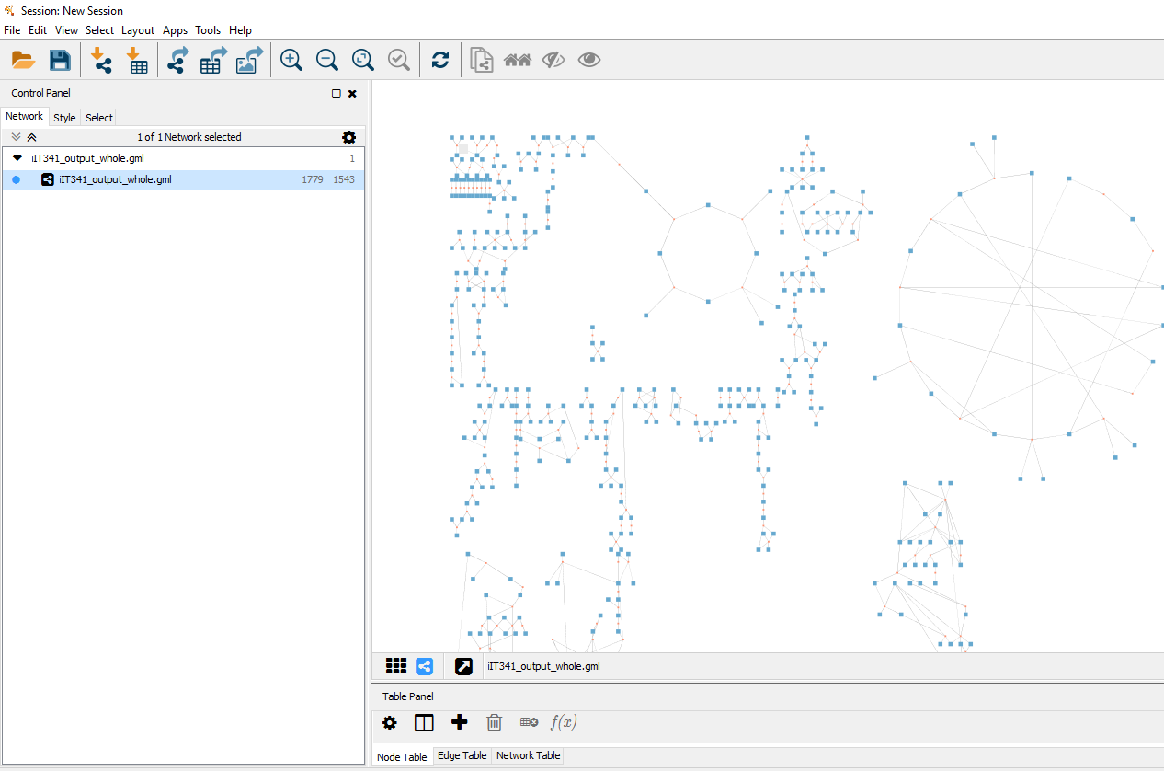
import GML file in Cytoscape

Slide 18
CBMViz Features (so far)
separation of layout and rendering information!
-> layout once, render many different parts with different configurations!
all generated information stored in SQLite database
-> compatibility with other graph visualization libraries (NetworkX, d3, Plotly, etc.)

Slide 19
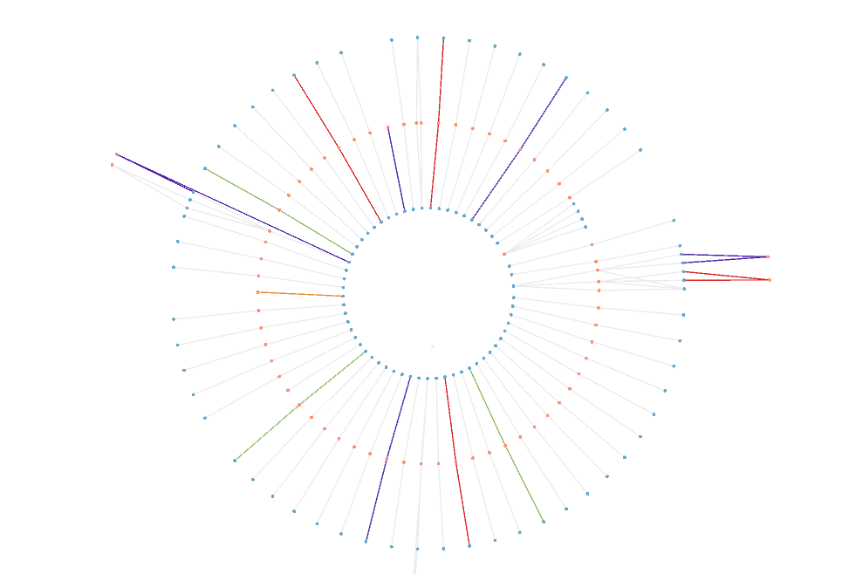
radial layout of all transport reactions in iIT341
render only part of the network in a specified way

Slide 20
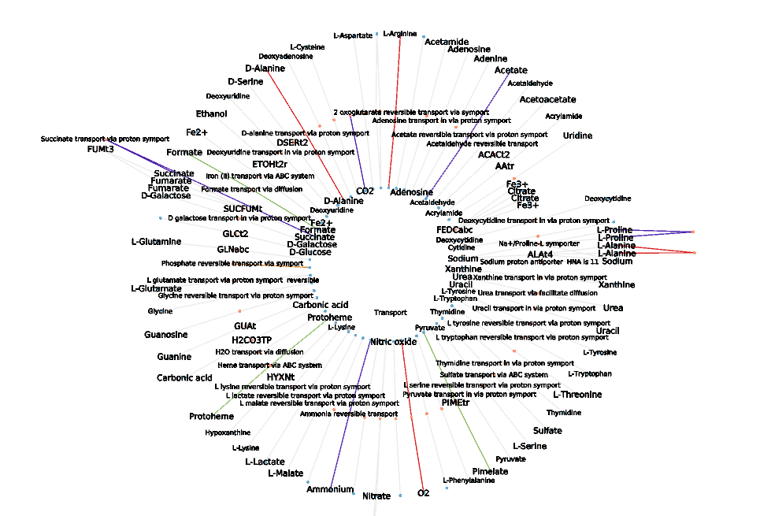
radial layout of all transport reactions in iIT341
render only part of the network in a specified way

Slide 21
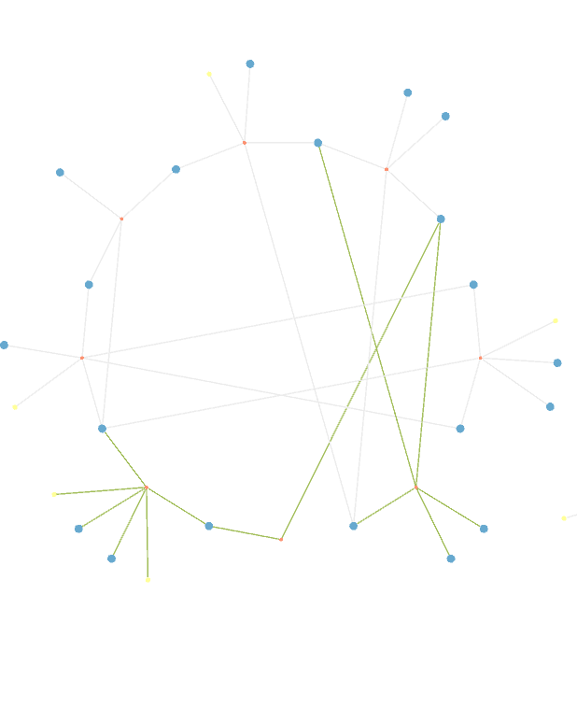
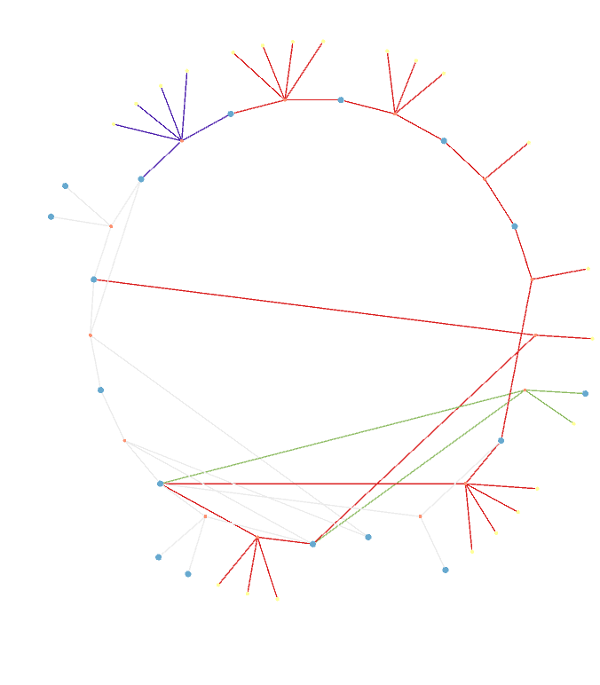
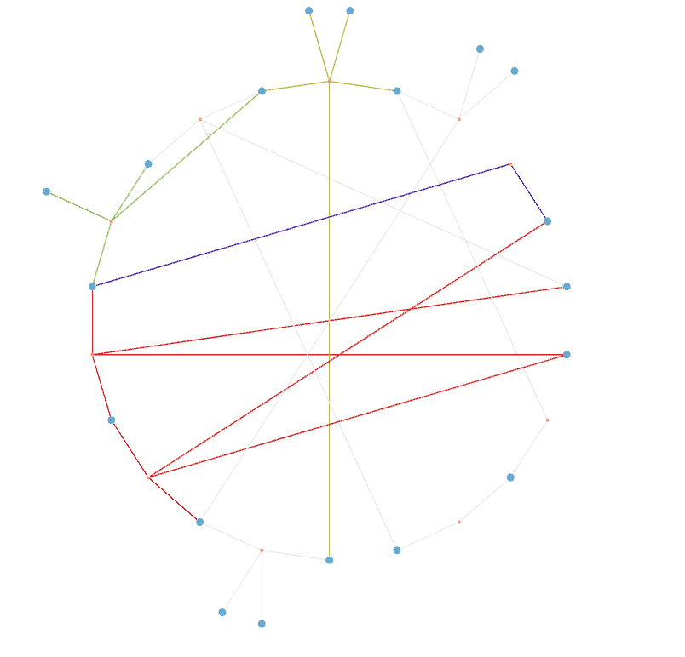
S. cerevisiae (iND750)
E. coli (iJ01366)
H.pylori (iIT341)
TCA in three different organisms with flux values

Slide 22
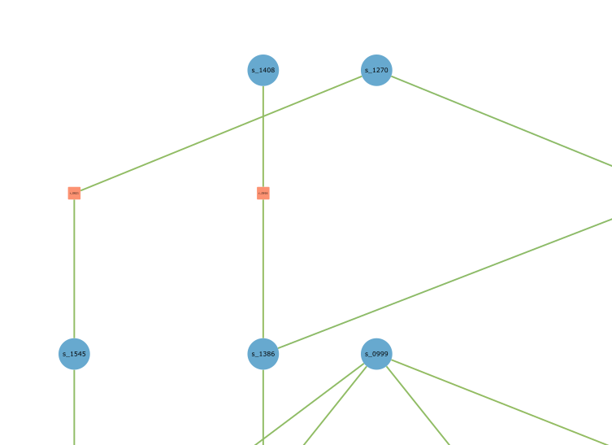
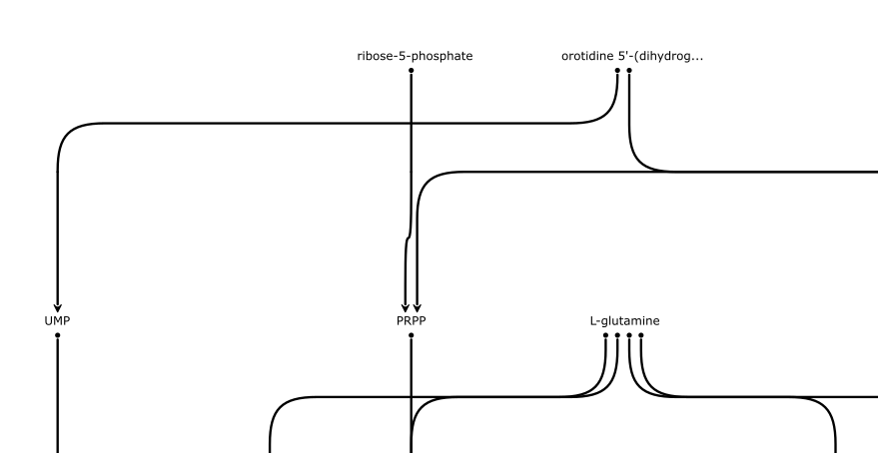
Use Case: Stijn
Layout nucleotide reactions from yeast model Y5
- CBMViz: Y5 SBML file → layout and export only specified pathway
- JSON file as input for Stijns script
JSON
(Layout)
Notes:
show my output svg corresponding to the JSON I gave to Stijn
add image of Stijns svg output which he generated by reading in a JSON file generated by CBMViz

Slide 23
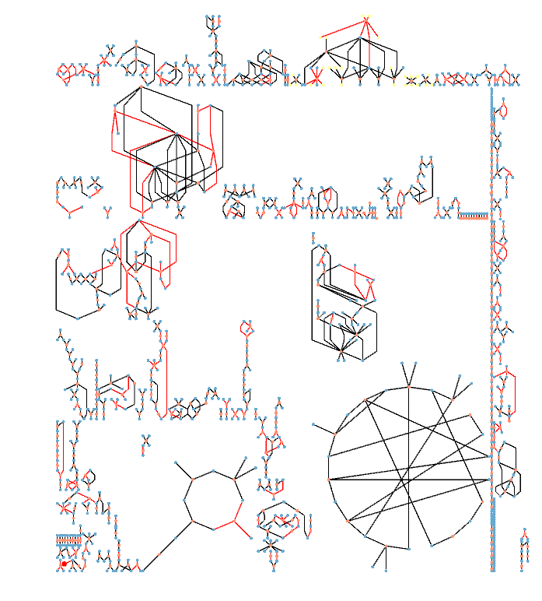
Use Case: Willi
Compare models:
highlight reactions
only existing in main model (gaps)
layout main model
get list of reaction ids
from sub model
apply coloring algorithm
→ visual gap filling!
Notes:
TODO: replace H.pylori test case with Lac. plantarum model (if it looks good with defined groups)
show different M5_M6 visualizations (groups, auto, compartments)
show which reactions in the output files are also in the template models (implement new coloring mode for that)
- > use black for reactions that exist in both and red for ones that don't

Slide 24
Use Case: Frank
visualize elementary flux modes (EFMs)
which steps where necessary?
Notes:
TODO: visualize elementary flux modes and biomass (radially like transport reactions?)

Slide 25


Slide 26




Credits
CBMViz was based on and uses some functions from Mimoza,
a metabolic model visualization and navigation system, developed by Anna Zhukova
github.com/annazhukova/mimoza
mimoza.bordeaux.inria.fr
Zhukova, A., Sherman, D. J. (2015) Mimoza: Web-Based Semantic Zooming and Navigation in Metabolic Networks
BMC Systems Biology, 9:10 doi:10.1186/s12918-015-0151-5
Notes:
National Institute for Research in Computer Science and Control (INRIA), the University of Bordeaux
INRIA (Institut National de Recherche en Informatique et en Automatique)

Slide 27
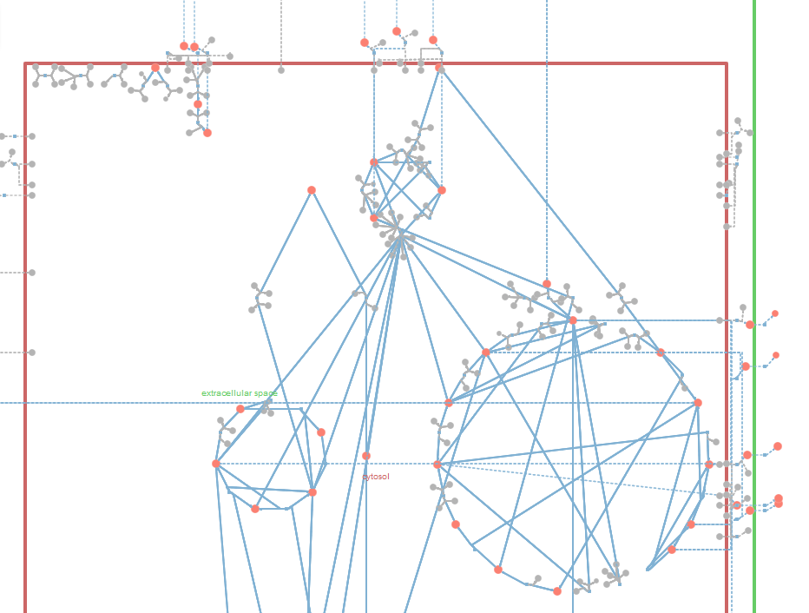
Mimoza
E. coli, core model
72 species
generates structured layout for small models

Slide 28
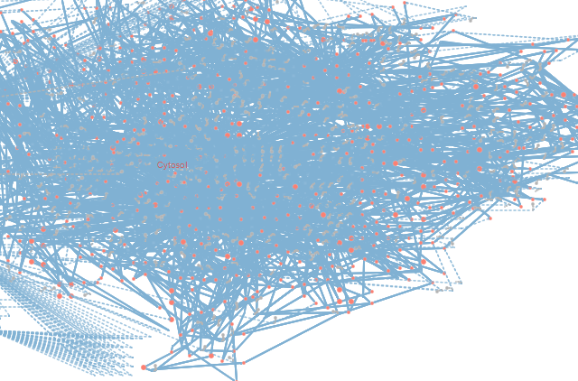
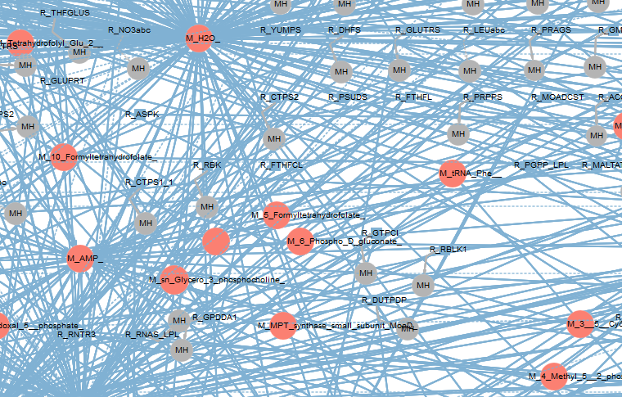
Mimoza
L. plantarum, genome-scale
775 species
(WCFS1)
Notes:
L. plantarum = Lactobacillus plantarum

Slide 29
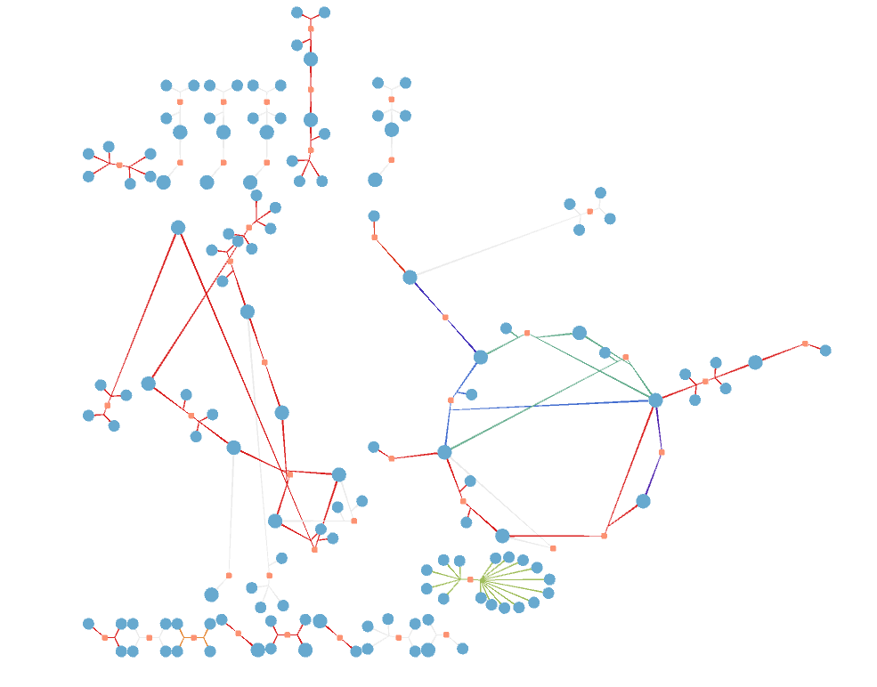
CBMViz
E. coli, core model
46 species
(Carlson model)
Layout without predefined groups
based on connectivity
(and autom. cycle detection)
Notes:
without groups, layout based only on connectivity

Slide 30
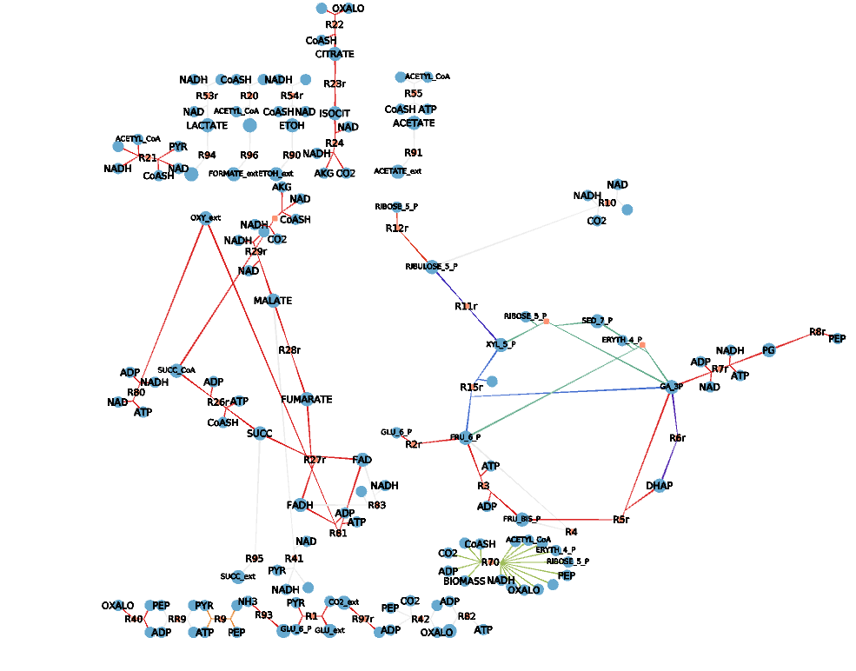
CBMViz
E. coli, core model
46 species
(Carlson model)
Layout without predefined groups
based on connectivity
(and autom. cycle detection)
Notes:
without groups, layout based only on connectivity

Slide 31
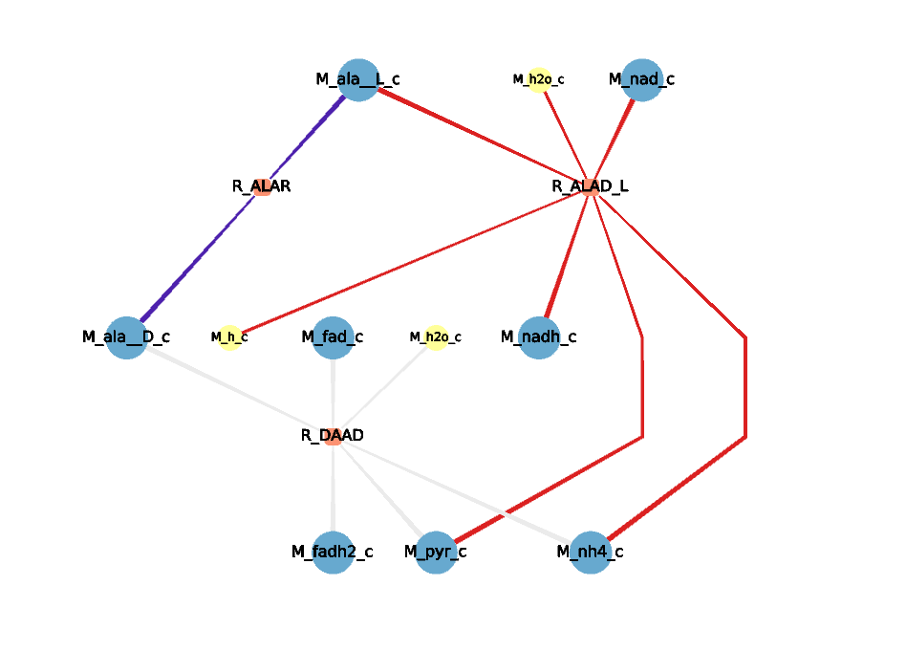
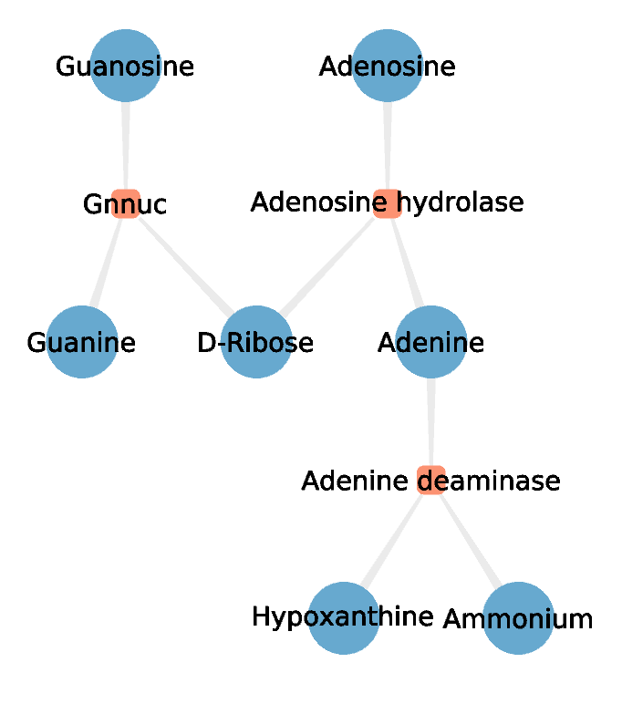
Alanine Metabolism (H.pylori, iIT341)
Purine Metabolism (H.pylori, iIT341)
- choose id or name for labels
- show/hide defined cofactors
- …
Notes:
Additonal Rendering Options

