Slide 1
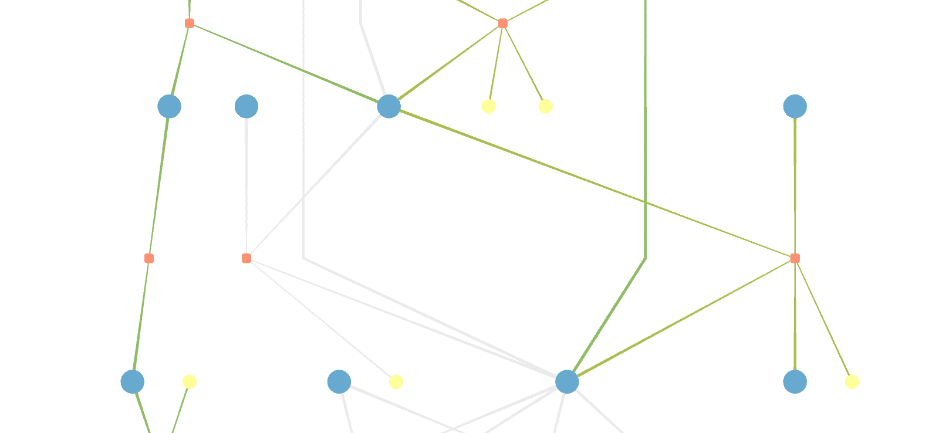
MetaViz
Metabolic Network Maps
Practical, Nicolas Huber
Supervisors: Prof. Bas Teusink, Dr. Brett Olivier

Slide 2
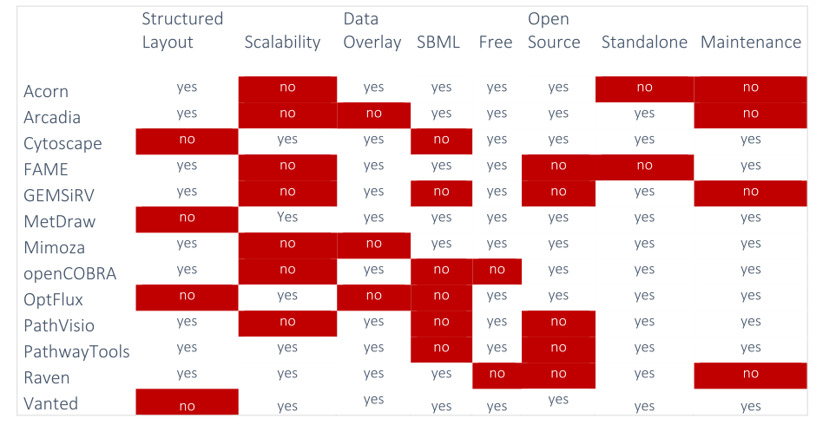
Why develop another tool?

Slide 3
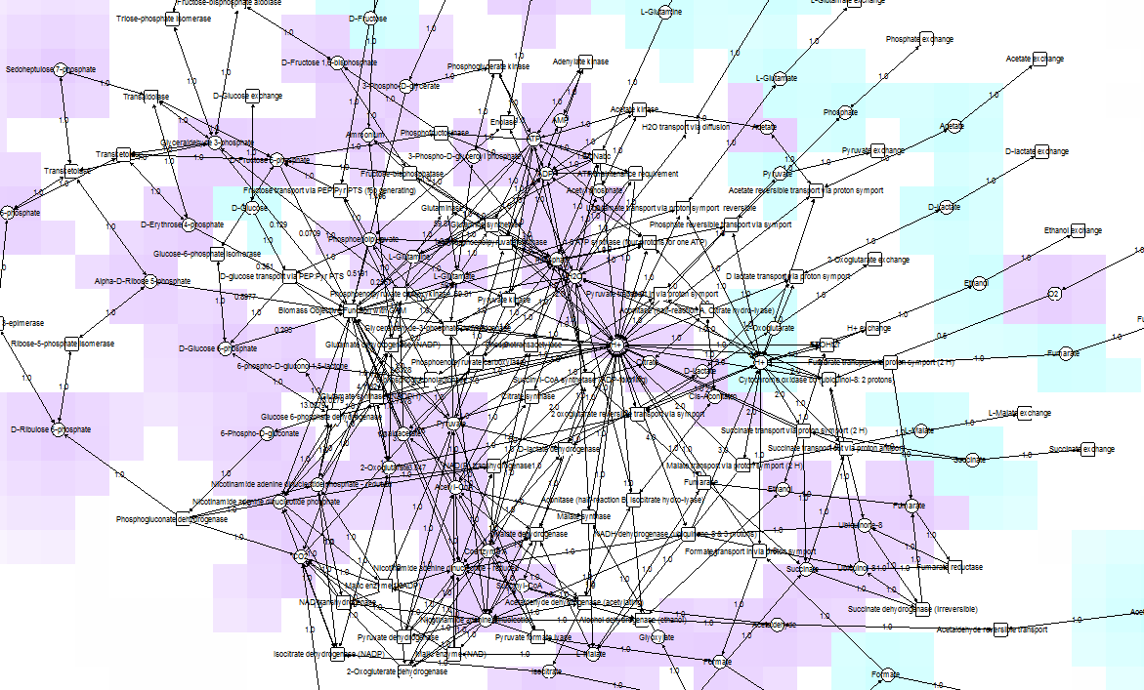
Vanted
E. coli, core model
72 species

Slide 4
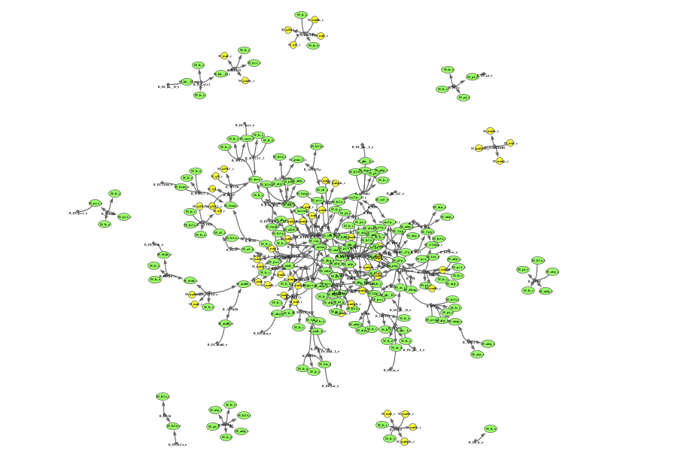
OptFlux
E. coli, core model
72 species

Slide 5
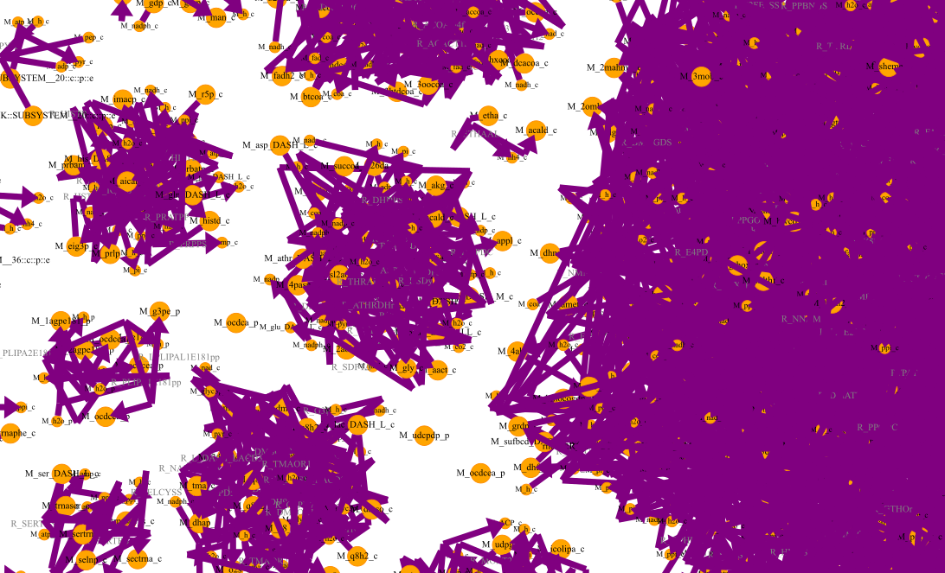
MetDraw
E. coli, genome-scale model
1367 species
(iJO1366)
automatic layout algorithms generate messy "hairballs"!
<->
manual layouting takes away valuable time!

Slide 6
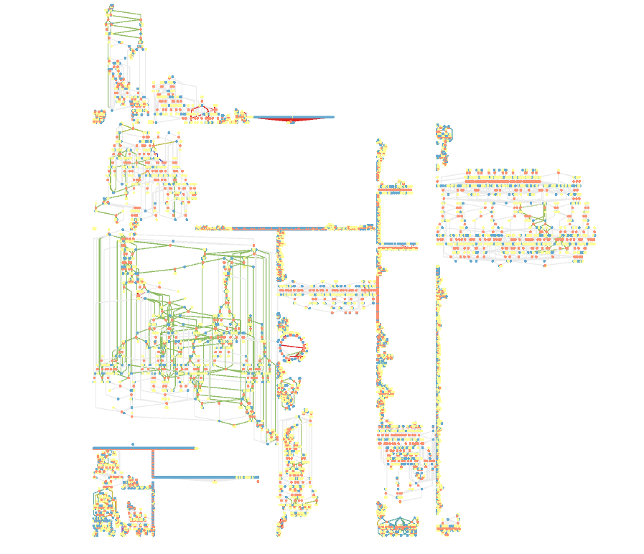
MetaViz
E. coli, genome-scale model
1367 species
(iJO1366)

Slide 7
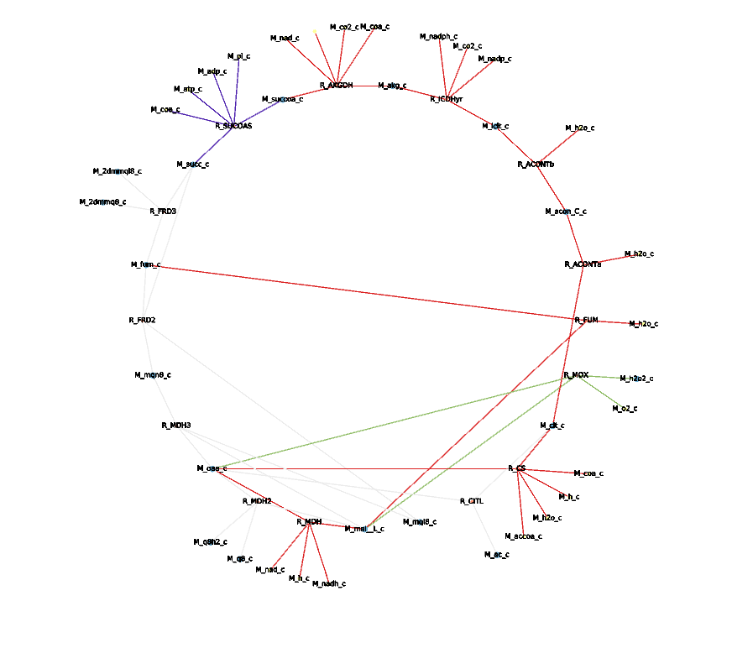
MetaViz
E. coli, genome-scale model
1367 species
(iJO1366)

Slide 8
MetaViz Features (so far)
only input: SBML level 3 file (groups annotation optional)
if no groups defined:
  clone parts of the network based on connectivity
  automatically detect cycles
if groups defined:
  layout pathways individually
  (TCA: circular, Glycolysis: linear, etc.)
Notes:
if nor groups -> identify highly connected nodes and alias/clone them

Slide 9
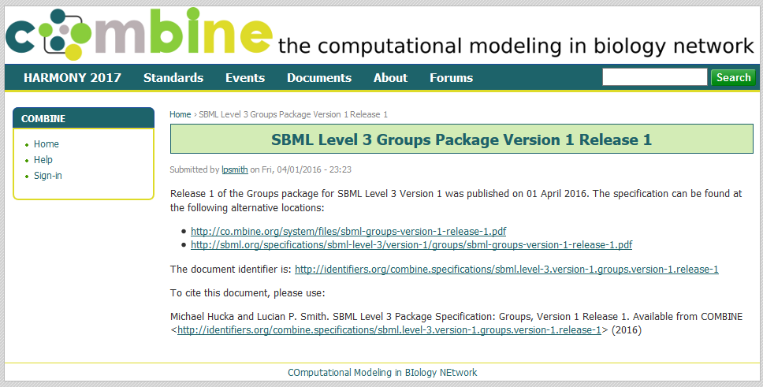
What are groups?
- groups are sets of reaction ids (of a compartment, a pathway, etc. … )
- defining groups (with CBMPY) will add a list of groups and their elements to the SBML file
Notes:
new extension for sbml level 3

Slide 10
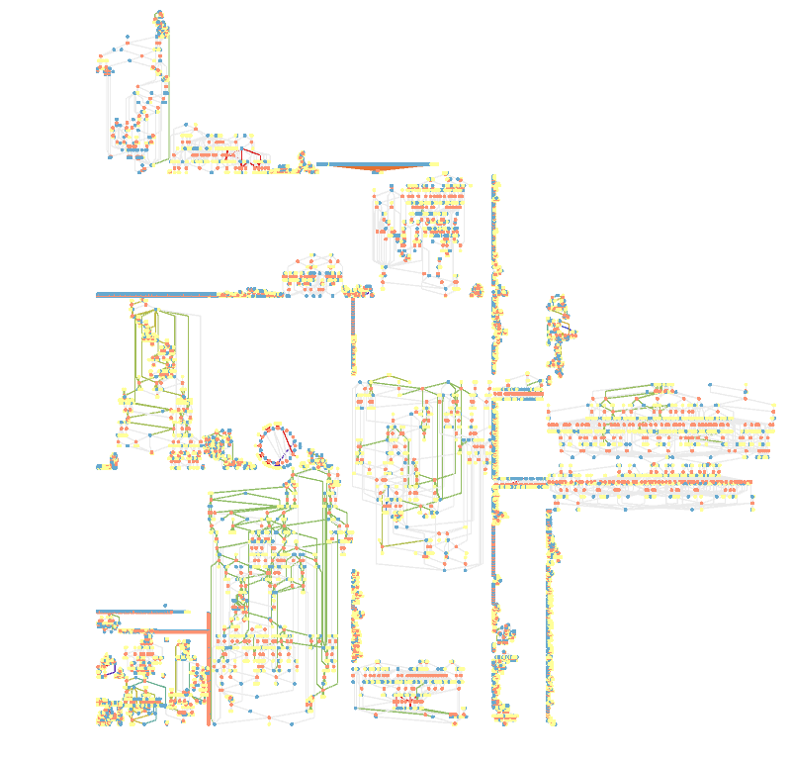
MetaViz
E. coli, genome-scale model
1668 species
(iAF1260)
Pentose Phosphate Pathway
Glycine Serine Metabolism

Slide 11
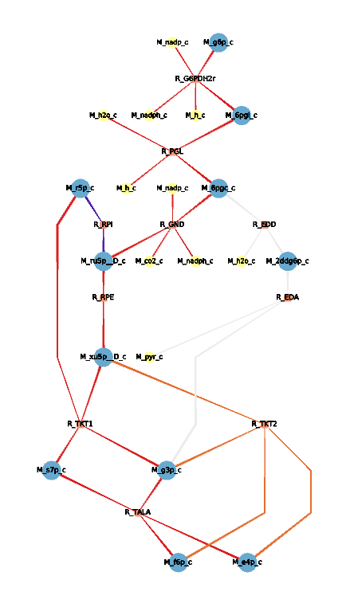
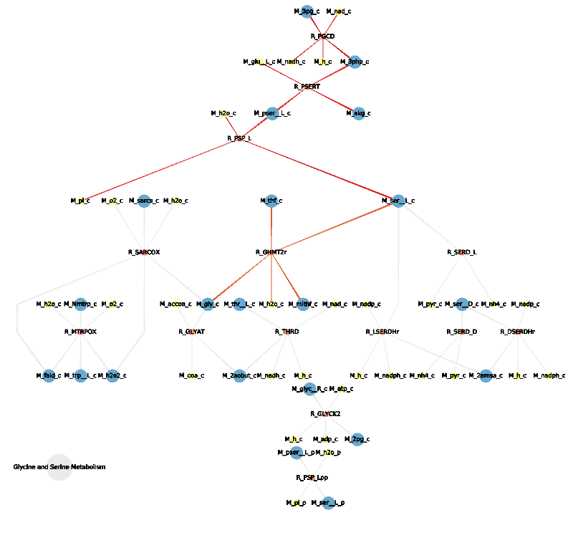
Pentose Phosphate Pathway
Glycine and Serine Metabolism

Slide 12
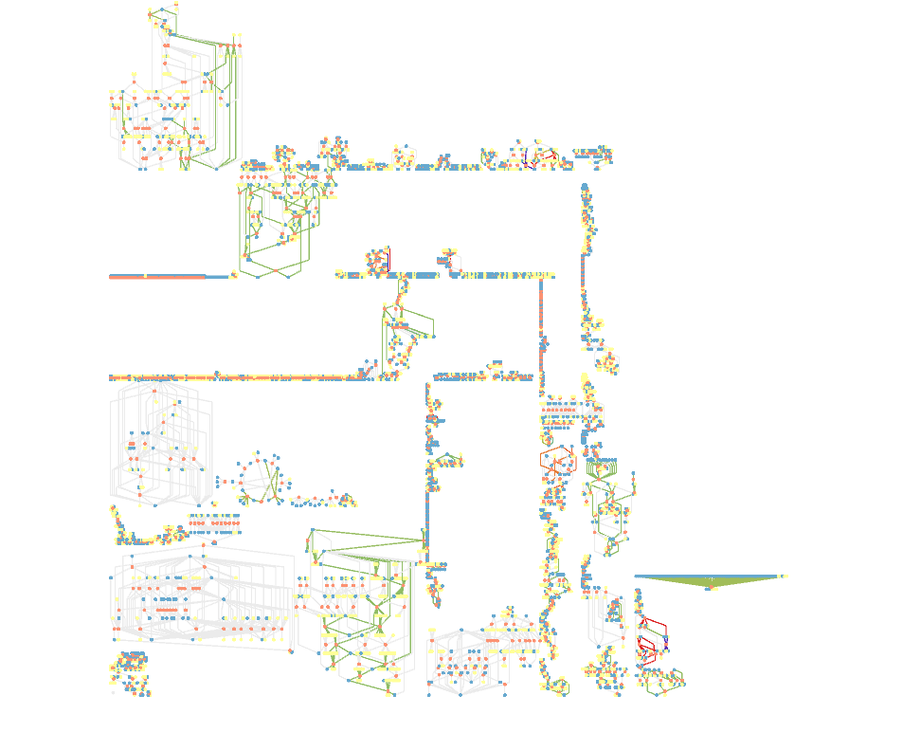
MetaViz
S. cerevisiae, genome-scale model
1059 species
(iND750)
Glycoprotein Metabolism
Oxidative Phosphorylation

Slide 13
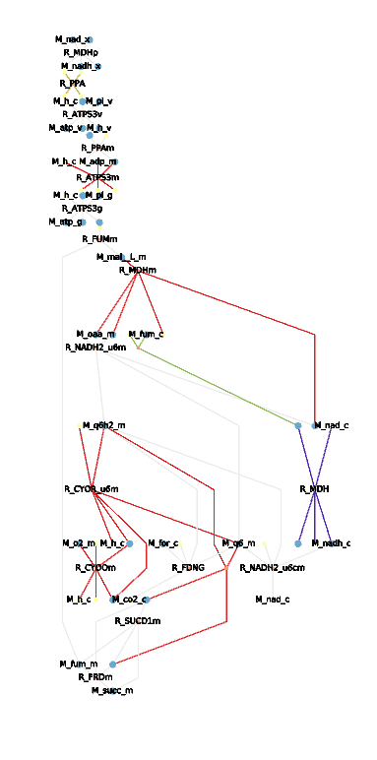
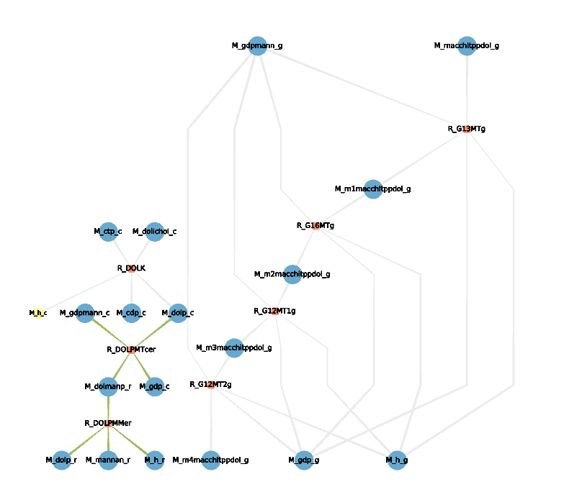
MetaViz
E. coli, genome-scale model
1367 species
(iJO1366)
Glycoprotein Metabolism
Oxidative Phosphorylation

Slide 14
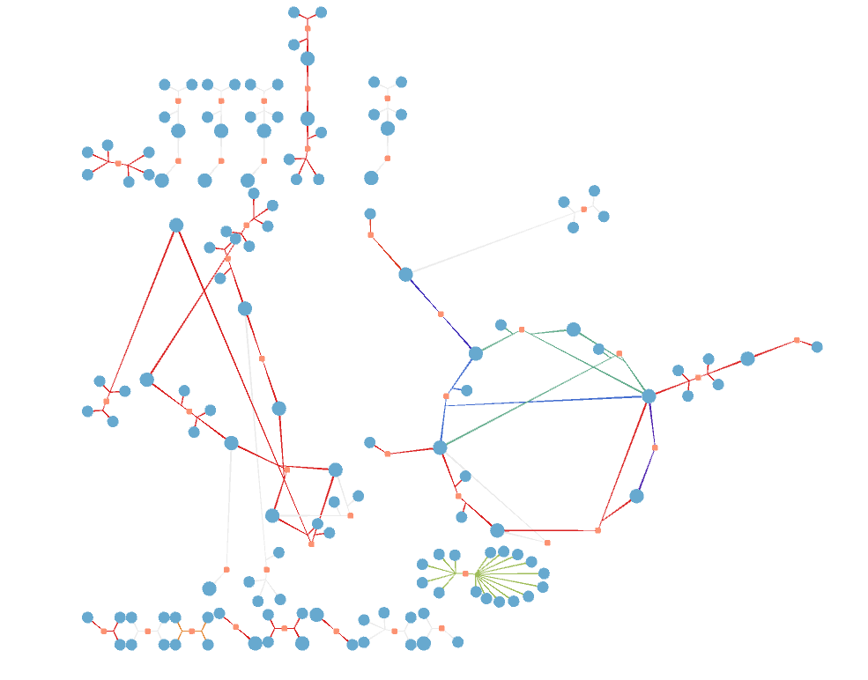
MetaViz
E. coli, core model
46 species
(Carlson model)
Layout without predefined groups
based on connectivity
(and autom. cycle detection)
Notes:
without groups, layout based only on connectivity

Slide 15
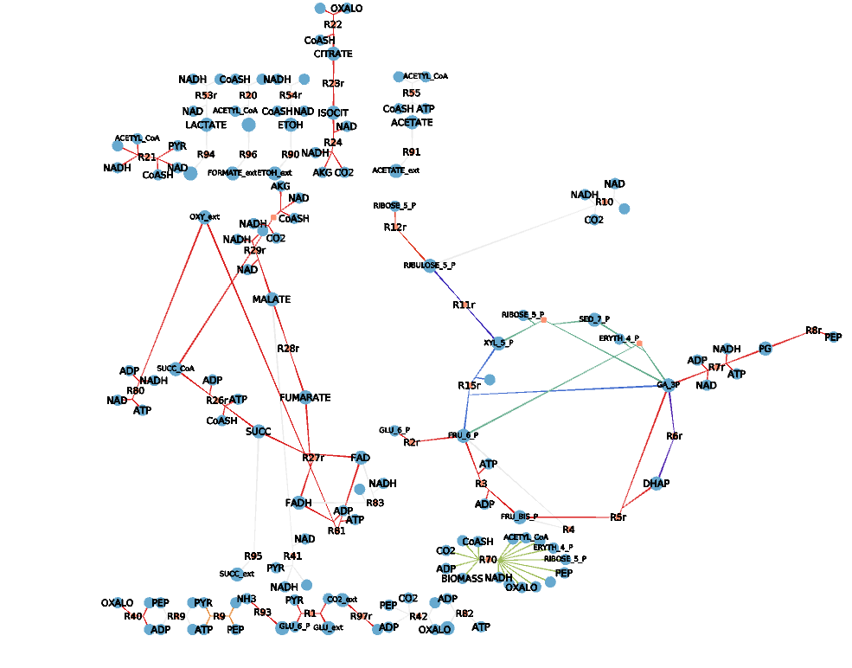
MetaViz
E. coli, core model
46 species
(Carlson model)
Layout without predefined groups
based on connectivity
(and autom. cycle detection)
Notes:
without groups, layout based only on connectivity

Slide 16
MetaViz Features (so far)
multiple coloring options
(overlay flux data, highlight pathways, etc.)
multiple output options:
  SVG
  JSON
  GML
  SBML with Layout Plugin
  SBGN
  Tulip graph file (.tlp)

Slide 17
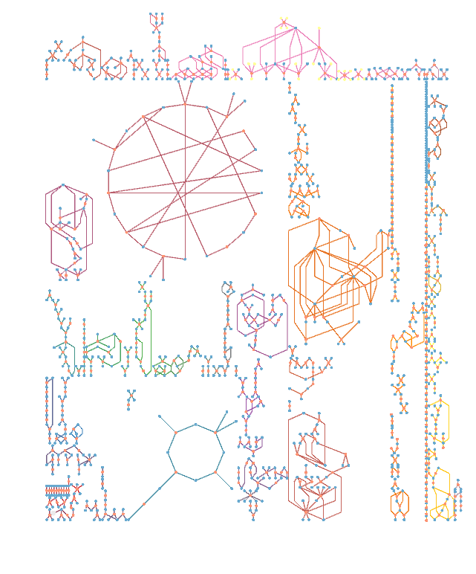
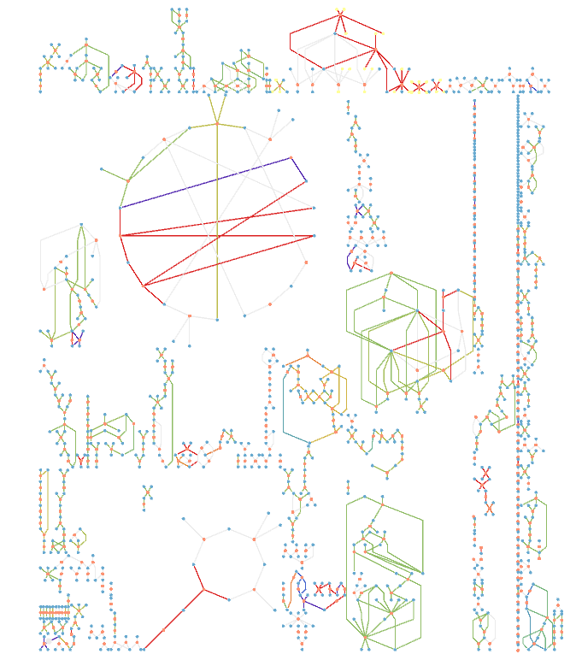
Pathway coloring
Flux coloring
Notes:
Model: iIT341
Organism:
Helicobacter pylori 26695
Genome:
NC_000915.1
Model metrics:
Component Count Metabolites485 Reactions554 Genes339

Slide 18
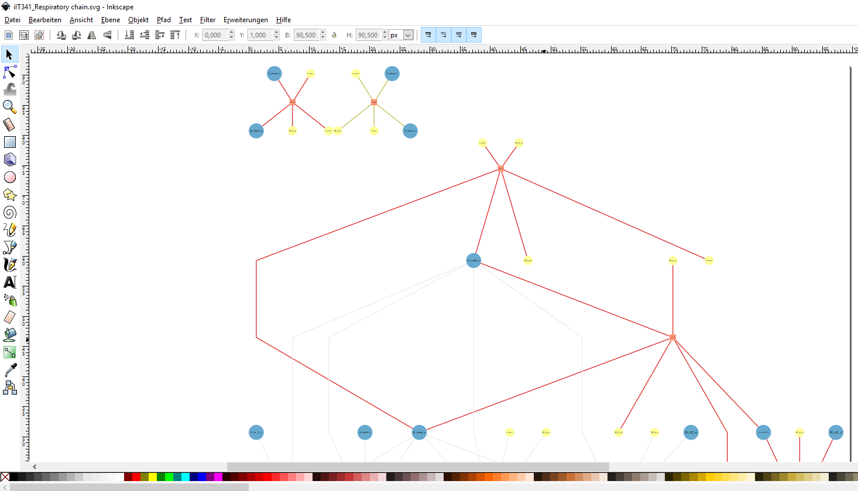
SVG output in Inkscape
Notes:
only rendered respiratory chain for performance reasons

Slide 19
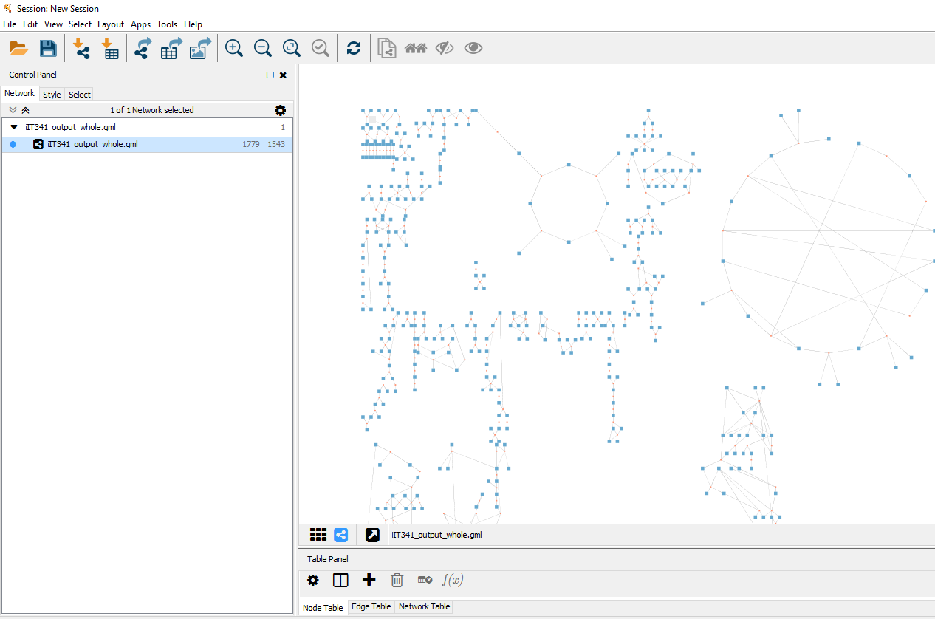
import GML file in Cytoscape

Slide 20
MetaViz Features (so far)
separation of layout and rendering information!
-> layout once, render many different parts with different configurations!
all generated information stored in SQLite database
-> compatibility with other graph visualization libraries (NetworkX, d3, Plotly, etc.)

Slide 21
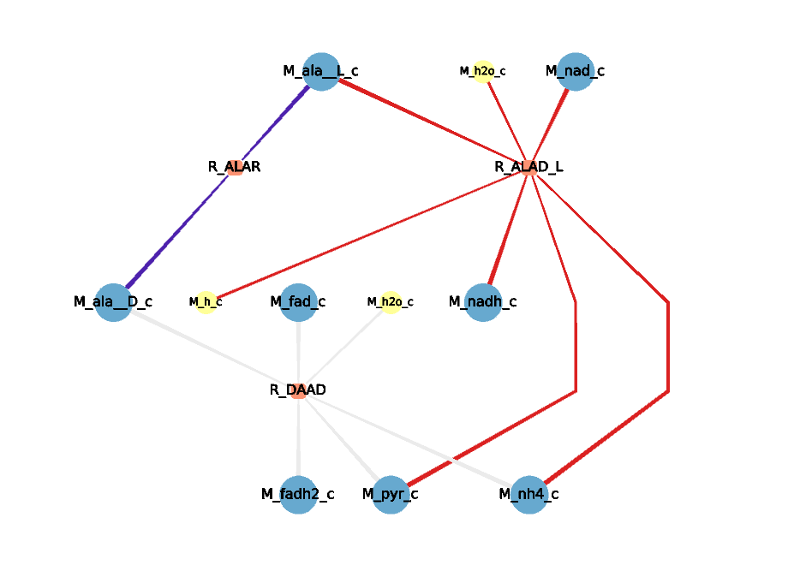
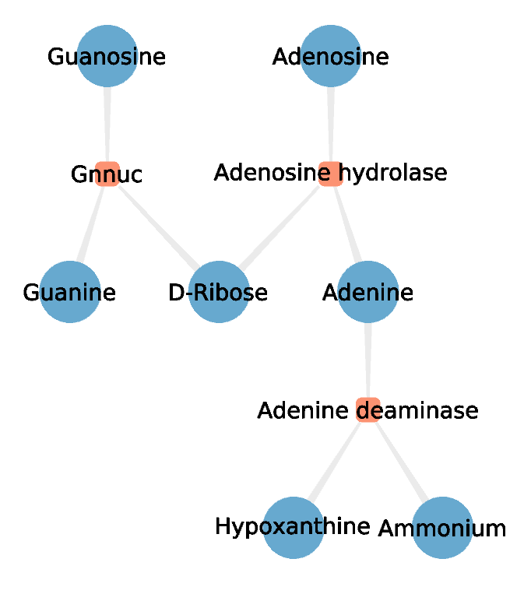
Alanine Metabolism (H.pylori, iIT341)
Purine Metabolism (H.pylori, iIT341)
- choose id or name for labels
- show/hide defined cofactors
- …

Slide 22
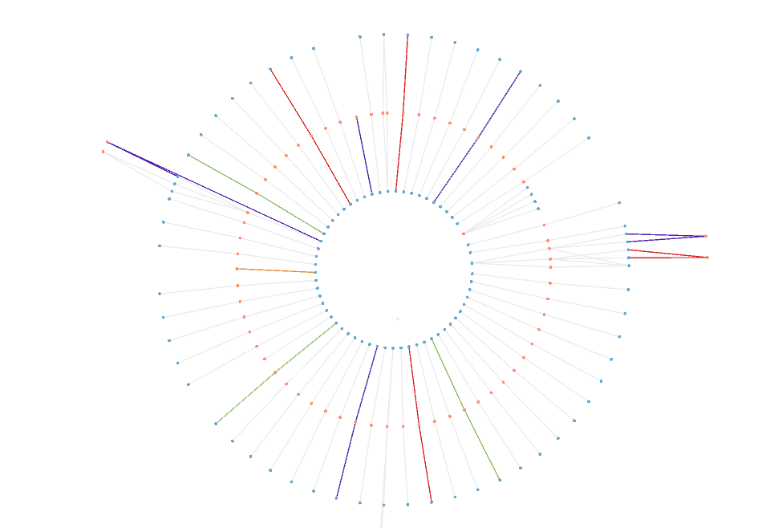
radial layout of all transport reactions in iIT341
render only part of the network in a specified way

Slide 23
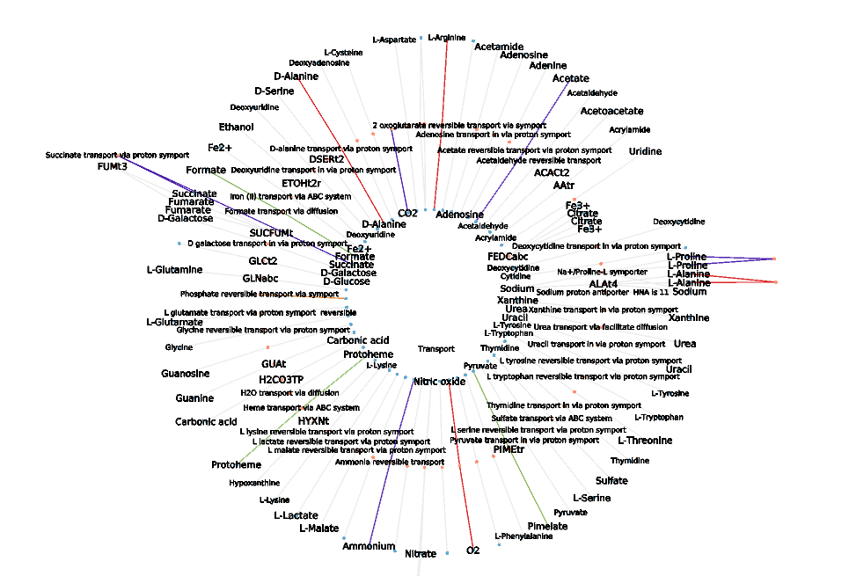
radial layout of all transport reactions in iIT341
render only part of the network in a specified way

Slide 24
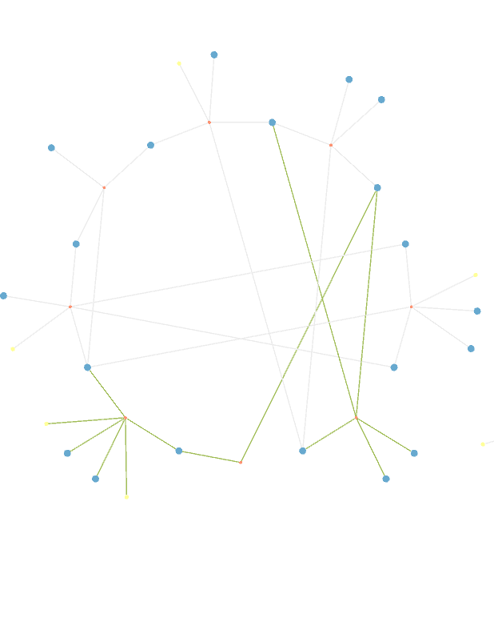
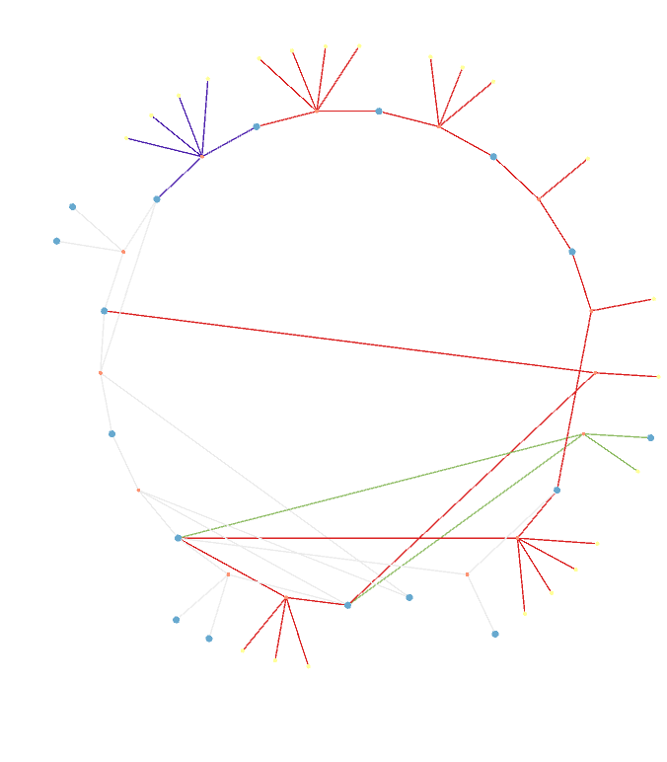
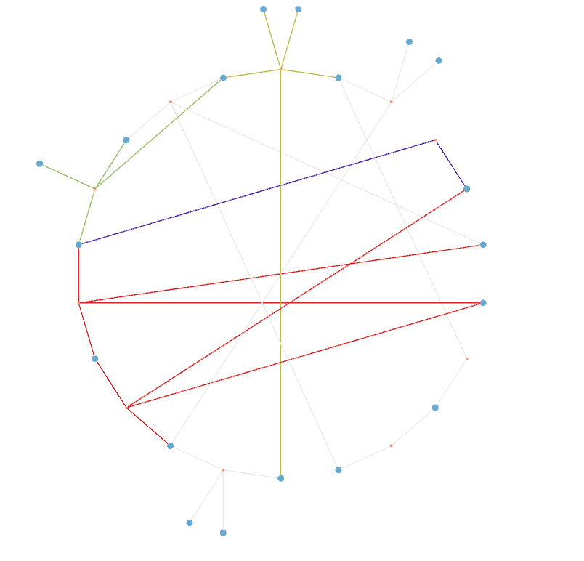
S. cerevisiae (iND750)
E. coli (iJ01366)
H.pylori (iIT341)
TCA in three different organisms with flux values

Slide 25
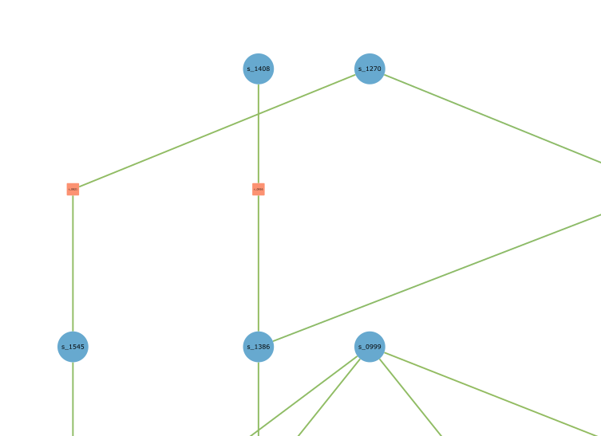
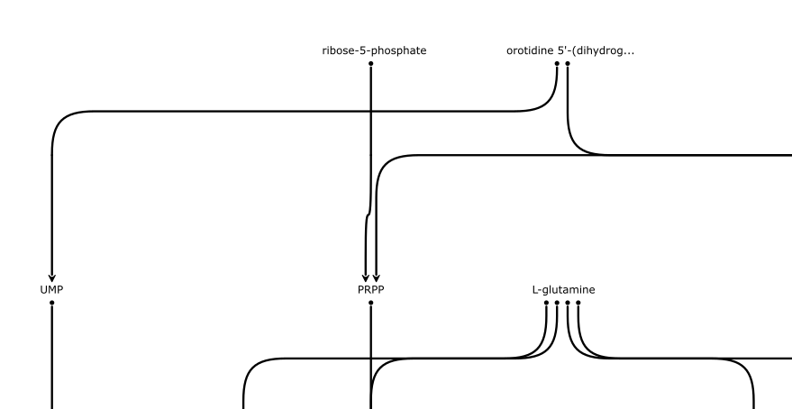
Use Case: Stijn
Layout nucleotide reactions from yeast model Y5
1.) MetaViz: Y5 SBML file → SVG and JSON files containing layout
2.) JSON file as input for Stijn script
JSON
(Layout)
Notes:
show my output svg corresponding to the JSON I gave to Stijn
add image of Stijns svg output which he generated by reading in a JSON file generated by MetaViz

Slide 26
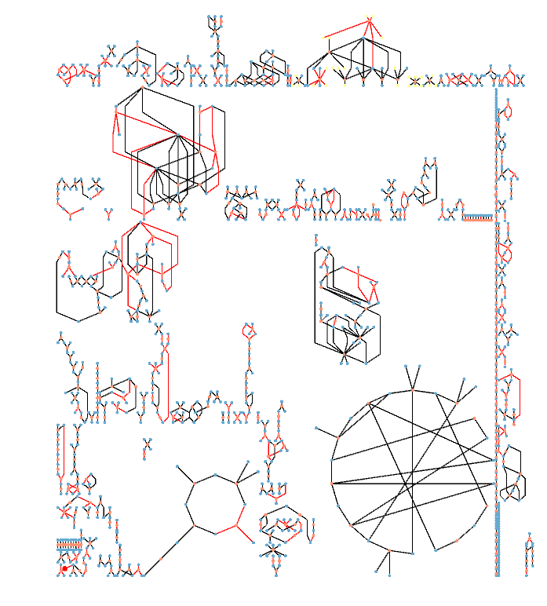
Use Case: Willi
Compare models:
highlight reactions
only existing in main model (gaps)
layout main model
get list of reaction ids
from sub model
apply coloring algorithm
→ visual gap filling!
Notes:
show different M5_M6 visualizations (groups, auto, compartments)
show which reactions in the output files are also in the template models (implement new coloring mode for that)
- > use black for reactions that exist in both and red for ones that don't

Slide 27
