Slide 1

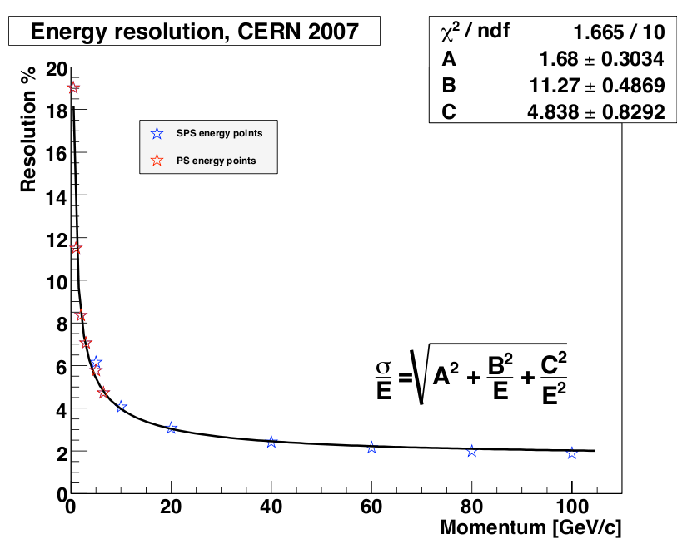
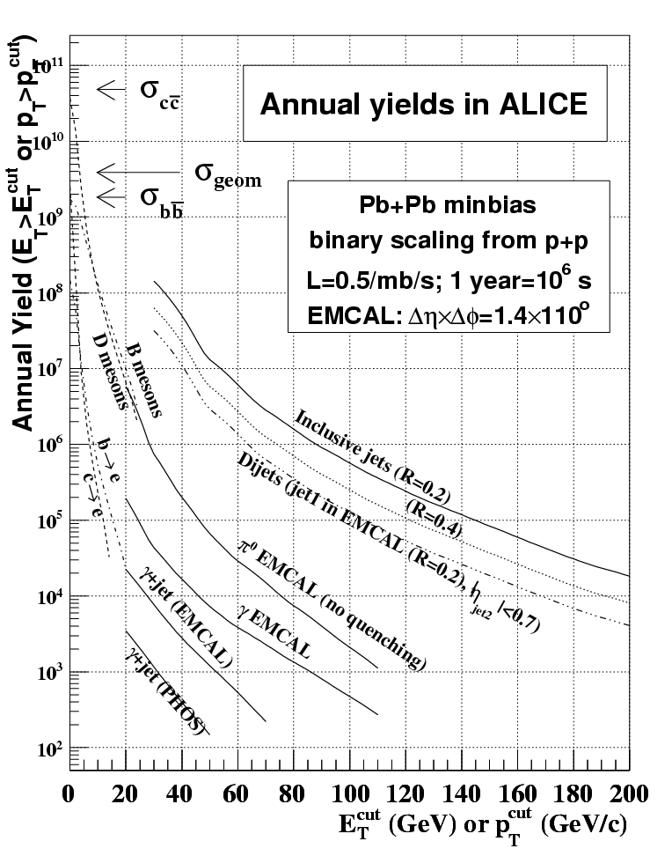
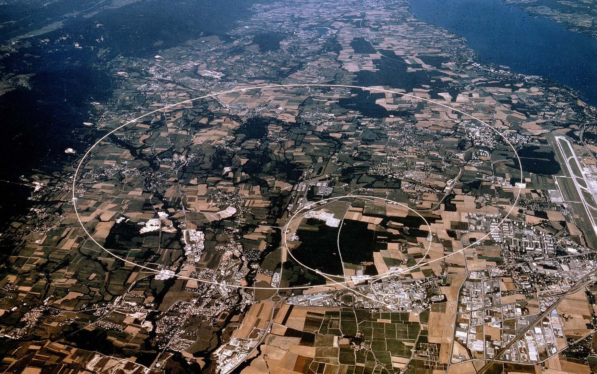
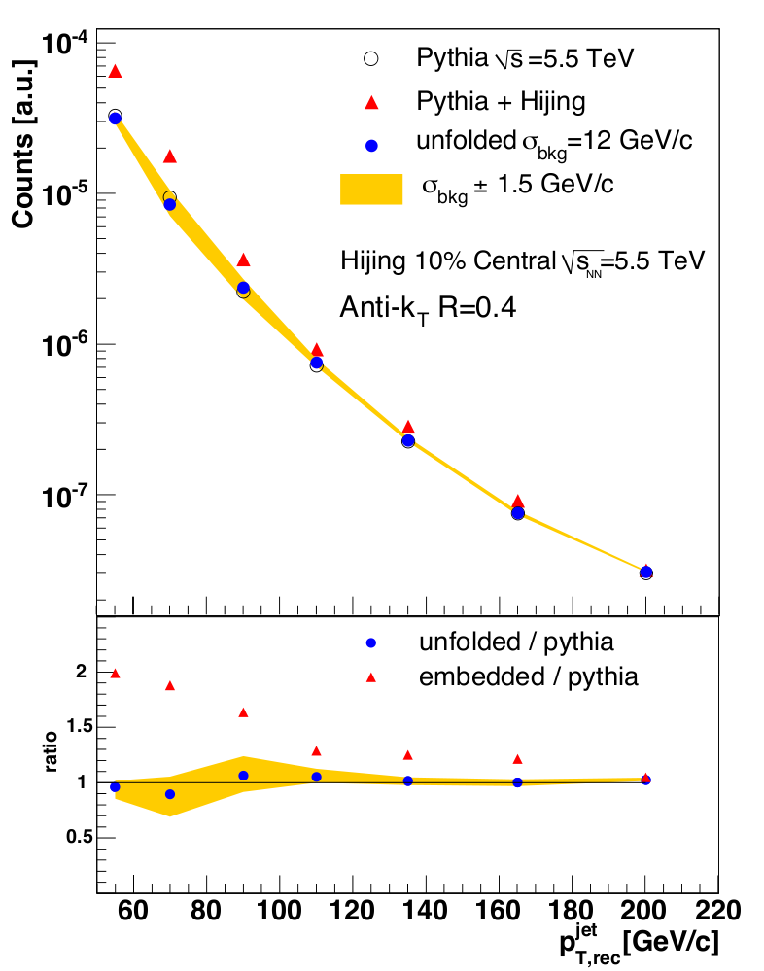
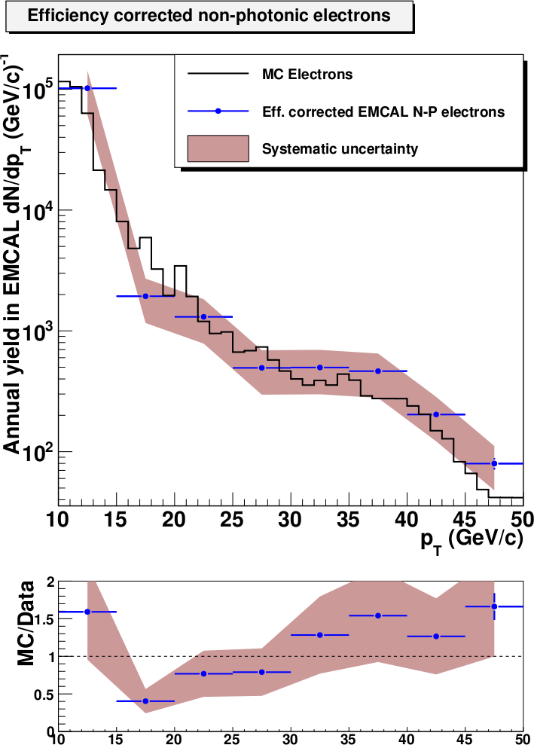
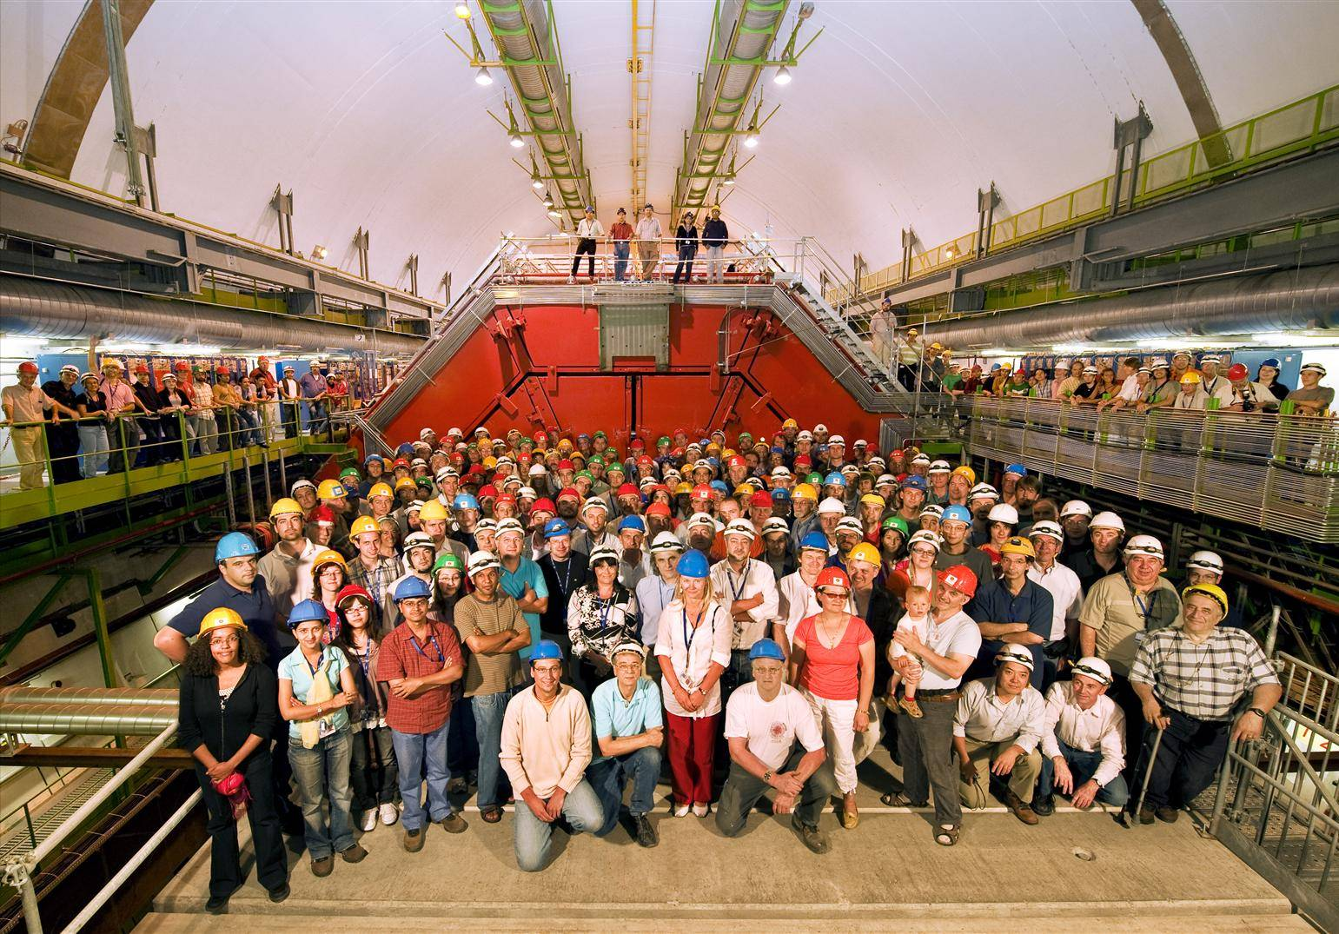
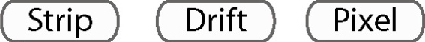



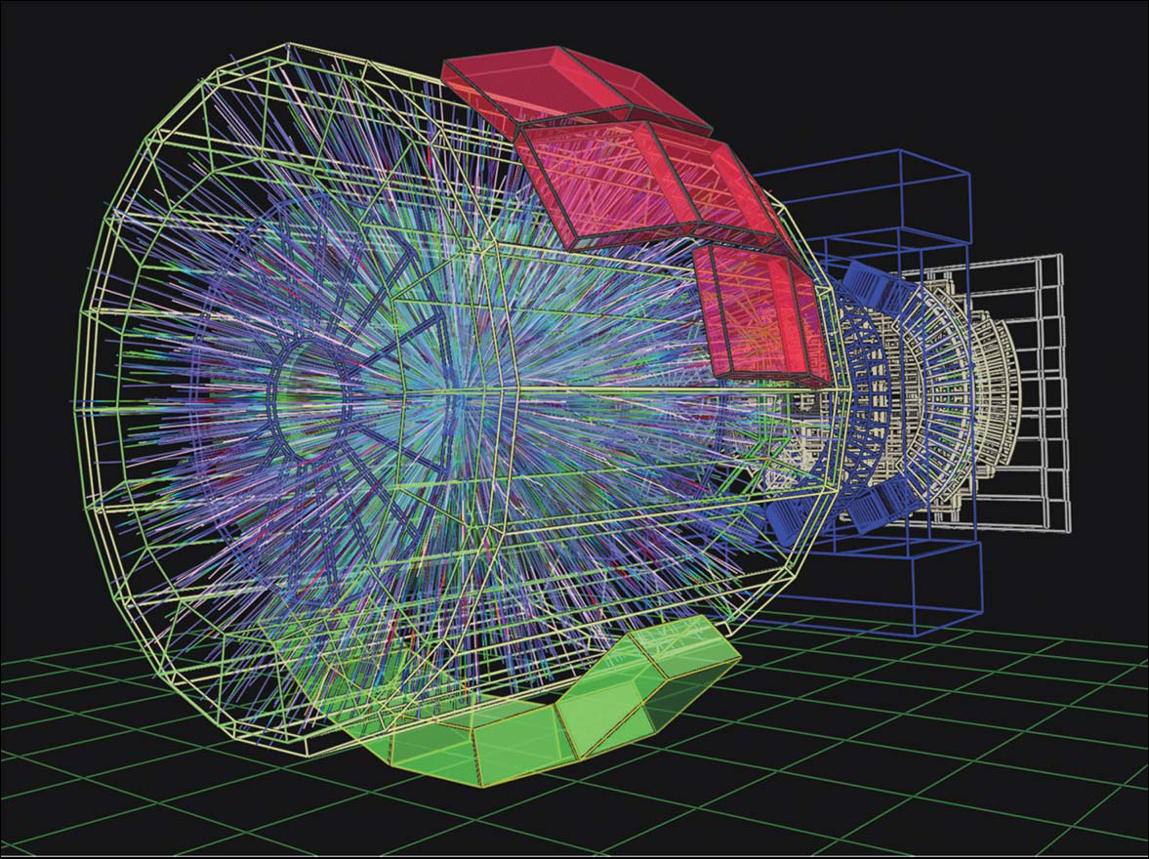
Studies of high energy nuclear collisions at ORNL/UT
Christine Nattrass (University of Tennessee at Knoxville)
The search for the Quark Gluon Plasma
The Electromagnetic Calorimeter
early universe
QCD predicts a phase transition in nuclear matter at high energy densities. This matter, called Quark Gluon Plasma (QGP), should have very different properties from normal nuclear matter due to the high temperature and densities. This dense, hot nuclear matter should have much more in common with the matter created after the Big Bang than nuclear matter at normal densities.
ORNL and UT has actively collaborated in the search for the Quark Gluon Plasma for more than 25 years. Members of ORNL's Physics Division (Terry Awes, Yuri Efremenko, Robert Ferguson, Felix Obenshain, Frank Plasil, Ken Read, David Silvermyr, Paul Stankus, Vince Cianciolo and Glenn Young) and UT's
The Electromagnetic Calorimeter (EMCal) is a Shashlik calorimeter. It is a layered Pb-scintillator sampling calorimeter with a longitudinal pitch of 1.44mm of Pb and 1.76mm of scintillator. It is segmented into 12,288 towers, each with 6cmX6cm of active volume. Fluctuations in the gain due to temperature variations are taken into account by an LED calibration system, which allows calibration events interspersed with collision data.
The energy resolution, as measured in a test beam at CERN, is shown to the right. The EMCal will allow the measurement of electromagnetic probes over a wide kinematic range.
250
quark-gluon plasma
200
Chemical Temperature Tch [MeV]
150
Lattice QCD
SPS
AGS
deconfinement
chiral restauration
100
hadron gas
SIS
50
atomic nuclei
Energy resolution as a function of the incident beam momentum
0
0
200
400
600
800
1000
1200
Baryonic Potential μ_{B} [MeV]
The EMCal was designed to measure π⁰, γ, e±, and jets in a heavy ion environment. The figure to the left shows the number of some of these probes expected from a month of dedicated Pb-Pb collisions, the amount anticipated in a typical year of running at the LHC. It shows that the kinematic reach expected from the first year of Pb-Pb running is quite good.
The group at UT and ORNL will focus on measurements of both jets and electrons from heavy flavor decays. In p+p and e⁻+e⁻, showers of particles called jets are created when two partons (quarks or gluons) suffer a hard (high momentum transfer) collision. The partons may interact in the medium, so the modification of the jet spectrum in Pb-Pb relative to p-p can be used to measure the opacity of the medium. Heavy flavor (charm and bottom quarks) is also produced early in the collision by hard parton collisions. This means that heavy quarks will have propagated through the medium, providing a good probe of the QGP.
Figure 1: The phase diagram of nuclear matter
Department of Physics (Ken Read, Soren Sorensen, and a host of students) together with more than a dozen post-docs from both institutions have together done experiments at the CERN SPS accelerator in the WA80/93/98 collaboration, at the BNL RHIC accelerator in the PHENIX collaboration, and now at the CERN LHC in the ALICE collaboration. Many ORNL staff members in several divisions have been responsible for the design and construction of several large scale detectors within this program and close to $20M worth of electronics. A scientific highlight of this research was the joint announcement of all the four RHIC experiments in 2005 (??) of the unambiguous discovery of the Quark Gluon Plasma together with the surprising finding that the plasma did not behave like at gas, but like the most superfluid liquid ever observed.
The Large Hadron Collider
The Large Hadron Collider (LHC) is a synchrotron collider, the largest and highest energy collider in the world. The LHC can collide protons at a center of mass energy of up to 14 TeV and lead nuclei up to a center of mass energy per nucleon of up to 5.5 TeV. The first collisions at the LHC were at the injection energy, 900 GeV, on November 23, 2009. Since then, the LHC has produced collisions at 2.36 TeV and 7 TeV. The first Pb-Pb collisions are expected in November 2010.
CMS
TOTEM
LHCb
ATLAS
Jets as a
probe of the QGP
Heavy flavor as a probe of the QGP
ALICE
LHCf
A Large Ion Collider Experiment
~1000 | Members 63% from CERN member states
~30 | Countries
~100 | Institutes
~150 | MCHF capital cost (+magnet)
US ALICE
11 Institutions53 members (inc. 12 grad. Students)
Cal. St. U. –San Luis Obispo, Creighton University,University of Houston, Lawrence Berkeley Nat. Lab,Lawrence Livermore Nat. Lab, Oak Ridge Nat. Lab,Ohio State University, Purdue University, University of Tennessee, Wayne State University,Yale University
A Large Ion Collider Experiment (ALICE) is a large detector with many different subdetectors. The beam pipe is surrounded by an inner tracking system comprising a pixel detector, a silicon drift detector, and a silicon strip detector. This surrounded the largest Time Projection Chamber (TPC) in the world, the primary tracking detector. The TPC is surrounded by a Transition Radiation Detector (TRD) and then a Time-Of-Flight (TOF) detector for particle identification. There is a High Momentum Particle Identification Detector (HMPID), a ring imaging Cherenkov counter, covering 1.2º<φ<58.8º in azimuth and |η|<0.6.
Spectrum distortion due to background fluctuations and correction via unfolding. Black: inclusive jet cross section from 5.5 TeV p-p collisions from PYTHIA. Blue: jet population embedded into central 5.5 TeV Pb-Pb events from HIJING. Red: embedded jet population after unfolding with background fluctuation width = 12 GeV. Yellow band indicates systematic variation in unfolded distribution due to variation in background fluctation = 12 1: 5 GeV. Lower panel shows ratio of both smeared and unfolded spectra to the undistorted PYTHIA spectrum.
Efficiency corrected signal of non-photonic electrons for EMCal PID compared to MC truth for bottom and W-decay electrons. Systematic errors due to varying the EMCal electron identification criteria are shown.
In a medium such as the QGP, jets, which are predominantly produced early in the collisions, must travel through this medium before detection. Since jets have been studied extensively in elementary collisions, it should be possible to determine how the properties of the medium modify the jet. The figure above shows the ratio of the jet spectrum in a simulated p-p event with the anticipated systematic error bars.
Heavy flavor hadrons are produced abundantly in p-p and Pb-Pb collisions at the LHC, allowing more precise measurements of heavy flavor in heavy ion collisions than previously available. Heavy flavor is readily measured by measuring electrons which decayed from heavy flavor electrons. This measurement has significant backgrounds from conversion electrons and Dalitz decays. The figure above shows the spectrum of electrons from heavy flavor decays with the anticipated systematic error bars.
At forward rapidities, the V0 detector consists of two arrays of scintillators on either side of the interaction point. The V0 can be used as a trigger and for determining the centrality of Pb-Pb collisions. At higher rapidity, there is a Photon Multiplicity Detector (PMD) and a Zero Degree Calorimeter (ZDC). There is also a muon spectrometer covering 2º-9º in azimuth and -4<η<-2.4 in pseudorapidity. At midrapidity, there are two electromagnetic calorimeters, the PHOton Spectrometer (PHOS) covering 220º<φ<320º in azimuth
and |η|<0.12 in pseudorapidity and the
ElectroMagnetic CALorimeter
(EMCAL), covering 107º in azimuth and |η|<0.7 in pseudorapidity.
Outlook
The participation of UT and ORNL at the LHC will allow further studies of rare probes in heavy ion collisions. The ALICE EMCal will enable the study of jets and heavy flavor out to high momentum in both proton-proton collisions and Pb-Pb collisions.
A simulated Pb-Pb event in ALICE

