Slide 1
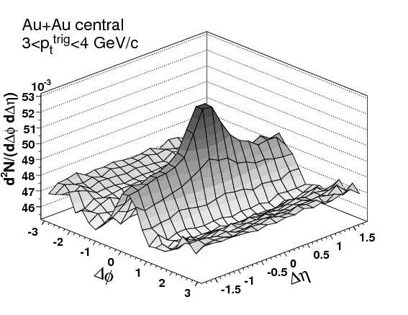
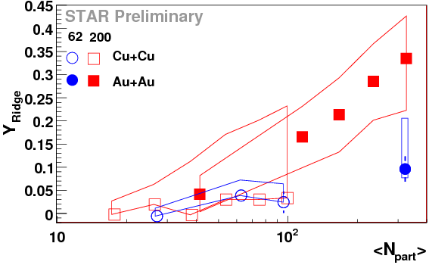
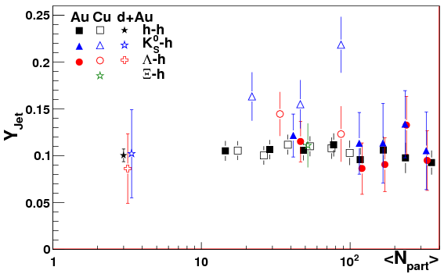
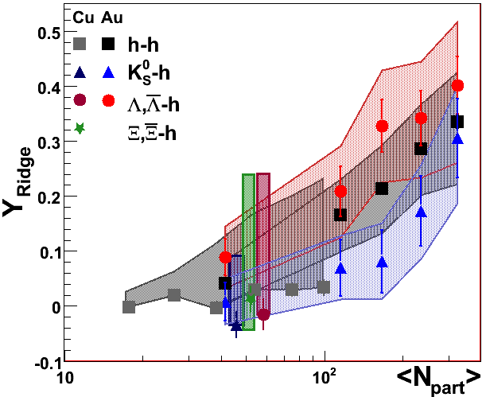
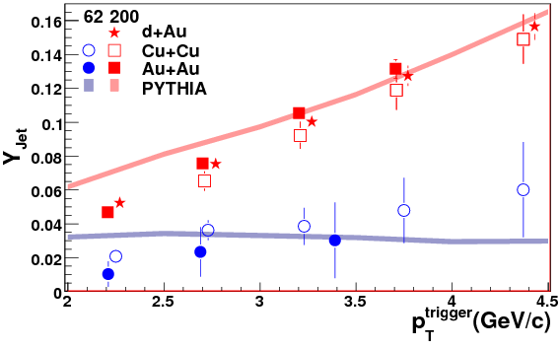
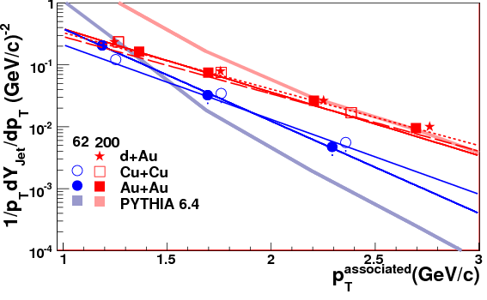
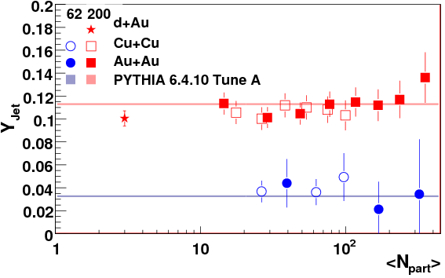
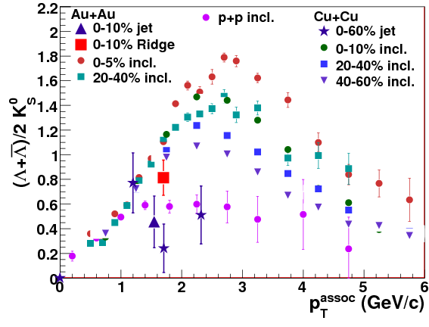
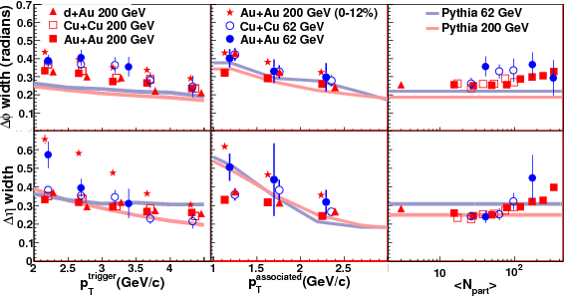
System, energy, and flavor dependence of jets through di-hadron correlations in heavy ion collisions
Christine Nattrass (Yale/University of Tennessee at Knoxville) for STAR
Abstract
ti
Previous studies indicated that the near-side peak of high-p_{T} triggered correlations can be decomposed
into two parts, the jet-like correlation and the ridge [1]. The jet-like correlation is narrow in both azimuth
and pseudorapidity and has properties consistent with vacuum fragmentation, while the ridge is narrow in azimuth but broad in pseudorapidity and roughly independent of pseudorapidity within STAR's acceptance. Attempts have been made to explain the production of the ridge component as coming from recombination, momentum kicks, and a plasma instability. However, few models have attempted to quantitatively calculate the characteristics of the ridge. We present data from Cu+Cu and Au+Au collisions at √s_{NN} = 62 GeV and 200 GeV, which should allow more robust tests of models. The yields of the jet-like correlation and ridge components are presented in both systems and at both energies. At √s_{NN} = 200 GeV the data are compared for h, Λ, K⁰_{S}, and Ξ trigger and associated particles. The trends in energy, system, and particle type dependence of the jet-like correlation and ridge present a more accessible be test for models than the absolute yields. The wealth of data should help distinguish models for the production mechanism of the ridge.
are larger than d + Au and the width grows with N_{part}. The widths in Δη generally agree
with the data except for the lowest p_{T}^{associated} in Cu + Cu collisions and for the lowest p_{T}^{trigger} in
Au + Au collisions at √s_{NN}=200 GeV. The width in Δη in Au + Au collisions at √s_{NN}=200 GeV matches
PYTHIA in the most peripheral collisions but by the most central collisions the width in Δη has almost doubled.
Before these studies were done, PYTHIA was not necessarily expected to describe any aspect of
di-hadron correlations well because of the observation of jet quenching. Additionally, PYTHIA has not been tuned to data from di-hadron correlations. PYTHIA not only qualitatively describes the jet-like correlation but also describes the jet-like yield fairly well quantitatively. The fact that few differences are observed between the jet-like correlation in d + Au, Cu + Cu, and Au + Au collisions implies that there are no strong nuclear effects modifying the jet-like correlation in A+A collisions. This means that the deviations of PYTHIA from the data at the lowest p_{T}^{trigger} and p_{T}^{associated} can be interpreted as a need for better tuning of PYTHIA to lower p_{T} data. Deviations from p + p, peripheral A + A, and PYTHIA observed in the central Au + Au can be understood to result from either modifications of the jet-like correlation or evidence of a slight dependence of the ridge on Δη.
Introduction and analysis method
The ridge
The distribution of associated particles relative to a high-p_{T} trigger particle in azimuth (Δφ) and pseudorapidity(Δη) is normalized per trigger. The raw correlation is separated into a jet-like component and the ridge. The jet-like yield (Y_{jet}) can be determined by taking the projection of the correlation in Δη for |Δφ| < 0.78. The ridge yield is determined by calculating the Δη integrated yield for |Δη| < 1.78 using the projection in Δφ and subtracting the jet-like yield. The background is subtracted assuming a two-component model with background from v₂ and using the Zero-Yield-At-Minimum (ZYAM) method [2]. The ridge yield is given for |Δη| < 1.78 and the jet-like yield is extracted in the range |Δφ| < 0.78 and |Δη| < 0.78. A
Figure 5 shows the dependence of the ridge yield, Y_{ridge}, on N_{part} for Cu + Cu and Au + Au collisions at √s_{NN} = 62 GeV and √s_{NN} = 200 GeV. No difference is observed between Cu+Cu and Au+Au collisions at either energy. The ridge monotonically increases with the system size. Both the jet-like correlation and the ridge are about 40% smaller in collisions at √s_{NN} = 62 GeV than in collisions at √s_{NN} = 200 GeV. PYTHIA simulations indicate that for the same pTtrigger the jet causing the near-side correlation is higher in energy for 200 GeV collisions than for 62 GeV collisions. The difference in Y_{ridge} may come either from different medium properties or from a different jet energy.
Jet
Ridge
RidgeNpart.eps
Figure 1: Sample di-hadron correlation showing the jet-like correlation and the ridge [1]
Figure 5: N_{part} dependence of Y_{ridge} for 3.0<p_{T}^{trigger} < 6.0 GeV/c and 1.5 GeV/c<p_{T}^{associated}<p_{T}^{trigger} for Cu + Cu and Au + Au collisions at √s_{NN} = 62 GeV and Cu+Cu and Au+Au collisions at √s_{NN} = 200 GeV. Lines indicate systematic errors due to v₂.
complete description of the method is described in [3]. The data from Au + Au collisions at √s_{NN} = 200 GeV are from [4]. All correlations are corrected for the detector efficiency for the associated particle. The Λ, K⁰_{S}, and Ξ are identified by reconstruction of their decay vertices.
There is a significant loss of track pairs at small Δφ and small Δη due to track merging and track crossing. The number of overlapping hits in a track pair is calculated and if the number of overlapping hits in the trigger and associated particles exceeds 10% of the number of possible hits, the track pair is thrown out even if it was successfully reconstructed. This is done for both mixed events and real events. This corrects most of the track pair loss. The remaining residual dip is corrected for by taking advantage of symmetries and reflecting data points to fill in the dips. This correction is described in greater detail in [3].
Results: Particle type dependence
Identified trigger particles
Results: Energy and system dependence
The jet-like correlation
Figure 2 shows the dependence of the jet-like correlation on p_{T}^{trigger} for all systems and energies studied compared to predictions from PYTHIA 6.4.10 tune A [5,6]. Since the d+Au data from di-hadron correlations match p+p where comparisons are possible, PYTHIA should be able to describe the d+Au data. However, since there are no differences observed between d+Au , Cu+Cu , and Au+Au , PYTHIA should be able to describe all of the data. PYTHIA overestimates the data at low p_{T} but matches the data at higher p_{T}. The data used to tune PYTHIA were from considerably higher jet energies and therefore may not constrain this kinematic region well. Deviations of PYTHIA from the data could be explained if either PYTHIA does not use the correct fragmentation functions or if the
Figure 6: N_{part} dependence of Y_{jet} for 3.0<p_{T}^{trigger} <6.0 GeV/c and 1.5 GeV/c <p_{T}^{associated}<p_{T}^{trigger} for identified trigger particles in d + Au,
Cu + Cu, and Au + Au collisions at √s_{NN} = 200 GeV for Λ, K⁰_{S}, and Ξ trigger particles.
Figure 7: N_{part} dependence of Y_{ridge} for 3.0<p_{T}^{trigger} < 6.0 GeV/c and 1.5 GeV/c<p_{T}^{associated}<p_{T}^{trigger} for identified trigger particles in Cu+Cu and Au+Au collisions at √s_{NN} = 200 GeV. Systematic errors are shown as bands in the same color as the data points.
The N_{part} dependence of Y_{jet} is shown in Figure 6 for Λ, K⁰_{S}, and Ξ trigger particles. The Au + Au data have not been corrected for track merging effects, and this may explain the difference between identified trigger particles and unidentified trigger particles. No statistically significant differences between different trigger particles are observed for the jet-like correlations, including non-strange, singly strange, and doubly strange hadrons. Studies in Au + Au collisions at √s_{NN} = 200 GeV indicated that there is no trigger particle dependence for even the trebly strange [11, 12]. Figure 7 shows the dependence of Y_{ridge} on N_{part} for identified Λ, K⁰_{S}, and Ξ trigger particles for Cu + Cu and Au + Au collisions at √s_{NN}=200 GeV. The data for identified trigger particles in Cu + Cu collisions at √s_{NN}=200 GeV are consistent, within large errors, of Y_{ridge} in Au + Au at the same N_{part}.
Figure 2: p_{T}^{trigger} dependence of Y_{jet} for 1.5 GeV/c < p_{T}^{associated} < p_{T}^{trigger} for 0-60% central Cu + Cu and 0-80% central Au + Au collisions at √s_{NN} = 62 GeV and minimum bias d + Au, 0-60% central Cu + Cu and 0-12% central Au + Au collisions at √s_{NN} = 200 GeV. Lines indicate predictions from PYTHIA.
jet spectrum which produces the jet-like correlation is not correct in PYTHIA. Preliminary studies of the fragmentation functions in heavy ion collisions indicate that PYTHIA describes the fragmentation functions in heavy ion collisions [7], although the jet sample used for these studies may be biased towards unmodified jets and the average jet energy which leads to the jet-like correlation presented in Figure 2 is considerably lower.
Identified associated particles
The inclusive baryon to meson ratio is higher in A+A collisions than in p+p collisions and this has been explained by mechanisms such as recombination. This effect has been observed in both Cu+Cu and Au+Au collisions. Particles originating from the medium are expected to have a composition similar to the bulk while particles originating from vacuum fragmentation are likely to be similar to those observed in p+p collisions. Measurements of the composition of the ridge and the jet-like correlation may give an indication of the origin of these features. Figure 7 compares the particle ratios in the ridge and the jet-like correlation to the inclusive ratios. Ratios in the jet-like correlation are similar to ratios in p+p. Particle ratios in the ridge in central Au+Au are somewhat higher than those observed in the p+p, indicating that the ridge may be formed in a mechanism similar to the bulk.
The inclusive baryon to meson ratio is higher in A+A collisions than in p+p collisions and this has been explained by mechanisms such as recombination. This effect has been observed in both Cu+Cu and Au+Au collisions. Particles originating from the medium are expected to have a composition similar to the bulk while particles originating from vacuum fragmentation are likely to be similar to those observed in p+p collisions. Measurements of the composition of the ridge and the jet-like correlation may give an indication of the origin of these features. Figure 7 compares the particle ratios in the ridge and the jet-like correlation to the inclusive ratios. Ratios in the jet-like correlation are similar to ratios in p+p. Particle ratios in the ridge in central Au+Au are somewhat higher than those observed in the p+p, indicating that the ridge may be formed in a mechanism similar to the bulk.
Figure 3: p_{T}^{associated} of jet 3.0<p_{T}^{trigger} < 6.0 GeV/c for 0-60% central Cu+Cu and 0-80% central Au+Au at √s_{NN} = 62 GeV and minimum bias d+Au , 0-60% central Cu+Cu, and 0-12% central Au+Au at √s_{NN} = 200 GeV. The lines that match the data indicate fits and the thicker, shaded lines indicate predictions from PYTHIA.
Figure 4: N_{part} dependence of Y_{jet} for 3.0 < p_{T}^{trigger} < 6.0 GeV/c and 1.5 GeV/c< p_{T}^{associated} < p_{T}^{trigger} for Cu + Cu and Au + Au collisions at √s_{NN} = 62 GeV and d+Au, Cu+Cu and Au+Au collisions at √s_{NN} = 200 GeV. Lines indicate predictions from PYTHIA.
Figure 7: Comparison of the inclusive Λ+Λ/2K⁰_{S}in Cu + Cu [8] and Au + Au [9] collisions at √s_{NN} = 200 GeV to that in the jet-like correlation in 0-60% central Cu+Cu and 0-12% central Au+Au collisions at √s_{NN} = 200 GeV and to the Ridge in 0-12% central collisions in Au + Au collisions at √s_{NN} = 200 GeV. [10].
Figure 3 shows the dependence of the jet-like yield on p_{T}^{associated} compared to PYTHIA. PYTHIA does not correctly describe the spectrum of particles in the jet-like correlation, particularly for collisions at 62 GeV. PYTHIA describes the data at higher p_{T}^{associated} better in 200 GeV. The agreement of PYTHIA with the data from
Conclusions
These data indicate that the jet-like correlation is produced dominantly by fragmentation. Y_{jet} is described well both qualitatively and quantitatively by PYTHIA, a surprise since PYTHIA is a model for p+p collisions. In addition, the composition of the jet-like correlation is similar to the inclusive particle ratios in p+p collisions. The small deviations of Y_{jet} in different collision systems indicate modifications of the jet-like correlation. The widths of the jet-like correlation in Δφ and Δη are not described well in PYTHIA and indicate that there is substantial modification of the shape of the jet-like correlation in central Au+Au collisions.
Data on the ridge are more difficult to interpret. The particle composition indicates that the ridge may be formed in way similar to the bulk. No dependence of the ridge on trigger particle species is observed, within large systematic errors. The ridge is observed to be substantially larger in collisions at √s_{NN}=200 GeV than √s_{NN}= 62 GeV. In order to use these data to test models, however, more quantitative models are needed.
collisions at 62 GeV in Figure 2 appears to be coincidental. The jet-like yield as a function of Npart is compared to PYTHIA in Figure 4. PYTHIA describes the data in this kinematic range well.
The widths in Δφ and Δη for p_{T}^{trigger}, p_{T}^{associated}, and N_{part} are shown in Figure 5. The widths in central Au+Au collisions at √s_{NN}=200 GeV are considerably larger than other those observed in data sets. For the other systems and energies, PYTHIA
underestimates the widths in Δφ,
particularly for the lowest p_{T}^{trigger}. While
the d+Au data are higher than
PYTHIA, the widths in A + A
Eh
References
[1] B. I. Abelev et al. (STAR), Phys. Rev. C80, 064912 (2009), 0909.0191.
[2] S S Adler et al (PHOBOS) 2005 Phys. Rev. Lett. 94 122303.
[3] C. Nattrass, PhD thesis, Yale University, 2009.
[4] Bielcikova J et al (STAR) nucl-ex/0701047.
[5] T. Sjostrand, L. Lonnblad, S. Mrenna, and P. Skands, Pythia 6.3
physics and manual, (2003), hep-ph/0308153.
[6] R. D. Field (CDF Collaboration), (2002),
hep-ph/0201192.
[7] J. Putschke (STAR Collaboration), Nucl-ex/0809.1419.
[8] A. R. Timmins (STAR Collaboration), Int. J. Mod. Phys. E16, 2055 (2007), 0708.3290.
[9] M. A. C. Lamont (STAR Collaboration), J. Phys. G30, S963 (2004), nucl-ex/0403059.
[10] J. Bielcikova (STAR Collaboration), nucl-ex/ 0707.3100.
[11] B. I. Abelev (STAR Collaboration), nucl-ex/0705.3371.
[12] B. Abelev, PhD thesis, Yale University, 2007.
Figure 5: Collision energy and system size dependence of Gaussian widths in Δφ and Δη as a function of p_{T}^{trigger}, p_{T}^{associated}, and N_{part} for Cu+Cu and Au+Au collisions at
√s_{NN} = 62 GeV and d + Au, Cu + Cu and Au + Au collisions at √s_{NN} = 200 GeV. Kinematic cuts and centralities are the same as used in Figure 2, Figure 3,
and Figure 4. Lines indicate predictions from PYTHIA.
[1] Ridge paper
[2] ZYAM
[3] my thesis
[4] Jana QM proceedings
[5] Pythia
[6] tune A
[7] Joern prelim ff

