Slide 1
Paper proposal: System and energy dependence of near-side jet-like correlations
PAs: Christine Nattrass, Jana Bielcikova, Jörn Putschke
Study of near-side Jet and Ridge components of h-h correlations in Cu+Cu, Au+Au at √s_{NN} = 62 GeV, 200 GeV
8 figures proposed
Beginning of analysis note web page: http://rhig.physics.yale.edu/~nattrass/Research/web/index.html
Target journal: PRC
Planned as rapid communication (5 pages)?

Slide 2
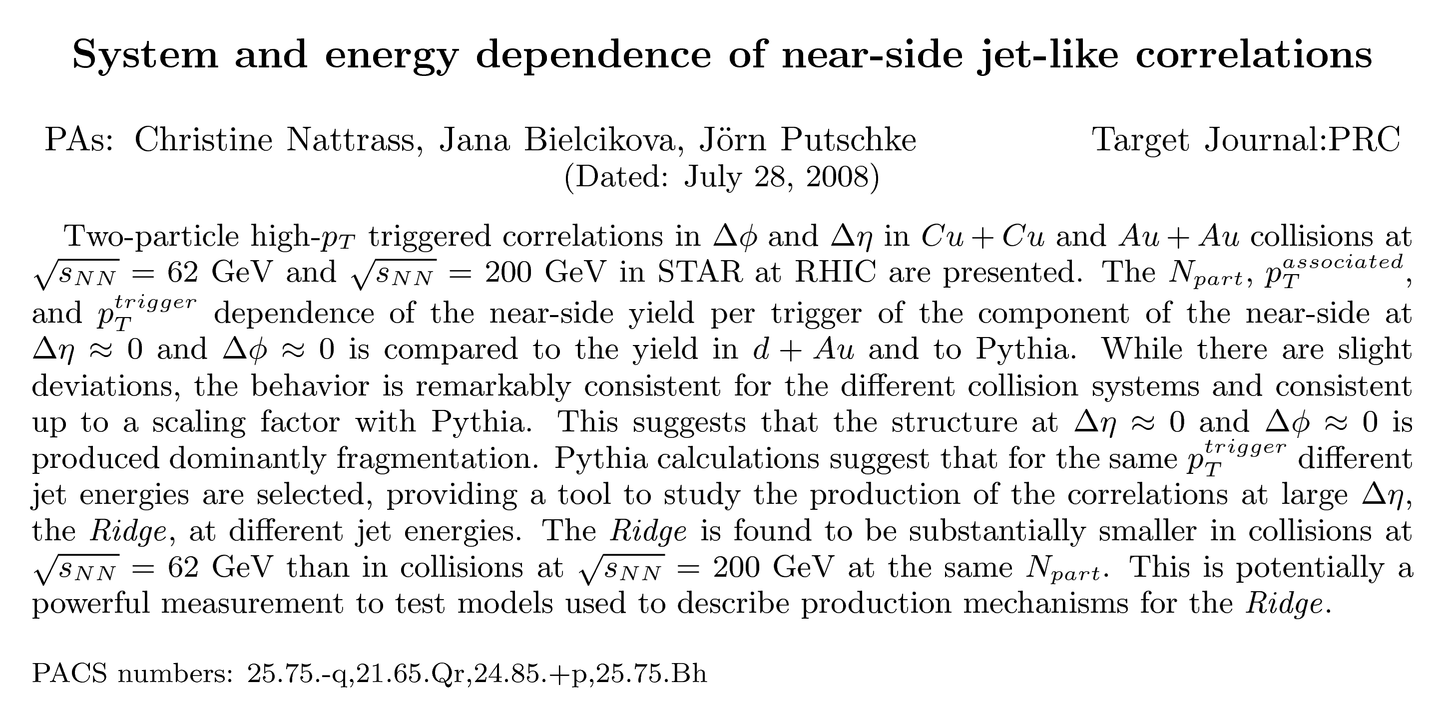

Slide 3
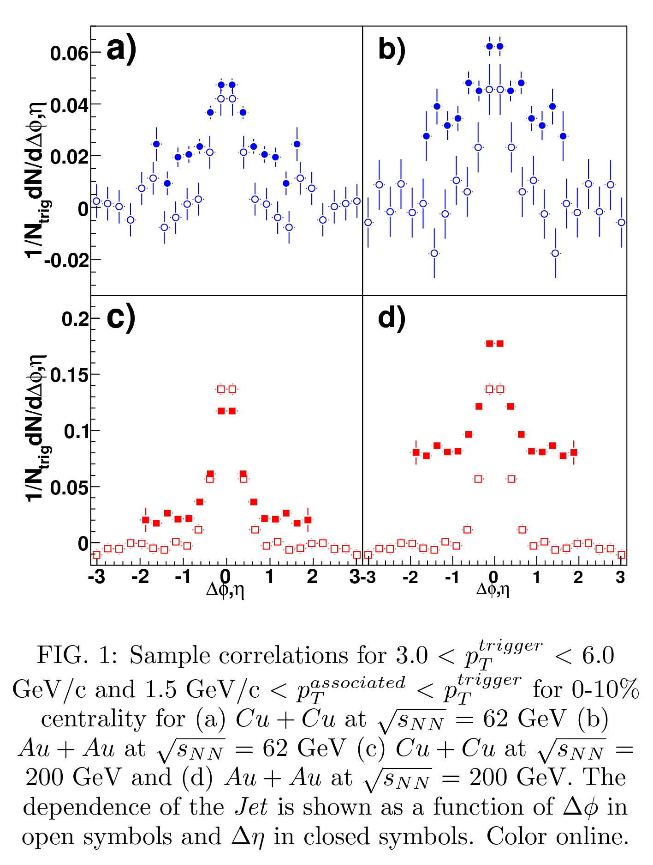
Figure 1

Slide 4
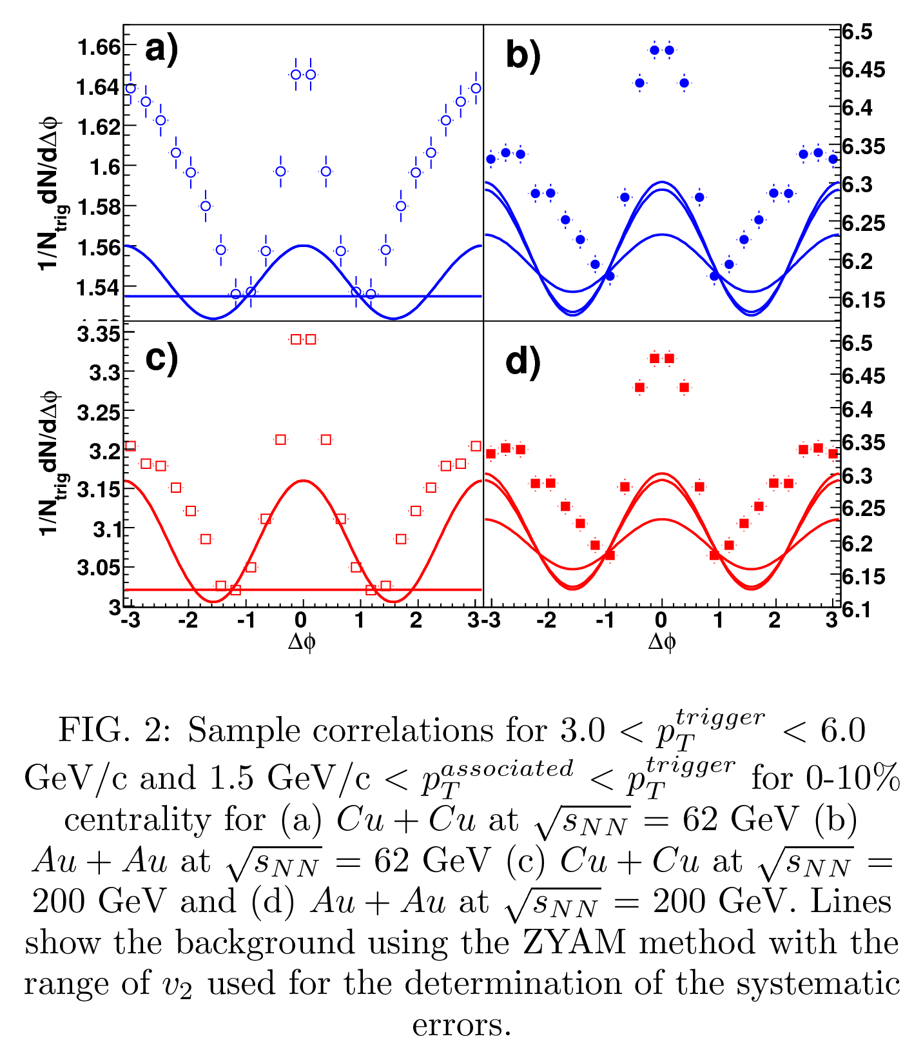
Figure 2

Slide 5
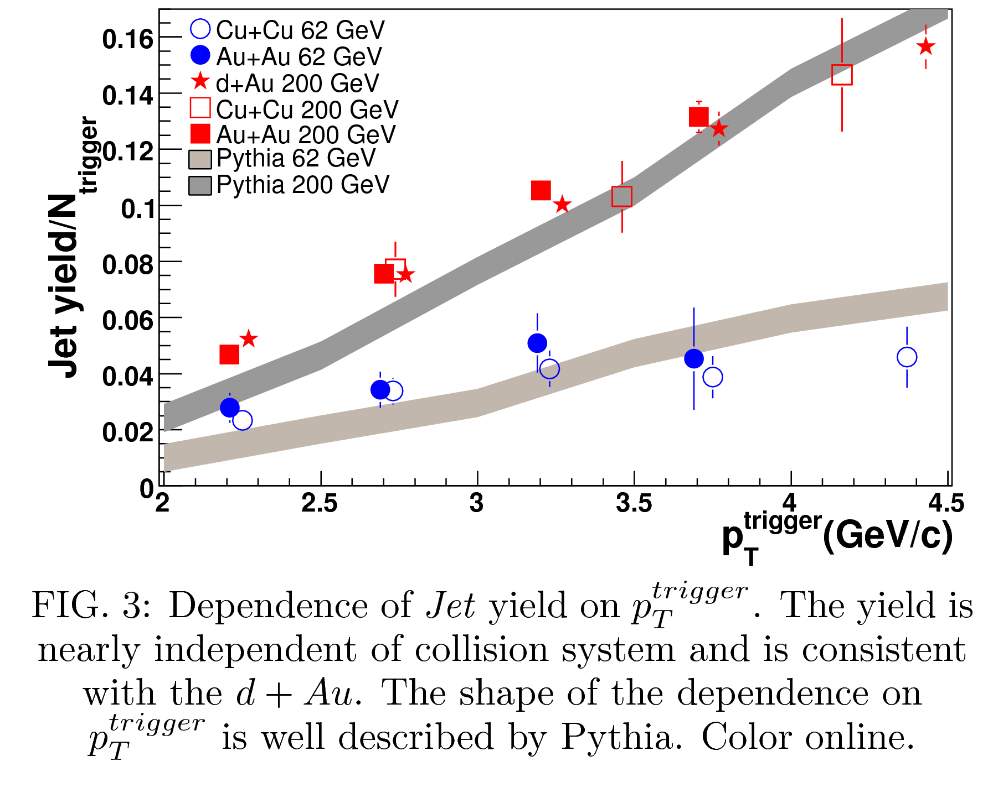
Figure 3

Slide 6
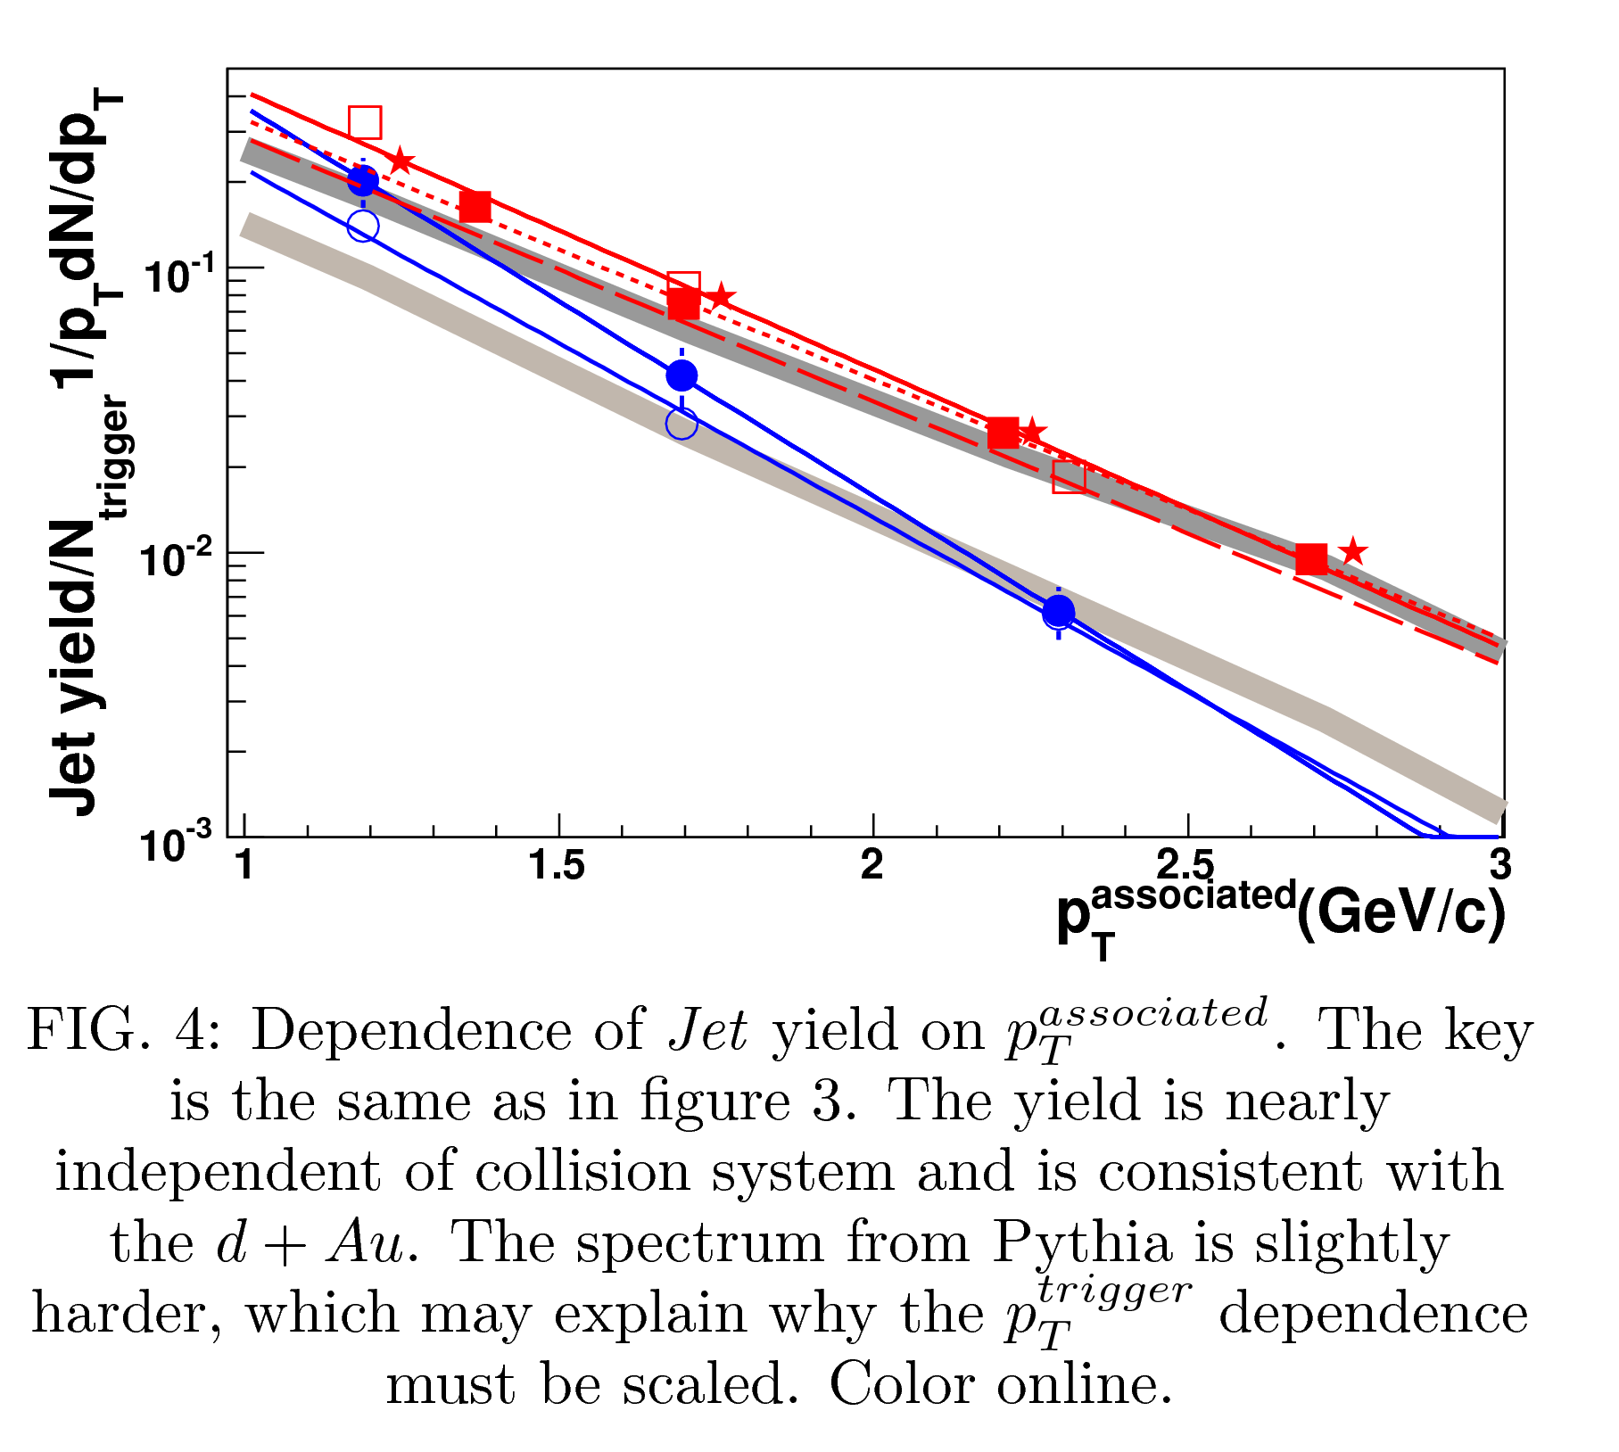
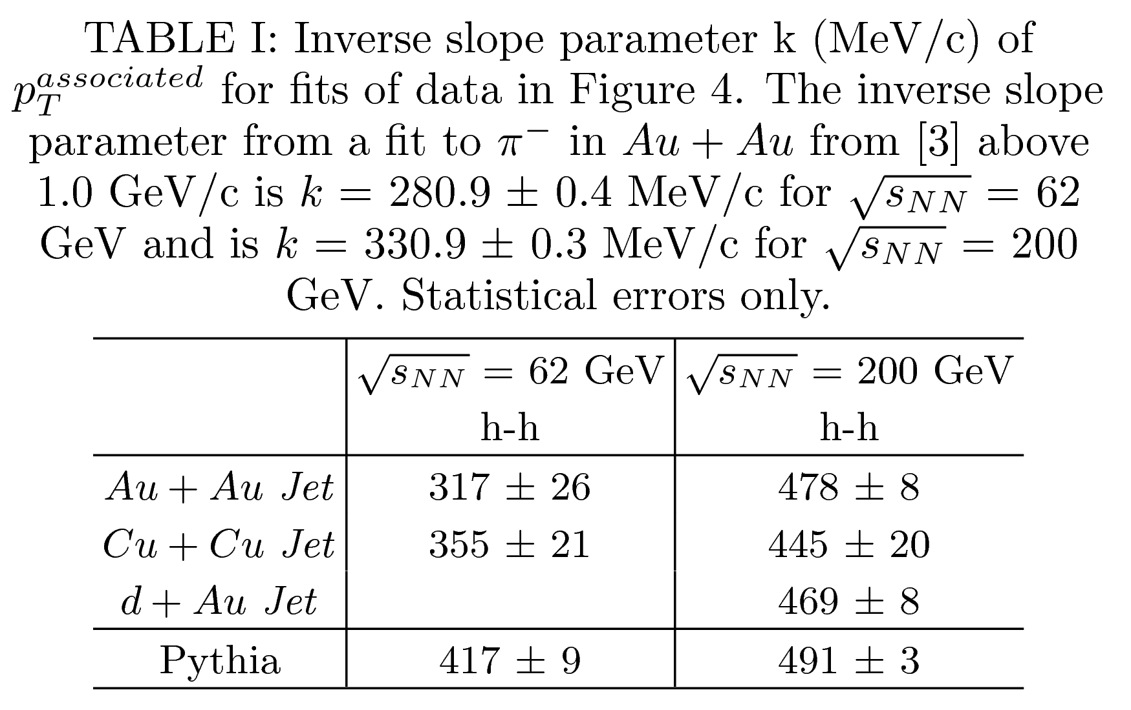
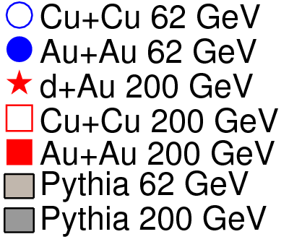
Figure 4

Slide 7
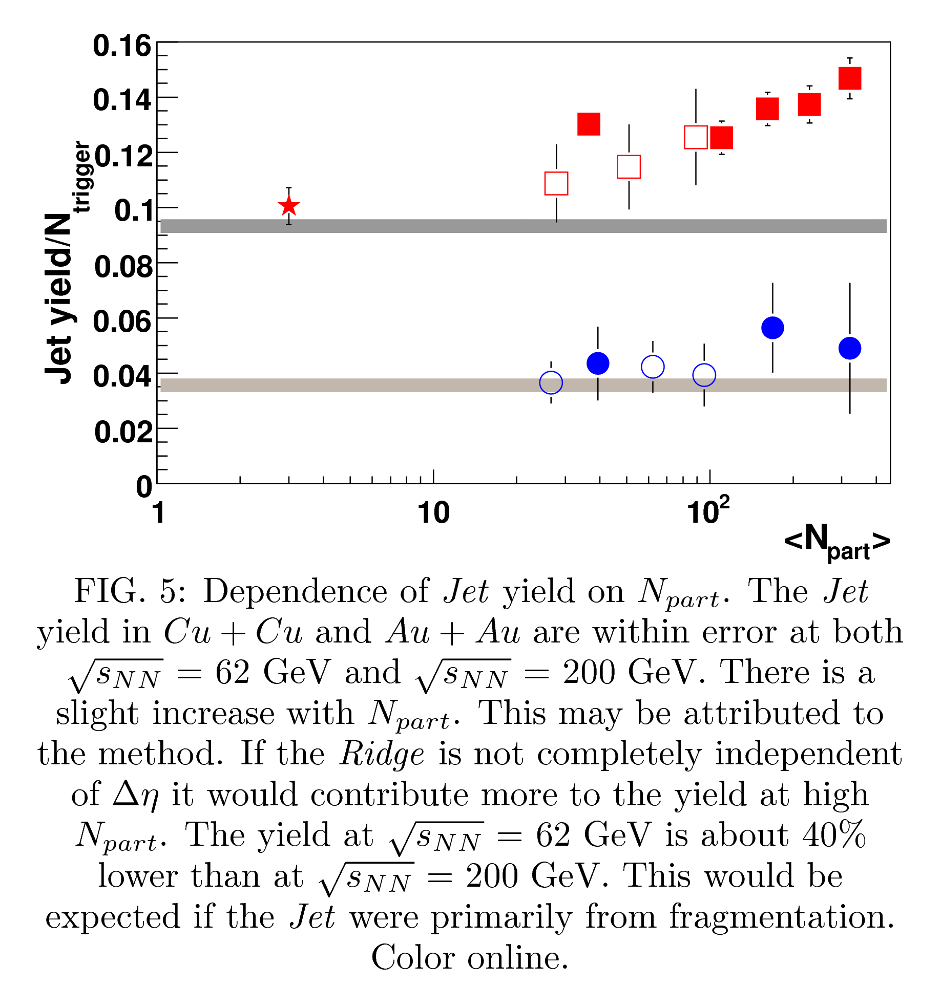
Figure 5

Slide 8
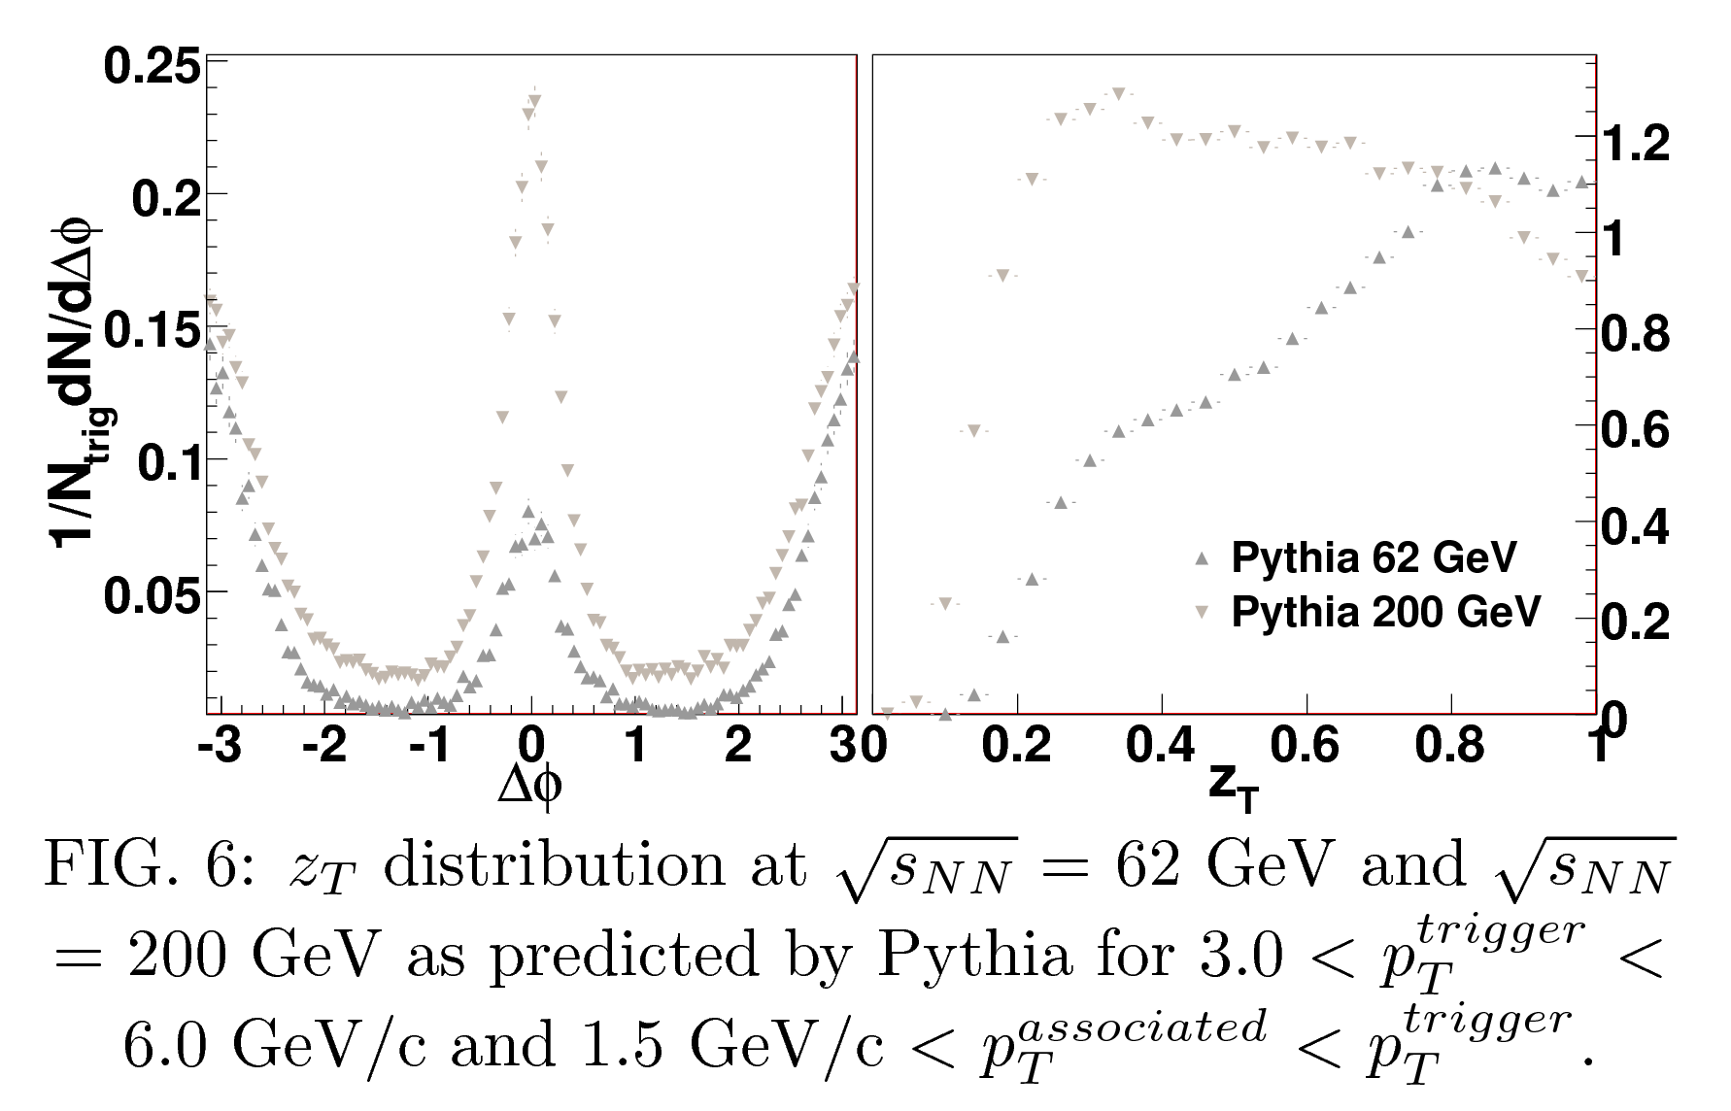
Figure 6

Slide 9
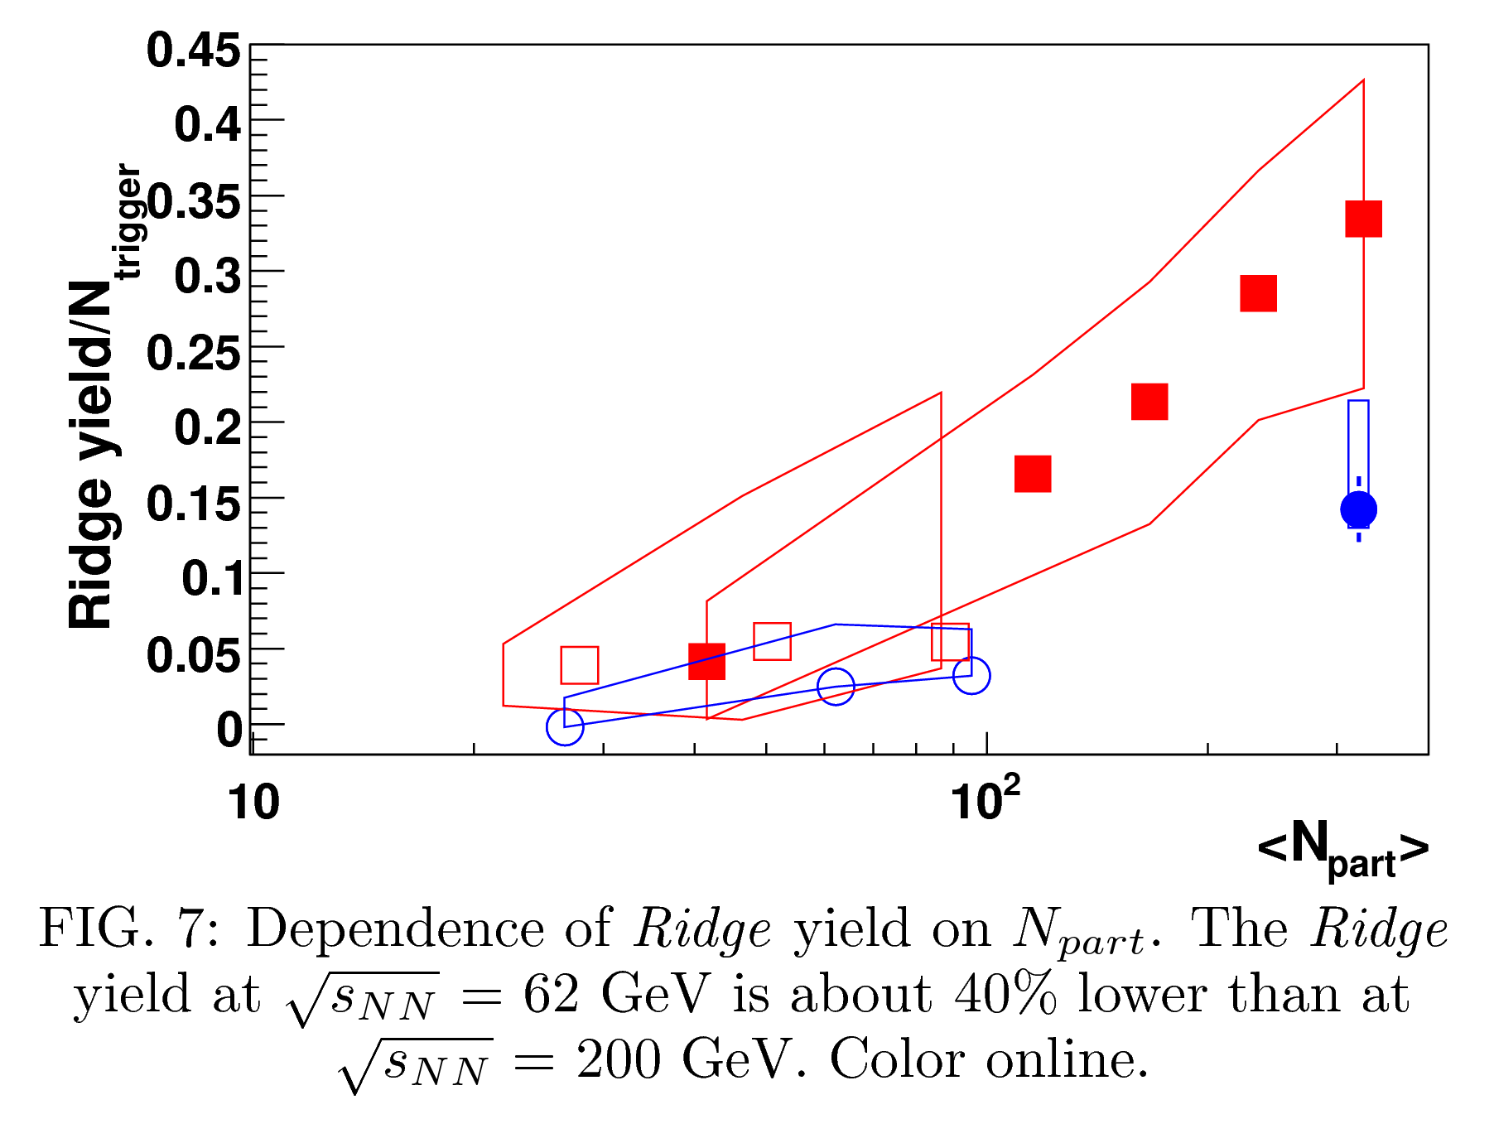
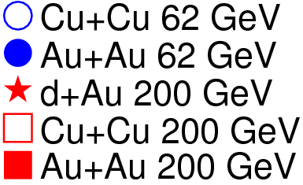
Figure 7

Slide 10
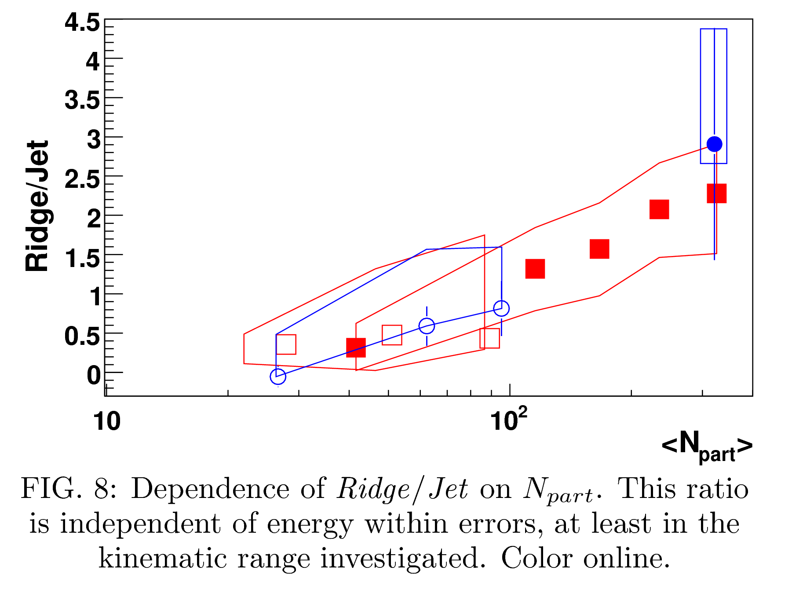
Figure 8

Slide 11
Conclusions
Jet
  Mostly independent of system, including Cu+Cu, Au+Au, and d+Au
  Mostly consistent with Pythia up to a scaling factor
  Differences could be
    Pythia doesn't work well at low pT
    Incomplete subtraction of Ridge
  But still remarkable Pythia does so well for something in heavy ion collisions and that there is so little system dependence
  Pythia simulations imply same trigger p_{T} selection at two different energies corresponds to different z_{T}, jet energy
Ridge
  Consistent (within large errors) at same N_{part} for different collision systems
  Ridge/Jet independent of energy (within this kinematic region)

Slide 12
