Slide 1
Paper proposal: Energy and system dependence of correlations in STAR at RHIC
PAs: Christine Nattrass, Jana Bielcikova Jörn Putschke
Study of near-side Jet and Ridge components of h-h correlations in Cu+Cu, Au+Au at √s_{NN} = 62 GeV, 200 GeV
8 figures proposed
Beginning of analysis note web page: http://rhig.physics.yale.edu/~nattrass/Research/web/index.html
Target journal: PRC
Planned as rapid communication (5 pages)‏

Slide 2
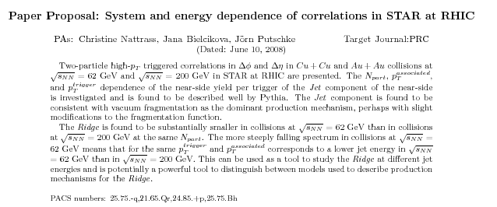

Slide 3
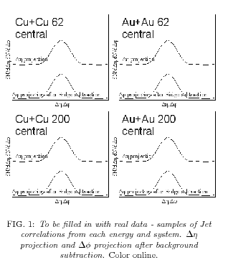
Figure 1

Slide 4
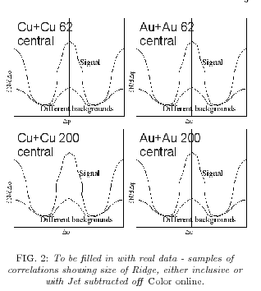
Figure 2

Slide 5
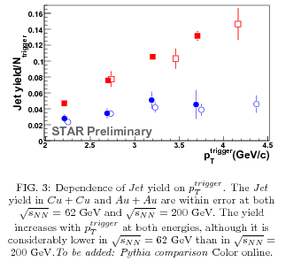
Figure 3

Slide 6
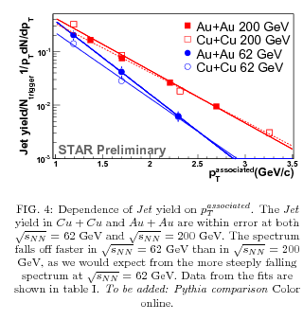
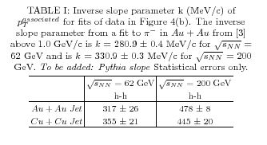
Figure 4

Slide 7
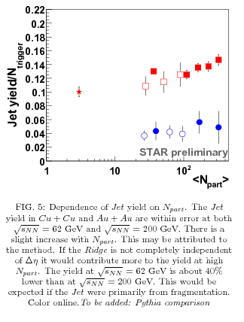
Figure 5

Slide 8
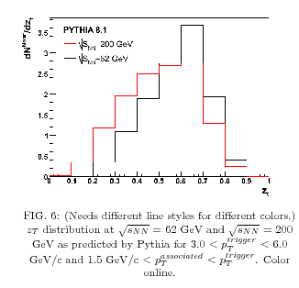
Figure 6

Slide 9
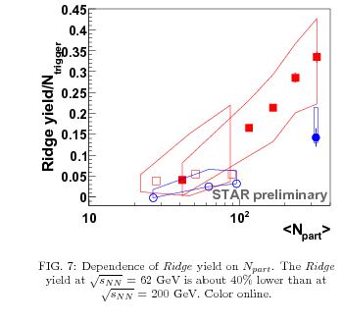
Figure 7

Slide 10
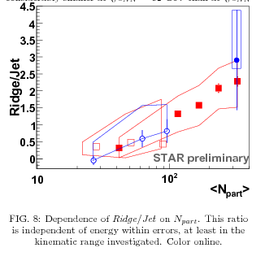
Figure 8

Slide 11
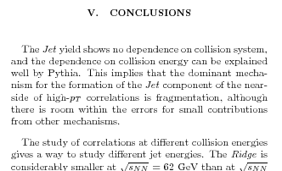

Conclusions

Slide 12

