Slide 1
Paper proposal: Particle and system dependence of correlations in STAR at RHIC
PAs: Christine Nattrass, Jana Bielcikova, Betty Abelev
Study of near-side Jet and Ridge components of h-V0 and V0-h correlations in Cu+Cu, Au+Au at √s_{NN} = 200 GeV
Likely will come out after energy and system dependence paper
May add more detailed multistrange track merging section
9 figures proposed
Beginning of analysis note web page: http://rhig.physics.yale.edu/~nattrass/Research/web/index.html
Target journal: PRC
Planned as rapid communication (5 pages) if possible

Slide 2
Reasoning behind separating this from the energy and system dependence paper
The paper on energy and system dependence has a clear, concise message that is distinct from the goal of this paper. The energy and system dependence paper posits that for h-h correlations a lot can be understood by looking at fragmentation alone (hence comparisons to Pythia,) that there is a Ridge at 62 GeV, and that the ratio of the Ridge/Jet, at least in the kinematic range we can study, is independence of collision energy and collision system. The message of this paper is that there is no system dependence for strangeness and no strangeness content dependence.
This paper involves strange particles, for which fragmentation is still poorly understood. Pythia comparisons would distract from the message in this paper and strangeness studies and details of identifying strange particles and correcting for track merging for the multistrange Xi would distract from the message in that paper.

Slide 3
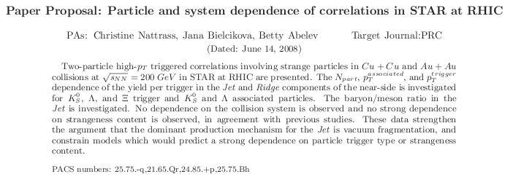
Abstract

Slide 4
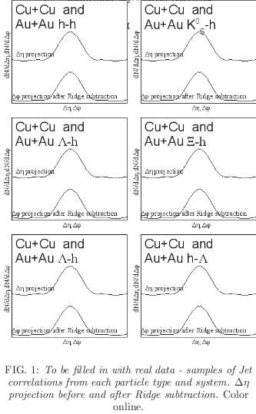
Figure 1

Slide 5
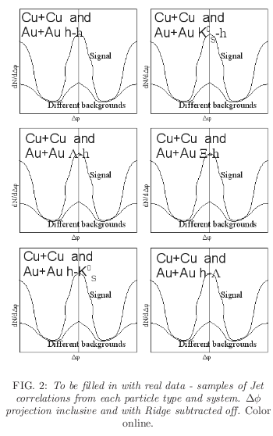
Figure 2

Slide 6
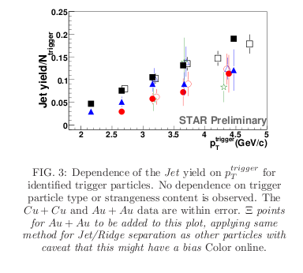
Figure 3

Slide 7
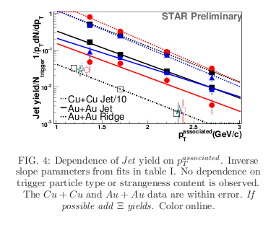
Figure 4

Slide 8
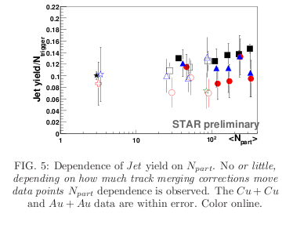
Figure 5

Slide 9
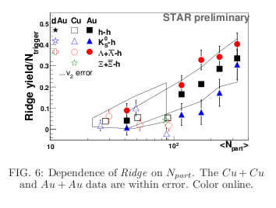
Figure 6

Slide 10
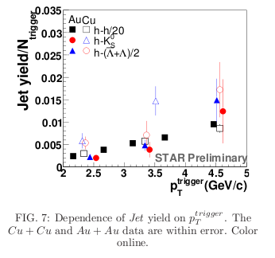
Figure 7

Slide 11
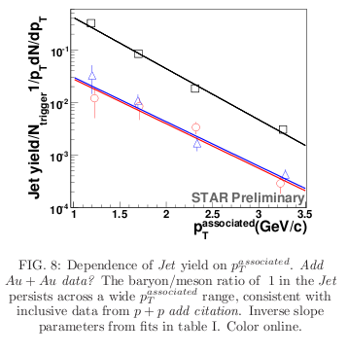
Figure 8

Slide 12
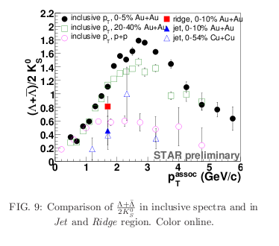
Figure 9

Slide 13

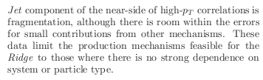
Conclusions

Slide 14
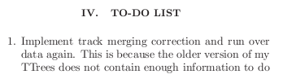
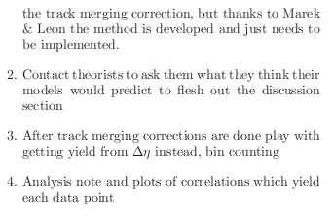
To-do list

