Slide 1

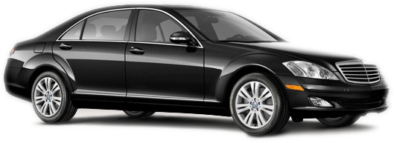
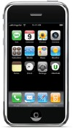
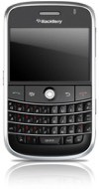
Next-Generation Car Service

Slide 2
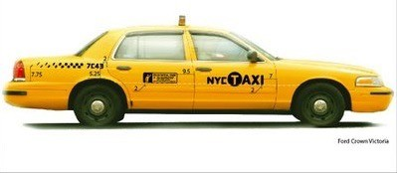
Cabs in 2008
Most use aging & inefficient technology
Radio dispatch, no 2-way communication
Most common car, Ford Crown Victoria = 14mpg
Hailing is done by hand or phone
No GPS coordination between client/driver
Significant fareseeking or “dead-time”

Slide 3
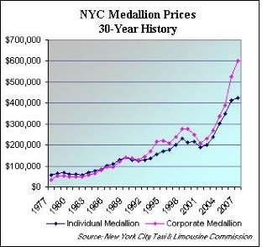
The Medallion System
Taxi-monopolies reduce quality of service
– Medallions are expensive, and drivers underpaid
Medallions cost ~$500k, drivers make 31k
No incentive/accountability for drivers/clients
Digital Hail can now make street hail unnecessary

Slide 4
UberCab Concept
A fast & efficient on-demand car service
Market: Professionals in American cities
Convenience of a cab in NYC + experience of a professional chauffeur. But in SF and NYC
Latest consumer web & device technology
– automate dispatch to reduce wait-time
Optimized fleets and incented drivers
The “NetJets of car services”

Slide 5
1-Click Car Service
Must be a member to use the service
Professional and trustworthly clientele
Not hailed from street
So no medallion licenses are required, since clients are service members & use digital-hail
Guaranteed Pick-up (unlike a yellowcab)
Mobile app will match client & driver
See photos of each other

Slide 6
Key Differentiators
Members Only - Respectable clientele
1-click hailing – “Pickup here in 5 mins”
Fast Response time – easier than calling
Luxury automobiles – Mercedes Sedans
Great drivers – “Rate your trip” feature
High-tech solution: Geo-aware auto-dispatch
Optimized fleet – Logistical LBS software

Slide 7
Operating Principles
Luxury service on-demand
Modern and fuel-efficient fleet
Customer-focused, computer-coordinated
The best end-user experience possible
Statistically optimized response time
Pre-paid, cashless billing system
Profitable by design

Slide 8
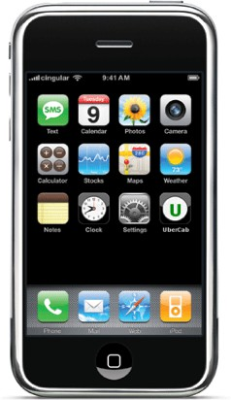
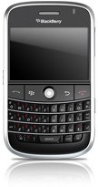
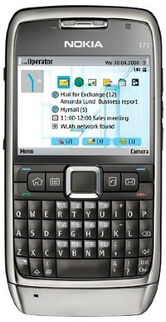
UberCab apps
1-Click request from Geo-aware devices
SMS from any phone: “pickup @work in 5”

Slide 9
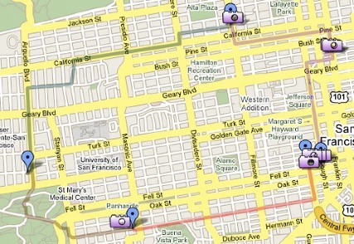
UberCab.com
Book Trips, show Fleet status, trip history
Pre-specify locations with labels + coordinates
To enable easy texting of pickup locations
Google Maps integration
Lat/long for “home”, “bob-work”, “alice-apt”

Slide 10
Use-Cases
Trips to/from restaurants, bars & shows
Fast local transport where parking isn’t easy
Airport pickup/dropoff (pre-scheduled)
Working while commuting (wifi in cars)
– 3 person rideshare to a South-Bay campus
Dropping off Kids at School
Elderly transport

Slide 11
User Benefits
Cabs don’t guarantee pickup, can take 45 mins
Cab aren’t as safe or clean as limos
Car services require 1-3 hours notice
Car services transfers average over $60 + tax
UberCab would be faster & cheaper than a limo, but nicer & safer than a taxicab

Slide 12
Environmental Benefits
Better Utilization of Vehicle Resources
In NYC, 35% of time is spend looking for fares
In less dense cities, can be over half “dead-time”
As swarm size increases, efficiency will improve
Hybrid vehicles (2x efficiency of a cab)
Mercedes S400 BlueHybrid, Lexus GS-450h
Reduce carbon footprint, better use of time in car
Ridesharing/Carpooling incentives – lower rates
Trip to SFO, or Ballpark to Marina after a game

Slide 13
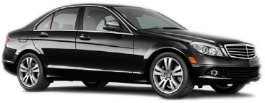
UberCab Fleet
Premium – S550 for SF Beta clients
30mpg with S400 BlueHybrid (in 2010)
Standard – Lexus GS450h or e320– 23mpg
Existing cab/towncar fleets get 14-16 mpg

Slide 14
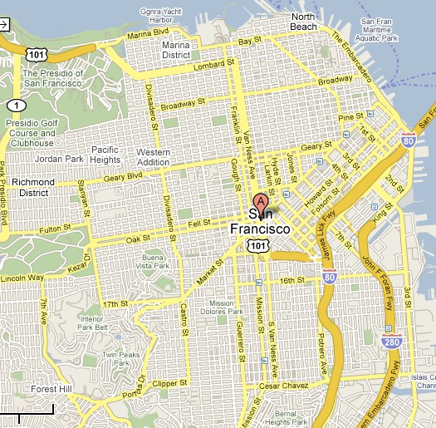
Initial Service Area
Central SF to Start, Manhattan soon after

Slide 15
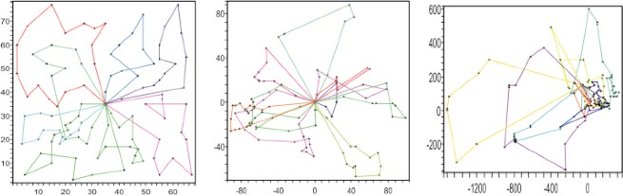
Technology
Mobile phones + intelligent scheduling
Applications for iphone, blackberry, symbian
Operations research for route optimization
Payment/utilization/reputation tracking
Patent-pending system design

Slide 16
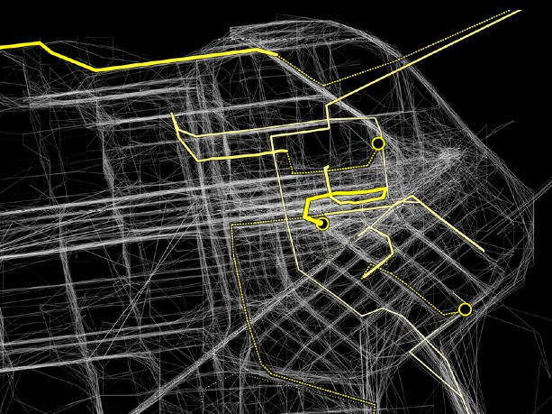
Demand Forecasting
Cars hover in statistically optimized positions
– minimize expected pickup time given hour of week & weather/traffic conditions

Slide 17
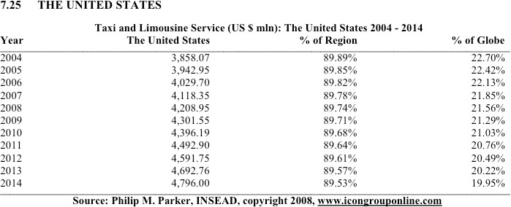
Overall Market
$4.2B annually and growing
Top 4 players combined only 22% of revenues

Slide 18
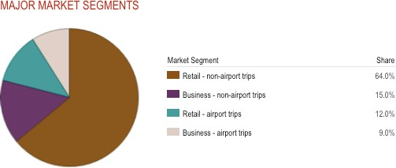
Composition of Market
Focus on Urban service on-demand
2007 Market

Slide 19
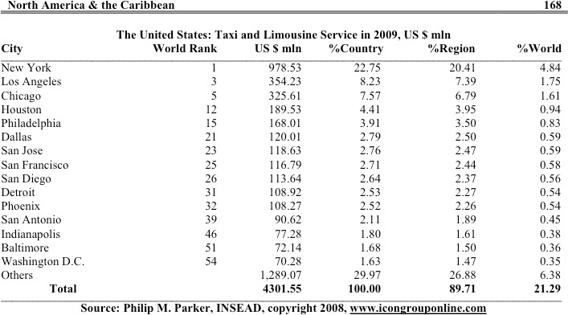
Target Cities
Focus on SF/NYC to begin
Expand to LA, Chicago, Houston, PA, Dallas
– This covers 50% of entire US market

Slide 20
Potential Outcomes
Best-Case Scenario
Becomes market leader, $1B+ in yearly revenue
Realistic Success Scenario
Gets 5% of the top 5 US Cities
Generates 20-30M+ per year profit
Worst-Case Scenario
Remains a 10 car, 100 client service in SF
Time-saver for San-Francisco based executives

Slide 21
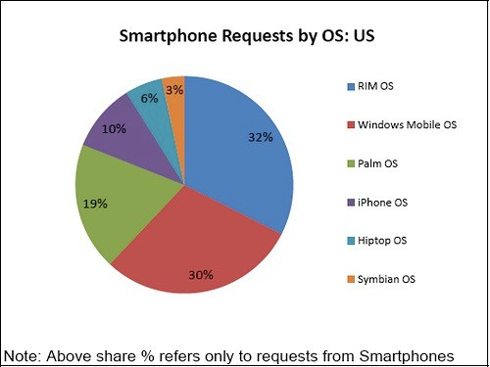
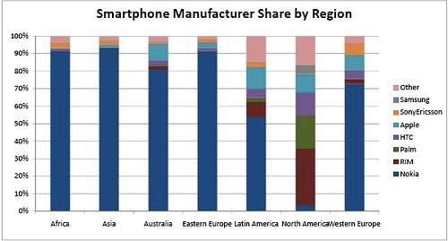
SmartPhones, Aug2008

Slide 22
Future Optimizations
Cheaper cars by buying used
Less expensive hybrid vehicles (prius)
More accurate GPS technology
Discounted rates for Sun-Tues multi-hour bookings
Pay premium for on-demand service
“get here now” costs more than “tomorrow at 5pm”

Slide 23
Marketing Ideas
YellowCab is the only recognizable brand
– Become the ubiquitous “premium” cab service
Invite Only, referred from an existing member
Possible slogan: The One-click cab
The NetJets of Limos
Cabs2.0

Slide 24
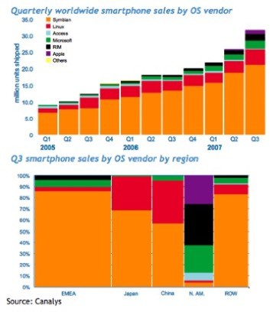
Location-Based Service
Extend infrastructure to other LBS applications
– Delivery, non-critical medical/governmental use
Growing to a $3.5B industry by 2010

Slide 25
Progress to Date
Ubercab.com reserved + “ubercab” SMS code
California LLC + trademark filed
Iphone dev license applied for Nov28,08
Bank Account + Paypal account created
5 advisors & 15 clients now recruited
Provisional patent filed
NEXT: buy 3 cars, develop app, Feb1st demo
– Raise a few million, small-office + GM in SF

