Slide 1
Bayesian Sample Size Determination for Multilevel Data – the BayesSSD Package
Lab seminar University of Geneva
Ulrich Lösener
PhD Candidate

Slide 2
Content Overview
Lab Seminar University of Geneva
The Problem
Multilevel Models
Bayesian Hypothesis Evaluation
The BayesSSD package
Modelling Attrition
Wrap-up

Slide 3
Content Overview
Lab Seminar University of Geneva
The Problem
Multilevel Models
Bayesian Hypothesis Evaluation
The BayesSSD package
Modelling Attrition
Wrap-up

Slide 4






The problem: Lack of software for Bayesian power analysis for multilevel trials
The problem

Slide 5


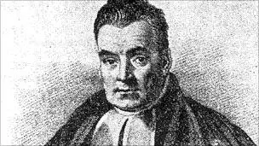
The solution: Create free software for Bayesian power analysis for multilevel trials

Slide 6
Content Overview
Lab Seminar University of Geneva
The Problem
Multilevel Models
Bayesian Hypothesis Evaluation
The BayesSSD package
Modelling Attrition
Wrap-up

Slide 7



Nested Data – Cluster Randomized Trial
Individuals nested within clusters

Slide 8

Nested Data – Longitudinal Experiment
Observations nested within individuals

Slide 9


Nested Data – Multilevel Model
Individuals randomly allocated to g conditions and measured repeatedly
Longitudinal experiment
Multilevel model formula for individual i at timepoint j
$$y_{ij}=π_{0i}+π_{1i}T_{j}+e_{ij} \\ π_{0i}=β_{0}+u_{0i} \\ π_{1i}=β_{1}COND_{1}+β_{2}COND_{2}+…+β_{g}COND_{g}+u_{1i}$$

Slide 10

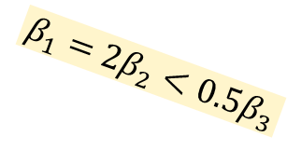
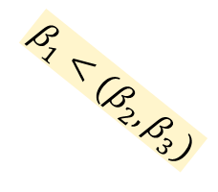
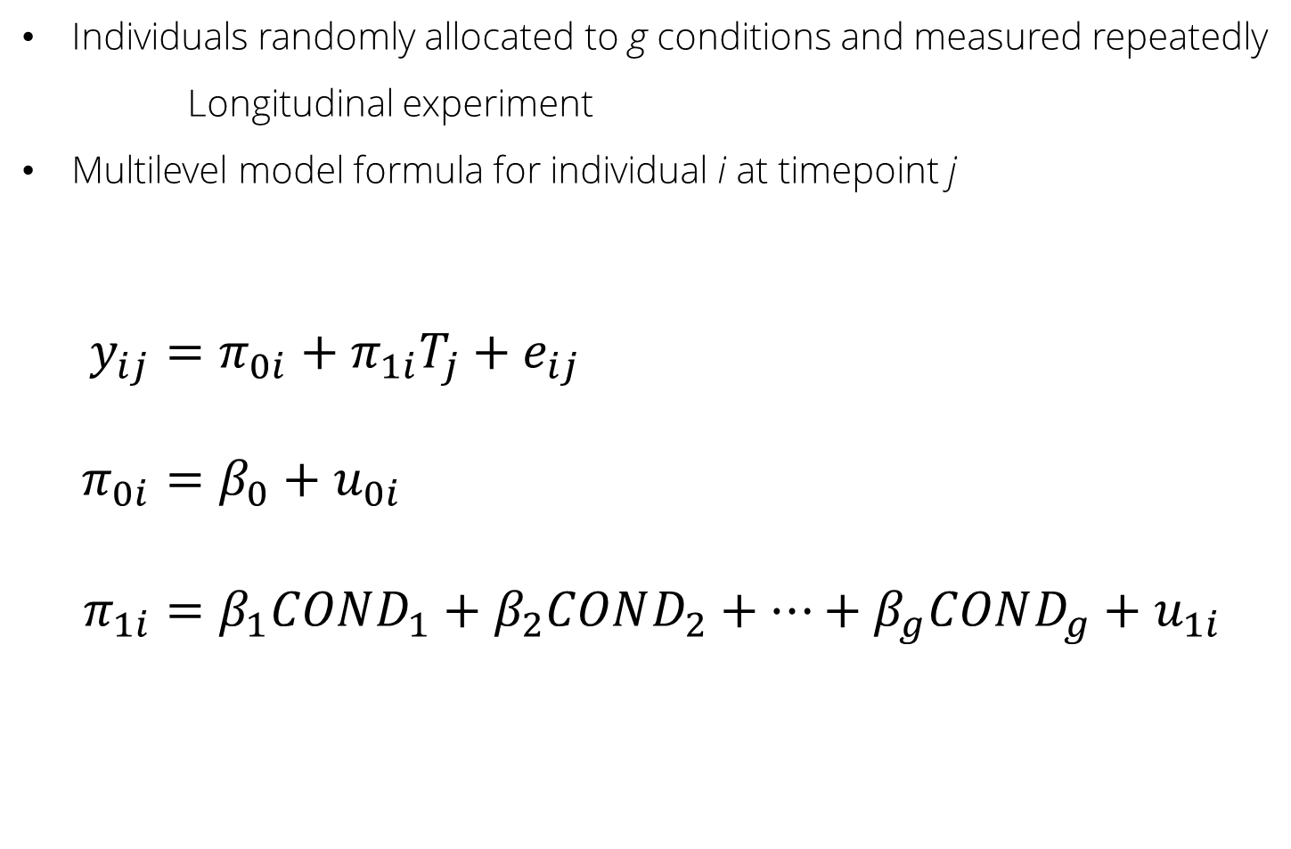

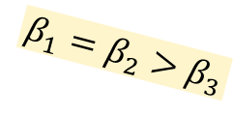
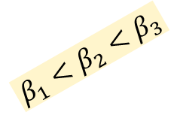
Nested Data – Multilevel Model
Individuals randomly allocated to g conditions and measured repeatedly
Longitudinal experiment
Multilevel model formula for individual i at timepoint j
$$y_{ij}=π_{0i}+π_{1i}T_{j}+e_{ij} \\ π_{0i}=β_{0}+u_{0i} \\ π_{1i}=β_{1}COND_{1}+β_{2}COND_{2}+…+β_{g}COND_{g}+u_{1i}$$
$$β_{1}=β_{2}>β_{3}$$
$$β_{1}<{(β}_{2},β_{3})$$
$$β_{1}<β_{2}<β_{3}$$
$$β_{1}={2β}_{2}<{0.5β}_{3}$$
$$β_{1}=β_{2}=β_{3}$$

Slide 11
Content Overview
Lab Seminar University of Geneva
The Problem
Multilevel Models
Bayesian Hypothesis Evaluation
The BayesSSD package
Modelling Attrition
Wrap-up

Slide 12


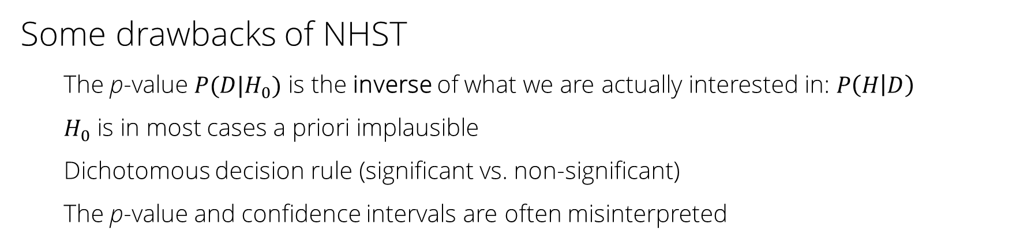
Bayesian Hypothesis Evaluation (BHE) Null Hypothesis Significance Testing (NHST)
Some drawbacks of NHST
The p-value $P(D|H_{0})$ is the inverse of what we are actually interested in: $P\left(H | D\right)$
$H_{0}$ is in most cases a priori implausible
Dichotomous decision rule (significant vs. non-significant)
The p-value and confidence intervals are often misinterpreted

Slide 13

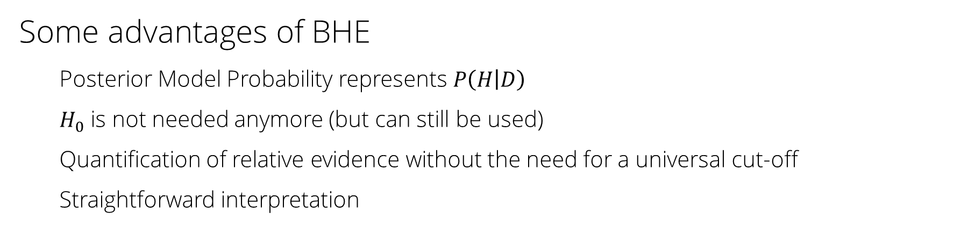
Bayesian Hypothesis Evaluation (BHE) Null Hypothesis Significance Testing (NHST)
Some advantages of BHE
Posterior Model Probability represents $P\left(H | D\right)$
$H_{0}$ is not needed anymore (but can still be used)
Quantification of relative evidence without the need for a universal cut-off
Straightforward interpretation

Slide 14


Slide 15


Slide 16

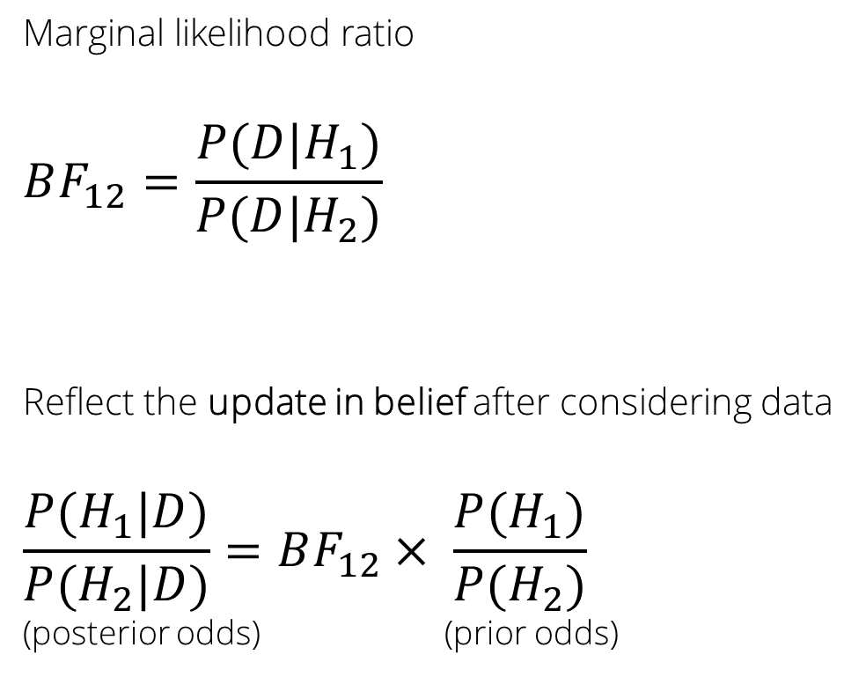

Bayes Factors
Marginal likelihood ratio
$$BF_{12}=\frac{P(D|H_{1})}{P(D|H_{2})}$$
Reflect the update in belief after considering data
$$\frac{P(H_{1}|D)}{P(H_{2}|D)}=BF_{12}× \frac{P(H_{1})}{P(H_{2})}$$
(posterior odds) (prior odds)
$$BF_{12}=1$$
H₁
H₂

Slide 17

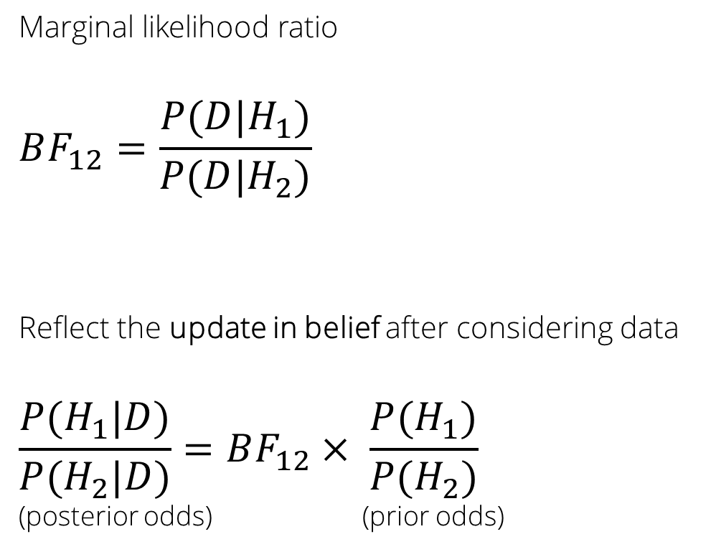

Bayes Factors
Marginal likelihood ratio
$$BF_{12}=\frac{P(D|H_{1})}{P(D|H_{2})}$$
Reflect the update in belief after considering data
$$\frac{P(H_{1}|D)}{P(H_{2}|D)}=BF_{12}× \frac{P(H_{1})}{P(H_{2})}$$
(posterior odds) (prior odds)
$$BF_{12}=2$$
H₂
H₁

Slide 18
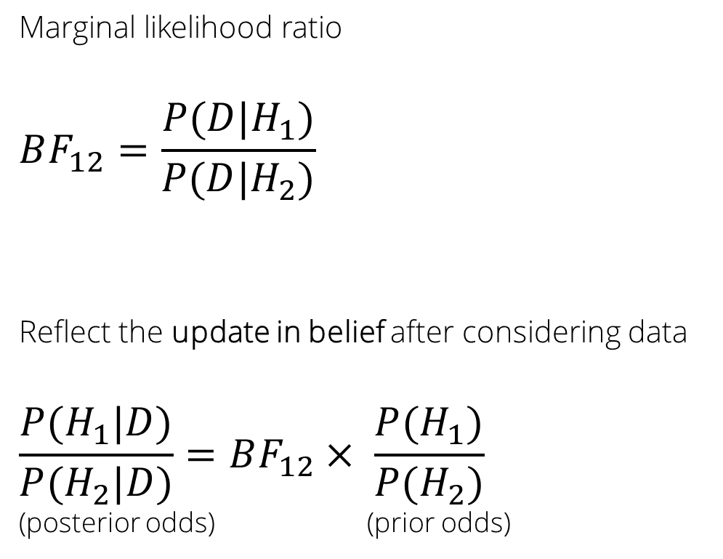

Bayes Factors
Marginal likelihood ratio
$$BF_{12}=\frac{P(D|H_{1})}{P(D|H_{2})}$$
Reflect the update in belief after considering data
$$\frac{P(H_{1}|D)}{P(H_{2}|D)}=BF_{12}× \frac{P(H_{1})}{P(H_{2})}$$
(posterior odds) (prior odds)
$$BF_{12}=0.5$$
H₁
H₂

Slide 19


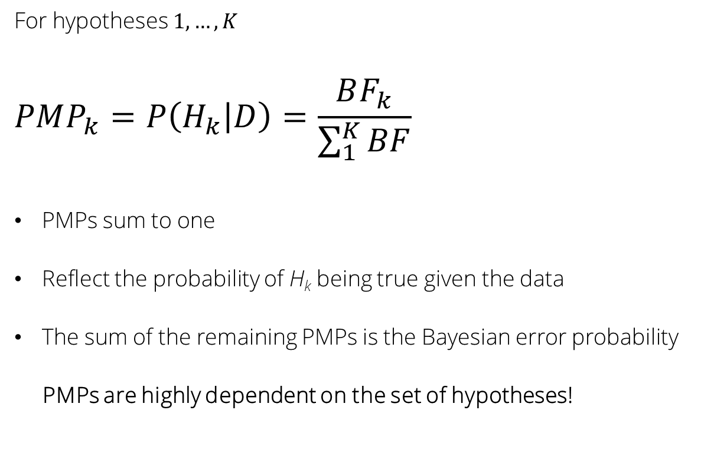
Posterior Model Probabilities
For hypotheses $1,…, K$
$$PMP_{k}=P\left(H_{k} | D\right)=\frac{BF_{k}}{\sum_{1}^{K}{BF}}$$
PMPs sum to one
Reflect the probability of H_{k} being true given the data
The sum of the remaining PMPs is the Bayesian error probability
PMPs are highly dependent on the set of hypotheses!
H₂
H₁
H₃

Slide 20
Content Overview
Lab Seminar University of Geneva
The Problem
Multilevel Models
Bayesian Hypothesis Evaluation
The BayesSSD package
Modelling Attrition
Wrap-up

Slide 21
The BayesSSD Package – Main Functions
SSD_longit()
Bayesian sample size determination for longitudinal experiments
SSD_crt_inform() and SSD_crt_null()
Bayesian sample size determination for cluster randomized trials (informative hypotheses and null hypothesis)

Slide 22

The BayesSSD Package – The Algorithm
Input
Data Generation
Adapt Sample Size
Fit Multilevel Model
Return Final Result
Compute Bayes Factors
Power Criterion met?

Slide 23

Approximate Adjusted Fractional Bayes Factor Gu, Mulder & Hoijtink (2018) Hoijtink, Mulder, van Lissa (2019)
$$AAFBF_{1u}=\frac{Fit_{1}}{Complexity_{1}}$$
Fit: How well the data is described by H₁
Complexity: How general/non-specific H₁ is

Slide 24
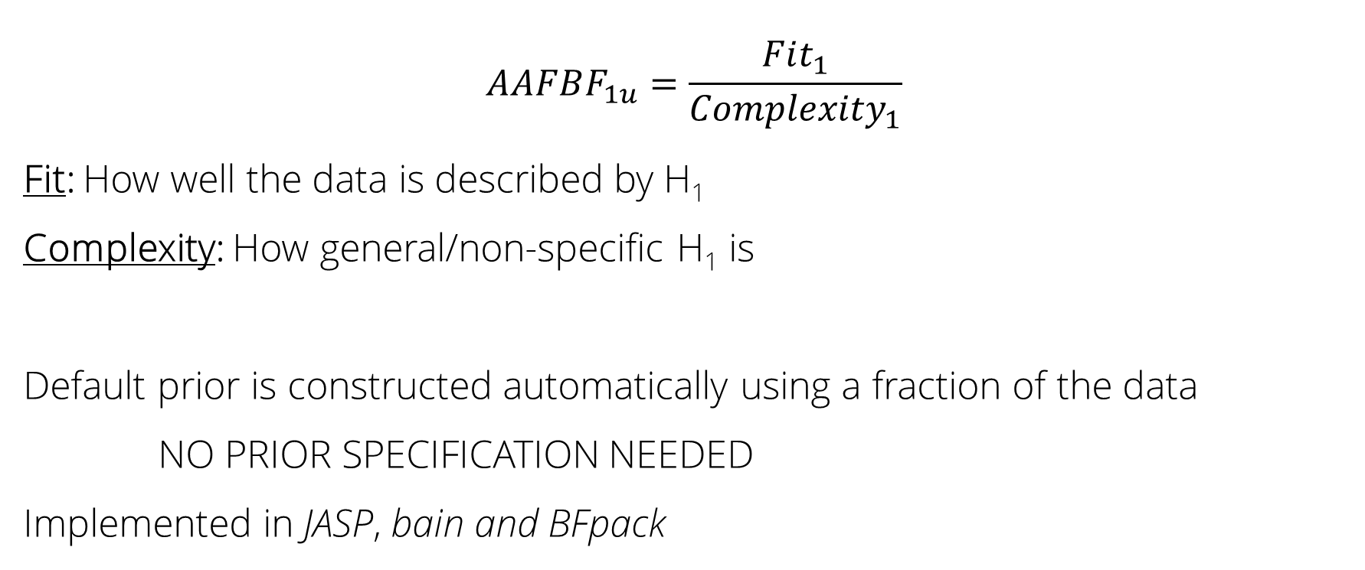
Approximate Adjusted Fractional Bayes Factor Gu, Mulder & Hoijtink (2018) Hoijtink, Mulder, van Lissa (2019)
$$AAFBF_{1u}=\frac{Fit_{1}}{Complexity_{1}}$$
Fit: How well the data is described by H₁
Complexity: How general/non-specific H₁ is
Default prior is constructed automatically using a fraction of the data
NO PRIOR SPECIFICATION NEEDED
Implemented in JASP, bain and BFpack

Slide 25
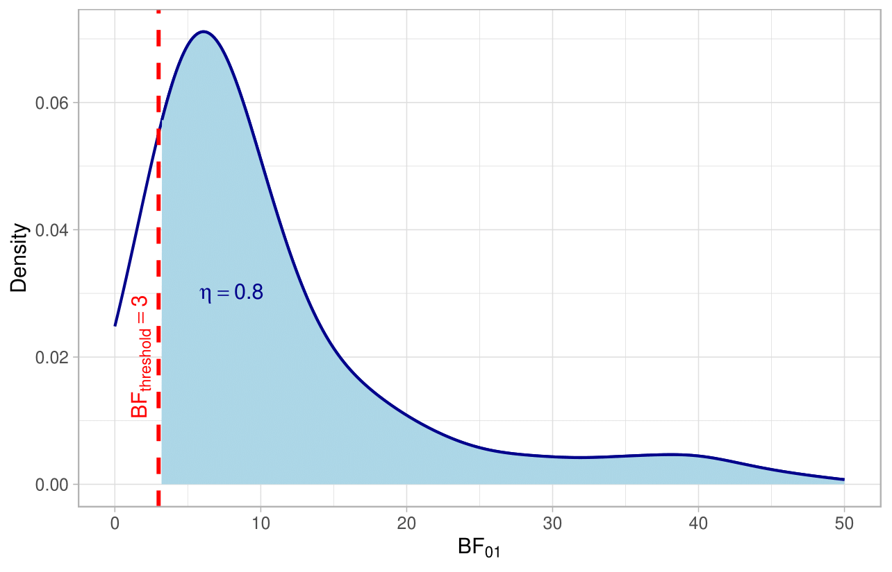
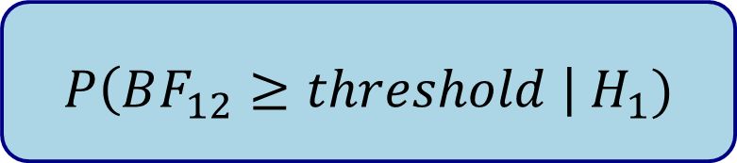
Power Criterion
Power is defined as probability
that a Bayes Factor for the true H₁ exceeds a user-specified threshold
$$P\left(BF_{12}≥threshold \right| H_{1})$$

Slide 26
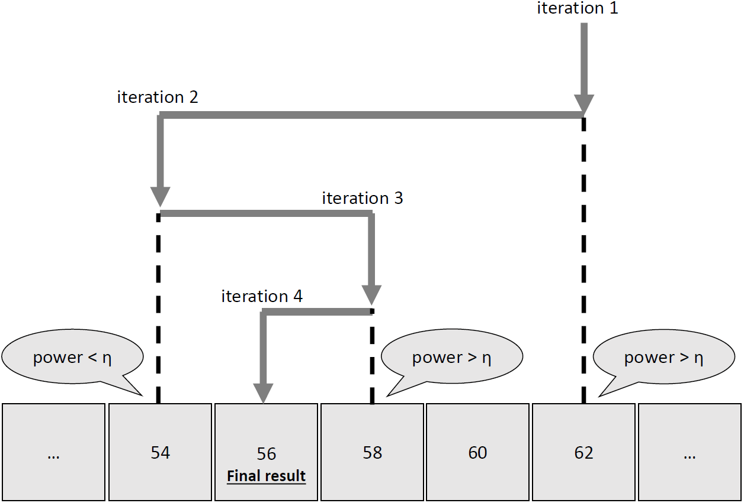
Binary Search

Slide 27
Content Overview
Lab Seminar University of Geneva
The Problem
Multilevel Models
Bayesian Hypothesis Evaluation
The BayesSSD package
Modelling Attrition
Wrap-up

Slide 28
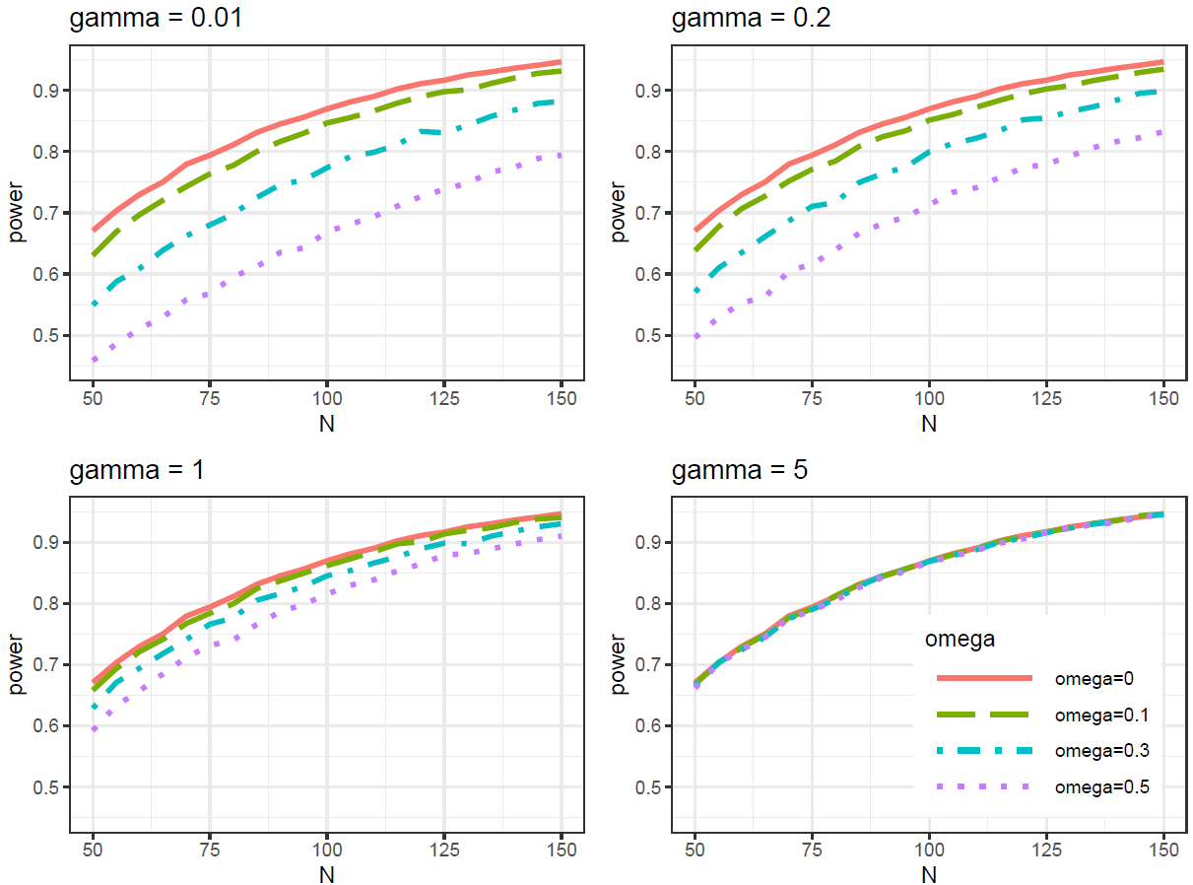

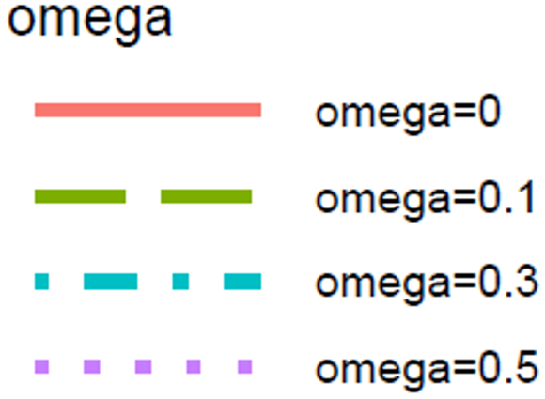
Attrition/Dropout
Attrition negatively impacts power!
omega: proportion of participants who drop out

Slide 29


Attrition/Dropout
Attrition negatively impacts power!
The timing of drop-out matters!
The earlier, the worse
How to account for this in the power analysis?
early dropout
early-ish dropout
ShinyApp
late-ish dropout
late dropout
omega: proportion of participants who drop out

Slide 30
Content Overview
Lab Seminar University of Geneva
The Problem
Multilevel Models
Bayesian Hypothesis Evaluation
The BayesSSD package
Modelling Attrition
Wrap-up

Slide 31
Code and Output Example
ssd_result <- SSD_longit(
eta = 0.8,
hypothesis = "a < b < c < d",
method = "bfc",
BFthres = 3,
attrition = "nonparametric",
params = c(1, 0.799, 0.465),
m = 10000,
t.points = c(0,2,8),
var.u0 = 0.01,
var.u1 = 0.1,
var.e = 0.1,
cov = 0,
eff.sizes = c(0, 0.2, 0.4, 0.6),
seed = 123,
N.min = 50,
N.max = 1500
)

Slide 32
Code and Output Example
Final sample size
=================
Hypotheses:
H1: a < b < c < d
Hc: not H1
Using a total of N = 684 Participants
Power = P(BF_1c > 3 | H1) = 0.806

Slide 34

Thank you for your attention!
Questions?
Comments?
Thoughts?
u.c.losener1@uu.nl

Slide 35
References
Gu, X., Mulder, J., & Hoijtink, H. (2018). Approximated adjusted fractional Bayes factors: A general method for testing informative hypotheses. British Journal of Mathematical and Statistical Psychology, 71(2), 229-261.
Hoijtink, H., Mulder, J., Van Lissa, C., & Gu, X. (2019). A tutorial on testing hypotheses using the Bayes factor. Psychological methods, 24(5), 539.
u.c.losener1@uu.nl

Slide 37
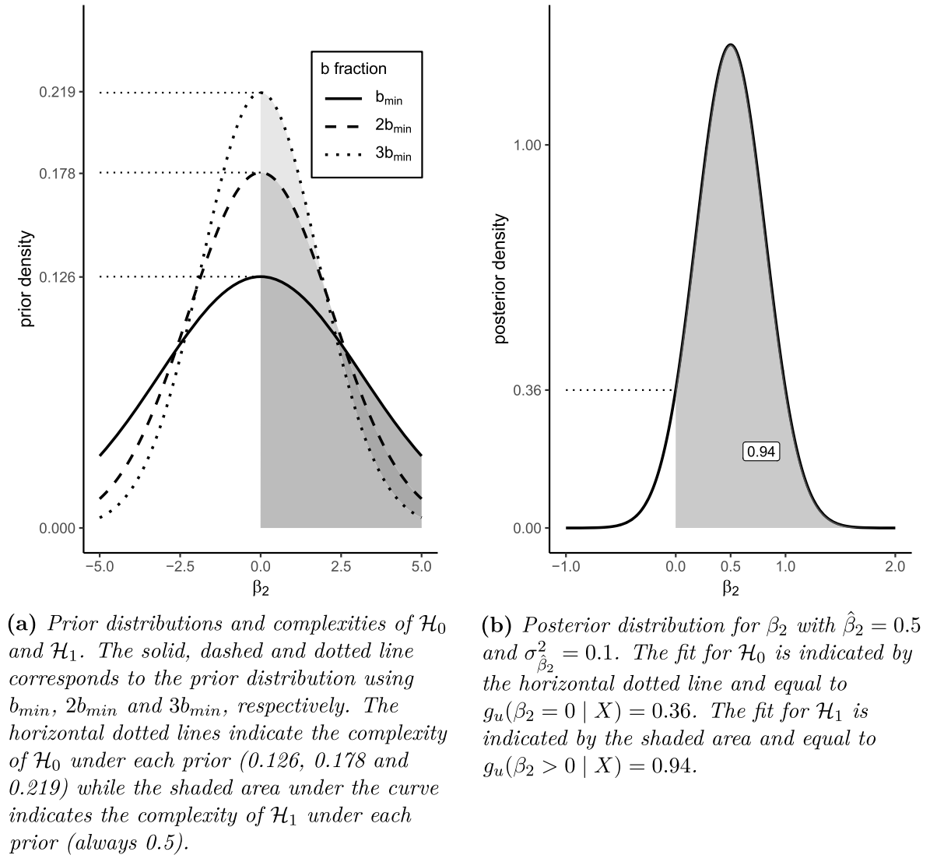
Approximate Adjusted Fractional BF (Gu et al., 2018)
BF_{1u} = fit₁ / complexity₁
BF₁₂ = BF_{1u} / BF_{2u}
Default fractional prior constructed using fraction of the data (b)
Posterior approximated by normal distribution
b-fraction sensitivity
(see left plot)
Figure taken from Lösener & Moerbeek, 2025

