Slide 1
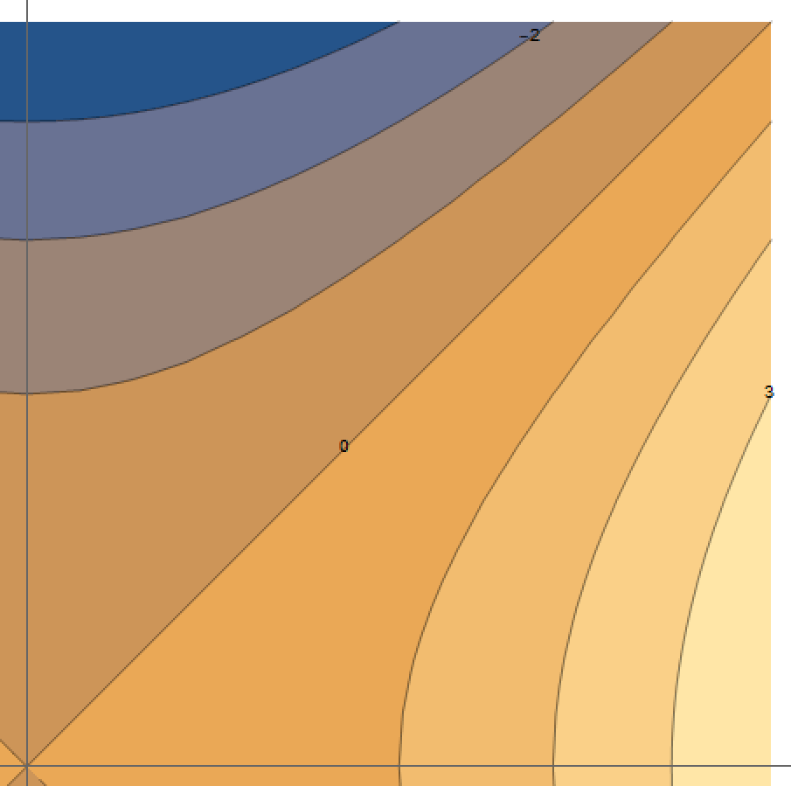




$$v$$
①
②
$$t_{0}=0$$
$$t_{0}=1$$
$$u$$

