Slide 1
Distributed Hierarchical Runtime for CnC
Srđan Milaković and Zoran Budimlić Rice university

Slide 2
Parallelism in large scale applications
Expressing parallelism is difficult
synchronization, coordination, data-races, communication
Developers should use high-level and implicitly parallel programming models instead
Concurrent Collections (CnC)

Slide 3
Concurrent Collections (CnC)
Declarative
Intuitive
Implicitly parallel
Dynamic single-assignment
Data-race free

Slide 4
Intuitive parallel program implementation in CnC
Intuitive
Performance overhead
Easy for domain experts
Natural way of expressing computation
Fine-grain dependencies and data
exposes maximal parallelism
Creating a lot of steps
Scheduling overhead
Frequent access to item collections
Restarting steps
Usually implemented as concurrent hash maps

Slide 5
Reducing the overhead
Tiled computation
Reduces scheduling overhead
Task creation/invocation/destruction
Tiled data
Reduces the access overhead
Improves locality
Reduces memory fragmentation

Slide 6
Writing tiled code by hand
Takes a lot of time
Error prone
Requires expertise
Usually not performance portable

Slide 7
Compiler-generated tiled code
Static analysis
Great if the dependencies are static
Cholesky factorization, Smith-Waterman, etc.
Everything is not analyzable statically
Programs with dynamic dependencies
UTS, Graph500, MADNESS apps, etc.

Slide 8
How can the runtime help?
Support for tiled computation and tiled data
Efficient implementation that supports both fine-grain and coarse-grain “views” of data and computation
Support for incomplete tiles
Hierarchical, multi-level tiling

Slide 9
Hierarchical CnC
Multiple views for item collections and steps collections
If each hierarchy level is a valid CnC program, we can easily track completion of irregular steps/items
data-ready, control-ready, ready, executed

Slide 10
Step Collection Hierarchy
Step Collection S
tag <i, j>
4 x 4 steps
Tiling strategies
2D tiles
Row tiles
Column tiles
Partial row tiles
Partial column tiles
S <0,0>
S <0,1>
S <0,2>
S <0,3>
S <1,0>
S <1,1>
S <1,2>
S <1,3>
S <2,0>
S <2,1>
S <2,2>
S <2,3>
S <3,0>
S <3,1>
S <3,2>
S <3,3>

Slide 11
Step Collection Hierarchy
Step Collection S
tag <i, j>
4 x 4 steps
Tiling strategies
2D tiles
Row tiles
Column tiles
Partial row tiles
Partial column tiles
S <0,0>
S <0,1>
S <0,2>
S <0,3>
S<0,0>
S<0,2>
S <1,0>
S <1,1>
S <1,2>
S <1,3>
S <2,0>
S <2,1>
S <2,2>
S <2,3>
S<2,0>
S<2,2>
S <3,0>
S <3,1>
S <3,2>
S <3,3>

Slide 12
Step Collection Hierarchy
Step Collection S
tag <i, j>
4 x 4 steps
Tiling strategies
2D tiles
Row tiles
Column tiles
Partial row tiles
Partial column tiles
S <0,0>
S <0,1>
S <0,2>
S <0,3>
S<0>
S <1,0>
S <1,1>
S <1,2>
S <1,3>
S<1>
S <2,0>
S <2,1>
S <2,2>
S <2,3>
S<2>
S <3,0>
S <3,1>
S <3,2>
S <3,3>
S<3>

Slide 13
Step Collection Hierarchy
Step Collection S
tag <i, j>
4 x 4 steps
Tiling strategies
2D tiles
Row tiles
Column tiles
Partial row tiles
Partial column tiles
S <0,0>
S <0,1>
S <0,2>
S <0,3>
S <1,0>
S <1,1>
S <1,2>
S <1,3>
S <2,0>
S <2,1>
S <2,2>
S <2,3>
S <3,0>
S <3,1>
S <3,2>
S <3,3>
S<0>
S<1>
S<2>
S<3>

Slide 14
Produce/Consume Hierarchy
Step Collection S
Item Collections IA, IB
S<i,j>
Consumes IA<i,j>
Produces IB<i,j>
IA <0,0>
S <0,0>
IB <0,0>
IA <0,0>
S <1,0>
IB <0,0>
IA <0,0>
S <2,0>
IB <0,0>
IA <0,0>
S <3,0>
IB <0,0>

Slide 15
Produce/Consume Hierarchy
Step Collection S
Item Collections IA, IB
S<i,j>
Consumes IA<i,j>
Produces IB<i,j>
IA <0,0>
S <0,0>
IB <0,0>
IA <1,0>
S <1,0>
IB <1,0>
IA <2,0>
S <2,0>
IB <2,0>
IA <3,0>
S <3,0>
IB <3,0>

Slide 16
Produce/Consume Hierarchy
Step Collection S
Item Collections IA, IB
S<i,j>
Consumes IA<i,j>
Produces IB<i,j>
IA <0,0>
S <0,0>
IB <0,0>
IA <1,0>
S <1,0>
IB <1,0>
IA <2,0>
S <2,0>
IB <2,0>
IA <3,0>
S <3,0>
IB <3,0>

Slide 17
Produce/Consume Hierarchy
3 tiles
1 step tile
S<0>
2 item tiles
IA<0>
IB<0>
IA <0,0>
S <0,0>
IB <0,0>
IA <1,0>
S <1,0>
IB <1,0>
IA <2,0>
S <2,0>
IB <2,0>
IA <3,0>
S <3,0>
IB <3,0>
IA<0>
S<0>
IB<0>

Slide 18
Produce/Consume Hierarchy
3 tiles
1 step tile
S<0>
2 item tiles
IA<0>
IB<0>
IA <0,0>
S <0,0>
IB <0,0>
IA <1,0>
S <1,0>
IB <1,0>
IA <2,0>
S <2,0>
IB <2,0>
IA <3,0>
S <3,0>
IB <3,0>
IA<0>
S<0>
IB<0>

Slide 19
Produce/Consume Hierarchy
3 tiles
1 step tile
S<0>
2 item tiles
IA<0>
IB<0>
IA <0,0>
S <0,0>
IB <0,0>
IA <1,0>
S <1,0>
IB <1,0>
IA <2,0>
S <2,0>
IB <2,0>
IA <3,0>
S <3,0>
IB <3,0>
IA<0>
S<0>
IB<0>

Slide 20
Hierarchy levels
Level 1 (fine grained)
Level 2 (coarse grained)
IA <0,0>
S <0,0>
IB <0,0>
IA <1,0>
S <1,0>
IB <1,0>
IA<0>
S<0>
IB<0>
IA <2,0>
S <2,0>
IB <2,0>
IA <3,0>
S <3,0>
IB <3,0>

Slide 21
Tile completeness – regular apps
How to detect when is the tile complete in regular applications?
S <0,0>
IB <0,0>
Executed
S <1,0>
IB <1,0>
IB<0> Complete?
Executed
S <2,0>
IB <2,0>
Yes ✅
No ❌
Executed
S <3,0>
IB <3,0>
Executed
S<0>
IB<0>
Executed
Complete

Slide 22
Tile completeness – irregular apps
How to detect when is the tile complete in irregular applications?
S <0,0>
IB <0,0>
Executed
S <1,0>
IB <1,0>
IB<0> Complete?
Executed
S <2,0>
❌
Yes ✅
No ❌
Executed
Item can be created by exactly one step
S <3,0>
IB <3,0>
Executed
S<0>
IB<0>
Executed
Complete

Slide 23
Tile completeness – irregular apps
S <0,0>
IB <0,0>
S <0,0>
IB <0,0>
S <0,0>
IB <0,0>
Executed
Executed
Executed
S <1,0>
IB <1,0>
S <1,0>
IB <1,0>
Executed
Executed
S <2,0>
IB <2,0>
S <2,0>
S <2,0>
Executed
Executed
Executed
S <3,0>
IB <3,0>
S <3,0>
IB <3,0>
S <3,0>
IB <3,0>
Executed
Executed
Executed
S<0>
IB<0>
S<0>
IB<0>
S<0>
IB<0>
Executed
Complete
Executed
Complete
Executed
Complete

Slide 24
CnC subgraphs
Every CnC subgraph is a valid CnC program
E.g., we can create a subgraph by picking all steps from a tile and its dependencies
IA <0,0>
S <0,0>
IB <0,0>
IA <1,0>
S <1,0>
IB <1,0>
IA <2,0>
S <2,0>
IB <2,0>
IA <3,0>
S <3,0>
IB <3,0>
IA<0>
S<0>
IB<0>

Slide 25
Micro-runtimes
Runtime concept
Idea:
Identify a CnC subgraph
Tell the runtime to execute this subgraph as a “group”
Enable a more efficient scheduling and execution of this group
Localize data
No concurrency -> no concurrency overhead

Slide 26
Micro-runtimes
Micro-runtime
Subgraphs that are created from a tile can be executed serially
Micro-runtimes:
improve locality
reduce number of accesses to shared concurrent data structures
simplify scheduling
reduce overhead
IA <0,0>
S <0,0>
IB <0,0>
IA <1,0>
S <1,0>
IB <1,0>
IA <2,0>
S <2,0>
IB <2,0>
IA <3,0>
S <3,0>
IB <3,0>
Item collection A
Item Collection B

Slide 27
Micro-runtimes

Slide 28
Performance results
Intel(R) Xeon(R) Gold 6154 CPU
18 cores @ 3.00GHz
1.5 TB RAM
Linux kernel - 3.10.0

Slide 29
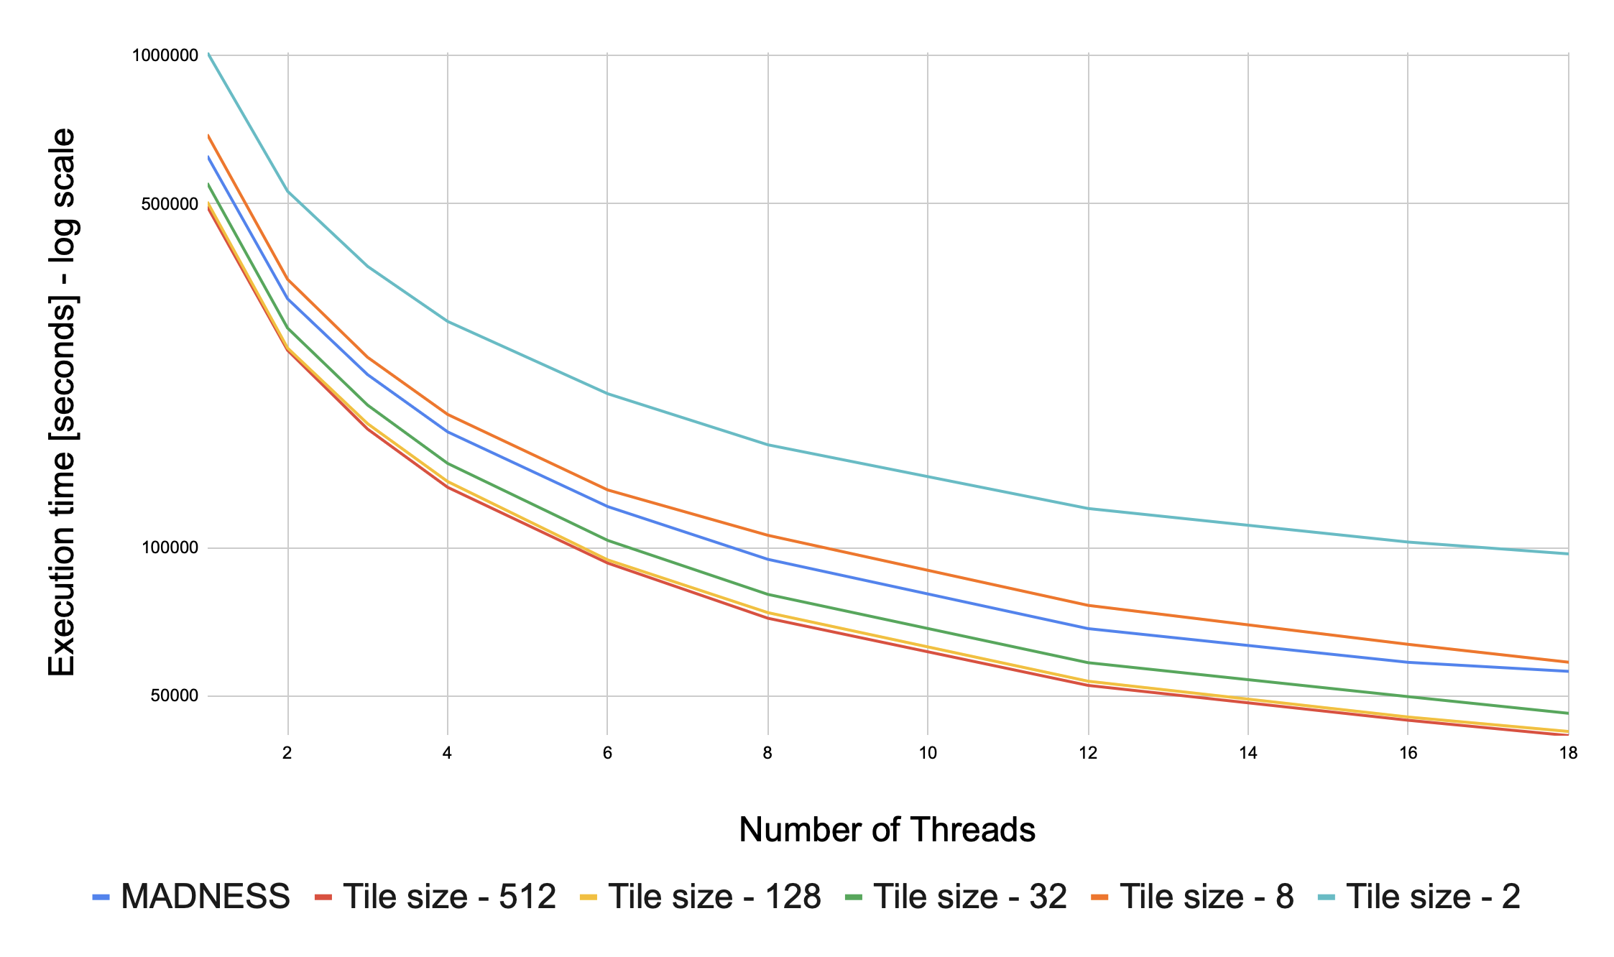
KEMC results
Kinematic energy matrix calculation
Input: 2 vectors of 3D functions (octrees)
Derivation (dx, dy, dz)
Compression
Inner product
Reduction
1.35x improvement over baseline

Slide 30
Conclusion
Distributed hierarchical CnC runtime
Micro-runtimes
KEMC 1.35x improvement over MADNESS

Slide 31
Future work
Analyze current performance results
Implement distributed version of KEMC
Hierarchy reconfiguration might be needed

