Slide 1
Tree Traversals in Dynamic CnC Applications
Srđan Milaković and Zoran Budimlić Rice university

Slide 2
Tree traversals
Many scientific applications include tree traversals
MADNESS (Multiresolution Adaptive Numerical Environment for Scientific Simulation)
High-level software environment for solving integral and differential equations in many dimensions
Each function is represented as K-d tree
KEMC (Kinetic Energy Matrix Computation)
refinement, derivation, compression, inner product, reduction
Tile shape, data distribution

Slide 3
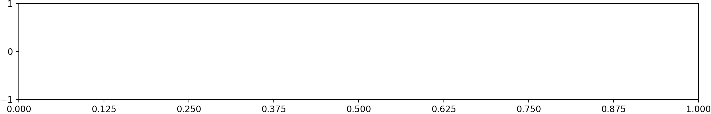
1D function in MADNESS

Slide 4
1D function in MADNESS

Slide 5
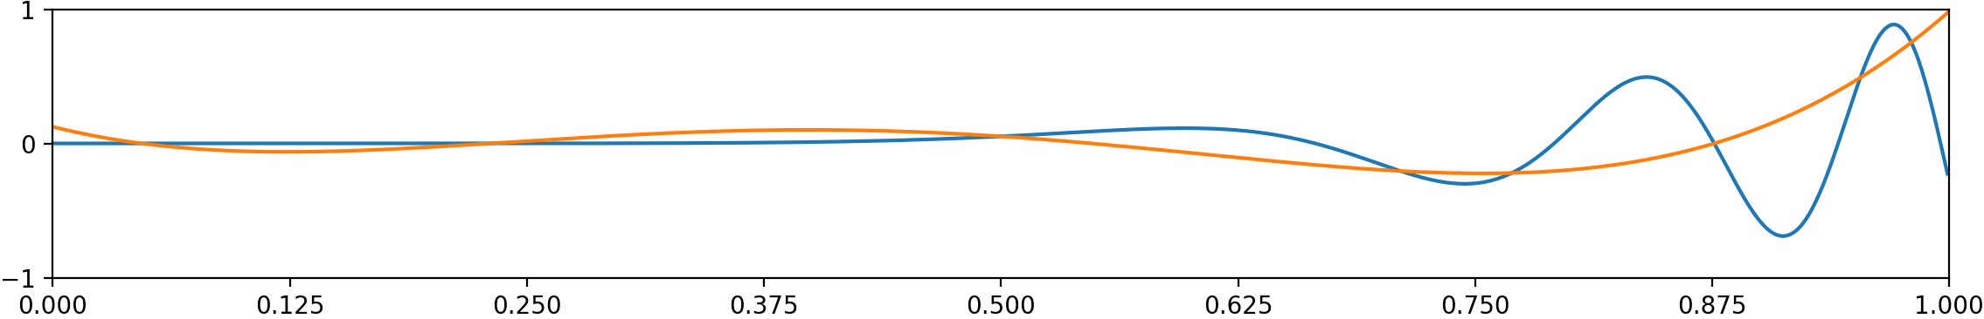
1D function in MADNESS

Slide 6
1D function in MADNESS

Slide 7
1D function in MADNESS

Slide 8
1D function in MADNESS

Slide 9
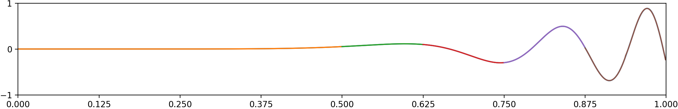
1D function in MADNESS

Slide 10
1D function in MADNESS

Slide 11
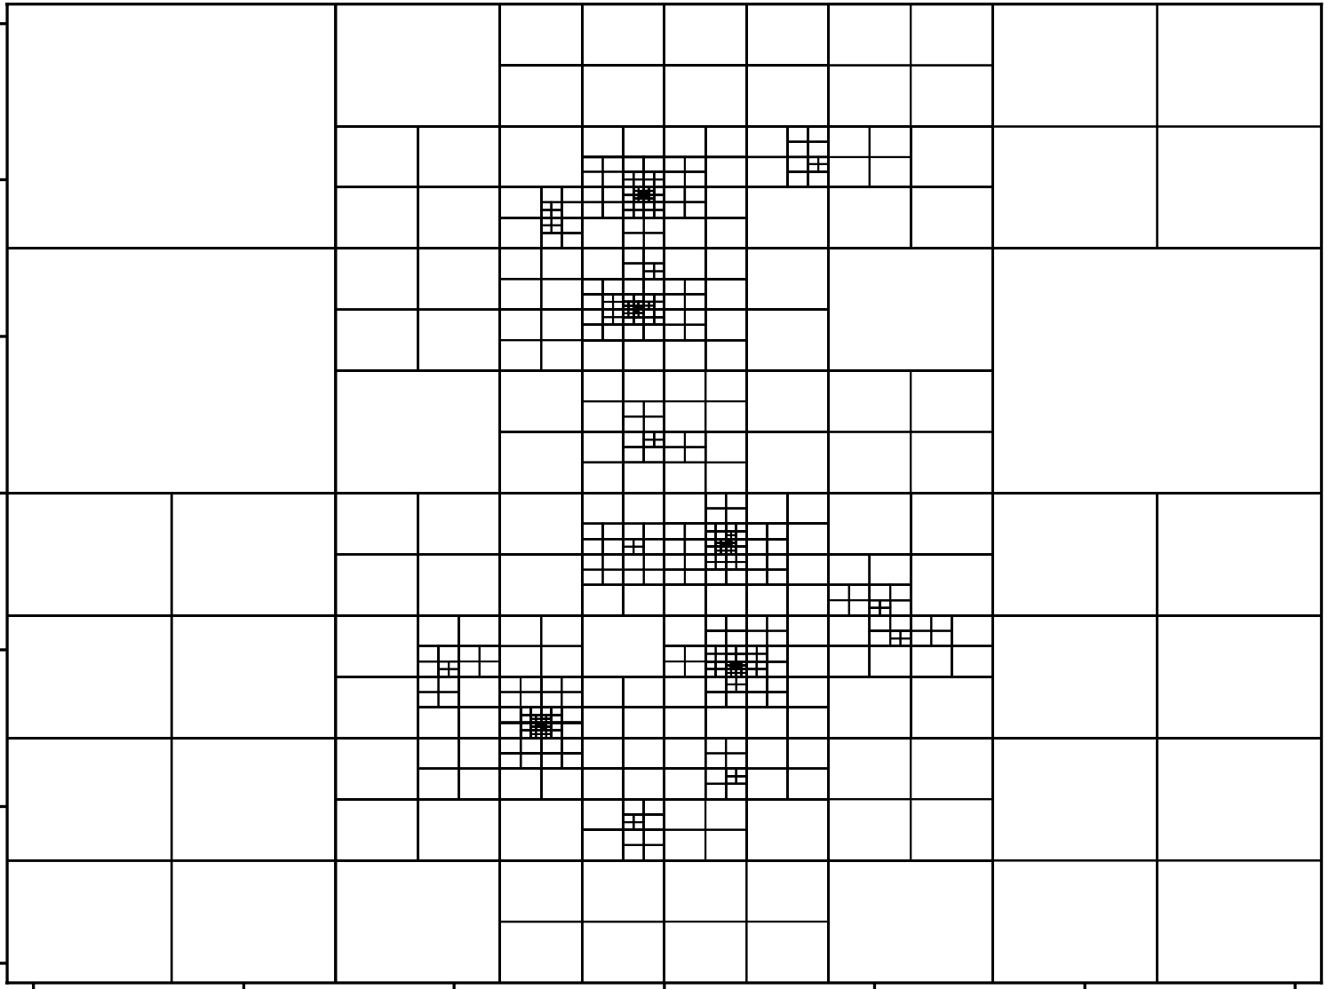
Trees are irregular and sparse
Irregular
Shape only known at execution time
Sparse
Multiresolution
988 nodes
Fixed resolution
4 194 304 nodes

Slide 12
Trees in CnC
Nodes are stored in item collections
MADNESS – 2 types of coefficients
sValues item collection
dValues item collection
Node tag contains
function ID
node key – <depth, offsets>

Slide 13
Node tag
Tags
1D tree - <functionID, depth, xOffset>
2D tree - <functionID, depth, xOffset, yOffset>
3D tree - <functionID, depth, xOffset, yOffset, zOffset>
<f, 0, 0>
<f, 1, 0>
<f, 1, 1>
<f, 2, 0>
<f, 2, 3>
<f, 3, 4>

Slide 14
Possible distributions
Distribution by tree ID
Distribution by node key
Tree 0
Tree 1
Tree 0
Tree 1
Tree 3
Tree 2
Tree 3
Tree 2

Slide 15
Possible tiling strategies
Tiling in tree dimension
Tiling in vector dimension

Slide 16
Refinement
Top-down traversal
We store coefficients at the leaf level
Refinement steps do not have any data dependencies
Distribution and tiling would depend on the kernel that follows refinement

Slide 17
Derivation
Top-down traversal
We store coefficients at the leaf level
To create a result node
Left node (or its parent)
Center node
Right node (or its parent)
Boundary conditions

Slide 18
Derivation – case 1
(1) Left and right nodes exist and have coefficients
Center node
Left node
Right node

Slide 19
Derivation – case 2
(2) Left or right node does not exist
Center node
Left node
Right node

Slide 20
Derivation – case 3
(3) Left or right node exists and does not have coefficients
Center node
Left node
Right node

Slide 21
Derivation
Top-down traversal
We store coefficients at the leaf level
Derivation might create more nodes
Distribution
Distribution by tree ID is better
Tiling
Tiling in tree dimension is better
We might see some benefits from tiling in vector dimension

Slide 22
Compression
Bottom-up traversal
Converts sValues to dValues
Compression step reads sValues from children and outputs dValues and sValues for current node
Distribution
A single tree should be stored on a single node
Tiling
Tiling in tree dimension is better
We might see some benefits from tiling in vector dimension

Slide 23
Inner product
Can be performed in any order, we do top-down traversal
The result is calculated on intersection of trees
Distribution by Node ID is better
Tiling in vector dimension is better
·
=

Slide 24
Inner product – DGEMM
Inner product between 2 vectors of functions
v₁ = v₂ = (f1, f2, f3, f4, f5, f6)
 | f1 | f2 | f3 | f4 | f5 | f6
f1 | f1 · f1 | f1 · f2 | f1 · f3 | f1 · f4 | f1 · f5 | f1 · f6
f2 | f2 · f1 | f2 · f2 | f2 · f3 | f2 · f4 | f2 · f5 | f2 · f6
f3 | f3 · f1 | f3 · f2 | f3 · f3 | f3 · f4 | f3 · f5 | f3 · f6
f4 | f4 · f1 | f4 · f2 | f4 · f3 | f4 · f4 | f4 · f5 | f4 · f6
f5 | f5 · f1 | f5 · f2 | f5 · f3 | f5 · f4 | f5 · f5 | f5 · f6
f6 | f6 · f1 | f6 · f2 | f5 · f3 | f6 · f4 | f6 · f5 | f6 · f6

Slide 25
Inner product – DGEMM
Inner product between 2 vectors of functions
v₁ = v₂ = (f1, f2, f3, f4, f5, f6)
 | f1 |  |  | f4 |  | f6
f1 | f1 · f1 |  |  | f1 · f4 |  | f1 · f6
f4 | f4 · f1 |  |  | f4 · f4 |  | f4 · f6
f6 | f6 · f1 |  |  | f6 · f4 |  | f6 · f6
Node
Dept = 3
Offset = 5

Slide 26
Inner product – DGEMM
Inner product between 2 vectors of functions
v₁ = v₂ = (f1, f2, f3, f4, f5, f6)
Each set off coefficients (e.g. f1<3, 6>) is an array
If we compress a vector of coefficients, we can use DGEMM
 | f1 | f4 | f6
f1 | f1 · f1 | f1 · f4 | f1 · f6
f4 | f4 · f1 | f4 · f4 | f4 · f6
f6 | f6 · f1 | f6 · f4 | f6 · f6
Node
Dept = 3
Offset = 5

Slide 27
Hierarchy tuner in CnC
template<class Tag, class Context, size_t NDIM, size_t TILE_DEPTH, size_t TILE_WIDTH> struct TopDownHierarchyTuner : cnc::StepCollectionHierarchyTuner<Tag, Tag> { size_t cnt{TILE_WIDTH}; std::vector<Tag> borderTags; static bool getSuperTag(const Tag &tag, Tag &superTag) { auto levelDiff = tag.key.level() % TILE_DEPTH; superTag.function = tag.function - tag.function % TILE_WIDTH; superTag.key = tag.key.parent(levelDiff); return true; } bool subTagPut(const Tag &tag) { borderTags.emplace_back(tag); return borderTags.size() == cnt; } bool subTagsPut(const std::vector<Tag> &tags) { for (auto tag : tags) { borderTags.emplace_back(tag); } return true; } const std::vector<Tag> &getBorderTags(const Tag &tag) { return borderTags; } };

Slide 28
Distribution Tuners
template<size_t NDIM> struct BinaryOpTagLevelTuner : cnc::StepCollectionLevelTuner<BinaryOpTag<NDIM>> { template<class C> int computeOn(const BinaryOpTag<NDIM> &tag, C &ctx) const { return std::hash(tag.key); }};
template<class T> struct SValuesLevelTuner : cnc::ItemCollectionLevelTuner<NodeTag<NDIM>, madness::GenTensor<T>*> { template<class Context> int producedOn(const NodeTag<NDIM> &tag, Context &ctx) const { return distributionFunc(tag.function, tag.key) % this->getNumPlaces(); }};

Slide 29
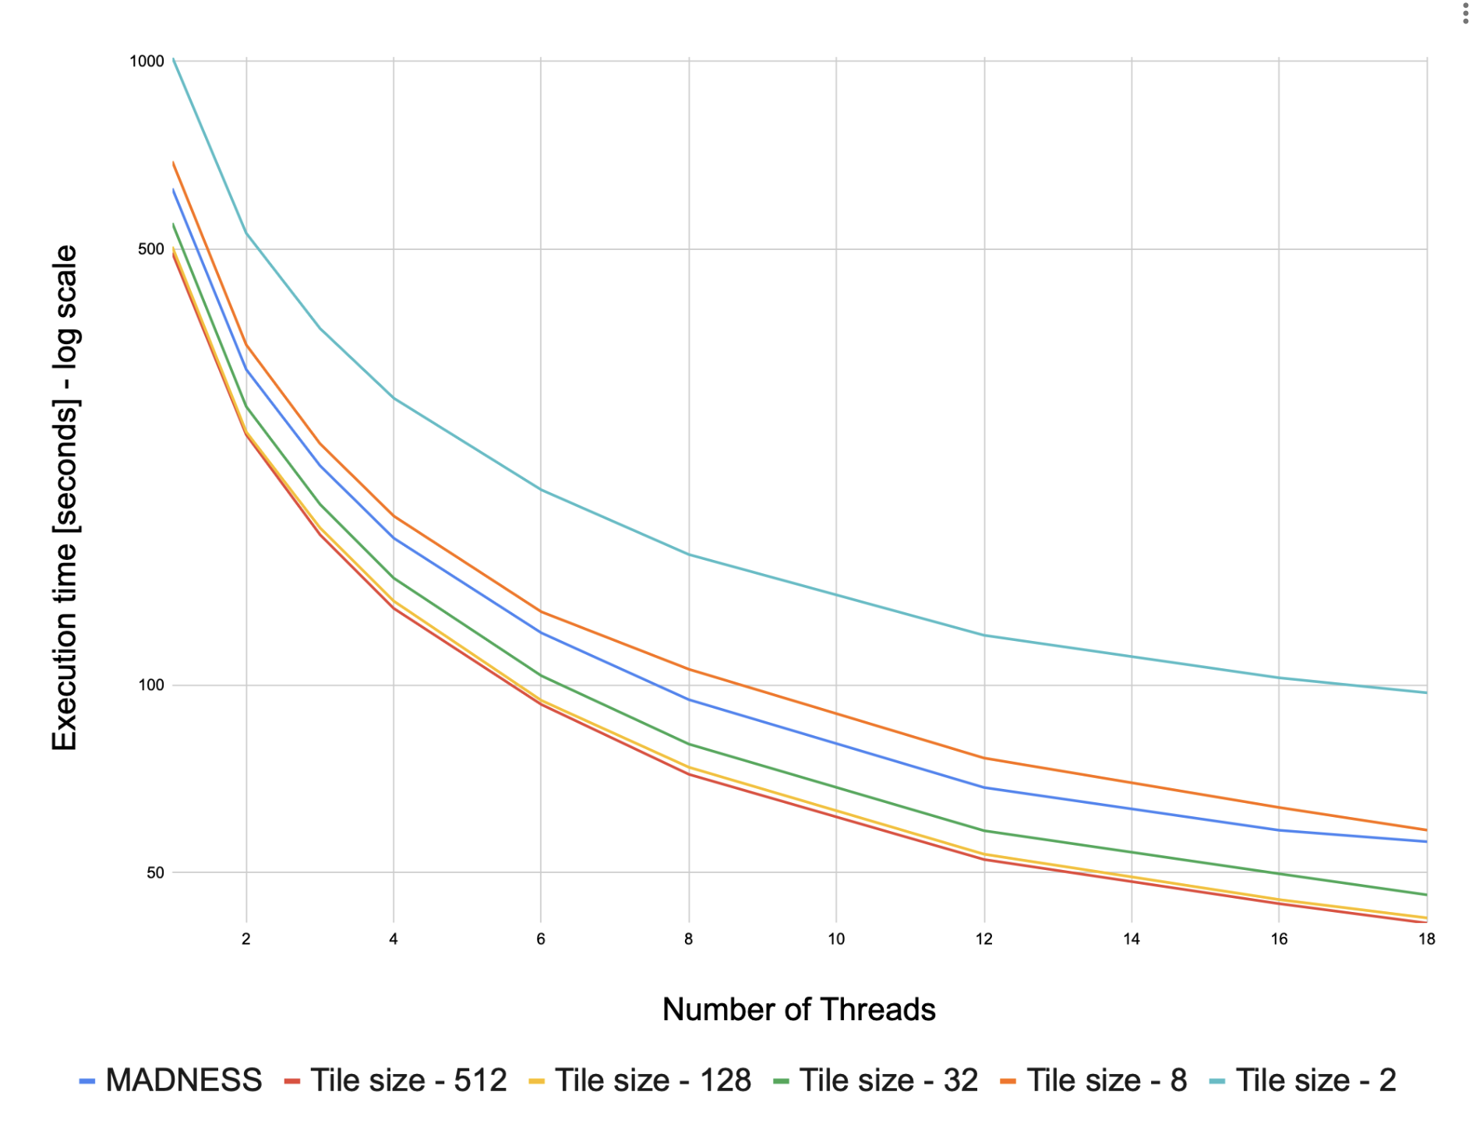
KEMC results
Kinematic energy matrix calculation
Input: 2 vectors of 3D functions (octrees)
Derivation (dx, dy, dz)
Compression
Inner product
Reduction
1.35x improvement over baseline

Slide 30
Summary and future work
We shown different tiling and distribution strategies for multiple MADNESS kernels
Some kernels work better with function ID distribution/tiling whereas some kernels work better with node ID distribution/tiling
If node ID distribution is used for Inner product, we can perform DGEMM transformation
Investigate performance of different distributions/tiling strategies using Hierarchical CnC Runtime

