Slide 1
軟體協作
角色與工具

Slide 2
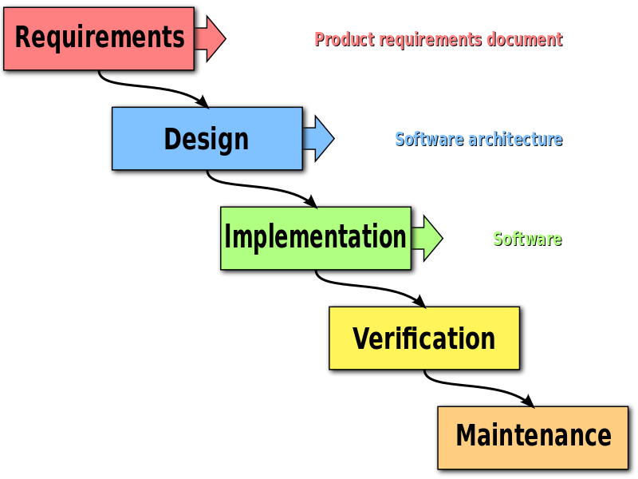
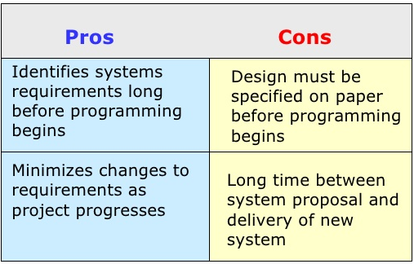
軟體開發 Waterfall model

Slide 3
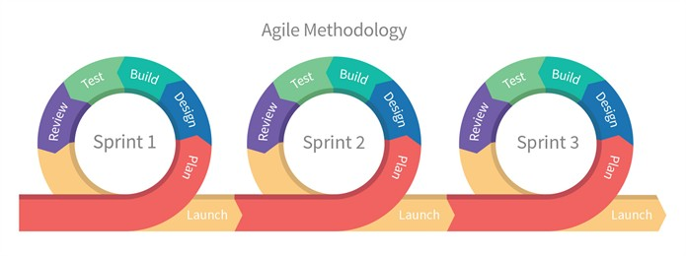
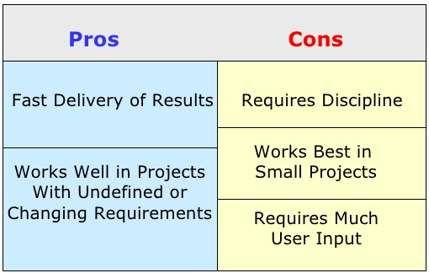
軟體開發 Agile

Slide 4
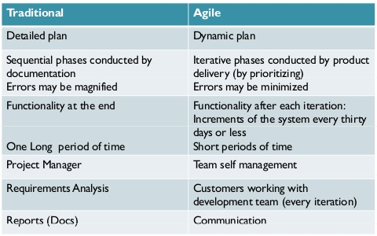
Waterfall vs. Agile

Slide 5
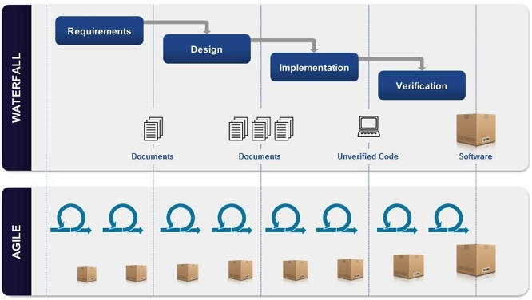
Waterfall vs. Agile

Slide 6
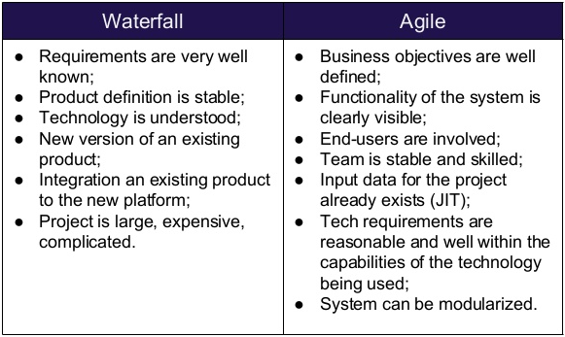
使用時機 Waterfall vs. Agile

Slide 7
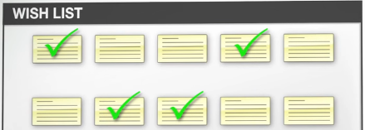
Scrum
Product or feature requests.
From customers, manager or team members.
User Story
As a (role), I want (feature), so that (benefit).
As a land owner, I want to buy music with a single click, so that there's a minimum of rework.
Product Backlog
A collestion of user stories.
Wish List
What would make this product great?

Slide 8
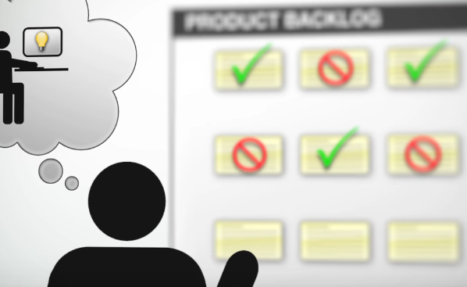
Scrum - roles
Product Owner
Make sure the direction of the product.
Choose right feature into the product.
Scrum Master (Project Manager)
Make sure the project run smoothly.
Handle daily team meeting.
Other team members
Developer, tester, customer

Slide 9
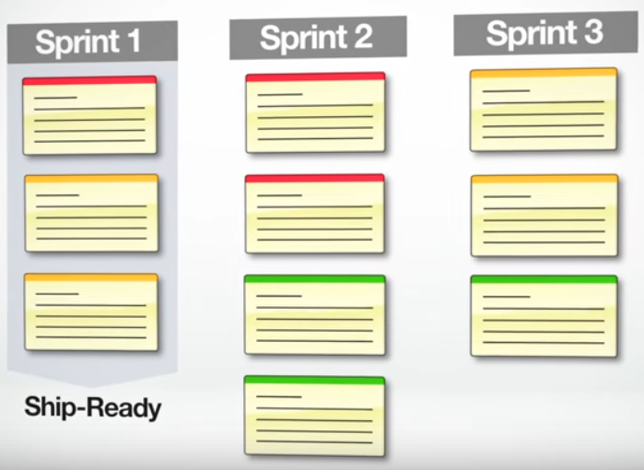
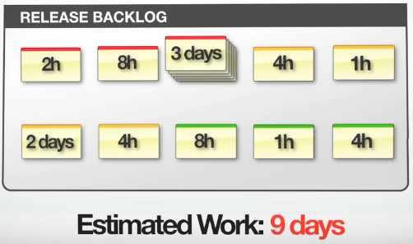
Scrum – Release Planing (Backlog)
Choose user story from product backlog and put it into this release planing.
Set prioruty from release backlog and estimate work days.
Sprint
A small milestone
Short sprint length short release cycle.

Slide 10
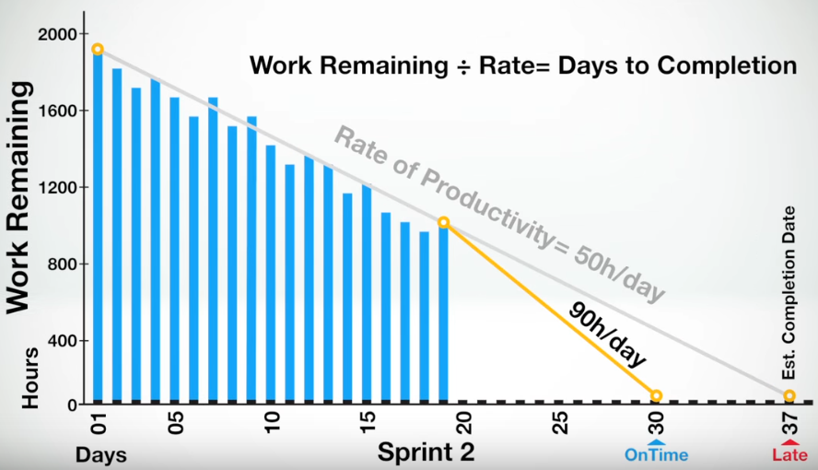
Scrum – Burndown Chart
Rate of (daily) proditcutivity
Estimate completion date

Slide 11
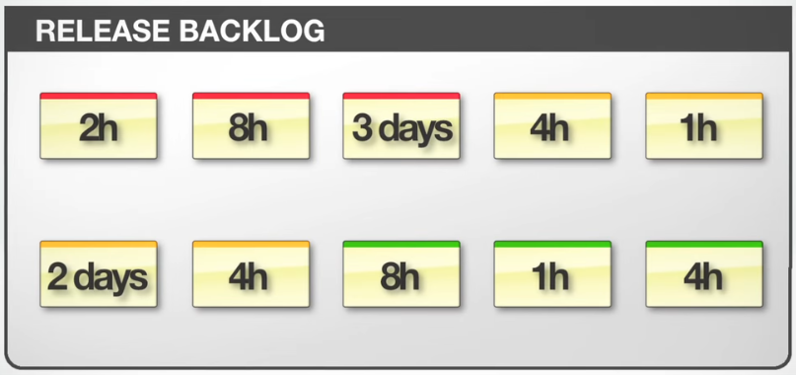
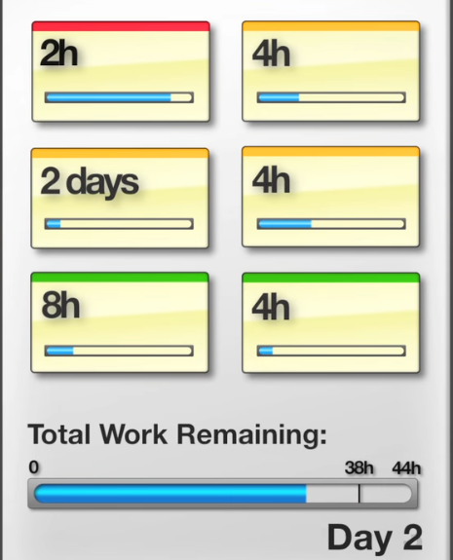
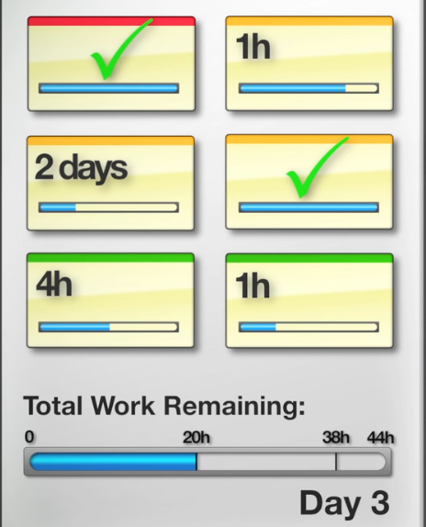
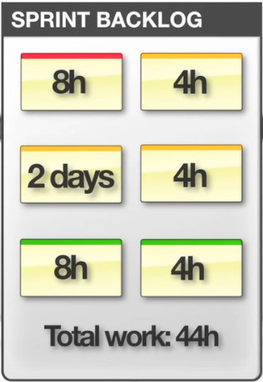
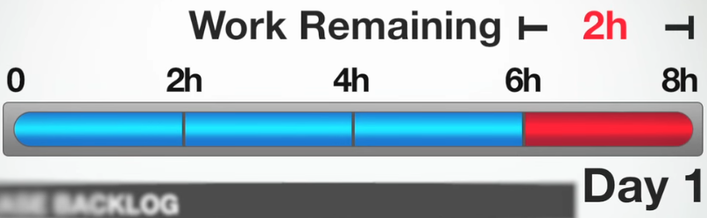
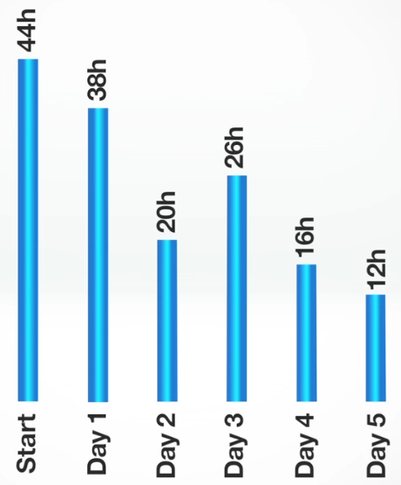
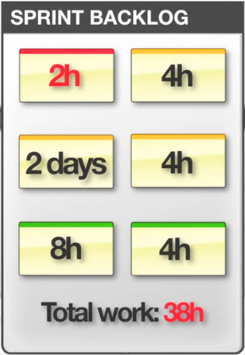
Scrum – Burndown Chart
8h Task

Slide 12
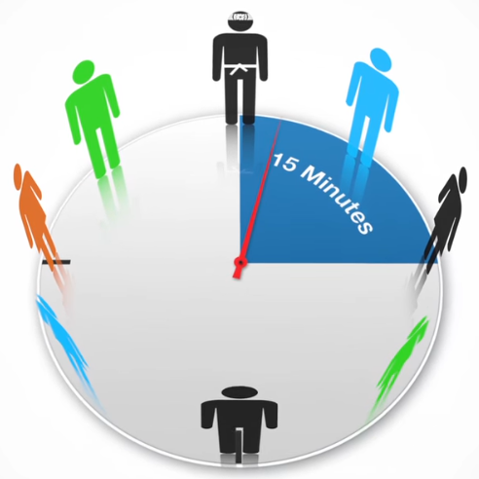
Scrum – Daily Standup Meeting
This is what I have done since last we met...
There are the problem I have encountered...
This is what I plan to do today...
Scrum master:
Does anyone have a solution to that problem?

Slide 13


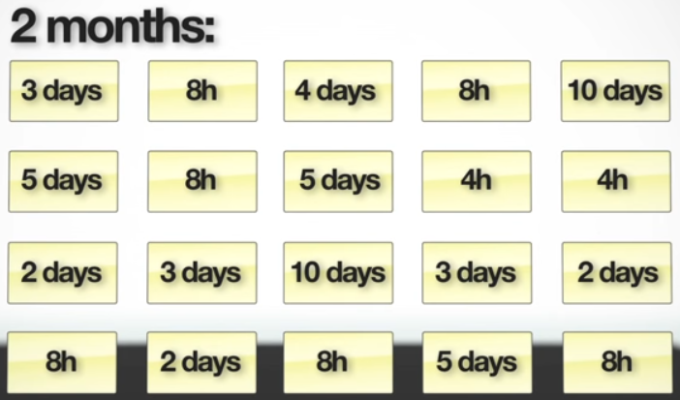
Scrum – Estimates in hours

Slide 14
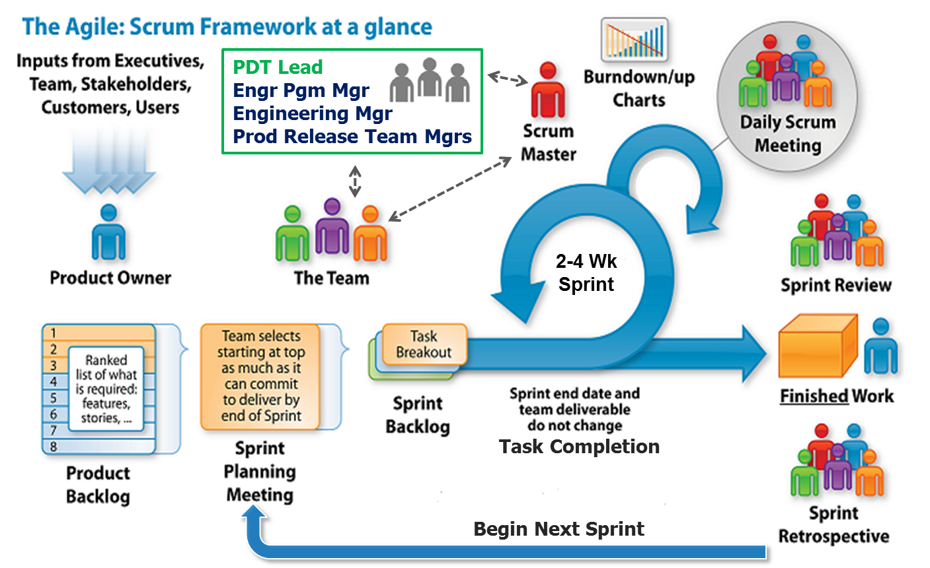
Scrum Summary
https://www.flying-donut.com

Slide 15
Mind Map
Xmind
Workflowy

Slide 16
Quality Assurance

