Slide 1


CnC: A Dependence Programming Model
Kath Knobe kath.knobe@rice.edu
Zoran Budimlić zoran@rice.edu

Slide 2
Motivation for the talk (not motivation for CnC)
Someone hears about CnC
To learn more they check into an implementation
It wasn’t designed for what they want
They walk away
Our marketing department needs to make some changes to how we present/write/... about CnC
Here’s a possible different slant
You know most of this but I’m looking for
Feedback/discussion on the problem
Feedback/discussion on the story here
Recommendations for changing the presentation
This seems like the right group

Slide 3
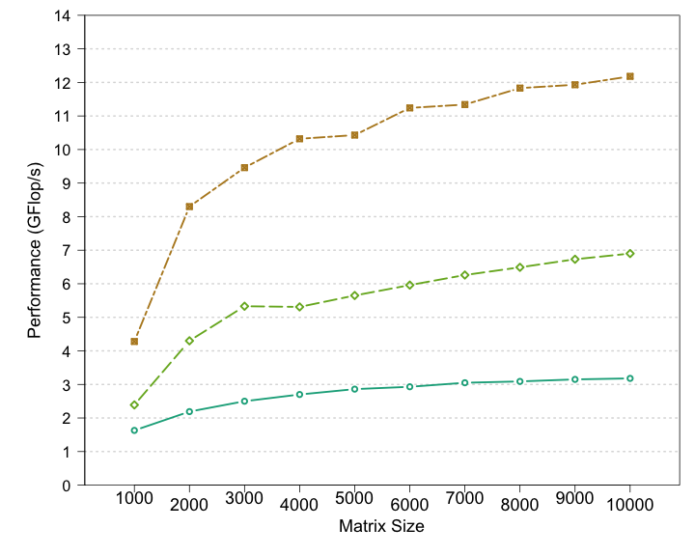
Performance Eigensolver
Used on
DARPA:
UHPC project at Intel
DOE:
X-Stack project at Intel
Dreamworks:
“How to train your dragon II”
Aparna Chandramolishwaren
One GaTech first year grad student intern at Intel
Concurrent Collections
Multithreaded Intel® MKL
Intel’s MKL team
Baseline
Intel 2-socket x 4-core Nehalem @ 2.8 GHz + Intel® Math Kernel Libraries 10.2
Notes:
3

Slide 4
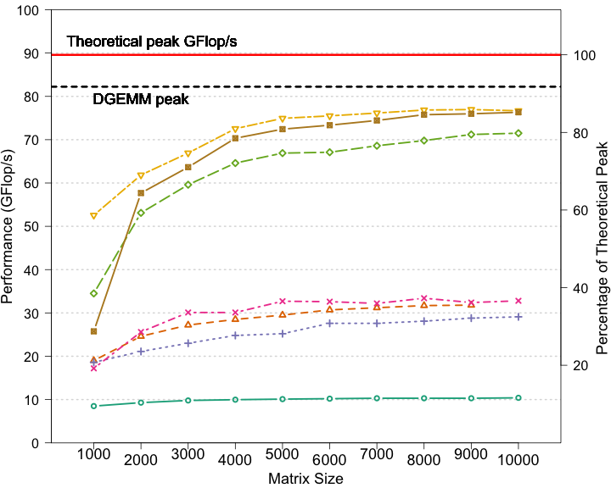
Cholesky
Plasma: Jack Dongarra’s group at Oak Ridge NL
Aparna Chandramolishwaren
One GaTech first year grad student intern at Intel
Intel 2-socket x 4-core Nehalem @ 2.8 GHz + Intel MKL 10.2

Slide 5
Outline
Motivation
CnC
Wide array of existing CnC tuning approaches

Slide 6
Outline
Motivation
CnC
Wide array of existing CnC tuning approaches

Slide 7
Styles of languages/models
Serial languages and Parallel languages
Orderings:
Required / tuning / arbitrary
Make a modification: must distinguish among these
Takes time
Leads to errors
Too few dependences: errors
Too many dependences: loose performance
Dependence languages
Orderings:
Required only
No tuning orderings
No arbitrary orderings
Make a modification => the ordering requirements are clear
No time
No errors
CnC is a dependence programming model
The dependences include data and control dependences
Both are explicit
They are at the same level
They are distinct

Slide 8
Some relevant current approaches
Start with an explicitly serial or an explicitly parallel program. Modify it for some specific target or specific optimization goal
Have to undo or trip over earlier tunings
Start with source code and automatically uncover the parallelism
We’ve been there
Start with the white board drawing
It’s how we think about our apps
Dependences are explicit but: not executable

Slide 9
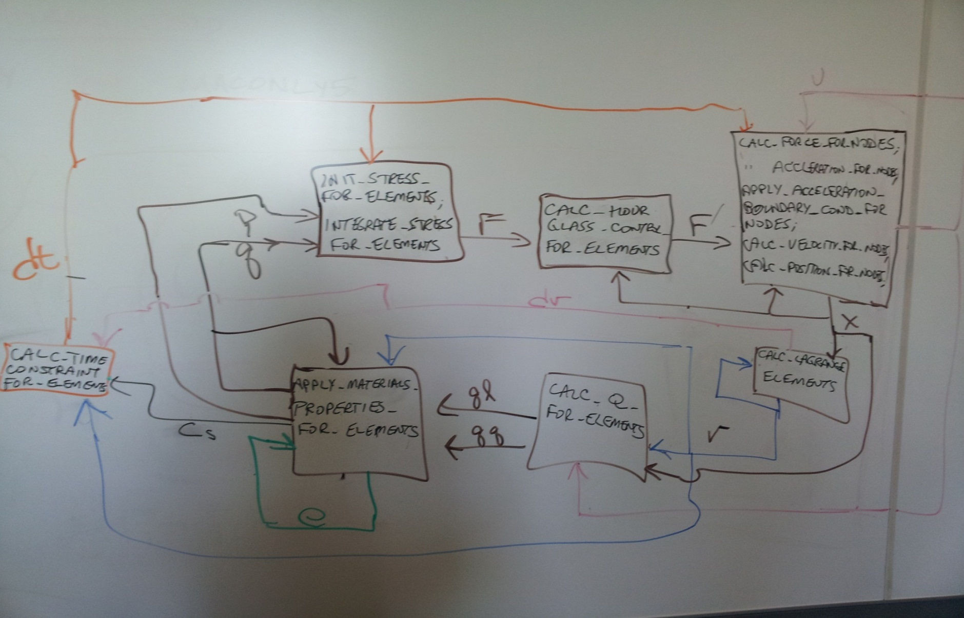
An actual white board sketch: LULESH a shock hydro-dynamics app

Slide 10
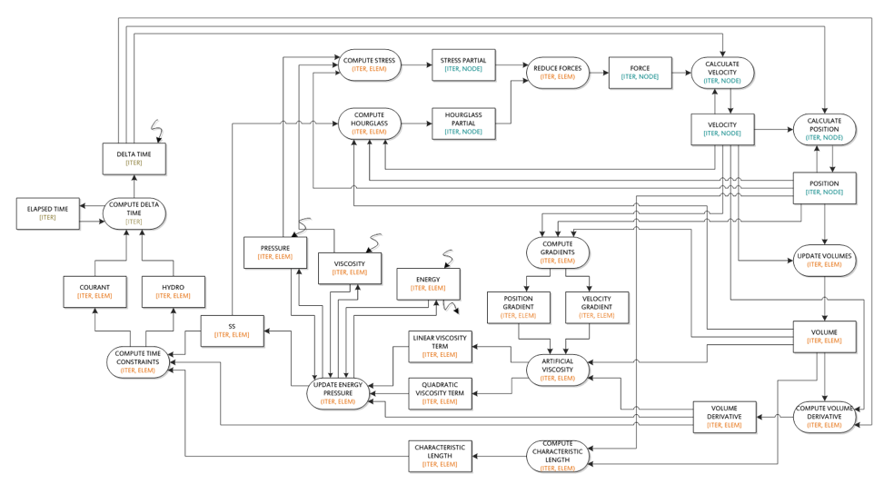
A CnC graph of flow of data for LULESH

Slide 11
Unlike an actual white board sketch CnC is a formal model
It is precise
It is executable
Has enough information
To prove properties about the program
To analyze the program
To optimize the program
At the graph level
Without access to computation code

Slide 12
Outline
Motivation
CnC
Goals that support exascale needs
CnC details via an example app
Wide array of existing CnC tuning approaches

Slide 13
Needs for exascale
Domain expert
(physicist, economist, biochemist, …)
Tuning expert (computer scientist).
Software engineering
Tuning
Separation of various activities (ways of thinking)
The details of the computation within the computation steps
The dependences among steps
The runtime
The tuning
Leads to improved reuse
Domain expert doesn’t need to know about
Architecture issues
Tuning goals
Given only dependences
Hides irrelevant low level computation details
Each new tuning starts from just dependences
Use any style of tuning
Just obey the dependences
Computer scientist doesn’t need to know about
Physics, economics, biochemistry
Same or different people
Different activity
Communicate at the level of the graph
Not about physics or about parallel performance

Slide 14
Tuning
Tuning consumes bulk of the time and energy
There is no CnC-specific approach to tuning
CnC is not a parallel programming model
Only one requirement:
the tuned app must obey domain spec semantics
Single domain spec / A wide range of tuning goals & styles
Faulty components
Distinct tuning goals (time, memory, energy, …)
Many different styles of runtimes (static / dynamic)
Many different styles of tuning (static / dynamic)
Domain spec isn’t modified by tunings
Tunings may refer to domain spec but are isolated from it

Slide 15
CnC simplifies tuning by separation of concerns
Separates the details of the computations and data from the dependences among them
Domain spec is isolated from tuning
It explicitly represents the ordering requirements
No orderings for tuning & no arbitrary orderings

Slide 16
Outline
Motivation
CnC
Goals that support exascale needs
CnC details via an example app
Wide array of existing CnC tuning approaches

Slide 17
Cholesky factorization
Cholesky
Trisolve | Update

Slide 18
Cholesky factorization
Cholesky
Trisolve | Update

Slide 19
Cholesky factorization
Cholesky
Trisolve | Update

Slide 20
Cholesky factorization
Cholesky
Trisolve | Update

Slide 21
Cholesky factorization
Cholesky
Trisolve | Update
Cholesky
Trisolve | Update

Slide 22
Cholesky factorization
 | Cholesky
 | Trisolve | Update

Slide 23
Cholesky CnC domain spec 1: white board drawing
Computation step collection
Collections are just sets of instances
Data item collection
Computation step collection
(C: iter)
Computation step collection
[C: iter]
(T:: iter, row)
Data item collection
Data item collection
[T: iter, row]
(U: iter, row, col)
[U: iter, row, col]

Slide 24
Cholesky CnC domain spec 1: white board drawing
By default:
computation steps are deterministic
(C: iter)
By default:
data items are dynamic single assignment
[C: iter]
(T:: iter, row)
[T: iter, row]
(U: iter, row, col)
[U: iter, row, col]

Slide 25
Cholesky CnC domain spec 2: I/O
(C: iter)
[C: iter]
(T:: iter, row)
[T: iter, row]
(U: iter, row, col)
[U: iter, row, col]

Slide 26
Cholesky CnC domain spec 3: Distinguish instances
Tags are just identifiers
Require an equality operator
Often integers: iteration, row, col
(C: iter)
[C: iter]
(T: iter, row)
[T: iter, row]
(U: iter, row, col)
[U: iter, row, col]

Slide 27
Cholesky CnC domain spec 3: Distinguish instances
Tags are just identifiers
Require an equality operator
Often integers: iteration, row, col
But not necessarily:
representation of a Sudoku board
(C: iter)
[C: iter]
(T: iter, row)
[T: iter, row]
(U: iter, row, col)
[U: iter, row, col]

Slide 28
Cholesky CnC domain spec 4: exact set of instances (control)
Control tag collection
<I: iter>
Control tag collection
(C: iter)
<IR: iter, row>
Control tag collection
[C: iter]
(T: iter, row)
<IRC: iter, row, col>
[T: iter, row]
(U: iter, row, col)
[U: iter, row, col]

Slide 29
Cholesky CnC domain spec 4: exact set of instances (control)
Computation step instance:
In/compute/out/done
No cyclic dependences on a single instance
<I: iter>
(C: iter)
<IR: iter, row>
[C: iter]
(T: iter, row)
<IRC: iter, row, col>
[T: iter, row]
(U: iter, row, col)
[U: iter, row, col]

Slide 30
Cholesky CnC domain spec 4: exact set of instances (control)
Data dependence
<I: iter>
(C: iter)
<IR: iter, row>
Control dependence
[C: iter]
(T: iter, row)
<IRC: iter, row, col>
[T: iter, row]
(U: iter, row, col)
[U: iter, row, col]

Slide 31
Cholesky CnC domain spec Optional: dependences functions
(C: iter) produces [C: iter]
<I: iter>
(C iter)
<IR: iter, row>
[C: iter]
(T: iter, row)
<IRC: iter, row, col>
[T: iter, row]
(U: iter, row, col)
[U: iter, row, col]
(C: iter) consumes [U: iter-1, iter, iter]

Slide 32
Semantics of CnC: specifies a partial order of execution
tag
avail
step
controlReady
step
ready
step
executed
step
dataReady
Item
avail

Slide 33
Outline
Motivation
CnC
Wide array of existing CnC tuning approaches

Slide 34
Tuning
Tuning starts with the domain spec
Just the required orderings
Wide range of tuning approaches
Existing static tunings
Existing dynamic tunings
Possible future tunings

Slide 35
Static tuning
Vivek Sarkar
Carl Offner
Alex Nelson
Totally static schedule across time and space
Automatic conversion of element-level data and computation to tiled versions
Polyhedral tiling
Distribution functions across nodes in a cluster
(dynamic within each node)
For data items or
For computation steps
Minimize RT overhead by eliminating redundant attribute propagation
PIPES for distributed apps (Static and dynamic)
Alina Sbirlea
Alina Sbirlea
Jun Shirako
Frank Schlimbach
Zoran Budimlić
Kath Knobe
Tiago Cogumbreiro
Martin Cong
Yuhan Peng

Slide 36
Dynamic tuning
Runtimes based on OCR, TBB, Babel and Haskell
Basic: determines when a step is ready
Tracks state changes and executes READY steps
Workflow coordination
Choice among CPU, GPU, FPGA
Dynamic compromise:
Static step preference and dynamic device availability
Hierarchical affinity groups for locality
Memory usage:
Dynamic single assignment is higher level:
Identifies values, not places
Mapping data values to memory is tuning
Garbage collection: Get-count
Inspector/executor
Vivek Sarkar
Nick Vrvilo
Zoran Budimlić
Vivek Sarkar
Frank
Schlimbach
Shams Imam
Ryan Newton
Rice team
Frank Schlimbach
Frank Schlimbach
Yves Vandriessche
Alina Sbirlea
Zoran Budimlić
Zoran Budimlić
Mike Burke
Sanjay Chatterjee
Kath Knobe
Nick Vrvilo
Frank Schlimbach
Dragos Sbirlea

Slide 37
Possible future tunings
Out-of-core computations
Based on hierarchical affinity groups
Checkpoint-continue
Automatic continuous asynchronous checkpointing
Collaborative runtimes
under development
Inspector/executor
For computation
Demand-driven execution
Speculative execution
Zoran Budimlić
Kath Knobe

Slide 38
Isolation: Tuning from domain spec
Critical for software engineering for exascale
Critical for ease of tuning
Just data and control dependences
No arbitrary constraints
Except for grain …
CnC domain spec is totally flexible wrt tuning:
More approaches in mind now
New architectures
New tuning goals
New tuning approaches

Slide 39
Tuning grain size: Hierarchy
Kath Knobe
Nick Vrvilo
Each computation step and data item can be decomposed
Hierarchy adds more tuning flexibility
Choose the best hierarchy
Choose the best grain
Different tunings can be applied at different levels in the hierarchy

Slide 40
Conclusion
CnC is a dependence language
Control and data dependences
Explicit, distinct and at the same level
Tuning is separate
No CnC-specific tuning
This isolation makes tuning easier and more flexible

Slide 41
Thanks to …
DARPA: UHPC
DOE: X-Stack
Cambridge Research Lab
DEC / Compaq / HP / Intel
Carl Offner, Alex Nelson
Intel
Frank Schlimbach, James Brodman, Mark Hampton, Geoff Lowney, Vincent Cave, Kamal Sharma, X-Stack TG team
Rice
Vivek Sarkar, Zoran Budimlić, Mike Burke, Sanjay Chatterjee, Nick Vrvilo, Martin Kong, Tiago Cogumbreiro
Reservoir
Rich Lethin
Benoit Meister
UC Irvine
Aparna Chandramowlishwaran (Intel intern)
Google
Alina Sbirlea (Rice)
Dragos Sbirlea (Rice)
UCSD
Laura Carrington
Pietro Cicotti
GaTech
Rich Vuduc
Hasnain Mandviwala (Inel intern)
Kishore Ramachandran
Indiana
Ryan Newton (Intel)
Purdue
Milind Kulkarni
Chenyang Liu
PNNL
John Feo
Ellen Porter
Facebook
Nicolas Vasilache (Reservoir)
Micron
Kyle Wheeler (xxNL)
Dreamworks
Martin Watt
Two Sigma
Shams Imam (Rice)
Sagnak Tasirlar (Rice

Slide 42
Intel
CnC on Intel’s WhatIf site
http://software.intel.com/en-us/articles/intel-concurrent-collections-for-cc
Available open source
https://icnc.github.io
Rice
https://wiki.rice.edu/confluence/display/HABANERO/CNC
Discuss CnC related topics
New apps, optimizations, runtime, tuning, … send mail to
kath.knobe@rice.edu, zoran@rice.edu, or frank.schlimbach@intel.com
CnC’16 workshop
Sept 27-28, 2016 Co-located with LCPC’16 in Rochester, NY
https://cncworkshop2016.github.io/
To get on mailing list send mail to
kath.knobe@rice.edu, zoran@rice.edu, or frank.schlimbach@intel.com

Slide 43
Thank you!

