Slide 1
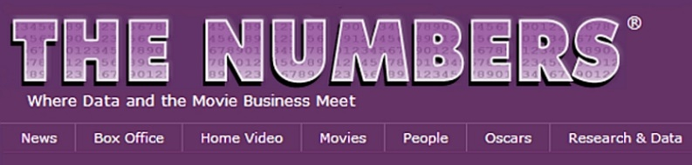
Regression Model using Web Scraping Algorithm w/
Can Demırkan

Slide 2
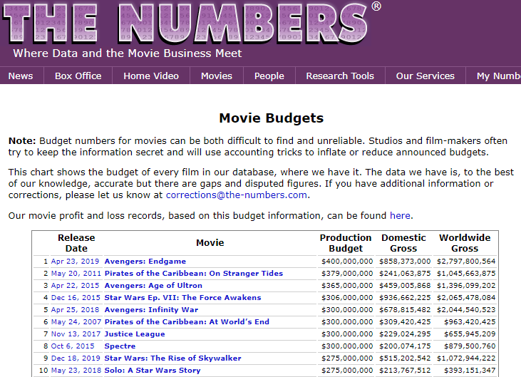
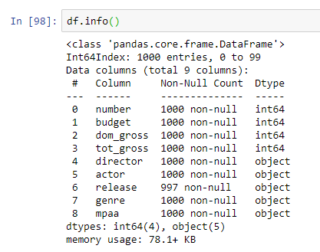
Introduction
Key Factors of Total Gross
Budget
Actor
Director
Target Audience
Genre
BeautifulSoup
First 1000 movies are scraped from web

Slide 3
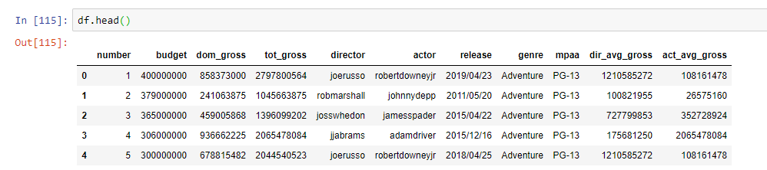
Methodology
Regression Model Selection
Web Scraping
Data Sorting
Data Cleaning
Movie Names from
the-numbers.com
Actor Names
Director Names
Ratings
Genre
Gross
Actor Names
Director Names
Gross
Added – Avg. Actor Gross
Added – Avg. Director Gross
Linear
Ridge
Lasso
Polynomial

Slide 4
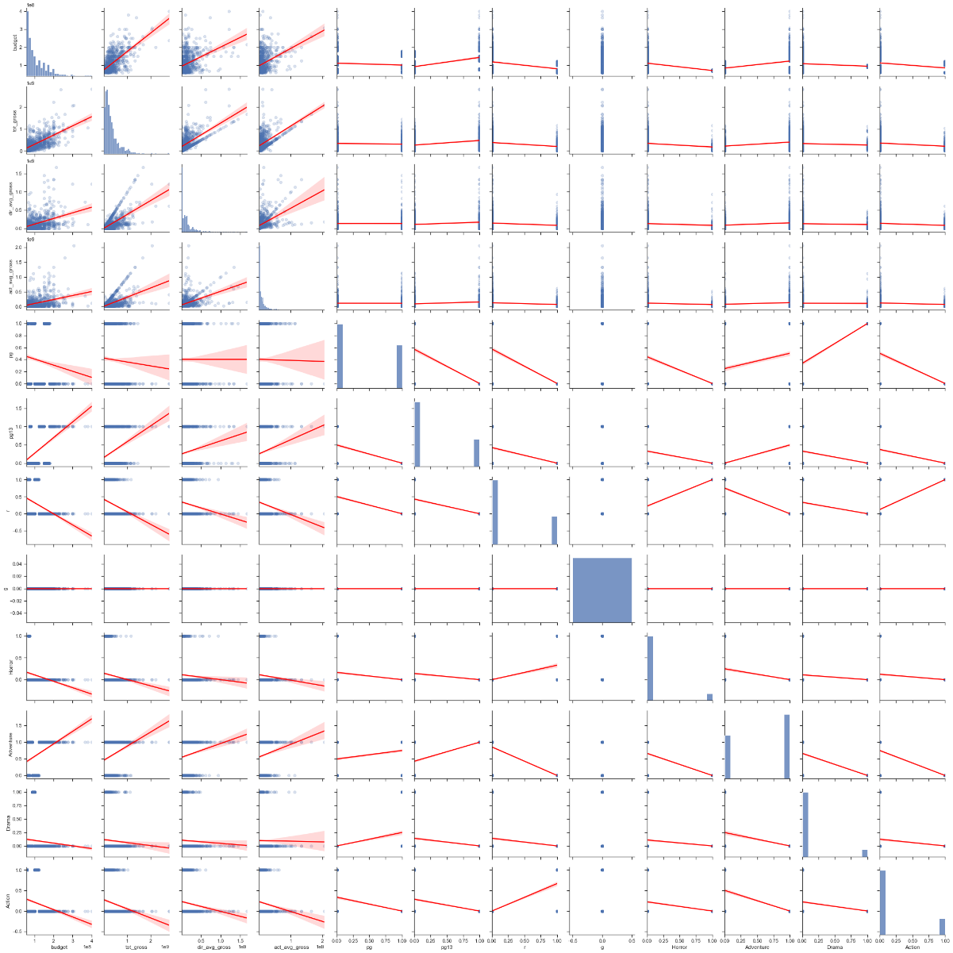
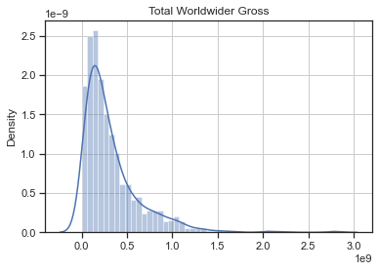
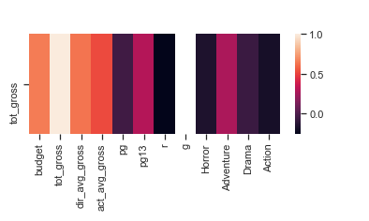
Results

Slide 5
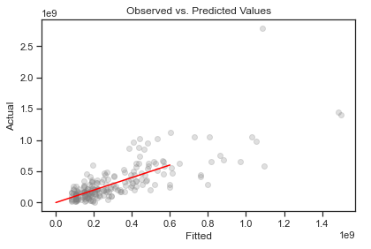
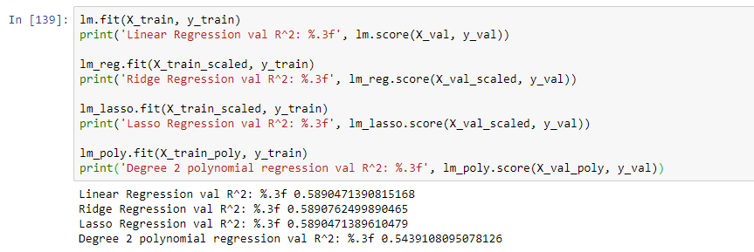
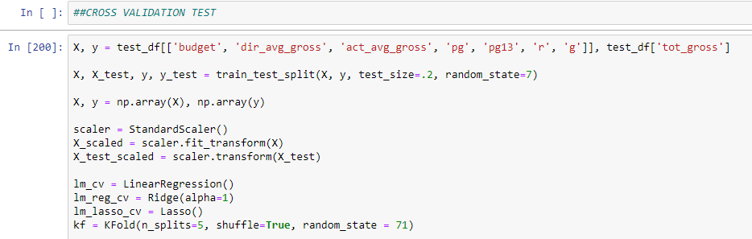
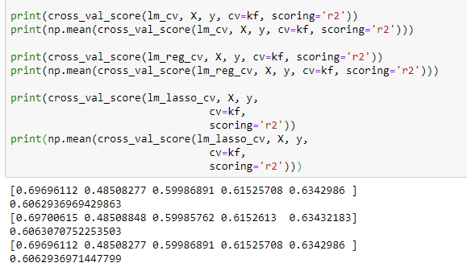
Results
One Hot Encoding – Genre / Rating

Slide 6
Future Work
Sentiment Analysis of the movies ordered by date
Producers
Year of the Movie

Slide 7
Thank You

