Slide 1
MRF-Belief Propagation
Chandana Neerukonda and Karthik Desingh

Slide 2
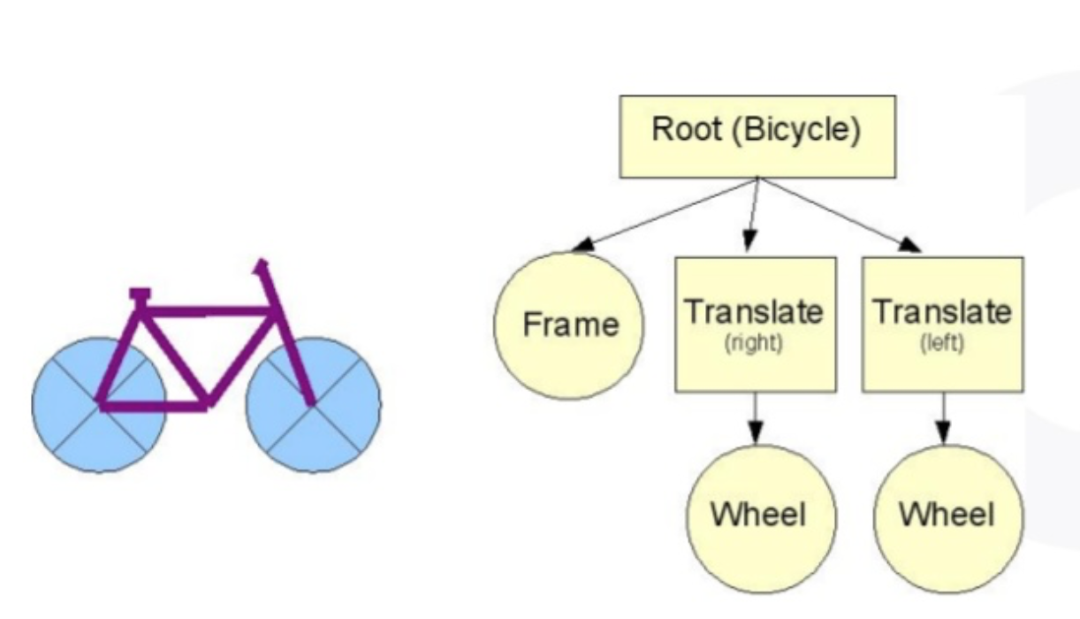
Problem Statement:
Draft: To output a scene graph with images(video?) as input- making use of pairwise confidences in MRF and belief Propagation.

Slide 3
Scene Graph
A data structure (graph or a tree) describing the logical and physical representation of the objects in a scene
Table
Box
Cylinder
Glass

Slide 4
How to ? (still in progress)
Traverse through the tree and place the object as a child to corresponding parent once finish step 2.
Get bounding boxes (contours using Instance segmentation ?) around the detected objects. Each bounding box would be a node
Define Node potentials and Edge Potentials
Use the joint potential of nodes of two objects to determine the spatial relationship between them

Slide 5
Example implementation of belief Propagation
Ground truth :

Slide 6
Initial Belief:

Slide 7

Updating belief over each iteration (video)

Slide 8
Observations
Loopy belief Propagation does not use previous belief
But it rather uses previously computed Messages
meaning
If I manage to get a nicer initialization to belief based on some other information , that would be replaced with the newly calculated belief using messages

