Slide 1
MRF-Belief Propagation

Slide 2
Bayesian Network
It is a probabilistic graphical model that represents a set of random variables and their conditional dependencies via a directed acyclic graph.

Slide 3
What is Markov Random Field ?
A random field that satisfies Markov Properties.
Similar to Bayesian network in its representation of dependencies
Bayesian networks are directed and acyclic, whereas Markov networks are undirected and may be cyclic.

Slide 4
Example:

Slide 5
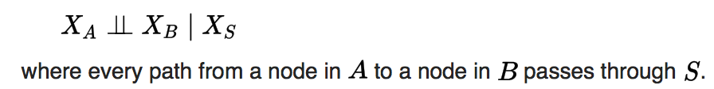
Markov Properties:
Pairwise Markov property: Any two non-adjacent variables are conditionally independent given all other variables:
Local Markov property: A variable is conditionally independent of all other variables given its neighbors:
Global Markov property: Any two subsets of variables are conditionally independent given a separating subset:

Slide 6
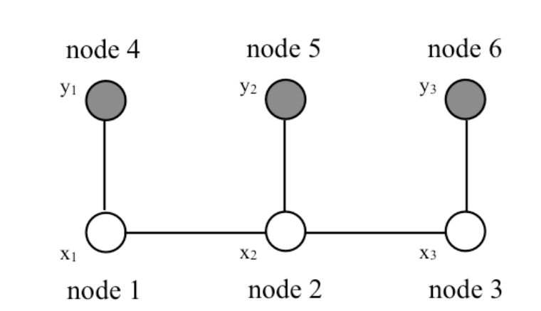
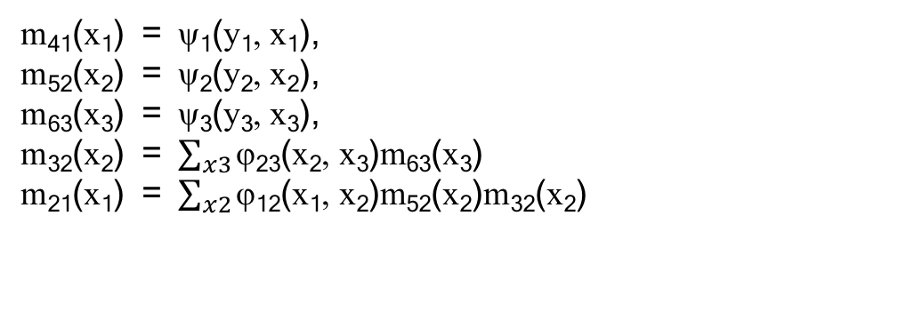
Belief Propagation: messages
In belief propagation for finding the marginal probability at every node, a message is a re-usable partial sum for the marginalization calculations.
m₄₁(x₁) = ψ₁(y₁, x₁),
m₅₂(x₂) = ψ₂(y₂, x₂),
m₆₃(x₃) = ψ₃(y₃, x₃),
m₃₂(x₂) = $\sum_{x3}{\text{φ}\text{23}\text{(}\text{x}\text{2}\text{, }\text{x}\text{3}\text{)}\text{m}\text{63}\text{(}\text{x}\text{3}\text{)}}$
m₂₁(x₁) = $\sum_{x2}{\text{φ}\text{12}\text{(}\text{x}\text{1}\text{, }\text{x}\text{2}\text{)}\text{m}\text{52}\text{(}\text{x}\text{2}\text{)}\text{m}\text{32}\text{(}\text{x}\text{2}\text{)}}$

Slide 7
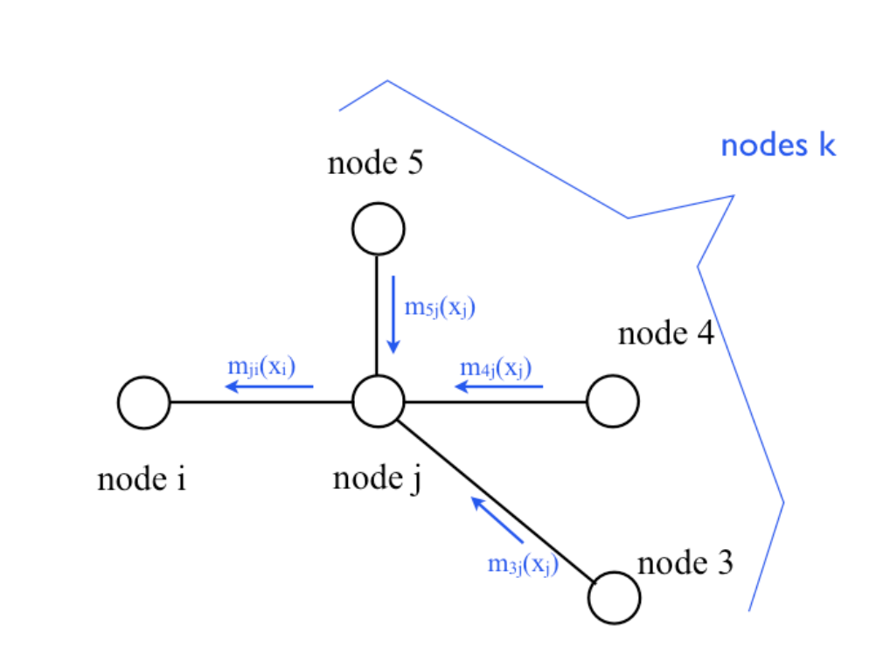
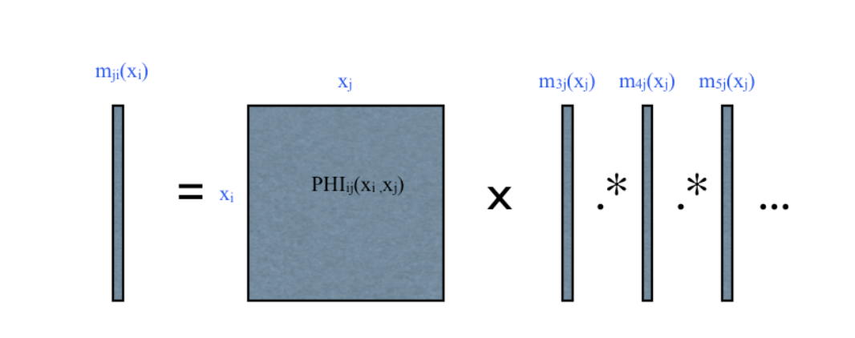
Message-passing rule : To compute the message from node j to node i:
Multiply together all messages coming in to node j, except for the message from node i back to node j (we ignore that one in this calculation).
Multiply by the compatibility function ψ_{ij(}xi,xj)
Marginalize over the variable x_{j}

Slide 8
Loopy Belief Propagation:
->The exact computation of marginal probabilities for graphs with loops depends on the treewidth of the graph.
->But the message update rules are described locally.
->It is a useful local operation to perform, even without the global guarantees of ordinary BP
Algorithm:
Convert graph to pairwise potentials
Initialize all messages to all ones, or to random values between 0 and 1.
Run BP update rules until convergence

