Slide 1
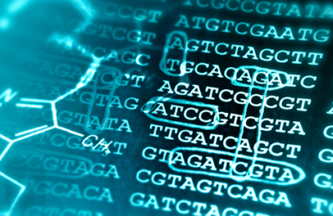
Introduction into bioinformatics
Day 1- Central dogma of molecular biologie, history of bioinformatics and command line interface

Slide 2
What does a bioinformatician actually do?
Bioinformaticians are rarely programming/coding.
Most bioinformaticians are either biologists or embedded into a life science working group.
Many molecular biologists know a lot about wetlab techniques and their organisms, but missing knowledge in actual data handling
A Bioinformatician uses computer science tools to answer biological questions!
The field is growing fast due to avaiablity of cheaper DNA/RNA sequencing techniques.
What are your experiences with bioinformatics?

Slide 3
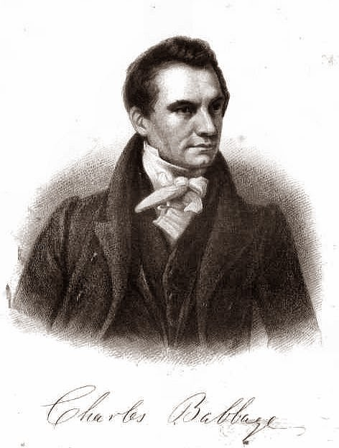
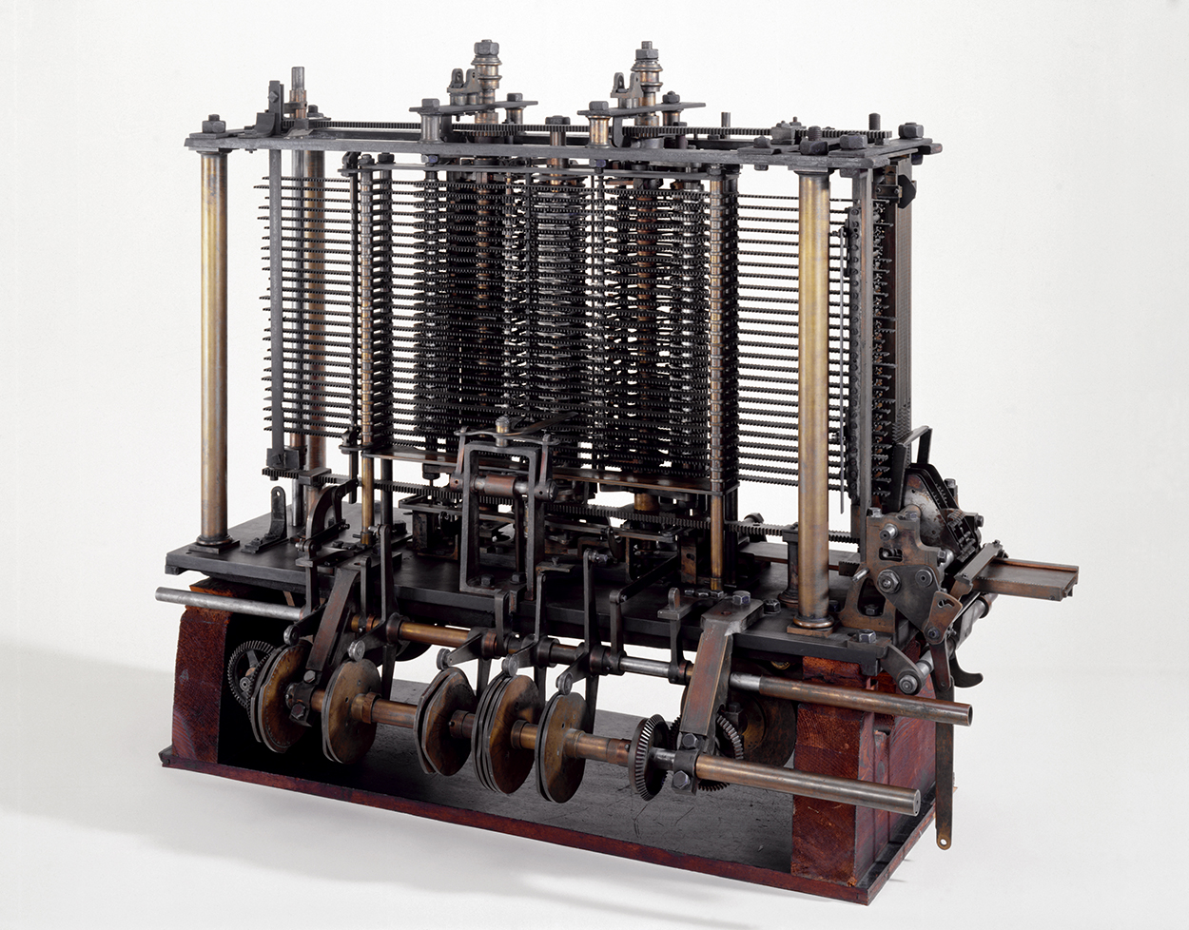
A short history of computing
Charles Babbage
  1791-1871
  Invented the Analytical Engine
  Solving linear equations

Slide 4
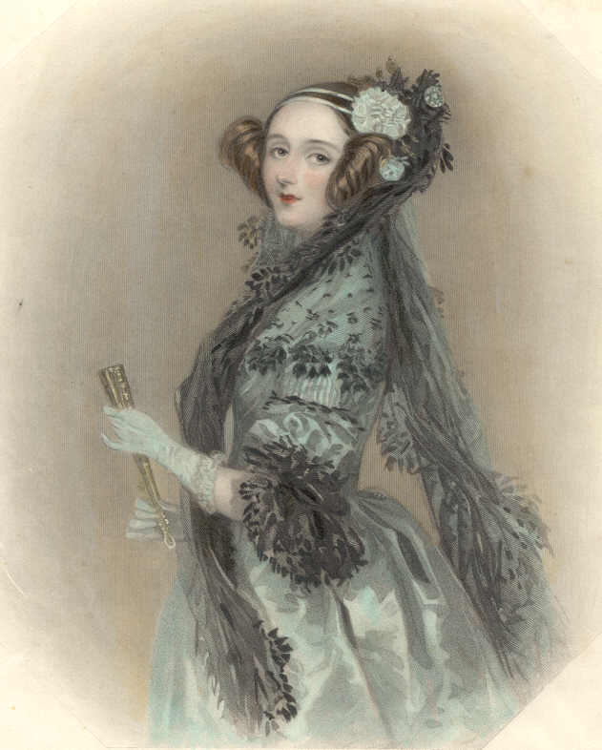
A short history of computing
Charles Babbage
  1791-1871
  Invented the Analytical Engine
  Solving linear equations
Ada Lovelace
  1815-1852
  Wrote the first algorithm
  Worked together with Charles Babbage

Slide 5
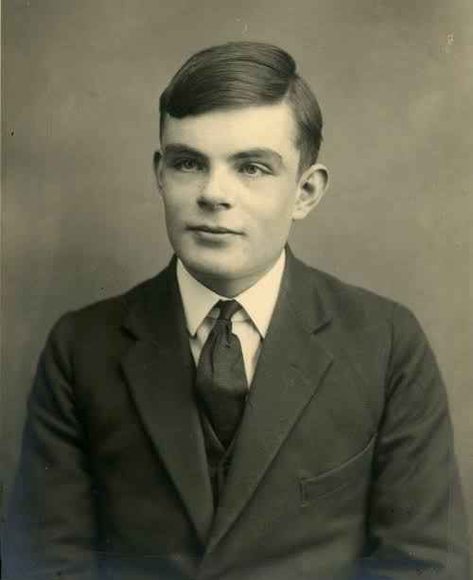
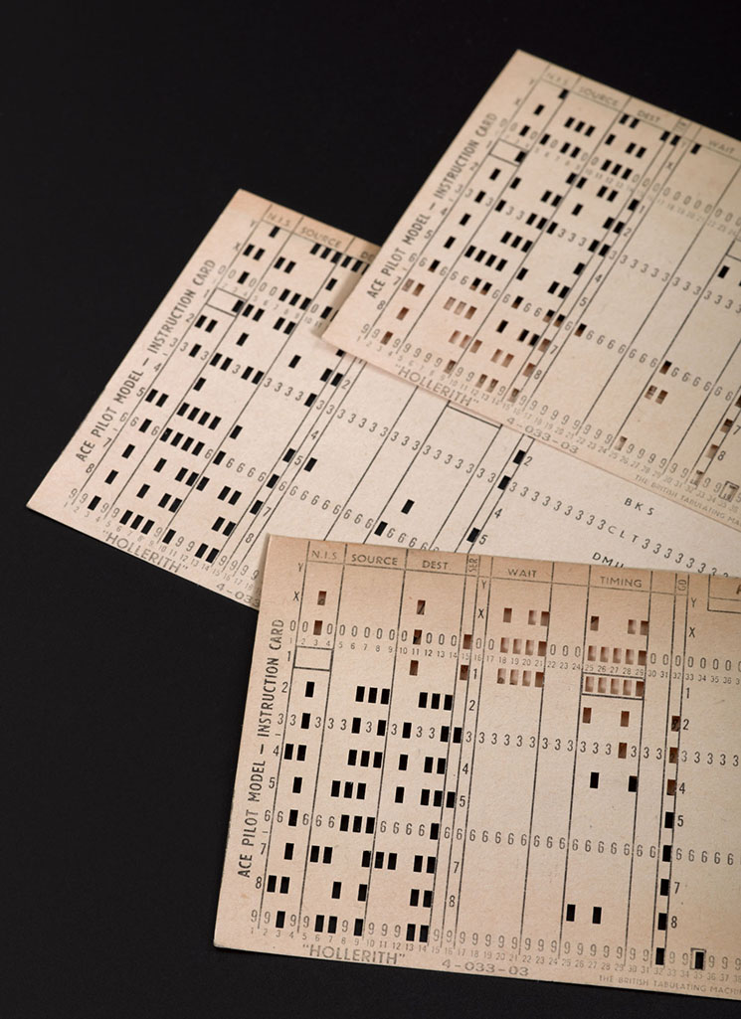
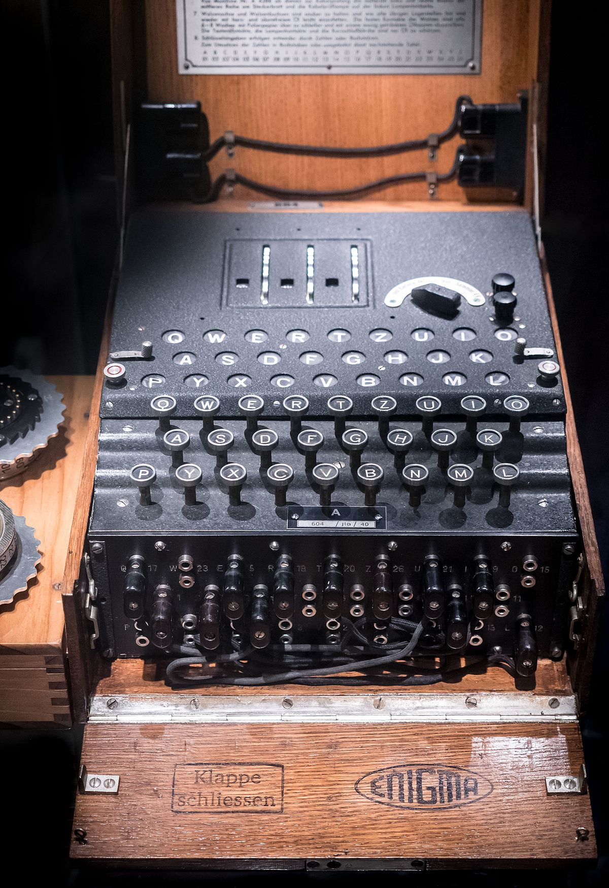
A short history of computing
Alan Turing
  1912-1954
  Theoretical foundations of modern computer sciences.

Slide 6
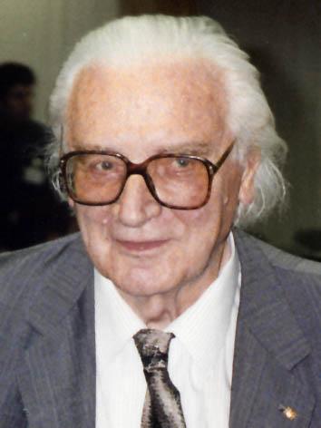
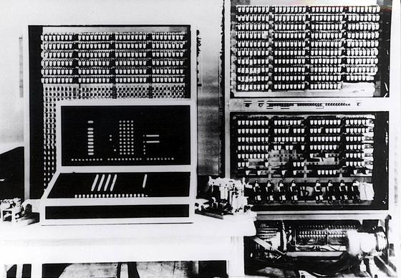
A short history of computing
Konrad Zuse
  1910-1995
  Invented the first programmable digital computer

Slide 7
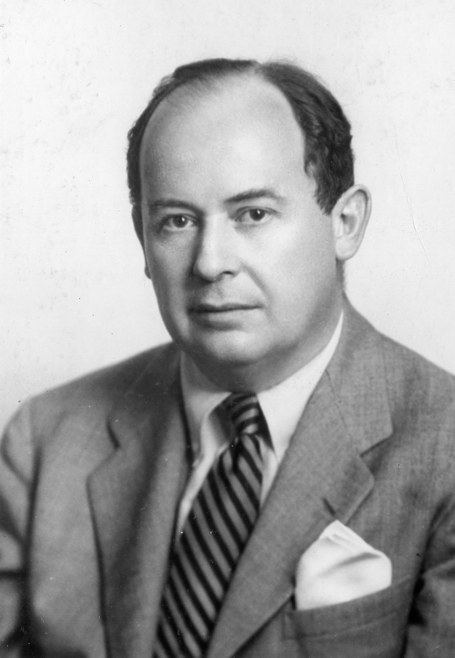
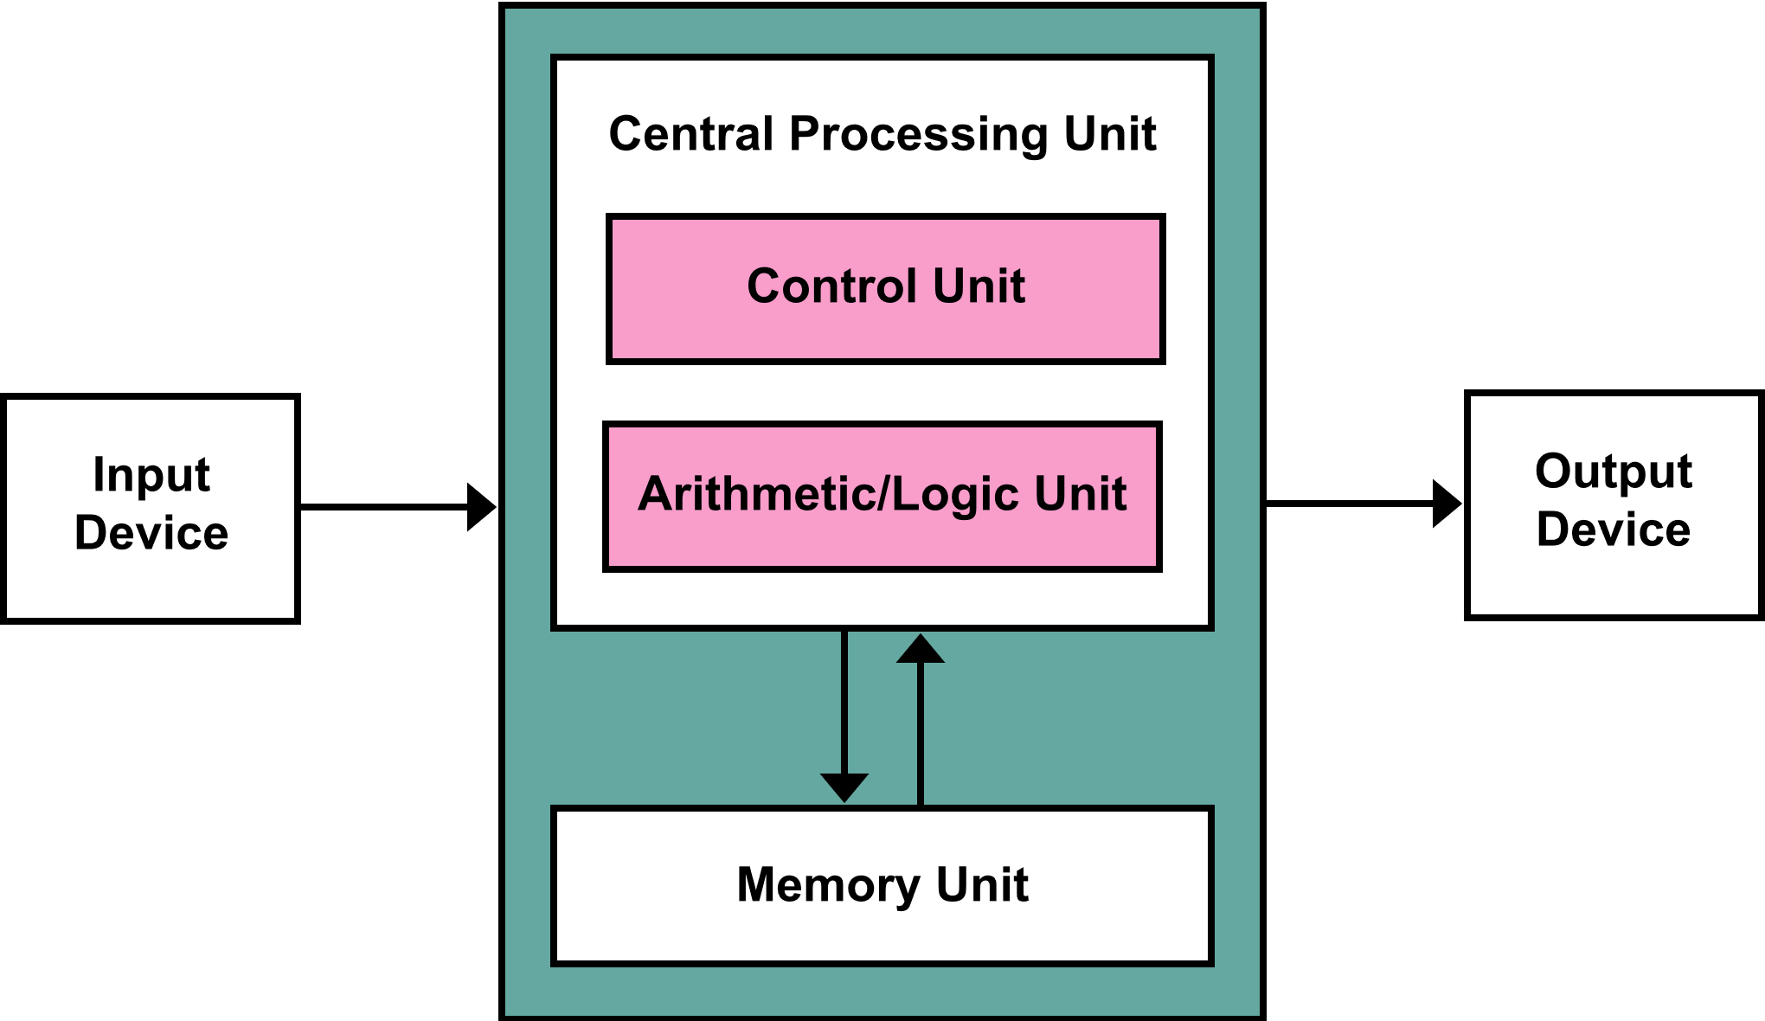
A short history of computing
John von Neumann
  1903-1957
  1945: Invention of modern computers
  ALL modern Computers are basically von Neumann machines

Slide 8
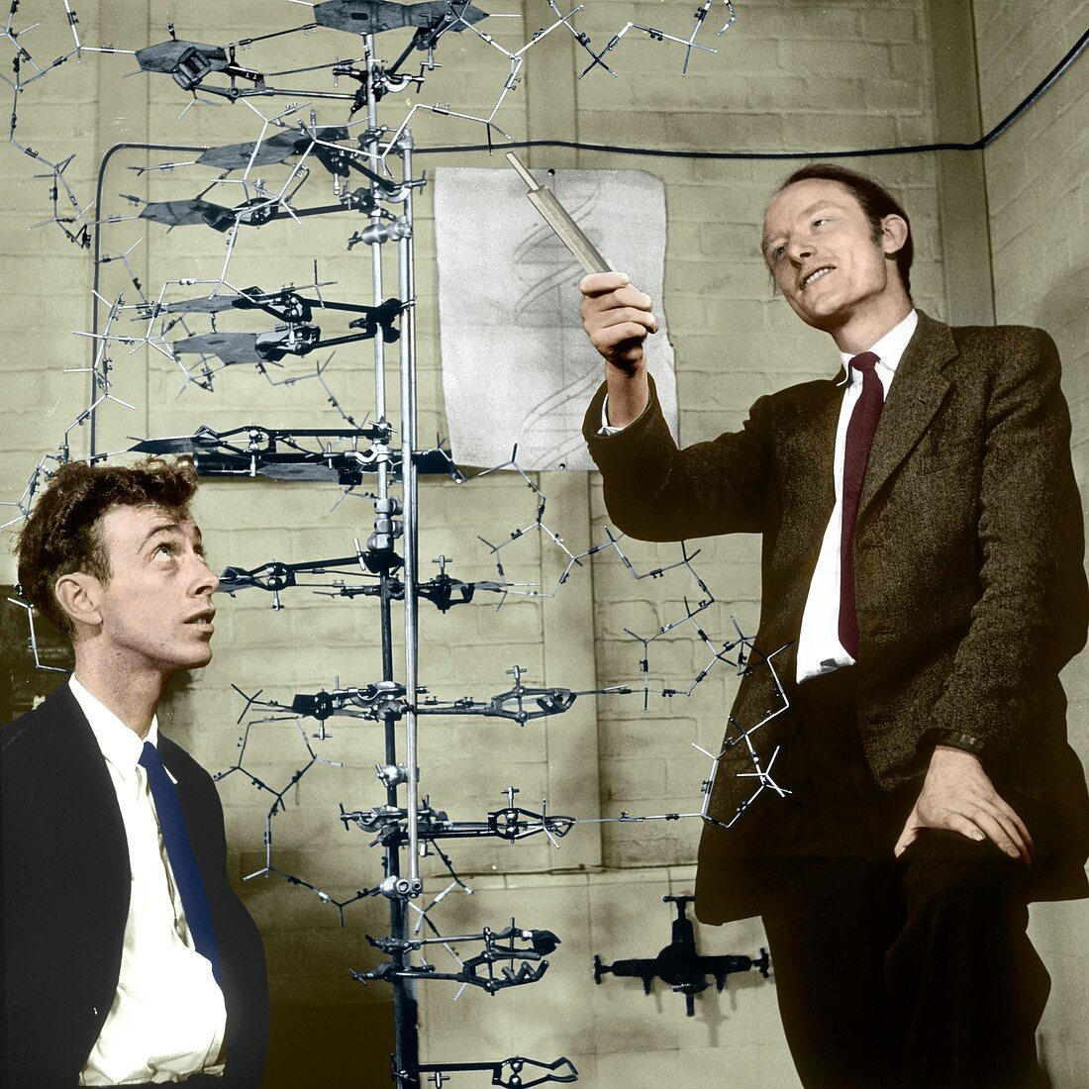
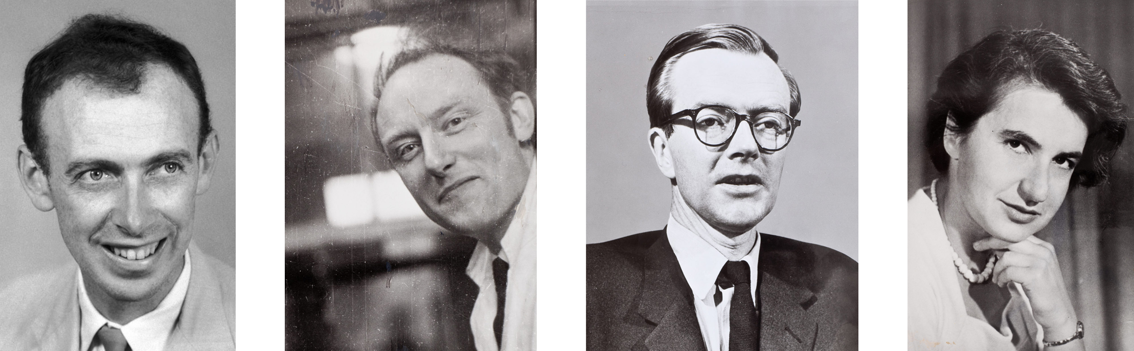
A short history of DNA-sequencing
Watson, Crick, Wilkins, Franklin
  1953: Discovery of DNA Double Helix
  1962: Nobel Prize

Slide 9
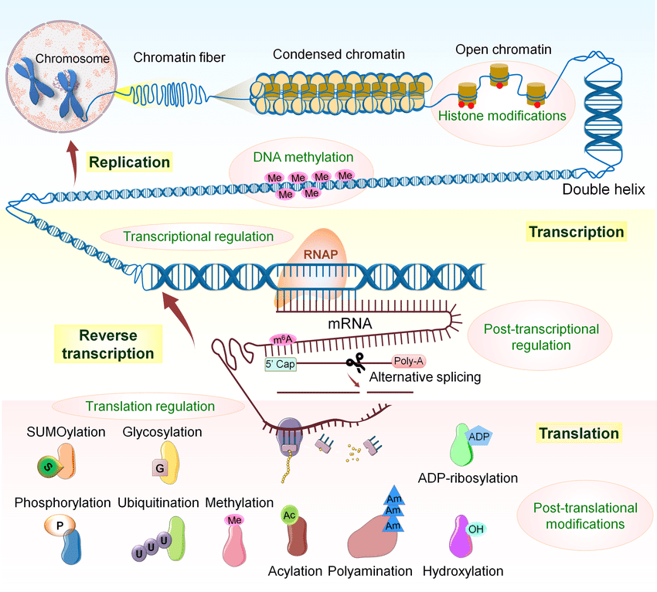
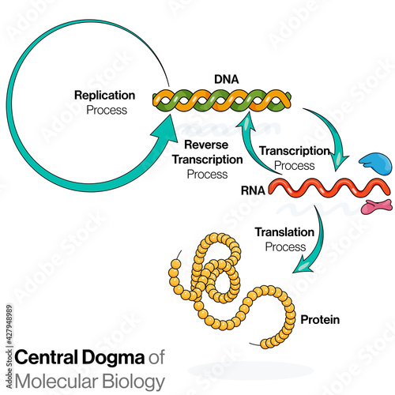
Central dogma of molecular biology
Postulated by Francis Crick in 1957.
The Central Dogma. This states that once "information" has passed into protein it cannot get out again. In more detail, the transfer of information from nucleic acid to nucleic acid, or from nucleic acid to protein may be possible, but transfer from protein to protein, or from protein to nucleic acid is impossible. Information here means the precise determination of sequence, either of bases in the nucleic acid or of amino acid residues in the protein.

Slide 10
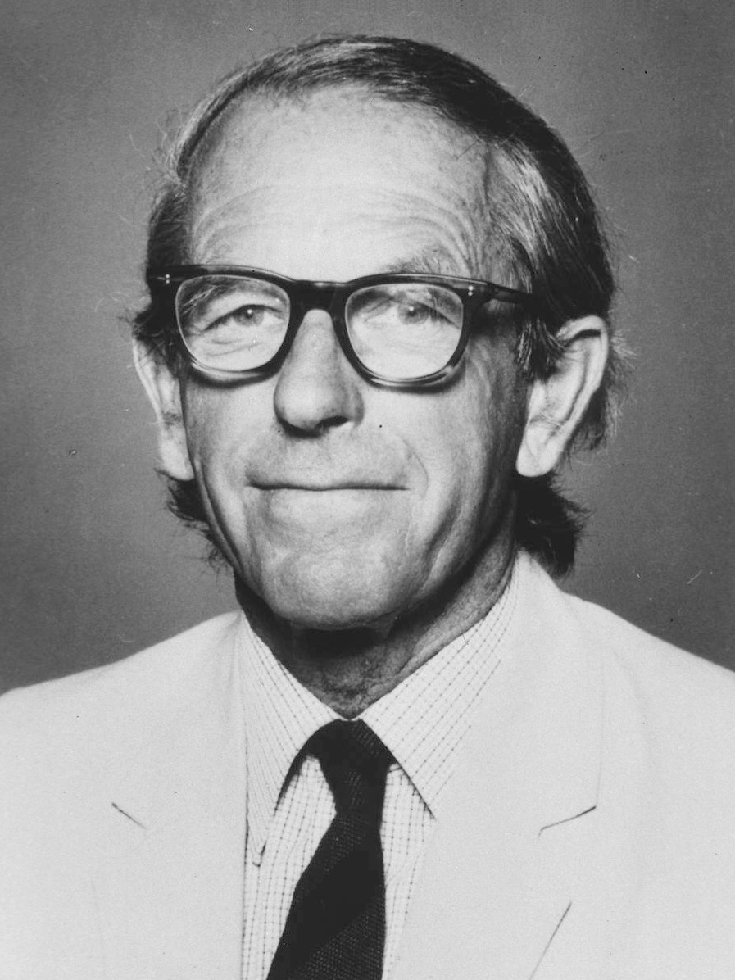
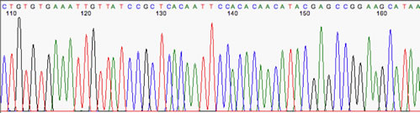
A short history of DNA-sequencing
Frederick Sanger
  1918-2013
  1977: DNA sequencing with chain-terminating inhibitors
  1980: Nobel Prize for decoding DNA sequence is Insulin
Father of DNA-sequencing.
Method is still used today.

Slide 11
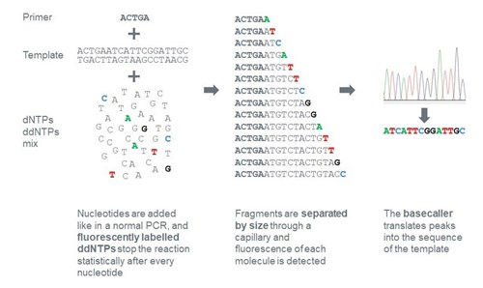
Sanger sequencing
Very precise for short DNA-sequences (approx. 1.000 bp)
Unreliable for longer fragments
Signal strength decreases at ‚later‘ bases.

Slide 12
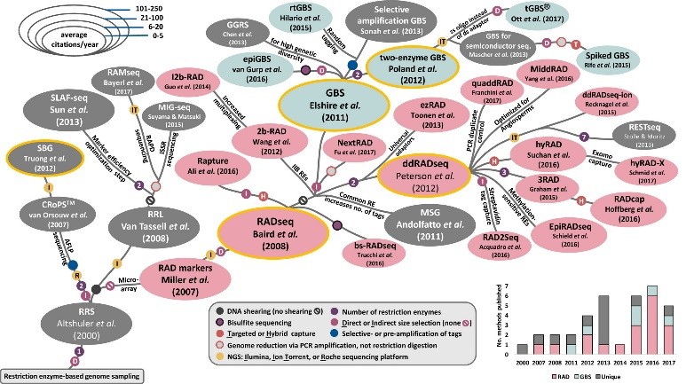
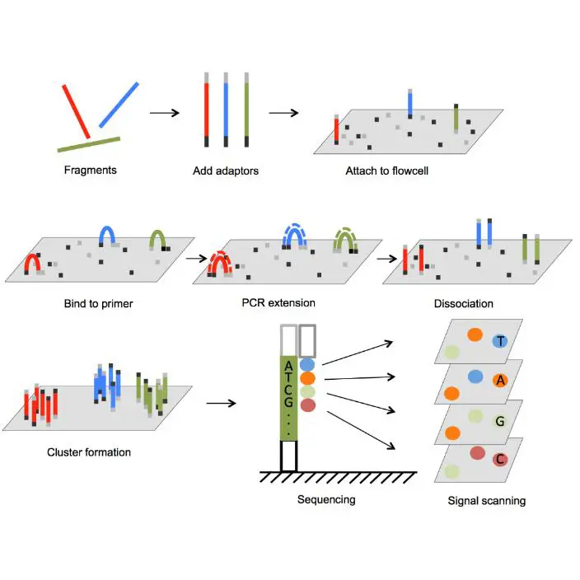
High throughput DNA sequencing (2nd generation)
Cutting DNA into short fragments, using restriction enzymes or sonication.
Amplification of short fragments.
Sequencing of amplified short fragments.

Slide 13
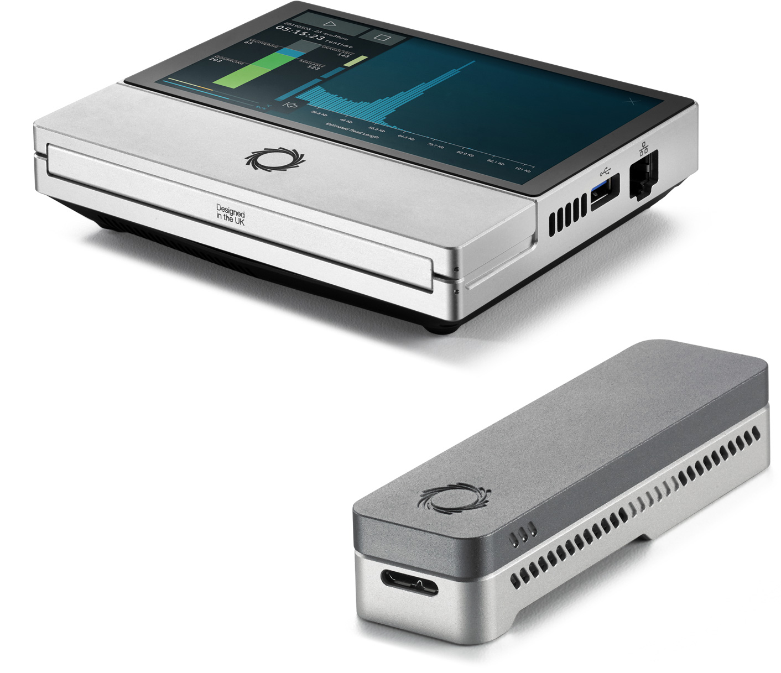
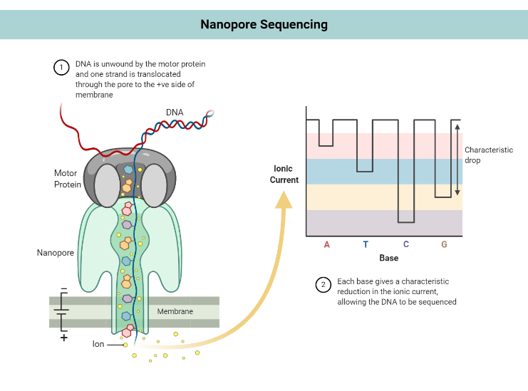
High throughput DNA sequencing (3rd generation)
Allows for sequencing of long DNA fragments.
  Personal record: 1.1 Mb
No restriction Enzymes needed, but high quality DNA.
High cost per sequencing run, low cost per sequenced DNA base
Can sequence up to 50 Gb
  Human genome: 3.1 Gb
Measures electrical signal instead of light absorption.

Slide 14
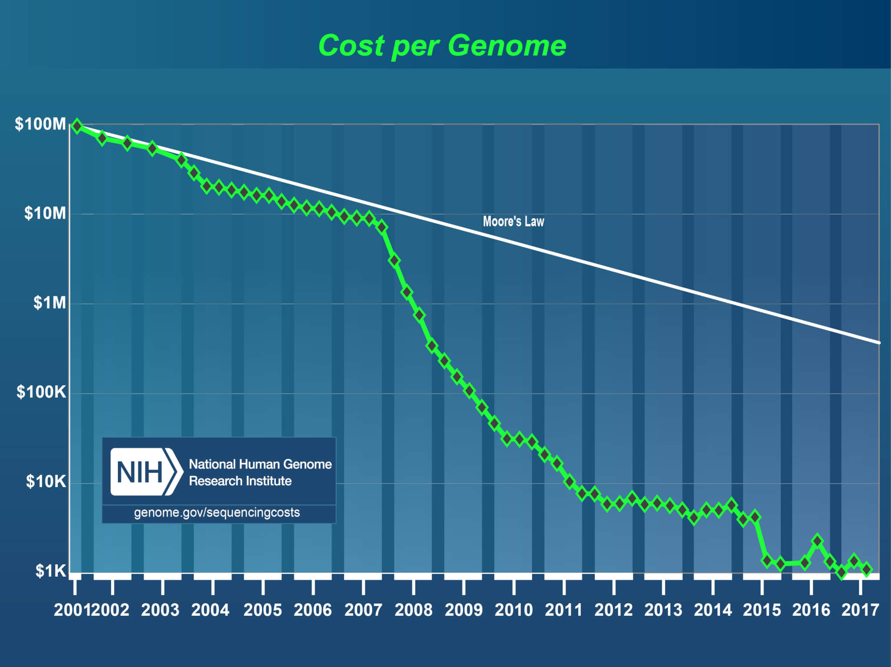
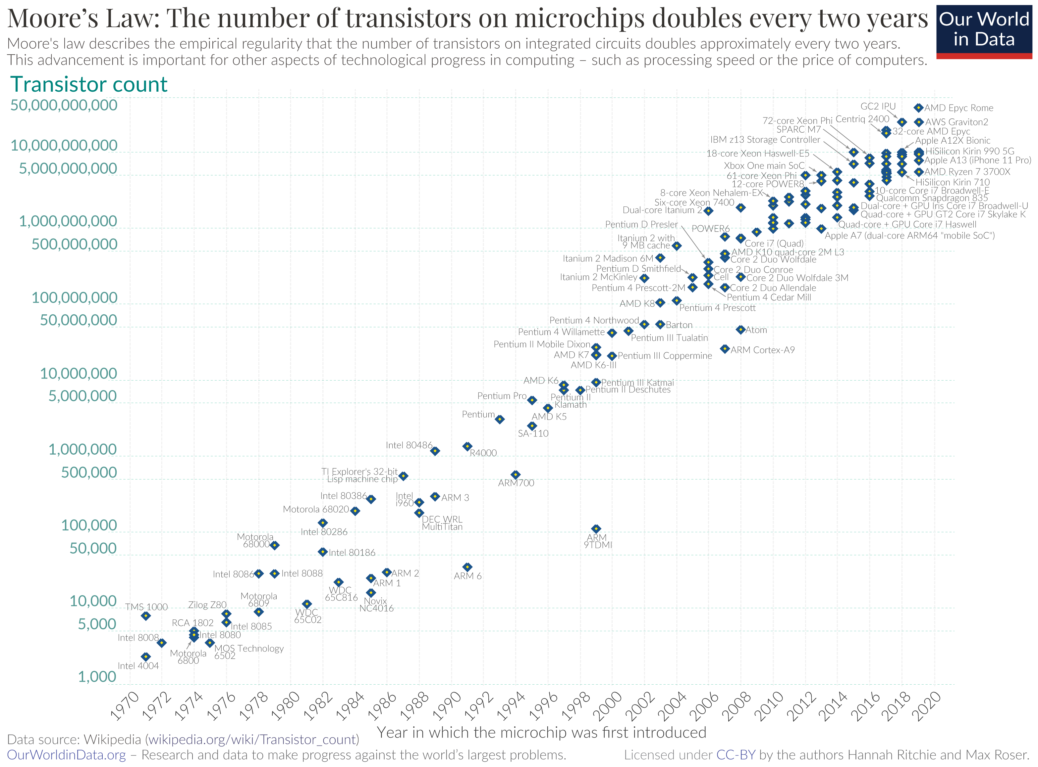
Why do we need bioinformatics?
We are not able to edit our sequence information per hand
  Too much data
  Need for streamlined analysis tools that are able to handle terabytes of data
Standardized tools facilitate reproducibility
Computing power gets cheaper
  Moore‘s law: doubling of speed every 1½ year.

Slide 15
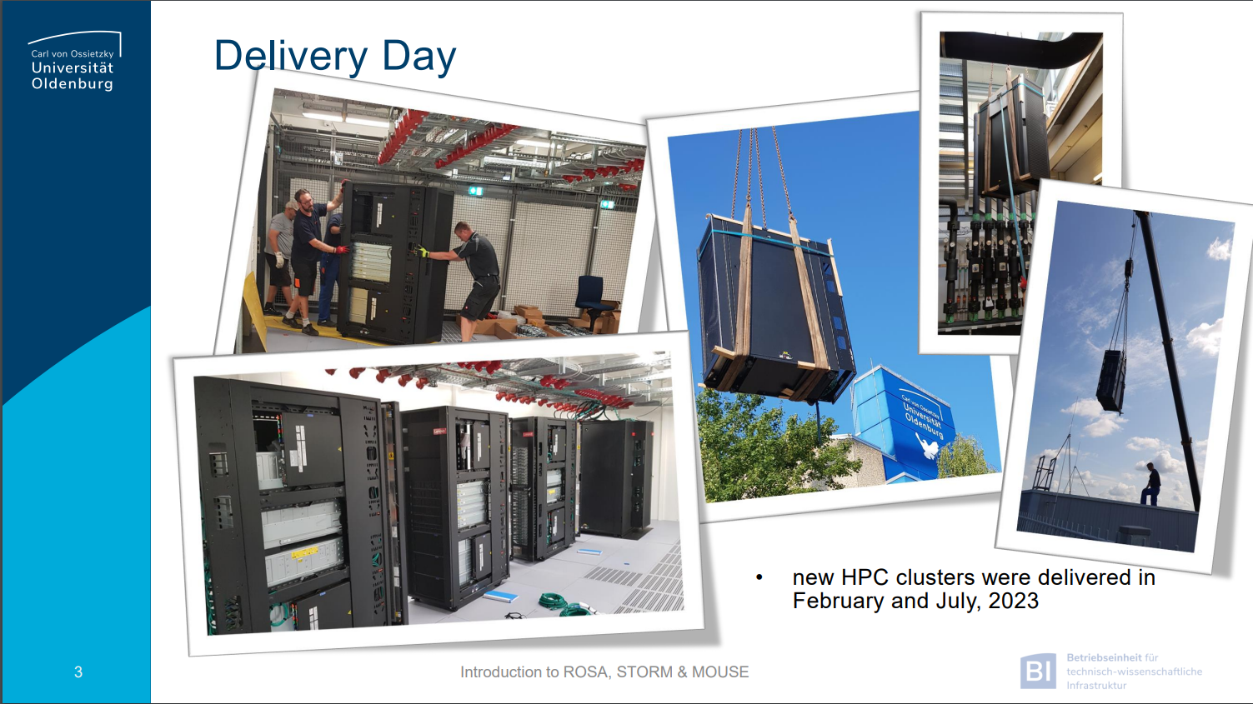
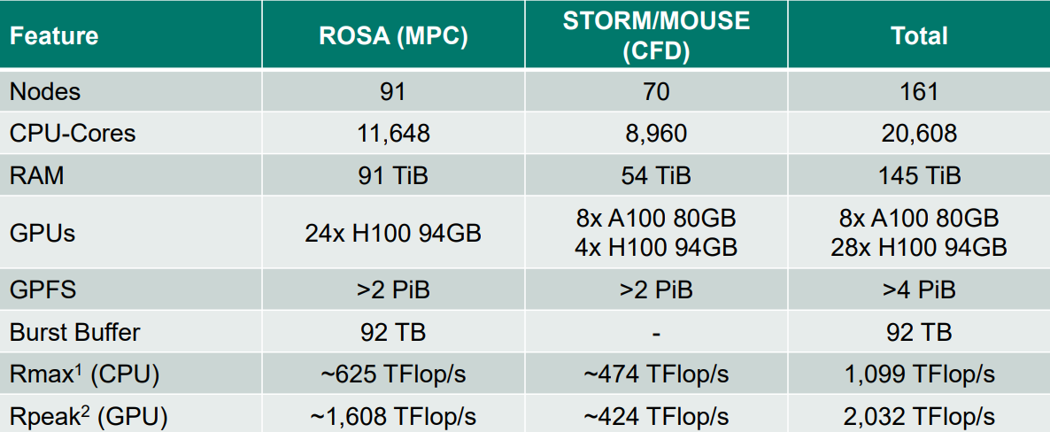
ROSA
High performance computing cluster of the University Oldenburg.

