Slide 1
Agenda
Activate WSL
CLI introduction
Install conda
Create conda environments
Install neccessary programs via conda

Slide 2
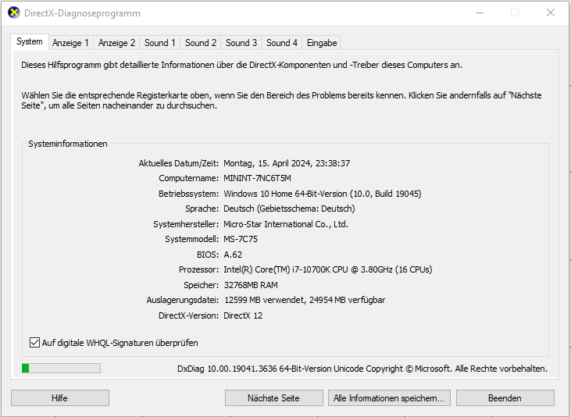
Which Operating System do I use?
Windows 10 or Windows 11?
If you don‘t know, type dxdiag into your searchbar and execute it.

Slide 3
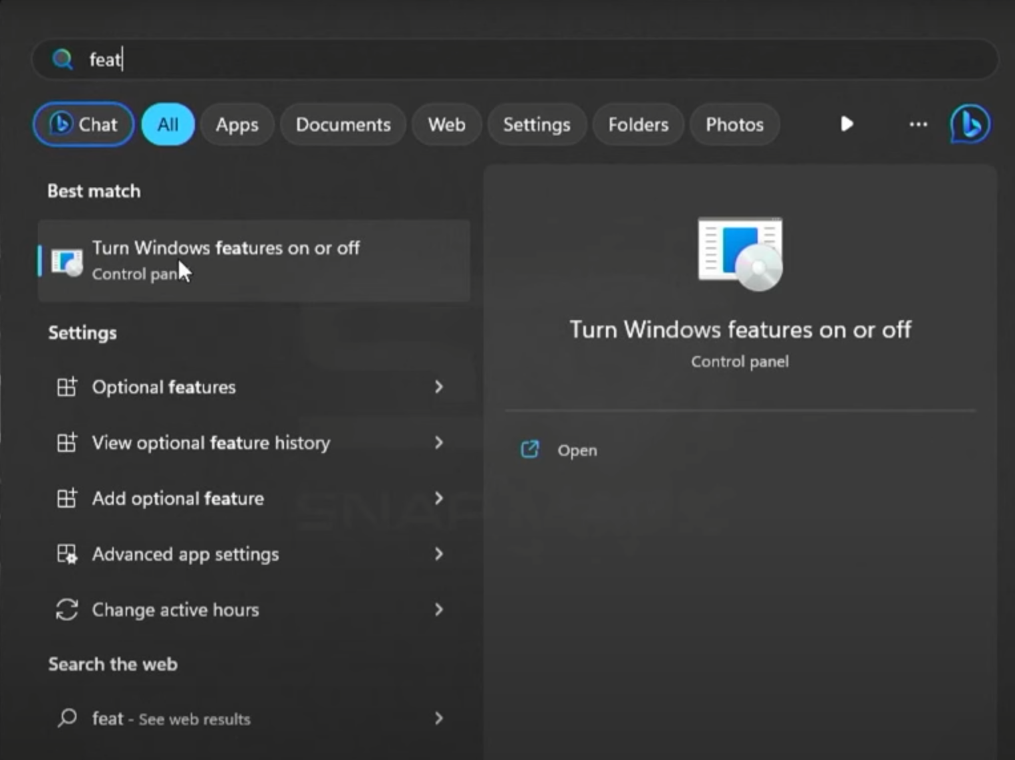
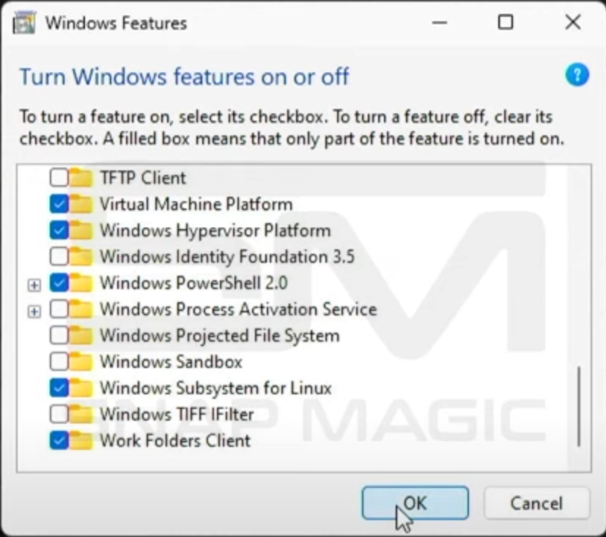
For Windows 10 Users only

Slide 4
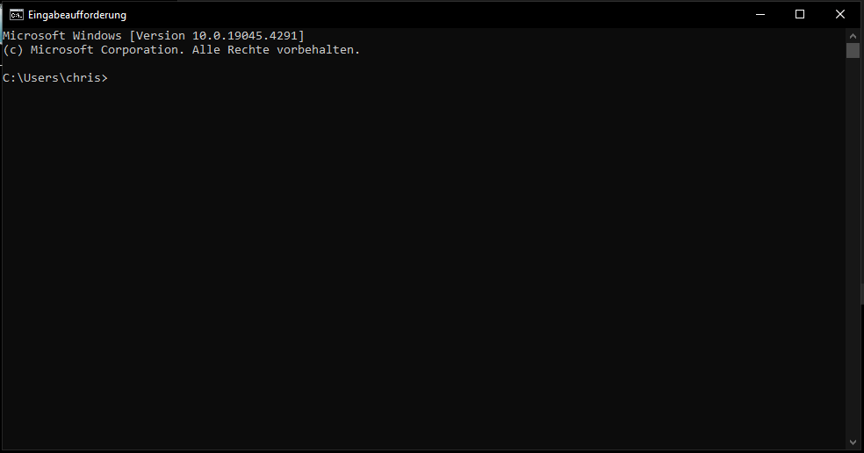
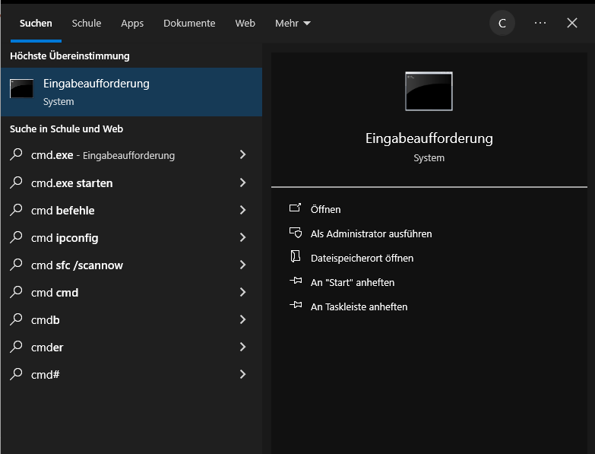
For Windows 10 + 11 Users
It should look something like this…
Search for the Windows command prompt by typing cmd into your search bar.
Windows 11 Users just have to type wsl.exe --install and follow the instructions.
Just to be sure type wsl --update after the installation is finished.
Windows 10 Users should enter wsl --set-default-version 2 afterwards.

Slide 5
Reboot your PC

Slide 6
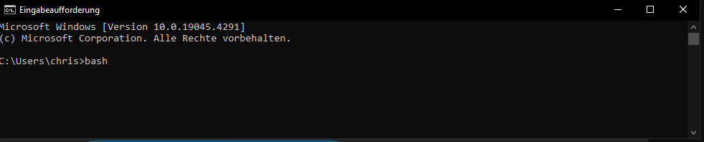
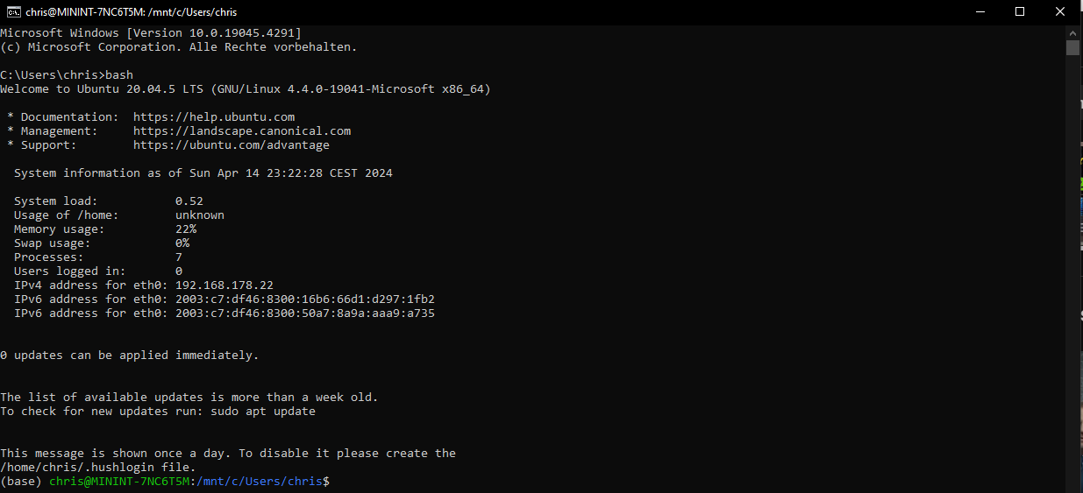
After the reboot is complete, open you Windows command prompt again by typing cmd into you search bar.
Then, type bash to change into your Linux command prompt.
Your Interface should now look similar to this:
Update and upgrade your Linux-Subsystem via
sudo apt-get update && sudo apt-get upgrade

Slide 7
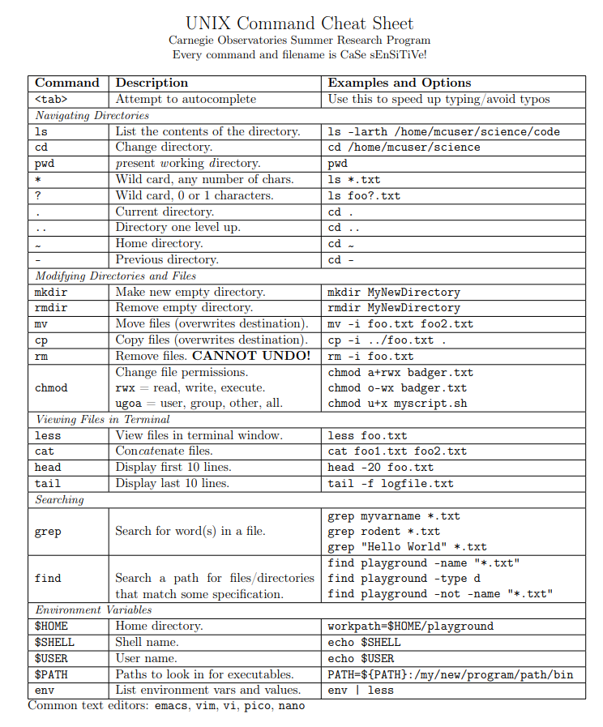
The Command Line Interface (CLI)
The CLI is the ‚opposite‘ of a Graphical User Interface (GUI)
It allows for direct interaction between you and a programm via text command.
The CLI we use is implemented in bash and uses UNIX/LINUX as a language
You can find many „cheat sheets“ listing the most important UNIX commands by doing a simple google search

Slide 8
Some small tasks for you
Open bash
Access your current directory
Navigate to your Desktop
Create a directory called bioinformatics
Change into the new directory
Open a text editor of your choice (recommendation: nano) by simply typing nano
Write hello world! into the text editor and save it as a .txt file
But how to get the programms we actually need for bioinformatical analyses?

Slide 9






Slide 10
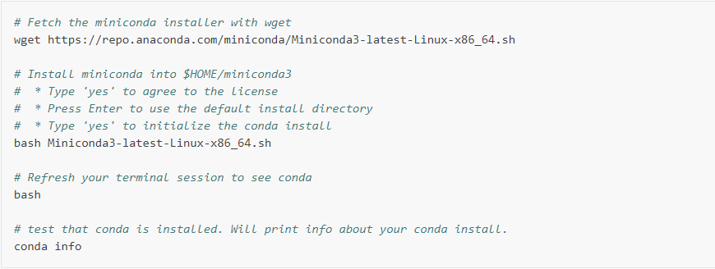
Advantages of Conda:
Open-source
Cross-platform
Supports many languages
Allows for the management of many working environments
Two versions:
Anaconda
Miniconda
Since Anaconda installs a lot of unnecessary junk, we will use Miniconda.

Slide 11
Important conda commands
#create a new conda environment
conda create –n [envname]
# activate an environment
conda activate [envname]
# deactivate the most recently activated environment
conda deactivate
# install package/tool/programm
conda install [packagename] –c [channelname]
-or-
conda install [channelname]::[packagename]
# list contents of currently activated environment
conda list
# list all user-created environments
conda env list
# remove environment and all of it‘s content
conda remove –n [envname] --all
Best practices
Every tool you want to use should be installed into a separate environment
Regulary check if there are avaiable updates for the installed tools.
Deactivate your current environment before activating another environment
Commonly used channels in bioinformatics are bioconda and conda-forge. However, some tools have their own channels.
Your task: Install IQtree!
Tip: A google search of the package-name you want to install plus the keyword conda should relay you to the conda-website, where you can find the appropriate channel to use.

Slide 12
Additional tasks
Install ipyrad (https://ipyrad.readthedocs.io/en/master/#)
  Remember: create and activate a conda environment for ipyrad before installing!
Create conda environments for ipyrad analysis tools (just ipa.pca and ipa.STRUCTURE) and install them
  Remember: Create a new conda environment for each ipyrad analysis tool!
  That means that you have to install ipyrad mutliple times, once in each environment.

Slide 13
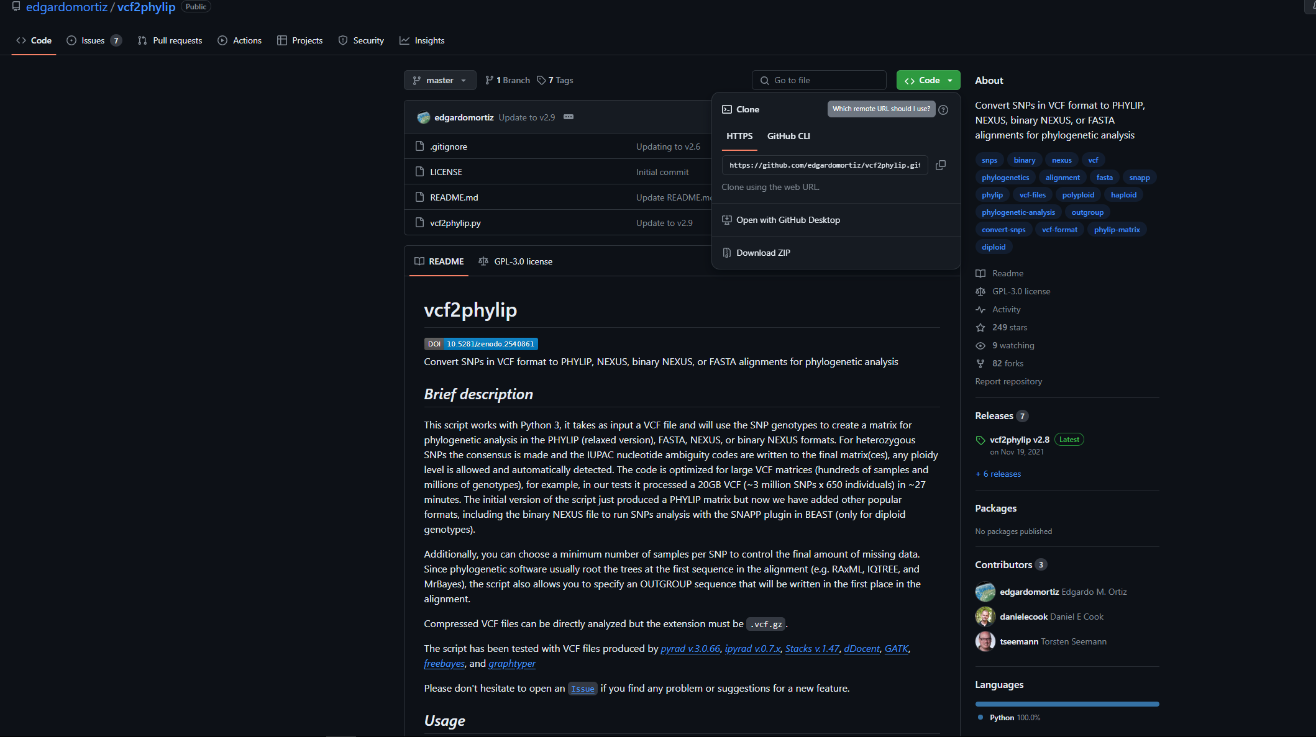
Another important repository for programms used in bioinformatics
To download a package from github:
Open your shell (bash)
Navigate to the directory you want the package
Type git clone, followed by the URL given on the website.
Try for yourself! We may use this tool later in the course.

Slide 14


