Slide 1
Maximum Parsimony
Quick and dirty – and commonly used

Slide 2
Optimality Methods
Tree Construction and Tree evaluation in separate calculations
1st step: Calculation of all possible tree topologies
2nd step: Calculation of support for each branch/node
How many topologies are possible?

Slide 3
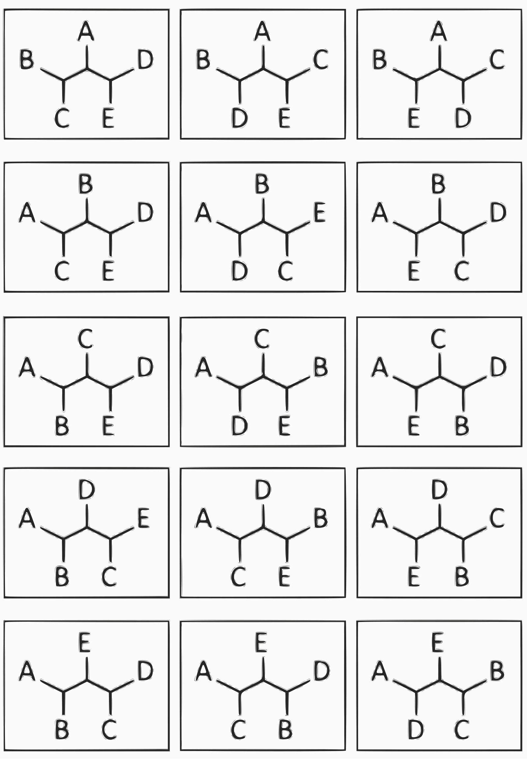
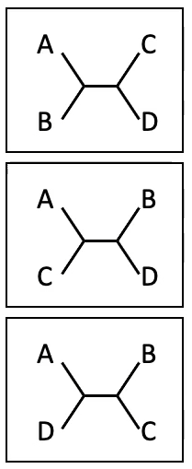
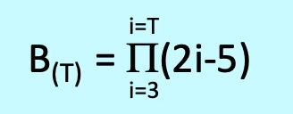
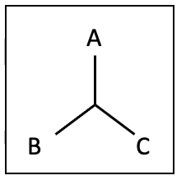
Number of possible topologies….
… in unrooted, completely resolved trees
number of trees (B) depending on number of Taxa (T)
-> 1, 3, 15, 105, 945, 10395, 135135
3 Taxa -> 1 Tree
4 Taxa -> 3 Trees
5 Taxa -> 15 Trees

Slide 4
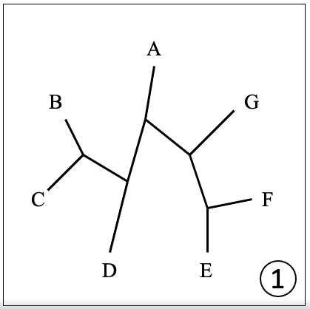
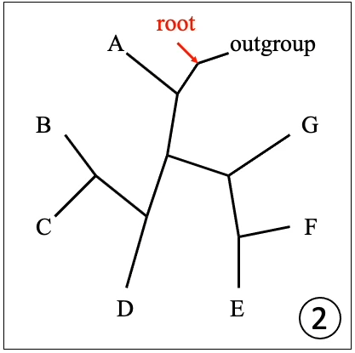
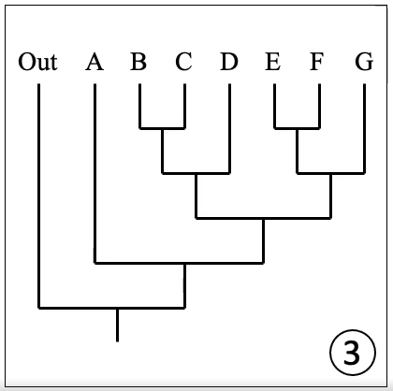
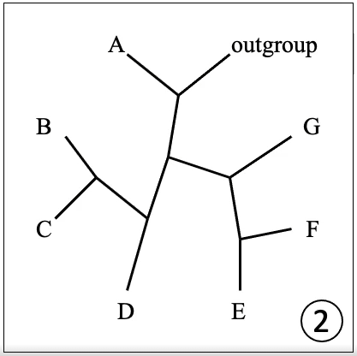
Rooting
Data only gives information about relative branching patterns
  unrooted tree
Evolutionary direction commonly inferred by outgroup comparison (outgroup rooting)
Root placed between outgroup and ingroup.

Slide 5
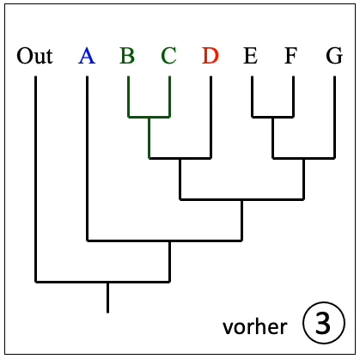
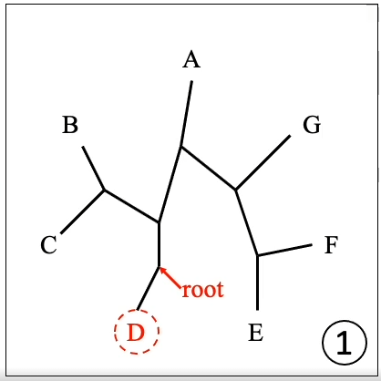
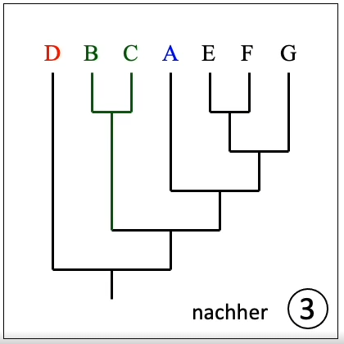
Outgroups
Should be as closely related to the ingroup as possible.
  … but not part of the ingroup.
Example: if B, C, D are from Africa and A, E, F, G are from Asia, the top side tree indicates a migration from Asia to Africa and the bottom tree indicates migration from Africa to Asia.

Slide 6
Maximum Parsimony (“größtmögliche Sparsamkeit”)
Developed by Willi Hennig (1950)
Finds the topology with the least number of necessary character-changes among all obtained topologies.
  Independent from type of character (DNA, binary data, etc….)
  Independent from all other characters

Slide 7
 | 1 | 2 | 3 | 4 | 5 | 6 | 7 | 8 | 9 | 10
Tx A | 0 | 0 | 0 | 0 | 0 | 0 | 0 | 0 | 0 | 0
Tx B | 1 | 1 | 1 | 1 | 0 | 0 | 0 | 0 | 0 | 0
Tx C | 1 | 1 | 0 | 0 | 1 | 1 | 1 | 0 | 0 | 0
Tx D | 1 | 1 | 0 | 0 | 1 | 1 | 0 | 1 | 1 | 0
Tx E | 1 | 1 | 0 | 0 | 1 | 1 | 0 | 1 | 0 | 1
  5 Taxa
  10 Characters
  Binary data
    Character present

Slide 8
 | 1 | 2 | 3 | 4 | 5 | 6 | 7 | 8 | 9 | 10
Tx A | 0 | 0 | 0 | 0 | 0 | 0 | 0 | 0 | 0 | 0
Tx B | 1 | 1 | 1 | 1 | 0 | 0 | 0 | 0 | 0 | 0
Tx C | 1 | 1 | 0 | 0 | 1 | 1 | 1 | 0 | 0 | 0
Tx D | 1 | 1 | 0 | 0 | 1 | 1 | 0 | 1 | 1 | 0
Tx E | 1 | 1 | 0 | 0 | 1 | 1 | 0 | 1 | 0 | 1
  5 Taxa
  10 Characters
  Binary data
    Character present
    Character not present

Slide 9
Step-by-step guide
1. Construction of every possible topology
2. Analyze the first topology (tree)
  If no outgroup defined, random root placement.

Slide 10
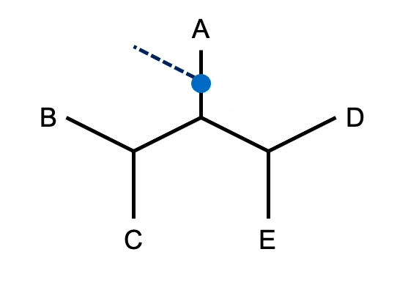
Step-by-step guide
 | 1 | 2 | 3 | 4 | 5 | 6 | 7 | 8 | 9 | 10
Tx A | 0 | 0 | 0 | 0 | 0 | 0 | 0 | 0 | 0 | 0
Tx B | 1 | 1 | 1 | 1 | 0 | 0 | 0 | 0 | 0 | 0
Tx C | 1 | 1 | 0 | 0 | 1 | 1 | 1 | 0 | 0 | 0
Tx D | 1 | 1 | 0 | 0 | 1 | 1 | 0 | 1 | 1 | 0
Tx E | 1 | 1 | 0 | 0 | 1 | 1 | 0 | 1 | 0 | 1
  3. Set tree length = 0 and begin with first character
  4. Enter the state of this character for each Taxon
tree 1
root
length = 0

Slide 11
Step-by-step guide
 | 1 | 2 | 3 | 4 | 5 | 6 | 7 | 8 | 9 | 10
Tx A | 0 | 0 | 0 | 0 | 0 | 0 | 0 | 0 | 0 | 0
Tx B | 1 | 1 | 1 | 1 | 0 | 0 | 0 | 0 | 0 | 0
Tx C | 1 | 1 | 0 | 0 | 1 | 1 | 1 | 0 | 0 | 0
Tx D | 1 | 1 | 0 | 0 | 1 | 1 | 0 | 1 | 1 | 0
Tx E | 1 | 1 | 0 | 0 | 1 | 1 | 0 | 1 | 0 | 1
  3. Set tree length = 0 and begin with first character
  4. Enter the state of this character for each Taxon
  5. Choose terminal node furthest away from the root, of which the character state is not yet determined
  6. Determine the node state
    If intersection of character states of more terminal nodes is not empty, then the node state = intersection
    If intersection of character states of more terminal nodes is empty, then the node state = union.
      Expand tree length by 1
  If examined node was the last node before the root continue with step 7, otherwise repeat, starting at step 5
tree 1
root
0
{1}
{1}
1
1
{1}
1
1
length = 0

Slide 12
Step-by-step guide
 | 1 | 2 | 3 | 4 | 5 | 6 | 7 | 8 | 9 | 10
Tx A | 0 | 0 | 0 | 0 | 0 | 0 | 0 | 0 | 0 | 0
Tx B | 1 | 1 | 1 | 1 | 0 | 0 | 0 | 0 | 0 | 0
Tx C | 1 | 1 | 0 | 0 | 1 | 1 | 1 | 0 | 0 | 0
Tx D | 1 | 1 | 0 | 0 | 1 | 1 | 0 | 1 | 1 | 0
Tx E | 1 | 1 | 0 | 0 | 1 | 1 | 0 | 1 | 0 | 1
  7. If the set of character states at the last node before root does not include the character state of the outgroup expand tree length by 1
  8. If examined character was the last within the matrix, then continue with step 9, otherwise jump back to step 4 and repeat with next character
tree 1
root
0
{1}
{1}
1
1
{1}
1
1
length = 0
length = 1

Slide 13
Step-by-step guide
 | 1 | 2 | 3 | 4 | 5 | 6 | 7 | 8 | 9 | 10
Tx A | 0 | 0 | 0 | 0 | 0 | 0 | 0 | 0 | 0 | 0
Tx B | 1 | 1 | 1 | 1 | 0 | 0 | 0 | 0 | 0 | 0
Tx C | 1 | 1 | 0 | 0 | 1 | 1 | 1 | 0 | 0 | 0
Tx D | 1 | 1 | 0 | 0 | 1 | 1 | 0 | 1 | 1 | 0
Tx E | 1 | 1 | 0 | 0 | 1 | 1 | 0 | 1 | 0 | 1
  7. If the set of character states at the last node before root does not include the character state of the outgroup expand tree length by 1
  8. If examined character was the last within the matrix, then continue with step 9, otherwise jump back to step 4 and repeat with next character
tree 1
root
0
{1}
{1}
1
1
{1}
1
1
length = 0
length = 1
length = 2

Slide 14
Step-by-step guide
 | 1 | 2 | 3 | 4 | 5 | 6 | 7 | 8 | 9 | 10
Tx A | 0 | 0 | 0 | 0 | 0 | 0 | 0 | 0 | 0 | 0
Tx B | 1 | 1 | 1 | 1 | 0 | 0 | 0 | 0 | 0 | 0
Tx C | 1 | 1 | 0 | 0 | 1 | 1 | 1 | 0 | 0 | 0
Tx D | 1 | 1 | 0 | 0 | 1 | 1 | 0 | 1 | 1 | 0
Tx E | 1 | 1 | 0 | 0 | 1 | 1 | 0 | 1 | 0 | 1
  7. If the set of character states at the last node before root does not include the character state of the outgroup expand tree length by 1
  8. If examined character was the last within the matrix, then continue with step 9, otherwise jump back to step 4 and repeat with next character
  6. Determine the character state
    If intersection of character states of more terminal nodes is not empty, then the node state = intersection
    If intersection of character states of more terminal nodes is empty, then the node state = union.
      Expand tree length by 1
tree 1
root
0
{0,1}
{0}
0
1
{0}
0
0
length = 2
length = 3

Slide 15
Step-by-step guide
 | 1 | 2 | 3 | 4 | 5 | 6 | 7 | 8 | 9 | 10
Tx A | 0 | 0 | 0 | 0 | 0 | 0 | 0 | 0 | 0 | 0
Tx B | 1 | 1 | 1 | 1 | 0 | 0 | 0 | 0 | 0 | 0
Tx C | 1 | 1 | 0 | 0 | 1 | 1 | 1 | 0 | 0 | 0
Tx D | 1 | 1 | 0 | 0 | 1 | 1 | 0 | 1 | 1 | 0
Tx E | 1 | 1 | 0 | 0 | 1 | 1 | 0 | 1 | 0 | 1
  7. If the set of character states at the last node before root does not include the character state of the outgroup expand tree length by 1
  8. If examined character was the last within the matrix, then continue with step 9, otherwise jump back to step 4 and repeat with next character
  6. Determine the character state
    If intersection of character states of more terminal nodes is not empty, then the node state = intersection
    If intersection of character states of more terminal nodes is empty, then the node state = union.
      Expand tree length by 1
tree 1
root
0
{0,1}
{0}
0
1
{0}
0
0
length = 2
length = 3
length = 4

Slide 16
Step-by-step guide
 | 1 | 2 | 3 | 4 | 5 | 6 | 7 | 8 | 9 | 10
Tx A | 0 | 0 | 0 | 0 | 0 | 0 | 0 | 0 | 0 | 0
Tx B | 1 | 1 | 1 | 1 | 0 | 0 | 0 | 0 | 0 | 0
Tx C | 1 | 1 | 0 | 0 | 1 | 1 | 1 | 0 | 0 | 0
Tx D | 1 | 1 | 0 | 0 | 1 | 1 | 0 | 1 | 1 | 0
Tx E | 1 | 1 | 0 | 0 | 1 | 1 | 0 | 1 | 0 | 1
  7. If the set of character states at the last node before root does not include the character state of the outgroup expand tree length by 1
  8. If examined character was the last within the matrix, then continue with step 9, otherwise jump back to step 4 and repeat with next character
  6. Determine the character state
    If intersection of character states of more terminal nodes is not empty, then the node state = intersection
    If intersection of character states of more terminal nodes is empty, then the node state = union.
      Expand tree length by 1
tree 1
root
0
0
{0,1}
{1}
1
{1}
1
1
length = 4
length = 5
length = 6

Slide 17
Step-by-step guide
 | 1 | 2 | 3 | 4 | 5 | 6 | 7 | 8 | 9 | 10
Tx A | 0 | 0 | 0 | 0 | 0 | 0 | 0 | 0 | 0 | 0
Tx B | 1 | 1 | 1 | 1 | 0 | 0 | 0 | 0 | 0 | 0
Tx C | 1 | 1 | 0 | 0 | 1 | 1 | 1 | 0 | 0 | 0
Tx D | 1 | 1 | 0 | 0 | 1 | 1 | 0 | 1 | 1 | 0
Tx E | 1 | 1 | 0 | 0 | 1 | 1 | 0 | 1 | 0 | 1
  7. If the set of character states at the last node before root does not include the character state of the outgroup expand tree length by 1
  8. If examined character was the last within the matrix, then continue with step 9, otherwise jump back to step 4 and repeat with next character
tree 1
root
0
0
{0,1}
{1}
1
{1}
1
1
length = 6
length = 8

Slide 18
Step-by-step guide
 | 1 | 2 | 3 | 4 | 5 | 6 | 7 | 8 | 9 | 10
Tx A | 0 | 0 | 0 | 0 | 0 | 0 | 0 | 0 | 0 | 0
Tx B | 1 | 1 | 1 | 1 | 0 | 0 | 0 | 0 | 0 | 0
Tx C | 1 | 1 | 0 | 0 | 1 | 1 | 1 | 0 | 0 | 0
Tx D | 1 | 1 | 0 | 0 | 1 | 1 | 0 | 1 | 1 | 0
Tx E | 1 | 1 | 0 | 0 | 1 | 1 | 0 | 1 | 0 | 1
  7. If the set of character states at the last node before root does not include the character state of the outgroup expand tree length by 1
  8. If examined character was the last within the matrix, then continue with step 9, otherwise jump back to step 4 and repeat with next character
tree 1
root
0
0
{0,1}
{0}
0
{0}
1
0
length = 8
length = 9

Slide 19
Step-by-step guide
 | 1 | 2 | 3 | 4 | 5 | 6 | 7 | 8 | 9 | 10
Tx A | 0 | 0 | 0 | 0 | 0 | 0 | 0 | 0 | 0 | 0
Tx B | 1 | 1 | 1 | 1 | 0 | 0 | 0 | 0 | 0 | 0
Tx C | 1 | 1 | 0 | 0 | 1 | 1 | 1 | 0 | 0 | 0
Tx D | 1 | 1 | 0 | 0 | 1 | 1 | 0 | 1 | 1 | 0
Tx E | 1 | 1 | 0 | 0 | 1 | 1 | 0 | 1 | 0 | 1
  7. If the set of character states at the last node before root does not include the character state of the outgroup expand tree length by 1
  8. If examined character was the last within the matrix, then continue with step 9, otherwise jump back to step 4 and repeat with next character
tree 1
root
0
0
{0}
{1}
1
{0,1}
0
1
length = 9
length = 10

Slide 20
Step-by-step guide
 | 1 | 2 | 3 | 4 | 5 | 6 | 7 | 8 | 9 | 10
Tx A | 0 | 0 | 0 | 0 | 0 | 0 | 0 | 0 | 0 | 0
Tx B | 1 | 1 | 1 | 1 | 0 | 0 | 0 | 0 | 0 | 0
Tx C | 1 | 1 | 0 | 0 | 1 | 1 | 1 | 0 | 0 | 0
Tx D | 1 | 1 | 0 | 0 | 1 | 1 | 0 | 1 | 1 | 0
Tx E | 1 | 1 | 0 | 0 | 1 | 1 | 0 | 1 | 0 | 1
  7. If the set of character states at the last node before root does not include the character state of the outgroup expand tree length by 1
  8. If examined character was the last within the matrix, then continue with step 9, otherwise jump back to step 4 and repeat with next character
tree 1
root
0
0
{0}
{0,1}
1
{0}
0
0
length = 10
length = 11

Slide 21
Step-by-step guide
 | 1 | 2 | 3 | 4 | 5 | 6 | 7 | 8 | 9 | 10
Tx A | 0 | 0 | 0 | 0 | 0 | 0 | 0 | 0 | 0 | 0
Tx B | 1 | 1 | 1 | 1 | 0 | 0 | 0 | 0 | 0 | 0
Tx C | 1 | 1 | 0 | 0 | 1 | 1 | 1 | 0 | 0 | 0
Tx D | 1 | 1 | 0 | 0 | 1 | 1 | 0 | 1 | 1 | 0
Tx E | 1 | 1 | 0 | 0 | 1 | 1 | 0 | 1 | 0 | 1
  7. If the set of character states at the last node before root does not include the character state of the outgroup expand tree length by 1
  8. If examined character was the last within the matrix, then continue with step 9, otherwise jump back to step 4 and repeat with next character
  9. If examined tree was last possible topology, continue with step 10, otherwise examine next topology (return to step 3)
tree 1
root
0
0
{0}
{0,1}
0
{0}
0
1
length = 11
length = 12

Slide 22
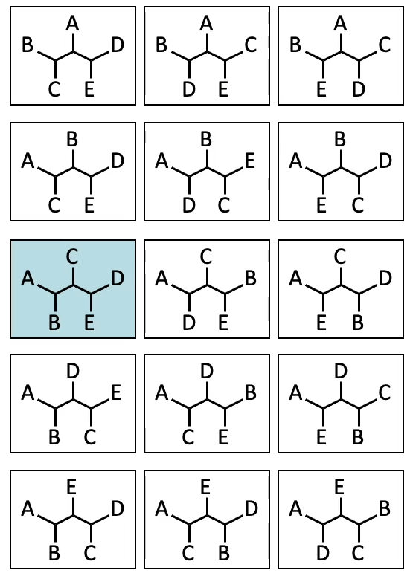
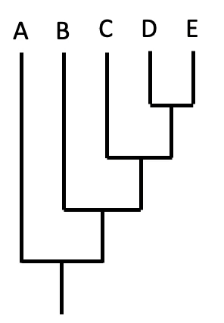
Step-by-step guide
  10. Compare the lengths of each examined tree. The smallest length is the optimal (most parsimonious) solution.

Slide 23
Step-by-step guide
 | 1 | 2 | 3 | 4 | 5 | 6 | 7 | 8 | 9 | 10
Tx A | 0 | 0 | 0 | 0 | 0 | 0 | 0 | 0 | 0 | 0
Tx B | 1 | 1 | 1 | 1 | 0 | 0 | 0 | 0 | 0 | 0
Tx C | 1 | 1 | 0 | 0 | 1 | 1 | 1 | 0 | 0 | 0
Tx D | 1 | 1 | 0 | 0 | 1 | 1 | 0 | 1 | 1 | 0
Tx E | 1 | 1 | 0 | 0 | 1 | 1 | 0 | 1 | 0 | 1
  11. observe the shortest tree
 | 1 | 2 | 3 | 4
1 | 01 | 1 | 1 | 1
2 | 01 | 1 | 1 | 1
3 | 0 | 01 | 0 | 0
4 | 0 | 01 | 0 | 0
5 | 0 | 01 | 1 | 1
6 | 0 | 01 | 1 | 1
7 | 0 | 0 | 01 | 0
8 | 0 | 0 | 01 | 1
9 | 0 | 0 | 0 | 01
10 | 0 | 0 | 0 | 01
4
3
2
1 = root

Slide 24
Step-by-step guide
 | 1 | 2 | 3 | 4 | 5 | 6 | 7 | 8 | 9 | 10
Tx A | 0 | 0 | 0 | 0 | 0 | 0 | 0 | 0 | 0 | 0
Tx B | 1 | 1 | 1 | 1 | 0 | 0 | 0 | 0 | 0 | 0
Tx C | 1 | 1 | 0 | 0 | 1 | 1 | 1 | 0 | 0 | 0
Tx D | 1 | 1 | 0 | 0 | 1 | 1 | 0 | 1 | 1 | 0
Tx E | 1 | 1 | 0 | 0 | 1 | 1 | 0 | 1 | 0 | 1
  11. observe the shortest tree
  12. starting with the first character, find the node nearest to the basis (but not the root) for which the state was not optimized yet
    If state of direct ancestor is included into set of states of the examined node, then state examined node = state ancestral node
    If this is not the case, choose random state
  13. Repeat step 12 until state allocation is optimized for last internal terminal node
  14. If last character was optimized continue with step 15, otherwise repeat step 13 with next character
 | 1 | 2 | 3 | 4
1 | 01 | 1 | 1 | 1
2 | 01 | 1 | 1 | 1
3 | 0 | 01 | 0 | 0
4 | 0 | 01 | 0 | 0
5 | 0 | 01 | 1 | 1
6 | 0 | 01 | 1 | 1
7 | 0 | 0 | 01 | 0
8 | 0 | 0 | 01 | 1
9 | 0 | 0 | 0 | 01
10 | 0 | 0 | 0 | 01
4
3
2
1 = root

Slide 25
Step-by-step guide
 | 1 | 2 | 3 | 4 | 5 | 6 | 7 | 8 | 9 | 10
Tx A | 0 | 0 | 0 | 0 | 0 | 0 | 0 | 0 | 0 | 0
Tx B | 1 | 1 | 1 | 1 | 0 | 0 | 0 | 0 | 0 | 0
Tx C | 1 | 1 | 0 | 0 | 1 | 1 | 1 | 0 | 0 | 0
Tx D | 1 | 1 | 0 | 0 | 1 | 1 | 0 | 1 | 1 | 0
Tx E | 1 | 1 | 0 | 0 | 1 | 1 | 0 | 1 | 0 | 1
  11. observe the shortest tree
  12. starting with the first character, find the node nearest to the basis (but not the root) for which the state was not optimized yet
    If state of direct ancestor is included into set of states of the examined node, then state examined node = state ancestral node
    If this is not the case, choose random state
  13. Repeat step 12 until state allocation is optimized for last internal terminal node
  14. If last character was optimized continue with step 15, otherwise repeat step 13 with next character
 | 1 | 2 | 3 | 4
1 | 01 | 1 | 1 | 1
2 | 01 | 1 | 1 | 1
3 | 0 | 01 | 0 | 0
4 | 0 | 01 | 0 | 0
5 | 0 | 01 | 1 | 1
6 | 0 | 01 | 1 | 1
7 | 0 | 0 | 01 | 0
8 | 0 | 0 | 01 | 1
9 | 0 | 0 | 0 | 01
10 | 0 | 0 | 0 | 01
4
3
2
1 = root

Slide 26
Step-by-step guide
 | 1 | 2 | 3 | 4 | 5 | 6 | 7 | 8 | 9 | 10
Tx A | 0 | 0 | 0 | 0 | 0 | 0 | 0 | 0 | 0 | 0
Tx B | 1 | 1 | 1 | 1 | 0 | 0 | 0 | 0 | 0 | 0
Tx C | 1 | 1 | 0 | 0 | 1 | 1 | 1 | 0 | 0 | 0
Tx D | 1 | 1 | 0 | 0 | 1 | 1 | 0 | 1 | 1 | 0
Tx E | 1 | 1 | 0 | 0 | 1 | 1 | 0 | 1 | 0 | 1
  11. observe the shortest tree
  12. starting with the first character, find the node nearest to the basis (but not the root) for which the state was not optimized yet
    If state of direct ancestor is included into set of states of the examined node, then state examined node = state ancestral node
    If this is not the case, choose random state
  13. Repeat step 12 until state allocation is optimized for last internal terminal node
  14. If last character was optimized continue with step 15, otherwise repeat step 13 with next character
 | 1 | 2 | 3 | 4
1 | 01 | 1 | 1 | 1
2 | 01 | 1 | 1 | 1
3 | 0 | 01 | 0 | 0
4 | 0 | 01 | 0 | 0
5 | 0 | 01 | 1 | 1
6 | 0 | 01 | 1 | 1
7 | 0 | 0 | 01 | 0
8 | 0 | 0 | 01 | 1
9 | 0 | 0 | 0 | 01
10 | 0 | 0 | 0 | 01
4
3
2
1 = root

Slide 27
Step-by-step guide
 | 1 | 2 | 3 | 4 | 5 | 6 | 7 | 8 | 9 | 10
Tx A | 0 | 0 | 0 | 0 | 0 | 0 | 0 | 0 | 0 | 0
Tx B | 1 | 1 | 1 | 1 | 0 | 0 | 0 | 0 | 0 | 0
Tx C | 1 | 1 | 0 | 0 | 1 | 1 | 1 | 0 | 0 | 0
Tx D | 1 | 1 | 0 | 0 | 1 | 1 | 0 | 1 | 1 | 0
Tx E | 1 | 1 | 0 | 0 | 1 | 1 | 0 | 1 | 0 | 1
  11. observe the shortest tree
  12. starting with the first character, find the node nearest to the basis (but not the root) for which the state was not optimized yet
    If state of direct ancestor is included into set of states of the examined node, then state examined node = state ancestral node
    If this is not the case, choose random state
  13. Repeat step 12 until state allocation is optimized for last internal terminal node
  14. If last character was optimized continue with step 15, otherwise repeat step 13 with next character
 | 1 | 2 | 3 | 4
1 | 01 | 1 | 1 | 1
2 | 01 | 1 | 1 | 1
3 | 0 | 0 | 0 | 0
4 | 0 | 01 | 0 | 0
5 | 0 | 01 | 1 | 1
6 | 0 | 01 | 1 | 1
7 | 0 | 0 | 01 | 0
8 | 0 | 0 | 01 | 1
9 | 0 | 0 | 0 | 01
10 | 0 | 0 | 0 | 01
4
3
2
1 = root

Slide 28
Step-by-step guide
 | 1 | 2 | 3 | 4 | 5 | 6 | 7 | 8 | 9 | 10
Tx A | 0 | 0 | 0 | 0 | 0 | 0 | 0 | 0 | 0 | 0
Tx B | 1 | 1 | 1 | 1 | 0 | 0 | 0 | 0 | 0 | 0
Tx C | 1 | 1 | 0 | 0 | 1 | 1 | 1 | 0 | 0 | 0
Tx D | 1 | 1 | 0 | 0 | 1 | 1 | 0 | 1 | 1 | 0
Tx E | 1 | 1 | 0 | 0 | 1 | 1 | 0 | 1 | 0 | 1
  11. observe the shortest tree
  12. starting with the first character, find the node nearest to the basis (but not the root) for which the state was not optimized yet
    If state of direct ancestor is included into set of states of the examined node, then state examined node = state ancestral node
    If this is not the case, choose random state
  13. Repeat step 12 until state allocation is optimized for last internal terminal node
  14. If last character was optimized continue with step 15, otherwise repeat step 13 with next character
 | 1 | 2 | 3 | 4
1 | 01 | 1 | 1 | 1
2 | 01 | 1 | 1 | 1
3 | 0 | 0 | 0 | 0
4 | 0 | 0 | 0 | 0
5 | 0 | 01 | 1 | 1
6 | 0 | 01 | 1 | 1
7 | 0 | 0 | 01 | 0
8 | 0 | 0 | 01 | 1
9 | 0 | 0 | 0 | 01
10 | 0 | 0 | 0 | 01
4
3
2
1 = root

Slide 29
Step-by-step guide
 | 1 | 2 | 3 | 4 | 5 | 6 | 7 | 8 | 9 | 10
Tx A | 0 | 0 | 0 | 0 | 0 | 0 | 0 | 0 | 0 | 0
Tx B | 1 | 1 | 1 | 1 | 0 | 0 | 0 | 0 | 0 | 0
Tx C | 1 | 1 | 0 | 0 | 1 | 1 | 1 | 0 | 0 | 0
Tx D | 1 | 1 | 0 | 0 | 1 | 1 | 0 | 1 | 1 | 0
Tx E | 1 | 1 | 0 | 0 | 1 | 1 | 0 | 1 | 0 | 1
  11. observe the shortest tree
  12. starting with the first character, find the node nearest to the basis (but not the root) for which the state was not optimized yet
    If state of direct ancestor is included into set of states of the examined node, then state examined node = state ancestral node
    If this is not the case, choose random state
  13. Repeat step 12 until state allocation is optimized for last internal terminal node
  14. If last character was optimized continue with step 15, otherwise repeat step 13 with next character
 | 1 | 2 | 3 | 4
1 | 01 | 1 | 1 | 1
2 | 01 | 1 | 1 | 1
3 | 0 | 0 | 0 | 0
4 | 0 | 0 | 0 | 0
5 | 0 | 0 | 1 | 1
6 | 0 | 01 | 1 | 1
7 | 0 | 0 | 01 | 0
8 | 0 | 0 | 01 | 1
9 | 0 | 0 | 0 | 01
10 | 0 | 0 | 0 | 01
4
3
2
1 = root

Slide 30
Step-by-step guide
 | 1 | 2 | 3 | 4 | 5 | 6 | 7 | 8 | 9 | 10
Tx A | 0 | 0 | 0 | 0 | 0 | 0 | 0 | 0 | 0 | 0
Tx B | 1 | 1 | 1 | 1 | 0 | 0 | 0 | 0 | 0 | 0
Tx C | 1 | 1 | 0 | 0 | 1 | 1 | 1 | 0 | 0 | 0
Tx D | 1 | 1 | 0 | 0 | 1 | 1 | 0 | 1 | 1 | 0
Tx E | 1 | 1 | 0 | 0 | 1 | 1 | 0 | 1 | 0 | 1
  11. observe the shortest tree
  12. starting with the first character, find the node nearest to the basis (but not the root) for which the state was not optimized yet
    If state of direct ancestor is included into set of states of the examined node, then state examined node = state ancestral node
    If this is not the case, choose random state
  13. Repeat step 12 until state allocation is optimized for last internal terminal node
  14. If last character was optimized continue with step 15, otherwise repeat step 13 with next character
 | 1 | 2 | 3 | 4
1 | 01 | 1 | 1 | 1
2 | 01 | 1 | 1 | 1
3 | 0 | 0 | 0 | 0
4 | 0 | 0 | 0 | 0
5 | 0 | 0 | 1 | 1
6 | 0 | 0 | 1 | 1
7 | 0 | 0 | 01 | 0
8 | 0 | 0 | 01 | 1
9 | 0 | 0 | 0 | 01
10 | 0 | 0 | 0 | 01
4
3
2
1 = root

Slide 31
Step-by-step guide
 | 1 | 2 | 3 | 4 | 5 | 6 | 7 | 8 | 9 | 10
Tx A | 0 | 0 | 0 | 0 | 0 | 0 | 0 | 0 | 0 | 0
Tx B | 1 | 1 | 1 | 1 | 0 | 0 | 0 | 0 | 0 | 0
Tx C | 1 | 1 | 0 | 0 | 1 | 1 | 1 | 0 | 0 | 0
Tx D | 1 | 1 | 0 | 0 | 1 | 1 | 0 | 1 | 1 | 0
Tx E | 1 | 1 | 0 | 0 | 1 | 1 | 0 | 1 | 0 | 1
  11. observe the shortest tree
  12. starting with the first character, find the node nearest to the basis (but not the root) for which the state was not optimized yet
    If state of direct ancestor is included into set of states of the examined node, then state examined node = state ancestral node
    If this is not the case, choose random state
  13. Repeat step 12 until state allocation is optimized for last internal terminal node
  14. If last character was optimized continue with step 15, otherwise repeat step 13 with next character
 | 1 | 2 | 3 | 4
1 | 01 | 1 | 1 | 1
2 | 01 | 1 | 1 | 1
3 | 0 | 0 | 0 | 0
4 | 0 | 0 | 0 | 0
5 | 0 | 0 | 1 | 1
6 | 0 | 0 | 1 | 1
7 | 0 | 0 | 0 | 0
8 | 0 | 0 | 01 | 1
9 | 0 | 0 | 0 | 01
10 | 0 | 0 | 0 | 01
4
3
2
1 = root

Slide 32
Step-by-step guide
 | 1 | 2 | 3 | 4 | 5 | 6 | 7 | 8 | 9 | 10
Tx A | 0 | 0 | 0 | 0 | 0 | 0 | 0 | 0 | 0 | 0
Tx B | 1 | 1 | 1 | 1 | 0 | 0 | 0 | 0 | 0 | 0
Tx C | 1 | 1 | 0 | 0 | 1 | 1 | 1 | 0 | 0 | 0
Tx D | 1 | 1 | 0 | 0 | 1 | 1 | 0 | 1 | 1 | 0
Tx E | 1 | 1 | 0 | 0 | 1 | 1 | 0 | 1 | 0 | 1
  11. observe the shortest tree
  12. starting with the first character, find the node nearest to the basis (but not the root) for which the state was not optimized yet
    If state of direct ancestor is included into set of states of the examined node, then state examined node = state ancestral node
    If this is not the case, choose random state
  13. Repeat step 12 until state allocation is optimized for last internal terminal node
  14. If last character was optimized continue with step 15, otherwise repeat step 13 with next character
 | 1 | 2 | 3 | 4
1 | 01 | 1 | 1 | 1
2 | 01 | 1 | 1 | 1
3 | 0 | 0 | 0 | 0
4 | 0 | 0 | 0 | 0
5 | 0 | 0 | 1 | 1
6 | 0 | 0 | 1 | 1
7 | 0 | 0 | 0 | 0
8 | 0 | 0 | 0 | 1
9 | 0 | 0 | 0 | 01
10 | 0 | 0 | 0 | 01
4
3
2
1 = root

Slide 33
Step-by-step guide
 | 1 | 2 | 3 | 4 | 5 | 6 | 7 | 8 | 9 | 10
Tx A | 0 | 0 | 0 | 0 | 0 | 0 | 0 | 0 | 0 | 0
Tx B | 1 | 1 | 1 | 1 | 0 | 0 | 0 | 0 | 0 | 0
Tx C | 1 | 1 | 0 | 0 | 1 | 1 | 1 | 0 | 0 | 0
Tx D | 1 | 1 | 0 | 0 | 1 | 1 | 0 | 1 | 1 | 0
Tx E | 1 | 1 | 0 | 0 | 1 | 1 | 0 | 1 | 0 | 1
  11. observe the shortest tree
  12. starting with the first character, find the node nearest to the basis (but not the root) for which the state was not optimized yet
    If state of direct ancestor is included into set of states of the examined node, then state examined node = state ancestral node
    If this is not the case, choose random state
  13. Repeat step 12 until state allocation is optimized for last internal terminal node
  14. If last character was optimized continue with step 15, otherwise repeat step 13 with next character
 | 1 | 2 | 3 | 4
1 | 01 | 1 | 1 | 1
2 | 01 | 1 | 1 | 1
3 | 0 | 0 | 0 | 0
4 | 0 | 0 | 0 | 0
5 | 0 | 0 | 1 | 1
6 | 0 | 0 | 1 | 1
7 | 0 | 0 | 0 | 0
8 | 0 | 0 | 0 | 1
9 | 0 | 0 | 0 | 0
10 | 0 | 0 | 0 | 01
4
3
2
1 = root

Slide 34
Step-by-step guide
 | 1 | 2 | 3 | 4 | 5 | 6 | 7 | 8 | 9 | 10
Tx A | 0 | 0 | 0 | 0 | 0 | 0 | 0 | 0 | 0 | 0
Tx B | 1 | 1 | 1 | 1 | 0 | 0 | 0 | 0 | 0 | 0
Tx C | 1 | 1 | 0 | 0 | 1 | 1 | 1 | 0 | 0 | 0
Tx D | 1 | 1 | 0 | 0 | 1 | 1 | 0 | 1 | 1 | 0
Tx E | 1 | 1 | 0 | 0 | 1 | 1 | 0 | 1 | 0 | 1
  11. observe the shortest tree
  12. starting with the first character, find the node nearest to the basis (but not the root) for which the state was not optimized yet
    If state of direct ancestor is included into set of states of the examined node, then state examined node = state ancestral node
    If this is not the case, choose random state
  13. Repeat step 12 until state allocation is optimized for last internal terminal node
  14. If last character was optimized continue with step 15, otherwise repeat step 13 with next character
 | 1 | 2 | 3 | 4
1 | 01 | 1 | 1 | 1
2 | 01 | 1 | 1 | 1
3 | 0 | 0 | 0 | 0
4 | 0 | 0 | 0 | 0
5 | 0 | 0 | 1 | 1
6 | 0 | 0 | 1 | 1
7 | 0 | 0 | 0 | 0
8 | 0 | 0 | 0 | 1
9 | 0 | 0 | 0 | 0
10 | 0 | 0 | 0 | 0
4
3
2
1 = root

Slide 35
Step-by-step guide
 | 1 | 2 | 3 | 4 | 5 | 6 | 7 | 8 | 9 | 10
Tx A | 0 | 0 | 0 | 0 | 0 | 0 | 0 | 0 | 0 | 0
Tx B | 1 | 1 | 1 | 1 | 0 | 0 | 0 | 0 | 0 | 0
Tx C | 1 | 1 | 0 | 0 | 1 | 1 | 1 | 0 | 0 | 0
Tx D | 1 | 1 | 0 | 0 | 1 | 1 | 0 | 1 | 1 | 0
Tx E | 1 | 1 | 0 | 0 | 1 | 1 | 0 | 1 | 0 | 1
  15. If examined tree was last shortest tree, then character reconstruction is finished. Otherwise, return to step 12 and examine the next equally short tree.
 | 1 | 2 | 3 | 4
1 | 01 | 1 | 1 | 1
2 | 01 | 1 | 1 | 1
3 | 0 | 0 | 0 | 0
4 | 0 | 0 | 0 | 0
5 | 0 | 0 | 1 | 1
6 | 0 | 0 | 1 | 1
7 | 0 | 0 | 0 | 0
8 | 0 | 0 | 0 | 1
9 | 0 | 0 | 0 | 0
10 | 0 | 0 | 0 | 0
4
3
2
1 = root

Slide 36
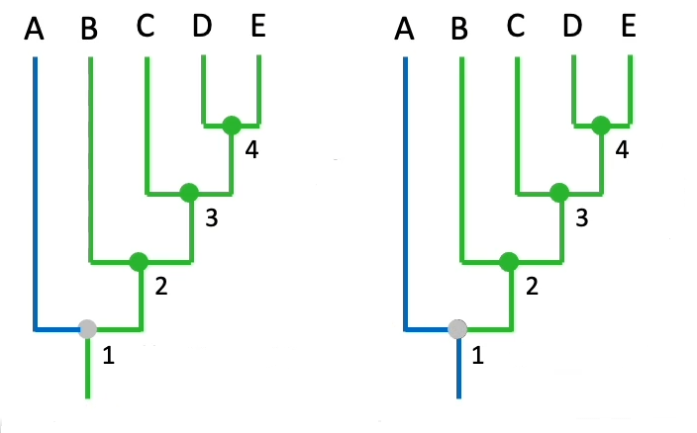
Conclusions
 | 1 | 2 | 3 | 4 | 5 | 6 | 7 | 8 | 9 | 10
Tx A | 0 | 0 | 0 | 0 | 0 | 0 | 0 | 0 | 0 | 0
Tx B | 1 | 1 | 1 | 1 | 0 | 0 | 0 | 0 | 0 | 0
Tx C | 1 | 1 | 0 | 0 | 1 | 1 | 1 | 0 | 0 | 0
Tx D | 1 | 1 | 0 | 0 | 1 | 1 | 0 | 1 | 1 | 0
Tx E | 1 | 1 | 0 | 0 | 1 | 1 | 0 | 1 | 0 | 1
  Where did character states change?
    two possibilities for characters 1 and 2
    Either character of Taxon A (0) or Taxon B (1) was ancestral state
 | 1 | 2 | 3 | 4
1 | 01 | 1 | 1 | 1
2 | 01 | 1 | 1 | 1
3 | 0 | 0 | 0 | 0
4 | 0 | 0 | 0 | 0
5 | 0 | 0 | 1 | 1
6 | 0 | 0 | 1 | 1
7 | 0 | 0 | 0 | 0
8 | 0 | 0 | 0 | 1
9 | 0 | 0 | 0 | 0
10 | 0 | 0 | 0 | 0

Slide 37
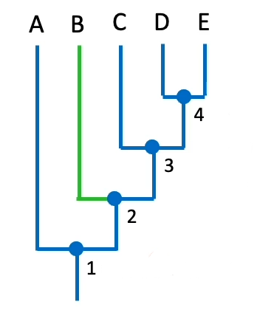
Conclusions
 | 1 | 2 | 3 | 4 | 5 | 6 | 7 | 8 | 9 | 10
Tx A | 0 | 0 | 0 | 0 | 0 | 0 | 0 | 0 | 0 | 0
Tx B | 1 | 1 | 1 | 1 | 0 | 0 | 0 | 0 | 0 | 0
Tx C | 1 | 1 | 0 | 0 | 1 | 1 | 1 | 0 | 0 | 0
Tx D | 1 | 1 | 0 | 0 | 1 | 1 | 0 | 1 | 1 | 0
Tx E | 1 | 1 | 0 | 0 | 1 | 1 | 0 | 1 | 0 | 1
  Where did character states change?
    two possibilities for characters 1 and 2
    Either character of Taxon A (0) or Taxon B (1) was ancestral state
    Just one possibility for the rest
 | 1 | 2 | 3 | 4
1 | 01 | 1 | 1 | 1
2 | 01 | 1 | 1 | 1
3 | 0 | 0 | 0 | 0
4 | 0 | 0 | 0 | 0
5 | 0 | 0 | 1 | 1
6 | 0 | 0 | 1 | 1
7 | 0 | 0 | 0 | 0
8 | 0 | 0 | 0 | 1
9 | 0 | 0 | 0 | 0
10 | 0 | 0 | 0 | 0
characters 3 and 4

Slide 38
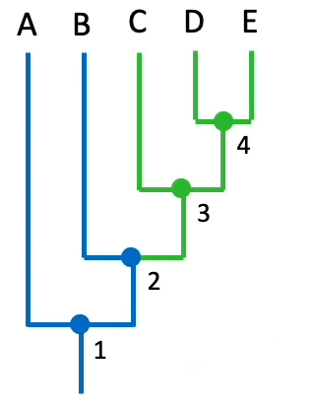
Conclusions
 | 1 | 2 | 3 | 4 | 5 | 6 | 7 | 8 | 9 | 10
Tx A | 0 | 0 | 0 | 0 | 0 | 0 | 0 | 0 | 0 | 0
Tx B | 1 | 1 | 1 | 1 | 0 | 0 | 0 | 0 | 0 | 0
Tx C | 1 | 1 | 0 | 0 | 1 | 1 | 1 | 0 | 0 | 0
Tx D | 1 | 1 | 0 | 0 | 1 | 1 | 0 | 1 | 1 | 0
Tx E | 1 | 1 | 0 | 0 | 1 | 1 | 0 | 1 | 0 | 1
  Where did character states change?
    two possibilities for characters 1 and 2
    Either character of Taxon A (0) or Taxon B (1) was ancestral state
    Just one possibility for the rest
 | 1 | 2 | 3 | 4
1 | 01 | 1 | 1 | 1
2 | 01 | 1 | 1 | 1
3 | 0 | 0 | 0 | 0
4 | 0 | 0 | 0 | 0
5 | 0 | 0 | 1 | 1
6 | 0 | 0 | 1 | 1
7 | 0 | 0 | 0 | 0
8 | 0 | 0 | 0 | 1
9 | 0 | 0 | 0 | 0
10 | 0 | 0 | 0 | 0
characters 5 and 6

Slide 39
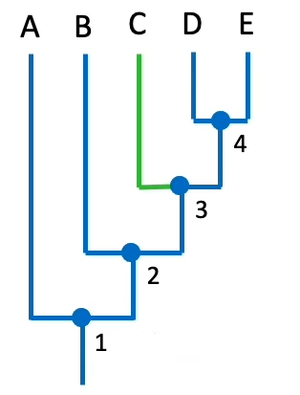
Conclusions
 | 1 | 2 | 3 | 4 | 5 | 6 | 7 | 8 | 9 | 10
Tx A | 0 | 0 | 0 | 0 | 0 | 0 | 0 | 0 | 0 | 0
Tx B | 1 | 1 | 1 | 1 | 0 | 0 | 0 | 0 | 0 | 0
Tx C | 1 | 1 | 0 | 0 | 1 | 1 | 1 | 0 | 0 | 0
Tx D | 1 | 1 | 0 | 0 | 1 | 1 | 0 | 1 | 1 | 0
Tx E | 1 | 1 | 0 | 0 | 1 | 1 | 0 | 1 | 0 | 1
  Where did character states change?
    two possibilities for characters 1 and 2
    Either character of Taxon A (0) or Taxon B (1) was ancestral state
    Just one possibility for the rest
 | 1 | 2 | 3 | 4
1 | 01 | 1 | 1 | 1
2 | 01 | 1 | 1 | 1
3 | 0 | 0 | 0 | 0
4 | 0 | 0 | 0 | 0
5 | 0 | 0 | 1 | 1
6 | 0 | 0 | 1 | 1
7 | 0 | 0 | 0 | 0
8 | 0 | 0 | 0 | 1
9 | 0 | 0 | 0 | 0
10 | 0 | 0 | 0 | 0
Character 7

Slide 40
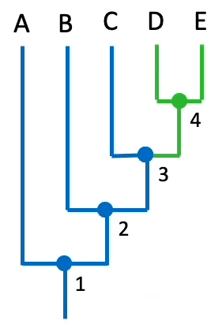
Conclusions
 | 1 | 2 | 3 | 4 | 5 | 6 | 7 | 8 | 9 | 10
Tx A | 0 | 0 | 0 | 0 | 0 | 0 | 0 | 0 | 0 | 0
Tx B | 1 | 1 | 1 | 1 | 0 | 0 | 0 | 0 | 0 | 0
Tx C | 1 | 1 | 0 | 0 | 1 | 1 | 1 | 0 | 0 | 0
Tx D | 1 | 1 | 0 | 0 | 1 | 1 | 0 | 1 | 1 | 0
Tx E | 1 | 1 | 0 | 0 | 1 | 1 | 0 | 1 | 0 | 1
  Where did character states change?
    two possibilities for characters 1 and 2
    Either character of Taxon A (0) or Taxon B (1) was ancestral state
    Just one possibility for the rest
 | 1 | 2 | 3 | 4
1 | 01 | 1 | 1 | 1
2 | 01 | 1 | 1 | 1
3 | 0 | 0 | 0 | 0
4 | 0 | 0 | 0 | 0
5 | 0 | 0 | 1 | 1
6 | 0 | 0 | 1 | 1
7 | 0 | 0 | 0 | 0
8 | 0 | 0 | 0 | 1
9 | 0 | 0 | 0 | 0
10 | 0 | 0 | 0 | 0
Character 8

Slide 41
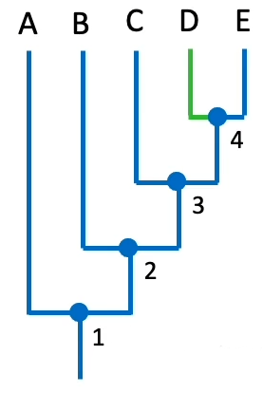
Conclusions
 | 1 | 2 | 3 | 4 | 5 | 6 | 7 | 8 | 9 | 10
Tx A | 0 | 0 | 0 | 0 | 0 | 0 | 0 | 0 | 0 | 0
Tx B | 1 | 1 | 1 | 1 | 0 | 0 | 0 | 0 | 0 | 0
Tx C | 1 | 1 | 0 | 0 | 1 | 1 | 1 | 0 | 0 | 0
Tx D | 1 | 1 | 0 | 0 | 1 | 1 | 0 | 1 | 1 | 0
Tx E | 1 | 1 | 0 | 0 | 1 | 1 | 0 | 1 | 0 | 1
  Where did character states change?
    two possibilities for characters 1 and 2
    Either character of Taxon A (0) or Taxon B (1) was ancestral state
    Just one possibility for the rest
 | 1 | 2 | 3 | 4
1 | 01 | 1 | 1 | 1
2 | 01 | 1 | 1 | 1
3 | 0 | 0 | 0 | 0
4 | 0 | 0 | 0 | 0
5 | 0 | 0 | 1 | 1
6 | 0 | 0 | 1 | 1
7 | 0 | 0 | 0 | 0
8 | 0 | 0 | 0 | 1
9 | 0 | 0 | 0 | 0
10 | 0 | 0 | 0 | 0
Character 9

Slide 42
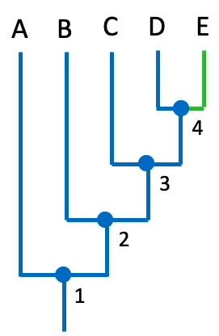
Conclusions
 | 1 | 2 | 3 | 4 | 5 | 6 | 7 | 8 | 9 | 10
Tx A | 0 | 0 | 0 | 0 | 0 | 0 | 0 | 0 | 0 | 0
Tx B | 1 | 1 | 1 | 1 | 0 | 0 | 0 | 0 | 0 | 0
Tx C | 1 | 1 | 0 | 0 | 1 | 1 | 1 | 0 | 0 | 0
Tx D | 1 | 1 | 0 | 0 | 1 | 1 | 0 | 1 | 1 | 0
Tx E | 1 | 1 | 0 | 0 | 1 | 1 | 0 | 1 | 0 | 1
  Where did character states change?
    two possibilities for characters 1 and 2
    Either character of Taxon A (0) or Taxon B (1) was ancestral state
    Just one possibility for the rest
 | 1 | 2 | 3 | 4
1 | 01 | 1 | 1 | 1
2 | 01 | 1 | 1 | 1
3 | 0 | 0 | 0 | 0
4 | 0 | 0 | 0 | 0
5 | 0 | 0 | 1 | 1
6 | 0 | 0 | 1 | 1
7 | 0 | 0 | 0 | 0
8 | 0 | 0 | 0 | 1
9 | 0 | 0 | 0 | 0
10 | 0 | 0 | 0 | 0
Character 10

Slide 43
Maximum Parsimony
Some would call this method outdated
  However, still commonly used (but not alone)
“Quick and dirty”
Implemented in numerous program packages
  PAUP
  PHYLIP
  MEGA – not recommended

Slide 44
Maximum Parsimony
Construction of all trees = exhaustive search
  Difficult for larger taxon samples due to exponentially growing number of trees
Solution: Stepwise addition, followed by branch-and-bound or heuristic search

Slide 45
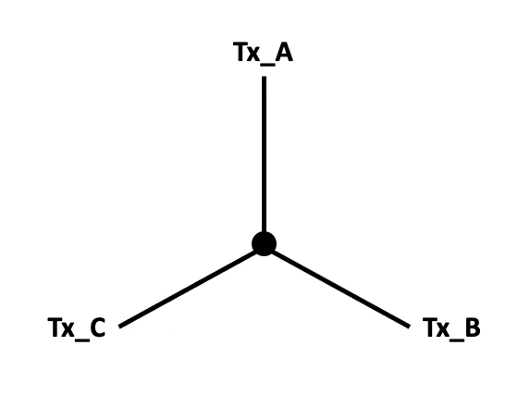
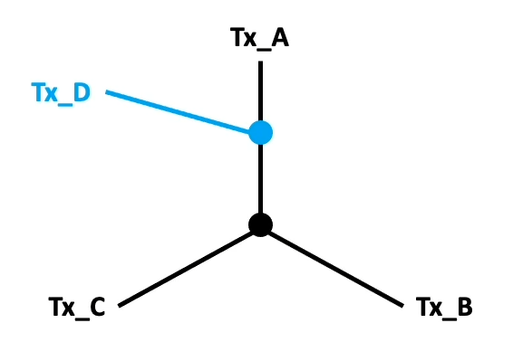
Stepwise addition
 | 1 | 2 | 3 | 4 | 5 | 6 | 7 | 8 | 9 | 10
Tx A | 0 | 0 | 0 | 0 | 0 | 0 | 0 | 0 | 0 | 0
Tx B | 1 | 1 | 1 | 1 | 0 | 0 | 0 | 0 | 0 | 0
Tx C | 1 | 1 | 0 | 0 | 1 | 1 | 1 | 0 | 0 | 0
Tx D | 1 | 1 | 0 | 0 | 1 | 1 | 0 | 1 | 1 | 0
Tx E | 1 | 1 | 0 | 0 | 1 | 1 | 0 | 1 | 0 | 1
  1. “Star” including 3 random (or chosen) taxa is build
  2. addition of fourth taxon at random branch, followed by tree length calculation

Slide 46
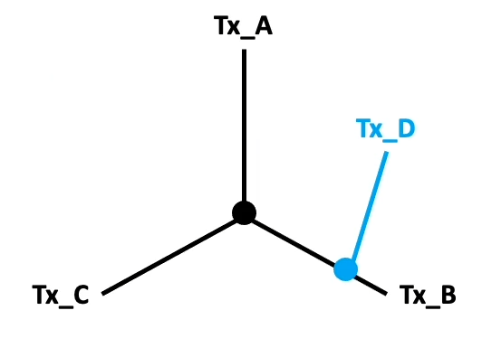
Stepwise addition
  3.1 branch-and-bound search
    Random tree (1) is generated as reference
    Afterwards another tree (2) is generated via stepwise addition
    tree length comparision
    If tree (2) is shorter than tree (1), another taxon is added to tree (2) without checking if there is a shorter 4-taxon-tree
    If at some point tree (2) becomes longer than tree (1), the tree will be discarded, and the previous step will be repeated.
    When all taxa were added tree (2) is compared to tree (1). If tree (2) is shorter than tree (1), tree (2) becomes new reference
    Process ends when all possible topologies were tested
  3.2 heuristic search
    Taxa will be added to each possible branch
    Test: which addition needs the least possible number of additional steps
 | 1 | 2 | 3 | 4 | 5 | 6 | 7 | 8 | 9 | 10
Tx A | 0 | 0 | 0 | 0 | 0 | 0 | 0 | 0 | 0 | 0
Tx B | 1 | 1 | 1 | 1 | 0 | 0 | 0 | 0 | 0 | 0
Tx C | 1 | 1 | 0 | 0 | 1 | 1 | 1 | 0 | 0 | 0
Tx D | 1 | 1 | 0 | 0 | 1 | 1 | 0 | 1 | 1 | 0
Tx E | 1 | 1 | 0 | 0 | 1 | 1 | 0 | 1 | 0 | 1

Slide 47
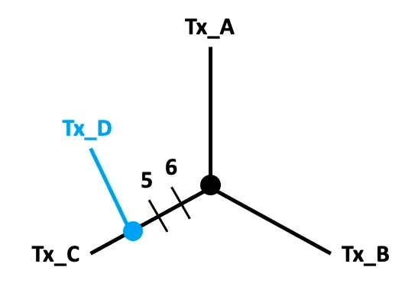
Stepwise addition
  3.1 branch-and-bound search
    Random tree (1) is generated as reference
    Afterwards another tree (2) is generated via stepwise addition
    tree length comparision
    If tree (2) is shorter than tree (1), another taxon is added to tree (2) without checking is there is a shorter 4-taxon-tree
    If at some point tree (2) becomes longer than tree (1), the tree will be discarded and the previous step will be repeated.
    When all taxa were added tree (2) is compared to tree (1). If tree (2) is shorter than tree (1), tree (2) becomes new reference
    Process ends when all possible topologies were tested
  3.2 heuristic search
    Taxa will be added to each possible branch
    Test: which addition needs the least possible amount of additional steps
 | 1 | 2 | 3 | 4 | 5 | 6 | 7 | 8 | 9 | 10
Tx A | 0 | 0 | 0 | 0 | 0 | 0 | 0 | 0 | 0 | 0
Tx B | 1 | 1 | 1 | 1 | 0 | 0 | 0 | 0 | 0 | 0
Tx C | 1 | 1 | 0 | 0 | 1 | 1 | 1 | 0 | 0 | 0
Tx D | 1 | 1 | 0 | 0 | 1 | 1 | 0 | 1 | 1 | 0
Tx E | 1 | 1 | 0 | 0 | 1 | 1 | 0 | 1 | 0 | 1

Slide 48
Stepwise addition
  3.1 branch-and-bound search
    Random tree (1) is generated as reference
    Afterwards another tree (2) is generated via stepwise addition
    tree length comparision
    If tree (2) is shorter than tree (1), another taxon is added to tree (2) without checking is there is a shorter 4-taxon-tree
    If at some point tree (2) becomes longer than tree (1), the tree will be discarded and the previous step will be repeated.
    When all taxa were added tree (2) is compared to tree (1). If tree (2) is shorter than tree (1), tree (2) becomes new reference
    Process ends when all possible topologies were tested
  3.2 heuristic search
    Taxa will be added to each possible branch
    Test: which addition needs the least possible amount of additional steps
    Process ends when all taxa are added
    Finds local optimum but not necessarily overall shortest tree
    Results depend on order of taxon addition
      Different orders must be tried
    Often resulting in different either equal or better solutions.
      Inferred via branch swapping.

Slide 49
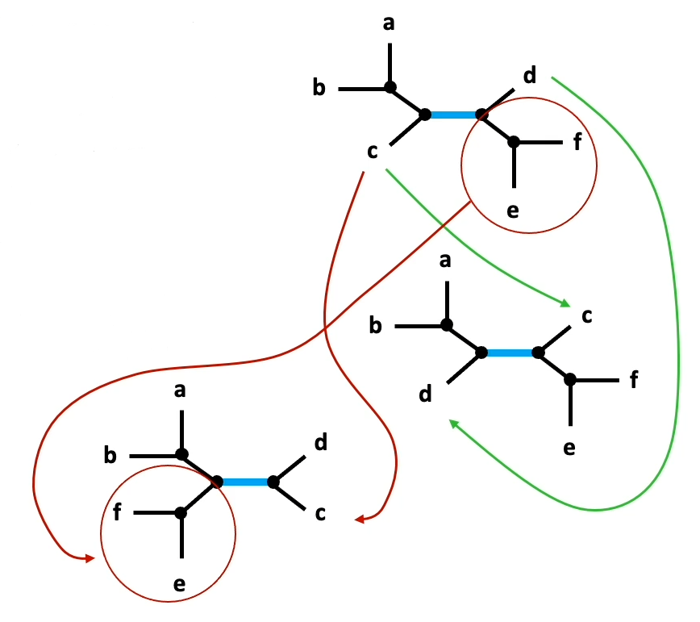
Branch swapping
  Branches are swapped in trees obtained from stepwise addition
    If obtained tree is longer, it will be discarded
    If obtained tree is shorter, it will be saved
  NNI = nearest neighbor interchange
    Swapping of branches on opposite sides of each internal node

Slide 50
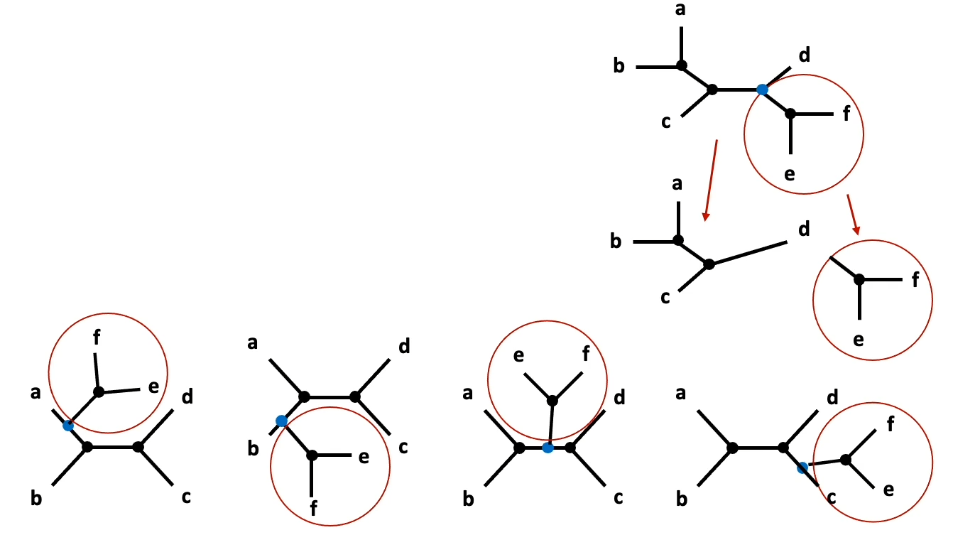
Branch swapping
  SBR = subtree pruning and re-grafting
    Subtrees are divided from their parental node
      Node disappears
  Subtree is added to each branch
  Tree length is calculated for each possible addition
    If obtained tree is longer, it will be discarded
    If obtained tree is shorter, it will be saved

Slide 51
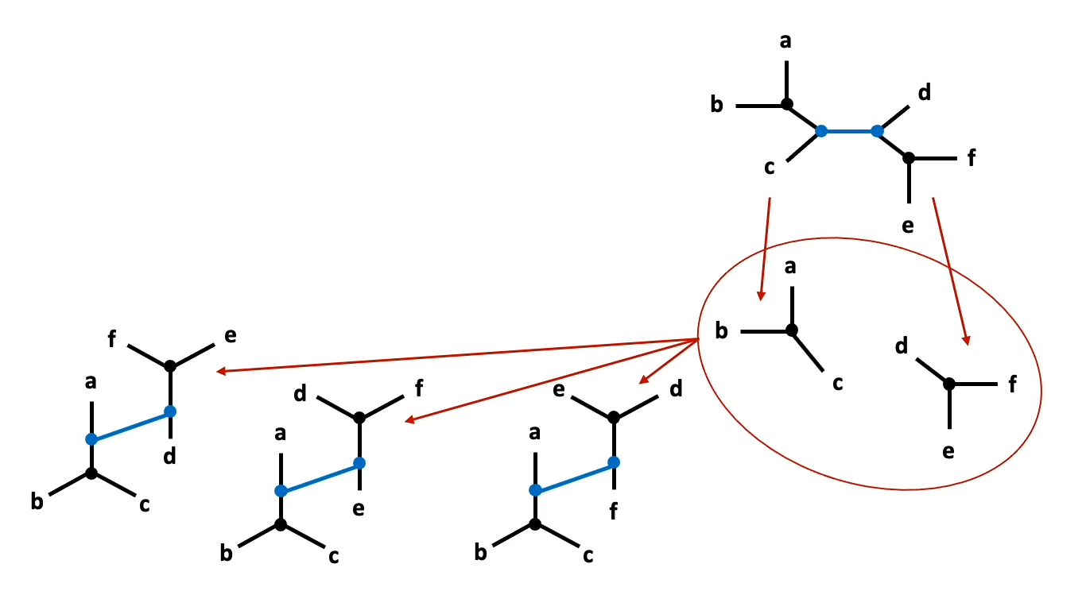
Branch swapping
  TBR = tree bisection and reconnection
  Every internal branch is dissolved
    Two nodes disappear
  Trees are reconnected in every possible manner
    Two new nodes are constructed
    If obtained tree is longer, it will be discarded
    If obtained tree is shorter, it will be saved

Slide 52
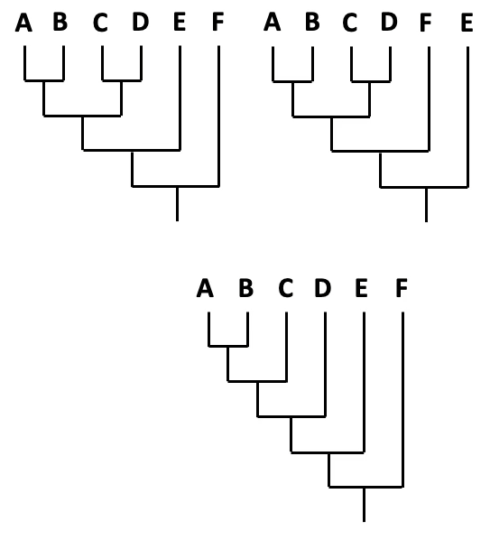
Consensus- Trees
  Real datasets often result in numerous equally parsimonious trees
    Not enough information (few mutations)
    Too much homoplasie (parallelism, reversions)
    Faulty alignment or wrong taxon (contamination?)
  What are the similarities among the trees?
    Consensus trees!

Slide 53
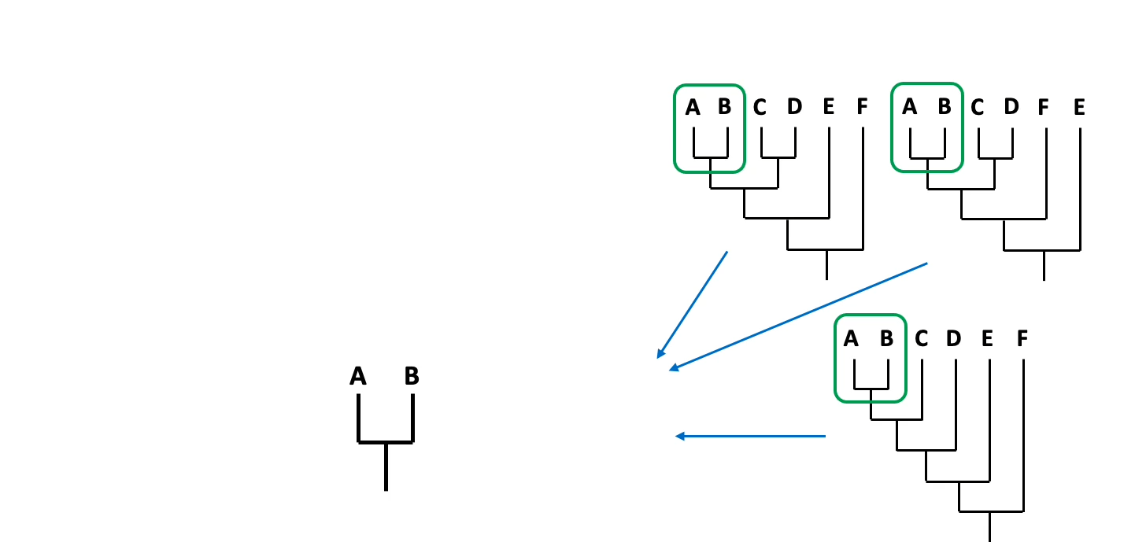
Strict Consensus
  Only shows groups retrieved in all trees

Slide 54
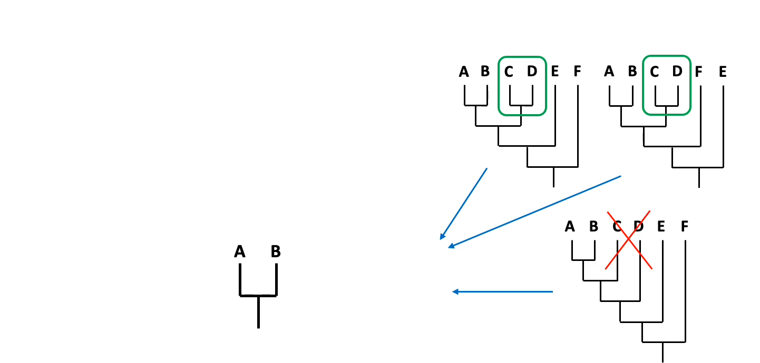
Strict Consensus
  Only shows groups retrieved in all trees

Slide 55
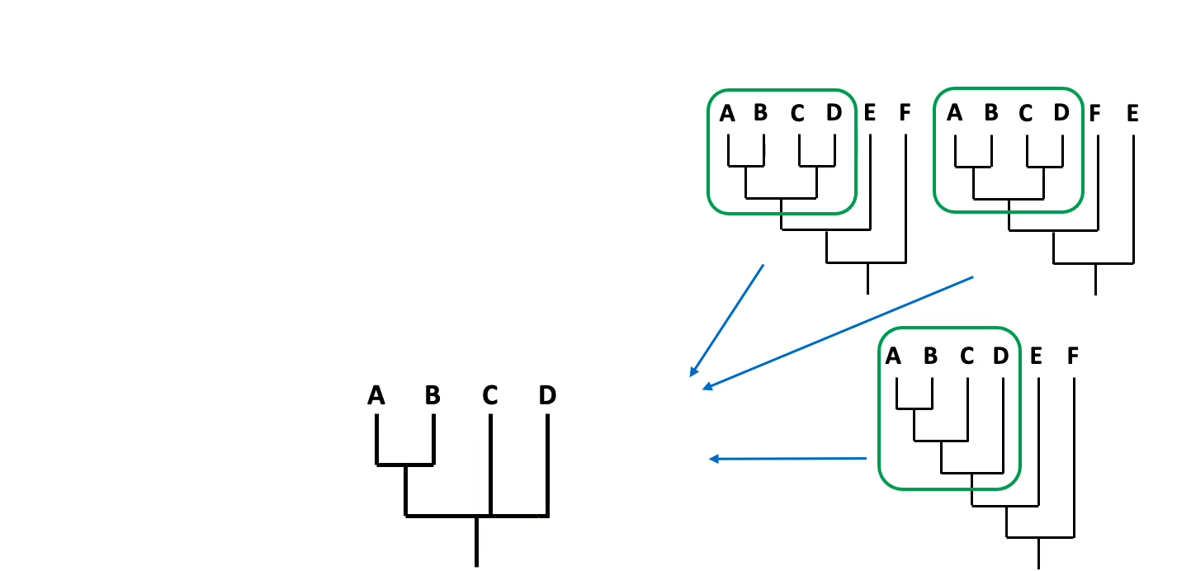
Strict Consensus
  Only shows groups retrieved in all trees

Slide 56
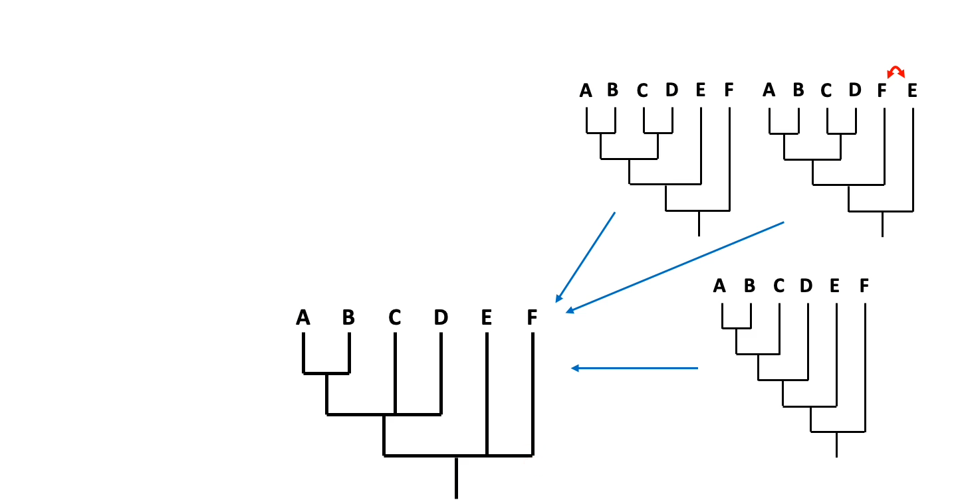
Strict Consensus
  Only shows groups retrieved in all trees

Slide 57
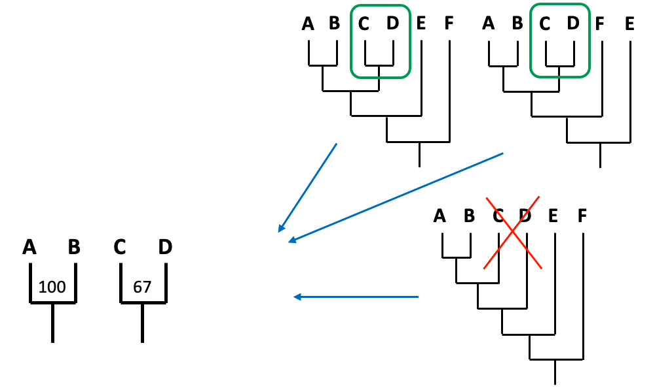
Majority consensus
  Shows groups retrieved in the majority of the trees

Slide 58
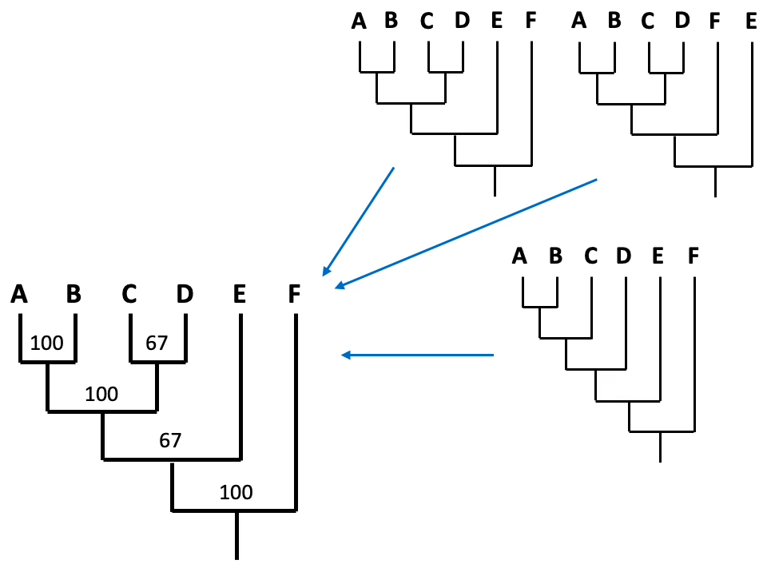
Majority consensus
  Shows groups retrieved in the majority of the trees
  Majority-values must not be viewed as statistical support

Slide 59
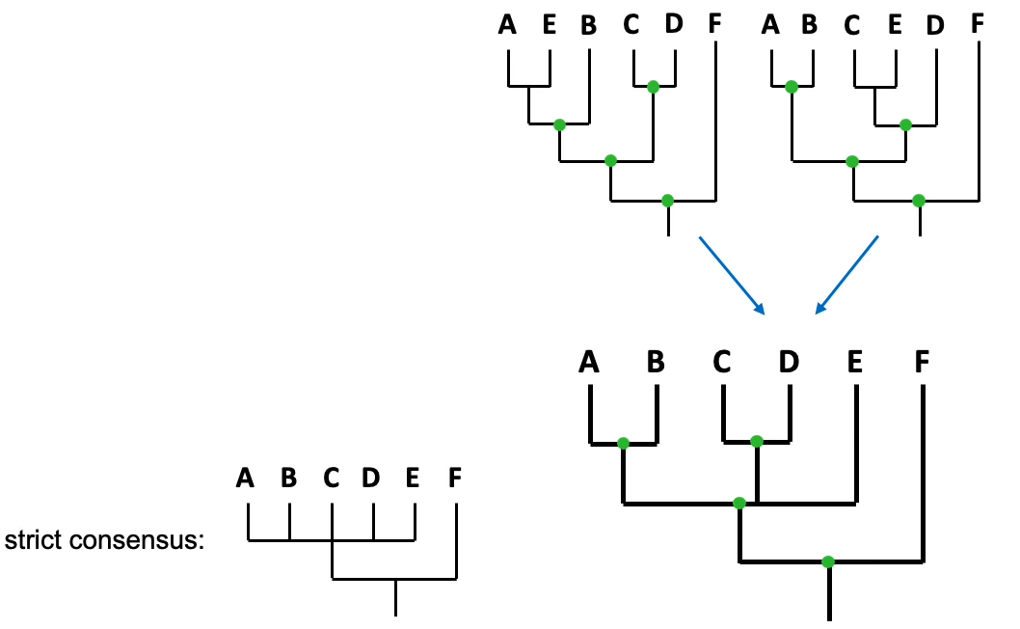
Adams consensus
  Shows nodes retrieved in all trees, even if groups are not identical
  Taxa with uncertain position will be placed at the basis

Slide 60
Maximum Parsimony - Variants
  Fitch parsimony
  Transition between character states with equal probability
  Multistate characters are disordered
  Symmetrical probability of mutation
  Wegner parsimony
  Symmetrical probability of mutation
  Multistate characters are ordered
  Dollo pasrimony
  Assymetrical probability of mutation
    Return to ancestral state possible
  Camin-Sokal parsimony
  Asymmetrical probability of mutation
    Return to ancestral state impossible
  Transversion parsimony
  Change of character states without equal probability
    A-G and C-T much more common than transversion
  Generalized parsimony
  Change of character state independently chosen for each kind of change
    Example: Tranisitions 5x more probable than Transversions
    coding for example in step matrix

Slide 61
step-matrix parsimony
parsimony analyses depends on background assumption (e.g. probability of substitutions)
  „costs“ of for each type of character change coded into matrix
determination of most parsimonious assigment of ancestral states on given tree
allows determination, if trait was independently gained or secondarily lost
  Which „direction“ is more likely?

