Slide 1
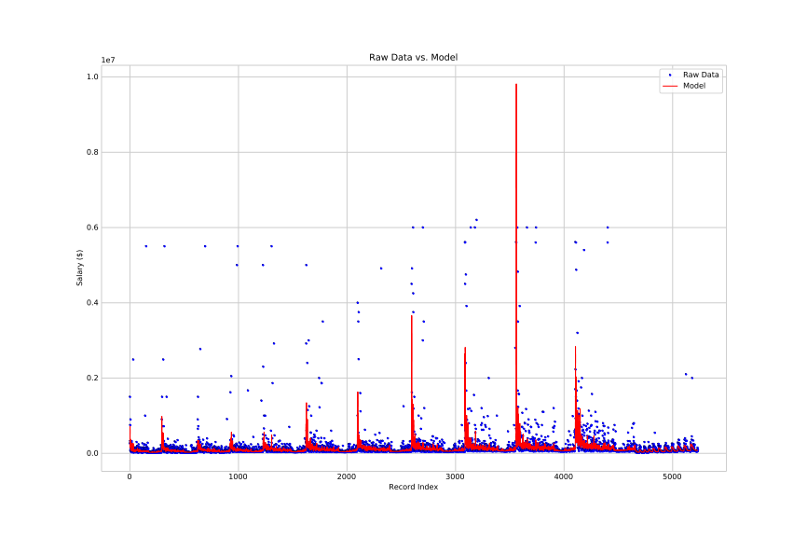
Model Does Not Capture Extreme Outliers

Slide 2
Feature Impact
Coefficient | Percent Impact on Salary (%) | Coefficient | Percent Impact on Salary (%)
PKA_FP | 32.5477357244 | SOGpct | 0.4586043597
Gp90 | 25.8568088069 | FS | 0.4523286982
Year | 10.6134593825 | SV | 0.2410767846
RC | 7.3870177109 | SvPct | 0.2289812027
ShO | 5.4442515508 | Intercept | 0
PKA_GK | 4.9635271146 | MINS | -0.0194951659
GS | 4.7729404405 | SCpct | -0.0508809467
YC | 4.715438316 | T | -0.0879207463
HmG | 3.1454867073 | Wpct | -0.158823584
HmA | 2.1578418175 | SHTS_GK | -0.2228613565
GWG | 1.7698012204 | FC | -0.5467891391
Ap90 | 1.6473275515 | PKG_GK | -0.6479129742
SHTS_FP | 1.5552856882 | L | -0.819715628
GWA | 1.3970009962 | RdG | -0.9754858886
A | 1.2054073241 | GP | -1.4568016904
RdA | 1.2041668306 | W | -1.4809324339
G | 1.0058805935 | GAA | -2.5138407749
OFF | 0.6343641294 | SOG | -3.1200577267
GA | 0.5415856721 | PKG_FP | -17.55778587

