Slide 1
IE7374 - Generative AI
PROJECT
PRESENTATION
VISION-TO-TEXT:​
AN IMAGE CAPTIONING SYSTEM
presented by group 7: Curtis Neiderer, Divya Maheshkumar, Desiree Reid, Minal Ahir, Arundhati Ubhad ​

Slide 2

Introduction & Project Objectives
what ?
Image Captioning is the task of automatically generating a descriptive sentence that summarizes the contents of an image. It involves two key components:​ Computer Vision (CV): to analyze and understand the visual elements in the image (objects, actions, scenes, etc.)​ and Natural Language Processing (NLP): to generate coherent and contextually appropriate textual descriptions based on that visual understanding​.
why ?
Makes images accessible to everyone (E.g., Helps the visually impaired understand images throughspoken or written descriptions.)​
Helps apps find and sort images easily (like Google Photos or Instagram tagging)​
Let's AI describe and talk about pictures​
Supports smart assistants, robots, and automation
how ?
Build an image captioning system using CNN + LSTM​
Evaluate and compare traditional metrics (BLEU, METEOR) vs. embedding-based metrics (BERTScore)​
Analyze model behavior (hallucinations, failure modes, etc.)​
Test generalization on out-of-domain datasets (Flickr30k)​

Slide 3
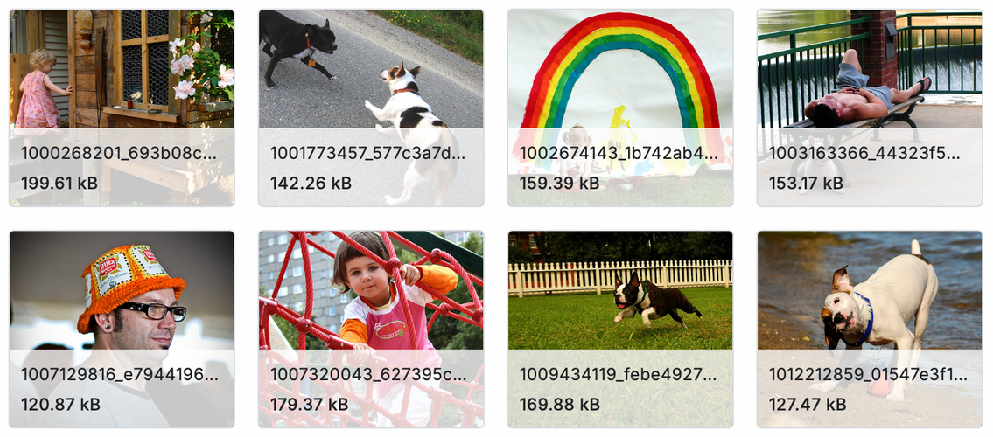
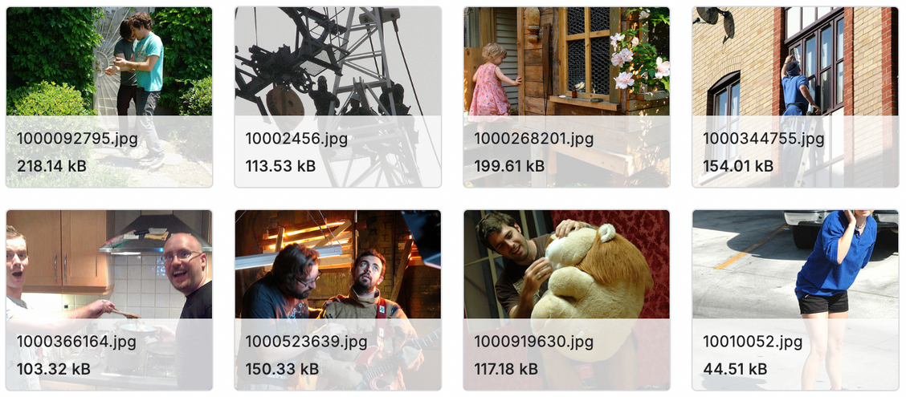
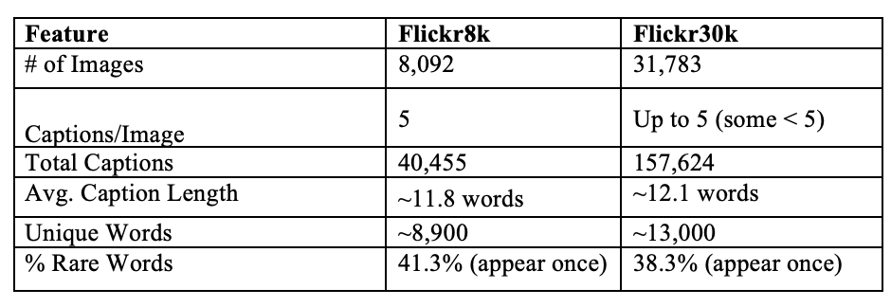
Dataset Insights
https://www.kaggle.com/datasets/adityajn105/flickr8k
https://www.kaggle.com/datasets/awsaf49/flickr30k-dataset?select=Images

Slide 4
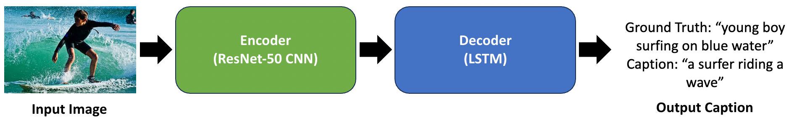
Approach: CNN-LSTM Model Architecture​
Encoder (ResNet-50 CNN)
Decoder (LSTM)
Technical Specs
Pretrained on ImageNet
Used to extract high-level image features
Output: fixed-length feature vector
Receives encoded image vector as input
Generates caption word-by-word (sequence modeling)
Trained on caption tokens with teacher forcing
Loss Function: Categorical Cross-Entropy
Optimizer: Adam
Epochs: 20–50 (with early stopping)
Batch Size: 64

Slide 5
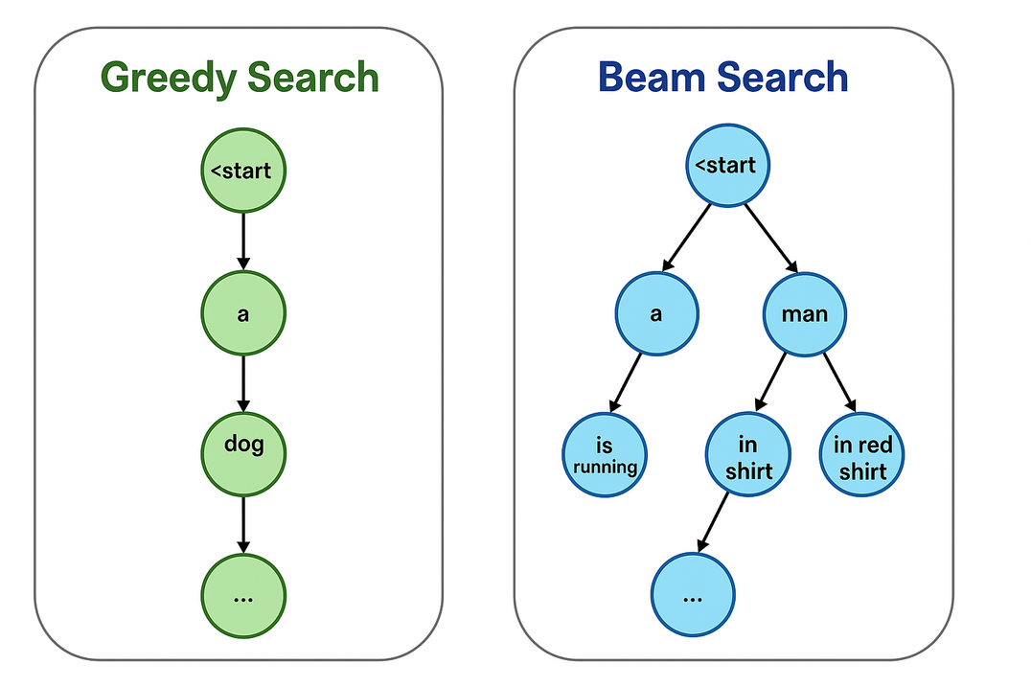
Decoding Strategies – Greedy vs. Beam Search
Greedy Search
Selects the most likely word at each step
Fast but prone to generic or suboptimal outputs
Single path, no lookahead
Beam Search (k = 5)
Keeps top-k sequences at each step
Balances fluency and diversity
Slightly slower, better results

Slide 6
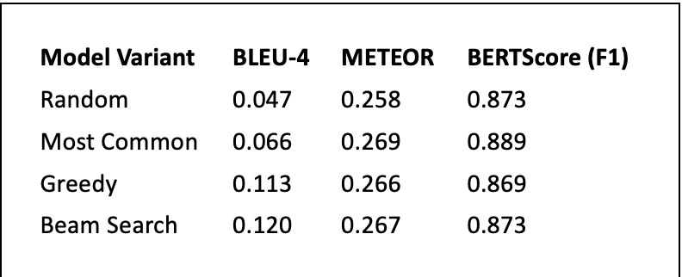
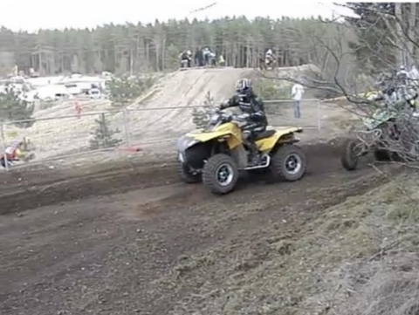
Experiment 1 : Baseline Training and Evaluation
Findings:
Learned decoding (Greedy/Beam) significantly outperforms baselines
Beam Search offers consistent, albeit small, improvements over Greedy
Frequency-based captions can deceptively perform well on BERTScore, but don't reflect true quality
Figure
Greedy: a man is riding a bike on a dirt path
Beam: a person is riding a dirt bike in the woods

Slide 7

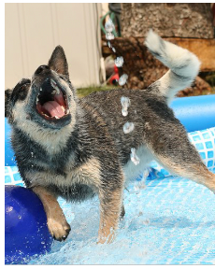
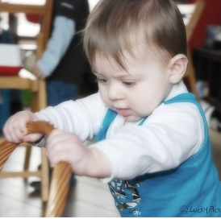
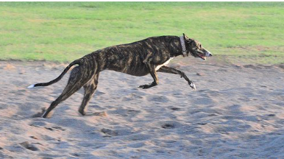
Experiment 2: Error Analysis
Subject Hallucination (Greedy)
Action Misattribution (Beam)
Gender & Clothing Inference (Beam)
Visual Detail Hallucination (Greedy)
Ground Truth: “a young girl in a pink swimsuit”​
Caption: “a man in a wetsuit is riding a dirt bike”​
→ Hallucinates subject identity, gender, and vehicle.​
Ground Truth: “a beige and dark brown dog plays in the swimming pool with his mouth open”​
Caption: “a little girl in a pink dress is swinging on a swing”​
→ Hallucinates not only subject type (dog → girl), but also gender, clothing, and action.​
Ground Truth: “a baby hold a wicker basket”​
Caption: “a little girl in a pink shirt is swinging on a swing”​
→ Incorrectly infers a common childhood activity.
Ground Truth: “a dog running through the sand”​
Caption: “a dog is running through the water”​
→ Misrepresents the scene context entirely.

Slide 8
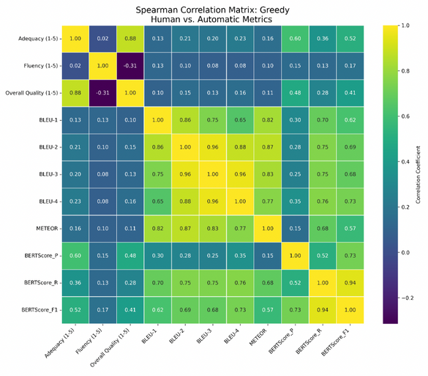
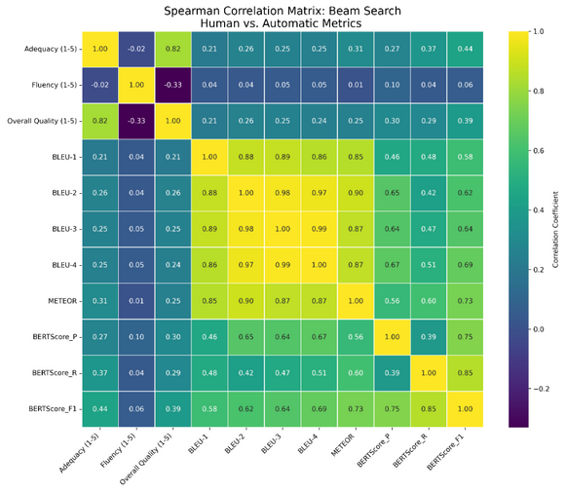
Experiment 3: Semantic Fidelity
Findings:​
Human judgments highly consistent (good for reliability)​
Traditional Metrics (BLEU, METEOR):Weak/negligible correlation (e.g., 0.10 - 0.28) with human perception of quality ​
Embedding-Based Metrics (BERTScore):Moderate/stronger correlation (e.g., 0.35 -0.46) with human judgment (better alignment)​
Key Insight: BERTScore is significantly better at capturing semantic fidelity from a human perspective​

Slide 9
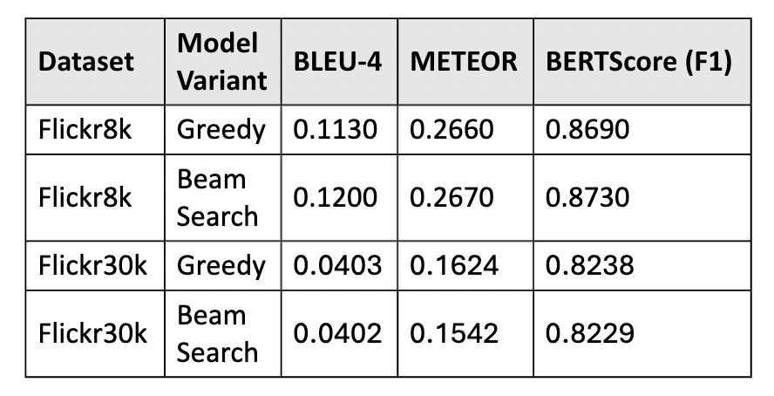
Experiment 4: Generalization​
Findings:​
Significant drop in BLEU scores on Flickr30k compared to Flickr8k​
BERTScore remains stable, demonstrating its robustness across different domains​
Interpretation: Performance drop is likely due to Flickr30k's​ :
Larger image diversity and broader contexts​
Vocabulary mismatch and higher number of out-of-vocabulary words​
More varied caption lengths and richer scene descriptions​
Annotation inconsistencies (fewer than 5 captions for some images)​

Slide 10
Conclusion & Key Takeaways​
CNN-LSTM model architecture is effective, but prone to hallucinations and omissions.​
BERTScore provides more accurate insights into semantic fidelity than traditional metrics (BLEU/METEOR), in terms of human correlation​.
Beam Search offers slight improvements over Greedy.​
Generalization remains a challenge for current model setup.​
Training Data Quality significantly impacts output, limited, or noisy datasets often lead to flawed caption generation.​
Multimodal alignment between visual and textual components remains an open challenge, especially in complex scenes requiring contextual understanding.

Slide 11
Future Work
Fine-tuning for improved generalization across diverse datasets​
​
Incorporating Attention mechanisms for better accuracy/relevancy​
Leveraging pre-trained word embeddings for semantically rich vector representations (GloVe)​
Exploring other embedding-based metrics (CLIPScore)

Slide 12
IE7374 - Generative AI
THANK
YOU!

