Slide 1

Go & Tell
By Charles Neill
April 20th, 2018
https://commons.wikimedia.org/wiki/File:Gopher-ru.png

Slide 2

History
Created at Google by Rob Pike, Robert Griesemer, and Ken Thompson
First version released in 2009
Envisioned as a simpler alternative to C/C++/Java in the compiled language world [1]
Desire to combine ease-of-use of popular interpreted languages with type safety and performance of compiled languages, among other things
Short compile times are also cool!
So is concurrency!
https://upload.wikimedia.org/wikipedia/commons/4/44/Gophercolor.jpg
Notes:
[1] https://web.stanford.edu/class/ee380/Abstracts/100428-pike-stanford.pdf

Slide 3
In their words
“Go aims to combine the safety and performance of a statically typed compiled language with the expressiveness and convenience of a dynamically typed interpreted language.
It also aims to be suitable for modern systems programming.” [1]
Notes:
[1] https://web.stanford.edu/class/ee380/Abstracts/100428-pike-stanford.pdf

Slide 4
Installing Go
Grab the installer/source for your OS: https://golang.org/dl/
If you’re on macOS or Windows, just run the installer 👍
For Linux, here are instructions for building from source: https://golang.org/doc/install/source
My env vars (.zshrc / .bash_profile):
export GOPATH=$HOME/.go
export GOROOT=/usr/local/go
export PATH=“[blahblah]:$GOPATH/bin:$GOROOT/bin:[blah]”
See “How to Write Go Code”: https://golang.org/doc/code.html

Slide 5
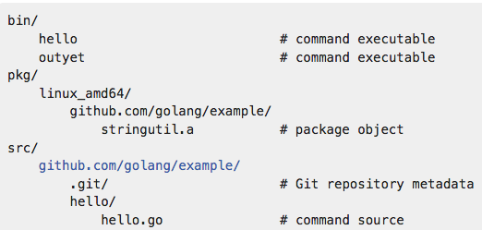
Example Workspace
This is what your $GOPATH will look like
For me: ~/.go/bin ~/.go/src etc.
I created this bash function for easier navigating (protip: use z.sh!)
function gh () {
cd "$GOPATH/src/github.com/cneill/$1"
}
Notes:
z.sh: https://github.com/rupa/z

Slide 6
Installing dependencies
Install a specific package: go get github.com/cneill/go-examples/ticker
Install all the packages in a project/directory: go get github.com/cneill/go-examples/...
Update:
go get –u [path]
More on imports / package namespaces here [1][2]
Notes:
[1] https://golang.org/doc/code.html#ImportPaths
[2] https://golang.org/cmd/go/#hdr-Import_path_syntax

Slide 7
Hello, world!
The Go Playground is an excellent place to experiment with Go: https://play.golang.org/
package main
import (
"fmt"
)
func main() {
fmt.Println("Hello, playground")
}

Slide 8
Hello, world!
The Go Playground is an excellent place to experiment with Go: https://play.golang.org/
package main
import (
"fmt"
)
func main() {
fmt.Println("Hello, playground")
}
Notes:
The name of the package is the first line of a go file. The special package name ”main” indicates that the current package is meant to be compiled and run as an executable (not a library to be imported) Learn more about “package” clause: https://golang.org/ref/spec#Package_clause

Slide 9
Hello, world!
The Go Playground is an excellent place to experiment with Go: https://play.golang.org/
package main
import (
"fmt"
)
func main() {
fmt.Println("Hello, playground")
}
Notes:
Learn more about “import” declarations: https://golang.org/ref/spec#Import_declarations
See the “fmt” package’s documentation: https://golang.org/pkg/fmt/

Slide 10
Hello, world!
The Go Playground is an excellent place to experiment with Go: https://play.golang.org/
package main
import (
"fmt"
)
func main() {
fmt.Println("Hello, playground")
}
Notes:
Main() is where the program begins execution Init() is another relevant meta-function

Slide 11
Hello, world!
The Go Playground is an excellent place to experiment with Go: https://play.golang.org/
package main
import (
"fmt"
)
func main() {
fmt.Println("Hello, playground")
}
Notes:
This calls the “fmt” package’s “Println” function

Slide 12
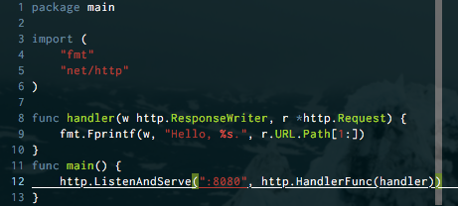
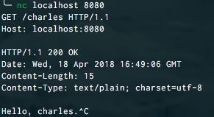
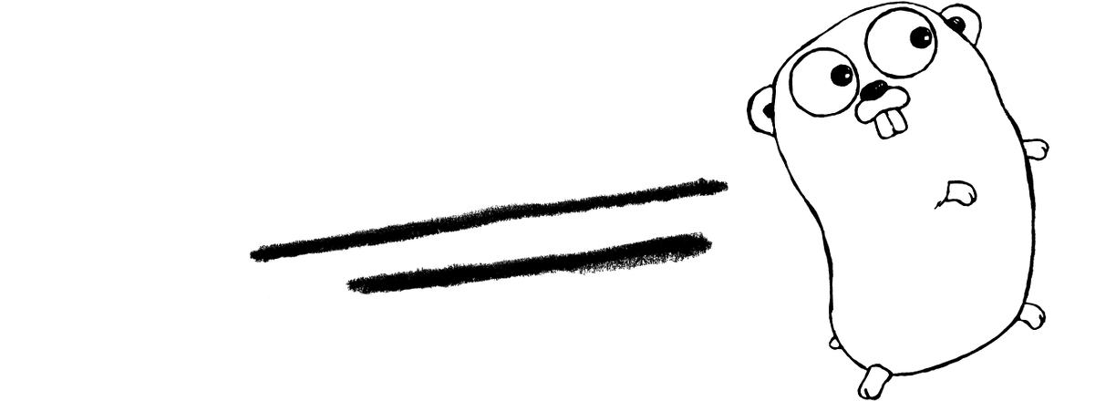
Hello, server world!
https://play.golang.org/p/8GDFzMo4ye5 (won’t actually work in the browser)
https://commons.wikimedia.org/wiki/File:Golang.png
Notes:
[1] (had to fix up their code – it no longer compiles as written here 😂) https://web.stanford.edu/class/ee380/Abstracts/100428-pike-stanford.pdf

Slide 13


Awesome stuff about Go
Easy to read and write – very little magic
Fast compile times
Concurrency, for real (no more GIL!)
Huge, (fairly) stable standard library
Compile binaries for any platform, on any platform
Performance, at least relative to interpreted alternatives [1][2]
Free documentation
Garbage collected
Static typing!
net/http
https://pixabay.com/en/rainbow-colors-natural-wonder-149485/
https://commons.wikimedia.org/wiki/File:Go_gopher_mascot_bw.png
Notes:
[1] https://benchmarksgame.alioth.debian.org/u64q/compare.php?lang=go&lang2=python3
[2] https://benchmarksgame-team.pages.debian.net/benchmarksgame/compare/go-node.html

Slide 14
Differences from familiar languages*
There is no ‘class’ type; Go is not technically an object-oriented language
There is no inheritance/subclassing (however, a concept called ‘embedding’ helps bridge this gap somewhat) [1]
Types implicitly implement interfaces
No declaration of “I implement this interface” – if the object has the method signatures required by the interface, it implements that interface
Very little syntactic sugar
In general, Go adheres to the principle that there should be one reasonable pattern for doing any common operation. This means no fancy “.forEach”, ternary operators, etc.
All loops are “for” loops [2]
All the functionality you’d expect in “while” loops is actually implemented by “for” loops
* This is not an exhaustive list
Notes:
[1] https://golang.org/doc/effective_go.html#embedding
[2] https://tour.golang.org/flowcontrol/1

Slide 15
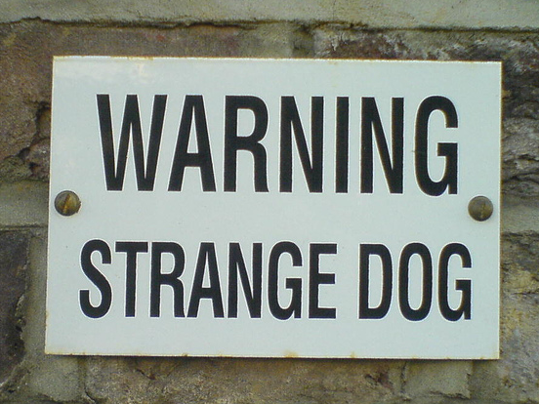

Other oddities
There is only one “stylistically correct” way to write Go. It is enforced by the go fmt command
This is easy to accommodate with e.g. VIM plugins, but it does require some getting used to (tabs over spaces!?!)
Every custom type can have methods
You can define a custom “int” data type that has a method float() – then any variable of that type can be cast to a float effortlessly while still, essentially, being an int
That’s what happened when we cast handler, a func(ResponseWriter, Request), as a HandlerFunc earlier – the new thing, in addition to being a function itself, acquired a method called ServeHTTP!
https://www.flickr.com/photos/bixentro/319724127/

Slide 16
Not-so-awesome stuff about Go
Not all platforms supported (no CentOS 5; NetBSD is buggy; Linux kernel version >=2.6.23)
More here [1]
Larger binary sizes than e.g. C/C++
Package versioning is... Suboptimal?
go get github.com/user/project is going to give you bleeding-edge, possibly-broken master; good luck to you
Lots of things are going on here [2][3]
Garbage collected (yes, I know I said this was awesome – it usually is)
No generics
This is being debated for the 2.0 release of Go. In practice, there are (imperfect) ways around this. See the notes for links about this debate [4][5][6]
Notes:
[1] https://github.com/golang/go/wiki/MinimumRequirements
[2] https://sdboyer.io/blog/vgo-and-dep/
[3] https://github.com/golang/dep/wiki/Roadmap
[4] “Summary of Go Generics Discussions”: https://docs.google.com/document/d/1vrAy9gMpMoS3uaVphB32uVXX4pi-HnNjkMEgyAHX4N4/edit#heading=h.vuko0u3txoew
[5] “Who needs generics? Use … instead!”: https://appliedgo.net/generics/ [6] “Should Go 2.0 Support Generics?” https://dave.cheney.net/2017/07/22/should-go-2-0-support-generics

Slide 17




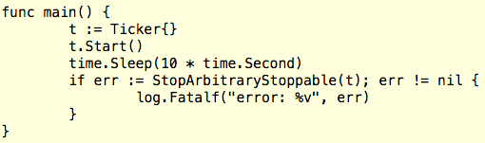

Example interface + struct
https://play.golang.org/p/z1vBjB245uX
https://www.pexels.com/photo/alarm-alarm-clock-analog-bell-358742/

Slide 18
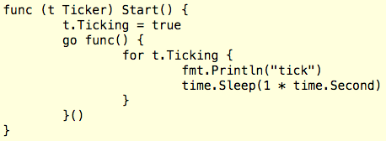
Example of simple concurrency
https://play.golang.org/p/z1vBjB245uX
https://www.pexels.com/photo/alarm-alarm-clock-analog-bell-358742/

Slide 19
You’ll read this 10,000 times, minimum
“Do not communicate by sharing memory; instead, share memory by communicating.” [1]
What does that mean?
Something like, “use channels to ensure that only one goroutine has access to data at any given time; don’t point to the same shared memory and restrict access with locks/mutexes/etc”*
See [1] for more info
*I’m not an expert, don’t play one on TV
Notes:
[1] https://blog.golang.org/share-memory-by-communicating

Slide 20
Resources
Go Playground: A place to try out Go code in the browser
https://play.golang.org/
How to Write Go Code: Learn the basics of workspace layout and writing, testing, and running Go code
https://golang.org/doc/code.html
A Tour of Go: A more comprehensive guide to learning Go basics
https://tour.golang.org/welcome/1
vim-go: VIM plugin for all your Go needs
https://github.com/fatih/vim-go#install
awesome-go: A curated list of all kinds of Go resources
https://awesome-go.com/

Slide 21
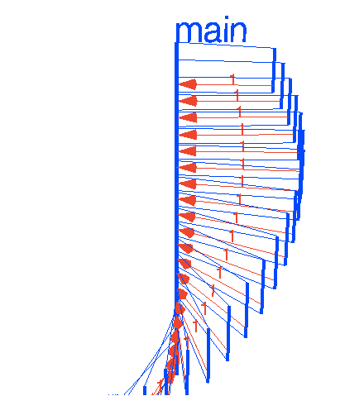
Advanced Resources
Effective Go: Good design patterns for writing Go code
https://golang.org/doc/effective_go.html
Visualizing Concurrency in Go: A visual guide to how different concurrency patterns work in Go
https://divan.github.io/posts/go_concurrency_visualize/

