Slide 1
Mexico analyses
July 2016

Slide 2
Total birds observed: 420
M: 110; P:310
Total sp richness:
Mean # birds per plot:
Mean # birds/hr/plot:
1.719658 times more individuals in P
On average 71.9% more individuals in P plots than M
M has 58.151% the number of birds as an average P plot

Slide 3
Bird abundance varies by plot
> plot_diff_abun<-aov(total_abun~PLOT,data=birds)
> summary(plot_diff_abun)
Df Sum Sq Mean Sq F value Pr(>F)
PLOT 31 515.1 16.615 1.861 0.0129 *
Residuals 87 776.6 8.926
---
plot_diff_abun<-aov(total_abun~PLOT+VISIT,data=birds)
> summary(plot_diff_abun)##bird abundance varies by plot
Df Sum Sq Mean Sq F value Pr(>F)
PLOT 31 515.1 16.615 1.829 0.0157 *
VISIT 3 13.4 4.483 0.493 0.6878
Residuals 84 763.1 9.085
Same deal when you include VISIT as random factor

Slide 4
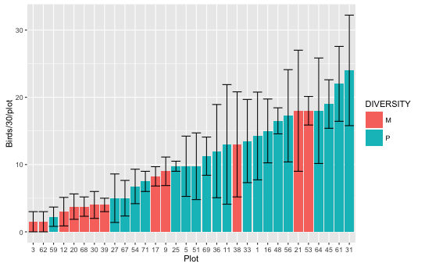

Slide 5
Bird abundance differs with tree diversity
summary(div_diff_abun)
Df Sum Sq Mean Sq F value Pr(>F)
DIVERSITY 1 85.2 85.18 9.543 0.00269 **
PLOT 30 429.9 14.33 1.605 0.04665 *
Residuals 87 776.6 8.93
---
Signif. codes: 0 ‘***’ 0.001 ‘**’ 0.01 ‘*’ 0.05 ‘.’ 0.1 ‘ ’ 1
>

Slide 6
