Slide 1
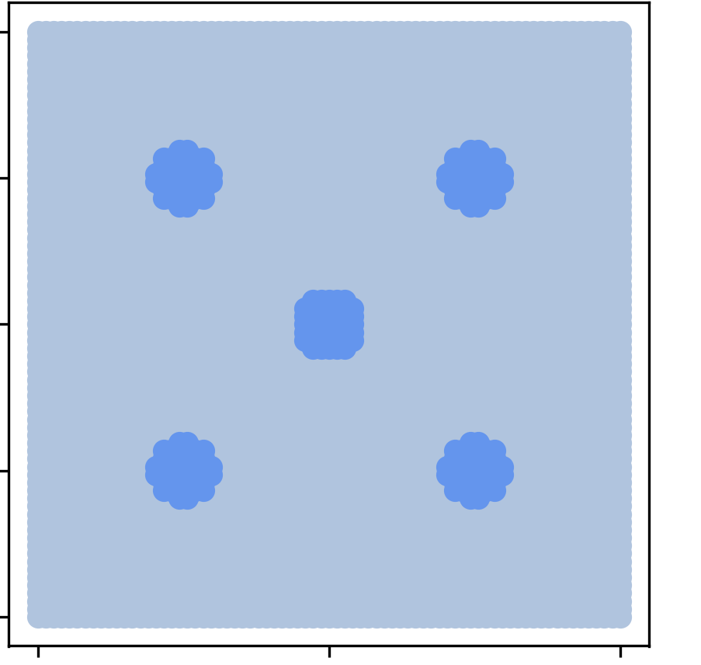
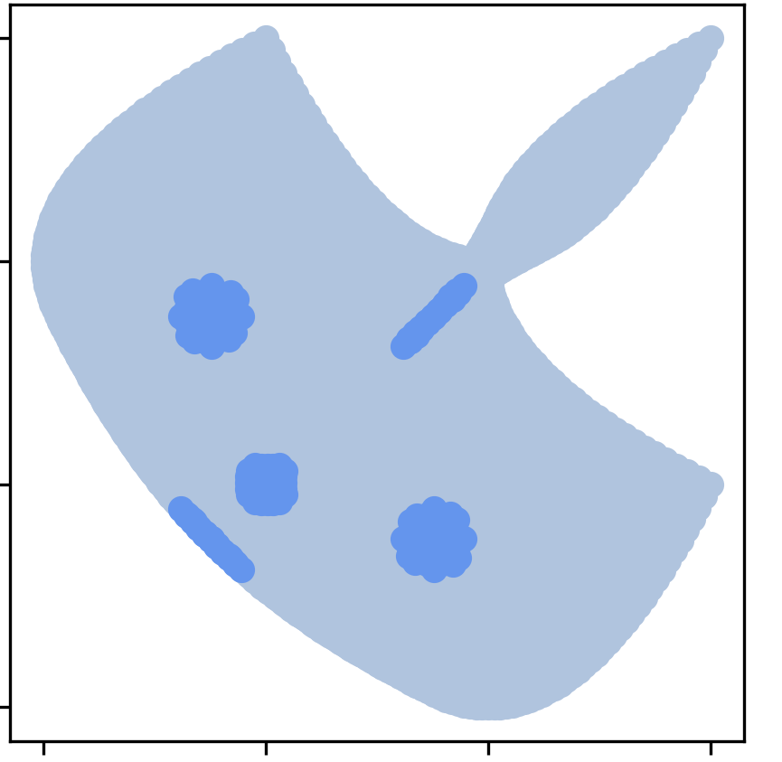
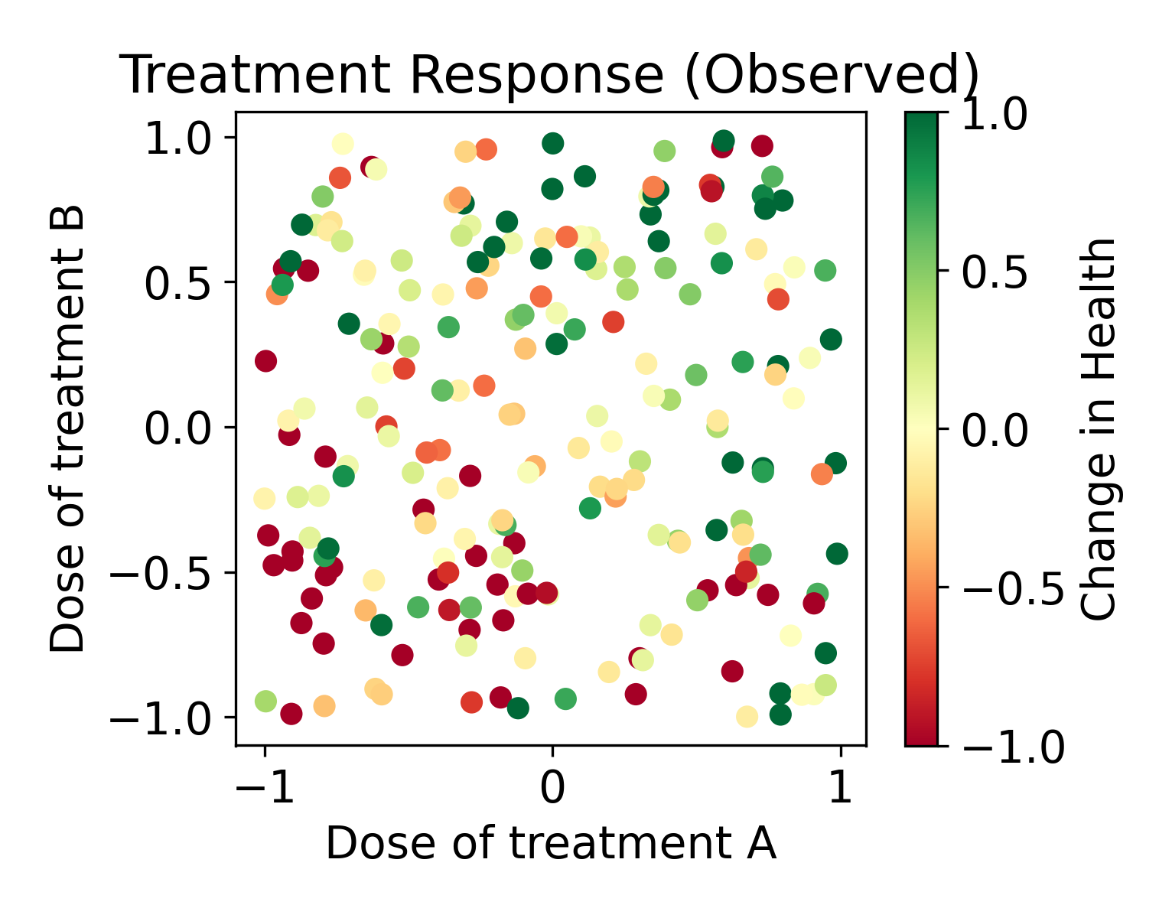
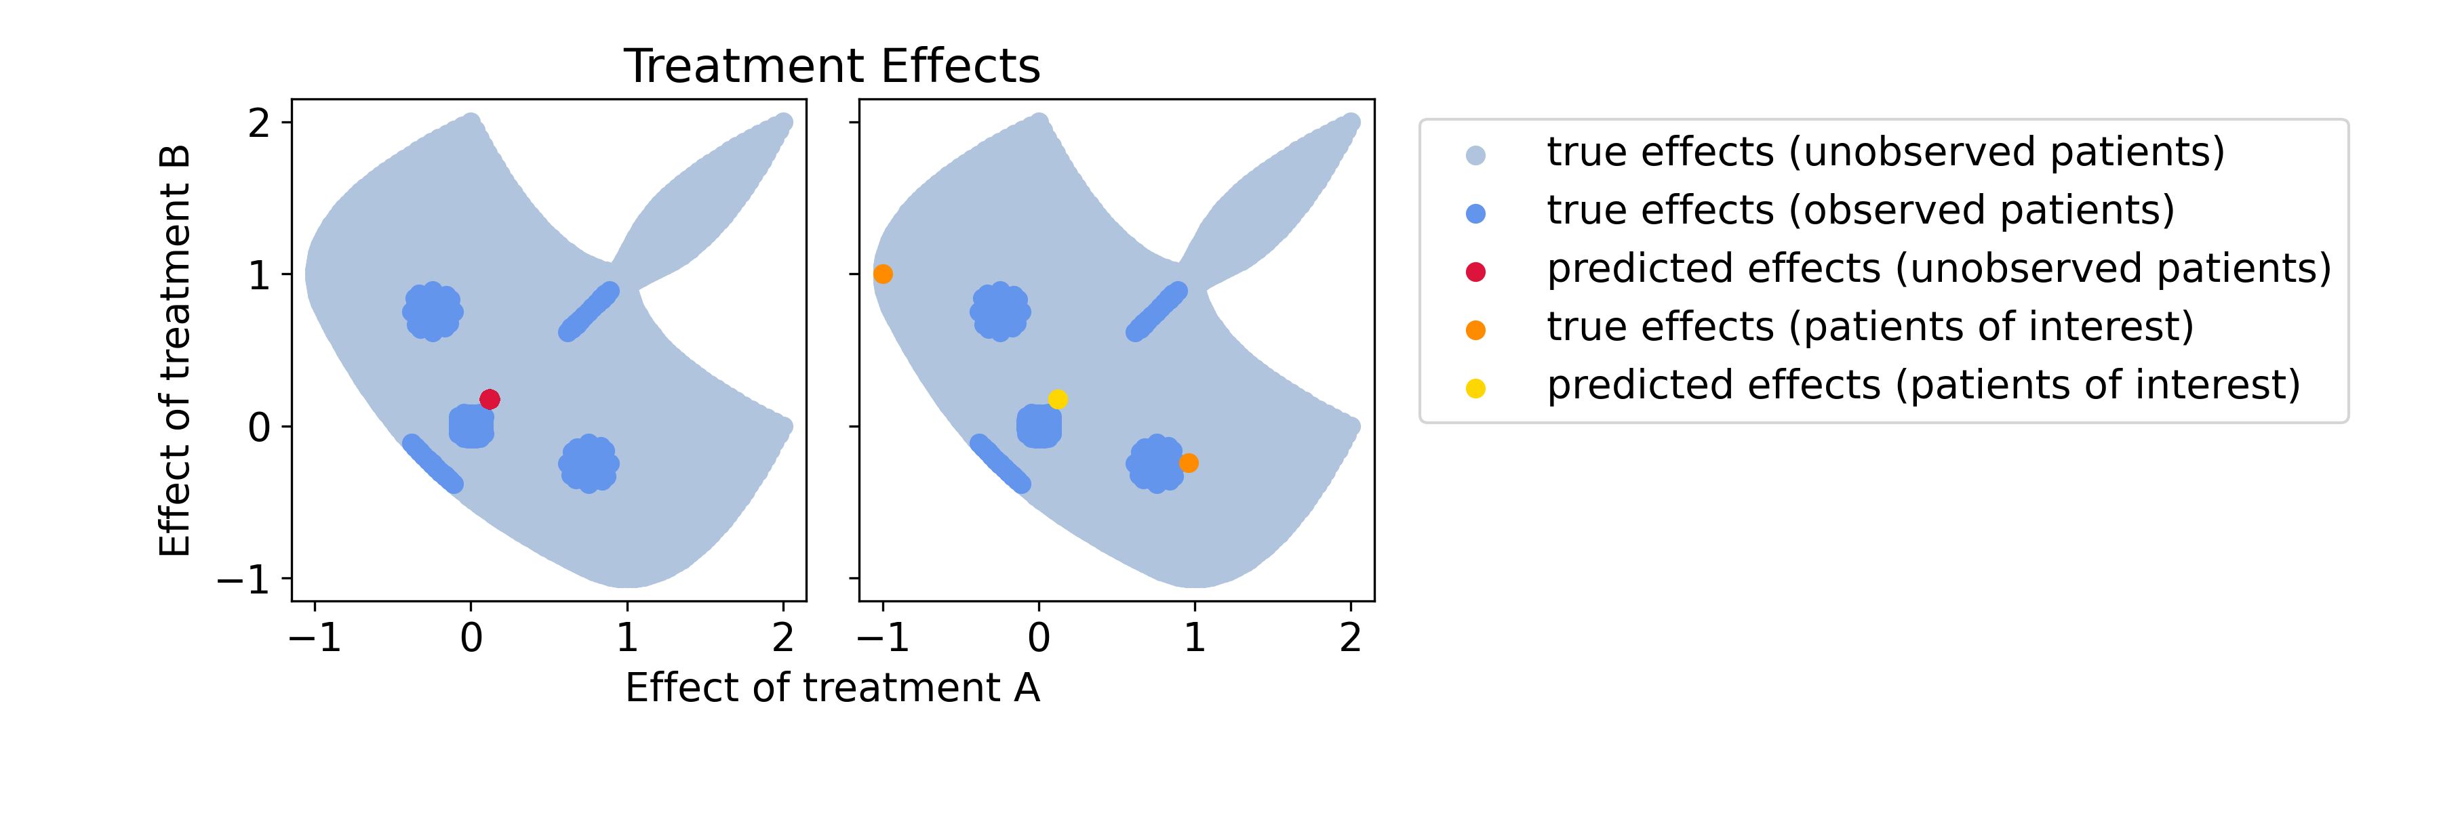

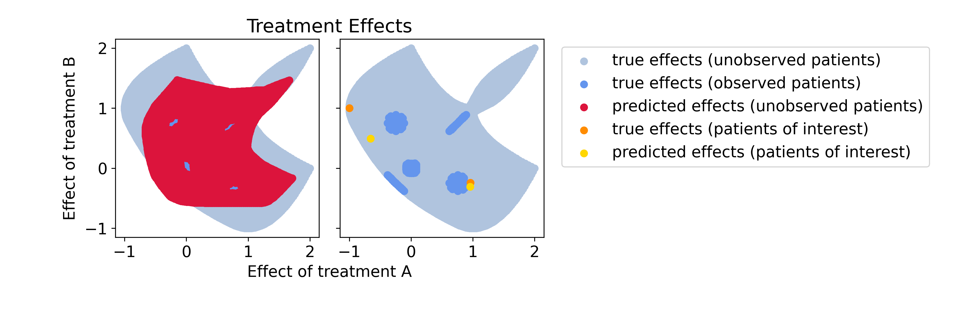
Context
System
Observations
Outcome
Population
Cluster
Contextualized
Interpolates between observations
Extrapolates to new domains
Globally robust to noise
True Effects (Unobserved Patients)
True Effects (Observed Patients)
Predicted Effects

