Slide 1




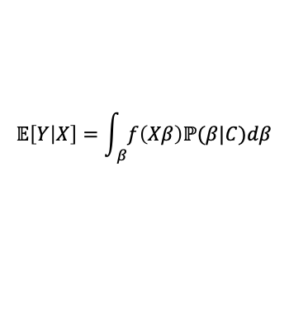
Cohort-Based
Contextualized
$$𝔼\left[Y | X\right]=f(Xβ)$$
$$𝔼\left[Y | X\right]=\int_{ β}{f\left(Xβ\right)ℙ(β|C)dβ}$$
Clustering $X$
Clustering $X|Y$
Clustering $β$

