Slide 1
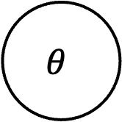
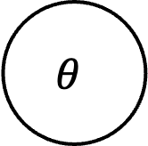
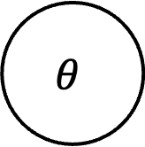
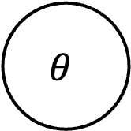
Naïve
Subtype
C
$$θ$$
X, Y
C
Z
$$θ$$
X, Y
Multi-Task
Task-Split
C
Z_{C}
C
$$θ$$
X, Y
Z
$$θ$$
X, Y
T
Z_{T}
T
Observed
Unobserved

