Slide 1
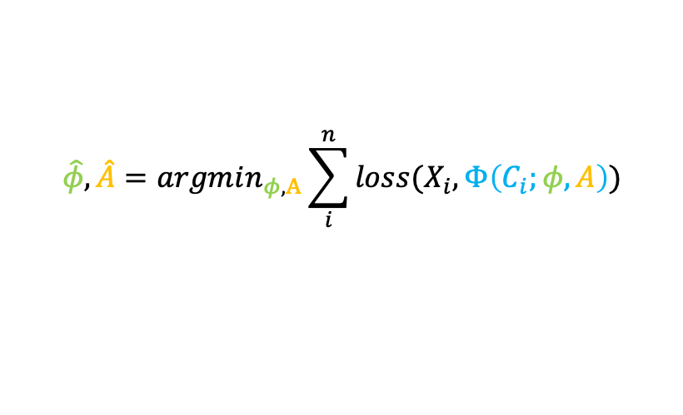

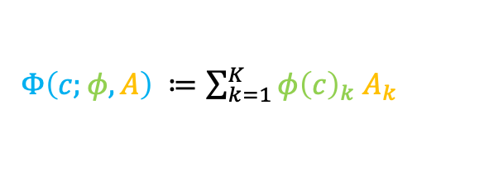


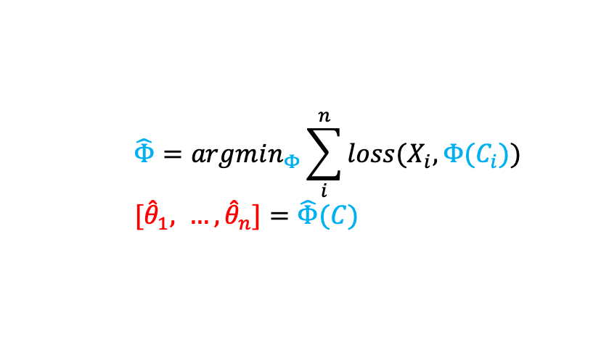

How to Contextualize Models with Deep Learning
$$\hat{θ}=argmin_{θ} loss(X, θ)$$
Define a differentiable objective for your model of interest
Replace model parameters with a differentiable context encoder
(Optional) Re-parameterize the context encoder to reduce the model solution space
$X∈ℝ^{n × p}$
$$\hat{Φ}=argmin_{Φ}\sum_{i}^{n}{loss(X_{i}, Φ(C_{i}))}$$
$[{\hat{θ}}_{1}, …, {\hat{θ}}_{n}]=\hat{Φ}(C)$
$C∈ℝ^{n × c}$
$Φ\left(c\right):ℝ^{c} → ℝ^{|θ|}$
$Φ\left(c;φ,A\right) ≔\sum_{k=1}^{K}{{φ\left(c\right)}_{k} A_{k}}$
$K≪|θ|$
$A∈ℝ^{K × |θ|}$
$$φ\left(c\right):ℝ^{c} → ℝ^{K}$$
$$\hat{φ},\hat{A}=argmin_{φ,A}\sum_{i}^{n}{loss(X_{i},Φ\left(C_{i};φ,A\right))}$$
Optimize with your favorite auto-differentiation library

