Slide 1
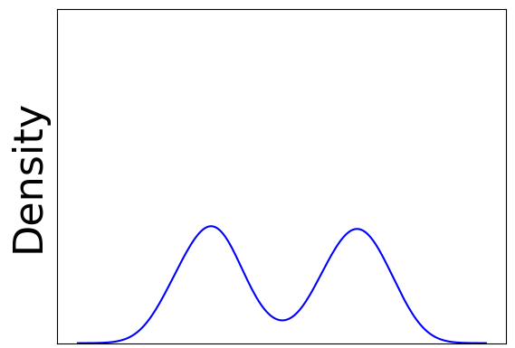
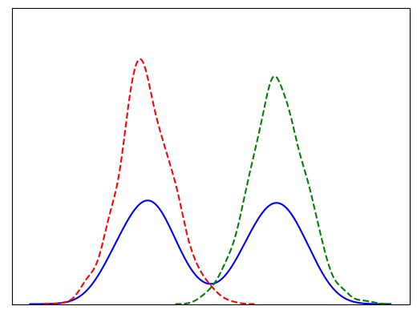
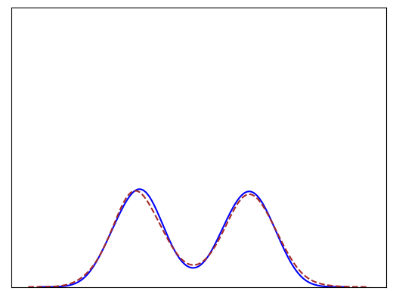
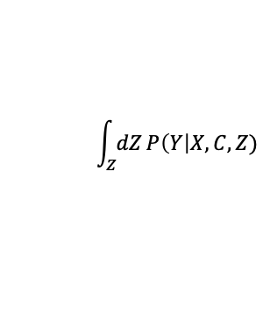






$$P\left(Y\right|X, C, Z=z_{1})$$
$$\int_{Z}{dZ}P\left(Y\right|X, C,Z)$$
$$P\left(Y\right|X, C)$$
$$P\left(Y\right|X, C, Z=z_{2})$$
$$Y$$
$$Y$$
$$Y$$

