Slide 1
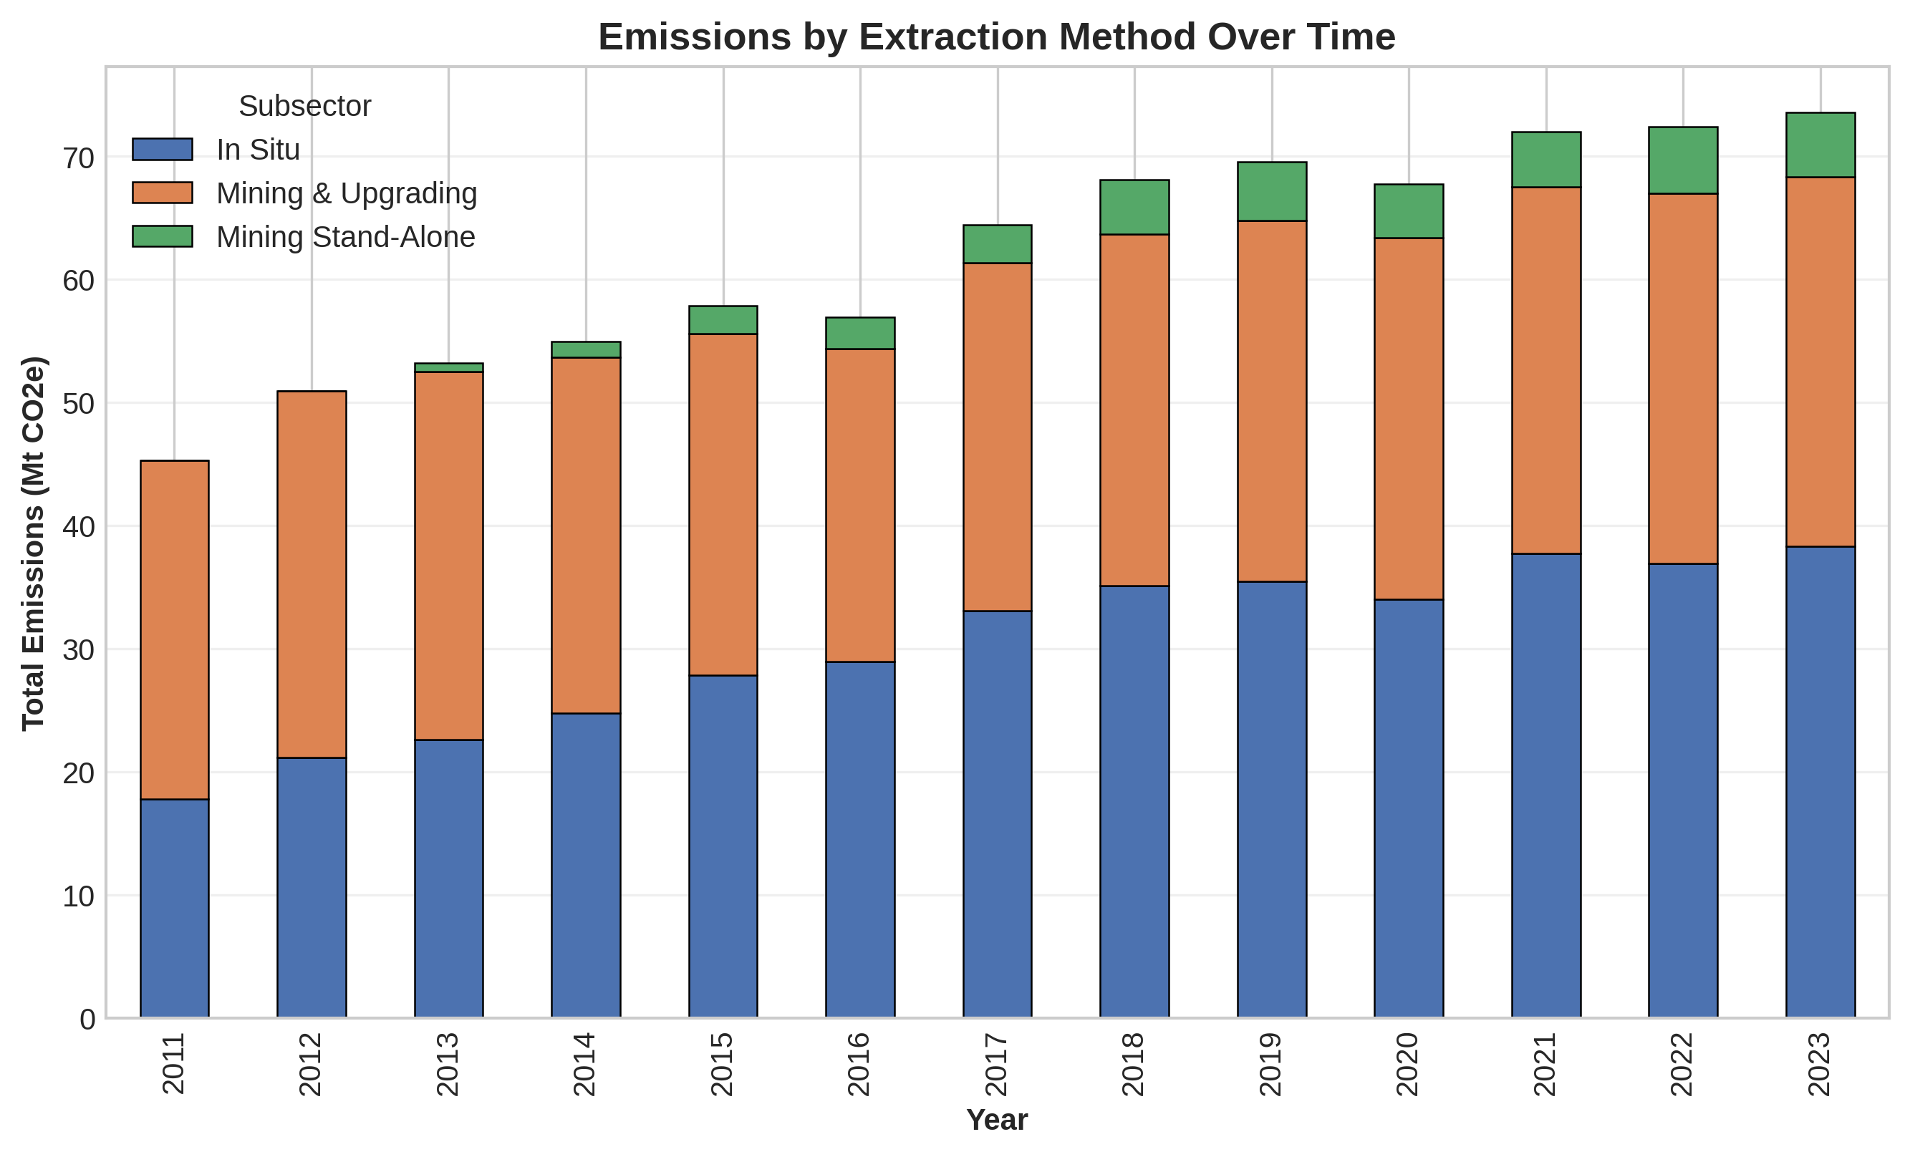
Predicting Facility-Level Greenhouse Gas Emissions
Intensity in Alberta's Oil Sands Using Machine Learning
Paul Moynihan, Ifeanyi Njoku, Anmol Sharma
DATA 606 | Final Project
Revised: corrected for target leakage — see slide 15 for methodology note

Slide 2
Executive Summary
Project Objective
Develop machine learning models to predict emissions intensity (tonnes CO2e/m³) at Alberta oil sands facilities, using only information that would legitimately be available for prediction — enabling better environmental compliance and emissions-reduction strategies.
Dataset Overview
Key Results
Facility-year records: 344 (2011–2023, after removing non-operational records)
Target variable: Emission Intensity (tonnes CO2e/m³)
Range: 0.184 – 7.433 | Average: 0.622
Features: production volume, extraction technology, subsector, product, facility production history, time
Best model: Random Forest — Test R² = 0.496, RMSE = 0.741
Top predictors: Log-transformed production (0.355) and raw production (0.259)
6 models compared: Linear Regression, Elastic Net, Random Forest, Gradient Boosting, SVR, Neural Network
Production scale explains ~61% of feature importance — the dominant driver
Note on this revision: An earlier draft reported R² = 0.681 using features (Cogen_Adjusted_Emission, Log_Emission) mathematically entangled with the target, and a separate draft reported R² = 0.058 using raw Facility identity as a predictor, which caused tree models to memorize rather than generalize. This deck uses a corrected, leakage-free feature set throughout.
2

Slide 3
Problem Statement & Business Context
The Challenge
Our Approach
Industrial facilities must monitor and reduce emissions intensity
Current emissions tracking is reactive, not predictive
High variability across facilities and extraction technologies
Need early indicators of high-intensity operations
Predictive modeling using only information available before operations complete
Careful feature engineering that avoids leaking the target into the inputs
Comparison of six ML algorithms on interpretability, accuracy, and generalization
Feature importance analysis to guide emissions-reduction strategy
Business Impact
Regulatory compliance (carbon pricing, emissions caps)
Cost optimization (reduce emissions tax burden)
Operational efficiency improvements
Environmental sustainability goals
3

Slide 4
Specific Objectives
Predict Emissions
Intensity
Compare ML
Models
Identify Key
Drivers
Develop accurate facility-level predictions of GHG emissions intensity using only legitimate operational and technological data.
Evaluate six machine learning approaches across interpretability, accuracy, and generalization performance.
Determine which operational factors most significantly and defensibly impact emissions intensity.
4

Slide 5
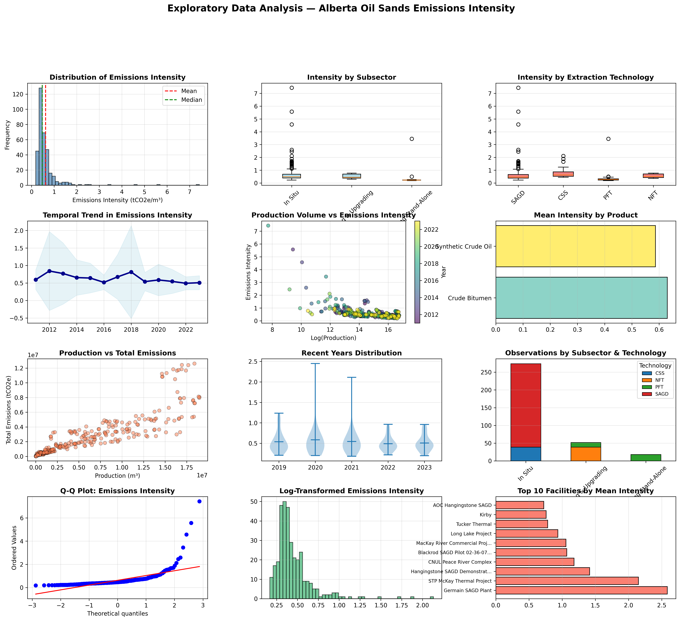
Exploratory Data Analysis: Key Insights
5

Slide 6
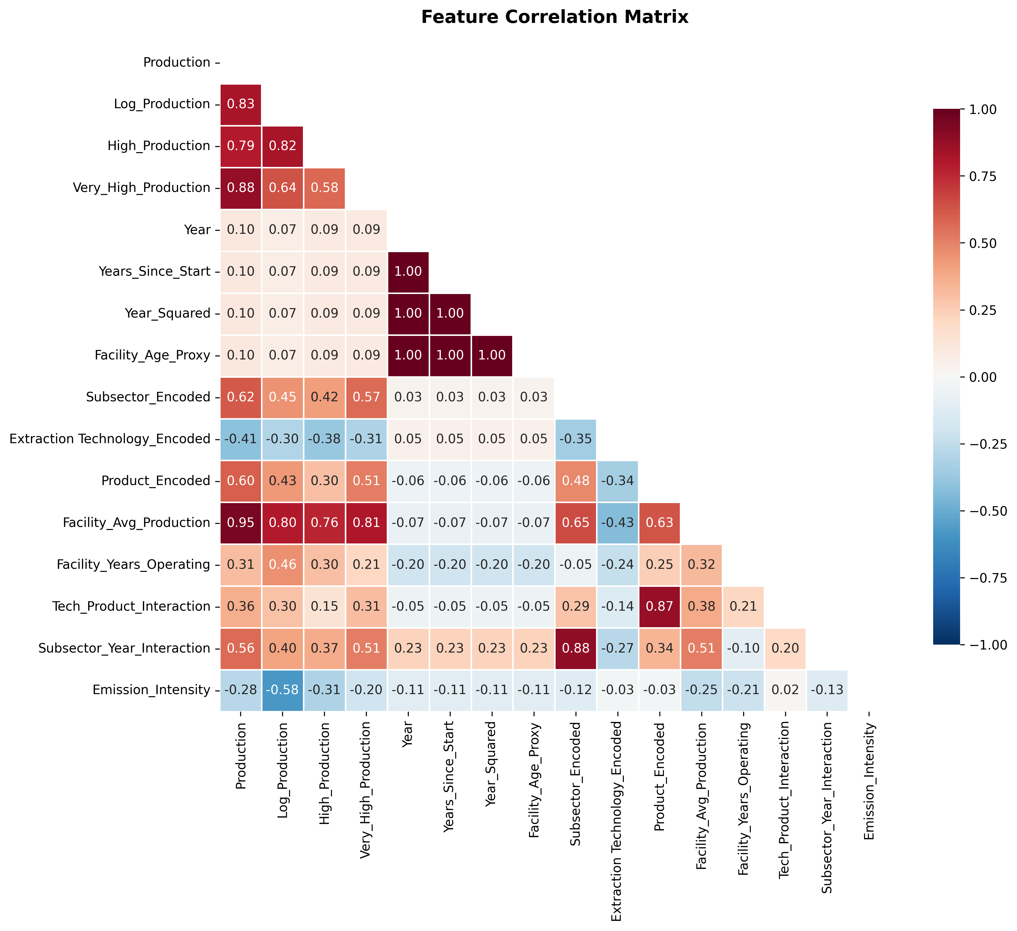
Exploratory Data Analysis: Feature Correlations
What the correlations show
Production and Log_Production are negatively correlated with intensity — larger facilities tend to be more efficient (economies of scale)
Facility_Avg_Production behaves similarly — a facility's production history is informative even without using its identity
Note: Cogen_Adjusted_Emission and Log_Emission are excluded from the model feature set, since they are mathematically entangled with the target
6

Slide 7
Data & Methodology
Variables
Machine Learning Pipeline
Production volume (m³)
Total (cogen-adjusted) emissions — used only to compute the target
Subsector, extraction technology, product type
Facility and year
Data
Cleaning
Feature
Engineering
Train/Test
Split
Leakage-Free Feature Engineering
Log transformations of production
Production-scale indicators (median / 75th percentile)
Encoded categorical variables (subsector, technology, product)
Facility-level historical aggregates (avg. production, years operating) — not facility identity
Interaction terms (technology × product, subsector × time)
Model
Training
Cross-
Validation
Evaluation
7

Slide 8
Machine Learning Models Compared
1. Linear Regression
Baseline linear model.
✓ Fast, interpretable, assumes linear relationships
2. Elastic Net
Combined L1/L2 regularization for feature selection.
✓ Handles multicollinearity, automatic feature selection
3. Random Forest
Ensemble of decision trees with bagging.
✓ Captures non-linearity, robust to outliers
4. Gradient Boosting
Sequential tree building with boosting.
✓ High accuracy, handles complex interactions
5. Support Vector Regression
Kernel-based regression with epsilon-insensitive loss.
✓ Effective in high dimensions, robust to outliers
6. Neural Network (MLP)
Multi-layer perceptron with early stopping.
✓ Captures complex non-linear relationships
8

Slide 9
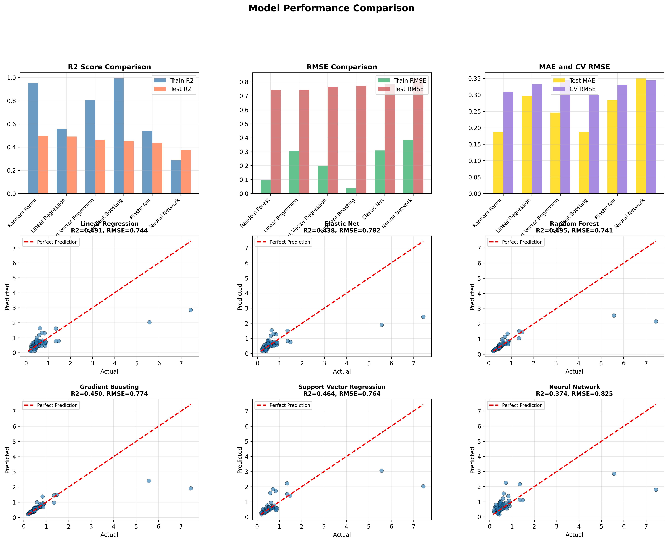
Model Comparison
9

Slide 10
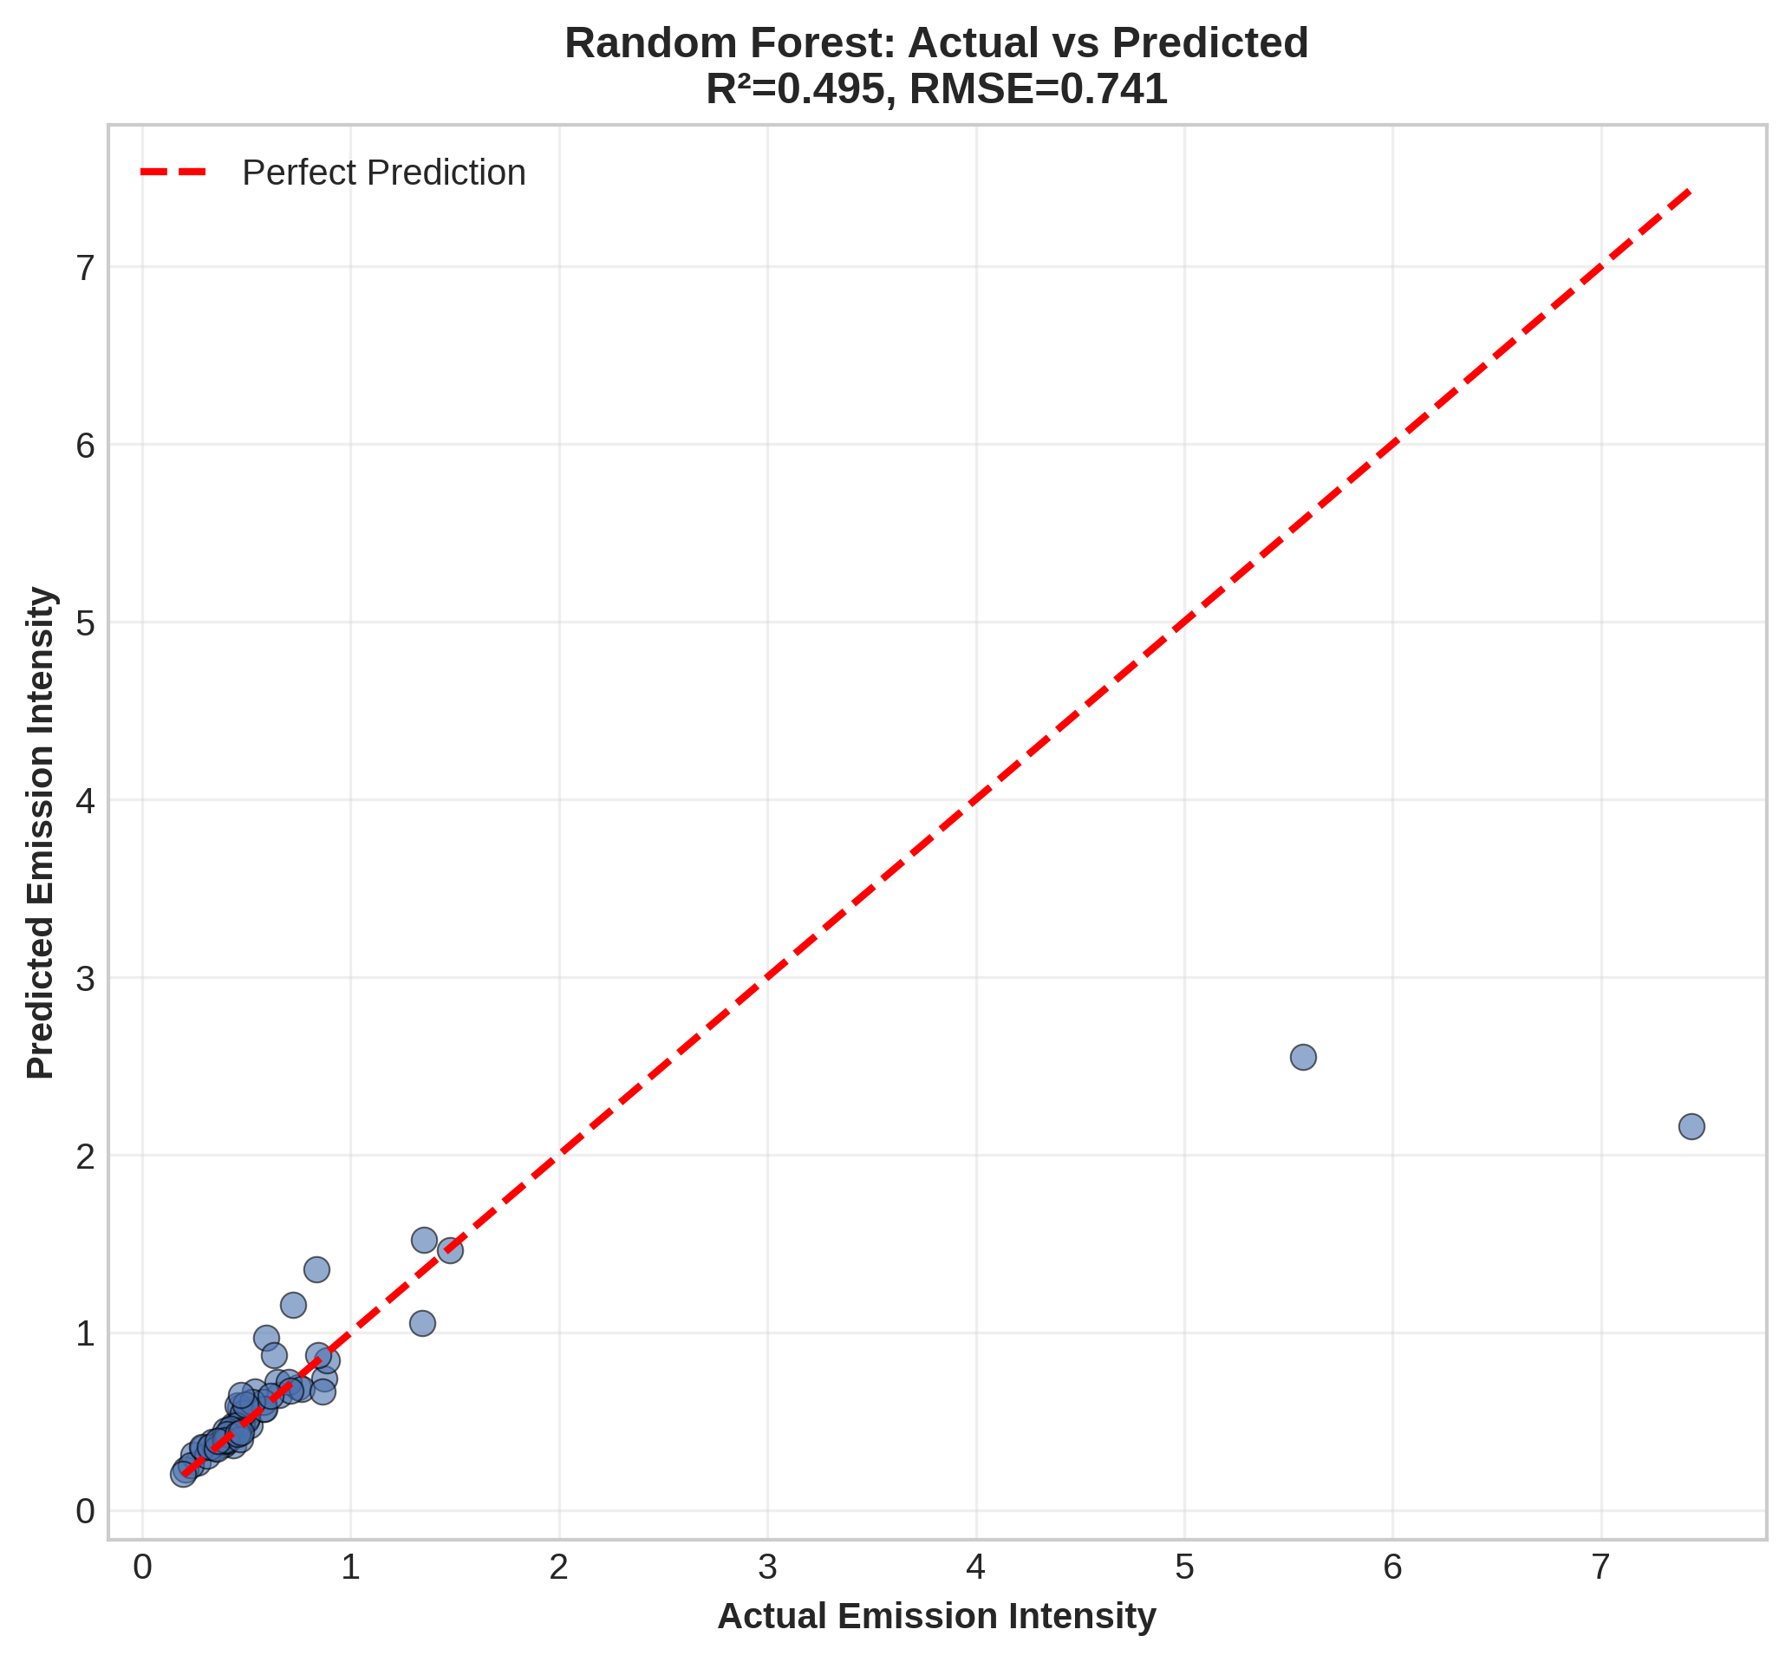
Model Performance Results
Model | Train R² | Test R² | Test RMSE | Test MAE | CV RMSE
Random Forest | 0.9558 | 0.4955 | 0.7410 | 0.1871 | 0.3087
Linear Regression | 0.5571 | 0.4913 | 0.7440 | 0.2973 | 0.3324
Support Vector Regression | 0.8082 | 0.4641 | 0.7637 | 0.2461 | 0.3439
Gradient Boosting | 0.9929 | 0.4498 | 0.7737 | 0.1866 | 0.2992
Elastic Net | 0.5388 | 0.4376 | 0.7823 | 0.2847 | 0.3303
Neural Network | 0.2868 | 0.3745 | 0.8250 | 0.3501 | 0.3442
★ Best Model: Random Forest | Test R² = 0.4955 | RMSE = 0.7410 | MAE = 0.1871
Random Forest achieves the best held-out performance, narrowly ahead of Linear Regression — both explain roughly half the variance using only production, technology, and temporal information.
10

Slide 11
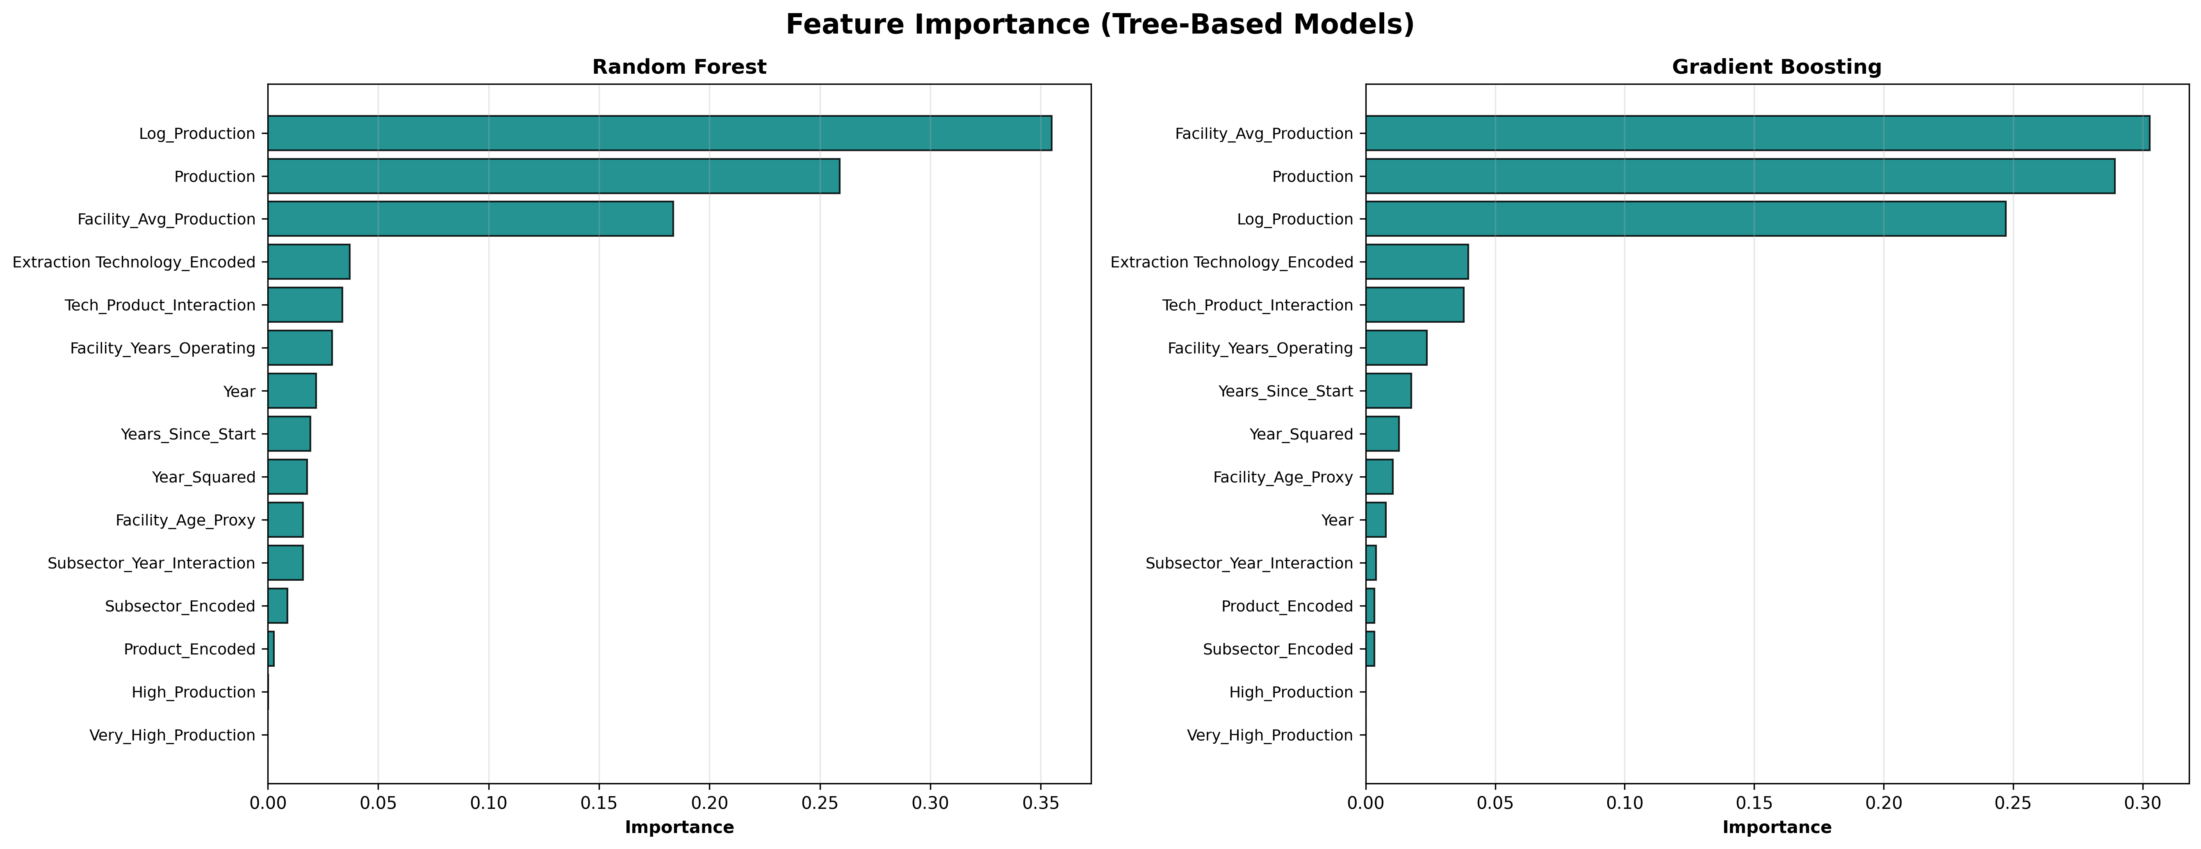
Model Comparison – Feature Importance
Log_Production (0.355) and Production (0.259) together explain ~61% of Random Forest importance — production scale is the dominant driver
Facility_Avg_Production (0.184) — a facility's production history matters, without needing to know which facility it is
Extraction Technology and interaction terms contribute smaller, secondary effects (~7% combined)
11

Slide 12
Key Findings & Insights
Statistical Insights
Key Drivers of Emissions Intensity
Best model explains 49.6% of variance in emissions intensity (Test R² = 0.496)
Average prediction error: 0.187 tonnes CO2e/m³ (Test MAE)
Emission intensity range: 0.184 – 7.433 tonnes CO2e/m³ (40× variation)
344 facility-year records analyzed, 2011–2023
Production scale (~61%): larger operations are systematically more efficient — economies of scale
Facility production history (~18%): experienced, historically high-output facilities perform better
Extraction technology (~7%): SAGD, CSS, NFT, PFT differ meaningfully but secondarily
Operational Implications
Focus emissions-reduction efforts on: (1) production-process optimization at scale, (2) sharing best practices from historically high-performing facilities, and (3) targeted evaluation of extraction technology upgrades where scale gains have been exhausted.
12

Slide 13
Model Diagnostics & Validation
Overfitting Analysis (Train R² − Test R²)
Why Random Forest Won
Gradient Boosting: gap = 0.543 (severe)
Random Forest: gap = 0.460
Support Vector Regression: gap = 0.344
Elastic Net: gap = 0.101
Linear Regression: gap = 0.066 (smallest)
Best test-set performance (Test R² = 0.4955)
Lowest test RMSE (0.7410) among all six models
Narrowly ahead of Linear Regression despite a larger train-test gap
Captures non-linear interactions among production, technology, and time
Model Limitations
All models show some overfitting (train performance exceeds test performance)
Roughly half of the variance in emission intensity remains unexplained
Missing variables: equipment age, maintenance schedule, energy source mix, carbon capture rates
Facility-year records are treated as independent; no panel/time-series structure is exploited
13

Slide 14
Recommendations & Next Steps
Immediate Actions
Operational Improvements
Future Model Enhancements
Use Random Forest predictions for facility benchmarking, not automated deployment
Flag facilities whose predicted intensity is far below their actual intensity for review
Report R² and RMSE together with the feature set used, to keep results reproducible
Prioritize production-process optimization at scale
Benchmark high- vs. low-intensity facilities within the same technology group
Share best practices from historically efficient, high-production facilities
Collect equipment specs, maintenance records, energy source, and CCS deployment data
Apply panel-data methods (fixed/random effects) to exploit repeated facility-year structure
Re-test facility identity only via random-effects terms, not as a raw leakage-prone predictor
14

Slide 15
Methodology Note: Correcting Target Leakage
The issue
Emission_Intensity = Cogen_Adjusted_Emission ÷ Production. An earlier draft included Cogen_Adjusted_Emission (and its log transform) directly as model features. Because these are mathematically entangled with the target's numerator, the resulting R² = 0.681 did not reflect genuine predictive skill. A later draft removed those features but used raw Facility identity as a label-encoded predictor; with 32 facilities and 344 rows, tree models memorized per-facility averages rather than learning generalizable drivers, producing near-zero or negative test R² (0.058 best case).
The fix
Removed all emissions-derived features (Cogen_Adjusted_Emission, Log_Emission, and any emission/production ratio)
Replaced raw Facility identity with facility-level historical aggregates (avg. production, years operating) — informative without being an identity key
Retained production volume, technology, subsector, product, and temporal features as legitimate predictors
Result: Test R² = 0.4955 (Random Forest) — lower than the inflated 0.681, far better than the underpowered 0.058, and defensible under scrutiny.
15

Slide 16
References
Charpentier, A. D., Bergerson, J. A., & MacLean, H. L. (2009). Understanding the Canadian oil sands industry's greenhouse gas emissions. Environmental Research Letters, 4(1), 014005.
Environment and Climate Change Canada. (2023). National inventory report: Greenhouse gas sources and sinks in Canada. Government of Canada.
Hastie, T., Tibshirani, R., & Friedman, J. (2017). The elements of statistical learning: Data mining, inference, and prediction (2nd ed.). Springer.
National Pollutant Release Inventory. (2024). Facility-reported greenhouse gas emissions data. Government of Canada.
Alberta Energy Regulator. (2024). Oil sands operational and production data. Government of Alberta.
Alberta Energy Regulator. (n.d.). About the AER. https://www.aer.ca/about-aer
16

Slide 17
THANK YOU
Paul Moynihan · Ifeanyi Njoku · Anmol Sharma

