Slide 1
Data Visualization Newmyer Wk4 Midterm Assignment (Redo)
MIDTERM ASSIGNMENT
June 2, 2023

Slide 2
Overview: Marijuana Excise Tax
For this assignment, The dataset being used is a real example of one Colorado town’s marijuana excise tax income.
Excise tax reporting is essential for the setting the town budget each year.
Calculating a percentage of all revenue sent to the State provides information on how much funding the Town should receive.
Information on individual grow reporting is essential for compliance.
I worked on this project for the Town. They were concerned about the amount of excise tax being paid by licensed businesses. In addition, there was a concern that the revenue was being underreported.
I designed a user-interface for data entry, then downloaded the .csv file. I created a couple of graphs to illustrate the conclusions for a town board meeting. One of these was a pie chart showing the percentage of grows filing reports per year.
For this assignment I am elevating the visualizations to provide more detailed information beyond showing that reports weren’t being filed.

Slide 3
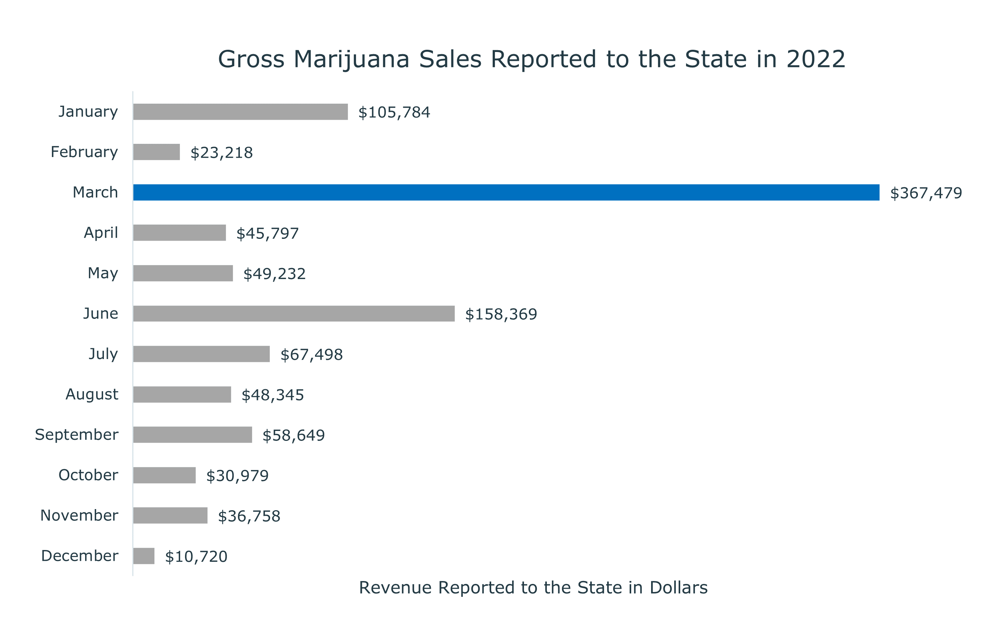
This horizontal bar chart illustrates the cumulative total of gross sales reported to the State of Colorado.
The Town calculates their Excise Sales Tax as a percentage of the gross sales reported to the State. The percentage varies by the length of time since the license was issued. Generally, the amount of excise tax is equal to 5% of the gross sales reported to the State.
It is also important to note which month has the greatest amount of gross sales. It is easy to identify that the amount of sales in March is nearly double the amount of the next closest reporting month June.
This is as expected with the local growing and tourist seasons.

Slide 4
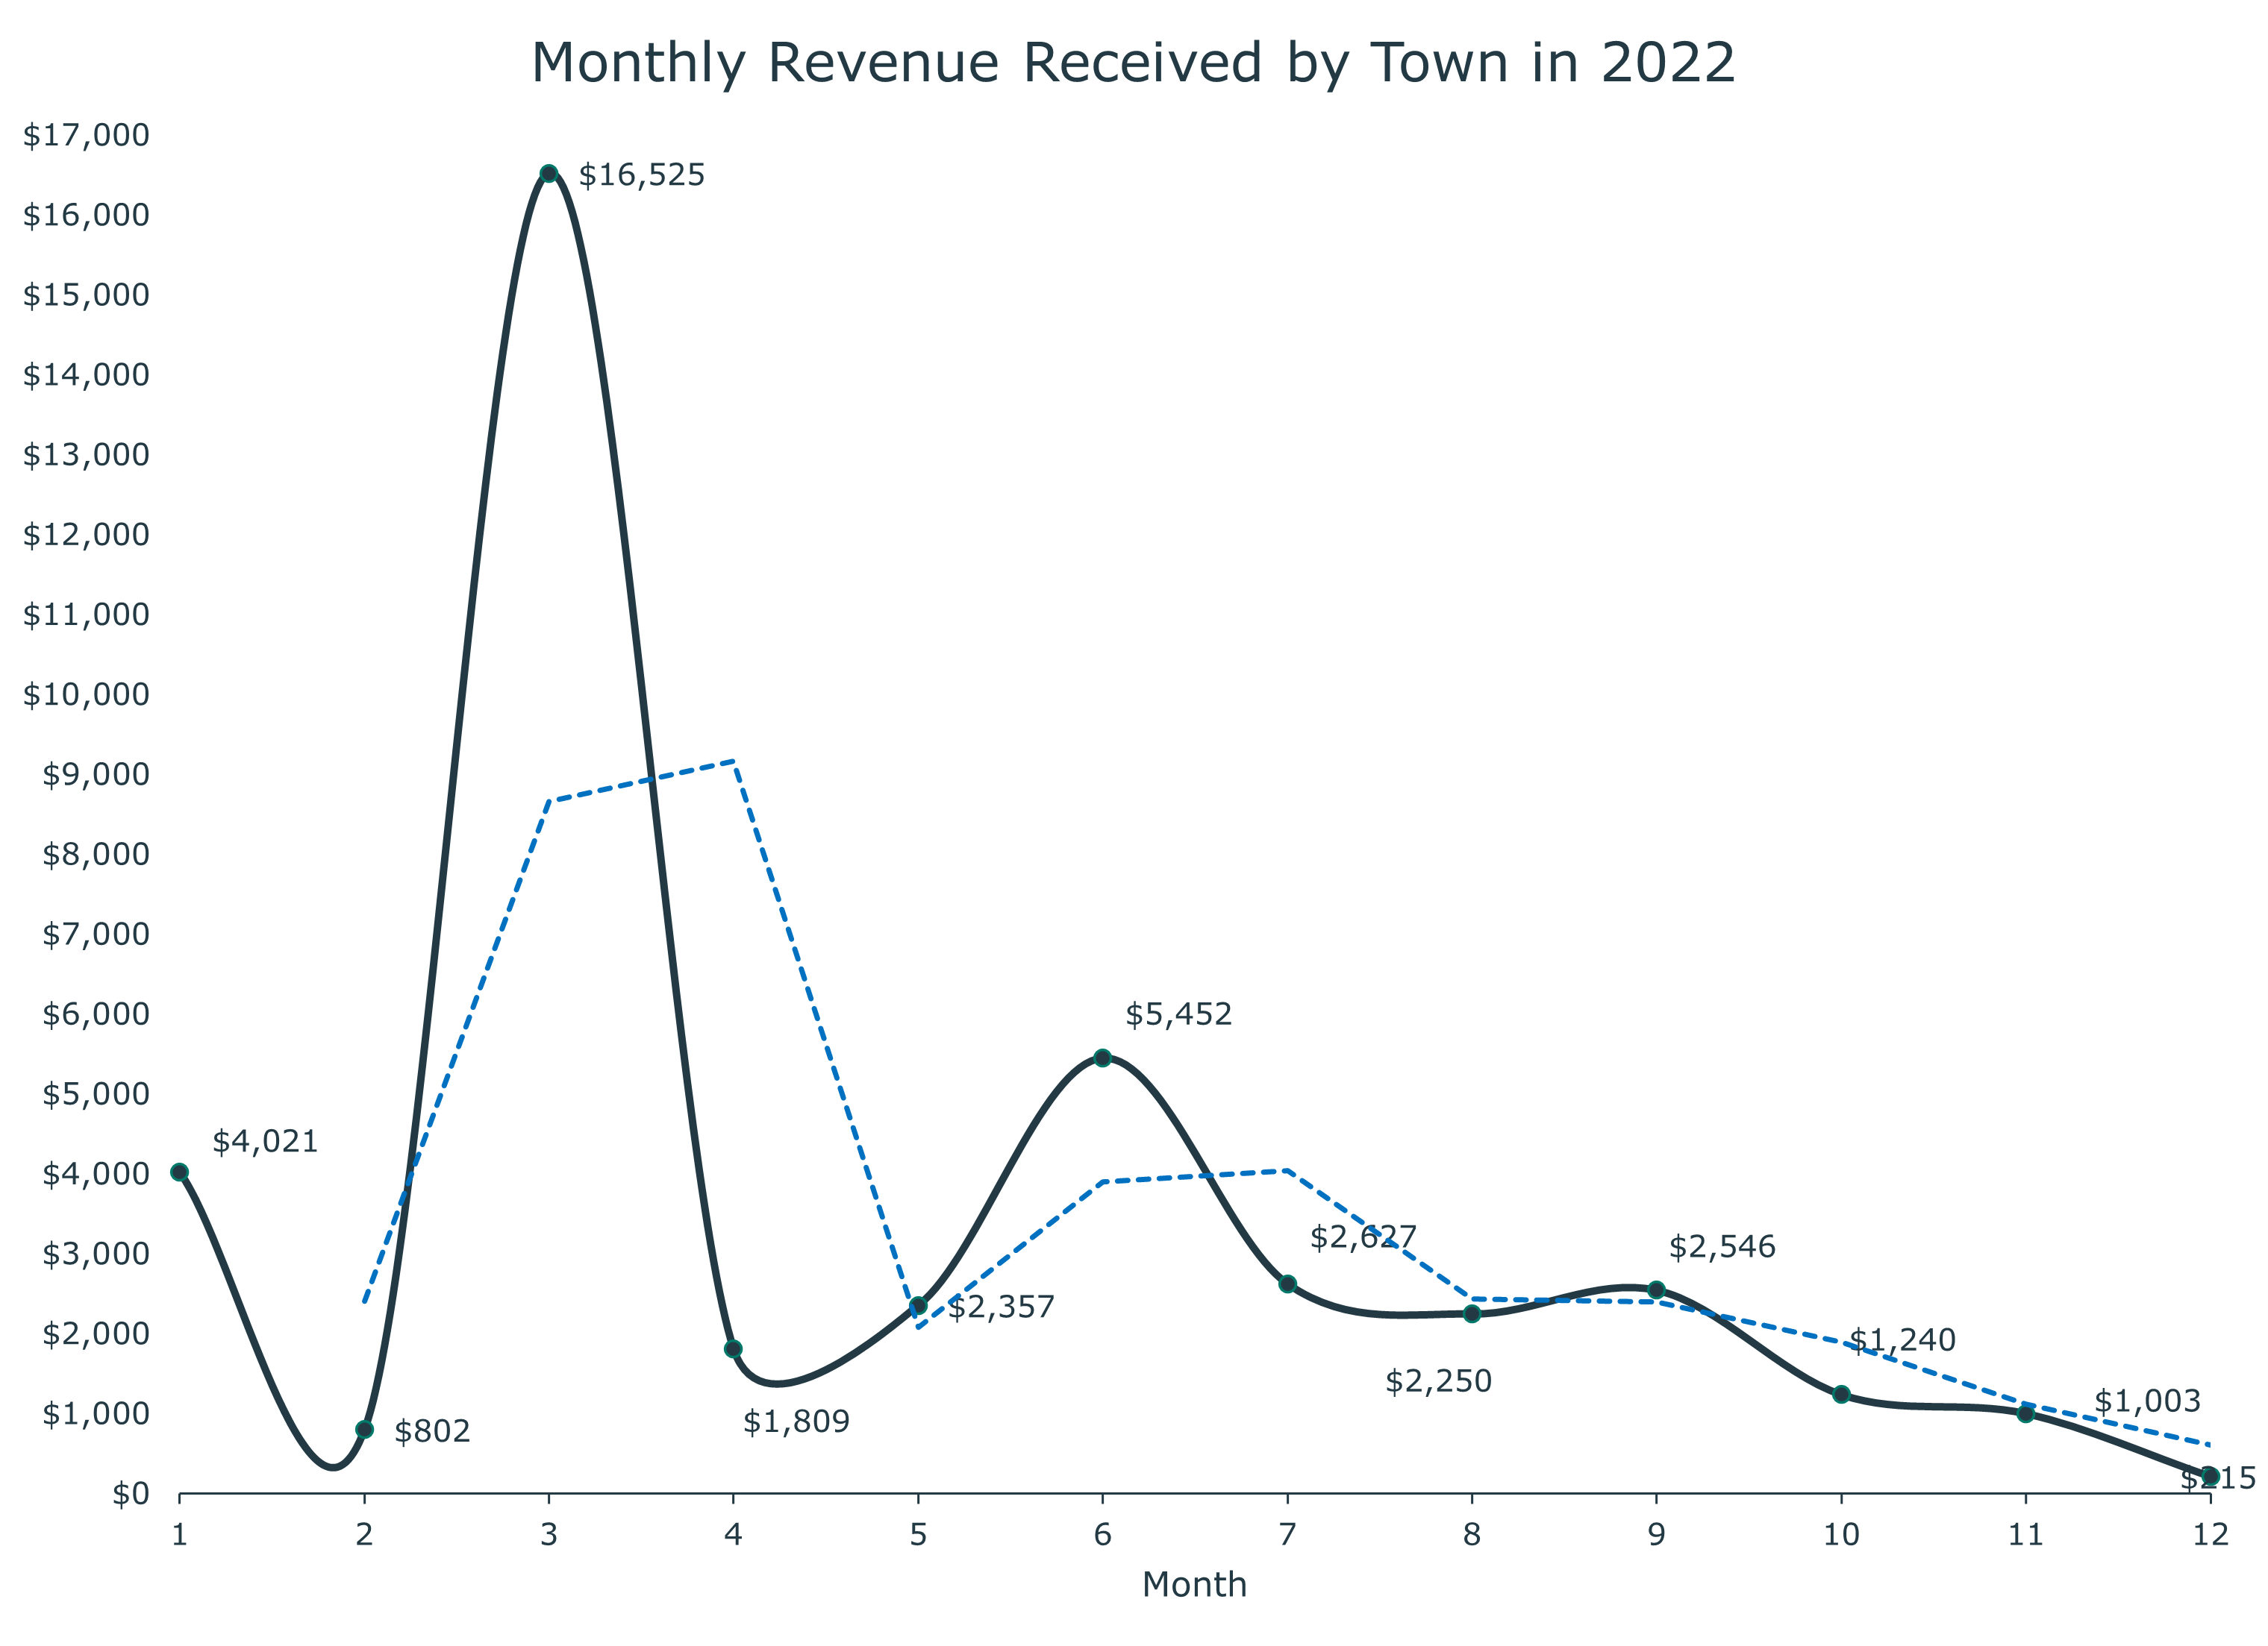
This line chart has the monthly maximum revenue received by the town labeled next to the point on the curve. This provides important information for the town as they plan and set the budget for the following year.
The average revenue trendline has been added as a guideline to illustrate the quarterly average revenue. This information is necessary for the Town Board to visualize how much money might be budgeted by quarter the following year.
Correspondingly, Town projects could be planned in the quarter following the highest revenue. Showing the average provides limits to the amount that the Town should allocate to maintain a balance throughout the year.

Slide 5
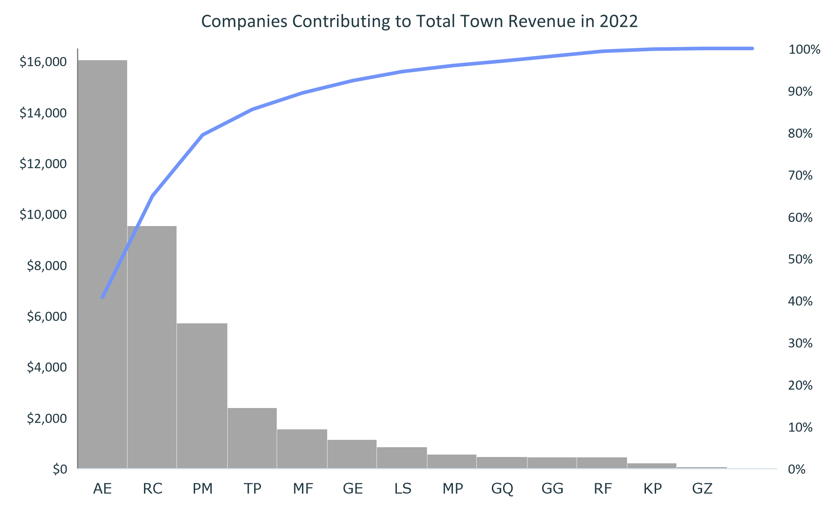
Total Revenue $39,372
The final illustration for this assignment is a pareto diagram. This is perhaps the most important visual. The information it provides includes the stark reality that of the 79 licensed grows that should be reporting gross sales and submitting excise tax revenue to the Town, only 16.5% are in fact reporting and submitting.
Furthermore, three of the top grows contribute most of the Town revenue. This information is impactful in that it begs further investigation regarding the lack of reporting and therefore lack of revenue to the Town from the remaining 76 licensed businesses.
Of 79 licensed companies 16.5% are contributing to 100% of the Total Revenue.

Slide 6
Conclusions: Marijuana Excise Tax
Chart 1
Chart 2
Chart 3
This data was generated using a Google Form user interface, results compiled in Google Sheets, and downloaded as an Excel File.
Cumulative data were written as formulas in Excel cells.
Each grow within the municipality is required to submit monthly tax returns to both the State of Colorado and the Town. The month of March shows the greatest amount of gross revenue reported to the State.
The next visualization shows the cumulative amount of excise tax being paid to the Town each month. This amount is based on the amount of gross sales reported to the State.
As expected, the month of March provided the most funding. (This corresponds with harvest).
The average revenue trendline provides a useful picture as the Town Board determines the budget for the following year.
The final visualization, a Pareto diagram, provides the most information out of these three.
One interesting piece of information is that most of the grows are either not reporting any gross sales to the State or not filing reports to the Town (or both). The town should investigate this further.
Most of the revenue is coming from the first six grows listed with AE reporting gross sales to the State and paying the most in taxes to the Town. Further investigation is warranted.

