Slide 1
Data Visualization Newmyer Wk5/6 Assignment
MATPLOTLIB ASSIGNMENT
June 8, 2023

Slide 2
Bank Marketing Dataset
Bank Marketing data: https://archive.ics.uci.edu/ml/datasets/bank+marketing. Use the bank-additional-full.csv.
The data comes from direct marketing campaigns of a Portuguese banking institution. The marketing campaigns were based on phone calls. Often, more than one contact to the same client was required, in order to access if the product (bank term deposit) would be ('yes') or not ('no') subscribed.
The heatmap is in the exploratory data analysis stage to examine possible collinearity of features.
The scree plot is used to assist in choosing the optimal number of clusters when building a machine learning model.
The final plot is a confusion matrix which is used in determining how well the model performs on test data prior to launching or tuning.

Slide 3
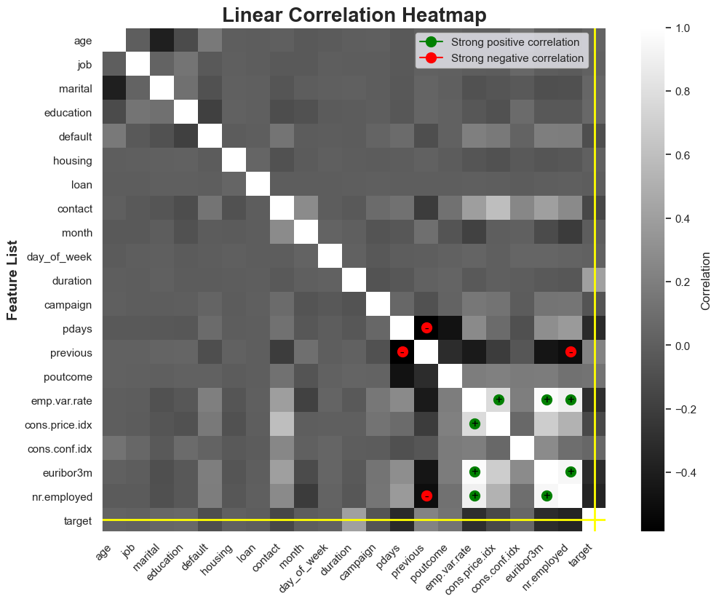
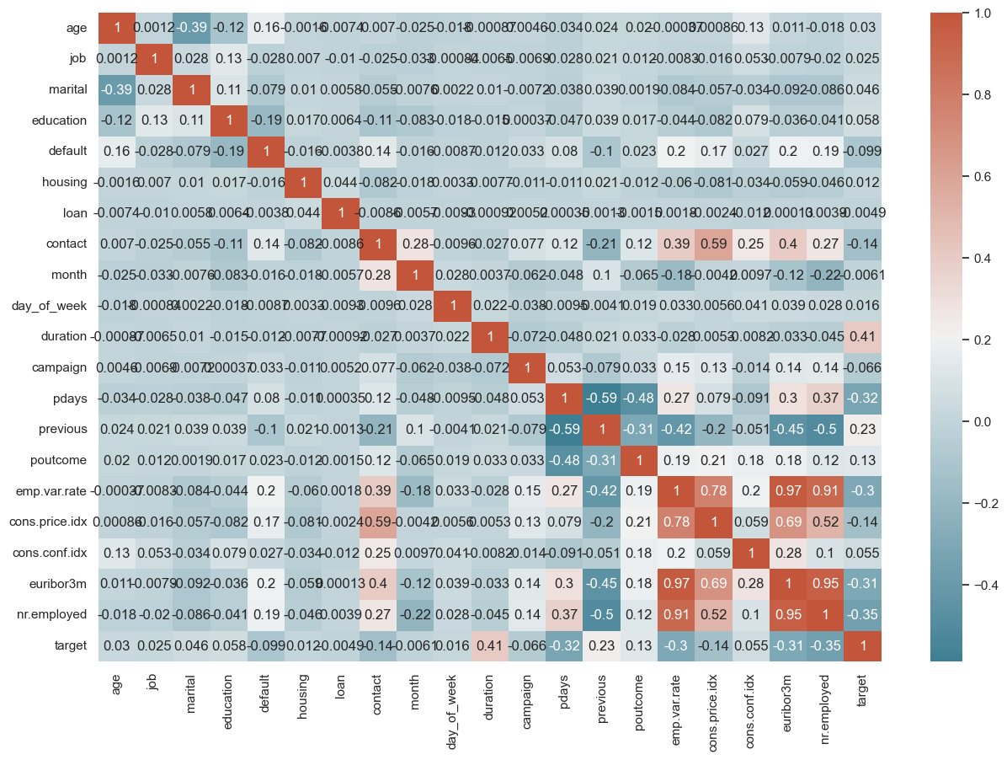
Linear Correlation (Heatmap)
Original Plot
The improved plot has a y axis label, a Title, a legend highlighting possible co-linearity, an annotation at the scores near +1 and -1, and the target feature is highlighted with a yellow line. The heatmap colors ‘gray’ was used because it was the easiest on the eyes and allowed the annotations to show up.

Slide 4
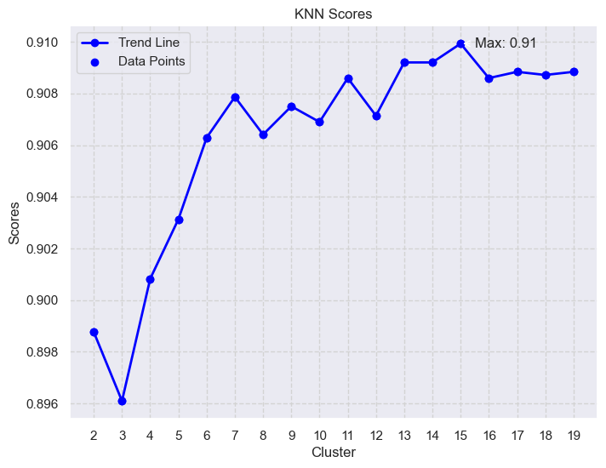
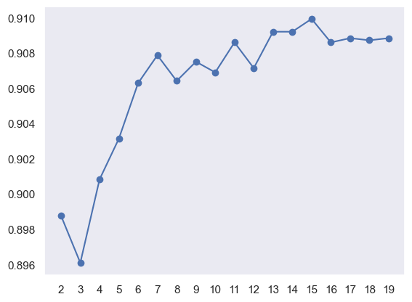
KNN Scores (Scree Plot)
Original Plot
The improved plot has axis labels, a Title, a legend identifying the trendline and the points of the KNN Scores, and an annotation at the maximum score. I made the decision to add the grid lines because it is a mathematical plot and it is important to follow the max y-value to its corresponding x value of 15.

Slide 5
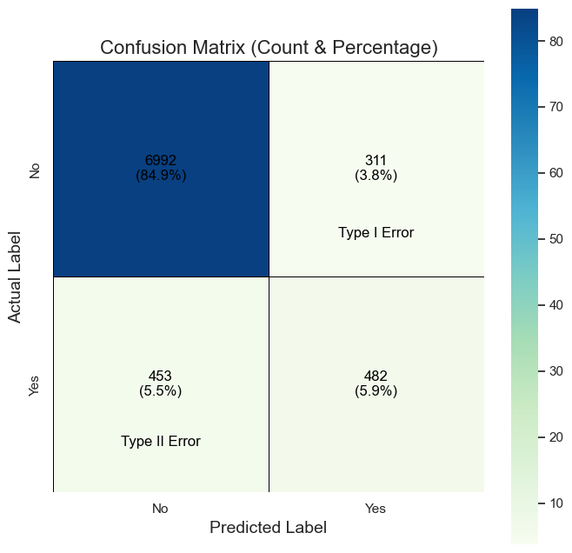
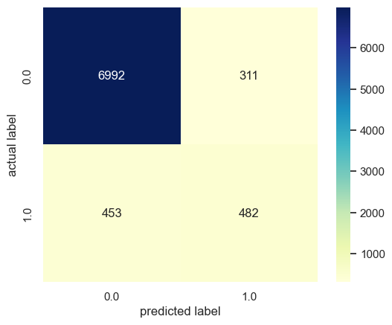
Confusion Matrix
Original Plot
The improved plot has axis labels, a Title, the original annotation was set to False and new annotations were added with the count and the percentage, the labels were changed from 0 and 1 which were unclear to ‘Yes’ and ‘No’, a gridline was added, Type I and Type II Errors were identified and annotated so that the user can choose which type of error they would like to focus on when tuning, the blue/green palette was chosen because the colors are muted but still communicate a gradient.

Slide 6
Conclusions: Bank Marketing Dataset
For this assignment, I chose a previous assignment from my Machine Learning class. In the original code I presented several visualizations. My intent for this assignment was to compare the original plot with the plot created after watching the Data Visualization content for Wk5/Wk6. The dataset being used is the bank/marketing_dataset.
I found (after watching the videos and doing some research), that the visualizations that I was able to create were more polished and I really appreciate understanding how the fig, ax system works.
I was searching for a way to make my confusion matrices and heatmaps provide more information that the basic ones I was using. I took the time to adjust these so that I can reuse them in the future and my code is ready. I will likely use color on the heatmap instead of greyscale.

