Slide 1
TrustOTP: Smartphone as One-Time Password Token
Instructor: Kun Sun, Ph.D.

Slide 2
Outline
Introduction
Background
Design & Implementation
Evaluation
Related work
Summary

Slide 3
Outline
Introduction
Background
Related work
Design & Implementation
Evaluation
Summary

Slide 4
One-time Password (OTP)
A password that is valid for only one login session or transaction
Not vulnerable to replay attacks
Widely used in Two-factor Authentication
HOTP (Hash-based) & TOTP (Time-based)
Hardware Token & Software APP

Slide 5
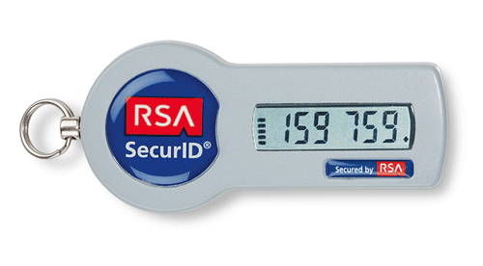
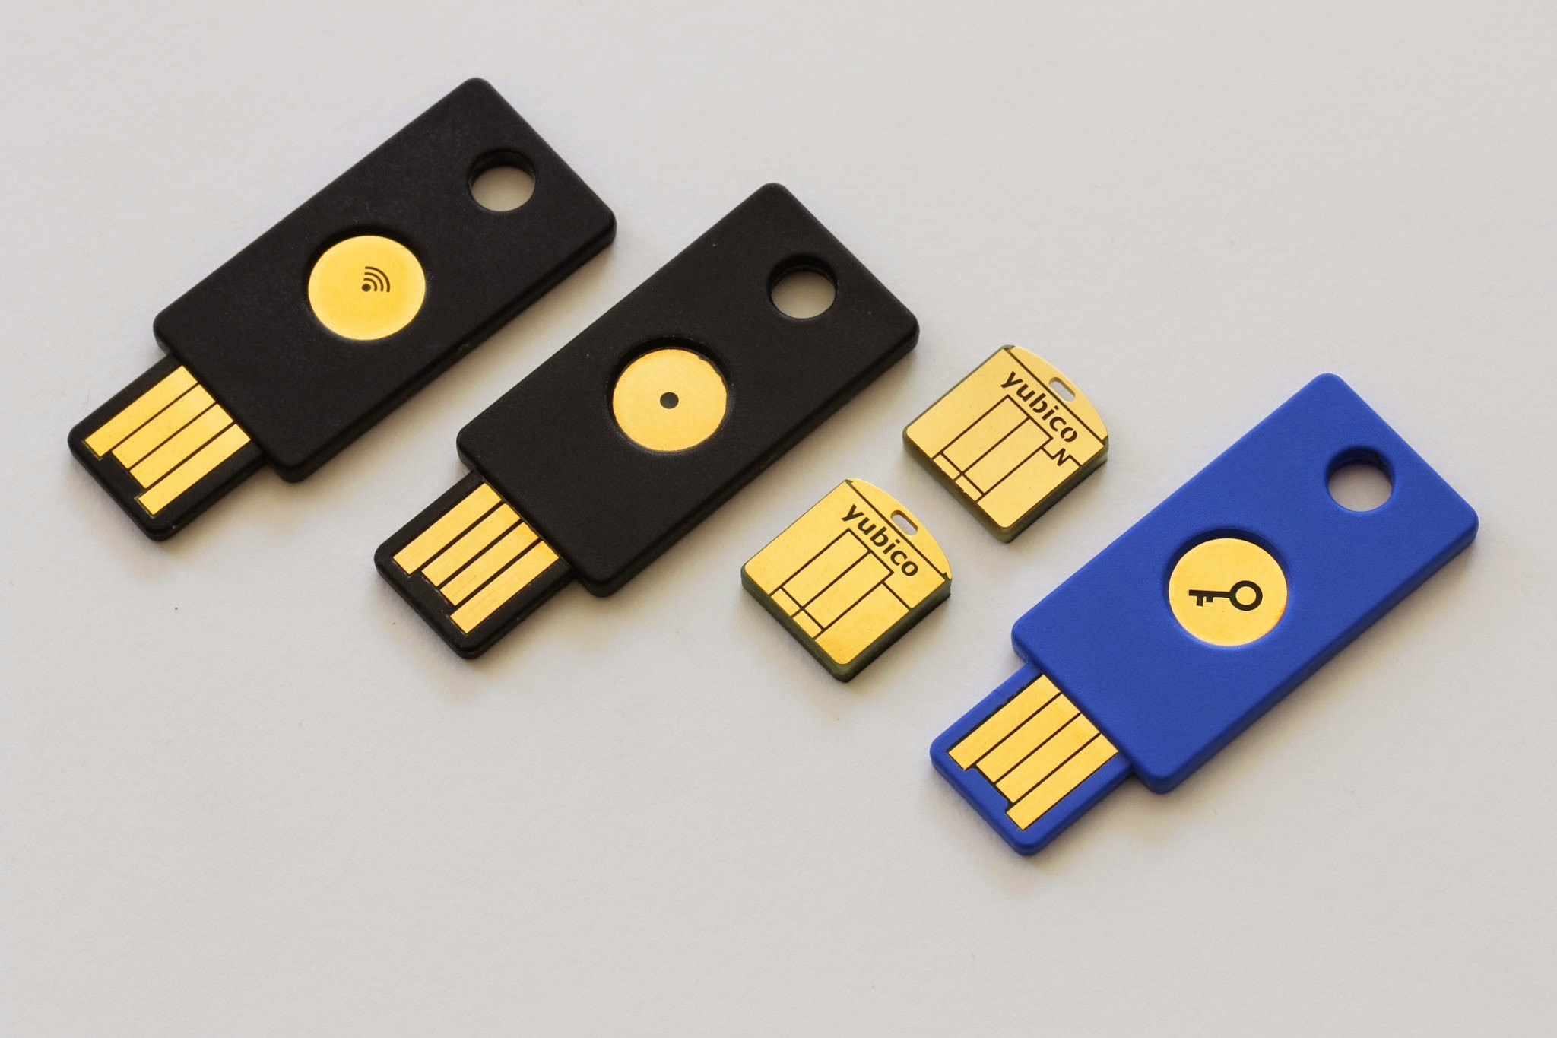
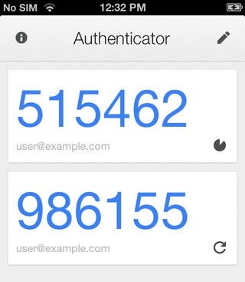
Existing Solutions
Hardware-based
RSA SecurID
Yubikey
Software-based
Google Authenticator
McAfee One-time Password
Limitations
Hardware: not flexible
Unprogrammable
Software: not secure
Vulnerable to external attacks

Slide 6
Outline
Introduction
Background
Related work
Design & Implementation
Evaluation
Summary

Slide 7
TrustZone Background
TrustZone
A system-wide approach
Two isolated execution domains: secure domain and normal domain
TZIC (TrustZone Interrupt Controller)
Secure interrupt--FIQ
Non-secure interrupt--IRQ
GPIO (General Purpose I/O)
Notes:
TrustZone is a system-wide approach to provide hardware-level isolation on ARM platforms.
It creates two isolated execution domains: secure
domain and normal domain. The secure domain has a higher access privilege than the
normal domain, so it can access the resources of the normal domain such as memory,
CPU registers and peripherals, but not vice versa. There’s an NS bit in the CPU processor
to control and indicate the state of the CPU - 0 means the secure state and is in secure domain while 1 means
the normal state and is in normal domain. There’s an additional CPU mode, monitor mode, which only runs in
the secure domain regardless of the value of the NS bit. The monitor mode serves as a
gatekeeper between the normal domain and the secure domain. If the normal domain
requests to switch to the secure domain, the CPU must first enter the monitor mode.
The system bus also contains a bit to indicate the state of the bus transaction. Thus, normal
peripherals can only perform normal transactions, but not the secure transactions.

Slide 8
Outline
Introduction
Background
Related work
Design & Implementation
Evaluation
Summary

Slide 9
TrustZone-related work
TrustICE (Sun et al.[1])
Isolated Computing Environment in the normal domain
SeCReT (Jang et al.[2])
Secure channel between secure domain and normal application
Hypervision (Azab et al.[3])
Real-time kernel protection in the normal domain
TrustDump (Sun et al.[4])
Reliable Memory Acquisition of the mobile OS
Smartphone as location verification token for payments (Marforio et al.[5])
Trusted Language Runtime for trusted applications in the secure domain (Santos et al.[6])

Slide 10
Outline
Introduction
Background
Related work
Design & Implementation
Evaluation
Summary

Slide 11
One-time Password on Smartphone
Integrate physical tokens into smartphone
Requirements:
Security
Malicious mobile OS cannot compromise the keying material in the one-time password (OTP) generator
It cannot read the OTP
Reliability and Availability
OTP works even if mobile OS crashes
Trusted inputs (e.g., clock time) for the OTP generator
Trusted display

Slide 12
TrustZone-based Solution
ARM TrustZone Technology
Two isolated execution environments
Mobile OS cannot access the disk, memory, CPU states of the OTP generator.
A secure clock for OTP generator
A self-contained display and touchscreen.

Slide 13
TrustOTP Framework
In the Secure domain
Shard I/O device with the Rich OS
Reliable switch between domains

Slide 14
Boot Sequence
Secure storage
MicroSD card
Memory Isolation
Watermark Mechanism
TZASC (TrustZone Address Space Controller)
Secure boot
Secure bootloader
Non-secure bootloader
Rich OS

Slide 15
TrustOTP Trigger
Reliable switch
Non-maskable interrupt (NMI)
The Rich OS cannot block or intercept
Secure interrupt (FIQ)
The Rich OS cannot manipulate
Interrupt source (Configurable)
Physical button
Timer

Slide 16
OTP Generation
Hash-based One-time Password (HOTP)
Event triggered
Key & Counter
Time-based One-time Password (TOTP)
Time synchronized
Key & Clock

Slide 17
OTP Display
Secure I/O
Display: IPU (Image Processing Unit)+LCD
Input: 4-wire resistive touchscreen
User-friendly manner
Rich OS and TrustOTP run concurrently
Watchdog timer
1.5 seconds / cycle (Through experiment)
0.5 second for display
1 second for input 2~3 numbers

Slide 18
Security Analysis
Information Leakage
Generated OTPs
Shared Keys
Control Flow Tampering
Code Integrity
Execution Integrity (Interrupt)
Denial-of-Service
Switch between domains
Static & dynamic code
Display

Slide 19
Outline
Introduction
Background
Related work
Design & Implementation
Evaluation
Summary

Slide 20
TrustOTP Performance
Before OTP display (60.48 ms)
After OTP display (7.52 ms)
Step | Operation | Time (ms)
1 | Domain Switching | 0.002
2 | Context Saving | 0.0006
3 | TOTP/HOTP Generation | 0.048/0.044
4 | Background Matching | 49.85
5 | OTP Drawing | 8.029
6 | IPU Check | 2.22
7 | Framebuffer Replacement | 0.28
Step | Operation | Time (ms)
1 | Flushing IPU & Rich OS Recovery | 7.47
2 | Domain Switching | 0.05

Slide 21
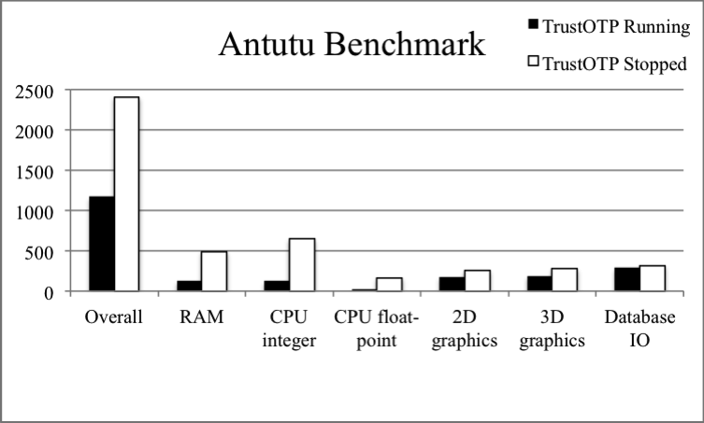
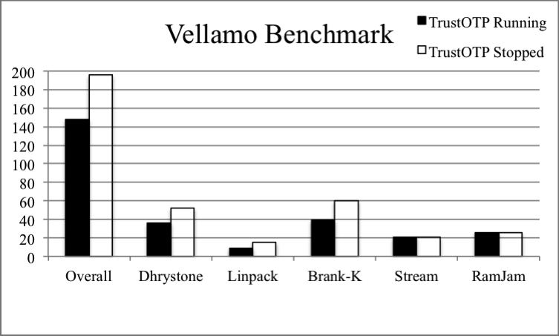
Impact on the Rich OS
Rich OS vs. TrustOTP
Antutu
CPU & RAM
I/O devices
Vellamo

Slide 22
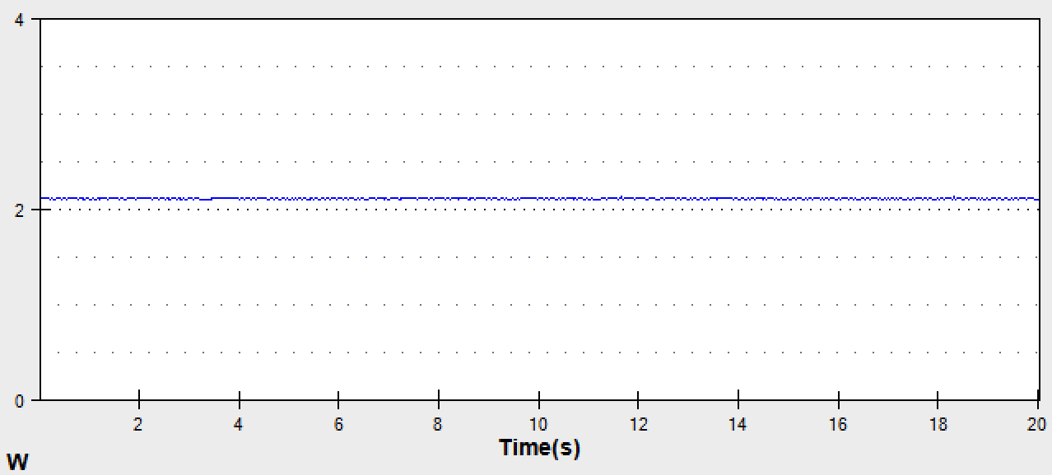
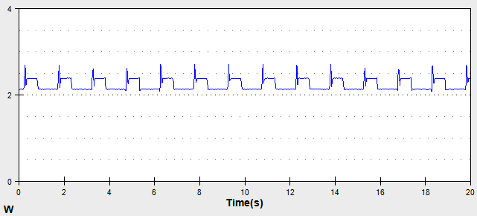
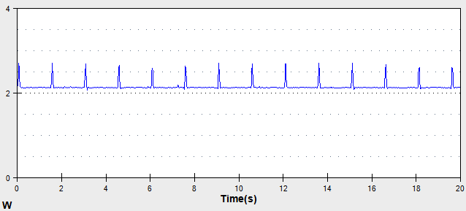
Power Consumption
Rich OS
Average=2,128 mW
TrustOTP Running
Average=2,230 mW
TrustOTP without Display

Slide 23
Outline
Introduction
Background
Related work
Design & Implementation
Evaluation
Summary

Slide 24
Summary
TrustOTP: Hardware-assisted OTP Token
Security (Confidentiality, Integrity, Availability)
Flexibility (Various and multiple ICEs)
Little Impact on the Rich OS
No need to modify the Rich OS
Little Power Consumption Difference

Slide 25
References
H. Sun, K. Sun, Y. Wang, J. Jing, and H. Wang, “TrustICE: Hardware-assisted Isolated Computing Environments on Mobile Devices,” in Proceedings of the 45th Annual IEEE/IFIP International Conference on Dependable Systems and Networks (DSN’15), June 22-25, 2015.
J. Jang, S. Kong, M. Kim, D. Kim, and B. B. Kang, “Secret: Secure channel between rich execution environment and trusted execution environment,” in 21st Annual Network and Distributed System Security Symposium, NDSS 2015, February 8-11, 2015.
A. M. Azab, P. Ning, J. Shah, Q. Chen, R. Bhutkar, G. Ganesh, J. Ma, and W. Shen, “Hypervision across worlds: Real-time kernel protection from the ARM trustzone secure world,” in Proceedings of the 2014 ACM SIGSAC Conference on Computer and Communications Security, November 3-7, 2014.
H. Sun, K. Sun, Y. Wang, J. Jing, and S. Jajodia, “Trustdump: Reliable memory acquisition on smartphones,” in Proceedings of 19th European Symposium on Research in Computer Security (ESORICS’14), September 7-11, 2014.
C. Marforio, N. Karapanos, C. Soriente, K. Kostiainen, and S. Capkun, “Smartphones as practical and secure location verification tokens for payments,” in 21st Annual Network and Distributed System Security Symposium, NDSS 2014, February 23-26, 2014.
N. Santos, H. Raj, S. Saroiu, and A. Wolman, “Using ARM trustzone to build a trusted language runtime for mobile applications,” in Architectural Support for Programming Languages and Operating Systems, ASPLOS ’14, March 1-5, 2014

