Slide 1
Reassembleable Disassembly
Shuai Wang, Pei Wang, Dinghao Wu
Presented by Chuong Ngo

Slide 2
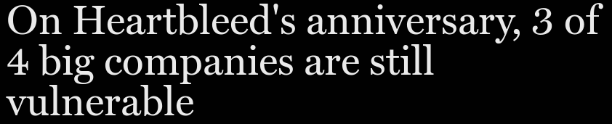
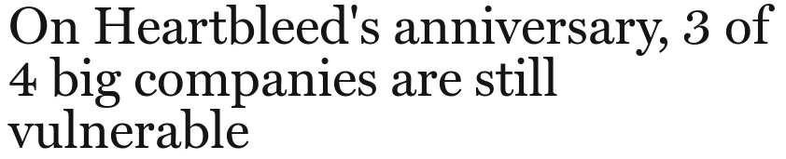



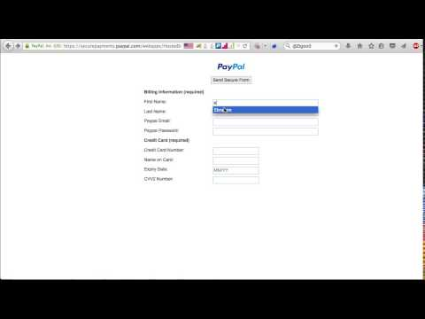

What’s in Your Dependency?
Notes:
Paypal - Ebrahim Hegazy, Stored XSS bug (Aug/Sep 2015)
Affects Paypal’s secure payments domain
HTML page engineered to intercept credentials

Slide 3

What’s in Your Dependency?
Notes:
Onstar - Sammy Kamker w/ Ownstar (Jun 2015)
Mobile app vulnerable, intercept app communication with server
Requests more info from app.
Allows unlock, remote start, GPS coordinates, etc...

Slide 4
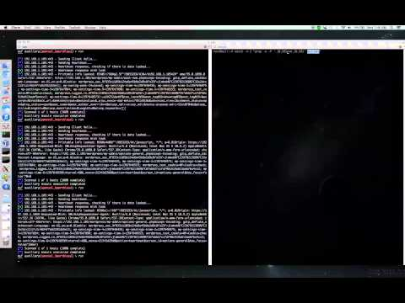
What’s in Your Dependency?
Notes:
Heartbleed - Neel Mehta of Google’s Security Team and Riku, Antti and Matti of Codenomicon. (2014)
Named by Codenomicon.
Vulnerability in OpenSSL library, bug in implementation of TLS/DTLS heartbeat extension.
Leaks memory contents from server to client and vice versa (private keys, user credentials, protected content, etc…)

Slide 5
Identifying Bugs, Flaws, and Exploits
Study the specifications/papers detailing the techniques and algorithms.
Penetration test the implementation.
Study the implementation.
Get lucky.
Notes:
Specifications/papers detailing technique/algorithms may have a flaw or may detail dependency with flaws.
May require extensive knowledge and expertise
Pentest needs some luck and knowledge of the systems and tools.
Study the code.
Needs the source/assembly code.

Slide 6
Identifying Bugs, Flaws, and Exploits
Study the specifications/papers detailing the techniques and algorithms.
Penetration test the implementation.
Study the implementation.
Get lucky.
Notes:
Need to convert binary to assembly code.
Go back to the future.

Slide 7
Identifying Bugs, Flaws, and Exploits
Study the specifications/papers detailing the techniques and algorithms.
Penetration test the implementation.
Study the implementation.
Get lucky.
But what if you don’t have the source code?
Notes:
Need to convert binary to assembly code.
Go back to the future.

Slide 8

Back to the Source
Notes:
Flux capicator (1981 -1983)
1.21 Gigawatts
58 mph

Slide 9
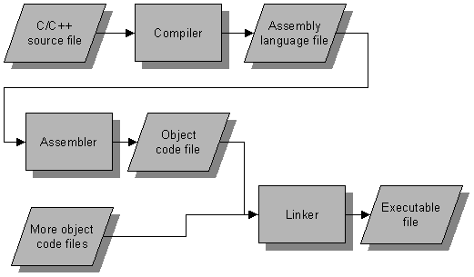
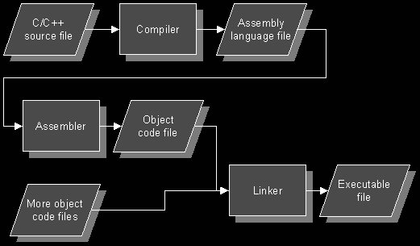
Review of Compilation Process
Stripped Binary
Notes:
Reduces binary size
Stripped binaries don’t have debugging info (variable names, line in source code)
Remove symbol tables
To store the names of all entities in a structured form at one place.
To verify if a variable has been declared.
To implement type checking, by verifying assignments and expressions in the source code are semantically correct.
To determine the scope of a name (scope resolution).

Slide 10




Disassemblers
IDA Pro-best commercial
EXE to assembly to C.
Not reassembleable.
MC-Semantics
Object to binary only
Reassembleable
Lower performance
Notes:
Lady is

Slide 11





Binary Rewriting Tools
Specific compiler or non-stripped binary.
Re-compiled binary bloat.
Large execution overhead.
Not reassembleable.
Notes:
Diablo - static binary rewriting technique
relocate instructions at patch point
stub-based ideas
large overhead during execution
DynamoRIO - dynamic binary rewriting
trace execution and patch on the fly
bloats executable size
large execution overhead

Slide 12
Code Relocatability is Key to Reassembility

Slide 13
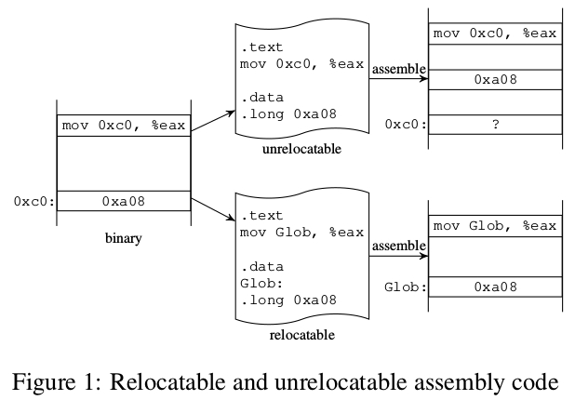
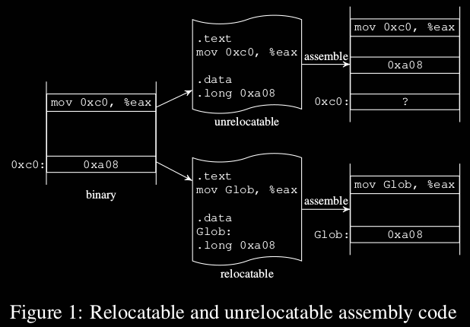
Problem of Relocatability - Data or Reference?
Notes:
First example, reference seen as data.
Offset in reassembled binary may be off.

Slide 14
Problem of Relocatability - Data or Reference?
Disassembler needs to symbolize references

Slide 15
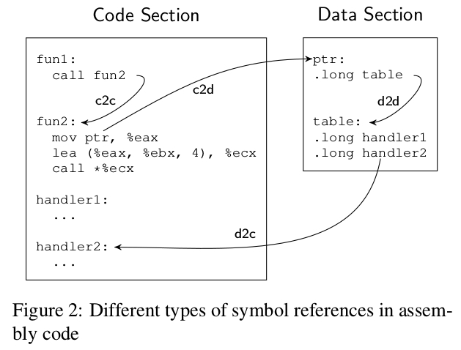
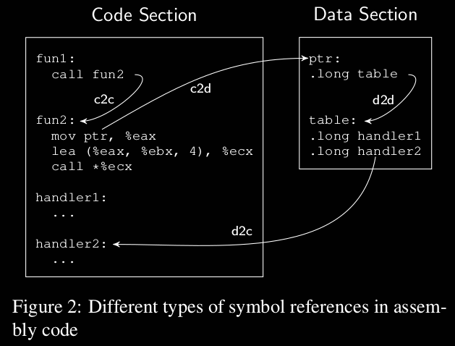
Types of Symbol References

Slide 16



Methodology
Simple filter for c2X.
4/8 byte aligned.
d2d irrelevant.
Find jump tables.
Notes:
Study on 244 binaries, simple filter good enough for c2x.
Slice data sections into individual lengths - A1
Usually aligned, sometimes not - “packed” gcc flag.
Sliding window advances 1 byte per, until match, then n-bytes forward.
d2d irrelevant - A2
d2c patterns - A3
starting address of some function or forms jump table
function identification via machine learning - 98% accuracy (assumed in experiment)
Jump tables
traverse data - table start if value referred to by instruction operand
table entry - value that points to instructions in same function that previous entries point to.

Slide 17


Enter Oroboros

Slide 18
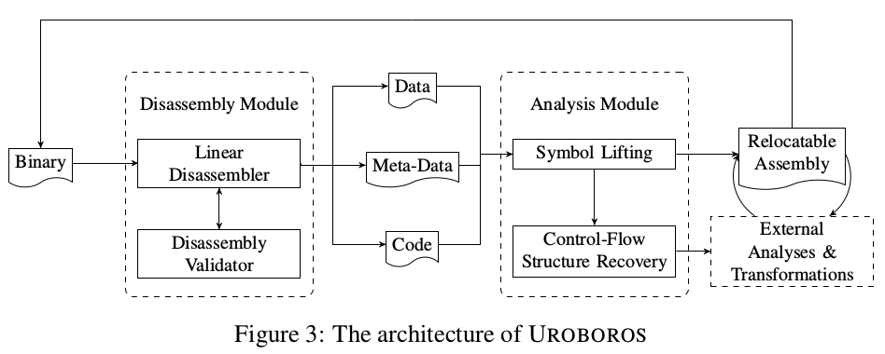
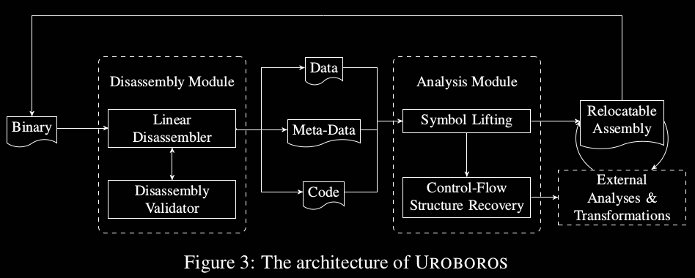
Architecture of Uroboros

Slide 19
Architecture of Uroboros
Notes:
Linear disassembler: objdump
Comments RIP and PIC
Interactive process ala BinCFI
Resolves “data gap” issues
May work with Analysis Module

Slide 20
Architecture of Uroboros
Notes:
Symbolizes instructions
Partial control-flow recovery
Direct control-flow transfers only
PLT and export table recovery
Skip prologue and epilogue functions on subsequent runs.
Remove padding from ELF data sections
Filter for main function

Slide 21
Oroboros Evaluation

Slide 22
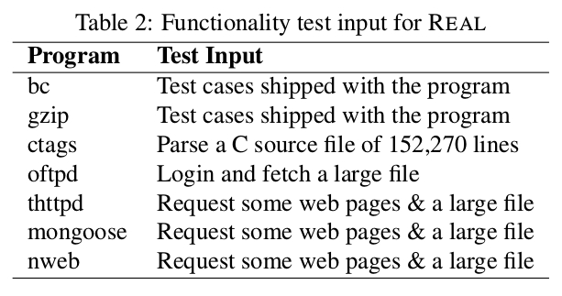
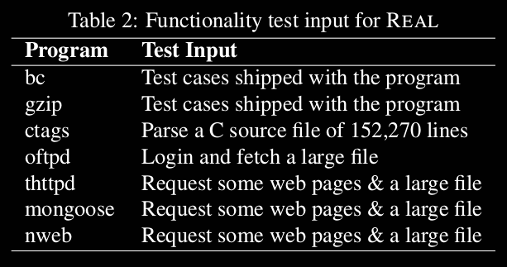
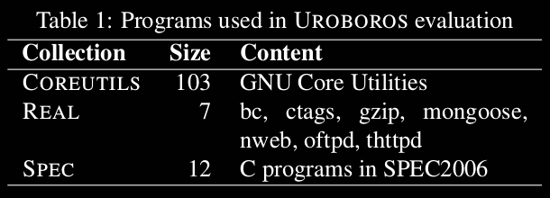
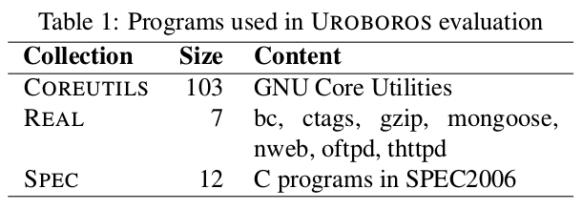
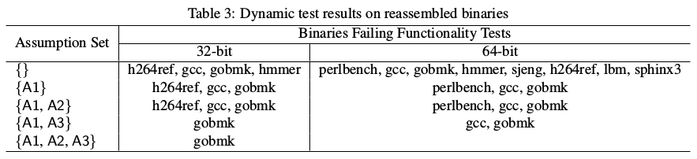
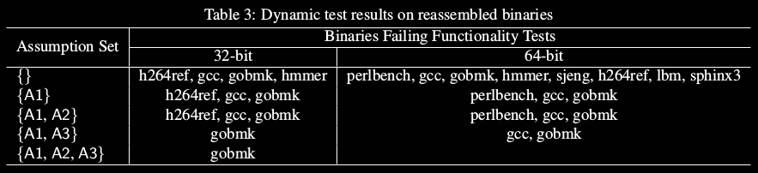
Evaluation Corpora
Notes:
Even split - 32/64 bit.

Slide 23
Evaluation Corpora
224 total
A1: Coreutils (103)
A2: Real (7)
A3: SPEC2006 C
Notes:
Even split - 32/64 bit.

Slide 24
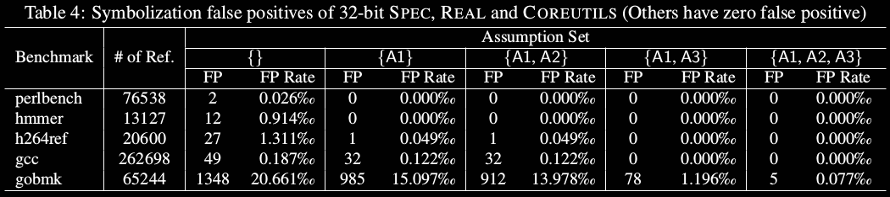
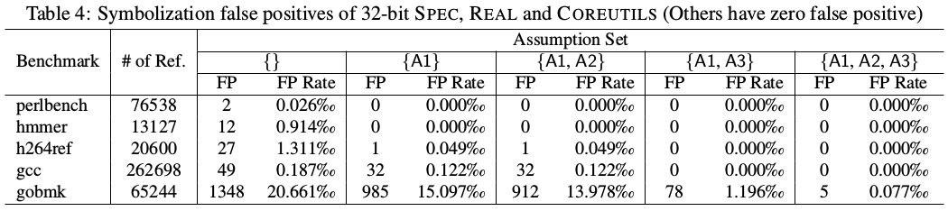
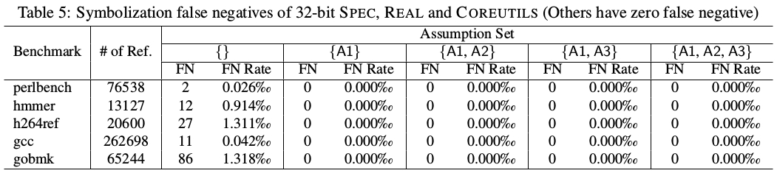
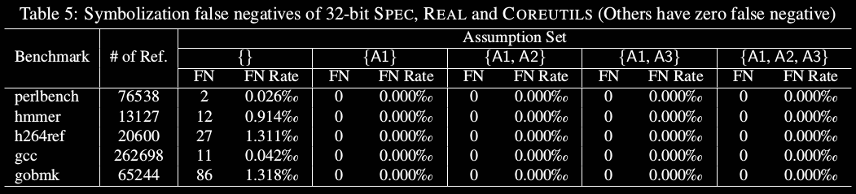
32-bit Binary Accuracies

Slide 25
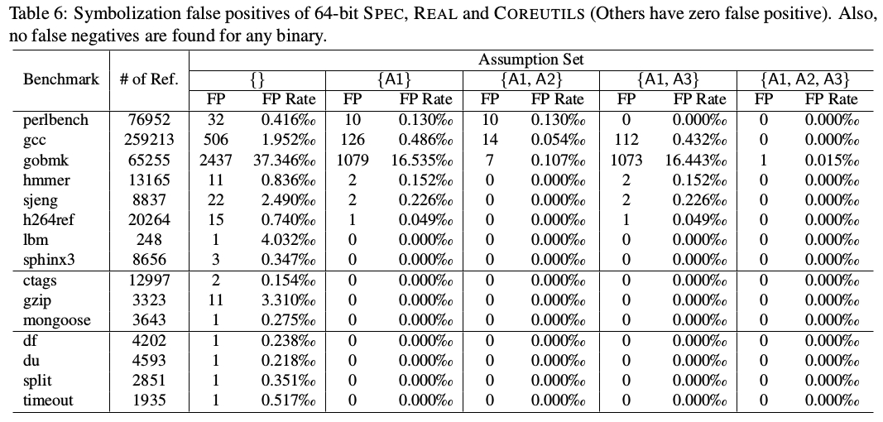
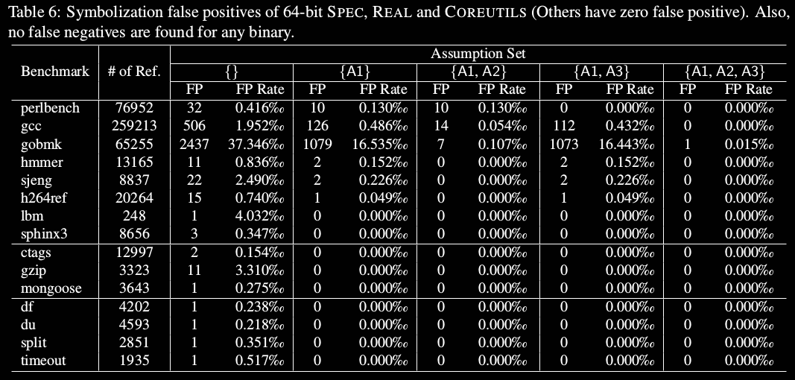
64-bit Binary Accuracies

Slide 26
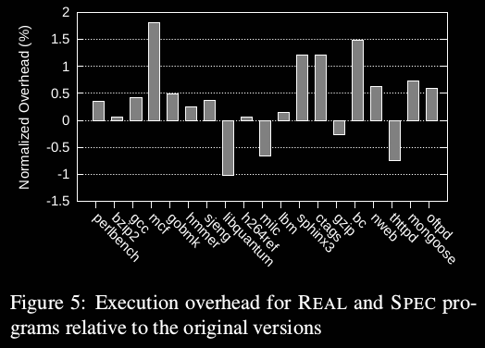
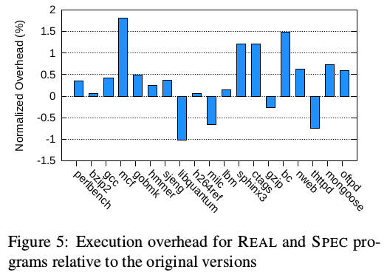
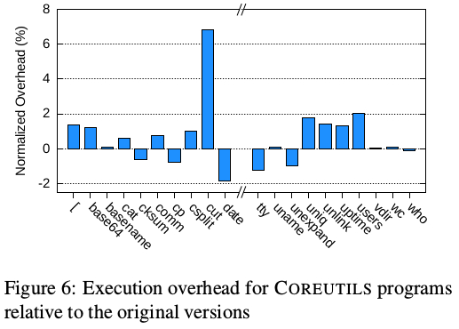
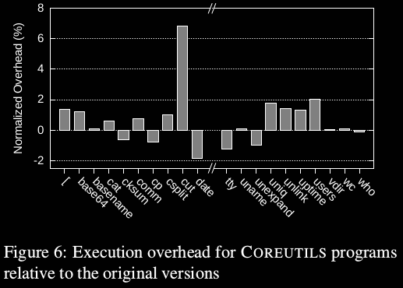
32-bit Binary Execution Overhead
Notes:
Average overhead: 0.44% coreutils, 0.29% SPEC, 0.52% REAL

Slide 27
32-bit Binary Processing Times
Notes:
Average processing times: 8.27 SPEC, 0.98 REAL, 0.57 COREUTILS

Slide 28
Summary
Reassembeable disassembly needed
Symbolization solves code relocatability
Uroboros comprised of Disassembly and Analysis module
Compiler independent
No C++ support

Slide 29
Questions
Why did the authors choose to report false positives and false negatives?
Was reporting on the first and last 10 programs, arranged alphabetically, a good idea?
What could explain the outliers in the reported processing times and execution overhead?

