Slide 1
Protecting Data on Smartphones and Tablets from Memory Attacks
Presenter: Luren Wang

Slide 2
Overview
Motivation
Threat Model
Background
Implementation
Evaluation
Conclusion
Future Work

Slide 3
Motivation
Smartphones and tablets are easily stolen.
According to Consumer Reports, smartphone theft rose to 3.1 million in the US in 2013 [1].
Encrypting data at rest is less useful. Devices are rarely turned off.
Vulnerable to an inexpensive class of memory attacks.

Slide 4

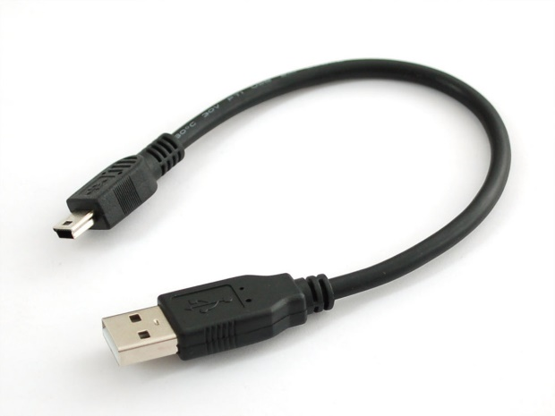

Using passwords, PIN, patterns, etc. are ineffective since RAM retains unencrypted data.
Using a freezer, USB cable, laptop, and a tool called Frost, researchers retrieved recent emails, photos, and visited websites.

Slide 5
Threat Model
Attacker has physical access to the device.
Device is in locked state.
Attacker will conduct memory attacks.
Not considered:
Side channel attacks.
Malware or any other software attacks.
Code-injection attacks
JTAG attacks
Sophisticated physical attacks.

Slide 6
Memory Attacks
Cold boot attacks – boot stolen device into an attack-controlled OS that outputs memory contents.
Bus monitoring attacks – obtain sensitive data over time by attaching bus monitoring tool.
DMA attack – attacker could manipulate DMA with a tool to dump the entire memory. Interfaces such as PCI Express and Thunderbolt are vulnerable.

Slide 7
Other Solutions
On Chip AES Schemes – storing AES keys in CPU registers. Cannot guard against monitoring attacks.
Encrypted RAM – encrypts most RAM all the time. Terrible overhead.

Slide 8
Background
System-on-Chip (SoC) – Chip which integrates components such as CPU, RAM, GPU, I/O. (Very simplified)
iRAM – internal SRAM used for storing runtime state of peripherals’ firmware.
Locked L2 Cache – Cortex-A9 ARM platforms have PL310 cache controller which can lock a portion of the cache from eviction. Originally used for making small computation faster and predictable.

Slide 9
On-SoC Storage
Two options to store secrets: iRAM and Locked L2 Cache.
Although DRAM and iRAM both suffer from data remanence, ARM zeroes out iRAM upon boot up.
Locked L2 cache prevents data from being evicted.
iRAM can protect against DMA attacks only if TrustZone takes explicit steps to protect it.

Slide 10
Implementation
Requirements
Device locked – All sensitive memory pages in DRAM are encrypted. When page needs to be accessed, it is decrypted in-place on SoC memory.
Device unlocked – Encryption is pointless. Encrypted pages are decrypted on-demand.
AES_On_SoC – Secret states (encryption key) need to be protected in SoC memory.

Slide 11
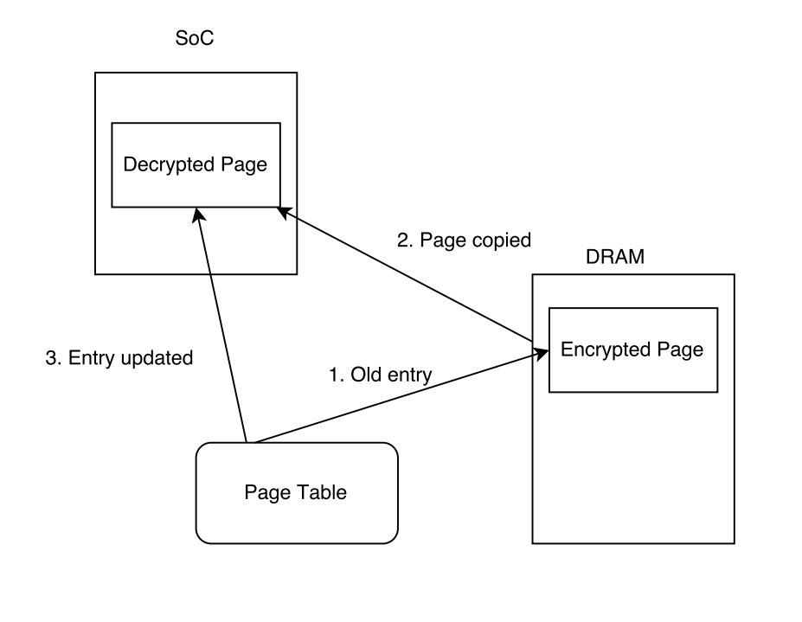
Schematic
Locked State

Slide 12
Unlocked State
Simply decrypted on-demand (lazy approach).
Encrypted pages are modified to generate a trap when page is accessed which causes Sentry to decrypt the page.

Slide 13
Selective Encryption
Could encrypt all user-level state and most of kernel state. However, this takes too long and too much power. Encrypting 2GB of DRAM on a smartphone takes over a minute with four CPU cores.
Solution - Only secure apps and OS subsystems marked as sensitive. User select applications for encryption in systems setting menu.

Slide 14
Protecting Persistent State
File-system encryption is not acceptable because crypto library leaves sensitive data in DRAM.
Solution – Incorporate AES_On_SoC in dm-crypt, an encryption module in Linux.
Two keys – volatile key and persistent key. Volatile key is generated every reboot with a new value and stored on SoC. Used to encrypt memory pages. Persistent key is used to encrypt data on disk. Store in secure hardware fuse.

Slide 15
Evaluation
The following experiments were performed on Nexus 4 which contains a quad-core SnapdragonS4 CPU (1.5 GHz and 2 GB RAM).

Slide 16
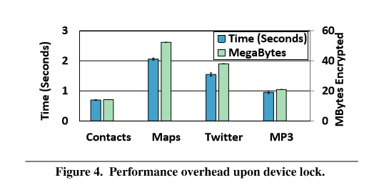
Device Lock Overhead

Slide 17
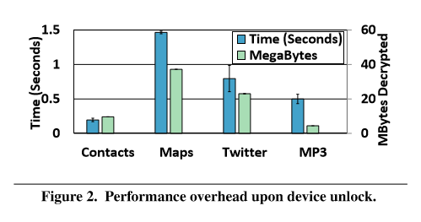
Device Unlock Overhead

Slide 18
Energy Profile
For a heavy weight application, Google Maps, the energy overhead of lock and unlock is an additional 2.3 joules.
Assuming the user locks and unlocks the phone 150 times a day, Sentry will use an additional 2% battery life.

Slide 19
Limitations
No published data regarding how prevelant zeroing out iRAM is.
Many devices, such as Nexus 4, lock their firmware which prevents enabling cache-locking through TrustZone.

Slide 20
Conclusion
Prevents memory attacks with relatively low sacrifices in performance and battery life.
More memory available on SoC which are isolated from DMA controllers would simplify the design.

Slide 21
Quiz
Why does Sentry use on-demand decryption after unlock?
Why is iRAM more suitable for storing sensitive data than DRAM even though both suffer from data-remanence?
Why is it important to implement an on-SoC version of AES?

Slide 22
Citations
[1] "Smart Phone Thefts Rose to 3.1 Million in 2013 - Consumer Reports." Smart Phone Thefts Rose to 3.1 Million in 2013 - Consumer Reports. N.p., n.d. Web. 08 Sept. 2015.

