Slide 1
A Messy State of the Union:
Taming the Composite State Machine of TLS
Benjamin Beurdouche, Karthikeyan Bhargavan,
Antoine Delignat-Lavaud, Cedric Fournety, Markulf Kohlweissy,Alfredo Pironti, Pierre-Yves Strubz, Jean Karim Zinzindohoue
Presented by Nan Liu

Slide 2
TLS
1.The Transport Layer Security(TLS) protocol is widely used to provide secure channels in a variety of scenarios.
2.TLS implementations are typically written as a set of
functions that generate and parse each message, and perform
the relevant cryptographic operations.
3. The composite state machine that this process
must implement is not standardized, and differs between implementations.

Slide 3
Outline
The TLS State Machine
Testing Implementations with FlexTLS
State Machine Flaws in TLS Implementations
Attacks on TLS Implementations
A Verified State Machine for OpenSSL
Towards Security Theorems for OpenSSL

Slide 4
The TLS State Machine
Message Sequences: Each TLS connection begins with either a full handshake or an abbreviated handshake.
Negotiation Parameters: the protocol version (v ), the key exchange method in the ciphersuite (kx ) and so on.
Implementation Pitfalls: first, the order of messages in the protocol has been carefully designed and it must be respected.

Slide 5
The TLS State Machine
Implementation Pitfalls: Second, it is not enough to implement a linear sequence of sends and receives. Third, one must be careful to not prematurely calculate session parameters and secrets.
Other Versions: state machines are different for different versions.
Extensions:renegotiation,false start.

Slide 6
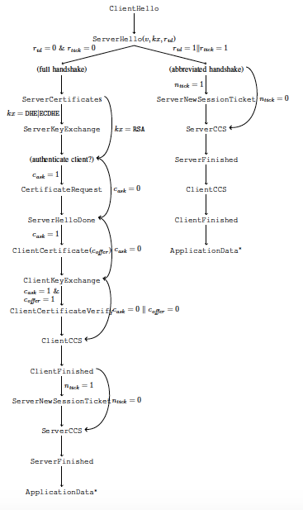

Slide 7
Testing Implementations with FlexTLS
FlexTLS scripting:provides a class equipped with send and receive functions, and a record that holds its parsed contents.
Searching for deviant traces:Skip, Hop and Repeat.
Skip: for every prefix of a valid message sequence, we skip a message if it is mandatory.
Hop: if two valid traces have the same prefix, up to their parameters, and they differ on their next message, we create a deviant trace from the context of the first trace and the next message of the second trace.

Slide 8
Testing Implementations with FlexTLS
Repeat: for every prefix of a valid message sequence, we take any message that has appeared before and send it again if this results in a deviant trace.
Automated testing: We generate a FlexTLS script for every deviant trace, and we run this script against a target implementation.
Turing bugs into exploits

Slide 9
State Machine Flaws in TLS Implementations
Implementation bugs in openSSL:early CCS, DH Certificate, Server-Gated Crypto(SGC), Export RSA, Static DH.
Early CCS:CCS can (incorrectly) appear at any point after ServerHello . Receiving a CCS message triggers the setup of a record key derived from the session key. It may enable both client and server impersonation attacks,

Slide 10
State Machine Flaws in TLS Implementations
DH Certificate: OpenSSL servers allow clients to omit the ClientCertificateVerify message after sending a Diffie-Hellman certificate. However, we found that sending a ClientKeyExchange along with a DH certificate enables a new client impersonation attack.
Server-Gated Crypto(SGC): SGC that allows clients to start over a handshake after receiving a ServerHello.

Slide 11
State Machine Flaws in TLS Implementations
Export RSA: the server sends a signed, but weak (at most 512 bits) RSA modulus in the ServerKeyExchange message. However, if such a message is received during a handshake that uses a stronger, non-export RSA ciphersuite, the weak ephemeral modulus will still be used to encrypt the client’s pre-master secret.
Static DH: OpenSSL clients allow the server to skip the ServerKeyExchange message when a DHE or ECDHE ciphersuite is negotiated.

Slide 12
State Machine Flaws in TLS Implementations
Implementation bugs in JSSE:client flaws, server flaws.
Implementation bugs in other implementation: NSS,Mono,CyaSSL, SecureTransport, GnuTLS, miTLS and others.

Slide 13
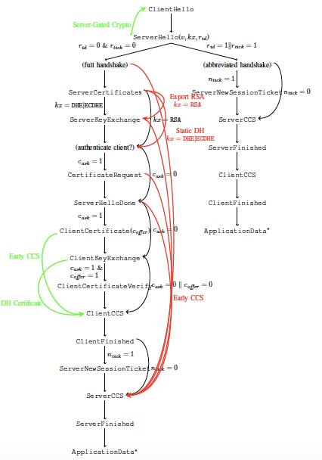
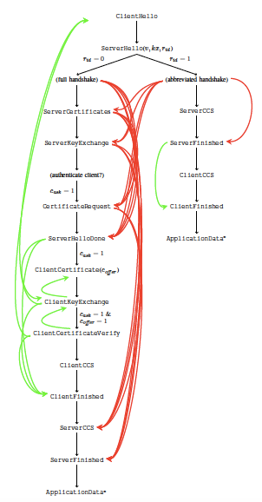

Slide 14
Attacks on TLS Implementations
Early Finished:server impersonation(Java,CyaSSL)
Skip Verify:client impersonation (Mono,CyaSSL,OpenSSL)
Skip ServerKeyExchange:forward secrecy rollback(NSS, OpenSSL)
Inject ServerKeyExchange:RSA_Export Flashback

Slide 15
A Verified State Machine for OpenSSL
OpenSSL Clients and Servers
A new state machine
Experimental Evaluation
Logical Specification of the State Machine
Verification with Frama-C

Slide 16
Towards Security Theorems for OpenSSL
The first step to prove this property is to show that the OpenSSL state machine correctly implements our chosen ciphersuite, and that message sequences are disjoint from all other supported ciphersuites.
The second hurdle is to show that the use of the same longterm signing key in different ciphersuites is safe.
The third challenge is to show that the session secrets of our verified ciphersuite are cryptographically independent from any other ciphersuite.

Slide 17
Questions
Which three well-defined rules can we use to generate deviant traces?
What advantage of generating deviant traces according to the three rules?
Why we develop FlexTLS?

