Slide 1

VTint
A System for Protecting the Integrity of Virtual Function Tables
Presentation on a paper by Chao Zhang, Chengyu Song, Kevin Zhijie Chen, Zhaofeng Chen, and Dawn Song

Slide 2
Background: Attacker’s Motivation
Memory corruption bugs are a classic vulnerability
Exploitation allows attackers to access data, code
This access can be used to alter program behavior, state, and control flow
Buffer overflow attacks, for example

Slide 3
Background: Attacker’s Motivation
Popular targets of attacks are pointers to code; “control data”
There has been a lot of work in preventing attacks on control data
StackGuard
SafeSEH
DEP
ASLR

Slide 4
Background: Attacker’s Motivation
Attackers turning to other targets in light of work protecting traditional control data targets
And what makes a better target but yet more pointers?
Pointers to control data: Virtual Function Table Pointers

Slide 5
Background: Virtual Function Tables
Virtual functions are used to support polymorphism and dynamic dispatch in languages like C++
Inheriting classes can overwrite these functions
vfptr: hidden field of classes with virtual functions
Points to the Virtual Function Table (vtable) for that object
This table contains function pointers that point to the appropriate (most-derived) versions of the functions for that object

Slide 6
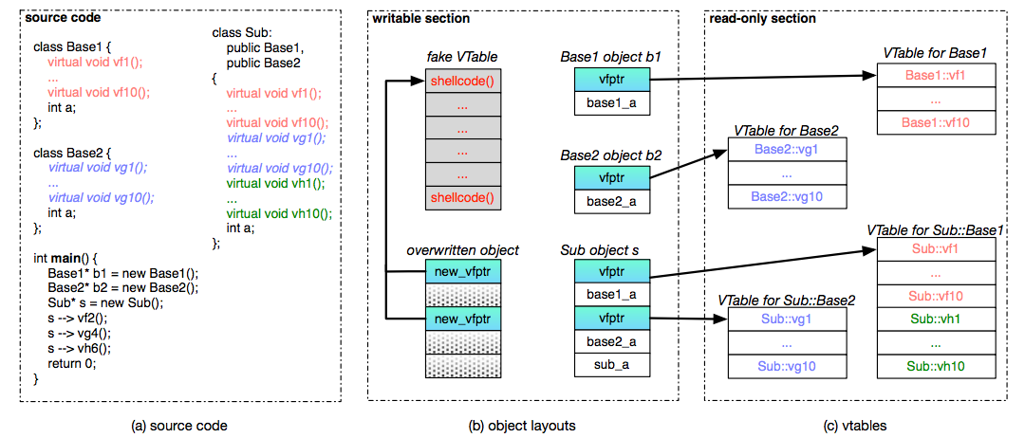
Background: Virtual Function Tables

Slide 7
Research Problem
How can we protect the integrity of virtual function tables and virtual function table pointers and make them resistant to attacks?

Slide 8
Threat Model
Assumptions about attackers:
Can read arbitrary readable memory
Can write to any writable memory
Cannot directly read or write registers
Can use multiple threads

Slide 9
Threat Model
Assumptions about defense:
Things like ASLR and DEP are in use
Applications won’t let attackers change memory protection
Control-flow transfers aside from virtual function calls are protected
Binaries are not obfuscated
Programs follow traditional calling conventions

Slide 10
Threat Model
Types of Vtable Hijacking Attacks:
Vtable corruption - corrupt a vtable’s contents
Vtable injection - create fake vtables and point vfptr to them
Vtable reuse - overwrite vfptr to point to other code

Slide 11
Threat Model
Commonly exploited vulnerabilities: buffer overflow, type confusion, use-after-free
Use-after-free is the most major threat
Accounts for 80% of attacks against chrome, 50% against Windows 7
Most of these attacks are vtable injection

Slide 12
Existing Solutions
VTGuard
SafeDispatch
DieHard

Slide 13
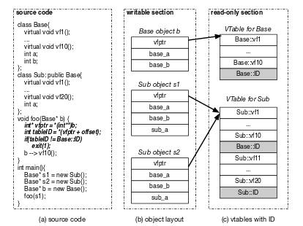
VTGuard
Used in IE
On a virtual function dispatch, checks for a secret cookie that was inserted into each vtable

Slide 14
SafeDispatch
Compiler-based
Analyzes classes to determine valid vtables and virtual functions
Inserts security checks before dispatch
Two types of checks: method and vtable

Slide 15
DieHard
Custom memory allocator randomizes and separates memory allocation
Probabilistic protection against vulnerabilities (ie. use-after-free)
Can protect against some cases of vtable and vfptr overwrites

Slide 16
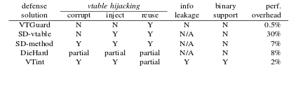
Limitations of Existing Solutions
Don’t cover all vtable hijacking possibilities
High levels of overhead (SD, DieHard)
Vulnerability to information leakage (VTGuard)
Lack of ability to protect binary executables

Slide 17
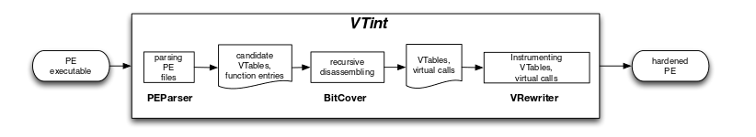
VTint Design
Consists of a security policy and a system to deploy this policy via binary rewriting
System takes in a PE executable and outputs a “hardened PE”
System is comprised of 3 major parts:
PEParser
BitCover
VRewriter

Slide 18
VTint Security Policy
Takes a cue from DEP
Enforces all vtables to be in read-only memory
This mitigates vtable injection and vtable corruption
Also takes cue from VTGuard
Gives vtables a special ID, checked on dispatch
Limits vtable reuse to legitimate vtables

Slide 19
VTint General Workflow
Parse PE executable
Identify candidate vtables and virtual function dispatch
Disassemble PE executable
Verify actual vtables and function calls from candidates
Instrument vtables with IDs, make sure all vtables read-only
Now you have a “hardened” PE

Slide 20
VTint Step 1: PEParser
Parses the binary (surprise!)
Builds the set of candidate vtables and function entries
But how with just the binary?
Relocation table
Relocation entries (addresses) that point to arrays (vfptr) with other relocation entries (function pointers) are candidate vtables
Export table
Entries in export table + other relocation entries = candidate function entries

Slide 21
VTint Step 2: BitCover
Takes the candidate function entries and vtables from PEParser
Uses candidate functions to start recursive disassembling
Once binary is disassembled, BitCover is responsible for:
Identifying actual vtables
Identifying actual virtual function calls

Slide 22
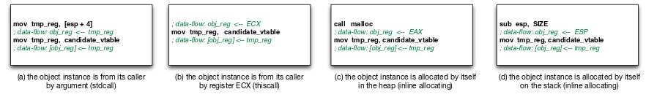
VTint Step 2a: BitCover Identifies vtables
There’s actually a step necessary before this can really happen
Must identify constructor functions
Consider assignments involving candidate vtables
Analyze target memory to identify register as candidate object pointer
Locate source of this register, and considering calling conventions, may mark as a constructor function

Slide 23
VTint Step 2a: BitCover Identifies vtables
With identified construction functions, can identify vtables
The process for each candidate vtable:
Examine all relocation entries to find references to the pointer
For each reference, examine data-flow
Reference is a vtable assignment if: pointer assigned to memory before accesses to it
If all references are vtable assignments, then we have an actual vtable

Slide 24
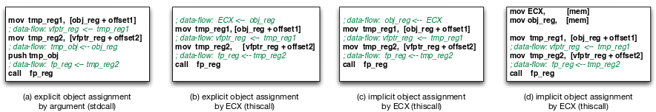
VTint Step 2b: BitCover identifies virtual function calls
Identify candidate virtual function calls via notion of definition point
For all call/jump instructions:
Find definition point of target function
If found and another register used, locate definition point of that register (candidate vfptr)
If found and another register used (candidate this), then candidate virtual function call found
Passing of this pointer to callee must then match one of four patterns

Slide 25
VTint Step 3: VRewriter, well, rewrites
Continuing trend of straightforward naming
3 parts:
Move vtables to read-only
Give vtables special ID
Place security checks before virtual function calls

Slide 26
VTint Step 3a: Moving vtables
Create read-only section named vtsec
Copy all identified vtables to this section
Copy some extra bytes to make sure to get all metadata

Slide 27
VTint Step 3b: vtable ID’s
Similar idea to VTGuard, differing implementation
VTGuard adds ID to end of vtable
Can’t do this with the binary
Instead, place an ID at beginning of each page in vtsec
Can’t forge a read-only page with these ID’s, nullifying information leakage

Slide 28
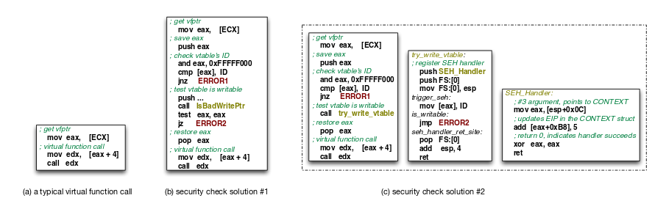
VTint Step 3c: Security checks before function calls
Add in check of vtable’s ID
Add in check of vtable’s writability
OS API function (IsBadWritePtr) or custom function making use of SEH
Second option is one used by VTint

Slide 29
VTint Modularity/Compatibility
What if all modules of a program can’t be hardened or weren’t hardened?
Security check may fail on a vtable without an ID
Fail-safe check to address this issue
Check for vtsec; if not found, it’s an unhardened PE
In this case, an ID mismatch won’t report an attack
Will still check for read-only

Slide 30
Evaluation of VTint
Prototype written in C++ for x86 PE on Windows
Experiments done with SPEC2000, SPEC2006 benchmarks, as well as Firefox, Chrome, IE6, and IE8
Results include:
Statistics regarding vtables
Runtime overhead on SPEC benchmarks
Runtime overhead on real browser and associated benchmarks
Detailed performance analysis
Effectiveness versus real vtable hijacking attacks

Slide 31
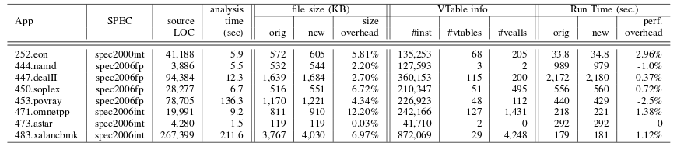
Evaluation of VTint
Mean value of SPEC benchmark overhead was 0.37%

Slide 32
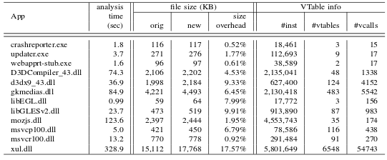
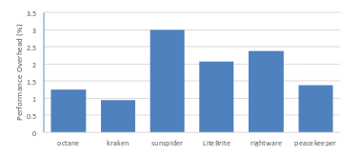
Evaluation of VTint
Mean value of Firefox overhead was 1.84%

Slide 33
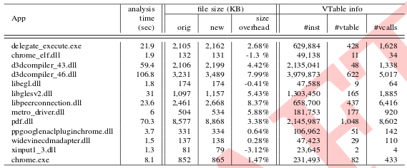
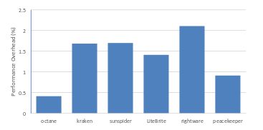
Evaluation of VTint
Mean value of Chrome overhead was 1.37%

Slide 34
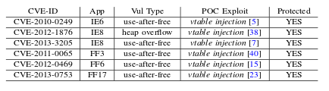
Evaluation of VTint
Tested 6 vtable injection attacks, 3 against IE and 3 against Firefox
Successfully protected against all 6 attacks

Slide 35
Limitations
VTint prototype was only designed for Windows platforms and more specifically Windows PE executables
Checking for writable memory imposes the most overhead, while having the least effect (most vtables are legitimate and read-only)
Has to be combined with VTGuard to defeat all vtable reuse attacks
Incompatible with unhardened modules having writable vtables

Slide 36
Criticisms
Paper mentions great degree of attacks against Chrome but tests none due to lack of public availability
This could make claim that VTint defeats ALL vtable injection attacks somewhat dubious
Claims security policy is “easy to enforce” but implementation seems fairly complicated
Doesn’t gracefully handle failed security checks; blocks or terminates application
Some threat model assumptions seem rather strong
What if the binary had been compromised and VTint “verifies” malicious vtables?

Slide 37
3 Questions
What comprises the candidate vtables and function entries?
What does VTint have to do before it can verify actual vtables?
What’s the difference between vtable injection and a vtable corruption attack?

Slide 38
Thanks!

